Slide 1
Course Overview 18-600 18-613: Foundations of Computer Systems 1st Lecture, Jan 15, 2019
Instructors:
Franz Franchetti
Seth Goldstein
Brandon Lucia
Brian Railing
The course formerly known as 18-600

Slide 2
Overview
18-600 18-613
Big Picture
Academic integrity
Logistics and Policies

Slide 3
18-600 18-613

Slide 4
18-600 18-613
This semester: 18-613, NOT 18-600
Full replacement in ECE curriculum w.r.t. prerequisites and requirements
Pittsburgh and Silicon Valley sections
No Silicon Valley instructor, but Silicon Valley TAs
Course will be officially renumbered in S3 soon
18-613 = 15-513 + 10 lectures + extra lab + extra exam questions
15-513 lectures are online in Canvas/Panopto (+ Rashid if space permits)
18-613 specific additional lectures are here (DH A302/B23 211) and recorded in Canvas, schedule in Canvas
Some lecture slots will be discussion slots (faculty recitations)
Pittsburgh TA office hours are joint with 15-213/15-513/18-213
Recitations are 18-613 specific (Section 18-613A/B/C/SV)
Course web page: http://www.cs.cmu.edu/~213/
My office hours will be in my office + BlueJeans ID 4122688297

Slide 5
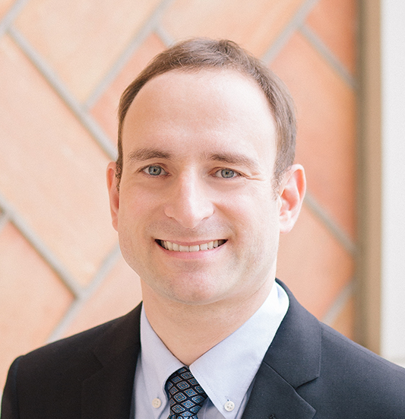
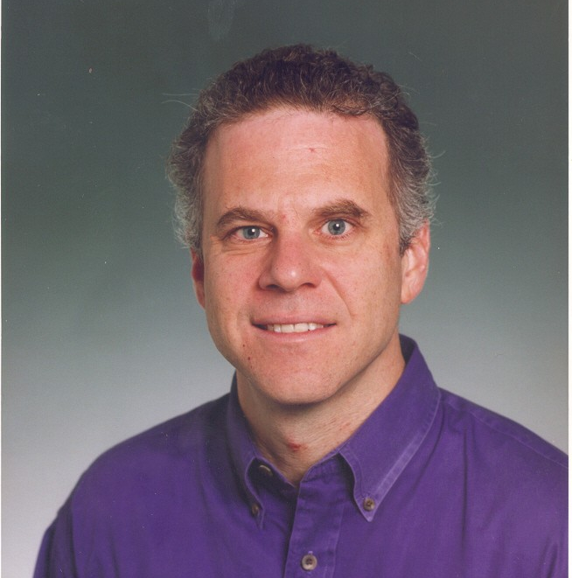

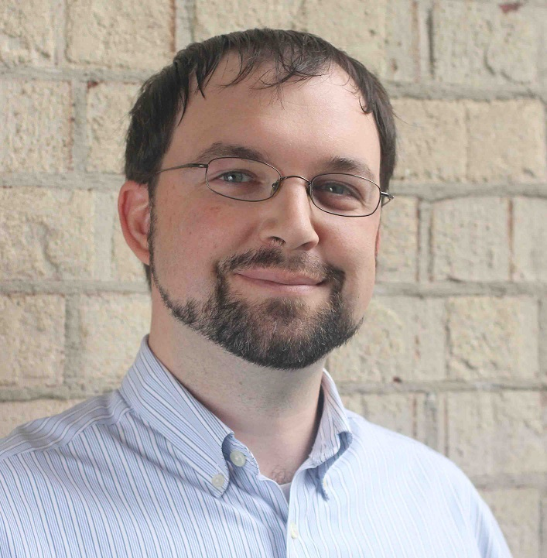
Instructors: The 1x-x13 Team
Carnegie Mellon
18-613 Franz Franchetti
15-213 Seth C. Goldstein
18-213 Brandon Lucia
15-513 Brian Railing
I am your main contact and official instructor but you may hear from/interact with all of us

Slide 6
The Big Picture

Slide 7
Course Theme: (Systems) Knowledge is Power!
Systems Knowledge
How hardware (processors, memories, disk drives, network infrastructure) plus software (operating systems, compilers, libraries, network protocols) combine to support the execution of application programs
How you as a programmer can best use these resources
Useful outcomes from taking 213/513
Become more effective programmers
Able to find and eliminate bugs efficiently
Able to understand and tune for program performance
Prepare for later “systems” classes in CS & ECE
Compilers, Operating Systems, Networks, Computer Architecture, Embedded Systems, Storage Systems, etc.

Slide 8
It’s Important to Understand How Things Work
Why do I need to know this stuff?
Abstraction is good, but don’t forget reality
Most CS and CE courses emphasize abstraction
Abstract data types
Asymptotic analysis
These abstractions have limits
Especially in the presence of bugs
Need to understand details of underlying implementations
Sometimes the abstract interfaces don’t provide the level of control or performance you need

Slide 9
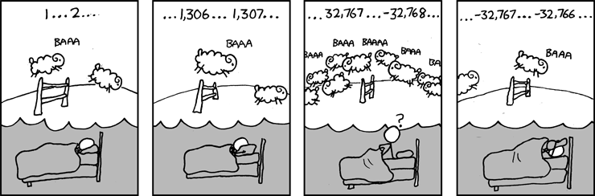
Great Reality #1: Ints are not Integers, Floats are not Reals
Example 1: Is x² ≥ 0?
Float’s: Yes!
Int’s:
40000 * 40000 --> 1600000000
50000 * 50000 --> ?
Example 2: Is (x + y) + z = x + (y + z)?
Unsigned & Signed Int’s: Yes!
Float’s:
(1e20 + -1e20) + 3.14 --> 3.14
1e20 + (-1e20 + 3.14) --> ??
Source: xkcd.com/571

Slide 10
Computer Arithmetic
Does not generate random values
Arithmetic operations have important mathematical properties
Cannot assume all “usual” mathematical properties
Due to finiteness of representations
Integer operations satisfy “ring” properties
Commutativity, associativity, distributivity
Floating point operations satisfy “ordering” properties
Monotonicity, values of signs
Observation
Need to understand which abstractions apply in which contexts
Important issues for compiler writers and serious application programmers

Slide 11
Great Reality #2: You’ve Got to Know Assembly
Chances are, you’ll never write programs in assembly
Compilers are much better & more patient than you are
But: Understanding assembly is key to machine-level execution model
Behavior of programs in presence of bugs
High-level language models break down
Tuning program performance
Understand optimizations done / not done by the compiler
Understanding sources of program inefficiency
Implementing system software
Compiler has machine code as target
Operating systems must manage process state
Creating / fighting malware
x86 assembly is the language of choice!

Slide 12
Great Reality #3: Memory Matters Random Access Memory Is an Unphysical Abstraction
Memory is not unbounded
It must be allocated and managed
Many applications are memory dominated
Memory referencing bugs especially pernicious
Effects are distant in both time and space
Memory performance is not uniform
Cache and virtual memory effects can greatly affect program performance
Adapting program to characteristics of memory system can lead to major speed improvements

Slide 13
Memory Referencing Bug Example
typedef struct {
int a[2];
double d;
} struct_t;
double fun(int i) {
volatile struct_t s;
s.d = 3.14;
s.a[i] = 1073741824; /* Possibly out of bounds */
return s.d;
}
fun(0) --> 3.14
fun(1) --> 3.14
fun(2) --> 3.1399998664856
fun(3) --> 2.00000061035156
fun(4) --> 3.14
fun(6) --> Segmentation fault
Result is system specific

Slide 14
Memory Referencing Bug Example
typedef struct {
int a[2];
double d;
} struct_t;
fun(0) --> 3.14
fun(1) --> 3.14
fun(2) --> 3.1399998664856
fun(3) --> 2.00000061035156
fun(4) --> 3.14
fun(6) --> Segmentation fault
Explanation:
Critical State | 6
? | 5
? | 4
d7 ... d4 | 3
d3 ... d0 | 2
a[1] | 1
a[0] | 0
Location accessed by fun(i)
struct_t

Slide 15
Memory Referencing Errors
C and C++ do not provide any memory protection
Out of bounds array references
Invalid pointer values
Abuses of malloc/free
Can lead to nasty bugs
Whether or not bug has any effect depends on system and compiler
Action at a distance
Corrupted object logically unrelated to one being accessed
Effect of bug may be first observed long after it is generated
How can I deal with this?
Program in Java, Ruby, Python, ML, …
Understand what possible interactions may occur
Use or develop tools to detect referencing errors (e.g. Valgrind)

Slide 16
Great Reality #4: There’s more to performance than asymptotic complexity
Constant factors matter too!
And even exact op count does not predict performance
Easily see 10:1 performance range depending on how code written
Must optimize at multiple levels: algorithm, data representations, procedures, and loops
Must understand system to optimize performance
How programs compiled and executed
How to measure program performance and identify bottlenecks
How to improve performance without destroying code modularity and generality

Slide 17
Memory System Performance Example
void copyij(int src[2048][2048],
int dst[2048][2048])
{
int i,j;
for (i = 0; i < 2048; i++)
for (j = 0; j < 2048; j++)
dst[i][j] = src[i][j];
}
void copyji(int src[2048][2048],
int dst[2048][2048])
{
int i,j;
for (j = 0; j < 2048; j++)
for (i = 0; i < 2048; i++)
dst[i][j] = src[i][j];
}
4.3ms
81.8ms
2.0 GHz Intel Core i7 Haswell
Hierarchical memory organization
Performance depends on access patterns
Including how step through multi-dimensional array

Slide 18
Why The Performance Differs
copyij
copyji

Slide 19
Great Reality #5: Computers do more than execute programs
They need to get data in and out
I/O system critical to program reliability and performance
They communicate with each other over networks
Many system-level issues arise in presence of network
Concurrent operations by autonomous processes
Coping with unreliable media
Cross platform compatibility
Complex performance issues

Slide 20
613 Extra: Great Reality #6: ECE MS Students in 18-613 learn extra stuff
Date | Topic
January 15 | Overview: Scope and mechanics of 18-613 and relationship to 15-513
January 22 | State of computing: The state-of-the-art of computer systems w.r.t. 18-613
January 31 | Data structures review: Review of data structures needed in the 18-613 labs
February 19 | SIMD instructions: floating-point and integer SIMD instructions in x86
February 21 | High performance CPU cores: super-scalar, out-of-order, speculation, etc.
March 5 | Multicore CPUs: Memory hierarchy, cache coherency, etc. (Brandon Lucia)
March 7 | Accelerators: GPUs, FPGAs, and Xeon PHI, and AI/ML accelerators
April 4 | Debugging: It is a science, not a black art. MallocLab and ProxyLab howto.
April 9 | Automatic Performance Tuning: Expert performance engineering
April 25 | Parallel computing: Concepts and frameworks, shared and distributed mem.
613: More hardware centric beyond 213/513

Slide 21
Course Perspective
Most Systems Courses are Builder-Centric
Computer Architecture
Design pipelined processor in Verilog
Operating Systems
Implement sample portions of operating system
Compilers
Write compiler for simple language
Networking
Implement and simulate network protocols

Slide 22
Course Perspective (Cont.)
Our Course is Programmer-Centric
By knowing more about the underlying system, you can be more effective as a programmer
Enable you to
Write programs that are more reliable and efficient
Incorporate features that require hooks into OS
E.g., concurrency, signal handlers
Cover material in this course that you won’t see elsewhere
Not just a course for dedicated hackers
We bring out the hidden hacker in everyone!
18-613 broadens this a bit and digs a bit deeper

Slide 23
Academic Integrity
Please pay close attention, especially if this is your first semester at CMU
http://www.cs.cmu.edu/afs/cs.cmu.edu/academic/class/15213-s19/www/academicintegrity.html

Slide 24
Cheating/Plagiarism: Description
Unauthorized use of information
Borrowing code: by copying, retyping, looking at a file
Describing: verbal description of code from one person to another
Even if you just describe/discuss how to put together CS:APP code snippets to solve the problem
Searching the Web for solutions, discussions, tutorials, blogs, other universities’ 213 instances,… in English or any other language
Copying code from a previous course or online solution
Reusing your code from a previous semester (here or elsewhere)
If you take the course this semester, all work has to be done this semester
Unattributed use of legal copies: all code not written by the student must be attributed (book, handout, recitation examples,…)

Slide 25
Cheating/Plagiarism: Description (cont.)
Unauthorized supplying of information
Providing copy: Giving a copy of a file to someone
Providing access:
Putting material in unprotected directory
Putting material in unprotected code repository (e.g., Github)
Applies to this term and the future
There is no statute of limitations for academic integrity violations

Slide 26
Cheating/Plagiarism: Description
What is NOT cheating?
Explaining how to use systems or tools
Helping others with high-level design issues
Using code supplied by us (needs to be attributed)
Using code from the CS:APP web site independently
See the course syllabus for details.
Ignorance is not an excuse

Slide 27
Cheating: Consequences
Penalty for cheating:
Best case: -100% for assignment
You would be better off to turn in nothing
Worst case: Removal from course with failing grade
This is the default
Permanent mark on your record
Loss of respect by you, the instructors and your colleagues
If you do cheat – come clean asap!
Detection of cheating:
We have sophisticated tools for detecting code plagiarism
In Fall 2015, 20 students were caught cheating and failed the course.
Some were expelled from the University
In January 2016, 11 students were penalized for cheating violations that occurred as far back as Spring 2014.
In Spring 2017 we caught people looking at Chinese-language blogs; 30+ AIV letters
Don’t do it!
Manage your time carefully
Ask the staff for help when you get stuck

Slide 28
Some Concrete Examples:
This is Cheating:
Searching the internet with the phrase 15-213, 18600, 213, 18213, malloclab,…
That’s right, just entering it in a search engine
Looking at someone’s code on the computer next to yours
Giving your code to someone else, now or in the future
Posting your code in a publicly on the Internet, now or in the future
Discussing with your friends how to solve a lab by putting together CS:APP code fragments
Hacking the course infrastructure
This is OK (and encouraged):
Googling a man page for fputs
Asking a friend for help with gdb
Asking a TA or course instructor for help, showing them your code, …
Looking in the textbook for a code example
Talking about a (high-level) approach to the lab with a classmate

Slide 29
How it Feels: Student and Instructor
Fred is desperate. He can’t get his code to work and the deadline is drawing near. In panic and frustration, he searches the web and finds a solution posted by a student at U. Oklahoma on Github. He carefully strips out the comments and inserts his own. He changes the names of the variables and functions. Phew! Got it done!
The course staff run checking tools that compare all submitted solutions to the solutions from this and other semesters, along with ones that are on the Web.
Remember: We are as good at web searching as you are
Meanwhile, Fred has had an uneasy feeling: Will I get away with it? Why does my conscience bother me?
Fred gets email from an instructor: “Please see me tomorrow at 9:30 am.”
Fred does not sleep well that night

Slide 30
Why It’s a Big Deal
This material is best learned by doing
Even though that can, at times, be difficult and frustrating
Starting with a copy of a program and then tweaking it is very different from writing from scratch
Planning, designing, organizing a program are important skills
We are the gateway to other system courses
Want to make sure everyone completing the course has mastered the material
Industry appreciates the value of this course
We want to make sure anyone claiming to have taken the course is prepared for the real world
Working in Teams and Collaboration is an Important Skill
But only if team members have solid foundations
This course is about foundations, not teamwork

Slide 31
How it Feels: Student and Instructor
The instructor feels frustrated. His job is to help students learn, not to be police. Every hour he spends looking at code for cheating is time that he cannot spend providing help to students. But, these cases can’t be overlooked
At the meeting:
Instructor: “Explain why your code looks so much like the code on Github.”
Fred: “Gee, I don’t know. I guess all solutions look pretty much alike.”
Instructor: “I don’t believe you. I am going to file an academic integrity violation.”
Fred will have the right to appeal, but the instructor does not need him to admit his guilt in order to penalize him.
Consequences
Fred may (most likely will) be given a failing grade for the course
Fred will be reported to the university
A second AIV will lead to a disciplinary hearing
Fred will go through the rest of his life carrying a burden of shame
The instructor will experience a combination of betrayal and distress

Slide 32
A Scenario: Cheating or Not?
Alice is working on malloc lab and is just plain stuck. Her code is seg faulting and she doesn't know why. It is only 2 days until malloc lab is due and she has 3 other assignments due this same week. She is in the cluster.
Bob is sitting next to her. He is pretty much done.
Sitting next to Bob is Charlie. He is also stuck.
1. Charlie gets up for a break and Bob makes a printout of his own code and leaves it on Charlie’s chair.
Who cheated: Charlie? Bob?
2. Charlie finds the copy of Bob’s malloc code, looks it over, and then copies one function, but changes the names of all the variables.
Who cheated: Charlie? Bob?

Slide 33
Another Scenario
Alice is working on malloc lab and is just plain stuck. Her code is seg faulting and she doesn't know why. It is only 2 days until malloc lab is due and she has 3 other assignments due this same week. She is in the cluster.
Bob is sitting next to her. He is pretty much done.
Sitting next to Bob is Charlie. He is also stuck.
1. Bob offers to help Alice and they go over her code together.
Who cheated: Bob? Alice?
2. Bob gets up to go to the bathroom and Charlie looks over at his screen to see how Bob implemented his free list.
Who cheated: Charlie? Bob?

Slide 34
Another Scenario (cont.)
3. Alice is having trouble with GDB. She asks Bob how to set a breakpoint, and he shows her.
Who cheated: Bob? Alice?
4. Charlie goes to a TA and asks for help
Who cheated: Charlie?
If you are uncertain which of these constitutes cheating, and which do not, please read the syllabus carefully. If you’re still uncertain, ask one of the staff

Slide 35
Version Control: Your Good Friend
We will be using Github Education
Assignment distribution
Your workspace
Use your course account, rather than a personal Github account
Use as you should a version server
Commit early and often
Document your commits
Missing GIT history can count against you
How we use it
If we suspect academic integrity issues, we can see if commit history looks reasonable.
Steady, consistent, and sustained work
It can serve as your character witness

Slide 36
How to Avoid AIVs
Start early
Don’t rely on marathon programming sessions
Your brain works better in small bursts of activity
Ideas / solutions will come to mind while you’re doing other things
Plan for stumbling blocks
Assignment is harder than you expected
Code doesn’t work
Bugs hard to track down
Life gets in the way
Minor health issues
Unanticipated events

Slide 37
Logistics

Slide 38
18-613, 15-213/18-213 and 15-513
Carnegie Mellon
18-613
Mainly ECE Masters students in Pittsburgh and Silicon Valley
15-513 Lectures by video (on the website and Panopto) Pittsburgh students are welcome to attend 15-213/18-213 lectures in Rashid Auditorium if space is available
Additional live lectures according to schedule in Canvas (also recorded)
Additional “faculty recitations” in 18-613 lecture slots
Additional lab (extra credit)
Additional exam questions (covering extra material and extra lab)
15-213/18-213
Only undergraduates
Live lectures
Recitations
15-513
Only Masters students
Lectures by video (on the website and Panopto)
Everything else is the same for all the courses

Slide 39
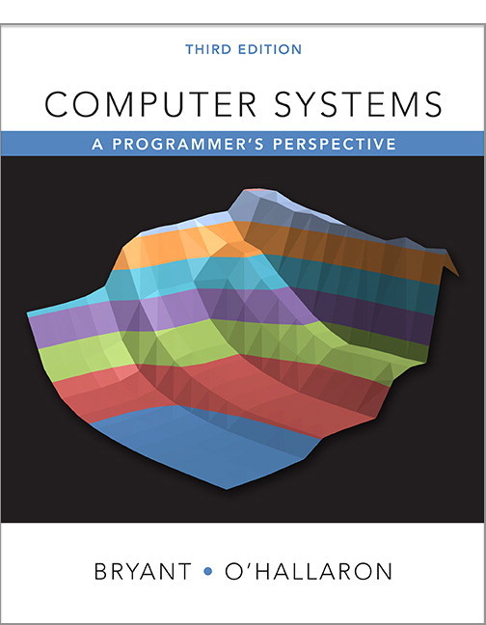
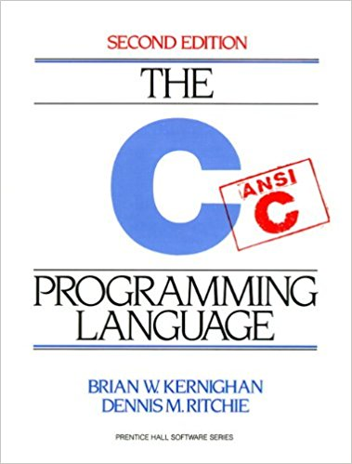
Textbooks
Randal E. Bryant and David R. O’Hallaron,
Computer Systems: A Programmer’s Perspective, Third Edition (CS:APP3e), Pearson, 2016, hard cover
http://csapp.cs.cmu.edu
This book really matters for the course!
How to solve labs
Practice problems typical of exam problems
Digital materials at: https://cmu.redshelf.com/
Brian Kernighan and Dennis Ritchie,
The C Programming Language, Second Edition, Prentice Hall, 1988
Still the best book about C, from the originators
Even though it does not cover more recent extensions of C

Slide 40
Course Components
Lectures
Higher level concepts
Recitations
More hands-on towards labs, start 1/30
Discussions
Labs (8+1)
The heart of the course
1-2+ weeks each (except for extra lab—spaced out more)
Provide in-depth understanding of an aspect of systems
Programming and measurement
Exams (midterm + final)
Test your understanding of concepts & mathematical principles

Slide 41
Carnegie Mellon
Carnegie Mellon
Getting Help
1x-x13 Class Web page: http://www.cs.cmu.edu/~213
Complete schedule of lectures, exams, and assignments
Copies of lectures, assignments, exams, solutions
Links to all infrastructure components (Canvas, Autolab, Piazza,…)
FAQ
1x-x13 Canvas and 18-613 Canvas
15-213/18-213/15-513 Canvas instance is gateway to all non-public course information
Additional 18-613 Canvas instance contains all 18-613 specific information
Piazza
Piazza 1x-x13: Standard questions and course material related questions
Piazza 18-613: 18-613 specific questions (see Piazza post)
Best place for questions about assignments
By default, your posts will be private

Slide 42
Getting Help
Email
Send email to individual TAs only to schedule appointments
Special situations, emergencies, meeting requests: franzf@ece.cmu.edu
Office hours (starting Tue Jan 22):
Pittsburgh TAs: SMTWR(FS), 5:00–9:00pm, location TBD
Silicon Valley TAs: TBD
Prof. Franchetti: Tue 3:15pm EST/12:15pm PST Pittsburgh: HH A312, Silicon Valley: BlueJeans ID 4122688297
Recitations, start 1/30
Section 18-613 A: Wed 4:30pm-5:50pm, HH B131 (TA: TBD) Section 18-613 B: Wed 4:30pm-5:50pm BH A53 (TA: TBD) Section 18-613 C: Wed 6:30pm-7:50pm HH B131 (TA: TBD) Section 18-613 SA: Wed 5pm-6:20pm B23 211 SV (TA: TBD)
Walk-in Tutoring (Pittsburgh)
Details TBA. Will put information on class webpage.

Slide 43

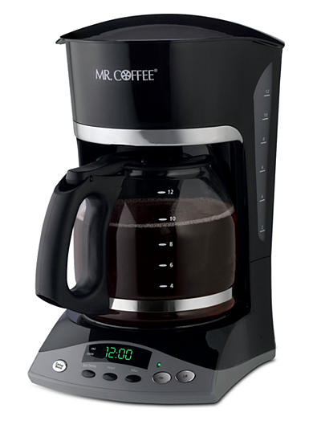
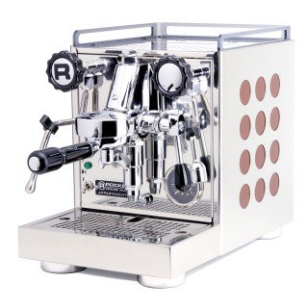

18-613 Student HowTo
Attend Lectures
Attend Recitations and boot camps
Start labs early (really) and use GIT properly
TA office hours: we need to manage load and waiting time
lab-related concrete questions
must write them down before getting help
Time slots
Faculty Office Hours
Grading, special cases, issues
Conceptual and longer questions
Open discussions
Please stop by and have a coffee, espresso, tea or hot chocolate (Pittsburgh-only, sorry)

Slide 44
Policies: Labs And Exams
Work groups
You must work alone on all lab assignments no “programming parties” at coffee shops etc.
Handins
Labs due at 11:59pm
Electronic handins using Autolab (no exceptions!) after a final GIT commit/push
Exams
Exams will be online in network-isolated clusters (this may change)
Held over multiple days. Self-scheduled; just sign up! (Need to see re SV)
Appealing grades
Exams & Problem Sets: Request via exam server
Labs: Via detailed private post to Piazza within 7 days of completion of grading
Follow formal procedure described in syllabus

Slide 45
Facilities
Labs will use the Intel Computer Systems Cluster
The “shark machines”
linux> ssh shark.ics.cs.cmu.edu
21 servers donated by Intel for 213/513
10 student machines (for student logins)
1 head node (for instructor logins)
10 grading machines (for autograding)
Each server: Intel Core i7: 8 Nehalem cores, 32 GB DRAM, RHEL 7.5
Rack-mounted in Gates machine room
Login using your Andrew ID and password

Slide 46
Timeliness
Grace days
5 grace days for the semester
Limit of 0, 1, or 2 grace days per lab used automatically
Covers scheduling crunch, out-of-town trips, illnesses, minor setbacks
Lateness penalties
Once grace day(s) used up, get penalized 15% per day
No handins later than 3 days after due date
Catastrophic events
Major illness, death in family, …
Formulate a plan (with your academic advisor) to get back on track
Advice
Once you start running late, it’s really hard to catch up
Try to save your grace days until the last few labs
Really, Really Hard!

Slide 47
Other Rules of the Lecture Hall
Laptops: permitted
Electronic communications: forbidden
No email, instant messaging, cell phone calls, etc
Presence in lectures (613): voluntary, recommended
No recordings of ANY KIND
Slides will be posted right before or soon after the lecture
Videos post the next day the latest

Slide 48
Policies: Grading
Exams (50%): midterm (20%), final (30%) 18-613 exams include extra material from lectures and ArchLab
Labs (50%): weighted according to effort
ArchLab is extra credit
Final grades based on a straight scale (90/80/70/60) with a small amount of curving
Only upward

Slide 49
Programs and Data
Topics
Bit operations, arithmetic, assembly language programs
Representation of C control and data structures
Includes aspects of architecture and compilers
Assignments
L0 (C programming Lab): Test/refresh your C programming abilities
L1 (datalab): Manipulating bits
L2 (bomblab): Defusing a binary bomb
L3 (attacklab): The basics of code injection attacks

Slide 50
The Memory Hierarchy
Topics
Memory technology, memory hierarchy, caches, disks, locality
Includes aspects of architecture and OS
Assignments
L4 (cachelab): Building a cache simulator and optimizing for locality.
Learn how to exploit locality in your programs.

Slide 51
Exceptional Control Flow
Topics
Hardware exceptions, processes, process control, Unix signals, nonlocal jumps
Includes aspects of compilers, OS, and architecture
Assignments
L5 (tshlab): Writing your own Unix shell.
A first introduction to concurrency

Slide 52
Virtual Memory
Topics
Virtual memory, address translation, dynamic storage allocation
Includes aspects of architecture and OS
Assignments
L6 (malloclab): Writing your own malloc package
Get a real feel for systems-level programming

Slide 53
Networking, and Concurrency
Topics
High level and low-level I/O, network programming
Internet services, Web servers
concurrency, concurrent server design, threads
I/O multiplexing with select
Includes aspects of networking, OS, and architecture
Assignments
L7 (proxylab): Writing your own Web proxy
Learn network programming and more about concurrency and synchronization.

Slide 54
18-613 Extra: Computer Architecture
Topics
Microarchitecture implementation
Superscalar and out of order cores
Speculation
Multicore memory hierarchy
Assignments
LX (ArchLab): Understand how assembly executes and use the GEM5 simulator
Learn about architecture level trade-offs and implementation issues
Learn about performance optimization both above and below the ISA abstraction level
Extra credit
Longer time active
Concepts tested in exams

Slide 55
Lab Rationale
Each lab has a well-defined goal such as solving a puzzle or winning a contest
Doing the lab should result in new skills and concepts
We try to use competition in a fun and healthy way
Set a reasonable threshold for full credit
Post intermediate results (anonymized) on Autolab scoreboard for glory!

Slide 56
Lab0: C Programming
Due 1/22 11:59pm
You can start now: download from 213 schedule page
It should all be review:
Basic C control flow, syntax, etc.
Explicit memory management, as required in C.
Creating and manipulating pointer-based data structures.
Implementing robust code that operates correctly with invalid arguments, including NULL pointers.
Creating rules in a Makefile
If this lab takes you more than 10 hours, please think hard about taking the course. And REALLY come to 18-613 Lecture 3

Slide 57
Doing L1—L7 + LX
https://autolab.andrew.cmu.edu/courses/15213-s19
Download the lab materials
(Usually as a tar file, so you will need to untar them in a new directory)
If you have questions
Piazza (log in via Canvas)
Office hours
Walkin-tutoring

Slide 58
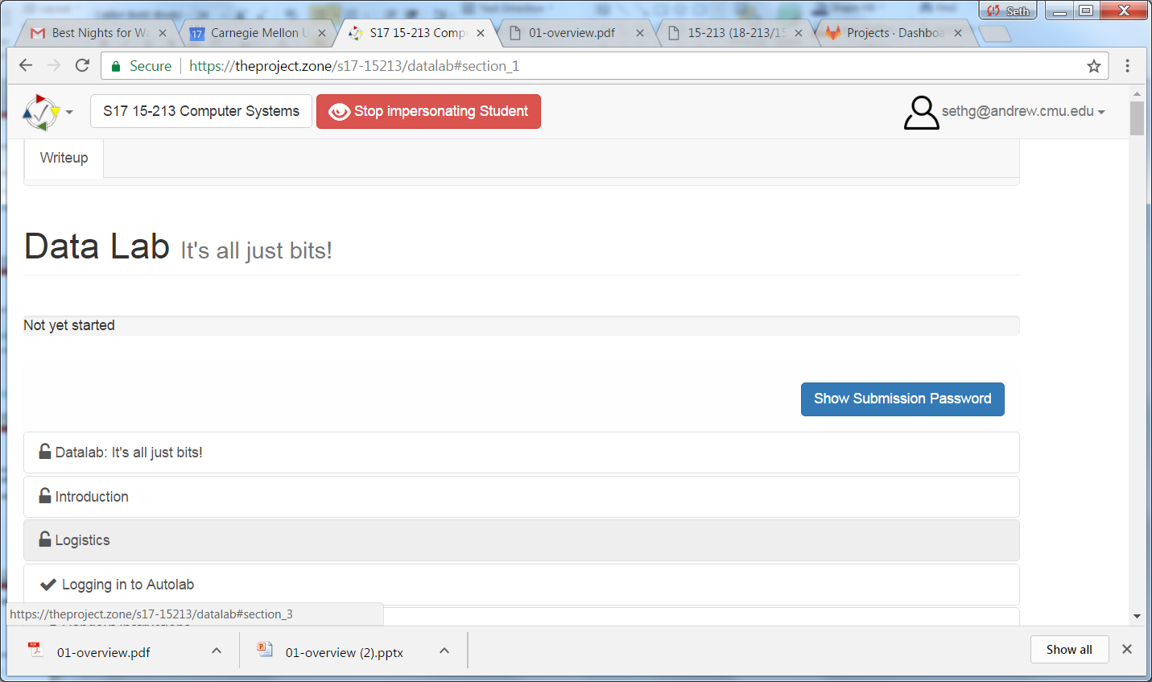
Theproject.zone
Lab writeups (L1—L7) will be online
As you read the writeup there will be assessment questions.
When you have completed all the assessment questions you will get a submission code.
Use the submission code when submitting your lab to autolab.
Not required for L0

Slide 59
Autolab (https://autolab.andrew.cmu.edu)
Labs are provided by the CMU Autolab system
Project page: http://autolab.andrew.cmu.edu – should have access on Fri
Developed by CMU faculty and students
Key ideas: Autograding and Scoreboards
Autograding: Providing you with instant feedback.
Scoreboards: Real-time, rank-ordered, and anonymous summary.
Used by over 3,000 students each semester
With Autolab you can use your Web browser to:
Download the lab materials
Handin your code for autograding by the Autolab server
View the class scoreboard
View the complete history of your code handins, autograded results, instructor’s evaluations, and gradebook.
View the TA annotations of your code for Style points.

Slide 60
Version Control: Your Good Friend
We use GIT classroom for version control
Must be used by all students for lab 1—7
Students must commit early and often at least at the end of each day working on a lab
If a student is accused of cheating (plagiarism), we will consult the GIT server and look for a reasonable commit history
Missing GIT history will count against you
We may ask you to include a GIT hash on your submissions
Learn how to use GIT now

Slide 61
Linux/Git bootcamp (Pittsburgh)
How to tar and untar files
How to set permissions on local and afs directories
How to recover old files from git
How to ssh to the lab machines
How to use a make file
And all the other things you were always afraid to ask …
This Sunday 1/20 in Rashid Auditorium @ 7pm. (as with everything else, monitor web page for changes)
Silicon Valley: Bootcamp slides will be available, and local TAs will be able to help

Slide 62
ECE Course Hub
Course Hub: coursehub@ece.cmu.edu

Slide 63
More Information regarding 1x-x13
Check Lecture 1 from 15-213/18-213/15-513 http://www.cs.cmu.edu/~213/schedule.html
Infrastructure will be discussed there as well and is joint
Their lecture is after our lecture…

Slide 64
Welcome and Enjoy!

