Slide 1
15-213 Recitation: C Review
TA’s
19 Feb 2018

Slide 2
Agenda
Logistics
Attack Lab Conclusion
C Activities
C Programming Style
C Exercise
Appendix:
  Valgrind
  Clang / LLVM
  Cache Structure

Slide 3
Logistics
Attack Lab is due tomorrow at midnight!
  Come to office hours for help
  rtarget phase 5 is only worth 5 points
    0.2% of your grade ≈ 0% of your grade
Cache Lab will be released shortly thereafter!

Slide 4
Attack Lab Conclusion
Don’t use functions vulnerable to buffer overflow (like gets)
  Use functions that allow you to specify buffer lengths:
    fgets instead of gets
    strncpy instead of strcpy
    strncat instead of strcat
    snprintf instead of sprint
  Use sscanf and fscanf with input lengths (%213s)
Stack protection makes buffer overflow very hard…
  But very hard ≠ impossible!

Slide 5
C Activities
Basic C Programming Questions
  Activity 1 and 2: Common Pointer Mistakes
  Activity 3 and 4: Common Malloc Mistakes
  Activity 5: Common Macro Mistakes
Learn to use getopt
  Extremely useful for Cache Lab
  Processes command line arguments

Slide 6
C Activities
Pair up!
  Login to a shark machine
  $ wget http://www.cs.cmu.edu/~213/activities/rec5.tar
  $ tar xvf rec5.tar
  $ cd rec5
  $ make
Open act_pointers.c

Slide 7
C Activity (pointers): act1
Open act_pointers.c, make sure main is running act1
  $ make pointers
  $ ./act_pointers
What happened? Let’s try to debug
  $ gdb act_pointers
  (gdb) run
  (gdb) backtrace
  $ valgrind --leak-check=full ./act_pointers
How would you fix this?
Is there another way?

Slide 8
C Activity (pointers): act2
Switch main to run act2
$ make pointers
$ ./act_pointers
What happened? Let’s try to debug
$ gdb act_pointers
(gdb) break act2
(gdb) run
(gdb) list
(gdb) watch *d
(gdb) continue

Slide 9
C Activity (malloc): act3
Make sure main is running act3
$ make malloc
$ ./act_malloc
What happened? Let’s try to debug
$ valgrind ./act_malloc
Are there any errors?
Is there any memory lost?

Slide 10
C Activity (malloc): act4
Switch main to run act4
$ make malloc
$ ./act_malloc
What happened? Let’s try to debug
$ gdb ./act_malloc
(gdb) run
(gdb) backtrace

Slide 11
C Activity (macros): act5
Switch to act_macros.c
$ make macros
$ ./act_macros
What happened? Let’s try to debug
$ gcc -std=c99 -E act_macros.c > expanded.txt
Open expanded.txt and look at act5
How did the macros expand?

Slide 12
C Activity (macros): Review
Macros are good for compile-time decisions
  Assert, requires, etc
  dbg_print
Macros are not functions and should not be used interchangeably
Use functions whenever you can

Slide 13
C Activities Conclusion
Did you answer every question correctly? If not…
  Refer the C Bootcamp slides
Was the test so easy you were bored? If not…
  Refer the C Bootcamp slides
When in doubt…
  Refer the C Bootcamp slides
This will be very important for the rest of this class, so make sure you are comfortable with the material covered or come to the C Bootcamp!

Slide 14
C Programming Style
Document your code with comments
Check error and failure conditions
Write modular code
Use consistent formatting
Avoid memory and file descriptor leaks
Warning: Dr. Evil has returned to grade style on Cache Lab! ☺
  Refer to full 213 Style Guide: http://cs.cmu.edu/~213/codeStyle.html

Slide 15
C Exercise: $ man 3 getopt
int getopt(int argc, char * const argv[], const char *optstring);
getopt returns -1 when done parsing
optstring is string with command line arguments
  Characters followed by colon require arguments
    Find argument text in char *optarg
  getopt can’t find argument or finds illegal argument sets optarg to “?”
  Example: “abc:d:”
    a and b are boolean arguments (not followed by text)
    c and d are followed by text (found in char *optarg)

Slide 16
C Exercise: getopt example
$ make getopt
$ ./getopt_example -n 10
$ ./getopt_example -n 10 -v
Try switching the parameters around. Does it still work?
Modify the example to include a step size
  $ ./getopt_example -n 10 -s 2 -v should count 0 – 10 by 2s
  The default step size should be 1

Slide 17
C Exercise: getopt
Now write your own!
Open a new file called getopt.c
Write a simple hashing function with usage
  -s : string with length at most 100
  -i : max index
  -v : optional verbose flag
  -f : which hashing function to use
  When f is off, sum all characters % i
  When f is set, multiply each character by it’s index before adding

Slide 18
If you get stuck…
C Bootcamp next Sunday 2/25
Reread the writeup
Look at CS:APP Chapter 6
Review lecture notes (http://cs.cmu.edu/~213)
Come to Office Hours (Sunday to Thursday, 5-9pm WH-5207)
Post private question on Piazza
man malloc, man valgrind, man gdb

Slide 19
Appendix
Valgrind
Clang / LLVM
Cache Structure

Slide 20
Appendix: Valgrind
Tool used for debugging memory use
  Finds many potential memory leaks and double frees
  Shows heap usage over time
  Detects invalid memory reads and writes
  To learn more… man valgrind
Finding memory leaks
  $ valgrind –leak-resolution=high –leak-check=full –show-reachable=yes –track-fds=yes ./myProgram arg1 arg2

Slide 21
Appendix: Clang / LLVM
Clang is a (gcc equivalent) C compiler
  Support for code analyses and transformation
  Compiler will check you variable usage and declarations
  Compiler will create code recording all memory accesses to a file
  Useful for Cache Lab Part B (Matrix Transpose)

Slide 22
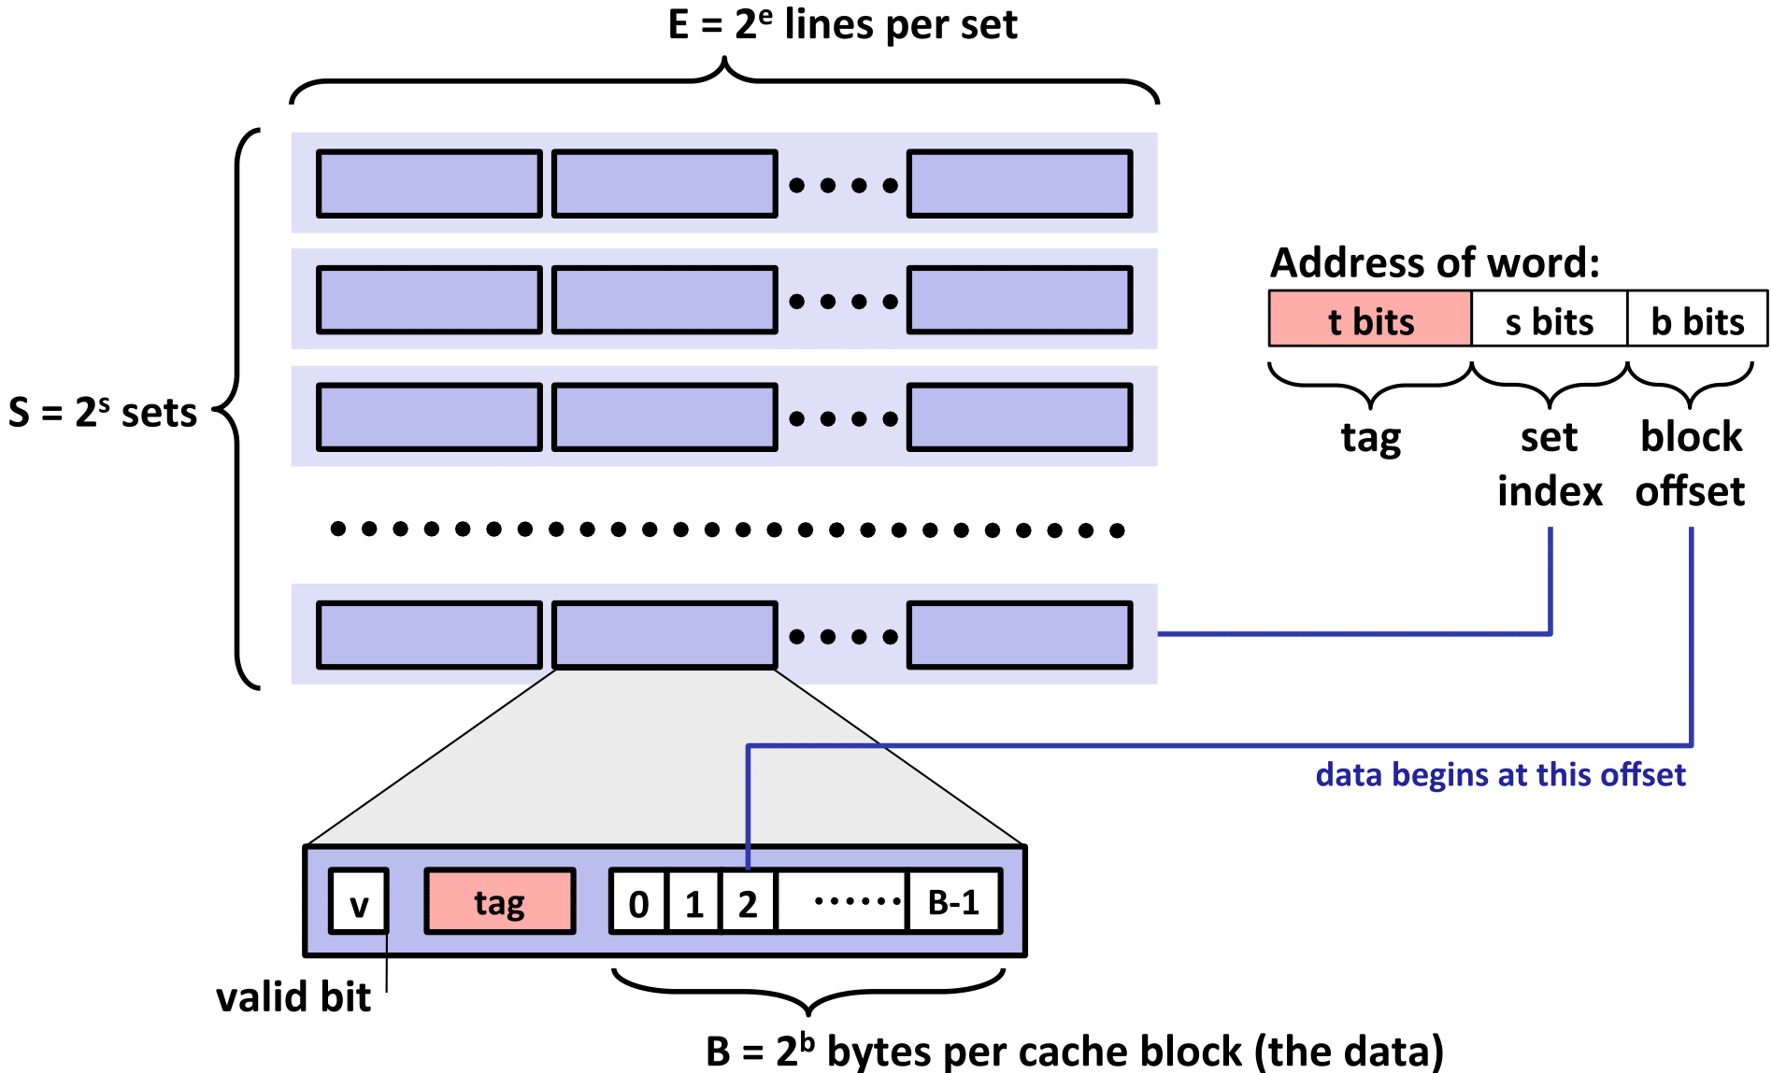
Appendix: Cache Structure

