Slide 1
15-213 Recitation: Attack Lab
12 Feb 2018

Slide 2
Agenda
Reminders
Buffer Overflow Attacks
Attack Lab Activities

Slide 3
Reminders
Bomb lab is due tomorrow (13 Feb, 2018)!
Don’t waste your grace days on this assignment
Attack lab will be released tomorrow
Start early!! (no more penalties for mistakes like bomb lab)

Slide 4
Attack Lab
We’re letting you hijack programs by running buffer overflow attacks on them…
To understand stack discipline and stack frames
To defeat relatively secure programs with return oriented programming

Slide 5
Stack Smashing Attack
Callq pushes the return address onto the stack
Retq pops this return address and jumps to it
Next return address
$rsp

Slide 6
Buffer Overflows
Local string variables are stored on the stack
C functions do not do size checking of strings
Next return address
Space allocated for string
$rsp

Slide 7
Buffer Overflows
You can write a string that overwrites the return address
Activity 1 steps through an example of overwriting the return address on the stack
Extra long string input
Next return address
Space allocated for string
$rsp

Slide 8
Executing Commands on the Stack
What if instead of jumping to a predefined function, we jumped to code on the stack?
Activity 2 steps through an example of executing code on the stack
Assembly instructions on the stack
Return address points to assembly above
$rsp

Slide 9
OS Countermeasures
Executable code is not allowed on the stack (unless we specifically allow it – e.g. through mprotect like we do for activity 2)
Thus, we have to use executable code already in the program to do what we want
But code often doesn’t already contain our exploit function – so what can we do instead?

Slide 10
Return-Oriented Programming
Goal: execute a small section of code, return, call another small section of code. Repeat until you execute your exploit
Activity 3 steps you through an example of a return oriented programming exploit

Slide 11
Attack Lab Activities
Three activities
Each relies on a specially crafted assembly sequence to purposefully overwrite the stack
Activity 1 – Overwrites the return addresses (Buffer Overflow)
Activity 2 – Writes assembly instructions onto the stack
Activity 3 – Uses byte sequences in libc as the instructions (Return-Oriented Programming)

Slide 12
Attack Lab Activities
Work in pairs: one student needs a laptop
Login to a shark machine
$ wget http://www.cs.cmu.edu/~213/activities/rec4.tar
$ tar xf rec4.tar
$ cd rec4
$ make
$ gdb act1
Notes:
Have students type out the url. Copy/pasting causes issues with the ~

Slide 13
Activity 1
(gdb) break clobber
(gdb) run
(gdb) x $rsp
(gdb) backtrace
Q. Does the value at the top of the stack match any frame?
A. 0x400553 is the address to return to in main

Slide 14
Activity 1 Continued
(gdb) x /2gx $rdi // Here are the two key values
(gdb) stepi // Keep doing this until
(gdb)
clobber () at support.s:16
16 ret
(gdb) x $rsp
Q. Has the return address changed?
A. 0x400500 was the first number pointed to by $rdi
(gdb) finish // Should exit and print out “Hi!”
Notes:
Note that the leading zeros in the address are important.

Slide 15
Activity 1 Post
Clobber overwrites part of the stack with memory at $rdi, including the all-important return address
In act1, it writes two new return addresses:
0x400500: address of printHi()
0x400560: address in main
Call clobber()
Clobber executes
In printHi()
In main()
0x7fffffffe338
0x000000400553
0x000000400560
0x000000400500
ret
ret
0x000000400560

Slide 16
Activity 2
$ gdb act2
(gdb) break clobber
(gdb) run
(gdb) x $rsp
Q. What is the address of the stack and the return address?
A. 0x7fffffffe018 -> 0x40058a
(gdb) x /4gx $rdi
Q. What will the new return address be?
A. 0x7fffffffe020 (First address stored using $rdi)

Slide 17
Activitity 2 Continued
(gdb) x /5i $rdi + 8 // Display as instructions
Q. Why $rdi + 8?
A. Want to ignore the 8-byte return address
Q. What are the three addresses?
A. 0x48644d, 0x4022e0, 0x4011a0
(gdb) break puts
(gdb) break exit
Q. Do these addresses look familiar?
A. puts – 0x4022e0, exit – 0x4011a0

Slide 18
Activity 2 Post
Normally programs cannot execute instructions on the stack
Main used mprotect to disable the memory protection for this activity
Clobber wrote an address that’s on the stack as a return address
Followed by a sequence of instructions
Three addresses show up in the exploit:
0x48644d → “Hi\n” string
0x4022e0 → puts() function
0x4011a0 → exit() function

Slide 19
Activity 3
$ gdb act3
(gdb) break clobber
(gdb) run
(gdb) x /5gx $rdi
Q. Which value will be first on the stack? Why is this important?
A. 0x457d0c, this is the address to return to from clobber

Slide 20
Activity 3 Continued
(gdb) x /2i <return address>
Q. What does this sequence do?
A. Pops next stack value into $rdi, then returns
Q. Check the other addresses. Note that some are return addresses and some are for data. When you continue, what will the code now do?
A. Print “Hi\n”

Slide 21
Activity 3 Post
It’s harder to stop programs from running existing pieces of code in the executable.
Clobber wrote multiple return addresses (aka gadgets) that each performed a small task, along with data that will get popped off the stack while running the gadgets.
0x457d0c: pop %rdi; retq
0x47fa64: Pointer to the string “Hi\n”
0x429a6a: pop %rax; retq
0x400500: Address of a printing function
0x47f001: callq *%rax

Slide 22
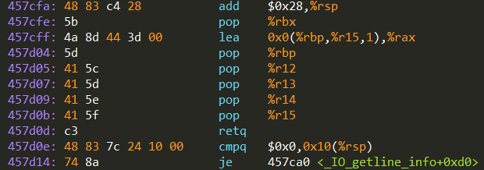

Activity 3 Post
Note that some of the return addresses actually cut off bytes from existing instructions
0x457d0b …0c …0d
-----------------------------------------
pop %r15 retq
41 5f c3
pop %rdi retq
5f c3
Notes:
This will require explanation of what a gadget it

Slide 23
If you get stuck…
Please read the writeup!
CS:APP Chapter 3
View lecture notes and course FAQ at http://www.cs.cmu.edu/~213
Office hours Sunday through Thursday at 5:00-9:00 in WH 5207, Friday at 3:00-5:00 in Gates Commons
Post a private question on Piazza
man gdb – gdb's help command

Slide 24
Attack Lab Tools
gcc –c test.s; objdump –d test.o > test.asm
Compiles the assembly code in test.s and shows the actual bytes for the instructions
./hex2raw < exploit.txt > converted.txt
Convert hex codes in exploit.txt into raw ASCII strings to pass to targets
See the writeup for more details on how to use this
(gdb) display /12gx $rsp (gdb) display /2i $rip
Displays 12 elements on the stack and the next 2 instructions to run
GDB is also useful for tracing to see if an exploit is working

Slide 25
Stack Review

Slide 26
Stacks
Last-in, first-out
x86 stack grows down
lowest address is “top”
$rsp contains the address of the topmost element in the stack
Uses the pushq and popq instructions to push and pop registers/constants onto and off the stack

Slide 27
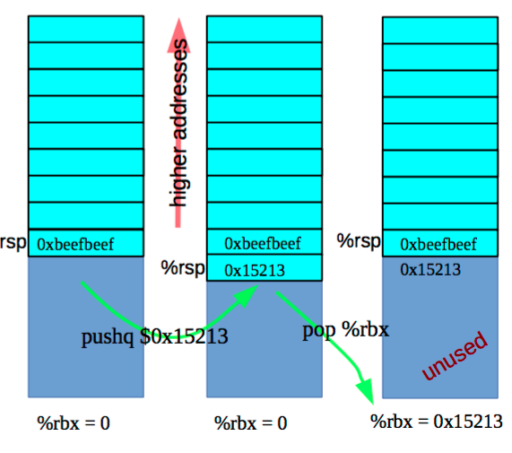
Stack – pushq & popq
pushq {value} is equivalent to
sub $8, %rsp
mov {value}, (%rsp)
popq {reg} is equivalent to
mov (%rsp), {reg}
add $8, %rsp

Slide 28
Stack – Caller vs. Callee
Function A calls function B
A is the caller
B is the callee
Stack space is allocated in “frames”
Represents the state of a single function invocation
Frame used primarily for two things:
Storing callee saved registers
Storing the return address of a function

Slide 29
Registers – Caller-saved vs. Callee-saved
Caller-saved
Registers used for function arguments are always caller-saved
$rax is also caller-saved
Called function may do as it wishes with the registers
Must save/restore register in caller’s stack frame if it still needs the value after a function call
Callee-saved
If the function wants to change the register, it must save the original value in its stack frame and restore it before returning
The calling function may store temporary values in callee-saved registers

Slide 30
Registers – Caller-saved vs. Callee-saved
Before function call
rdi = first argument
rsi = second argument
rax = some temporary value
rbx = some important number to use later (ex: 15213)
rsp = pointer to some important buffer (ex: 0x7fffffffaaaa)
After function call
rdi = garbage
rsi = garbage
rax = return value
rbx = some important number to use later (ex: 15213)
rsp = pointer to some important buffer (ex: 0x7fffffffaaaa)

Slide 31
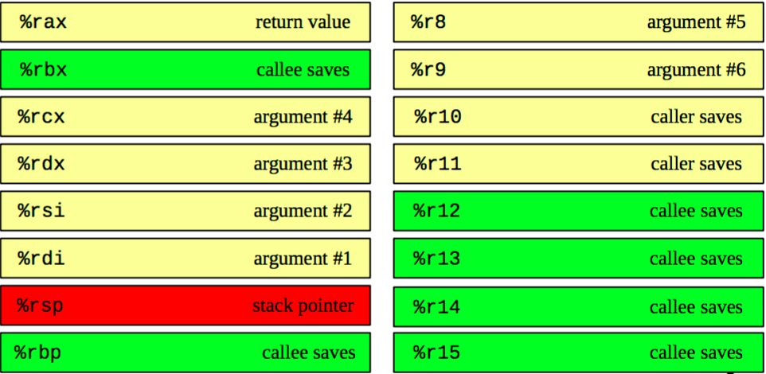
x86-64 Register Usage Conventions
Notes:
This slide may be useful for exams ;-)

Slide 32
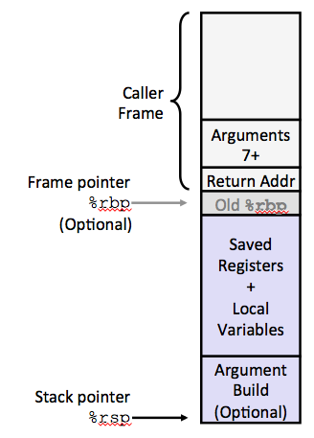
x86-64/Linux Stack Frame
Current Stack Frame (“Top” to Bottom)
“Argument build:” - Parameters for function about to call
Local variables - If can’t keep in registers
Saved register context
Old frame pointer (optional)
Caller Stack Frame
Return address
- Pushed by call instruction
Arguments for this call
Notes:
The key thing for Attack Lab is the return address

Slide 33
Stack Maintenance
Functions free their frame before returning
Return instruction looks for the return address at the top of the stack
…What if the return address has been changed?
Notes:
What? The return address can be changed?!

Slide 34
Byte Ordering Example
Example
Variable x has 4-byte value of 0x01234567
Address given by &x is 0x100
Big Endian
0x100
0x101
0x102
0x103
01
23
45
67
01
23
45
67
Little Endian
0x100
0x101
0x102
0x103
67
45
23
01
67
45
23
01
Notes:
For more Endianness, see lecture “Bits, Bytes, & Integers II”

Slide 35
Reading Byte-Reversed Listings
Disassembly
Text representation of binary machine code
Generated by program that reads the machine code
Example Fragment
Deciphering Numbers
Value: 0x12ab
Pad to 32 bits: 0x000012ab
Split into bytes: 00 00 12 ab
Reverse: ab 12 00 00
Address Instruction Code Assembly Rendition
8048365: 5b pop %ebx
8048366: 81 c3 ab 12 00 00 add $0x12ab,%ebx
804836c: 83 bb 28 00 00 00 00 cmpl $0x0,0x28(%ebx)
Notes:
For more Endianness, see lecture “Bits, Bytes, & Integers II”

