Slide 1
Stacks and Buflab
15/18-213: Introduction to Computer Systems
Recitation 5
February 9, 2015
Mukund Tibrewala

Slide 2
News!
Bomb Lab is due tomorrow (Tuesday) at 11.59pm!
If you haven’t started yet, good luck ☺
Try not to use late days (you’ll want to save them for Malloc Lab…)
Buffer Lab will come out tomorrow
Hacking the Stack ® with buffer overflow
Stacks will be on the midterm, so you should understand them well!

Slide 3
Today’s Agenda
Bomb Lab/Assembly Review
Jump Tables vs. Sparse Switches
Stacks
x86-32 (IA32) Stack Discipline
Function Call Walkthrough
Stack Walkthrough
Extras: x86-64
Buflab
Introduction
Tools + Approach
Tricks

Slide 4
Assembly: Jump Tables
Generally used for dense switch statements
Array of addresses in memory
Jump instructions used to execute from these addresses
Each entry holds addresses of instructions
switch (x) {
case 0: return 210;
case 1: return 213;
case 2: return 251;
}

Slide 5
Jump Table Example
Tip-off looks like this:
jmpq *0x15213(,%rax,8)
Empty base ➔ implied 0
%rax is index
8 is the scale
* indicates a dereference (C-style notation)
Putting it all together: “Jump to address stored at the address (0x15213 + %rax*8)”

Slide 6
Assembly: Sparse Switch
Sparse switch statements
Doesn’t make sense to allocate space for hundreds of entries if we only use three!
Labels are used to go to the next instruction
Similar to If-Else statements
switch (x) {
case 111: return 210;
case 222: return 213;
case 333: return 251;
default: return -1;
}

Slide 7
Sparse Switch Example
switch (x) {
case 111: return 210;
case 222: return 213;
case 333: return 251;
default: return -1;
}
cmpl $333,%eax # x == 333?
je L8
jg L16
...
cmpl $111,%eax # x == 111?
je L4
jmp L14 # Default case

Slide 8
Definitions + Conventions
Register
Hardware storage area (usually word size)
Separate from main memory (stack, heap)
Fast access!
Caller Saved: %eax, %ecx, %edx
Before a function call, the caller must save the values of these registers on the stack, if it wants them preserved
Callee Saved: %ebx, %edi, %esi
During a function call, the callee must save (and later restore) values in these registers if it wants to use those registers!

Slide 9
Special IA32 Registers
Base Pointer (remember, not used in x86-64!)
%ebp
Points to ‘bottom’ of stack frame (remember, bottom is up in the stack-world)
The value of %ebp is pushed on the stack (and later restored) by the callee on function entry
Stack Pointer
%esp
Points to ‘top’ of stack frame
Instruction Pointer
%eip
Points to the next instruction to be executed

Slide 10
IA32 Stack
Stack Bottom
(Higher addresses)
===================
Stack Top
===================
(Lower addresses)
Upside-down
Grows downward
New values → lower memory address
%esp holds address of top of stack
Direction of stack growth
%esp

Slide 11
Stack Operation: Push
pushl src →
subl $4, %esp
movl src, (%esp)
Stack Bottom
===================
0x15
===================
Stack Bottom
===================
0x15
===================
0x213
===================
pushl %eax
%esp→
%esp→

Slide 12
Stack Operation: Pop
popl dest →
movl (%esp), dest
addl $0x4, %esp
Stack Bottom
===================
0x15
===================
0x213
===================
Stack Bottom
===================
0x15
===================
popl %eax
%esp→
%esp→

Slide 13
Stack Frames
Every function has its own stack frame
Sections of the stack ‘marked off’ by base addresses
Data included in stack frame:
Local variables (scalars, arrays, structs)
What the compiler couldn’t fit into registers
Caller/Callee saved register values
Arguments
Grab arguments from caller functions
Give arguments to a function about to be called

Slide 14
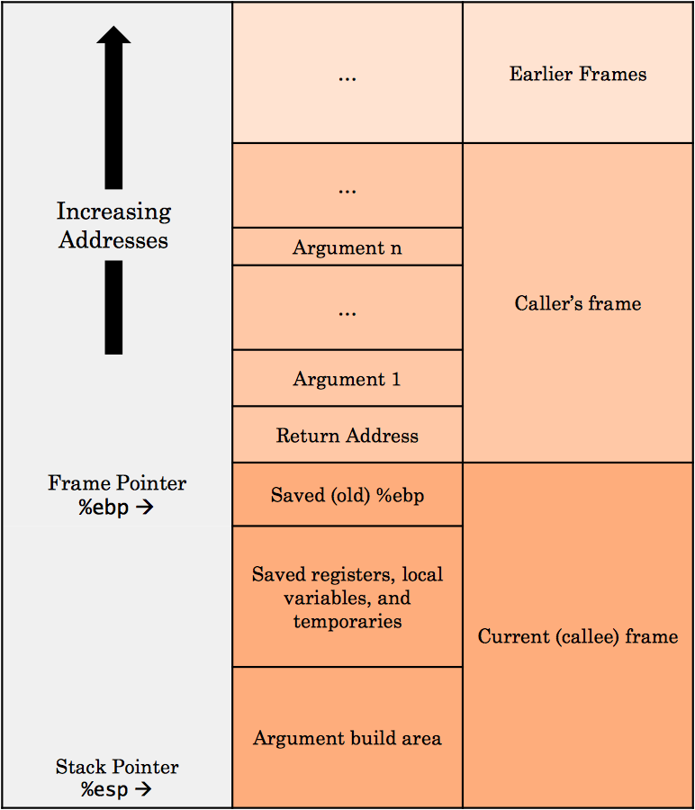
Stack Frame Example

Slide 15
Function Calls: Setup
Caller
Save (push) registers whose values should to be preserved
Push arguments
call label
Push return address (address of instruction directly after call)
Jump to label
Callee
Save (push) %ebp (save caller’s stack frame)
Copy (move) %esp into %ebp (old stack pointer is current base pointer)
Save (push) callee saved registers that it wants to use

Slide 16
Function Calls: Return
Callee
Restore (pop) callee saved registers
leave
Copy (move) %ebp into %esp (so the stack pointer is pointing to the base of the stack frame)
Restore (pop) %ebp (so caller function will have the correct base address value)
ret
Pop return address into %eip (address of the next instruction)
Function call is now over
Caller
Remove (pop) arguments
Restore (pop) caller saved registers

Slide 17
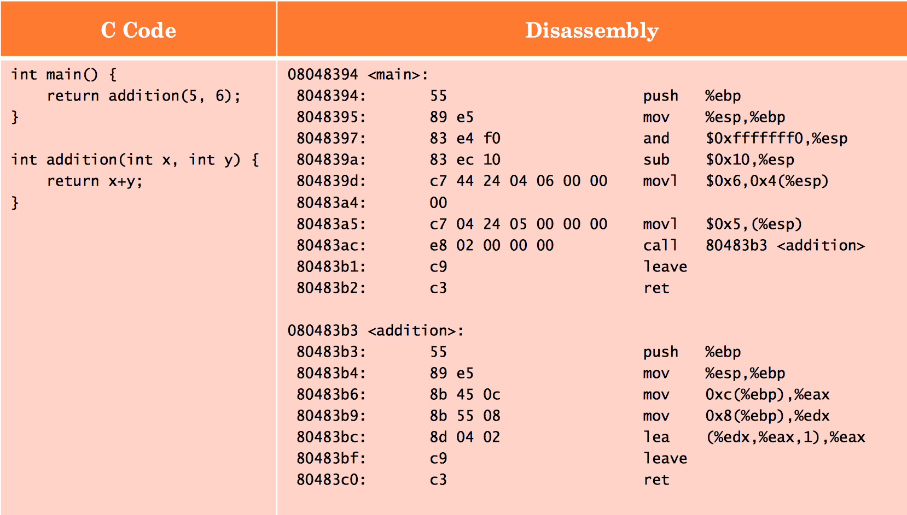
Visualization: Argument Build
Arguments are placed in the order they appear (with the first argument at the lowest memory address)

Slide 18
Visualization: Function Call
Remember, call first pushes the address of the next instruction (return address), and then jumps to the label!

Slide 19
Visualization: Callee Setup
Callee sets up its own stack frame (saves old base pointer, then updates %ebp with its own stack base address)

Slide 20
Visualization: Accessing Arguments
Remember, arguments will be in the caller’s stack frame – the callee must wade through the saved %ebp and return address first!

Slide 21
Visualization: Return
Move %ebp into %esp to go back to top of stack frame; restore caller’s %ebp; pop return address into %eip

Slide 22
Stacks on x86-64
Arguments (up to six) passed via registers
%rdi, %rsi, %rdx, %rcx, %r8, %r9
Extra arguments passed via stack!
Don’t need to store base pointer in %ebp
Compilers became smarter!
Overall less stack use
Better performance

Slide 23
Buflab
A series of exercises asking you to overflow the stack and change program execution
Exploit vulnerabilities in
string input
Do this by crafting inputs to overwrite key stack values
Incorrect inputs will not hurt your score!

Slide 24
Basic Approach
Examine provided C code + dissassembly
Disassembling
> objdump –d bufbomb > outfile
Remember, you’ll still be using GDB for this lab!
x/i addr
Examine instruction at <addr>
Find out how long to make your input string
Write exploits to stealthily divert program execution
$$$

Slide 25
Buflab Tools
./makecookie andrewID
Makes a unique “cookie” based on your Andrew ID
./hex2raw
Use the hex generated from assembly to pass raw strings into bufbomb
Use with –n in the last stage
./bufbomb –t andrewID
The actual program to attack
Always pass in with your Andrew ID, so we can log your score!
Use with –n in the last stage

Slide 26
How to Input Answers
Earlier Stages:
Put your byte code exploit into a text file
Feed it through hex2raw
Later Stages:
Write (corruption) assembly
Compile it
> gcc –m32 –c example.s
Get the byte code
> objdump -d example.o > outfile
Then feed it through hex2raw

Slide 27
Potential Points of Confusion/Error
Don’t use the byte value 0A in your exploit
ASCII for newline
Gets() will terminate early if it encounters this
Each level always takes the latest submission
So if you pass correctly once, but accidentally pass the wrong exploit later, just pass the correct one again
As long as your latest submission for each level is correct, you will not lose points!
Don’t forget the –n flag on the last level (Nitro Mode!)

Slide 28
Tricks
Will come in useful in later stages
Canaries
Detect overrun buffers
Sit at end of buffer (array)
If the buffer overflows, hopefully we can detect this with a change in canary value…
nop sleds
The nop instruction means “no operation”
Used to “pad” instructions (…or, exploits!)
Place your exploits at the end of the nop sled

Slide 29
Buflab Secret Hints
Read the handout very carefully!
Good luck!
Hack the Planet!
(Bonus points if you know where this line is from)

Slide 30
Credits
Anita Zhang’s slides from Fall 2013
CS:APP (p. 220 – 263)

