Slide 1
Virtual Memory
15-213 : Introduction to Computer Systems
23rd March 2015

Slide 2
Today
Virtual Memory
Overview
Address translation
TLB
Memory mapping

Slide 18
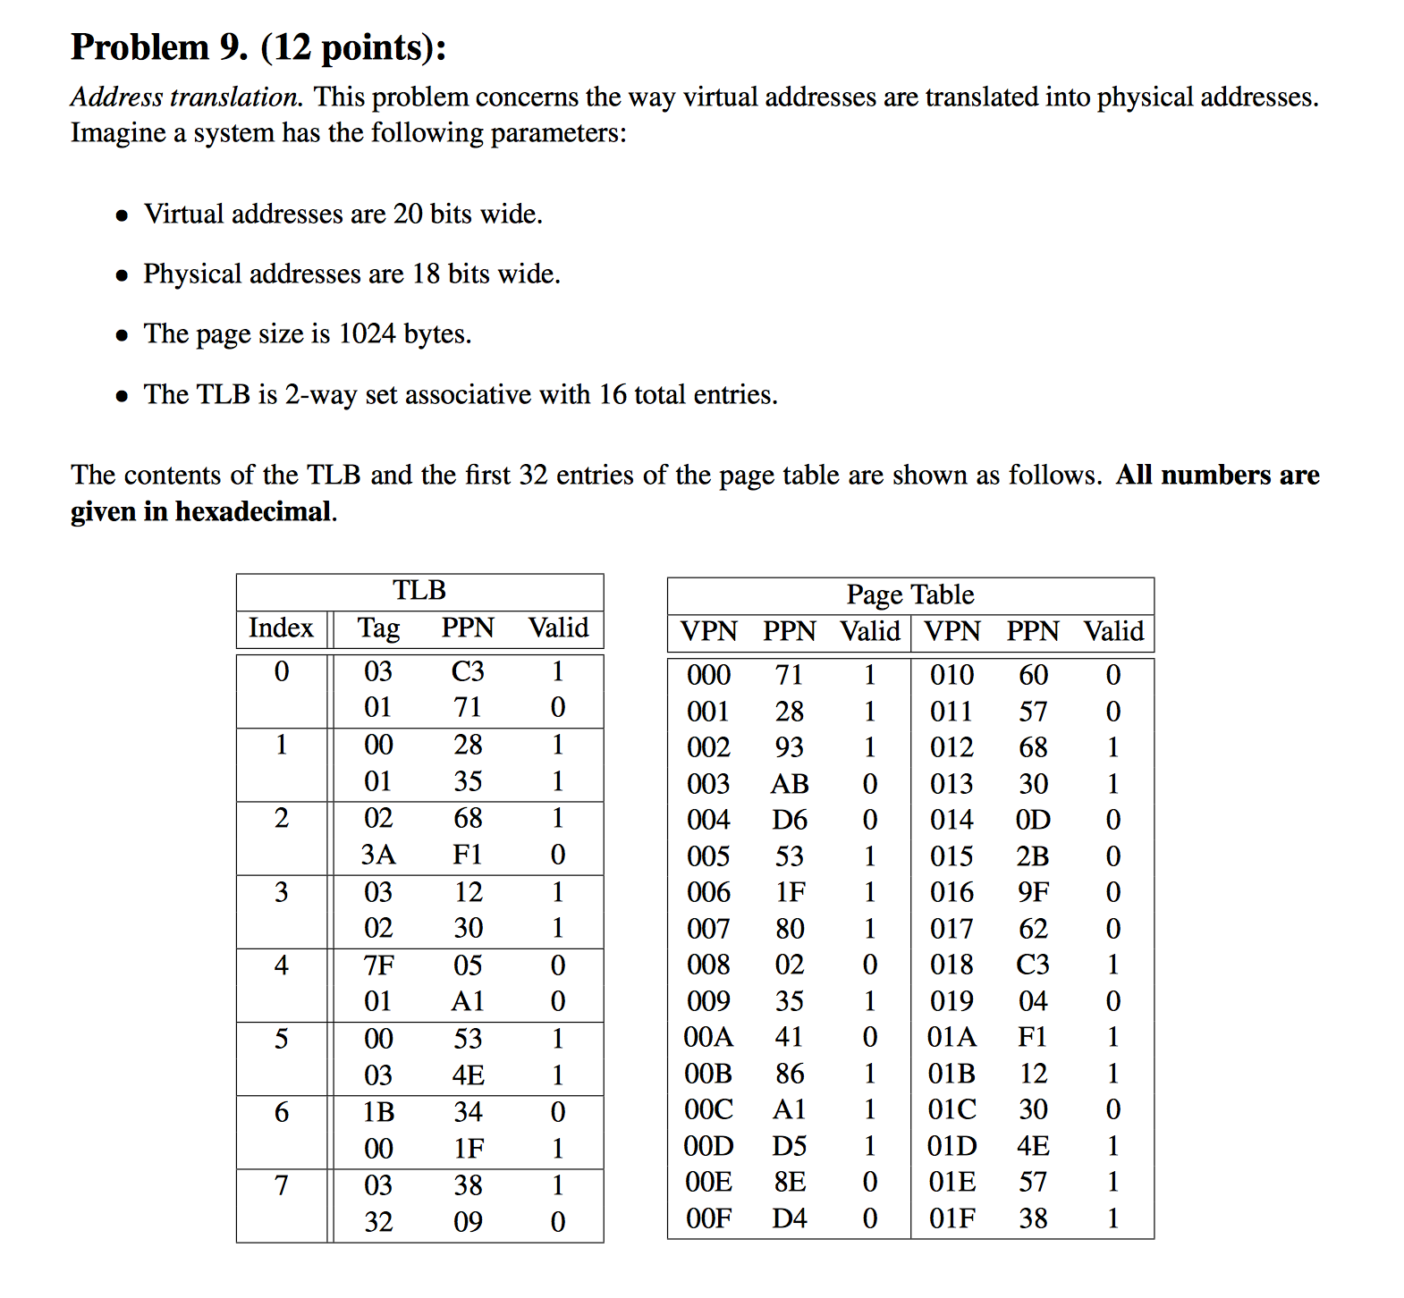

Slide 19
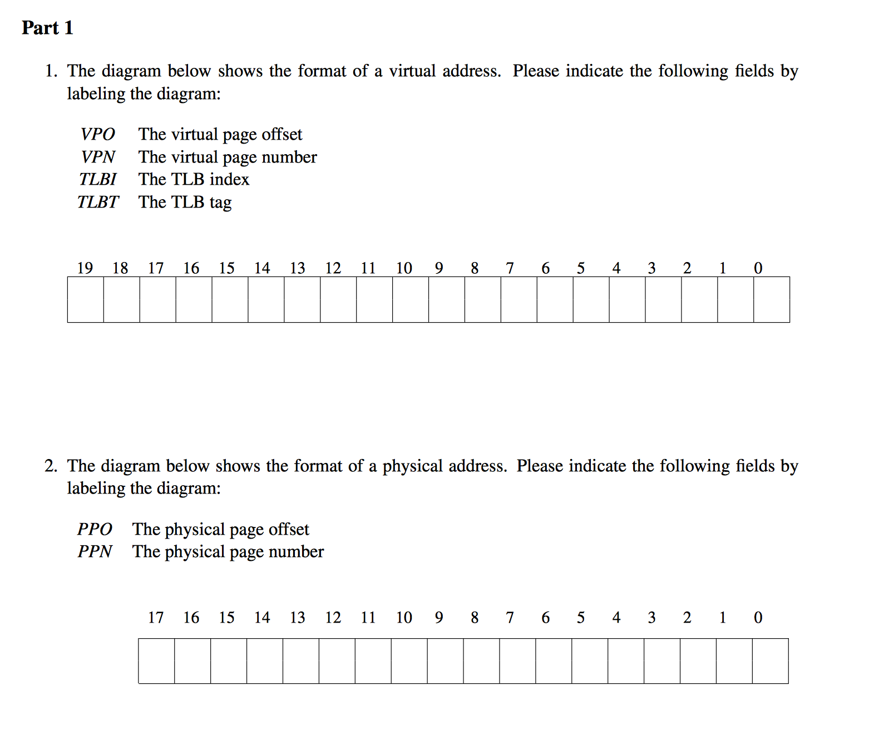

Slide 21
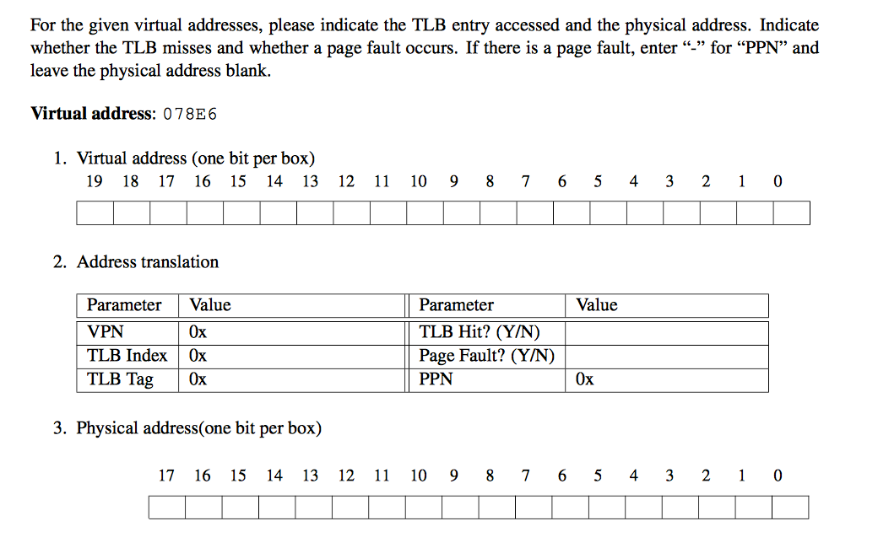

Slide 22
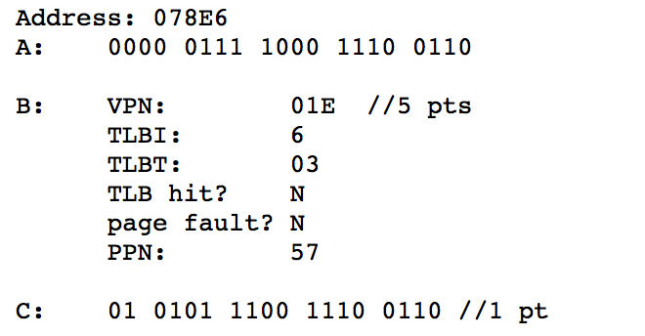

Slide 23
Memory Mapping
VM areas initialized by associating them with disk objects.
Process is known as memory mapping.
Area can be backed by (i.e., get its initial values from) :
Regular file on disk (e.g., an executable object file)
Initial page bytes come from a section of a file
Anonymous file (e.g., nothing)
First fault will allocate a physical page full of 0's (demand-zero page)
Once the page is written to (dirtied), it is like any other page
Dirty pages are copied back and forth between memory and a special swap file.

Slide 24
Demand paging
Key point: no virtual pages are copied into physical memory until they are referenced!
Known as demand paging
Crucial for time and space efficiency

Slide 25
User-Level Memory Mapping
void *mmap(void *start, int len,
int prot, int flags, int fd, int offset)
Map len bytes starting at offset offset of the file specified by file description fd, preferably at address start
start: may be 0 for “pick an address”
prot: PROT_READ, PROT_WRITE, ...
flags: MAP_ANON, MAP_PRIVATE, MAP_SHARED, ...
Return a pointer to start of mapped area (may not be start)

Slide 26
User-Level Memory Mapping
void *mmap(void *start, int len,
int prot, int flags, int fd, int offset)
len bytes
start
(or address
chosen by kernel)
len bytes
offset
(bytes)
0
0
Disk file specified by
file descriptor fd
Process virtual memory

Slide 27
Using mmap to Copy Files
Copying without transferring data to user space .
#include "csapp.h"
/*
* mmapcopy - uses mmap to copy
* file fd to stdout
*/
void mmapcopy(int fd, int size)
{
/* Ptr to mem-mapped VM area */
char *bufp;
bufp = Mmap(NULL, size,
PROT_READ,
MAP_PRIVATE, fd, 0);
Write(1, bufp, size);
return;
}
/* mmapcopy driver */
int main(int argc, char **argv)
{
struct stat stat;
int fd;
/* Check for required cmdline arg */
if (argc != 2) {
printf("usage: %s <filename>\n”,
argv[0]);
exit(0);
}
/* Copy the input arg to stdout */
fd = Open(argv[1], O_RDONLY, 0);
Fstat(fd, &stat);
mmapcopy(fd, stat.st_size);
exit(0);
}

Slide 28
Questions?

