Slide 1
15213 Recitation Fall 2014
Section A, 8th September
Vinay Bhat

Slide 2
Welcome to a fun course!
Yes, it really is fun!
Recitation will be a place for …
… a quick overview of the last week’s lectures.
… re-iteration of some key concepts.
… some problem solving (if needed).
… lab related discussion.
Ask questions if you have – from textbooks or otherwise
We will get back if we cannot answer immediately (yes, we may not know everything!)
Let us know if you want anything else – we will try to squeeze it in

Slide 3
Agenda
Some general stuffs/tips/logistics
Data Lab
Bits and bytes
Unsigned Numbers
Signed Number
Arithmetic/Logical Shift – Many questions on this!
Floating Points – IEEE formats and rounding – Some questions on this!

Slide 4
Getting help: how-to?
Attend lectures – there is no substitution for this!
Course website – Go over the FAQ section
Refer the textbook – it will be useful long after this semester ends
Always email the staff mailing list – you will get quicker response (15-213-staff@cs.cmu.edu)
Attend recitations – some problems will/might be solved!
All recitations are on Monday – different place and time – check course website
Visit TA office hours – for any specific questions or lab problems
All office hours are in WEH 5207 - 5:30 PM to 8:30 PM – different days of the week – check course website

Slide 5
Data Lab - General
Due this Thursday (Sept 11th)
Try not to use grace days for the initial labs – the value of grace days appreciates as the semester progresses!
If you have to use grace days – autolab will do it for you, just submit
Beware - you can use only 2 grace days per lab! (Again, you should really be not using them now!)
Try to get accustomed to shark machines – really! Future labs will force you to use only shark machines

Slide 6
Data Lab – How to get started?
Download the handout
- From Autolab
- If not registered yet, download from course website (schedule page)
Un-tar on shark machine (tar xvf <tar-file-name>)
- Else you might see permission denied error
- If you see any permission related issues, try “chmod +x <filename>”
Hope everyone has already done this by now!

Slide 7
Data Lab – Which files to edit and submit?
bits.c is the file you will be working on
Read the instructions carefully – both in the bits.c file header and the lab writeup
Run driver.pl before submitting – runs the same test that autolab uses to grade the lab
You need to submit to autolab
You have unlimited submission – but please do not use autolab as your own driver.pl

Slide 8
Data Lab – The last slide!
You are expected to write C which follows ANSI C standards – Only for this lab!
This means you cannot mix statements with variable declarations – all variables declared at the beginning of the function
The closing brace should be in the 1st column!
Be aware of operator precedence in C – better use braces when you are not sure. Ex: (((a-b) >> 2) & (c | (~a) | 0x1))
Be clever to use some special values – 0, ~0, Tmin, -1 etc
Try and finish all puzzles before you set out to optimize your solution
Any specific question?

Slide 9
Bits and Bytes
Computers understand everything in bits – in 0’s and 1’s
So, even you should be able to understand bit level arithmetic – binary representation of numbers
Might be difficult at first since we are more accustomed to counting in base-10
But then, if it was easy then there would be no fun in it! (Right?)
8 bits make up 1 byte

Slide 10
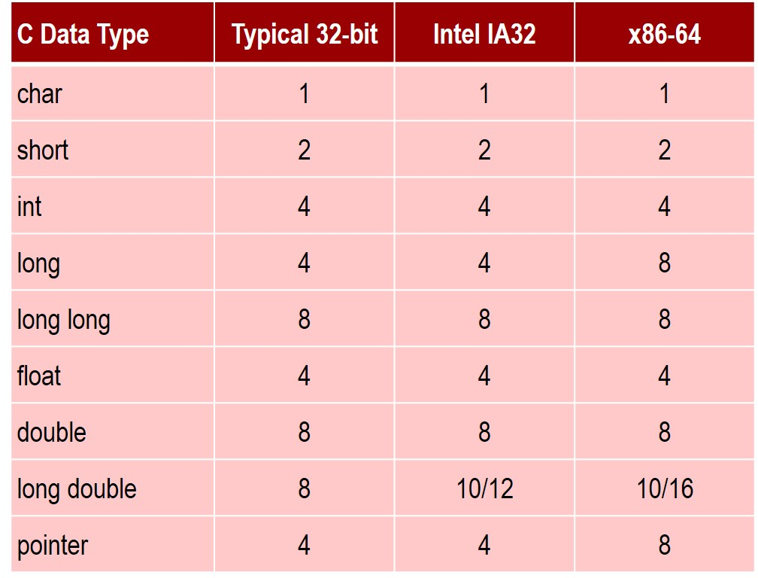
Bits and Bytes - Example Data Representation

Slide 11
Bits and Bytes - Endianness
Order in which bits are stored in memory matters – called Endianness
Not so important for Data Lab
You will get to see this in Bomb Lab and Buffer Lab
Big Endian
- Most significant byte is stored in the smallest address in memory
- i.e the ‘big’ part goes first into memory
Little Endian
- Least significant byte is stored in the smallest address in memory
- i.e the ‘little’ part goes first into memory

Slide 12
Unsigned Numbers
Unsigned are non-negative numbers (including zero)
Represented using direct binary notation
Using k bits, we can represent 2^{k} distinct numbers
So, the range becomes 0 to 2^{k}-1
So, U_{min} = 0 and U_{max} = 2^{k}-1

Slide 13
Signed Numbers (C ‘int’s)
Most significant bit used to represent the sign
- MSB = 0 for +ve integers
- MSB = 1 for –ve integers
So, with k bits, we get only k-1 bits to encode the value
Using k bits, we can represent 2^{k-1} distinct ‘int’s
The range becomes -2^{k-1} to (2^{k-1}-1)
Note how we can represent one more negative integer than the number of positive integer
This is where the expression “|T_{min}| = T_{max} + 1” comes from

Slide 14
Operators of interest
Bitwise
- AND -> &
- OR -> |
- NOT -> ~
- XOR -> ^
Logical
- AND -> &&
- OR -> ||
- NOT -> !
Mixing logical AND/OR with bitwise AND/OR is a common source of bug (and frustration)
Ex: x = (2 & 1) makes x to be equal to 0
Ex: x = (2 && 1) makes x to be equal to 1

Slide 15
Operators of interest
Bitwise Shift
- Right Shift -> ‘>>’
- Left Shift -> ‘<<‘
Mixing bitwise shift with relational operators is a common source of bug (and frustration)
Ex: x = (4 >> 1) makes x to be equal to 2
Ex: x = (4 > 1) makes x to be equal to 1

Slide 16
Some insights on right shifts
Most modern machine performs arithmetic right shift on signed numbers i.e int’s
This means that the sign bit is extended on right shift of signed numbers
Wrong assumption - shark machines always perform arithmetic right shift
Right assumption - shark machines always perform arithmetic right shift on signed numbers
Int’s are signed in C. Unsigned are, well, not-signed numbers in C
So, what actually determines the arithmetic or logical right shifts are not the machines. It is the signed-ness of the number

Slide 17
Some insights on right shifts
Long story short
- Arithmetic right shift on int’s: MSB gets filled with the sign bit
- Logical right shift on unsigned: MSB always gets filled with a 0
Remember, in C, numbers are ‘typed’ to be signed (i.e int) only after specifying it explicitly.
By default everything is unsigned
Try this out to get a clear picture:
int x = 0x80000000; int x = 0x80000000 >> 1;
x = x >> 1; printf(“%x\n”, x);
printf(“%x\n”, x);

Slide 18
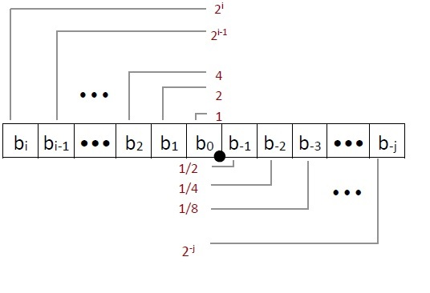

Floating Point – Binary Fractions
Bits to the right of ‘binary point’ indicate fractional powers of 2
How to calculate the value:
Ex: 1101.1011

Slide 19



Floating Point – IEEE Standards
Single Precision: 32 bits
Double Precision: 64 bits
Extended Precision: 80 bits (Intel only)

Slide 20
Floating Point – IEEE Standards
Can be thought of as : (-1^{sign}) M 2E
MSB represents the sign: 1 for negative, 0 for positive
The exp field encodes E (but is not equal to E)
The frac field encodes M (but is not equal to M)

Slide 21
Floating Point – Normalized Values
When exp ≠ 000..0 and exp ≠ 111..1
E = Exp – bias
- Exp = unsigned value of exp
- bias = 2^{k-1} – 1, where k = number of exp bits
Significand coded with implied leading 1: M = 1.xxx…xxx (base 2)
- xxx…xxx: bits of frac
For single precision: k=8, bias=127
Ex: 15213 = 11 1011 0110 1101 = 1.1101101101101 * 2¹³
Exp = E + bias = 13 + 127 = 140 = 1000 1100 (base 2)
frac = 11011011011010000000000
Ex: 15213.0 = 0 10001100 11011011011010000000000

Slide 22
Floating Point – Denormalized Values
When exp = 000…0
E = -bias + 1
Significand coded with implied leading 0: M = 0.xxx…xxx (base 2)
- xxx…xxx: bits of frac
Exp = 000…0 and frac = 000…0 represents 0
- +0 and -0 have different representation!
Exp = 000…0 and frac != 000…0 represents numbers closest to 0.0

Slide 23
Floating Point – Special Values
When exp = 111…1
Exp = 111…1 and frac = 000…0
- Represents infinity (∞)
- Both positive and negative (depending on sign bit)
Exp = 111…1 and frac ≠ 000…0
- Represents Not-a-Number (NaN)
- Ex: √-1, ∞- ∞, ∞ * 0

Slide 24
Floating Point - Rounding
Cannot accurately represent all fractional ranges with limited number of bits
Fractions need to be rounded most of the time
Rounding scheme – round to even
Ex:
10.1011 → More than ½, round up → 10.11
10.1010 → Equal to ½, round down to even → 10.10
10.0101 → Less than ½, round down → 10.01
10.0110 → Equal to ½, round up to even → 10.10
Round up/down to even used only in interesting cases (Equal to ½ cases above)
All other cases involve rounding up or rounding down

Slide 25
Floating Point - Examples
Consider the following 5 bit floating point representation
- k=3 exponent bits
- n=2 frac bits
- no sign bit (only positive floats)
Bias = ?
Largest normalized number = ?
Smallest normalized number = ?
Largest denormalized number = ?
Smallest denormalized number = ?

Slide 26
Floating Point - Examples
Consider the following 5 bit floating point representation
- k=3 exponent bits
- n=2 frac bits
- no sign bit (only positive floats)
Bias = 3
Largest normalized number = 110 11 = 1110.0₂ = 14
Smallest normalized number = 001 00 = 0.0100 ₂ = 1/4
Largest denormalized number = 000 11 = 0.0011₂ = 3/16
Smallest denormalized number = 000 01 = 0.0001₂ = 1/16

Slide 27
Floating Point - Examples
When converting to IEEE floating points, assume that the IEEE floating point would be normalized
It will be - most of the time
If not, you can easily tell – exponent would not make any sense

Slide 28
Floating Point - Examples
Consider the following 5 bit floating point representation
- k=3 exponent bits
- n=2 frac bits
- no sign bit (only positive floats)
Value in Decimal | IEEE floating point representation | Rounded Value
9/32
3
9
3/16
15/2

Slide 29
Floating Point - Examples
Consider the following 5 bit floating point representation
- k=3 exponent bits
- n=2 frac bits
- no sign bit (only positive floats)
Value in Decimal | IEEE Floating point representation | Rounded Value
9/32 | 001 00 | 1/4
3 | 100 10 | 3
9 | 110 00 | 8
3/16 | 000 11 | 3/16
15/2 | 110 00 | 8

Slide 30
Credits
http://www.cs.cmu.edu/~213/
The course text book
Lecture slides
Previous recitation slides

