Slide 1
Malloc Lab
15-213: Introduction to Computer Systems
Friday, July 10, 2015
Shen Chen Xu

Slide 2
Today
Dynamic memory allocation and malloc lab.
Pointers.
Simple implementations of malloc/free.

Slide 3
Malloc Lab
Is out.
Due at Thursday, July 23rd.
Please start early.

Slide 4
Malloc Lab
void *malloc(size_t size);
void *realloc(void *ptr, size_t size);
void *calloc(size_t nmemb, size_t size);
void free(void *ptr);
int mm_init(void);
void mm_checkheap(int);

Slide 5

Watch out for…
Driver will complain about:
  Memory alignment.
  Garbled bytes.
  Out of memory.
  Etc.
But most of the time…

Slide 6
Debugging
gdb and gcc with option -g.
valgrind: illegal accesses, unintialized values, etc.
Hard to reason about a such complicated program only using these generic tools.
Use your heap checker to print out more information before it crash and burns!

Slide 7
Pointers
Declaring a pointer:
  int *ptr;
Getting the address of a variable:
  &x;
Dereferencing a pointer:
  *ptr;

Slide 8
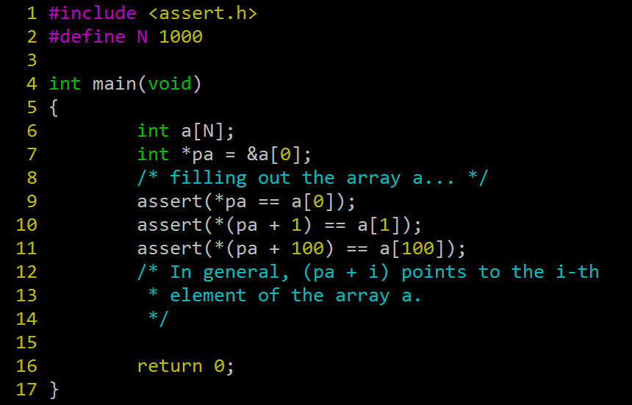
Pointers and Arrays

Slide 9
Pointers and Arrays
In fact, &arr[0] and arr are interchangeable.
What if ptr is did not come from an array? What is (ptr + 1) in this case?
(ptr + i) points to the i-th element that comes after ptr, as if ptr points to the start of an array.

Slide 10
Pointer arithmetic
Recall: pointers are simply numbers that index into memory.
For a pointer p of type T, (ptr + i)
is equivalent to
((unsigned) ptr) + i * sizeof(T)
(*assuming unsigned has the same size as a pointer)

Slide 11
Casting Pointers
Pointers have types!
Casting to a different type only changes compiler’s interpretation, not the value.
However this affects pointer arithmetic!

Slide 12
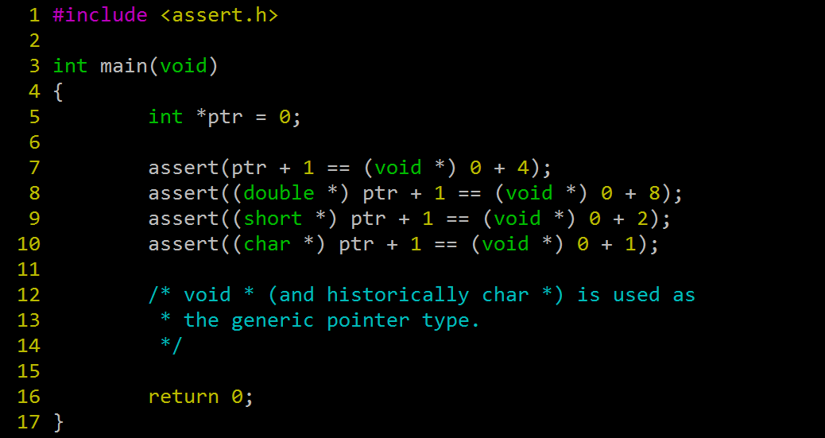
Casting Pointers

Slide 13
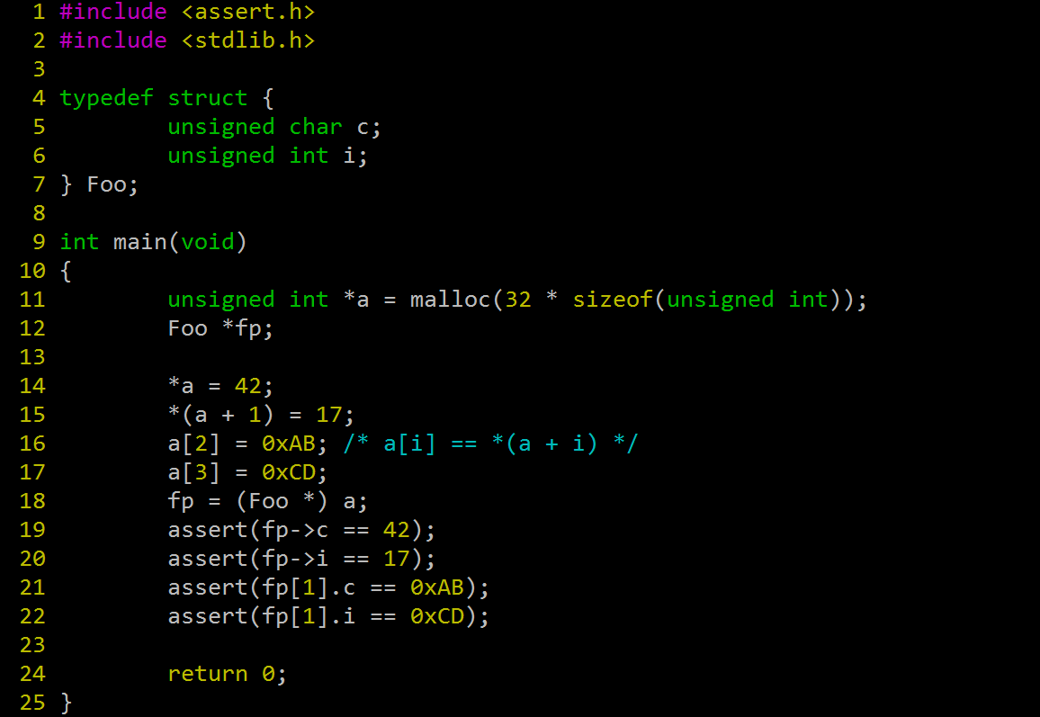
More Casting

Slide 14
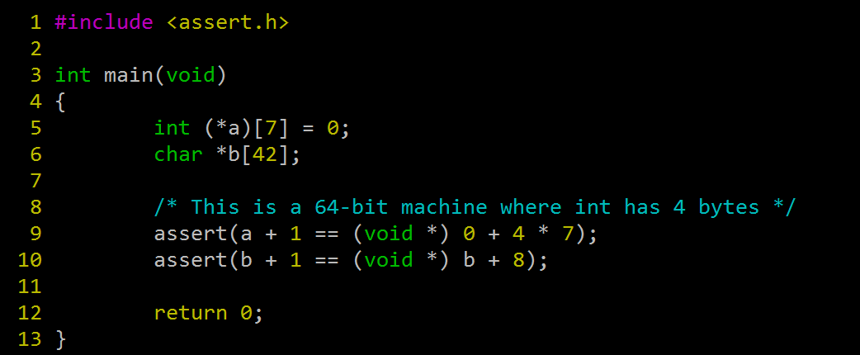
Complicated Declarations
Declaration agrees with usage.

Slide 15
Allocator Designs
We evaluate you based on throughput and memory utilization.

Slide 16
Allocator Designs
Free list
  Implicit, explicit, segregated, etc.
Placement
  First-it, next-fit, best-fit, etc.
Splitting
  Splitting vs tolerating internal fragmentation.
Coalescing
  Immediate vs deferred.

Slide 17
Example Allocator #1
Suppose we are on a 32-bit machine.
We only want to allocate and free memories that fits one ‘double’.
Simple strategy:
  Singly linked explicit free list.
  First fit placement policy.
Code walkthrough…

Slide 18
Example Allocator #2
Brian W. Kernighan and Dennis M. Ritchie, The C Programming Language, Second Edition, Prentice Hall, 1988.
Explicit List of free blocks.
Header as a basic unit of allocation.
Code walkthrough…

