Slide 1
Part 1: Camaroptera
A Batteryless, Long-Range Camera
18613: Future of Computing

Slide 2
Contents
Motivation – Remote Sensing Applications
Camaroptera Design
Experimental Results
Future Directions

Slide 3
Contents
Motivation – Remote Sensing Applications
Camaroptera Design
Experimental Results
Future Directions

Slide 4
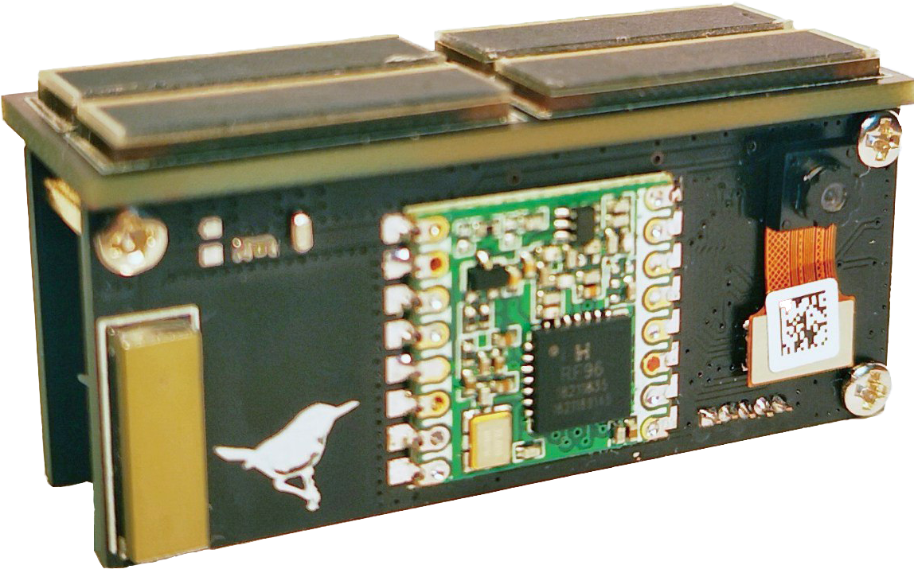



Motivation - Remote Sensing Applications
$x$ km
Sensing
Devices
Nearest
Infrastructure
National Highways
Notes:
https://giphy.com/explore/smart-city
https://www.behance.net/gallery/73416639/Walking-Animals

Slide 5
Requirements for Remote Sensing Applications
Requirement 1: Kilometer-range communication
$x$ km
Sensing
Devices
Nearest
Infrastructure
National Highways

Slide 6
Requirements for Remote Sensing Applications
Requirement 1: Kilometer-range communication
$x$ km
Sensing
Devices
Requirement 2: Maintenance-Free Long Lifetimes
Nearest
Infrastructure
National Highways

Slide 7
Requirements for Remote Sensing Applications
Requirement 1: Kilometer-range communication
$x$ km
Sensing
Devices
Requirement 2: Maintenance-Free Long Lifetimes
Nearest
Infrastructure
Requirement 3: Support Different Applications
National Highways

Slide 8
Requirements for Remote Sensing Applications
Requirement 1: Kilometer-range communication
Solution: LoRa (kms-range, low-power)
$x$ km
Sensing
Devices
Requirement 2: Maintenance-Free Long Lifetimes
Nearest
Infrastructure
Requirement 3: Support Different Applications
National Highways

Slide 9
Requirements for Remote Sensing Applications
Requirement 1: Kilometer-range communication
Solution: LoRa (kms-range, low-power)
$x$ km
Sensing
Devices
Requirement 2: Maintenance-Free Long Lifetimes
Solution: Batteryless Operation
Nearest
Infrastructure
Requirement 3: Support Different Applications
National Highways

Slide 10
Requirements for Remote Sensing Applications
Requirement 1: Kilometer-range communication
Solution: LoRa (kms-range, low-power)
$x$ km
Sensing
Devices
Requirement 2: Maintenance-Free Long Lifetimes
Solution: Batteryless Operation
Nearest
Infrastructure
Requirement 3: Support Different Applications
National Highways
Solution: Image Sensing

Slide 11
Requirements for Remote Sensing Applications
Requirement 1: Kilometer-range communication
Solution: LoRa (kms-range, low-power)
$x$ km
Sensing
Devices
Requirement 2: Maintenance-Free Long Lifetimes
Solution: Batteryless Operation
Nearest
Infrastructure
Requirement 3: Support Different Applications
National Highways
Solution: Image Sensing
Challenge: Image Communication over kms is costly

Slide 12
Requirements for Remote Sensing Applications
Requirement 1: Kilometer-range communication
Solution: LoRa (kms-range, low-power)
$x$ km
Sensing
Devices
Requirement 2: Maintenance-Free Long Lifetimes
Solution: Batteryless Operation
Nearest
Infrastructure
Requirement 3: Support Different Applications
National Highways
Solution: Image Sensing
Challenge: Image Communication over kms is costly
Solution: Local, On-Device Computing

Slide 13
Contents
Motivation – Remote Sensing Applications
Camaroptera Design
Experimental Results
Future Directions

Slide 14
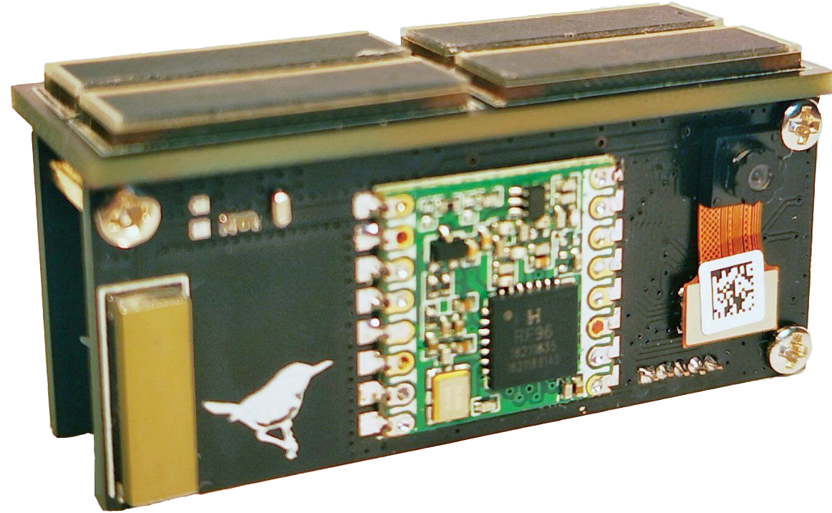
Hardware Design
Sensing & Communication
Processing
Energy Harvesting

Slide 15
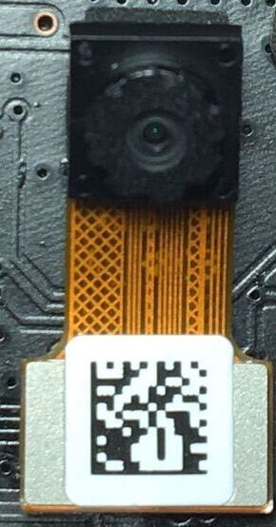
Sensing & Communication
Camera Sensor – Himax HM01B0
Ultra-low power image sensor
~1.1mW @QQVGA
Camaroptera Resolution
QQVGA – 160 x 120
suffices for machine inference
Notes:
https://www.okdo.com/shop/sbc-iot/rf-development-tools/99130807-rf_modules/rfm95w-lora-transceiver-module-868mhz/

Slide 16
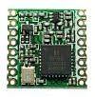
Sensing & Communication
Camera Sensor – Himax HM01B0
LoRa Radio – RFM95W
Ultra-low power image sensor
~1.1mW @QQVGA
Camaroptera Resolution
QQVGA – 160 x 120
suffices for machine inference
Cheap, low-energy radio with range in kilometer(s)
Permits pervasive deployment
Notes:
https://www.okdo.com/shop/sbc-iot/rf-development-tools/99130807-rf_modules/rfm95w-lora-transceiver-module-868mhz/Z

Slide 17
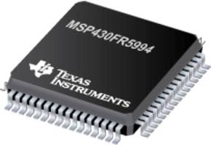
Processing
Microcontroller – Texas Instruments MSP430FR5994
Ultra-low power 16-bit microcontroller:
  Clock – upto 16MHz
  Memory – 256kB FRAM
  Power consumption - ~3mW

Slide 18
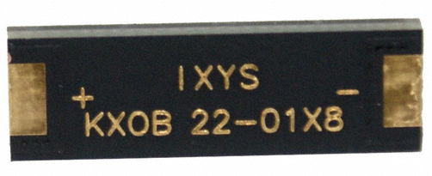
Energy Harvesting
Solar Panels
22mm x 7mm x 1.8mm
V_{MPP} = 3.4V
I_{MPP} = 3.8mA
Camaroptera:
Four in parallel
Notes:
https://www.digikey.com/product-detail/en/ixys/KXOB22-01X8/KXOB22-01X8-ND/2754274
https://www.digikey.com/product-detail/en/avx-corporation/BZ055A333ZSB/478-3646-ND/1045920

Slide 19
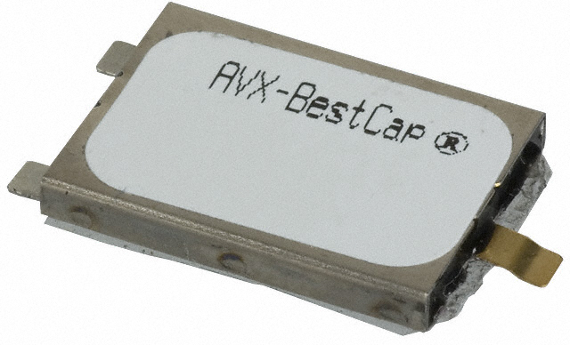
Energy Harvesting
Solar Panels
Super Capacitor
22mm x 7mm x 1.8mm
V_{MPP} = 3.4V
I_{MPP} = 3.8mA
20mm x 15mm x 3.5mm
C = 33mF
V_{RATED} = 5.5V
Camaroptera:
Four in parallel
Notes:
https://www.digikey.com/product-detail/en/ixys/KXOB22-01X8/KXOB22-01X8-ND/2754274
https://www.digikey.com/product-detail/en/avx-corporation/BZ055A333ZSB/478-3646-ND/1045920

Slide 20
Energy Harvesting
Solar Panels
Super Capacitor
Dual Booster Circuit
Input Booster (#1):
Charge the Super Capacitor
Output Booster (#2):
Provide regulated 3V voltage
Booster #2
22mm x 7mm x 1.8mm
V_{MPP} = 3.4V
I_{MPP} = 3.8mA
20mm x 15mm x 3.5mm
C = 33mF
V_{RATED} = 5.5V
Booster #1
Camaroptera:
Four in parallel
Notes:
https://www.digikey.com/product-detail/en/ixys/KXOB22-01X8/KXOB22-01X8-ND/2754274
https://www.digikey.com/product-detail/en/avx-corporation/BZ055A333ZSB/478-3646-ND/1045920

Slide 21

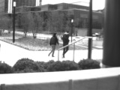
At-Sensor Processing Pipeline
DISCARD
SAME
Image Capture
Diff
Image Differencing w.r.t. last image
Notes:
https://gfycat.com/seriouspossibleafricanhornbill-capture-camera-photo

Slide 22
At-Sensor Processing Pipeline
DISCARD
DISCARD
SAME
UNINTERESTING
Image Capture
Diff
Infer
Image Differencing w.r.t. last image
Human Detection DNN
(Lenet-based )
ACC = 78%
Hyperparameter Optimization
=> ~180X
size reduction
Device-specific Optimizations :
Notes:
https://gfycat.com/seriouspossibleafricanhornbill-capture-camera-photo

Slide 23
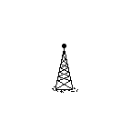
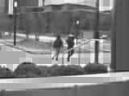
At-Sensor Processing Pipeline
DISCARD
DISCARD
SAME
UNINTERESTING
Image Capture
Diff
Infer
Compress
Radio Send
Image Differencing w.r.t. last image
Human Detection DNN
(Lenet-based )
ACC = 78%
JPEG
Hyperparameter Optimization
=> ~180X
size reduction
Fixed-point
Skip JPEG
Header
Device-specific Optimizations :
Notes:
https://gfycat.com/seriouspossibleafricanhornbill-capture-camera-photo

Slide 24
Contents
Motivation – Remote Sensing Applications
Camaroptera Design
Experimental Results
Future Directions

Slide 25
Experimental Results
We send more useful images

Slide 26
Experimental Results
We send more useful images
We send less useless images

Slide 27
Experimental Results
We send more useful images
We send less useless images
We collect more total images

Slide 28
Contents
Motivation – Remote Sensing Applications
Camaroptera Design
Experimental Results
Future Directions

Slide 29
Future Directions
Faster computation with new architectures
Integration with other applications e.g. AR/VR Systems, Stereo Vision, Pose Detection

Slide 30
Summary
Camaroptera: a batteryless, wireless, long-range image sensor
Designed for Remote Sensing Applications
On-device software pipeline

Slide 31
Part 2:
How to Run
Energy-harvesting Systems Faster

Slide 32
Contents
The Challenge
Our Proposal - PHASE

Slide 33
Contents
The Challenge
Our Proposal - PHASE

Slide 34
The Challenge
How to run an Energy-harvesting (EH) System faster?
EH systems derive energy from environments
Every J spent has to be collected
Time has to be spent on recharging during which the system is inactive
This recharging time could bottleneck execution, affecting
end-to-end performance.

Slide 35
Performance in Energy Harvesting Systems
Why not simply use a faster processor?

Slide 36

Performance in Energy Harvesting Systems
Why not simply use a faster processor?
Energy-efficient,
slower processor
Execute
Recharge
. . . .
time
Ready

Slide 37
Performance in Energy Harvesting Systems
Why not simply use a faster processor?
Energy-efficient,
slower processor
Execute
Recharge
. . . .
time
Ready
Faster processor,
Less energy-efficient
Execute
Recharge
. . . .
Ready

Slide 38
Contents
The Challenge
Our Proposal - PHASE

Slide 39

PHASE
Modeling Performance in Energy-Harvesting Sensors
Time for end-to-end workload latency:
$t_{e2e}={max⁡( t}_{execution},t_{recharge})$
$={max⁡( t}_{execution}, \frac{E_{execution}}{P_{input}} )$
t_{e2e}
t_{e2e}
t_{execution}
t_{execution}
t_{recharge}
t_{recharge}

Slide 40

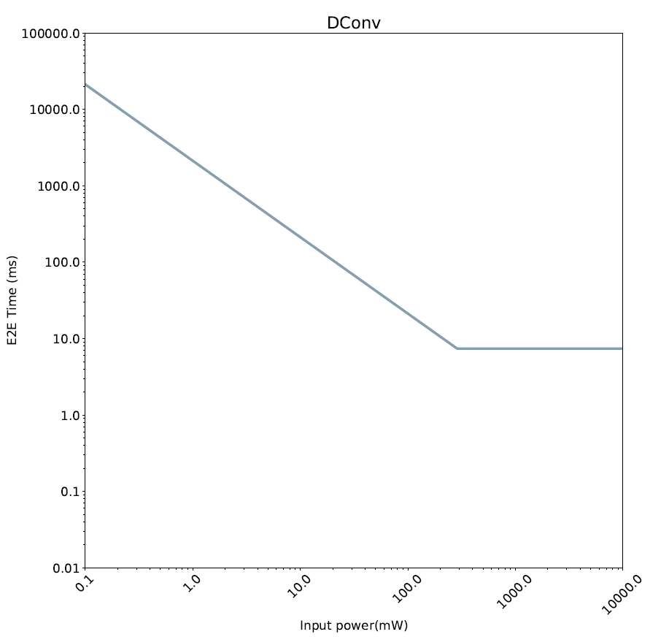
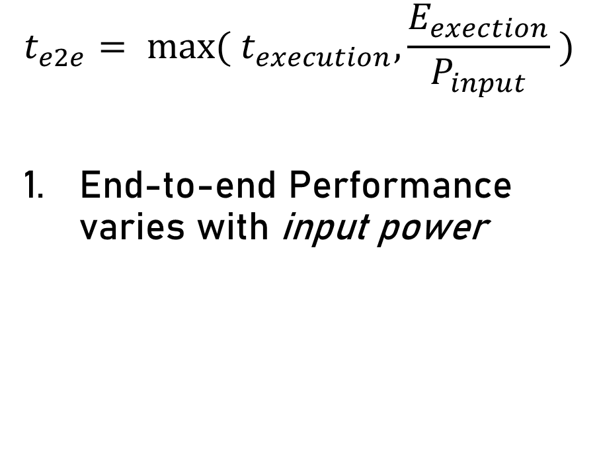
PHASE Implications
$$t_{e2e}= {max⁡( t}_{execution}, \frac{E_{exection}}{P_{input}} )$$
End-to-end Performance varies with input power
Faster

Slide 41

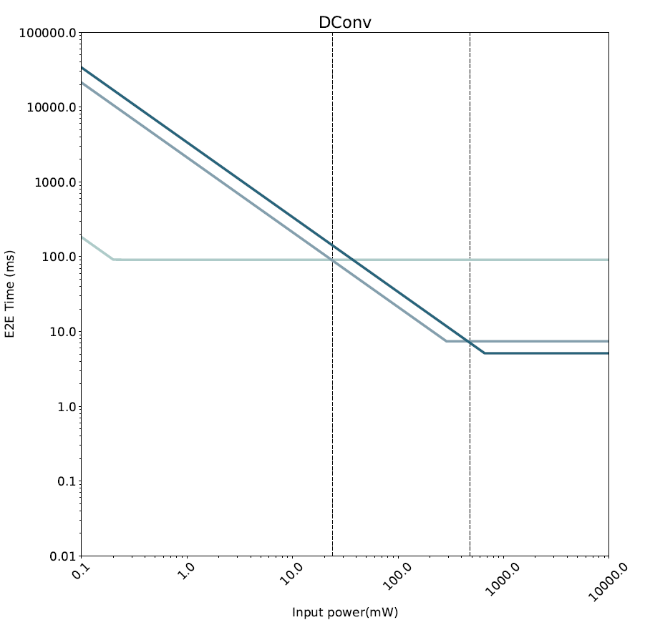
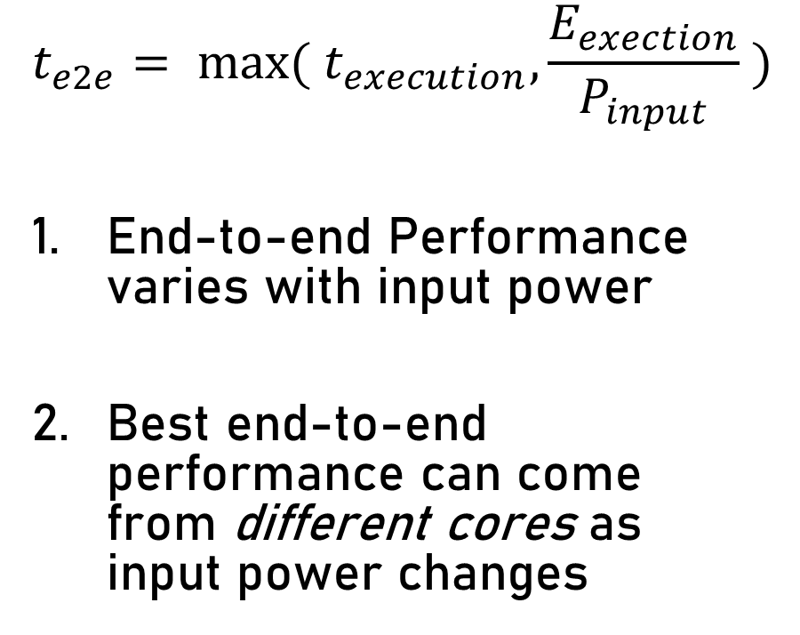
PHASE Implications
$$t_{e2e}= {max⁡( t}_{execution}, \frac{E_{exection}}{P_{input}} )$$
End-to-end Performance varies with input power
Best end-to-end performance can come
from different cores as
input power changes
Faster

Slide 42
Using PHASE – Part 1
If input power doesn’t vary in target environment
Target Environment
Faster

Slide 43
Using PHASE – Part 1
If input power doesn’t vary in target environment
Target Environment
Selected Core
Faster

Slide 44
Using PHASE – Part 2
If input power varies in target environment
Target Environment
Faster

Slide 45



Using PHASE – Part 2
If input power varies in target environment
PHASE-Online Architecture
- High Efficiency
Adaptation Controller
Heterogeneous Cores
Target Environment
- Balanced
- High
Performance
Workload Energy
Predictor
Shared Memory/
LLC
Energy Harvester
Workload Runtime
Predictor
Faster
Power Management
Input Power
Predictor
Energy Storage
Sensors

Slide 46
Summary
First performance model for EH devices
Select fastest e2e core when input power doesn’t vary much
Dynamically switch to fastest e2e core when input power varies significantly

Slide 47
Thank You!

Slide 48
Experimental Results

