Slide 1
Virtual Memory
15-213 : Introduction to Computer Systems
27th October 2014

Slide 19
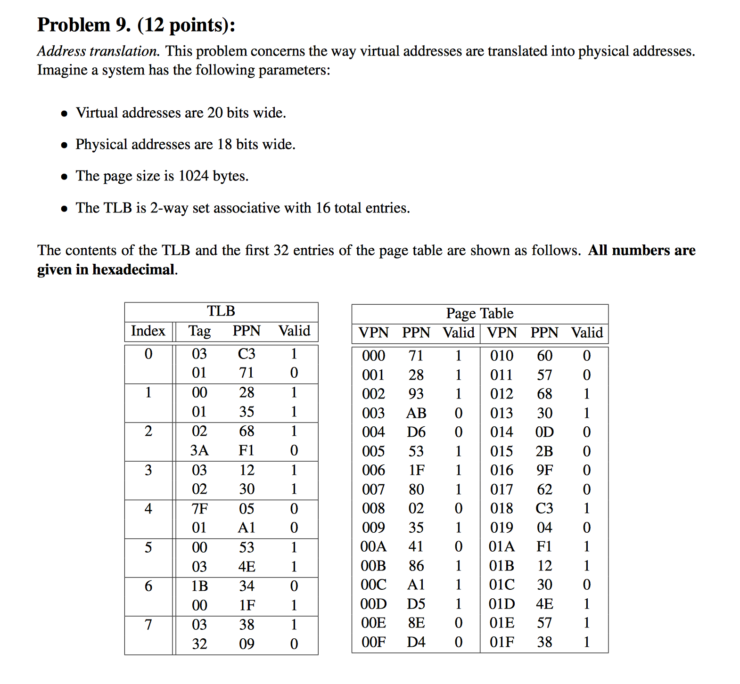

Slide 20
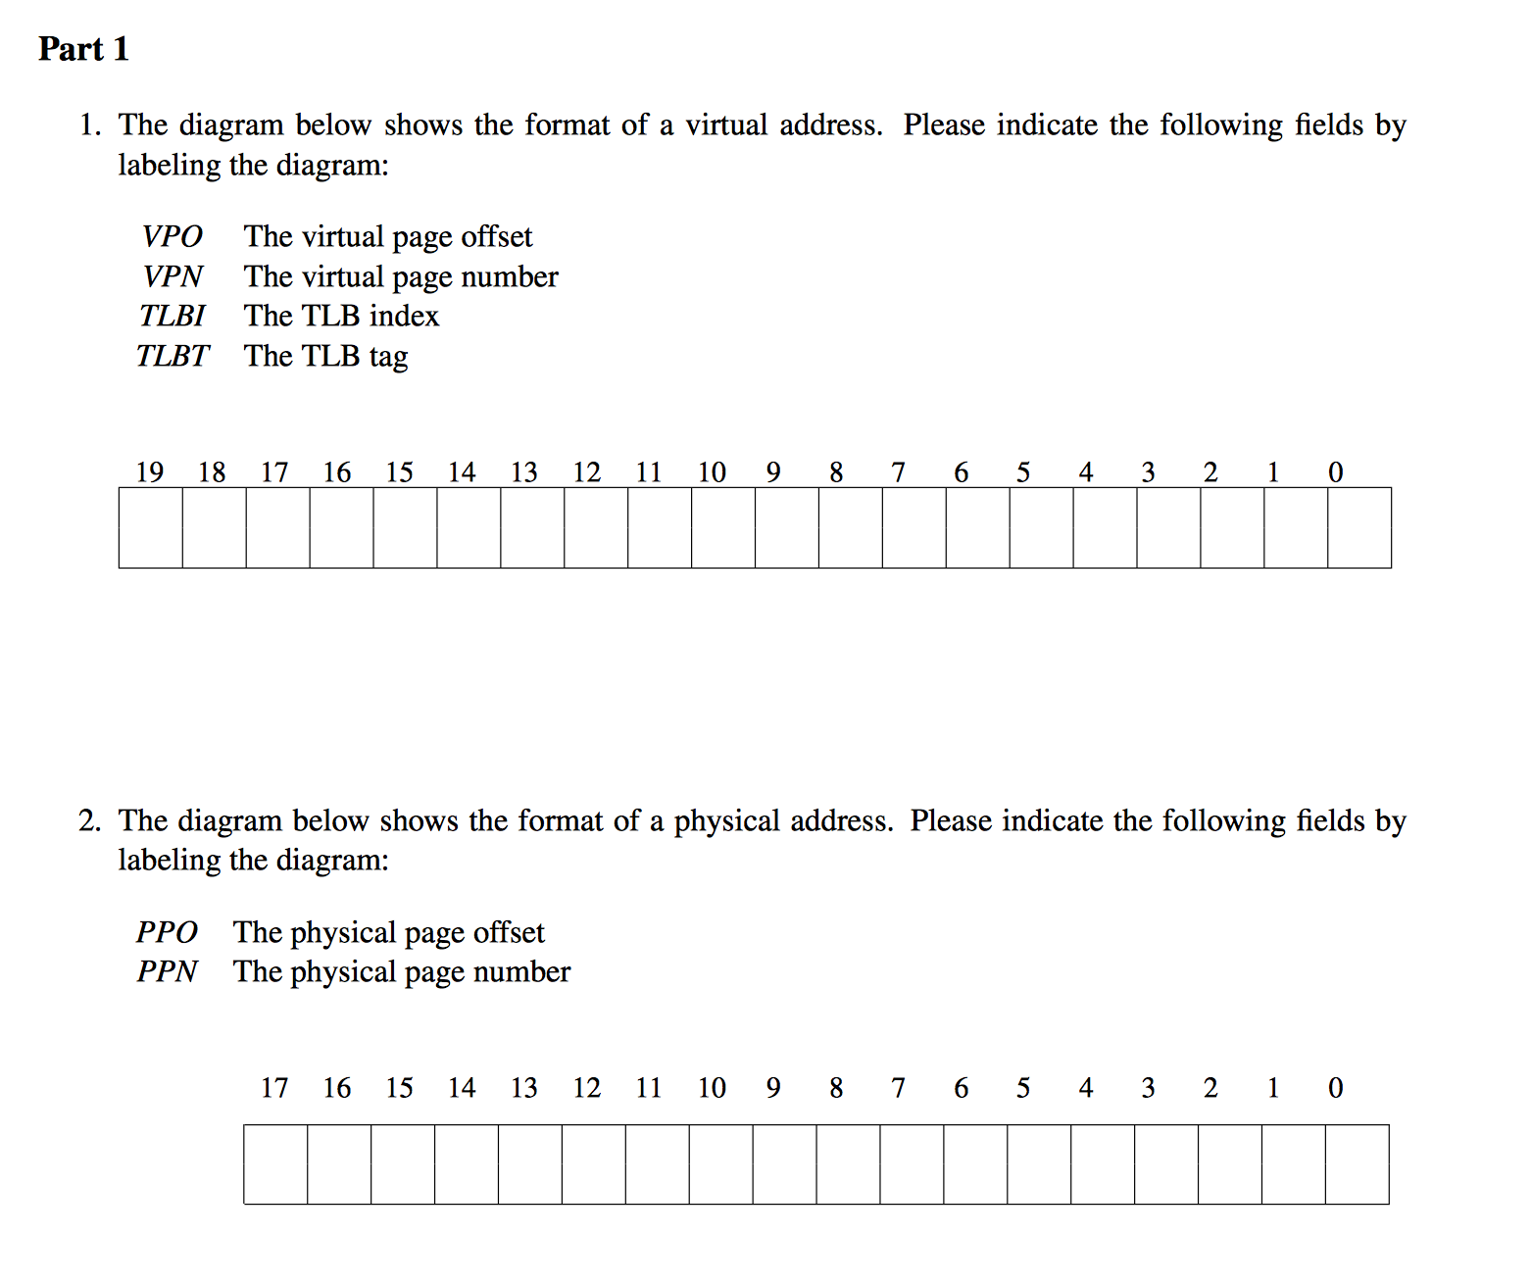

Slide 22
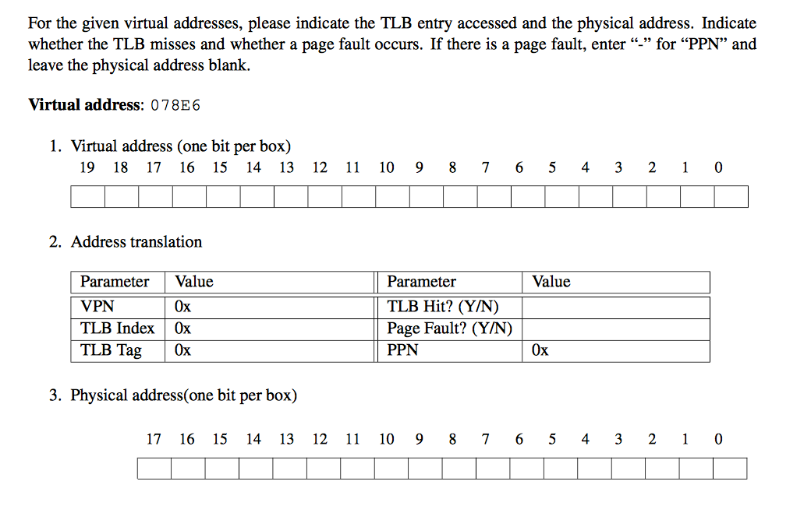

Slide 23
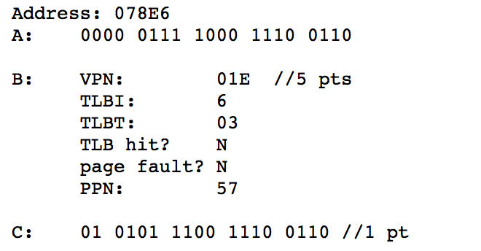

Slide 24
Questions?

