Slide 1
Proxy
Web & Concurrency
Ian Hartwig
15/18-213 - Section E
Recitation 13
April 15th, 2013

Slide 2
Outline
Getting content on the web: Telnet/cURL Demo
How the web really works
Proxy
  Due Tuesday, Dec. 3rd
  You can use your late days this year
  No partners this year
Threading
  Semiphores & Mutexes
  Readers-Writer Lock

Slide 3
The Web in a Textbook
Client request page, server provides, transaction done.
A sequential server can handle this. We just need to serve one page at a time.
This works great for simple text pages with embedded styles.
Web
client
(browser)
Web
server

Slide 4
Telnet/Curl Demo
Telnet
  Interactive remote shell – like ssh without security
  Must build HTTP request manually
    This can be useful if you want to test response to malformed headers
[03:30] [ihartwig@lemonshark:proxylab-handout-f13]% telnet www.cmu.edu 80
Trying 128.2.42.52...
Connected to WWW-CMU-PROD-VIP.ANDREW.cmu.edu (128.2.42.52).
Escape character is '^]'.
GET http://www.cmu.edu/ HTTP/1.0
HTTP/1.1 301 Moved Permanently
Date: Sun, 17 Nov 2013 08:31:10 GMT
Server: Apache/1.3.42 (Unix) mod_gzip/1.3.26.1a mod_pubcookie/3.3.4a mod_ssl/2.8.31 OpenSSL/0.9.8e-fips-rhel5
Location: http://www.cmu.edu/index.shtml
Connection: close
Content-Type: text/html; charset=iso-8859-1
<!DOCTYPE HTML PUBLIC "-//IETF//DTD HTML 2.0//EN">
<HTML><HEAD>
<TITLE>301 Moved Permanently</TITLE>
</HEAD><BODY>
<H1>Moved Permanently</H1>
The document has moved <A HREF="http://www.cmu.edu/index.shtml">here</A>.<P>
<HR>
<ADDRESS>Apache/1.3.42 Server at <A HREF="mailto:webmaster@andrew.cmu.edu">www.cmu.edu</A> Port 80</ADDRESS>
</BODY></HTML>
Connection closed by foreign host.

Slide 5
Telnet/cURL Demo
cURL
  “URL transfer library” with a command line program
  Builds valid HTTP requests for you!
  Can also be used to generate HTTP proxy requests:
[03:28] [ihartwig@lemonshark:proxylab-handout-f13]% curl http://www.cmu.edu/
<!DOCTYPE HTML PUBLIC "-//IETF//DTD HTML 2.0//EN">
<HTML><HEAD>
<TITLE>301 Moved Permanently</TITLE>
</HEAD><BODY>
<H1>Moved Permanently</H1>
The document has moved <A HREF="http://www.cmu.edu/index.shtml">here</A>.<P>
<HR>
<ADDRESS>Apache/1.3.42 Server at <A HREF="mailto:webmaster@andrew.cmu.edu">www.cmu.edu</A> Port 80</ADDRESS>
</BODY></HTML>
[03:40] [ihartwig@lemonshark:proxylab-conc]% curl --proxy lemonshark.ics.cs.cmu.edu:3092 http://www.cmu.edu/
<!DOCTYPE HTML PUBLIC "-//IETF//DTD HTML 2.0//EN">
<HTML><HEAD>
<TITLE>301 Moved Permanently</TITLE>
</HEAD><BODY>
<H1>Moved Permanently</H1>
The document has moved <A HREF="http://www.cmu.edu/index.shtml">here</A>.<P>
<HR>
<ADDRESS>Apache/1.3.42 Server at <A HREF="mailto:webmaster@andrew.cmu.edu">www.cmu.edu</A> Port 80</ADDRESS>
</BODY></HTML>

Slide 6
How the Web Really Works
In reality, a single HTML page today may depend on 10s or 100s of support files (images, stylesheets, scripts, etc.)
Builds a good argument for concurrent servers
  Just to load a single modern webpage, the client would have to wait for 10s of back-to-back request
  I/O is likely slower than processing, so back
Caching is simpler if done in pieces rather than whole page
  If only part of the page changes, no need to fetch old parts again
  Each object (image, stylesheet, script) already has a unique URL that can be used as a key

Slide 7
How the Web Really Works
Excerpt from www.cmu.edu/index.html:
<html lang="en" xml:lang="en" xmlns="http://www.w3.org/1999/xhtml">
<head>
...
<link href="homecss/cmu.css" rel="stylesheet" type="text/css"/>
<link href="homecss/cmu-new.css" rel="stylesheet" type="text/css"/>
<link href="homecss/cmu-new-print.css" media="print" rel="stylesheet" type="text/css"/>
<link href="http://www.cmu.edu/RSS/stories.rss" rel="alternate" title="Carnegie Mellon Homepage Stories" type="application/rss+xml"/>
...
<script language="JavaScript" src="js/dojo.js" type="text/javascript"></script>
<script language="JavaScript" src="js/scripts.js" type="text/javascript"></script>
<script language="javascript" src="js/jquery.js" type="text/javascript"></script>
<script language="javascript" src="js/homepage.js" type="text/javascript"></script>
<script language="javascript" src="js/app_ad.js" type="text/javascript"></script>
...
<title>Carnegie Mellon University | CMU</title>
</head>
<body> ...

Slide 8
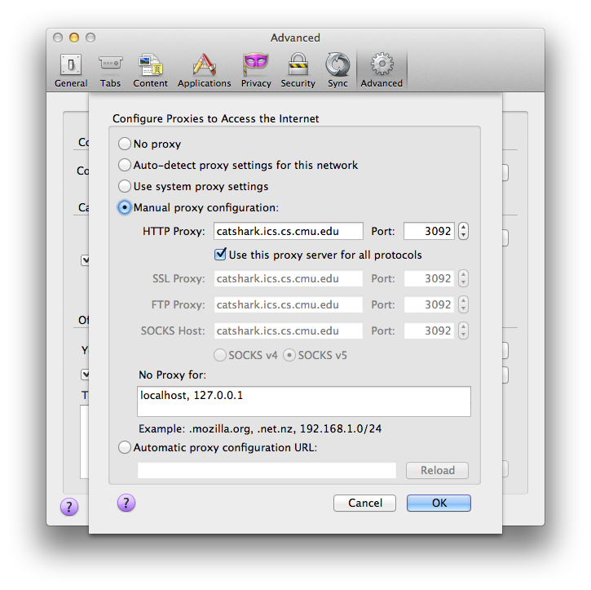
Aside: Setting up Firefox to use a proxy
You may use any browser, but we’ll be grading with Firefox
Preferences > Advanced > Network > Settings… (under Connection)
Check “Use this proxy for all protocols” or your proxy will appear to work for HTTPS traffic.

Slide 9
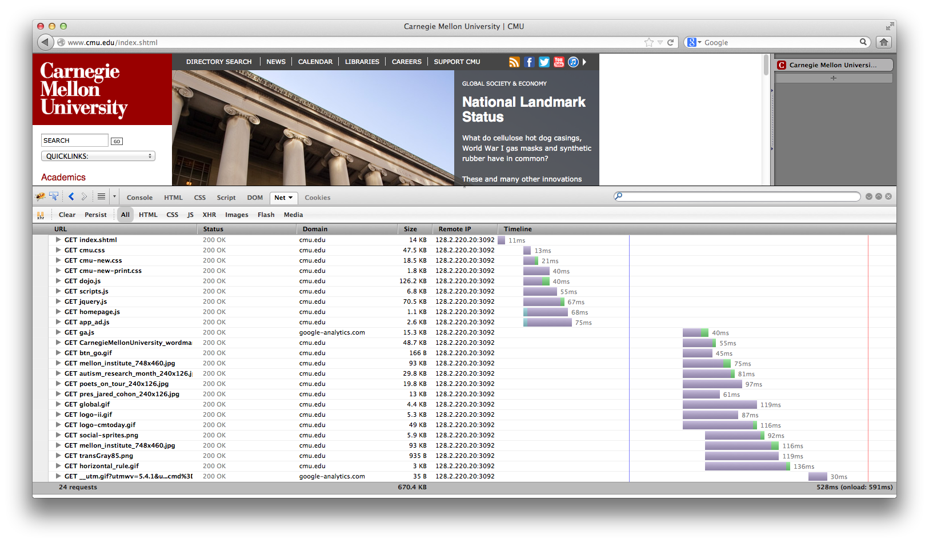
Sequential Proxy

Slide 10
Sequential Proxy
Note the sloped shape of when requests finish
  Although many requests are made at once, the proxy does not accept a new job until it finishes the current one
  Requests are made in batches. This results from how HTML is structured as files that reference other files.
Compared to the concurrent example (next), this page takes a long time to load with just static content

Slide 11
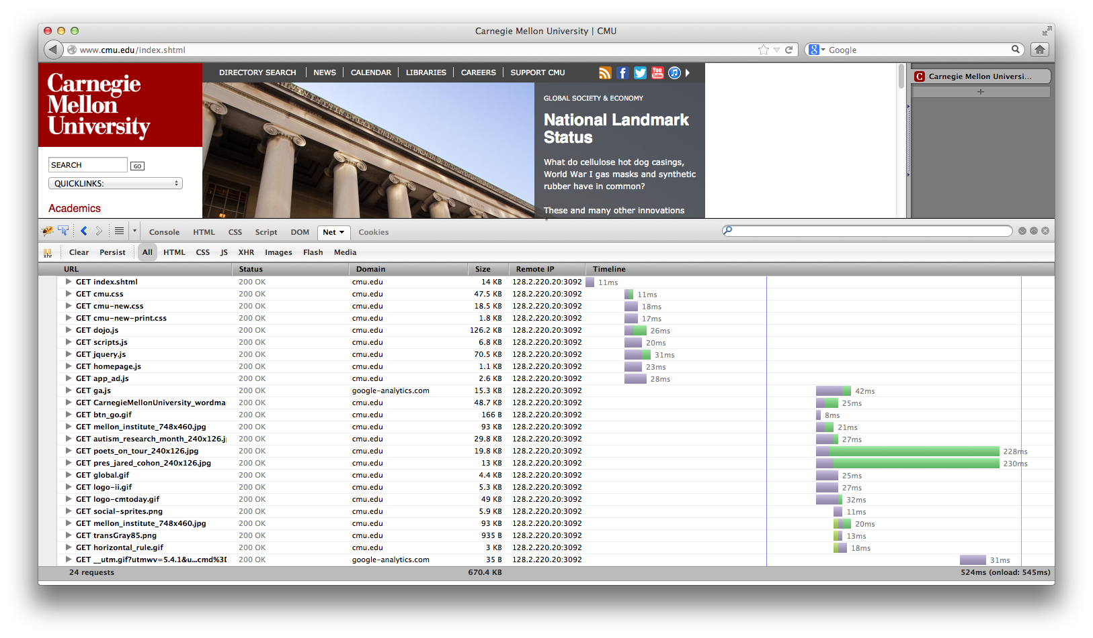
Concurrent Proxy

Slide 12
Concurrent Proxy
Now, we see much less purple (waiting), and less time spent overall.
Notice how multiple green (receiving) blocks overlap in time
  Our proxy has multiple connections open to the browser to handle several tasks at once

Slide 13
How the Web Really Works
A note on AJAX (and XMLHttpRequests)
  Normally, a browser will make the initial page request then request any supporting files
  And XMLHttpRequest is simply a request from the page once it has been loaded & the scripts are running
  The distinction does not matter on the server side – everything is an HTTP Request

Slide 14
Proxy - Functionality
Should work on vast majority of sites
  Reddit, Vimeo, CNN, YouTube, NY Times, etc.
  Some features of sites which require the POST operation (sending data to the website), will not work
    Logging in to websites, sending Facebook message
  HTTPS is not expected to work
    Google (and some other popular websites) now try to push users to HTTPs by default; watch out for that
Cache previous requests
  Use LRU eviction policy
  Must allow for concurrent reads while maintaining consistency
  Details in write up

Slide 15
Proxy - Functionality
Why a multi-threaded cache?
  Sequential cache would bottleneck parallel proxy
  Multiple threads can read cached content safely
    Search cache for the right data and return it
    Two threads can read from the same cache block
  But what about writing content?
    Overwrite block while another thread reading?
    Two threads writing to same cache block?

Slide 16
Proxy - How
Client
Server
socket
socket
bind
open_listenfd
open_clientfd
listen
Connection
request
connect
accept
Client / Server
Session
rio_writen
rio_readlineb
rio_readlineb
rio_writen
close
EOF
rio_readlineb
close

Slide 17
Proxy - How
Remember that picture?
  Proxies are a bit special; they are a server and a client at the same time.
  They take a request from one computer (acting as the server), and make it on their behalf (as the client).
  Ultimately, the control flow of your program will look like a server, but will have to act as a client to complete the request
Start small
  Grab yourself a copy of the echo server (pg. 910) and client (pg. 909) in the book
  Also review the tiny.c basic web server code to see how to deal with HTTP headers
    Note that tiny.c ignores these; you may not

Slide 18
Proxy - How
What you end up with will resemble:
Client socket address
128.2.194.242:51213
Server socket address
208.216.181.15:80
Client
Proxy
Server
(port 80)
Proxy server socket address
128.2.194.34:15213
Proxy client socket address
128.2.194.34:52943

Slide 19
Proxy – Testing & Grading
New: Autograder
  ./driver.sh will run the same tests as autolab:
    Ability to pull basic web pages from a server
    Handle a (concurrent) request while another request is still pending
    Fetch a web page again from your cache after the server has been stopped
  This should help answer the question “is this what my proxy is supposed to do?”
  Please don’t use this grader to definitively test your proxy; there are many things not tested here

Slide 20
Proxy – Testing & Grading
Test your proxy liberally
  The web is full of special cases that want to break your proxy
  Generate a port for yourself with ./port-for-user.pl [andrewid]
  Generate more ports for web servers and such with ./free-port.sh
  Consider using your andrew web space (~/www) to host test files
    You have to visit https://www.andrew.cmu.edu/server/publish.html to publish your folder to the public server
Create a handin file with make handin
  Will create a tar file for you with the contents of your proxylab-handin folder

Slide 21
Tips: Version Control
What is Git?
  Version control software
  Easily roll back to previous version if needed
  Already installed on Andrew machines
  Set up a repo on GitHub, BitBucket, or AFS
    Make sure only can access it!
Using Git
  git pull
  git add .
  git commit -m “I changed something”
  git push

Slide 22
Mutexes & Semaphores
Mutexes
  Allow only one thread to run code section at a time
  If other threads are trying to run the code, they will wait
Semaphores
  Allows a fixed number of threads to run the code
  Mutexes are a special case of semaphores, where the number of threads=1
    Examples will be done with semaphores to illustrate

Slide 23
Read-Write Lock
Also called a Readers-Writer lock in the notes
Cache can be read in parallel safely
If thread is writing, no other thread can read or write
If thread is reading, no other thread can write
Potential issues
  Writing starvation
    If threads always reading, no thread can write
    Fix: if a thread is waiting to write, it gets priority over any new threads trying to read
How can we lock out threads?

Slide 24
Read-Write Locks Cont.
How would you make a read-write lock with semaphores?
  Luckily, you don't have to!
    pthread_rwlock_* handles that for you
      pthread_rwlock_t lock;
      pthread_rwlock_init(&lock,NULL);
      pthread_rwlock_rdlock(&lock);
      pthread_rwlock_wrlock(&lock);
      pthread_rwlock_unlock(&lock);

Slide 25
Questions?

