Slide 1
CacheLab Recitation 7
10/8/2012

Slide 2
Outline
Memory organization
Caching
Different types of locality
Cache organization
Cachelab
Tips (warnings, getopt, files)
Part (a) Building Cache Simulator
Part (b) Efficient Matrix Transpose
Blocking

Slide 3
Memory Hierarchy
Registers
SRAM
DRAM
Local Secondary storage
Remote Secondary storage
We will discuss this interaction
Notes:
Make it clear that the idea of caching happens between every level. We are just going to focus on the interaction between main memory and SRAM cache today.

Slide 4
SRAM vs DRAM tradeoff
SRAM (cache)
Faster (L1 cache: 1 CPU cycle)
Smaller (Kilobytes (L1) or Megabytes (L2))
More expensive and “energy-hungry”
DRAM (main memory)
Relatively slower (hundreds of CPU cycles)
Larger (Gigabytes)
Cheaper

Slide 5
Caching
Temporal locality
A memory location accessed is likely to be accessed again multiple times in the future
After accessing address X in memory, save the bytes in cache for future access
Spatial locality
If a location is accessed, then nearby locations are likely to be accessed in the future.
After accessing address X, save the block of memory around X in cache for future access

Slide 6
Memory Address
64-bit on shark machines
Block offset: b bits
Set index: s bits

Slide 7
Cache
A cache is a set of 2^s cache sets
A cache set is a set of E cache lines
E is called associativity
If E=1, it is called “direct-mapped”
Each cache line stores a block
Each block has 2^b bytes

Slide 8
Cachelab
Warnings are errors!
Include proper header files
Part (a) Building a cache simulator
Part (b) Optimizing matrix transpose

Slide 9
Warnings are Errors
Strict compilation flags
Reasons:
Avoid potential errors that are hard to debug
Learn good habits from the beginning
Add “-Werror” to your compilation flags

Slide 10
Missing Header Files
If function declaration is missing
Find corresponding header files
Use: man <function-name>
Live example
man 3 getopt
Notes:
Show live example of the getopt function

Slide 11
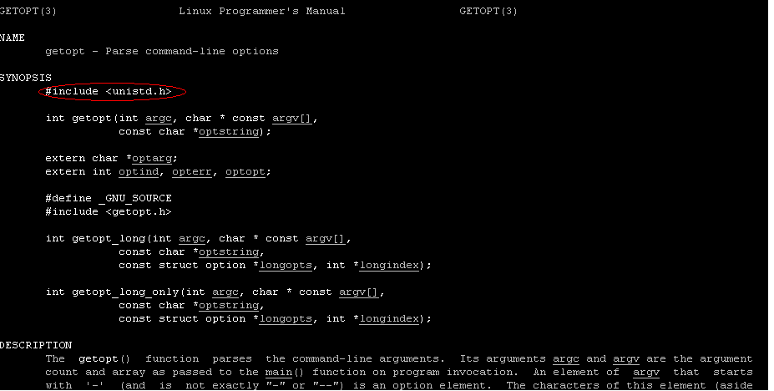
Getopt function

Slide 12
We want you to use getopt!
You don’t have t, but why waste time reinventing the wheel?
Your programs MUST us the same command line arguments as the reference programs or the autograder will not work

Slide 13
Part (a) Cache simulator
A cache simulator is NOT a cache!
Memory contents NOT stored
Block offsets are NOT used
Simply counts hits, misses, and evictions
Your cache simulator need to work for different s, b, E, given at run time.
Use LRU replacement policy
Notes:
Lots of students get confused about this.

Slide 14
Files
#include <stdio.h>
FILE *my_fp=fopen(char * filename, char *mode)
Mode = “r” for read, “w+” for read/write, “w” for a new file
Returns NULL (or 0) if opening fails
fscanf(fp,char *format, pointers to vars …
Same formats as printf
Returns # of items scanned
Returns EOF at the end of the file
Man fscanf for details
If reading a string, watch out for string length! Remember buf lab. Stops at white space
fclose(fp) when done with the file

Slide 15
Cache simulator: Hints
A cache is just 2D array of cache lines:
struct cache_line cache[S][E];
S = 2^s, is the number of sets
E is associativity
Each cache_line has:
Valid bit
Tag
LRU counter
Notes:
Tell them what Least Recently Used is. The LRU counter can be a time stamp, or just an integer.

Slide 16
Part (b) Efficient Matrix Transpose
Matrix Transpose (A -> B)
Matrix A Matrix B
1 | 2 | 3 | 4
5 | 6 | 7 | 8
9 | 10 | 11 | 12
13 | 14 | 15 | 16
1 | 5 | 9 | 13
2 | 6 | 10 | 14
3 | 7 | 11 | 15
4 | 8 | 12 | 16
Notes:
Describe what is matrix transpose

Slide 17
Part (b) Efficient Matrix Transpose
Matrix Transpose (A -> B)
Suppose block size is 8 bytes (2 ints)
Matrix A Matrix B
Access A[0][0] cache miss
Access B[0][0] cache miss
Access A[0][1] cache hit
Access B[1][0] cache miss
1 | 2 | 3 | 4
5 | 6 | 7 | 8
9 | 10 | 11 | 12
13 | 14 | 15 | 16
1
2
Question: After we handle 1&2. Should we handle 3&4 first, or 5&6 first ?
Notes:
Say that accessing A[0][0] puts the whole block in cache. And if we access A[0][1] next, we get a cache hit.
However, when put A[0][1] into B[1][0], we get another miss.

Slide 18
Blocking
What inspiration do you get from previous slide ?
Divide matrix into sub-matrices
This is called blocking (CSAPP2e p.629)
Size of sub-matrix depends on
cache block size, cache size, input matrix size
Try different sub-matrix sizes
We hope you invent more tricks to reduce the number of misses !

Slide 19
Part (b)
Cache:
You get 1 kilobytes of cache
Directly mapped (E=1)
Block size is 32 bytes (b=5)
There are 32 sets (s=5)
Test Matrices:
32 by 32, 64 by 64, 61 by 67
Notes:
Emphasize that the transpose function must be correct! Because an inco

