Slide 1
Carnegie Mellon
Welcome to recitation!
15-213: Introduction to Computer Systems
3rd Recitation, Sept. 10, 2012
Instructor: Adrian Trejo (atrejo)
Section H, 3:30p – 4:30p WEH5302

Slide 2
Outline
Carnegie Mellon
General
UNIX
Integers
IEEE Floating Point
Datalab Tips
Style
Cheating
Summary

Slide 3
General Stuff
Carnegie Mellon
www.cs.cmu.edu/~213
www.autolab.cs.cmu.edu
Everything related to the course can be found on these two sites.

Slide 4
UNIX Basics
Carnegie Mellon
In case you missed the boot camp:
Use the shark machines!
ssh/scp (on Mac/UNIX)
PuTTY/Filezilla (on Windows)
tar
Learn to use an editor well (e.g. vim, emacs) and stick with it.

Slide 5
Integers
Carnegie Mellon
Signed vs. Unsigned
Two’s complement representation
Implicit casting between signed and unsigned

Slide 6
Floating Point
Carnegie Mellon
Sign (one bit)
Exponent (single precision: 8 bits; double precision: 11 bits)
Fraction (Mantissa)
Bias (2^(k-1) – 1, where k is the number of exponent bit)
Normalized (E = Exp – Bias) vs. Denormalized (E = 1 – Bias)
Special Values (Exp is all ones)

Slide 7
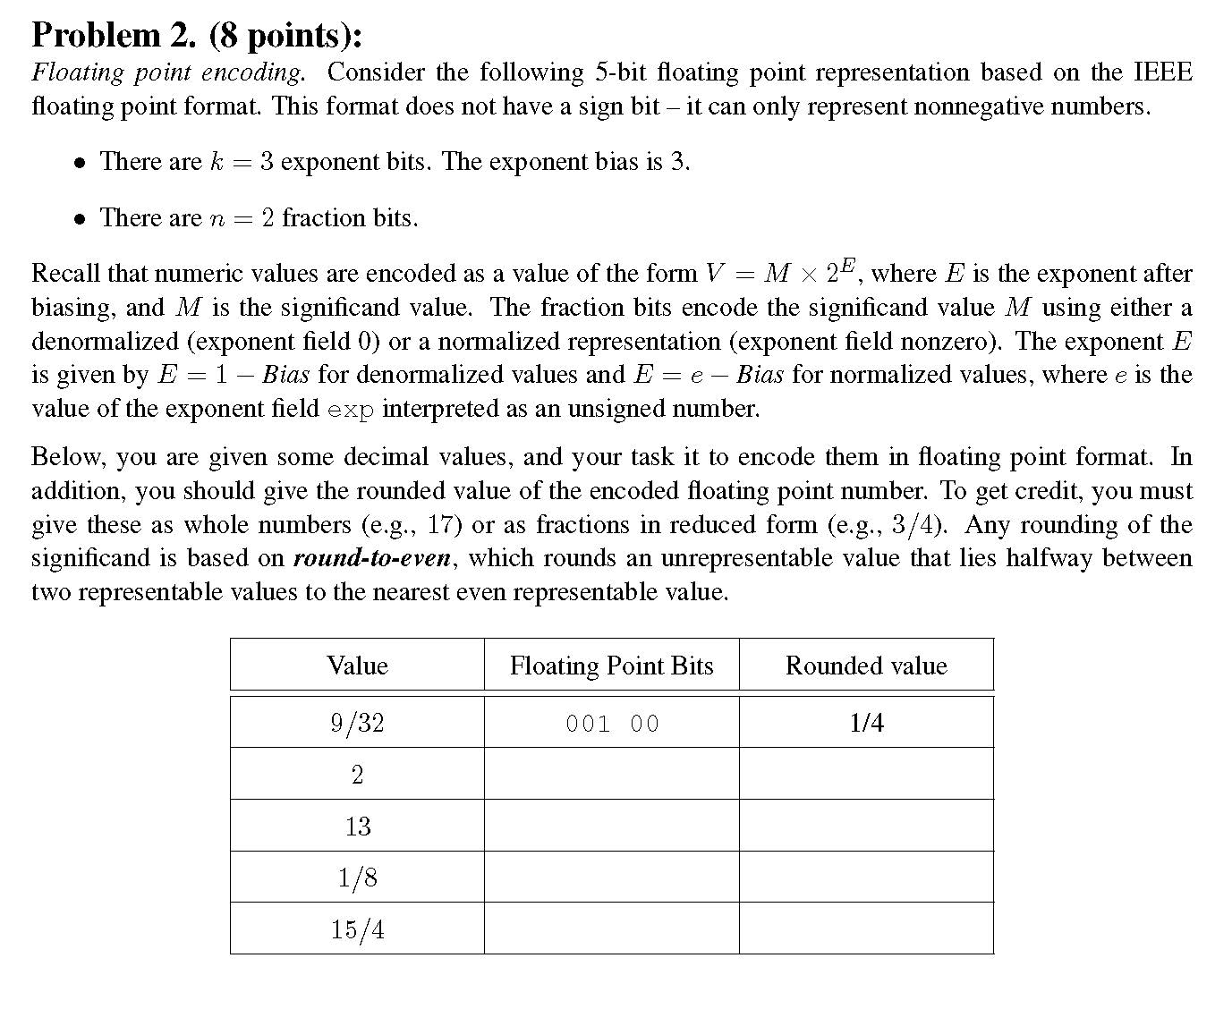
Floating Point (cont.)
Carnegie Mellon
A favorite exam question:

Slide 8
Datalab Tips
Carnegie Mellon
Signed negation
-x == ~x + 1
Always works except for x = Tmin
Properties of Zero
0 & x = 0 for all x
(0-1) & x = x for all x
int x = 0
int y = -x
x and y are both positive since their MSBs is 0

Slide 9
Parity Example
Carnegie Mellon
Let’s write a function that takes an integer and returns 1 if it has an odd number of ‘1’ bits, and 0 otherwise.
How can we get the answer?
If we XOR all the bits together, then we’ll get the answer!
10011010 (function should return 0)
1 ^ 0 ^ 0 ^ 1 ^ 1 ^ 0 ^ 1 ^ 0 = 0
1001 ^ 1010 = 0011
00 ^ 11 = 11
1 ^ 1 = 0

Slide 10
Style
Carnegie Mellon
  http://www.cs.cmu.edu/~213/codeStyle.html
  Make sure you read through it since we’ll use it as a rubric when we grade your labs.
  Look out for:
    Comments
    Magic numbers (without #define)
    Line length
    Consistency
    etc.

Slide 11
Cheating policy
Carnegie Mellon
Don’t do it!
MOSS checker built into Autolab

Slide 12
Need help?
Carnegie Mellon
Email: 15-213-staff@cs.cmu.edu
Office hours: UMTWH 5:30p – 8:30p WeH 5207
Recitation: bring us questions

