Slide 1
Proxylab and stuff 15-213: Introduction to Computer Systems Recitation 13: November 19, 2012
Carnegie Mellon
Donald Huang (donaldh)
Section M

Slide 2
Topics
Carnegie Mellon
Summary of malloclab
News
Sockets
Threads
Proxylab

Slide 3
Malloclab review
Carnegie Mellon
Questions, comments, lessons learned?
Starting simple and making improvements is a good way to write code
Nice because you can have something simple working relatively easily
You can test each new optimization alone
When you write your code, write it so that it can be easily maintained/changed
“how can I write my explicit list so that I can change it to seglists later?”

Slide 4
Topics
Carnegie Mellon
Summary of malloclab
News
Sockets
Threads
Proxylab

Slide 5
News
Carnegie Mellon
Last day to turn in malloc is today (if using two late days and taking a late penalty)
Proxylab was out last Friday

Slide 6
Topics
Carnegie Mellon
Summary of malloclab
News
Sockets
Threads
Proxylab

Slide 7
Sockets
Carnegie Mellon
To get a struct hostent for a domain name:
struct hostent * gethostbyname(const char *name);
not threadsafe, threadsafe version is gethostbyname_r
What is a socket?
To an application, a socket is a file descriptor that lets the application read/write from/to the network
(all Unix I/O devices, including networks, are modeled as files)
Clients and servers communicate with each other by reading from and writing to socket descriptors
The main difference between regular file I/O and socket I/O is how the application “opens” the socket descriptors

Slide 8
Sockets API
Carnegie Mellon
int socket(int domain, int type, int protocol);
int bind(int socket, const struct sockaddr *address, socklen_t address_len);
int listen(int socket, int backlog);
int accept(int socket, struct sockaddr *address, socklen_t *address_len);
int connect(int socket, struct sockaddr *address, socklen_t address_len);
int close(int fd);
ssize_t read(int fd, void *buf, size_t nbyte);
ssize_t write(int fd, void *buf, size_t nbyte);

Slide 9
Sockets API
Carnegie Mellon
int socket(int domain, int type, int protocol);
used by both clients and servers
int sock_fd = socket(PF_INET, SOCK_STREAM, IPPROTO_TCP);
Create a file descriptor for network communication
One socket can be used for two-way communication

Slide 10
Sockets API
Carnegie Mellon
int bind(int socket, const struct sockaddr *address, socklen_t address_len);
used by servers
struct sockaddr_in sockaddr; memset(&sockaddr, 0, sizeof(sockaddr); sockaddr.sin_family = AF_INET; sockaddr.sin_addr.s_addr = INADDR_ANY; sockaddr.sin_port = htons(listenPort) err = bind(sock_fd, (struct sockaddr *) sockaddr, sizeof(sockaddr));
sock_fd: file descriptor of socket
my_addr: address to bind to, and information about it, like the port
addrlen: size of addr struct
Associate a socket with an IP address and port number

Slide 11
Sockets API
Carnegie Mellon
int listen(int socket, int backlog);
used by servers
err = listen(sock_fd, MAX_WAITING_CONNECTIONS);
socket: socket to listen on
backlog: maximum number of waiting connections
int accept(int socket, struct sockaddr *address, socklen_t *address_len);
used by servers
struct sockaddr_in client_addr; socklen_t my_addr_len = sizeof(client_addr); client_fd = accept(listener_fd, &client_addr, &my_addr_len);
socket: socket to listen on
address: pointer to sockaddr struct to hold client information after accept returns
return: file descriptor

Slide 12
Sockets API
Carnegie Mellon
int connect(int socket, struct sockaddr *address, socklen_t address_len);
used by clients
attempt to connect to the specified IP address and port described in address
int close(int fd);
used by both clients and servers
(also used for file I/O)
fd: socket fd to close

Slide 13
Sockets API
Carnegie Mellon
ssize_t read(int fd, void *buf, size_t nbyte);
used by both clients and servers
(also used for file I/O)
fd: (socket) fd to read from
buf: buffer to read into
nbytes: buf length
ssize_t write(int fd, void *buf, size_t nbyte);
used by both clients and servers
(also used for file I/O)
fd: (socket) fd to write to
buf: buffer to write
nbytes: buf length

Slide 14
Carnegie Mellon

Slide 15
Topics
Carnegie Mellon
Summary of malloclab
News
Sockets
Threads
Proxylab

Slide 16
Threads
Carnegie Mellon
Similarities to processes
each thread has its own logical control flow (its own registers, so its own eip and stuff)
multiple threads can be in the middle of running at the same time, possibly on different cores
the kernel decides when to context switch to and from a thread (or a thread can voluntarily give up its share of cpu time by calling sleep, pause, sigsuspend, or something similar)
Differences with processes
threads share code and data; processes generally don’t
threads are less expensive to make than processes (processes are about 2x more expensive to create and reap)

Slide 17
Threads
Carnegie Mellon
Each thread has its own stack/registers, including stack pointer and program counter (imagine what would happen otherwise)
Processes start out as having one thread, and they also have code, data, page directory/table, file descriptors, and some other things associated with them

Slide 18
Threads: pthreads interface
Carnegie Mellon
Creating/reaping threads
pthread_create
pthread_join
To get your thread ID
pthread_self
Terminating threads
pthread_cancel
pthread_exit
synchronizing access to shared variables
pthread_mutex_init
pthread_mutex_[un]lock
pthread_rwlock_init
pthread_rwlock_[wr]rdlock

Slide 19
Threads
Carnegie Mellon
A thread terminates implicitly when its top-level thread routine returns
A thread terminates explicitly by calling pthread_exit(NULL)
pthread_exit(NULL) only terminates the current thread, NOT the process
exit(0) terminates ALL the threads in the process (meaning the whole process terminates
pthread_cancel(tid) terminates the thread with id equal to tid

Slide 20
Threads
Carnegie Mellon
Joinable threads can be reaped and killed by other threads
must be reaped with pthread_join to free memory and resources
Detached threads cannot be reaped or killed by other threads
resources are automatically reaped on termination
Default state is joinable
use pthread_detach(pthread_self()) to make detached

Slide 21
Multithreaded Hello World
Carnegie Mellon

Slide 22
Topics
Carnegie Mellon
Summary of malloclab
News
Sockets
Threads
Proxylab

Slide 23
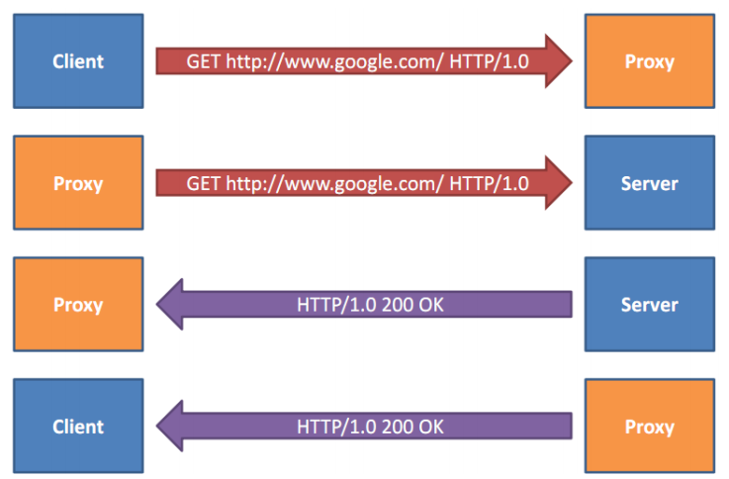
Proxylab: what a proxy is??
Carnegie Mellon
intermediary between client and server

Slide 24
Proxylab
Carnegie Mellon
write a web proxy
multi-threaded
caching
should work for most sites (not https connections though)
cnn.com
google.com
youtube.com
(not facebook.com)
Forwards requests from the client to the server
acts as a server to the client, but as a client to the server the client is asking you to read from

Slide 25
Proxylab: recommended progress
Carnegie Mellon
implement a sequential proxy
this proxy will be very slow in loading webpages
upgrade to multithreaded proxy
should be decently fast
add caching
this involves some multithreading issues we’ll talk about solving next week
You are not given any tests, so make sure you test your proxy well on your own!

Slide 26
Questions? (sockets, proxylab, what a proxy is??) (come to office hours if you need help)
Carnegie Mellon

