Slide 1
Malloc Recitation
Section K (Kevin Su)
November 5th, 2012

Slide 2
Agenda
Macros / Inline functions
Quick pointer review
Malloc

Slide 3
Macros / Inline Functions

Slide 4
Macros
Runtime, compile-time, or pre-compile time?
Constant:
#define NUM_ENTRIES 100
OK
Macro
#define twice(x) 2*x
Not OK
twice(x+1) becomes 2*x+1
#define twice(x) (2*(x))
OK
Use lots of parenthesis, it’s a naïve search-and-replace!

Slide 5
Macros
Why macros?
“Faster” than function calls
Why?
For malloc
Quick access to header information (payload size, valid)

Slide 6
Inline Functions
What’s the keyword inline do?
At compile-time replaces “function calls” with code
More efficient than a normal function call
Overhead – no need to set up stack/function call
Useful for functions that are
Called frequently
Small, i.e. int add(int x, int y);

Slide 7
Differences
Macros done at pre-compile time
Inline functions done at compile time
Stronger type checking / Argument consistency
Macros cannot return anything (why not?)
Macros can have unintended side effects
#define xsquared(x) (x*x)
What happens when xsquared(x++) is called?
Hard to debug macros – errors generated on expanded code, not code that you typed

Slide 8
Macros / Inline Functions
You will likely use both in malloc lab
Macros are good for small tasks
Saves work in retyping tedious calculations
Can make code easier to understand
HEADER(ptr) versus doing the pointer arithmetic
Some things are hard to code in macros, so this is where inline functions come into play
More efficient than normal function call
More expressive than macros

Slide 9
Pointer casting, arithmetic, and dereferencing

Slide 10
Pointer casting
Separate from non-pointer casting
float to int, int to float
<struct_a> to <struct_b>
No! gcc error.
Cast from
<type_a> * to <type_b> *
<type_a> * to integer/ unsigned int
integer/ unsigned int to <type_a> *

Slide 11
Pointer casting
What actually happens in a pointer cast?
Nothing! It’s just an assignment. Remember all pointers are the same size.
The magic happens in dereferencing and arithmetic

Slide 12
Pointer arithmetic
The expression ptr + a doesn’t always evaluate into the arithmetic sum of the two
Consider: <type_a> * pointer = …; (void *) pointer2 = (void *) (pointer + a);
Think about it as
leal (pointer, a, sizeof(type_a)), pointer2;

Slide 13
Pointer arithmetic
int * ptr = (int *)0x12341234; int * ptr2 = ptr + 1;
char * ptr = (char *)0x12341234; char * ptr2 = ptr + 1;
int * ptr = (int *)0x12341234; int * ptr2 = ((int *) (((char *) ptr) + 1));
void * ptr = (char *)0x12341234; void * ptr2 = ptr + 1;
void * ptr = (int *)0x12341234; void * ptr2 = ptr + 1;

Slide 14
Pointer arithmetic
int * ptr = (int *)0x12341234; int * ptr2 = ptr + 1; //ptr2 is 0x12341238
char * ptr = (char *)0x12341234; char * ptr2 = ptr + 1; //ptr2 is 0x12341235
int * ptr = (int *)0x12341234; int * ptr2 = ((int *) (((char *) ptr) + 1)); //ptr2 is 0x12341235
void * ptr = (char *)0x12341234; void * ptr2 = ptr + 1; //ptr2 is 0x12341235
void * ptr = (int *)0x12341234; void * ptr2 = ptr + 1; //ptr2 is still 0x12341235

Slide 15
More pointer arithmetic
int ** ptr = (int **)0x12341234; int * ptr2 = (int *) (ptr + 1);
char ** ptr = (char **)0x12341234; short * ptr2 = (short *) (ptr + 1);
int * ptr = (int *)0x12341234; void * ptr2 = &ptr + 1;
int * ptr = (int *)0x12341234; void * ptr2 = ((void *) (*ptr + 1));
This is on a 64-bit machine!

Slide 16
More pointer arithmetic
int ** ptr = (int **)0x12341234; int * ptr2 = (int *) (ptr + 1); //ptr2 = 0x1234123c
char ** ptr = (char **)0x12341234; short * ptr2 = (short *) (ptr + 1); //ptr2 = 0x1234123c
int * ptr = (int *)0x12341234; void * ptr2 = &ptr + 1; //ptr2 = ?? //ptr2 is actually 8 bytes higher than the address of the variable ptr
int * ptr = (int *)0x12341234; void * ptr2 = ((void *) (*ptr + 1)); //ptr2 = ?? //ptr2 is just one higher than the value at 0x12341234 (so probably segfault)

Slide 17
Pointer dereferencing
Basics
It must be a POINTER type (or cast to one) at the time of dereference
Cannot dereference (void *)
The result must get assigned into the right datatype (or cast into it)

Slide 18
Pointer dereferencing
What gets “returned?”
int * ptr1 = malloc(100); *ptr1 = 0xdeadbeef;
int val1 = *ptr1;
int val2 = (int) *((char *) ptr1);
What are val1 and val2?

Slide 19
Pointer dereferencing
What gets “returned?”
int * ptr1 = malloc(sizeof(int)); *ptr1 = 0xdeadbeef;
int val1 = *ptr1;
int val2 = (int) *((char *) ptr1);
// val1 = 0xdeadbeef;
// val2 = 0xffffffef;
What happened??

Slide 20
Malloc

Slide 21
Malloc basics
What is dynamic memory allocation?
Terms you will need to know
malloc / calloc / realloc
free
sbrk
payload
fragmentation (internal vs. external)
coalescing
Bi-directional
Immediate vs. Deferred

Slide 22
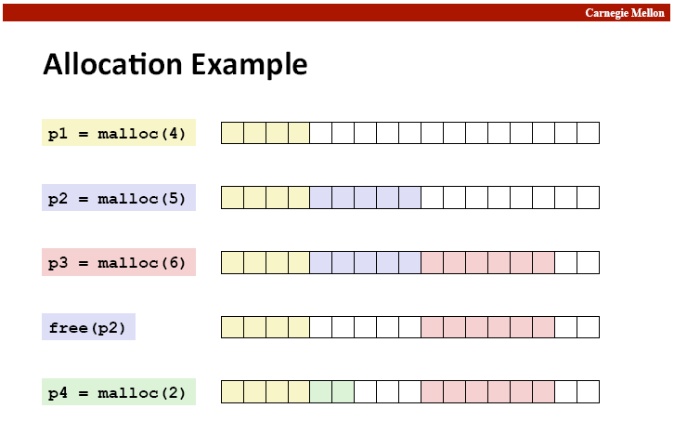

Slide 23
Fragmentation
Internal fragmentation
Result of payload being smaller than block size.
void * m1 = malloc(3); void * m1 = malloc(3);
m1,m2 both have to be aligned to 8 bytes…
External fragmentation

Slide 24
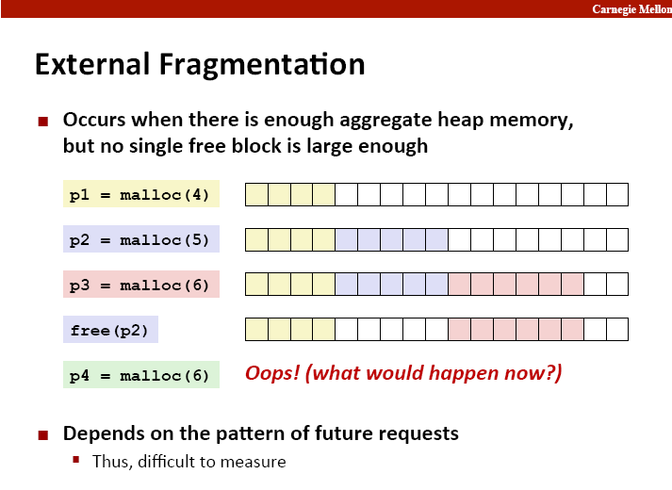

Slide 25
Implementation Hurdles
How do we know where the chunks are?
How do we know how big the chunks are?
How do we know which chunks are free?
Remember: can’t buffer calls to malloc and free… must deal with them real-time.
Remember: calls to free only takes a pointer, not a pointer and a size.
Solution: Need a data structure to store information on the “chunks”
Where do I keep this data structure?

Slide 26
The data structure
Requirements:
The data structure needs to tell us where the chunks are, how big they are, and whether they’re free
We need to be able to CHANGE the data structure during calls to malloc and free
We need to be able to find the next free chunk that is “a good fit for” a given payload
We need to be able to quickly mark a chunk as free/allocated
We need to be able to detect when we’re out of chunks.
What do we do when we’re out of chunks?

Slide 27
The data structure
It would be convenient if it worked like:
malloc_struct malloc_data_structure;
… ptr = malloc(100, &malloc_data_structure);
…
free(ptr, &malloc_data_structure);
…
Instead all we have is the memory we’re giving out.
All of it doesn’t have to be payload! We can use some of that for our data structure.

Slide 28
The data structure
The data structure IS your memory!
A start:
<h1> <pl1> <h2> <pl2> <h3> <pl3>
What goes in the header?
That’s your job!
Lets say somebody calls free(p2), how can I coalesce?
Maybe you need a footer? Maybe not?

Slide 29
The data structure
Common types
Implicit List
Root -> chunk1 -> chunk2 -> chunk3 -> …
Explicit List
Root -> free chunk 1 -> free chunk 2 -> free chunk 3 -> …
Segregated List
Small-malloc root -> free small chunk 1 -> free small chunk 2 -> …
Medium-malloc root -> free medium chunk 1 -> …
Large-malloc root -> free large chunk1 -> …

Slide 30
Implicit List
From the root, can traverse across blocks using headers
Can find a free block this way
Can take a while to find a free block
How would you know when you have to call sbrk?

Slide 31
Explicit List
Improvement over implicit list
From a root, keep track of all free blocks in a (doubly) linked list
Remember a doubly linked list has pointers to next and previous
When malloc is called, can now find a free block quickly
What happens if the list is a bunch of small free blocks but we want a really big one?
How can we speed this up?

Slide 32
Segregated List
An optimization for explicit lists
Can be thought of as multiple explicit lists
What should we group by?
Grouped by size – let’s us quickly find a block of the size we want
What size/number of buckets should we use?
This is up to you to decide

Slide 33
Design Considerations
I found a chunk that fits the necessary payload… should I look for a better fit or not? (First fit vs. Best fit)
Splitting a free block:
void* ptr = malloc(200);
free(ptr);
ptr = malloc(50); //use same space, then “mark” remaining bytes as free
void* ptr = malloc(200);
free(ptr);
ptr = malloc(192);//use same space, then “mark” remaining bytes as free??

Slide 34
Design Considerations
Free blocks: address-ordered or LIFO
What’s the difference?
Pros and cons?
Coalescing
When do you coalesce?
Probably should use explicit or a seg list

