Slide 1
Virtual Memory 15-213 / 18-213: Introduction to Computer Systems 10th Recitation, October 29th, 2012
Grant Skudlarek
Section G

Slide 2
Today
Style
Shell Lab
Malloc Lab
Malloc/pointer review
Git primer
Virtual Memory

Slide 3
Style
Style isn’t about best practice, but conformity
Our style guideline is on the course website
Feel free to ask us with style questions

Slide 4
Today
Style
Shell Lab
Malloc Lab
Malloc/pointer review
Git primer
Virtual Memory

Slide 5
Shell Lab
Due Thursday, November 1

Slide 6
Shell Lab
Some more useful functions…
Sigsuspend()
Sleeps a process while waiting for a signal
http://www.gnu.org/software/libc/manual/html_node/Sigsuspend.html

Slide 7
Shell Lab
Some more useful functions…
Tcsetpgrp()
Takes file descriptor , process group id
Shifts terminal control by fd to pgrp from calling process
Eg routing STDIN to FG job instead of shell
http://www.cs.utah.edu/dept/old/texinfo/glibc-manual-0.02/library_24.html

Slide 8
Today
Style
Shell Lab
Malloc Lab
Malloc/pointer review
Git primer
Virtual Memory

Slide 9
Malloc Lab
Out November 1st
Due November 15th
Start early
Ask questions

Slide 10
Today
Style
Shell Lab
Malloc/pointer review
Git primer
Virtual Memory

Slide 11
Malloc/pointer review
Today!
6:00 pm -7:30pm
GHC 4401 (Rashid Auditorium)
How and when to use malloc()
The different types of pointers
What’s a char(*(*x())[])()?

Slide 12
Today
Style
Shell Lab
Malloc Lab
Malloc/pointer review
Git primer
Virtual Memory

Slide 13
Git primer
Afraid of losing files but too confused/lazy to learn Git and set up an account?
Make a local repository
No account required
>cd tshlab-handout >git init >git add (files) >git commit

Slide 14
Git primer
http://www.contrib.andrew.cmu.edu/~cakrivou/98174/
Website for 98-174, Git stuco course
Lecture 2 on basic commands is particularly useful

Slide 15
Today
Style
Shell Lab
Malloc Lab
Malloc/pointer review
Git primer
Virtual Memory

Slide 16
Virtual Memory Abstraction
Virtual memory is layer of indirection between processor and physical memory providing:
Caching
Memory treated as cache for much larger disk
Memory management
Uniform address space eases allocation, linking, and loading
Memory protection
Prevent processes from interfering with each other by setting permission bits

Slide 17
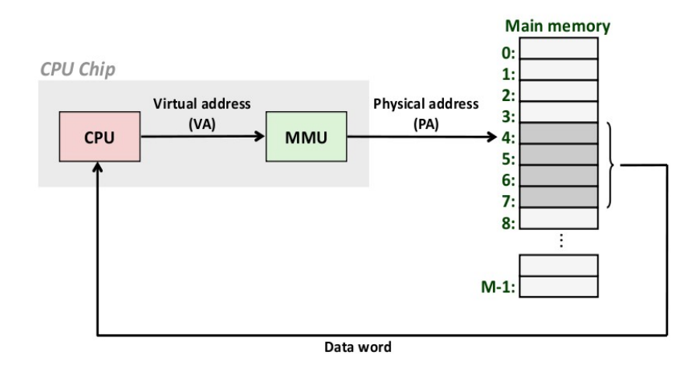
Virtual Memory Implementation
Virtual memory implemented by combination of hardware and software
Operating system creates page tables
Page table is array of Page Table Entries (PTEs) that map virtual pages to physical pages
Hardware Memory Management Unit (MMU) performs address translation

Slide 18
Address Translation and Lookup
On memory access (e.g., mov 0xdeadbeef, %eax)
CPU sends virtual address to MMU
MMU uses virtual address to index into in-memory page tables
Cache/memory returns PTE to MMU
MMU constructs physical address and sends to mem/cache
Cache/memory returns requested data word to CPU

Slide 19
Recall: Address Translation With a Page Table
Virtual address
Page table base register
(PTBR)
n-1
p
p-1
0
Virtual page number (VPN)
Virtual page offset (VPO)
Page table address
for process
Page table
Valid
Physical page number (PPN)
Valid bit = 0:
page not in memory
(page fault)
m-1
p
p-1
0
Physical page number (PPN)
Physical page offset (PPO)
Physical address

Slide 20
Translating with a k-level Page Table
VIRTUAL ADDRESS
n-1
p-1
0
VPN 1
VPN 2
...
VPN k
VPO
Level 1
page table
Level 2
page table
Level k
page table
...
...
PPN
m-1
p-1
0
PPN
PPO
PHYSICAL ADDRESS

Slide 21
x86 Example Setup
Page size 4KB (2^12 Bytes)
Addresses: 32 bits (12 bit VPO, 20 bit VPN)
Consider a one-level page table with:
Base address: 0x01000000
4-byte PTEs
4KB aligned (i.e., lowest 12 bits are zero)
Lowest 3 bits used as permissions
Bit 0: Present?
Bit 1: Writeable?
Bit 2: UserAccessible?
How big overall?
2^20 indicies, so 4MB

Slide 22
Example
Given the setup from the previous slide, what are the VPN (index), PPO, and VPO of address: 0xdeadbeef?

Slide 23
Example
Answers:
VPN (index) = 0xdeadb (1101 1110 1010 1101 1011)
VPO = PPO = 0xeef
Consider a page table entry in our example PT:
Location of PTE = base + (size * index)
0x0137ab6c = base + 4 * index
PTE: 0x98765007
Physical address: 0x98765eef

Slide 24
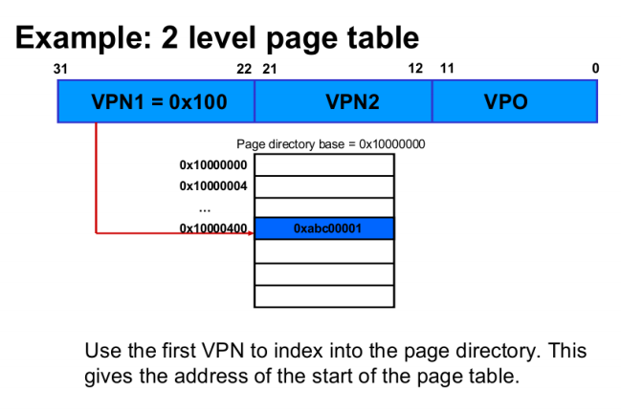

Slide 25
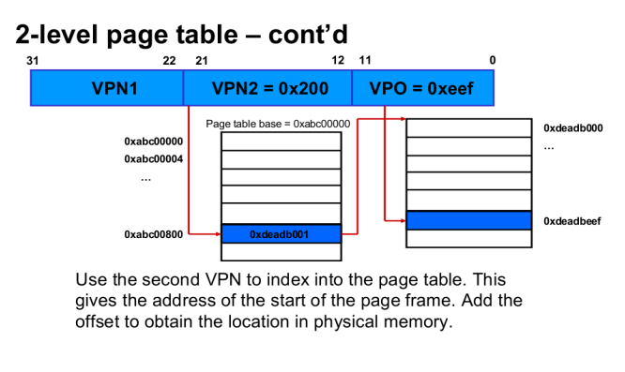

Slide 26
Questions?

