Slide 1
Thread-Level Parallelism
15-213 / 18-213: Introduction to Computer Systems
26th Lecture, Nov 29, 2012
Instructors:
Dave O’Hallaron, Greg Ganger, and Greg Kesden

Slide 2
Today
Thread safety
Parallel Computing Hardware
  Multicore
    Multiple separate processors on single chip
Thread-Level Parallelism
  Splitting program into independent tasks
    Example: Parallel summation
    Some performance artifacts
  Divide-and conquer parallelism
    Example: Parallel quicksort

Slide 3
Crucial concept: Thread Safety
Functions called from a thread must be thread-safe
Def: A function is thread-safe iff it will always produce correct results when called repeatedly from multiple concurrent threads.
Classes of thread-unsafe functions:
  Class 1: Functions that do not protect shared variables
  Class 2: Functions that keep state across multiple invocations
  Class 3: Functions that return a pointer to a static variable
  Class 4: Functions that call thread-unsafe functions

Slide 4
Thread-Unsafe Functions (Class 1)
Failing to protect shared variables
  Fix: Use P and V semaphore operations
  Example: goodcnt.c
  Issue: Synchronization operations will slow down code

Slide 5
Thread-Unsafe Functions (Class 2)
Relying on persistent state across multiple function invocations
  Example: Random number generator that relies on static state
static unsigned int next = 1;
/* rand: return pseudo-random integer on 0..32767 */
int rand(void)
{
next = next*1103515245 + 12345;
return (unsigned int)(next/65536) % 32768;
}
/* srand: set seed for rand() */
void srand(unsigned int seed)
{
next = seed;
}

Slide 6
Thread-Safe Random Number Generator
Pass state as part of argument
  and, thereby, eliminate static state
Consequence: programmer using rand_r must maintain seed
/* rand_r - return pseudo-random integer on 0..32767 */
int rand_r(int *nextp)
{
*nextp = *nextp*1103515245 + 12345;
return (unsigned int)(*nextp/65536) % 32768;
}

Slide 7
Thread-Unsafe Functions (Class 3)
Returning a pointer to a static variable
Fix 1. Rewrite function so caller passes address of variable to store result
  Requires changes in caller and callee
Fix 2. Lock-and-copy
  Requires simple changes in caller (and none in callee)
  However, caller must free memory.
/* lock-and-copy version */
char *ctime_ts(const time_t *timep,
char *privatep)
{
char *sharedp;
P(&mutex);
sharedp = ctime(timep);
strcpy(privatep, sharedp);
V(&mutex);
return privatep;
}

Slide 8
Thread-Unsafe Functions (Class 4)
Calling thread-unsafe functions
  Calling one thread-unsafe function makes the entire function that calls it thread-unsafe
  Fix: Modify the function so it calls only thread-safe functions ☺

Slide 9
Reentrant Functions
Def: A function is reentrant iff it accesses no shared variables when called by multiple threads.
  Important subset of thread-safe functions
    Require no synchronization operations
    Only way to make a Class 2 function thread-safe is to make it reentrant (e.g., rand_r )
All functions
Thread-safe
functions
Reentrant
functions
Thread-unsafe
functions

Slide 10
Thread-Safe Library Functions
All functions in the Standard C Library (at the back of your K&R text) are thread-safe
  Examples: malloc, free, printf, scanf
Most Unix system calls are thread-safe, with a few exceptions:
Thread-unsafe function Class Reentrant version
asctime 3 asctime_r
ctime 3 ctime_r
gethostbyaddr 3 gethostbyaddr_r
gethostbyname 3 gethostbyname_r
inet_ntoa 3 (none)
localtime 3 localtime_r
rand 2 rand_r

Slide 11
Today
Thread safety
Parallel Computing Hardware
  Multicore
    Multiple separate processors on single chip
  Hyperthreading
    Multiple threads executed on a given processor at once
Thread-Level Parallelism
  Splitting program into independent tasks
    Example: Parallel summation
    Some performance artifacts
  Divide-and conquer parallelism
    Example: Parallel quicksort

Slide 12
Multicore Processor
Core 0
Core n-1
Regs
Regs
L1
d-cache
L1
i-cache
…
L1
d-cache
L1
i-cache
L2 unified cache
L2 unified cache
L3 unified cache
(shared by all cores)
Main memory
Intel Nehalem Processor
  E.g., Shark machines
  Multiple processors operating with coherent view of memory

Slide 13
Exploiting parallel execution
So far, we’ve used threads to deal with I/O delays
  e.g., one thread per client to prevent one from delaying another
Multi-core CPUs offer another opportunity
  Spread work over threads executing in parallel on N cores
  Happens automatically, if many independent tasks
    e.g., running many applications or serving many clients
  Can also write code to make one big task go faster
    by organizing it as multiple parallel sub-tasks
Shark machines can execute 16 threads at once
  8 cores, each with 2-way hyperthreading (not covered)
  Theoretical speedup of 16X
    never achieved in our benchmarks

Slide 14
Summation Example
Sum numbers 0, …, N-1
  Should add up to (N-1)*N/2
Partition into K ranges
  ⎣N/K⎦ values each
  Accumulate leftover values serially
Method #1: All threads update single global variable
  1A: No synchronization
  1B: Synchronize with pthread semaphore
  1C: Synchronize with pthread mutex
    “Binary” semaphore. Only values 0 & 1

Slide 15
Accumulating in Single Global Variable: Declarations
typedef unsigned long data_t;
/* Single accumulator */
volatile data_t global_sum;
/* Mutex & semaphore for global sum */
sem_t semaphore;
pthread_mutex_t mutex;
/* Number of elements summed by each thread */
size_t nelems_per_thread;
/* Keep track of thread IDs */
pthread_t tid[MAXTHREADS];
/* Identify each thread */
int myid[MAXTHREADS];

Slide 16
Accumulating in Single Global Variable: Operation
nelems_per_thread = nelems / nthreads;
/* Set global value */
global_sum = 0;
/* Create threads and wait for them to finish */
for (i = 0; i < nthreads; i++) {
myid[i] = i;
Pthread_create(&tid[i], NULL, thread_fun, &myid[i]);
}
for (i = 0; i < nthreads; i++)
Pthread_join(tid[i], NULL);
result = global_sum;
/* Add leftover elements */
for (e = nthreads * nelems_per_thread; e < nelems; e++)
result += e;

Slide 17
Thread Function: No Synchronization
void *sum_race(void *vargp)
{
int myid = *((int *)vargp);
size_t start = myid * nelems_per_thread;
size_t end = start + nelems_per_thread;
size_t i;
for (i = start; i < end; i++) {
global_sum += i;
}
return NULL;
}

Slide 18
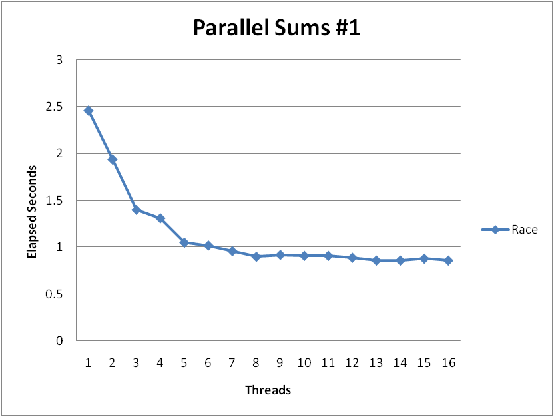
Unsynchronized Performance
N = 2³⁰
Best speedup = 2.86X
Gets wrong answer when > 1 thread!

Slide 19
Thread Function: Semaphore / Mutex
Semaphore
void *sum_sem(void *vargp)
{
int myid = *((int *)vargp);
size_t start = myid * nelems_per_thread;
size_t end = start + nelems_per_thread;
size_t i;
for (i = start; i < end; i++) {
sem_wait(&semaphore);
global_sum += i;
sem_post(&semaphore);
}
return NULL;
}
sem_wait(&semaphore);
global_sum += i;
sem_post(&semaphore);
Mutex
pthread_mutex_lock(&mutex);
global_sum += i;
pthread_mutex_unlock(&mutex);

Slide 20
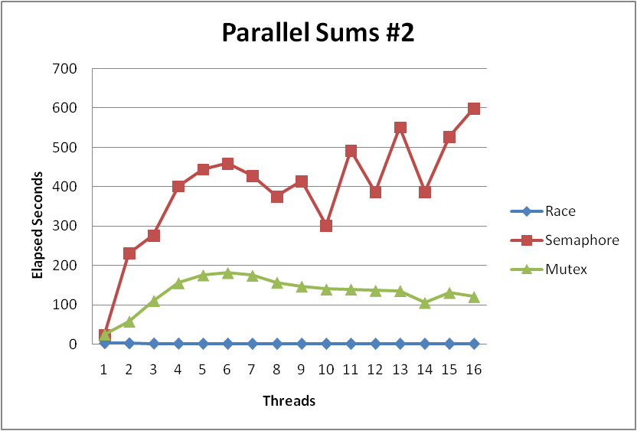
Semaphore / Mutex Performance
Terrible Performance
  2.5 seconds ➔ ~10 minutes
Mutex 3X faster than semaphore
Clearly, neither is successful

Slide 21
Separate Accumulation
Method #2: Each thread accumulates into separate variable
  2A: Accumulate in contiguous array elements
  2B: Accumulate in spaced-apart array elements
  2C: Accumulate in registers
/* Partial sum computed by each thread */
data_t psum[MAXTHREADS*MAXSPACING];
/* Spacing between accumulators */
size_t spacing = 1;

Slide 22
Separate Accumulation: Operation
nelems_per_thread = nelems / nthreads;
/* Create threads and wait for them to finish */
for (i = 0; i < nthreads; i++) {
myid[i] = i;
psum[i*spacing] = 0;
Pthread_create(&tid[i], NULL, thread_fun, &myid[i]);
}
for (i = 0; i < nthreads; i++)
Pthread_join(tid[i], NULL);
result = 0;
/* Add up the partial sums computed by each thread */
for (i = 0; i < nthreads; i++)
result += psum[i*spacing];
/* Add leftover elements */
for (e = nthreads * nelems_per_thread; e < nelems; e++)
result += e;

Slide 23
Thread Function: Memory Accumulation
void *sum_global(void *vargp)
{
int myid = *((int *)vargp);
size_t start = myid * nelems_per_thread;
size_t end = start + nelems_per_thread;
size_t i;
size_t index = myid*spacing;
psum[index] = 0;
for (i = start; i < end; i++) {
psum[index] += i;
}
return NULL;
}

Slide 24
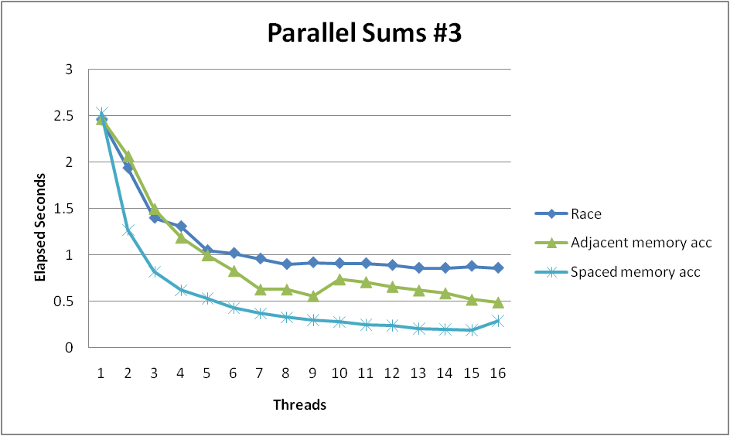
Memory Accumulation Performance
Clear threading advantage
  Adjacent speedup: 5 X
  Spaced-apart speedup: 13.3 X (Only observed speedup > 8)
Why does spacing the accumulators apart matter?

Slide 25
False Sharing
0
7
8
15
psum
…
…
Cache Block m
Cache Block m+1
Coherency maintained on cache blocks
To update psum[i], thread i must have exclusive access
  Threads sharing common cache block will keep fighting each other for access to block

Slide 26
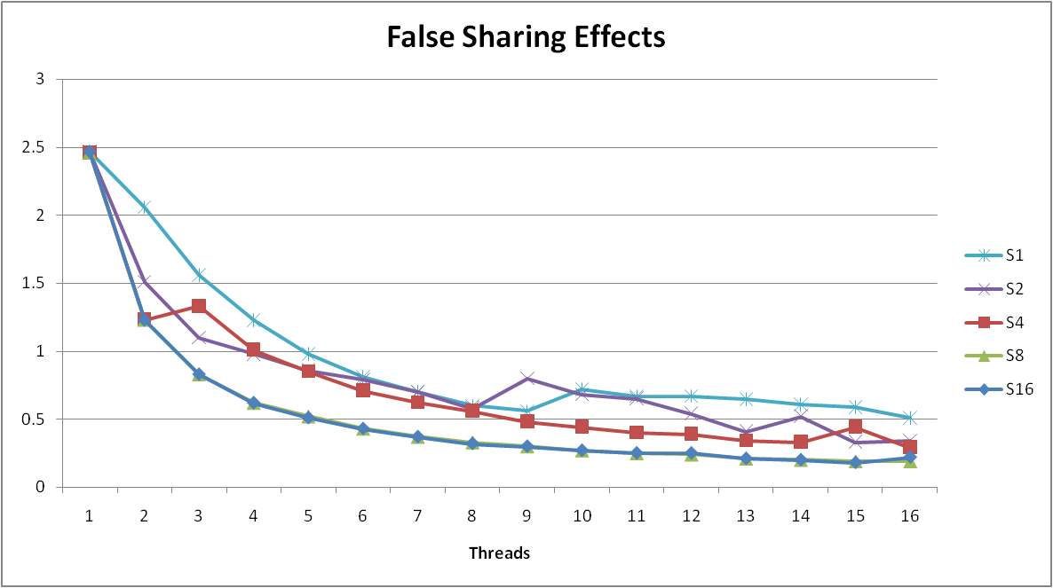
False Sharing Performance
  Best spaced-apart performance 2.8 X better than best adjacent
Demonstrates cache block size = 64
  8-byte values
  No benefit increasing spacing beyond 8

Slide 27
Thread Function: Register Accumulation
void *sum_local(void *vargp)
{
int myid = *((int *)vargp);
size_t start = myid * nelems_per_thread;
size_t end = start + nelems_per_thread;
size_t i;
size_t index = myid*spacing;
data_t sum = 0;
for (i = start; i < end; i++) {
sum += i;
}
psum[index] = sum; return NULL;
}

Slide 28
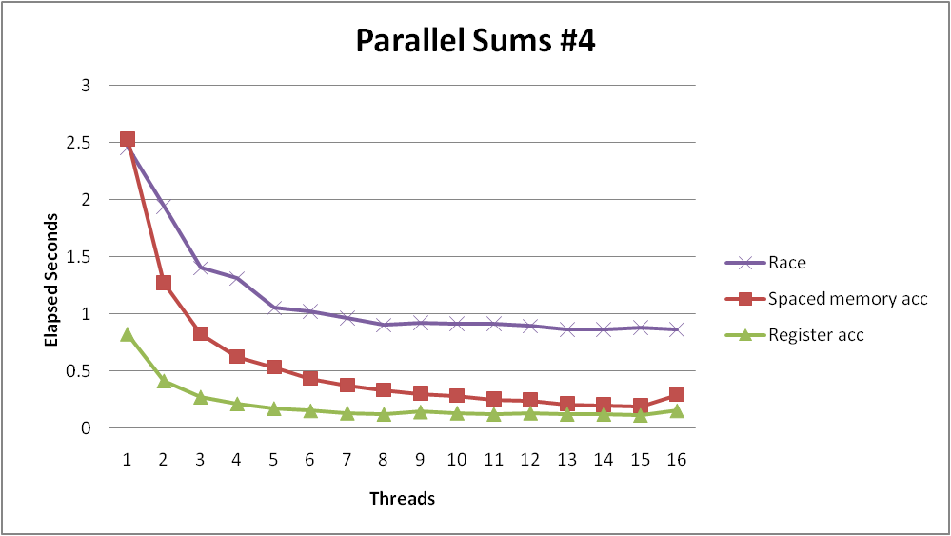
Register Accumulation Performance
Clear threading advantage
  Speedup = 7.5 X
2X better than fastest memory accumulation

Slide 29
Amdahl’s Law
Overall problem
  T Total sequential time required
  p Fraction of total that can be sped up (0 ≤ p ≤ 1)
  k Speedup factor
Resulting Performance
  T_{k} = pT/k + (1-p)T
    Portion which can be sped up runs k times faster
    Portion which cannot be sped up stays the same
  Maximum possible speedup
    k = ∞
    T∞ = (1-p)T

Slide 30
Amdahl’s Law Example
Overall problem
  T = 10 Total time required
  p = 0.9 Fraction of total which can be sped up
  k = 9 Speedup factor
Resulting Performance
  T₉ = 0.9 * 10/9 + 0.1 * 10 = 1.0 + 1.0 = 2.0
  Maximum possible speedup
    T∞ = 0.1 * 10.0 = 1.0

Slide 31
A More Substantial Example: Sort
Sort set of N random numbers
Multiple possible algorithms
  Use parallel version of quicksort
Sequential quicksort of set of values X
  Choose “pivot” p from X
  Rearrange X into
    L: Values ≤ p
    R: Values ≥ p
  Recursively sort L to get L′
  Recursively sort R to get R′
  Return L′ : p : R′

Slide 32
Sequential Quicksort Visualized
X
p
L
p
R
p2
L2
p2
R2
•
•
•
L′

Slide 33
Sequential Quicksort Visualized
X
L′
p
R
p3
L3
p3
R3
•
•
•
R′
L′
p
R′

Slide 34
Sequential Quicksort Code
void qsort_serial(data_t *base, size_t nele) {
if (nele <= 1)
return;
if (nele == 2) {
if (base[0] > base[1])
swap(base, base+1);
return;
}
/* Partition returns index of pivot */
size_t m = partition(base, nele);
if (m > 1)
qsort_serial(base, m);
if (nele-1 > m+1)
qsort_serial(base+m+1, nele-m-1);
}
Sort nele elements starting at base
  Recursively sort L or R if has more than one element

Slide 35
Parallel Quicksort
Parallel quicksort of set of values X
  If N ≤ Nthresh, do sequential quicksort
  Else
    Choose “pivot” p from X
    Rearrange X into
      L: Values ≤ p
      R: Values ≥ p
    Recursively spawn separate threads
      Sort L to get L′
      Sort R to get R′
    Return L′ : p : R′

Slide 36
Parallel Quicksort Visualized
X
p
L
p
R
p2
p3
L2
p2
R2
p
L3
p3
R3
•
•
•
•
•
•
L′
p
R′

Slide 37
Parallel Quicksort Data Structures
/* Structure that defines sorting task */
typedef struct {
data_t *base;
size_t nele;
pthread_t tid;
} sort_task_t;
volatile int ntasks = 0;
volatile int ctasks = 0;
sort_task_t **tasks = NULL;
sem_t tmutex;
Data associated with each sorting task
  base: Array start
  nele: Number of elements
  tid: Thread ID
Generate list of tasks
  Must protect by mutex

Slide 38
Parallel Quicksort Initialization
static void init_task(size_t nele) {
ctasks = 64;
tasks = (sort_task_t **) Calloc(ctasks, sizeof(sort_task_t *));
ntasks = 0;
Sem_init(&tmutex, 0, 1);
nele_max_serial = nele / serial_fraction;
}
Task queue dynamically allocated
Set Nthresh = N/F:
  N Total number of elements
  F Serial fraction
    Fraction of total size at which shift to sequential quicksort

Slide 39
Parallel Quicksort: Accessing Task Queue
static sort_task_t *new_task(data_t *base, size_t nele) {
P(&tmutex);
if (ntasks == ctasks) {
ctasks *= 2;
tasks = (sort_task_t **)
Realloc(tasks, ctasks * sizeof(sort_task_t *));
}
int idx = ntasks++;
sort_task_t *t = (sort_task_t *) Malloc(sizeof(sort_task_t));
tasks[idx] = t;
V(&tmutex);
t->base = base;
t->nele = nele;
t->tid = (pthread_t) 0;
return t;
}
Dynamically expand by doubling queue length
  Generate task structure dynamically (consumed when reap thread)
Must protect all accesses to queue & ntasks by mutex

Slide 40
Parallel Quicksort: Top-Level Function
void tqsort(data_t *base, size_t nele) {
int i;
init_task(nele);
tqsort_helper(base, nele);
for (i = 0; i < get_ntasks(); i++) {
P(&tmutex);
sort_task_t *t = tasks[i];
V(&tmutex);
Pthread_join(t->tid, NULL);
free((void *) t);
}
}
Actual sorting done by tqsort_helper
Must reap all of the spawned threads
  All accesses to task queue & ntasks guarded by mutex

Slide 41
Parallel Quicksort: Recursive function
void tqsort_helper(data_t *base, size_t nele) {
if (nele <= nele_max_serial) {
/* Use sequential sort */
qsort_serial(base, nele);
return;
}
sort_task_t *t = new_task(base, nele);
Pthread_create(&t->tid, NULL, sort_thread, (void *) t);
}
If below Nthresh, call sequential quicksort
Otherwise create sorting task

Slide 42
Parallel Quicksort: Sorting Task Function
static void *sort_thread(void *vargp) {
sort_task_t *t = (sort_task_t *) vargp;
data_t *base = t->base;
size_t nele = t->nele;
size_t m = partition(base, nele);
if (m > 1)
tqsort_helper(base, m);
if (nele-1 > m+1)
tqsort_helper(base+m+1, nele-m-1);
return NULL;
}
Same idea as sequential quicksort

Slide 43
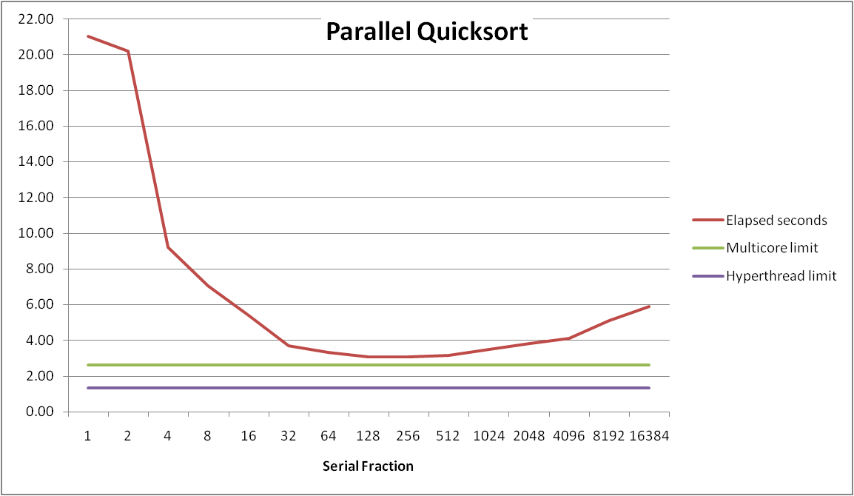
Parallel Quicksort Performance
Number of threads
Sort 2³⁷ (134,217,728) random values
Best speedup = 6.84X

Slide 44
Parallel Quicksort Performance
Number of threads
Good performance over wide range of fraction values
  F too small: Not enough parallelism
  F too large: Thread overhead + run out of thread memory

Slide 45
Amdahl’s Law & Parallel Quicksort
Sequential bottleneck
  Top-level partition: No speedup
  Second level: ≤ 2X speedup
  k^{th} level: ≤ 2^{k-1}X speedup
Implications
  Good performance for small-scale parallelism
  Would need to parallelize partitioning step to get large-scale parallelism
    Parallel Sorting by Regular Sampling
      H. Shi & J. Schaeffer, J. Parallel & Distributed Computing, 1992

Slide 46
Lessons Learned
Must have strategy
  Partition into K independent parts
  Divide-and-conquer
Inner loops must be synchronization free
  Synchronization operations very expensive
Watch out for hardware artifacts
  Sharing and false sharing of global data
You can do it!
  Achieving modest levels of parallelism is not difficult

Slide 47
Extra slides

Slide 48
Out-of-Order Processor Structure
Instruction Control
Instruction
Cache
Instruction Decoder
Registers
Op. Queue
PC
Functional Units
Data Cache
Integer
Arith
Integer
Arith
FP
Arith
Load /
Store
Instruction control dynamically converts program into stream of operations
Operations mapped onto functional units to execute in parallel

Slide 49
Hyperthreading
Instruction Control
Instruction
Cache
Instruction Decoder
Reg A
Op. Queue A
Reg B
Op. Queue B
PC A
PC B
Functional Units
Data Cache
Integer
Arith
Integer
Arith
FP
Arith
Load /
Store
Replicate enough instruction control to process K instruction streams
K copies of all registers
Share functional units

Slide 50
Summary: Creating Parallel Machines
Multicore
  Separate instruction logic and functional units
  Some shared, some private caches
  Must implement cache coherency
Hyperthreading
  Also called “simultaneous multithreading”
  Separate program state
  Shared functional units & caches
  No special control needed for coherency
Combining
  Shark machines: 8 cores, each with 2-way hyperthreading
  Theoretical speedup of 16X
    Never achieved in our benchmarks

Slide 51
Memory Consistency
int a = 1;
int b = 100;
Thread consistency
constraints
Wa
Rb
Thread1:
Wa: a = 2;
Rb: print(b);
Thread2:
Wb: b = 200;
Ra: print(a);
Wb
Ra
What are the possible values printed?
  Depends on memory consistency model
  Abstract model of how hardware handles concurrent accesses
Sequential consistency
  Overall effect consistent with each individual thread
  Otherwise, arbitrary interleaving

Slide 52
Sequential Consistency Example
Thread consistency
constraints
int a = 1;
int b = 100;
Wa
Rb
Thread1:
Wa: a = 2;
Rb: print(b);
Thread2:
Wb: b = 200;
Ra: print(a);
Wb
Ra
Rb
Wb
Ra
100, 2
Wa
Rb
Ra
200, 2
Wb
Ra
Rb
2, 200
Ra
Wa
Rb
1, 200
Wb
Ra
Rb
2, 200
Wa
Rb
Ra
200, 2
Impossible outputs
  100, 1 and 1, 100
  Would require reaching both Ra and Rb before Wa and Wb

Slide 53
Non-Coherent Cache Scenario
int a = 1;
int b = 100;
Write-back caches, without coordination between them
Thread1:
Wa: a = 2;
Rb: print(b);
Thread2:
Wb: b = 200;
Ra: print(a);
Thread1 Cache
Thread2 Cache
a: 2
b:100
a:1
b:200
print 1
print 100
Main Memory
a:1
b:100

Slide 54
Snoopy Caches
int a = 1;
int b = 100;
Tag each cache block with state
  Invalid Cannot use value
  Shared Readable copy
  Exclusive Writeable copy
Thread1:
Wa: a = 2;
Rb: print(b);
Thread2:
Wb: b = 200;
Ra: print(a);
Thread1 Cache
Thread2 Cache
E
a: 2
E
b:200
Main Memory
a:1
b:100

Slide 55
Snoopy Caches
int a = 1;
int b = 100;
Tag each cache block with state
  Invalid Cannot use value
  Shared Readable copy
  Exclusive Writeable copy
Thread1:
Wa: a = 2;
Rb: print(b);
Thread2:
Wb: b = 200;
Ra: print(a);
Thread1 Cache
Thread2 Cache
E
S
a: 2
a: 2
S
a:2
print 2
S
b:200
E
S
b:200
b:200
print 200
Main Memory
When cache sees request for one of its E-tagged blocks
  Supply value from cache
  Set tag to S
a:1
b:100

