Slide 1
Malloc & VM
By sseshadr

Slide 2
Agenda
Administration
Process lab code will be inked by Thursday (pick up in ECE hub)
Malloc due soon (Thursday, November 4th)
Exam 2 in a week (Tuesday, November 9th)
Proxy Lab out in a week (Tuesday, November 9th)
Plan for today
Finish malloc questions
mm_checkheap
VM

Slide 3
Malloc
Questions?

Slide 4
mm_checkheap
More for YOU than for US.
But we’ll grade it.
Checks consistency of data structure
(Doubly) linked lists are pointed correctly?
Headers and footers match up?
No allocated blocks in your explicit list?
No free blocks NOT in your explicit list?
Any of YOUR OWN invariants! (address-ordering?)
Seg lists: no big chunks in small lists / vice versa?

Slide 5
Virtual Memory

Slide 6
Basic Concepts

Slide 7
Basic Concepts

Slide 8
Basic Concepts
Assumptions
n-bit virtual address
m-bit physical address
P = 2^{p} = Page size
How big is…
The virtual page number?
The physical page number?
The virtual page offset?
The physical page offset?

Slide 9
Basic Concepts
Assumptions
n-bit virtual address
m-bit physical address
P = 2^{p} = Page size
How big is…
The virtual page number? (n-p) bits
The physical page number? (m-p) bits
The virtual page offset? p bits
The physical page offset? p bits

Slide 10
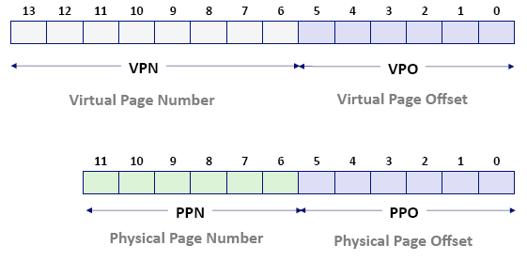
Basic Concepts
Anatomy of addresses (using 14-bit VA, 12-bit PA, 64 byte page size)
The VPN needs to have enough information so that the TLB can look up a PPN for it.
The PPN needs to have enough information so that the cache can look up the DATA at the given address.

Slide 11
Basic Concepts
These addresses are stored as Page Table Entries in a Page Table.
Just a listing of conversions from VPN -> PPN
And whether it’s valid
Since memory translations happen very often, modern architectures speed this up with a TLB.

Slide 12
Basic Concepts
Translation Lookaside Buffer
Hardware!
Is like a cache from VPNs to PPNs
During a translation, ask the TLB first by giving it an INDEX and TAG
How big is…
The index?
The tag?

Slide 13
TLB
Translation Lookaside Buffer
Hardware!
Is like a cache from VPNs to PPNs
During a translation, ask the TLB first by giving it an INDEX and TAG
How big is…
The index? log₂ (# of sets)
The tag? (n - p - index_size)

Slide 14
TLB
TLB Hit
Got away with the shortcut!
TLB Miss
Not necessarily a page fault!
Go check the page table, and then come back and fill in the missing spot in TLB.
TLB Miss and not in the page table
Page fault. What does the OS do?
Make some mappings?
Throw a SIGSEGV?
Kill the process?

Slide 15
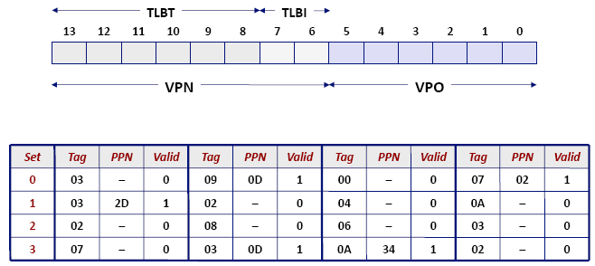
Virtual Address Anatomy
TLB has 4 sets, 14-bit VA, 64 byte pages

Slide 16
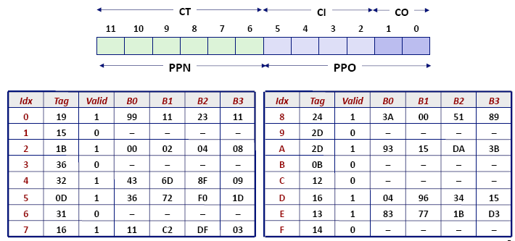
Physical Address Anatomy
Direct-mapped cache has 16 lines, each block has 4-bytes. 12-bit PA, 64 byte pages

Slide 17
Translation!
End-to-end translation in the book from pages 794 to 798

Slide 18
Practice!
Lots of VM questions in past Exam 2s
Means you’re likely to see one on this test!

