Slide 1
15-213
Intro to Computer Systems
Recitation #1
By sseshadr

Slide 2
Today
Introductions
Datalab Tricks
  Floating point questions? Go to Office Hours.
Integer Puzzles
Parity Example
Style

Slide 3
Introductions

Slide 4
Datalab Tricks
Basics
  >>, <<
  | vs. ||
  & vs. &&
  ! vs. ~
What is x?
  int x = (9 | 12) << 1;
  x = 26

Slide 5
Datalab Tricks
Trick #1: Signed-ness
  The MOST significant bit
    0 -> positive or zero
    1 -> negative
  What is…
    int x = (10 >> 31);
    int y = (-10 >> 31);
      It’s NOT 1 (what is arithmetic shifting?)
      How do we fix that?
  Answers:
    x = 0 and y = -1

Slide 6
Datalab Tricks
Trick #2: Properties of Zero
  Masking
    0 & (something) == 0 [why?]
    (0-1) & (something) == something [why?]
    Why is this useful?
  Positive zero vs. negative zero
    int x = 0; int y = -x;
    Neither x nor y is negative (MSB is 0 for both)
    Why is this useful?

Slide 7
Datalab Tricks
Trick #3: Negation
  Review: take a 5-bit twos compliment system
1 0 0 1 0
-2⁴
2³
2²
2¹
2⁰
-16 + 2 = -14

Slide 8
Datalab Tricks
Trick #3: Negation
  Review: take a 5-bit twos compliment system
0 1 1 1 0
-2⁴
2³
2²
2¹
2⁰
8+ 4 + 2 = 14

Slide 9
Datalab Tricks
Trick #3: Negation
  Example:
1 0 0 1 0 int x = -14; // -14
0 1 1 0 1 int y = ~x; // 13
0 1 1 1 0 int z = ~x+1; // 14

Slide 10
Datalab Tricks
Trick #3: Negation
  In general
  -x == (~x + 1)
  Does this always work?
    Tmin?
      No!
    Tmax?
      Yes!
    Zero?
      Yes!
    Everything else?
      Yes!

Slide 11
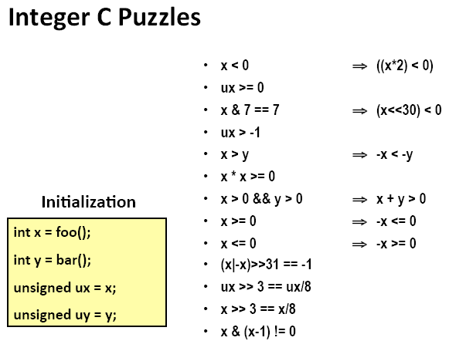
Integer Puzzles

Slide 12
Integer Puzzles
(x < 0) => ((x*2) < 0)
  Nope. Tmin?
(ux >= 0)
  Yup!
(x&7 == 7) => ((x << 30) < 0)
  Yup!
  (x&7 == 7) means last 3 bits are 1
  Examine the “negative bit” of (x<<30)

Slide 13
Integer Puzzles
(ux > -1)
  Nope. Unsigned comparison means -1 is Umax!
(x > y) => (-x < -y)
  Nope. Boundary cases.
  x = 0, y = Tmin (what is -Tmin?)
(x*x >= 0)
  Nope. Overflow into “negative bit”
  int x = 65535; // 2^16 - 1

Slide 14
Integer Puzzles
(x > 0 && y > 0) => (x + y > 0)
  Nope. Overflow into “negative bit”
  x, y = Tmax
(x >= 0) => (-x <= 0)
  Yup! Why doesn’t break for Tmax?
(x <= 0) => (-x >= 0)
  Nope. What is –Tmin?

Slide 15
Integer Puzzles
(x|-x) >> 31 == -1
  Nope. x = 0
(ux >> 3) == (ux / 8)
  Yup!
(x >> 3) == (x / 8)
  Nope. Careful on rounding!
  int x = -19;
  int y = x >> 3; // y = -3
  int z = x / 8; // z = -2

Slide 16
Integer Puzzles
(x & (x-1)) != 0
  Nope. x = 0, x = 1

Slide 17
Parity Example
Write a function which takes an integer and returns
  1 if there are an odd number of ‘1’ bits
  0 if there are an even number of ‘1’ bits
  int parity_check(int x){
  …
  }
Any ideas?

Slide 18
Parity Example
Inspiration:
  If we could XOR all of the bits in the argument… we would get the answer!
11011001011000111110010100101101
11011001011000111110010100101101
1101100101100011
1110010100101101
XOR
0011110001001110 (down to 16 bits)

Slide 19
Parity Example
Just keep going!
0011110001001110
0011110001001110
00111100
01001110
XOR
01110010 (down to 8 bits)

Slide 20
Parity Example
Just keep going!
01110010
01110010
0111
0010
XOR
0101 (down to 4 bits)

Slide 21
Parity Example
You can take it from there.
  Still confused on high-level algorithm? Can’t write the C code for the Parity Problem? Office Hours.

Slide 22
Style
Here is what we grade on:
  http://www.cs.cmu.edu/~213/codeStyle.html
It is in your best interest to read it ASAP!
Autolab isn’t the whole grade. We read your code.

Slide 23
Style
Documentation
Whitespace
Line length
Variable names
Magic Numbers
Dead Code
Modularity
Error checking
Consistency

