Slide 1
Active and Proactive Machine Learning:
From Fundamentals to Applications
Jaime Carbonell (www.cs.cmu.edu/~jgc)
With Pinar Donmez, Jingui He, Vamshi Ambati, Oznur Tastan, Xi Chen
Language Technologies Inst. & Machine Learning Dept.
Carnegie Mellon University
26 March 2010

Slide 2
Why is Active Learning Important?
Labeled data volumes << unlabeled data volumes
  1.2% of all proteins have known structures
  < .01% of all galaxies in the Sloan Sky Survey have consensus type labels
  < .0001% of all web pages have topic labels
  << E-10% of all internet sessions are labeled as to fraudulence (malware, etc.)
  < .0001 of all financial transactions investigated w.r.t. fraudulence
If labeling is costly, or limited, select the instances with maximal impact for learning

Slide 3
Active Learning
Training data:
  Special case:
Functional space:
Fitness Criterion:
  a.k.a. loss function
Sampling Strategy:

Slide 4
Sampling Strategies
Random sampling (preserves distribution)
Uncertainty sampling (Lewis, 1996; Tong & Koller, 2000)
  proximity to decision boundary
  maximal distance to labeled x’s
Density sampling (kNN-inspired McCallum & Nigam, 2004)
Representative sampling (Xu et al, 2003)
Instability sampling (probability-weighted)
  x’s that maximally change decision boundary
Ensemble Strategies
  Boosting-like ensemble (Baram, 2003)
  DUAL (Donmez & Carbonell, 2007)
    Dynamically switches strategies from Density-Based to Uncertainty-Based by estimating derivative of expected residual error reduction

Slide 5
Which point to sample?
Grey = unlabeled
Red = class A
Brown = class B

Slide 6
Density-Based Sampling
Centroid of largest unsampled cluster

Slide 7
Uncertainty Sampling
Closest to decision boundary

Slide 8
Maximal Diversity Sampling
Maximally distant from labeled x’s

Slide 9
Ensemble-Based Possibilities
Uncertainty + Diversity criteria
Density + uncertainty criteria

Slide 10
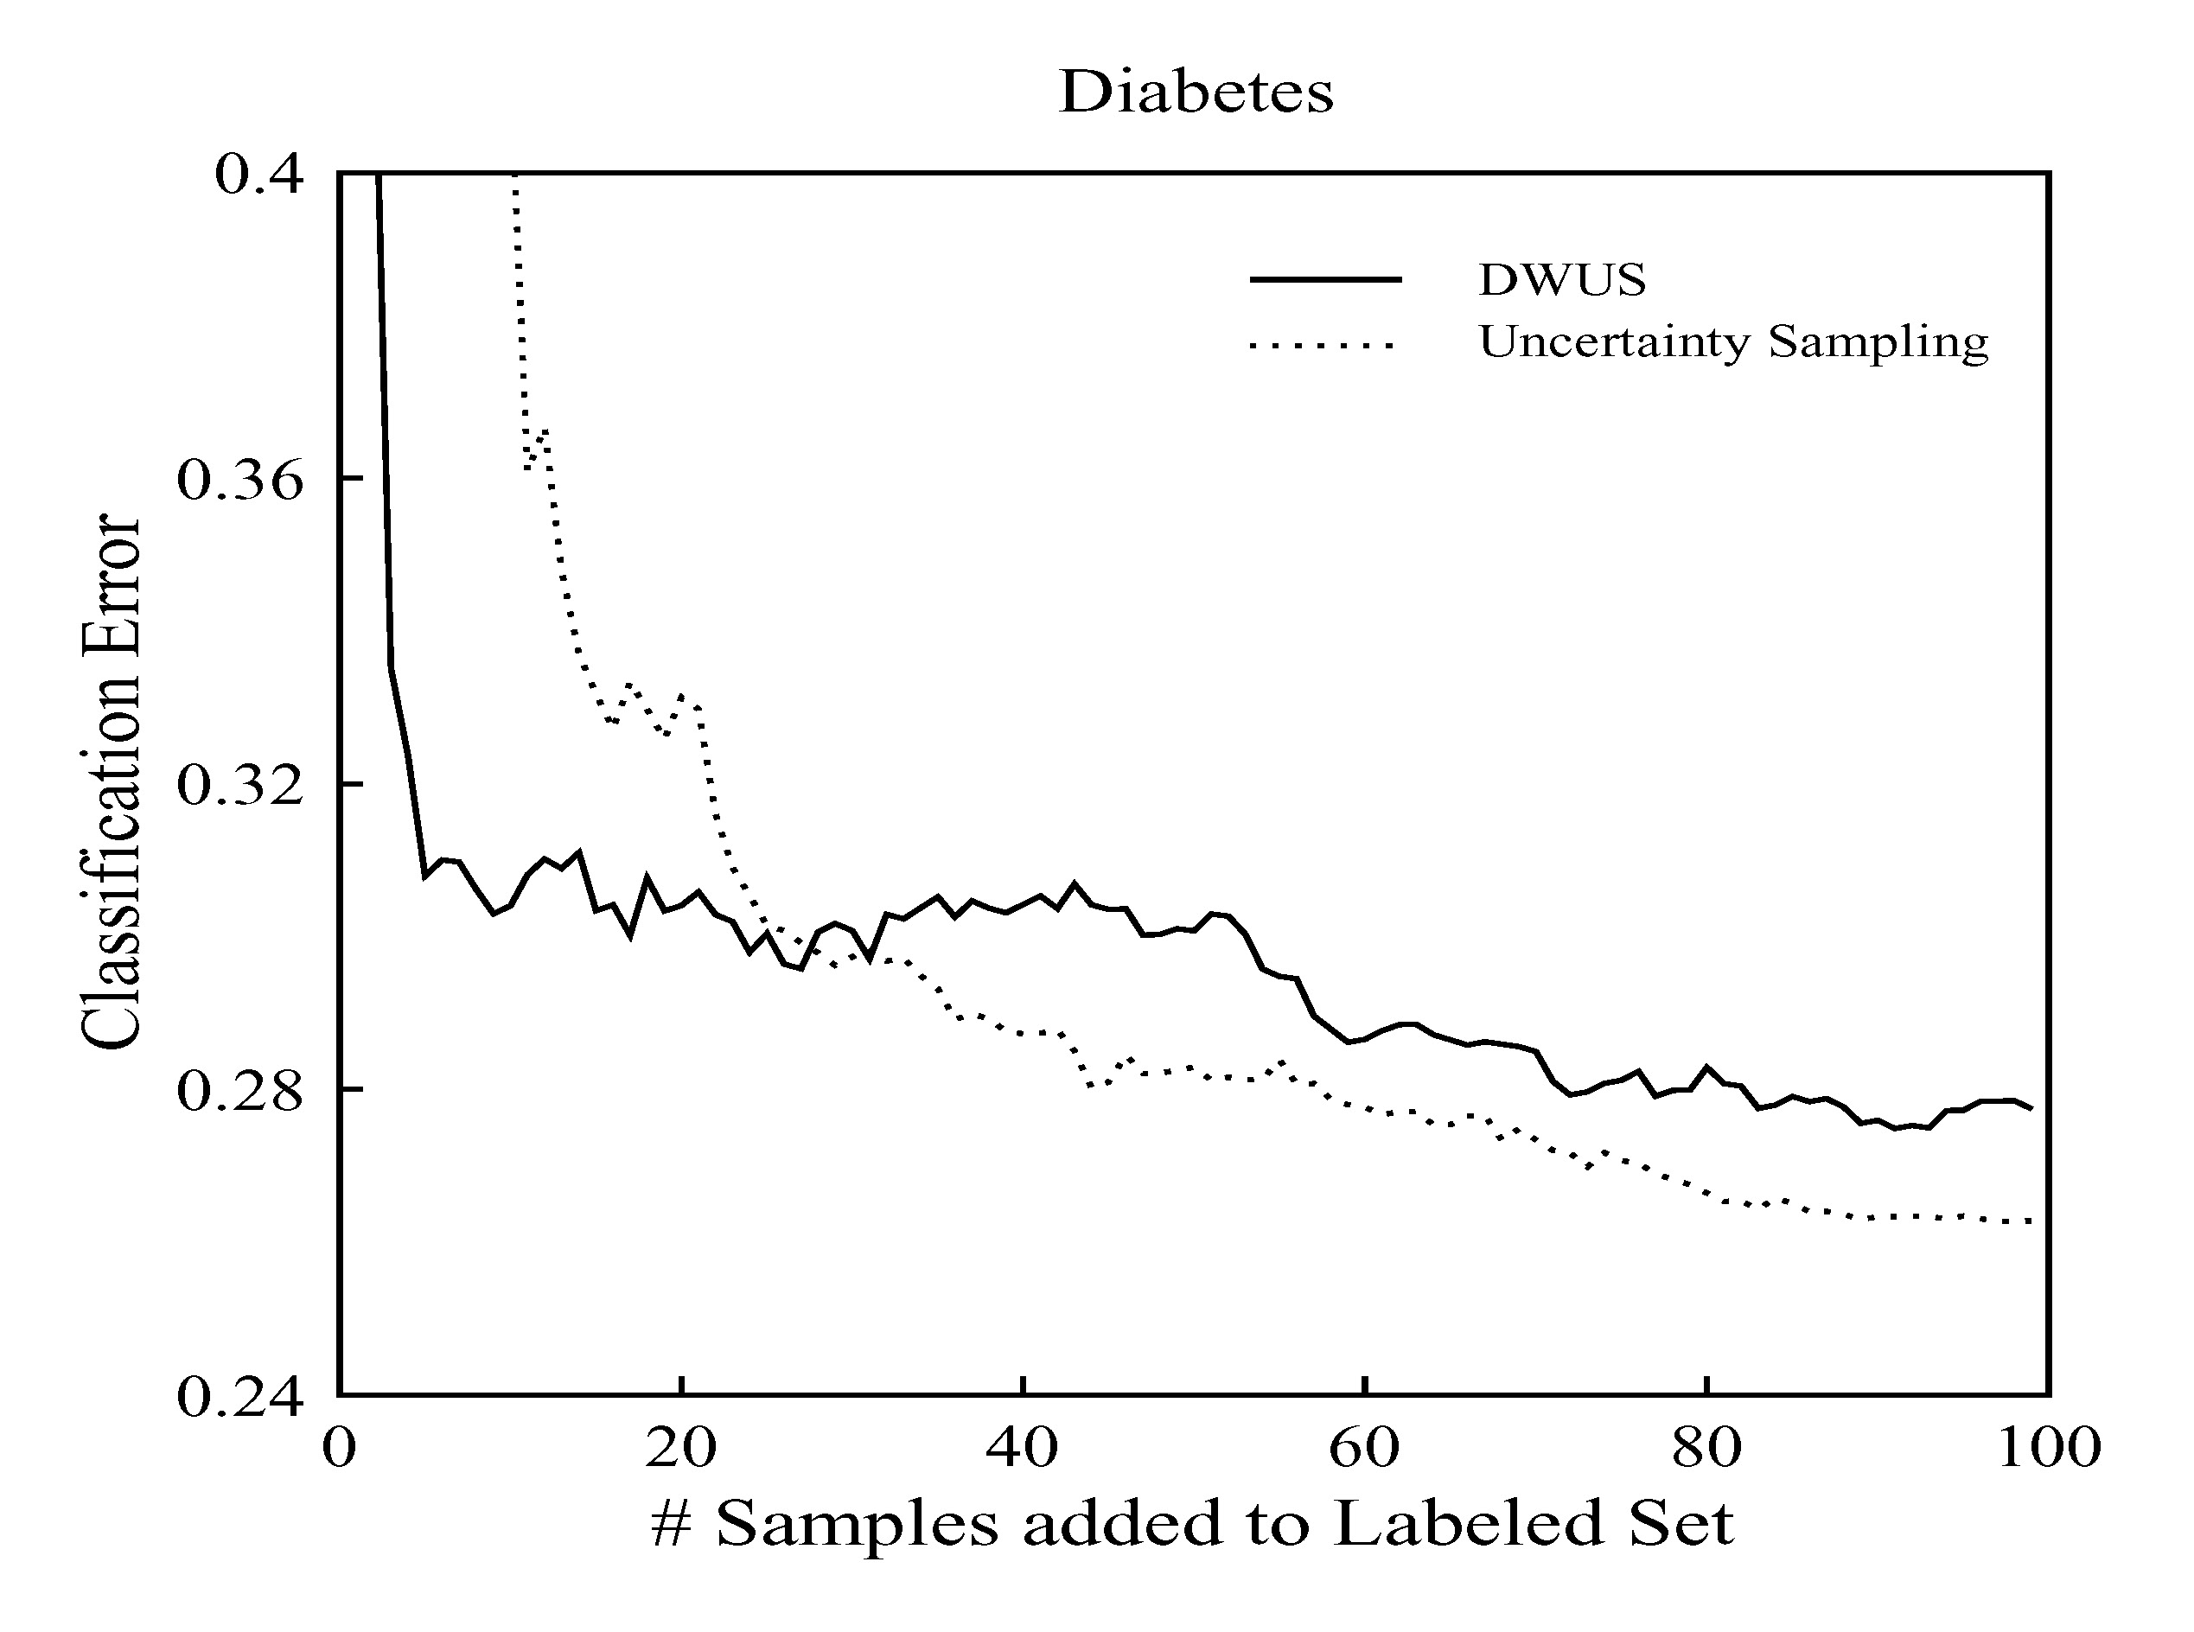
Strategy Selection:
No Universal Optimum
Optimal operating range for AL sampling strategies differs
How to get the best of both worlds?
(Hint: ensemble methods, e.g. DUAL)

Slide 11



How does DUAL do better?
Runs DWUS until it estimates a cross-over
Monitor the change in expected error at each iteration to detect when it is stuck in local minima
DUAL uses a mixture model after the cross-over ( saturation ) point
Our goal should be to minimize the expected future error
  If we knew the future error of Uncertainty Sampling (US) to be zero, then we’d force
  But in practice, we do not know it
Notes:
Given the motivation, we can now talk about DUAL. We said before that DUAL combines the best of both worlds. And here we see how.
DUAL runs DWUS until it estimates that it has stabilized. It does so by estimating when the derivative of the expected error
becomes zero because it tells us the error is not changing anymore
It monitors the change in the expected error at each iteration. and when it becomes close to zero then it switches criteria.
After deciding to switch, its sampling strategy becomes a linear combination of density and uncertainty.
Pi is the weight of the uncertainty score and 1-pi is the weight of the density score. At the end of the day, all we want is to minimize the expected future error.
If we knew that in the future uncertainty sampling will have a zero error, then we’d force pi to be equal to 1 so that we’d sample acc. to uncertainty of each point. Unfortunately, we don’t know the future error.

Slide 12

More on DUAL [ECML 2007]
After cross-over, US does better => uncertainty score should be given more weight
should reflect how well US performs
  can be calculated by the expected error of
US on the unlabeled data* =>
Finally, we have the following selection criterion for DUAL:
* US is allowed to choose data only from among the already sampled instances, and is calculated on the remaining unlabeled set to
Notes:
The catch here is that the weight of uncertainty sampling should reflect how well it performs. We don’t know truly how it performs on the
future data, but we can estimate how it performs on the unlabeled data by calculating the expected error and use it as an indicator of its performance.
So, we arrive at this selection criterion where density and uncertainty is linearly combined and the weight of uncertainty is substituted
by 1 - its expected error.
An important note in this scheme is the following:
We shouldn’t request additional labeled data for US to estimate its expected error over time. Therefore, we restrict US s.t. it can only sample from among the already sampled points
and we calculate the expected error on the remaining unlabeled data. This way, estimating the performance of US introduces no additional cost of labeling

Slide 13
Results: DUAL vs DWUS
Notes:
Even though we conducted tests on 6 datasets, today I show you only four because of the time constraints.
For instance, this figure compares DUAL vs DWUS. We see that DUAL reduces the error to a lower level.

Slide 14
Active Learning Beyond Dual
Paired Sampling with Geodesic Density Estimation
  Donmez & Carbonell, SIAM 2008
Active Rank Learning
  Search results: Donmez & Carbonell, WWW 2008
  In general: Donmez & Carbonell, ICML 2008
Structure Learning
  Inferring 3D protein structure from 1D sequence
  Remains open problem

Slide 15
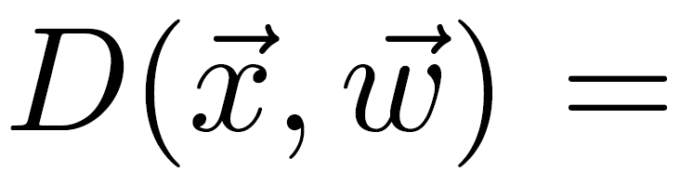
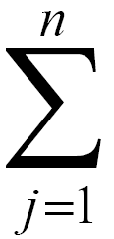
Active Sampling for RankSVM
Consider a candidate
Assume is added to training set with
Total loss on pairs that include is:
n is the # of training instances with a different label than
Objective function to be minimized becomes:
Notes:
We develop two active sampling methods, one for RankSVM and one for RankBoost.
We will start with active sampling for RankSVM.
Consider an unlabeled instance x. And assume it is added into the training set with the label y.
The total hinge loss on the pairs that include x then becomes this formula here. Jy is the # of instances in the training set with a different label than the label of x.
Then, the objective function for RankSVM to minimize can be written as follows where K is the current number of training pairs and we have this extra term here:

Slide 16
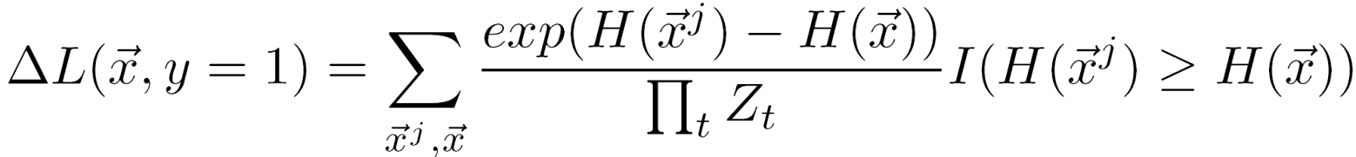

Active Sampling for RankBoost
Difference in the ranking loss between the current and the enlarged set:
indicates how much the current ranker needs to change to compensate for the loss introduced by the new instance
Finally, the instance with the highest loss differential is sampled:
Notes:
Then, the difference in the ranking loss with and without x is this sum.
Please note that we assume the label of x is positive. We will have a similar calculation for the other labels that x can assume.
Again, this function estimates the likelihood of the loss differential.
Finally, we sample the instance with the highest expected loss differential.

Slide 17
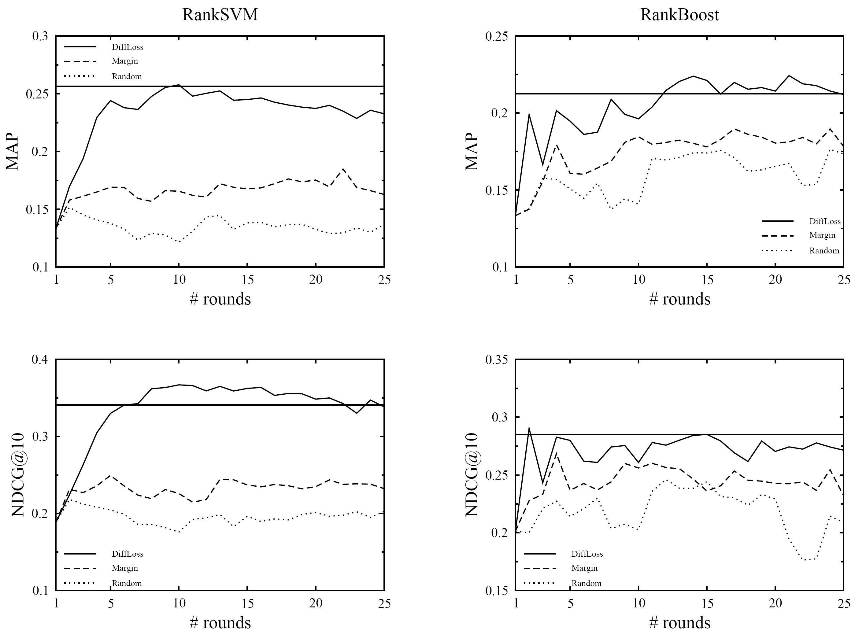
Results on TREC03
Notes:
These are the comparative results on TREC03. In this graph, we plot the results on RankSVM on the left column, and the results
on RankBoost on the right column both in MAP and NDCG.
Our method is the solid line. We compared our method against margin based sampling and random sampling baselines.
The horizontal line indicates the optimal performance in the sense that the performance you could get if you used
the entire training data. Clearly, our method quickly reaches the optimal performance based on both metrics.

Slide 18
Active vs Proactive Learning
 | Active Learning | Proactive Learning
Number of Oracles | Individual (only one) | Multiple, with different capabilities, costs and areas of expertise
Reliability | Infallible (100% right) | Variable across oracles and queries, depending on difficulty, expertise, …
Reluctance | Indefatigable (always answers) | Variable across oracles and queries, depending on workload, certainty, …
Cost per query | Invariant (free or constant) | Variable across oracles and queries, depending on workload, difficulty, …
Note: “Oracle” ∈ {expert, experiment, computation, …}

Slide 19
Reluctance or Unreliability
2 oracles:
  reliable oracle: expensive but always answers with a correct label
  reluctant oracle: cheap but may not respond to some queries
Define a utility score as expected value of information at unit cost
Notes:
Let us start with discussing First scenario. In this scenario, we assume there exist 2 oracles: one is a perfectly reliable oracle which always answers with the correct label
the other is a reluctant oracle that may not respond to all queries. Obviously, the reliable oracle costs more than the reluctant one but both charge uniform fees over instances.
We define utility of instance-oracle pair as the expected value of information to the learner if the label of x is queried from oracle k at unit cost. There are two components
in this formula to be estimated. One is the value of information for labeling the instance, and the second is the probability of actually obtaining the information from the oracle for that
particular instance. Value function can be substituted with your favorite active sampling criterion. We used a density-weighted uncertainty scoring function we developed in one
of our earlier work. I will not go into the details of that since it is not essential for this work here. If you’re interested you can read it in the paper. I’d rather spend time on the discussion for the unreliability of the oracle which is defined in terms of reluctance in this scenario. There are two issues with oracle reluctance. One is how we can simulate it since we do not currently have any benchmark collection that provides us with oracle properties. The second is how we can learn it since we don’t know in advance for what types of queries the oracle becomes reluctant to.

Slide 20
How to estimate ?
Cluster unlabeled data using k-means
Ask the label of each cluster centroid to the reluctant oracle. If
  label received: increase of nearby points
  no label: decrease of nearby points
equals 1 when label received, -1 otherwise
# clusters depend on the clustering budget and oracle fee
Notes:
Now, let us see how we can estimate the oracle reliability. We assume we are not given this information in advance. Hence, we dont know when the oracle becomes reluctant although we know which oracle is perfect and which one is reluctant. The way we estimate it is as follows:
First we cluster the data using k-means. Then, we query the label of each cluster centroid to the reluctant oracle. We assume that the oracle will be unreliable for
similar points. So, we propagate the information we obtain by querying the centroid to nearby points. If we receive a label, then we increase... othwerwise we decrease it
using this formula here. Everything starts with random guess, .5 probability and then if the indicator function h is 1 (meaning that we receive the label of the centroid) then this probability increases proportional to the proximity to the centroid.
The number of clusters depends on the clustering budget allocated for this exploration phase and the cost of the oracle.

Slide 21
Underlying Sampling Strategy
Conditional entropy based sampling, weighted by a density measure
Captures the information content of a close neighborhood
close neighbors of x

Slide 22
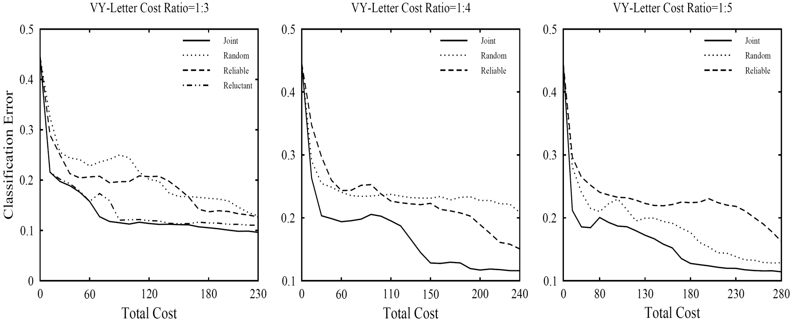
Results: Reluctance

Slide 23
Proactive Learning in General
Multiple Experts (a.k.a. Oracles)
  Different areas of expertise
  Different costs
  Different reliabilities
  Different availability
What question to ask and whom to query?
  Joint optimization of query & oracle selection
  Scalable from 2 to N oracles
  Learn about Oracle capabilities as well as solving the Active Learning problem at hand
  Cope with time-varying oracles

Slide 24
New Steps in Proactive Learning
Large numbers of oracles [Donmez, Carbonell & Schneider, KDD-2009]
  Based on multi-armed bandit approach
Non-stationary oracles [Donmez, Carbonell & Schneider, SDM-2010]
  Expertise changes with time (improve or decay)
  Exploration vs exploitation tradeoff
What if labeled set is empty for some classes?
  Minority class discovery (unsupervised) [He & Carbonell, NIPS 2007, SIAM 2008, SDM 2009]
  After first instance discovery → proactive learning, or → minority-class characterization [He & Carbonell, SIAM 2010]
Learning Differential Expertise → Referral Networks

Slide 25
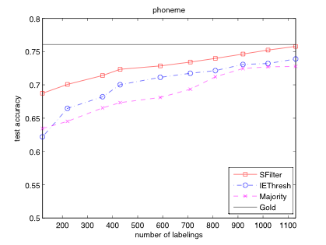
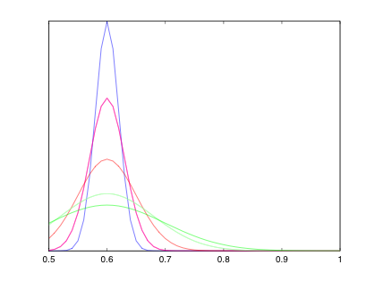
What if Oracle Reliability “Drifts”?
Resample Oracles if Prob(correct )> θ
t=1
Drift ~ N(µ,f(t))
t=10
t=25
Notes:
One of the advantages of using this framework is that we can predict the true label at any time t by using the estimated expected accuracy of each source selected at time t and the noisy labels they omit. And train a logistic regression classifier on the data labeled by each method and tested the classifier on a held-out test set. The y-axis shows the test accuracy and the x-axis shows the number of source queries issued. We compared our method against two baselines that uses majority voting to predict the true label. The purple line uses all sources and take their majority vote and the blue line is our IE method that selects a subset of sources and use only their majority vote. None of these techniques take the time-varying accuracy into account. The horizontal black line is the performance of a classifier trained on the true labels. Clearly, we get close to the gold standard level and significantly outperform the baselines. That means we can produce clean and reliable datasets even when we do not know what the true labels are.

Slide 26
Discovering New Minority Classes via Active Sampling
Method
  Density differential
  Majority class smoothness
  Minority class compactness
  No linear separability
  Topological sampling
Applications
  Detect new fraud patterns
  New disease emergence
  New topics in news
  New threats in surveillence

Slide 27
Minority Classes vs Outliers
Outliers
  A single point
  Scattered
  Separable
Rare classes
  A group of points
  Clustered
  Non-separable from the majority classes

Slide 28
GRADE: Full Prior Information
1. For each rare class c,
2. Calculate class-specific similarity
3. , ,
Relevance
Feedback
Increase t by 1
4.
5. Query
No
6. class c?
Yes
7. Output

Slide 29
Summary of Real Data Sets
Data Set | n | d | m | Largest Class | Smallest Class
Ecoli | 336 | 7 | 6 | 42.56% | 2.68%
Glass | 214 | 9 | 6 | 35.51% | 4.21%
Page Blocks | 5473 | 10 | 5 | 89.77% | 0.51%
Abalone | 4177 | 7 | 20 | 16.50% | 0.34%
Shuttle | 4515 | 9 | 7 | 75.53% | 0.13%
Moderately Skewed
Extremely Skewed

Slide 30
Results on Real Data Sets
Ecoli
Glass
MALICE
MALICE
Abalone
Shuttle
MALICE
MALICE

Slide 31
Application Areas: A Whirlwind Tour
Machine Translation
  Focus on low-resource languages
  Elicit: translations, alignments, morphology, …
Computational Biology
  Mapping the interactome (protein-protein)
  Host-pathogen interactome (e.g. HIV-human)
Wind Energy
  Optimization of turbine farms & grid
  Proactive sensor net (type, placement, duration)
Several More (no time in this talk)
  HIV-patient treatment, Astronomy, …

Slide 32
Low Density Languages
6,900 languages in 2000 – Ethnologue www.ethnologue.com/ethno_docs/distribution.asp?by=area
77 (1.2%) have over 10M speakers
  1st is Chinese, 5th is Bengali, 11th is Javanese
3,000 have over 10,000 speakers each
3,000 may survive past 2100
5X to 10X number of dialects
# of L’s in some interesting countries:
  Afghanistan: 52, Pakistan: 77, India 400
  North Korea: 1, Indonesia 700

Slide 33

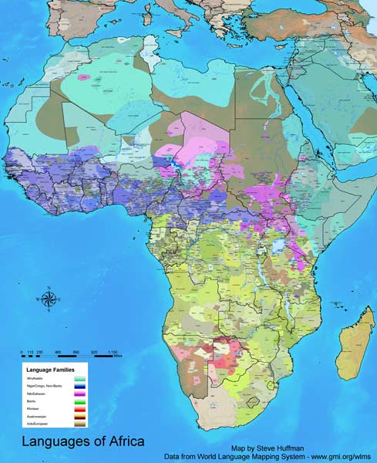
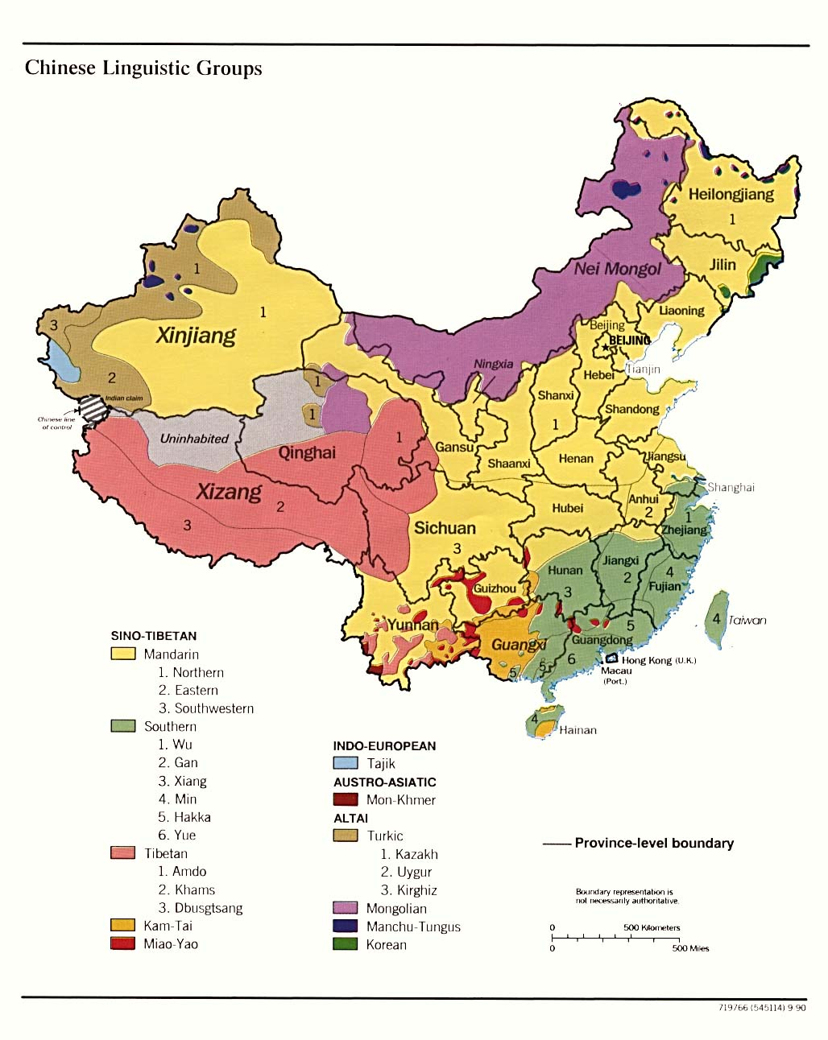
Some Linguistics Maps

Slide 34

Active Learning for MT
Expert
Translator
Parallel corpus
S,T
Trainer
S
Monolingual source corpus
Model
MT System
Source
Language
Corpus
Active
Learner

Slide 35


Active Crowd Translation
S,T₁
S,T₂
Trainer
.
.
.
Translation
Selection
S,T_{n}
Model
S
Sentence
Selection
MT System
Source
Language
Corpus
ACT
Framework

Slide 36
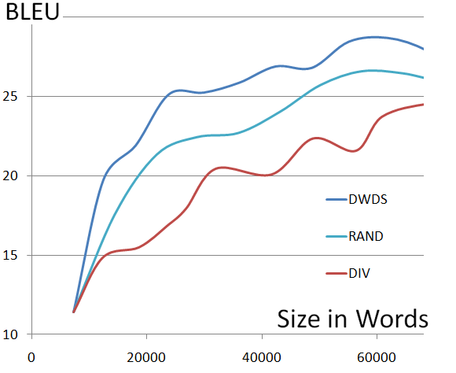
Active Learning Strategy:
Diminishing Density Weighted Diversity Sampling
Experiments:
Language Pair: Spanish-English
Batch Size: 1000 sentences each
Translation: Moses Phrase SMT
Development Set: 343 sens
Test Set: 506 sens
Graph:
X: Performance (BLEU )
Y: Data (Thousand words)

Slide 37
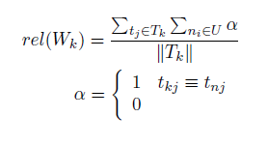
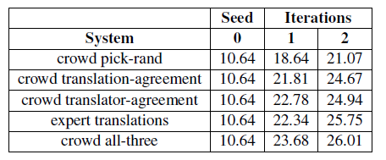
Translation Selection from Mechanical Turk
Translator Reliability
Translation Selection:

Slide 38
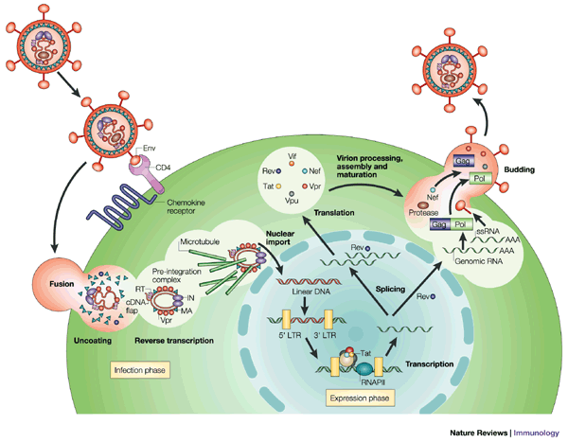
Virus life cycle
1. Attachment
5. Release
4. Assembly
2. Entry
3. Replication
Peterlin and Trono Nature Rev. Immu. 3. (2003)
  Host machinery is essential in the viral life cycle.

Slide 39
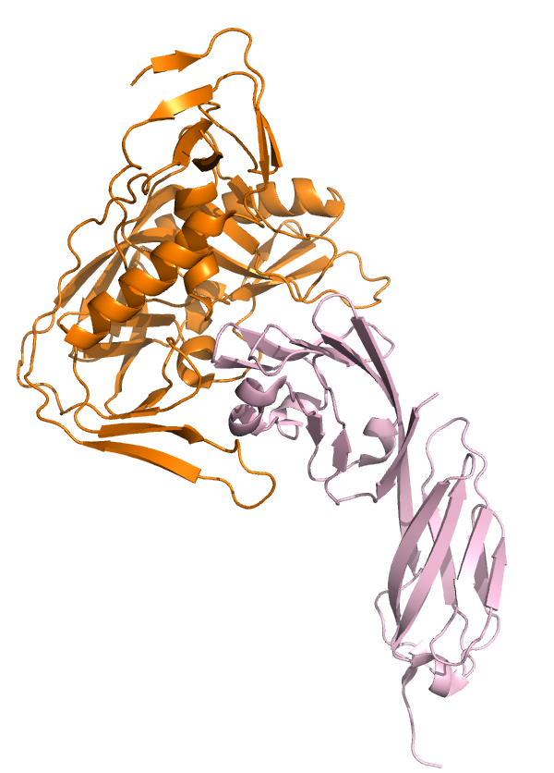
Viral communication is through PPIs
Example: HIV-1 viral protein gp120 binds to human
cell surface receptor CD4
In every step of the viral replication
host-viral PPIs are present.
Peterlin and Trono Nature Rev. Immu. 3. (2003)

Slide 40
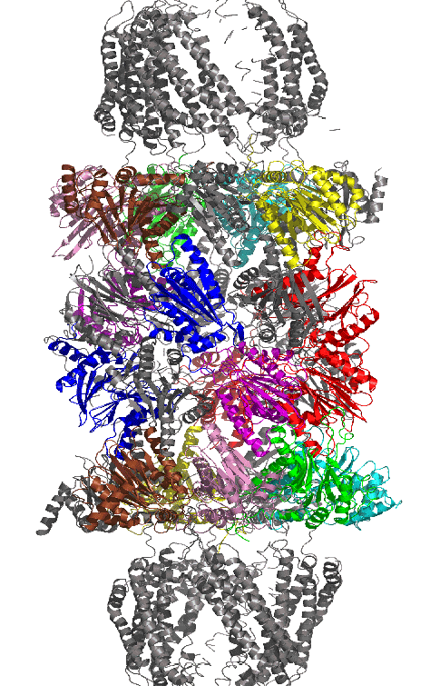
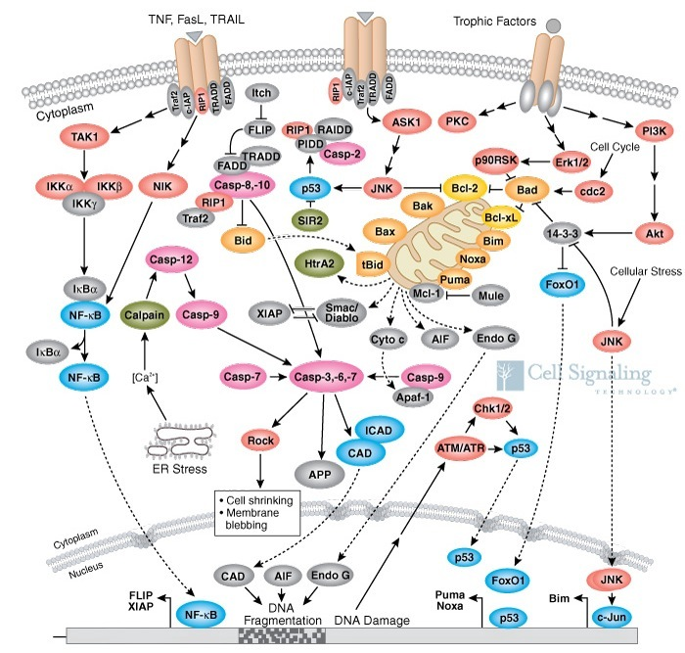
The cell machinery is run by the proteins
  Enzymatic activities, replication, translation, transport, signaling, structural
Proteins interact with each other to perform these functions
Through physical contact
Indirectly
in a protein complex
Indirectly in pathway
http://www.cellsignal.com/reference/pathway/Apoptosis_Overview.html
Notes:
Considering the possible diverse background of audience today,
I would give a simple introduction of related biological knowledge
In the following several slides. For those of you who knows all this
very well, please forgive the simplicity.
To get a better understanding why we want to study protein interactions,
I made an analogy from protein to human beings …
Proteins live in the Cell. Cell is simplest living units of every organism …
it is the basic units of every life.
(The structural and functional unit of all known living organisms)
Proteins are the main actors that participate in every
functions in the cell…
which is just like our human society …. City is the basic unit …
And human beings are the main actors

Slide 41
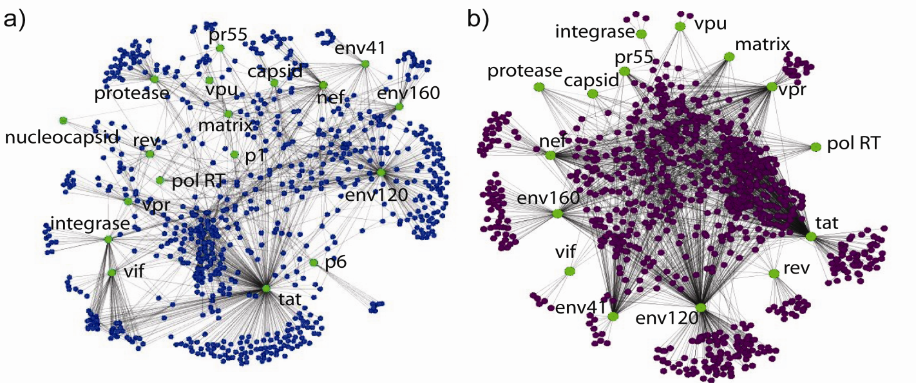
Interactions reported in NIAID
“Nef binds hemopoietic cell kinase isoform p61HCK”
Group 1: more likely direct
Group 2: could be indirect
Keywords: binds, cleaves, interacts with, methylated by, myristoylated by etc …
1063 interactions
  721 human proteins
  17 HIV-1 proteins
Keywords: activates, associates with, causes accumulation of etc …
1454 interactions
  914 human proteins
  16 HIV-1 proteins
http://www.ncbi.nlm.nih.gov/RefSeq/HIVInteractions/
HIV-1 protein
Human protein

Slide 42
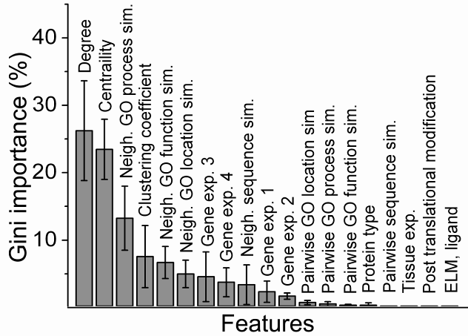
Feature Importance
Active Selection of Instances and Reliable Labelers
Sources of Labels
Literature
Lab Experiments
Human Experts

Slide 43

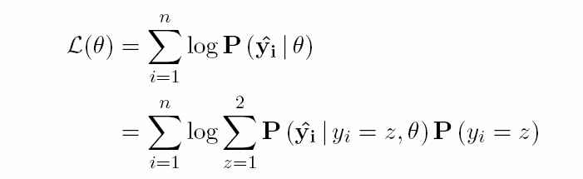
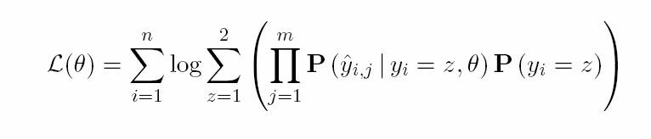
Estimating expert labeling accuracies
Solve this
through expectation maximization
Assuming experts are conditionally independent given true label

Slide 44
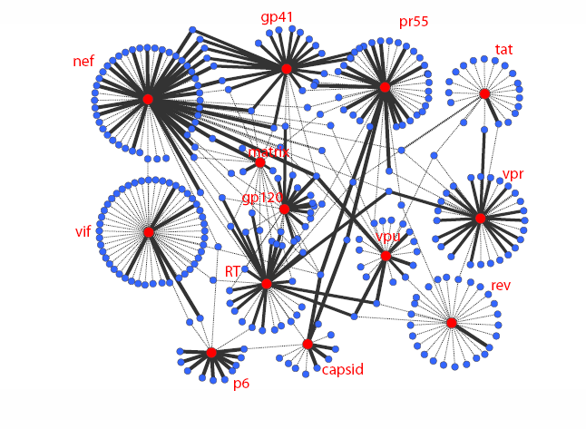
Refined interactome
Solid line: probability of being a direct interaction is ≥0.5
Dashed line: probability of being a direct interaction is <0.5
Edge thickness indicates confidence in the interaction

Slide 45

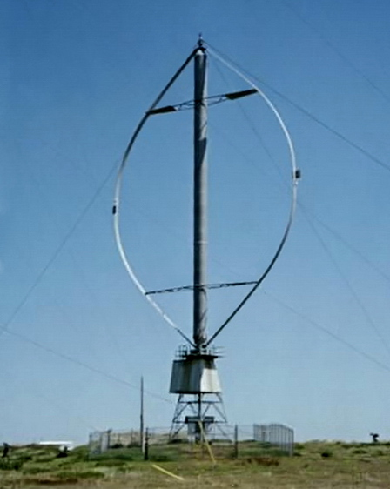
Wind Turbines (that work)
HAWT: Horizontal Axis
VAWT: Vertical Axis

Slide 46

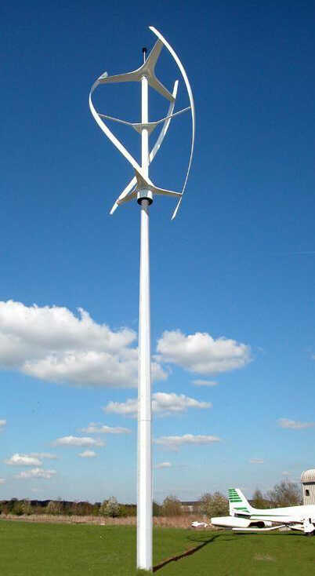
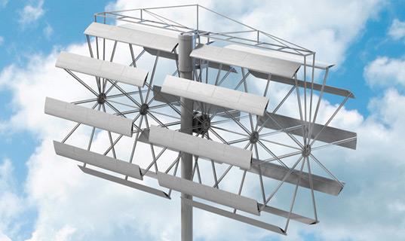

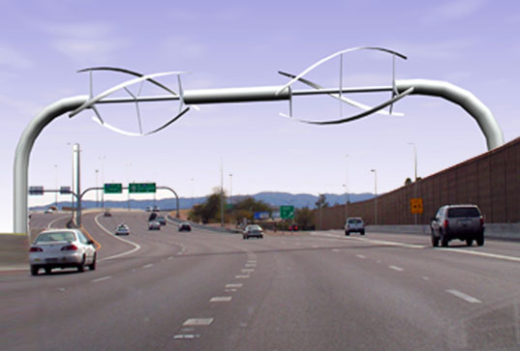
Wind Turbines (flights of fancy)

Slide 47

Wind Power Factoids
Potential: 10X to 40X total US electrical power
  1% in 2008 → 2% in 2011
Cost of wind: $.03 – $.05/kWh
  Cost of coal $.02 – $.03 (other fossils are more)
  Cost of solar $.15 – .25/kWh
    “may reach $.10 by 2011” Photon Consulting
State with largest existing wind generation
  Texas (7.9 MW) – Greatest capacity: Dakotas
Wind farm construction is semi recession proof
  Duke Energy to build wind farm in Wyoming – Reuters Sept 1, 2009
  Government accelerating R&D, keeping tax credits
Grid requires upgrade to support scalable wind

Slide 48
Top Wind Power Producers in TWh for 2008
Country | Wind TWh | Total TWh | % Wind
Germany | 40 | 585 | 7%
USA | 35 | 4,180 | < 1%
Spain | 29 | 304 | 10%
India | 15 | 727 | 2%
Denmark | 9 | 45 | 20%

Slide 49
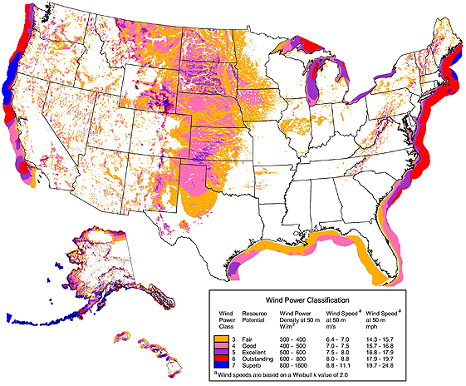
Sustained Wind-Energy Density
From: National Renewable Energy Laboratory, public domain, 2009

Slide 50
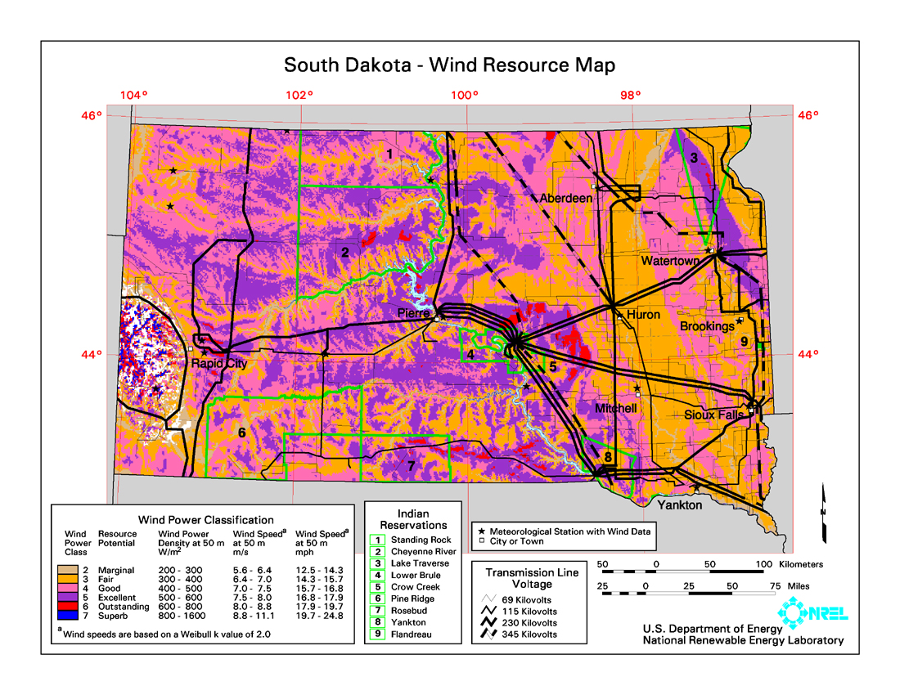

Slide 51
Power Calculation
Wind kinetic energy:
Wind power:
Electrical power:
  C_{b} ≈ .35 (<.593 “Betz limit”)
    Max value of
  N_{g} ≈ .75 generator efficiency
  N_{t} ≈ .95 transmission efficiency

Slide 52
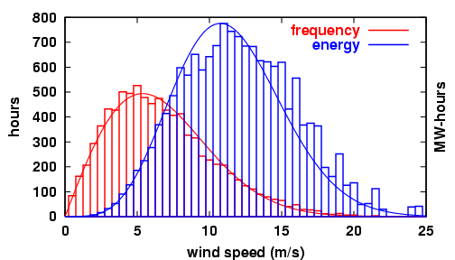
Wind v & E match Weibull Dist.
Weibull Distribution:
Red = Weibull distribution of wind speed over time
Blue = Wind energy (P = dE/dt)
Data from Lee Ranch, Colorado wind farm

Slide 53
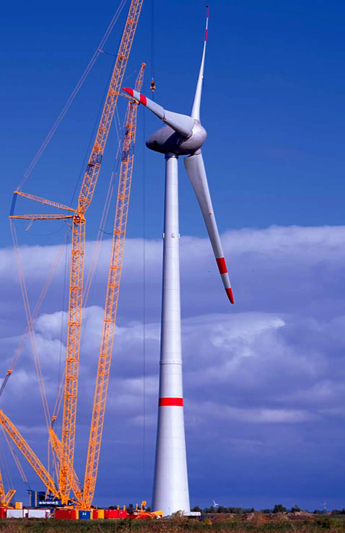
Optimization Opportunities
Site selection
  Altitude, wind strength, constancy, grid access, …
Turbine selection
  Design (HAWTs vs VAWTs), vendor, size, quantity,
  Turbine Height: “7th root law”
    Greater precision for local conditions
Local topography (hills, ridges, …)
  Turbulence caused by other turbines
  Prevailing wind strengths, direction, variance
  Ground stability (support massive turbines)
Grid upgrades: extensions, surge capacity, …
Non-power constraints/preferences
  Environmental (birds, aesthetics, power lines, …)
  Cause radar clutter (e.g. near airports, air bases)
World’s Largest Wind Turbine (7+Megawatts, 400+ feet tall)

Slide 54
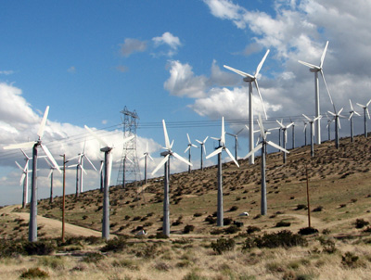
Oops...
What’s wrong with this picture?
Proximity of turbines
Orientation w.r.t. prevaling winds
Ignoring local topography
…
Near Palm Springs, CA

Slide 55
Economic Optimization
$1M-3M/MW capacity
$3M-20M/turbine
Questions
  Economy of scale?
  NPV & longevity?
  Interest rate?
  Operational costs?
Price of Electricity
8% improvement in 25B invested = $2B
Price of storage & upgrade of grid transmission

Slide 56
Penultimate Optimization Challenge
Objective Function f
  Construction: cost, time, risk, capacity, …
  Grid: access & upgrade cost,
  Operation: cost/year, longevity,
  Risks: price/year of electricity, demand, reliability, …
Constraints c_{i}
  Grid: Ave & surge capacity, max power storage, …
  Physical: area, height, topography, atmospherics, …
  Financial: capital raising, timing, NPV discounts, …
  Regulatory: environmental, permits, safety, …
  Supply chain: availability & timing of turbines, …

Slide 57
Optimization Methods
Gradient Descent
  For differentiable convex functions
  Many variants: coordinate descent, Nesterov’s, …
  Conjugate gradient
Generalized Newton
Other: Ellipsoid, Cutting Plane, Dual Interior Point, …
Convex → Non-Convex?
  Approximations: submodularity, multiple restart, …
  “Holistic” methods: simulated annealing with jumps
Additional Challenge
  Predictions of wind-speed with limited labeld data

Slide 58
Energy Storage
Compressed-air storage
  Potentially viable
  Efficiency ~50%
Pumped hydroelectric
  Cheap & scalable
  Efficiency < 50%
Advanced battery
  Requires more R&D
Flywheel arrays (unviable)
Superconducting capacitors
  Requires more R&D, explosive discharge danger

Slide 59
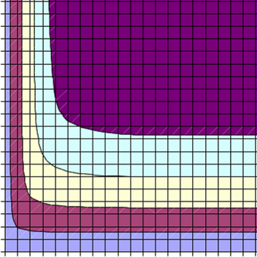
Compressed-Air Storage System
Wind resource:
k = 3, v_{avg} = 9.6 m/s,
P_{wind} = 550 W/m² (Class 5)
h_{A} = 5 hrs.
1.5
Slope ~ 1.7
1
CF = 81%
0.5
CF = 76%
P_{C} = 0.85 P_{T}
(1700 MW)
P_{G} = 0.50 P_{T}
(1000 MW)
CF = 72%
CF = 68%
0
0.5
1
1.5
Comp
Gen
h_{S} = 10 hrs.
(at P_{C})
Wind farm:
P_{WF} = 2 P_{T} (4000 MW)
Spacing = 50 D²
v_{rated} = 1.4 v_{avg}
E_{o}/E_{i} = 1.30
Underground storage
Transmission:
P_{T} = 2000 MW

Slide 60
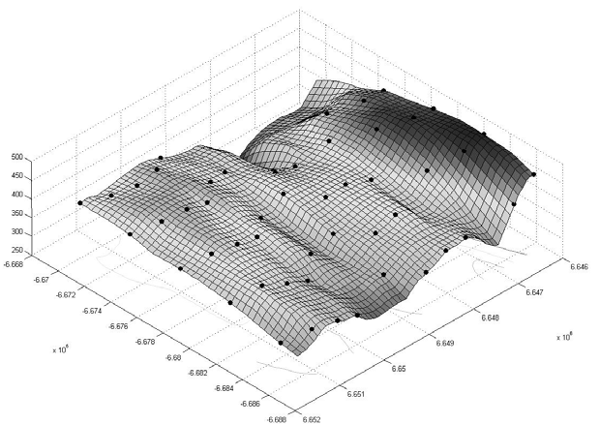
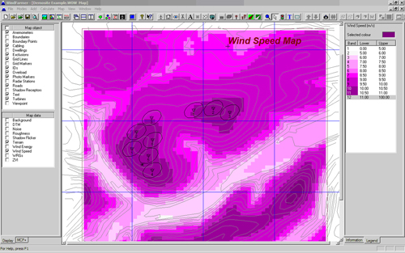
Optimization To Date
Turbine blade design
  Huge literature
Generators
  Already near optimal
Wind farm layout
  Mostly offshore
  Integer programming
Topography
Multi-site
+ Transmission
+ Storage
new challenge

Slide 61
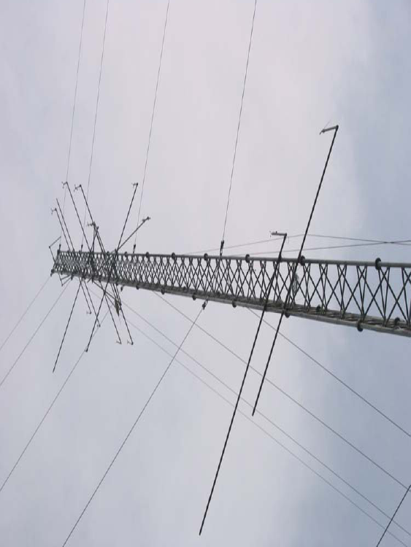
Proactive Learning: Wind Sampling
Predict: Prevalent Direction, Speed, seasonality
Measurement towers: Expensive

Slide 62

Proactive Learning in Wind
Cannot optimize w/o knowing wind-speed map
  Different locations, altitudes, seasons, …
Cost vs reliability (ground vs. tower sensors)
  Sensor type, placement, duration, reliability
  Analytic models reduce sensor net density
Prediction precedes optimization
  Rough for site location, precise for turbine lcation
San Goronio Pass, CA

Slide 63
Wind References
Schmidt, Michael, “The Economic Optimization of Wind Turbine Design” MS Thesis, Georgia Tech, Mech E. Nov, 2007.
Donovan, S. “Wind Farm Optimization” University of Auckland Report, 2005.
Elikinton, C. N. “Offshore Wind Farm Layout Optimization”, PhD Dissertation, UMass, 2007.
Lackner MA, Elkinton CN. An Analytical Framework for Offshore Wind Farm Layout Optimization. Wind Engineering 2007; 31: 17-31.
Elkinton CN, Manwell JF, McGowan JG. Optimization Algorithms for Offshore Wind Farm Micrositing, Proc. WINDPOWER 2007 Conference and Exhibition, American Wind Energy Association, Los Angeles, CA, 2007.
Zaaijer, M.B. et al, “Optimization Through Conceptial Varation of a Baseline Wind Farm”, Delft University of Technology Report, 2004.
First Wind Energy Optimization Summit, Hamburg, Feb 2009.

Slide 64

THANK YOU!

