Slide 1
Lecture 10: Toolkits: Intrinsics, Callbacks, Resources, Widget hierarchies, Geometry management
Brad Myers
05-830 Advanced User Interface Software

Slide 2
Widgets as objects
Menus, buttons, scrollbars
Refresh themselves and handle input, redraw if change
In Unix: Motif and Tk each widget is at least one window
Since windows already have mechanisms for mouse enter/leave, etc.
But high overhead
In most other toolkits, widgets are not windows
Decorative lines, labels and boxes also are "widgets“

Slide 3
Intrinsics
How the widgets are implemented
Motif -- "fake" object system out of C (same in Andrew)
Tk -- Tcl language, and descendents
Amulet -- Prototype-instance object system, constraints, Opal graphics model, Interactors input model, command objects
Java (for swing): graphics2d & awt input events

Slide 4
“Resources”
Starting from original Macintosh as “resource fork” – for language independence (& better memory management)
Every parameter of widgets in Motif
Passed as a parameter to the create routine, set afterwards, or read from a configuration file
Called "options" by Tk
Each resource has a default value defined by the class
In an X file = appl.widget1.resource: value appl.widget1.widget2.resource: value *.resource: value

Slide 5
Callbacks
In Motif, associate C procedures with widgets
Many different callbacks for the same widget
create, start, abort, finish, destroy, ...
Registered (set) at widget creation time, invoked at run time
Are "resources"
There are also "actions" which are internal to the widget and called by events.
In VB, “event handlers”
Button: click, focus-in/out, change, etc.
In tk, associate tcl script with "events" in widgets
or the widget action if it has one
In Amulet, invoke Command Objects on "interactors" or widget finish, and call-back is the DO method.

Slide 6
Widget Hierarchies
Inheritance to give the right methods to widgets
Functions down the parent or class hierarchy
Java swing hierarchy:
http://docs.oracle.com/javase/7/docs/api/index.html?javax/swing/package-tree.html
Thousands of interfaces, classes, subclasses, etc.
Separate hierarchies for internal look-and-feel classes
Visible when debugging

Slide 7
Geometry Management
Widgets don't set their own location.
Widgets put into special group objects called "geometry managers" that perform the layout by setting the component's positions and size
Each widget negotiates with parent for more room when resize

Slide 8
History: TeX layout model
Typesetting system designed and mostly written by Donald Knuth starting in 1977
Boxes (of type) connected by “glue”
\vspace also between characters, etc.
Can control the “stretchiness” of the glue

Slide 9
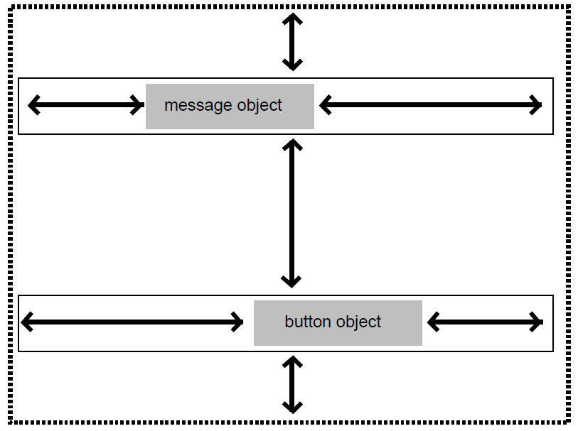
History: Interviews layout model
“Interviews” – one of the first C++ toolkits
Linton, M.A., Vlissides, J.M., and Calder, P.R., “Composing user interfaces with InterViews.” IEEE Computer, Feb, 1989. 22(2): pp. 8-22.
Adopted the TeX boxes and glue metaphor
hbox tiles its components horizontally
hglue
vbox tiles them vertically
Vglue
Controls have a “natural” size
Different glues and controls have different stretchiness

Slide 10
Motif Geometry Management
Motif
RowColumn - add widgets and it lays them out
Treats all children the same, so not for ScrollBars
(picture)
Form - generic constrained layout
Put extra resources on the children widgets
"For details, see the Motif Reference Manual, because the complete behavior of Form is quite complicated."
Each edge can be constrained
at a position or offset from an edge of the Form
at an offset from an edge of another widget
percent of the way across the Form (edge, not center)
a percent calculated based on the initial position
If wrong, widgets are on top of each other

Slide 11
TK Geometry Management
All widgets must be in a geometry manager, or else not displayed
Any widget with any geometry manager
Layout depends on
widget specified sizes
programmer specifications,
size of geometry manager itself
Widgets must adjust themselves to the size given
Geometry manager requests size recursively

Slide 12
TK Geometry, Cont.
Placer - specific location for each widget
Each widget treated independently
Place "anchor" in absolute coords or as a % of way across
then say which part of object is at the anchor
n, ne, e, se, ... center
Packer - "constraint based"
specify position of each widget in available space
side left, right, top, bottom
fill x, -fill y stretch widget to fill available space
Text
Canvas - mix graphics and widgets

Slide 13
Amulet geometry management
Group can have the Am_LAYOUT slot set with a constraint that depends on other slots
Sets positions of parts by side effect
Default layout routines: Horizontal and Vertical layout, for lists or tables.
Rest done by arbitrary constraints

Slide 14
Java Widget Layout
“Using Layout Managers”
BorderLayout – layout around the edges, center gets extra space
BoxLayout – vertical or horizontal columns
CardLayout – overlapping JPanels
FlowLayout – fills row, then goes to next row
GridBagLayout – “one of the most flexible — and complex — layout managers the Java platform provides…. uses a grid of rows and columns, allowing specified components to span multiple rows or columns.”
GridLayout -- components in a grid of cells. Resizes children to fill cell
GroupLayout – new, designed for use by IBs
SpringLayout -- also new for IBs, constraints for layouts

Slide 15
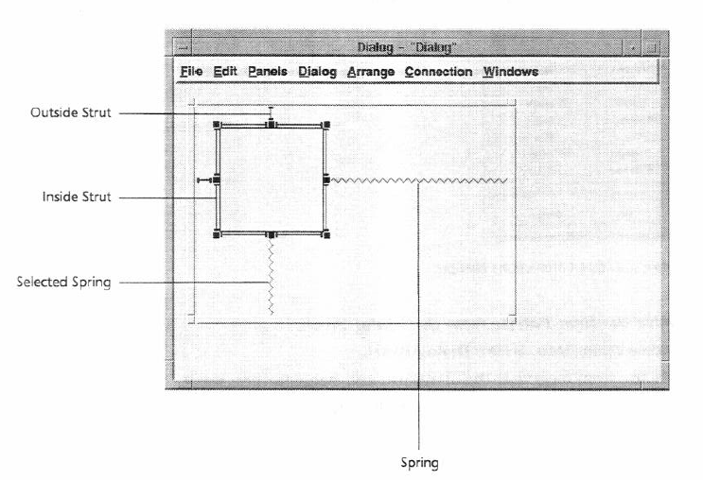
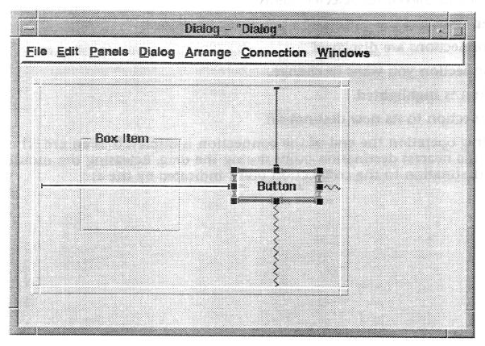
“Struts and Springs” layout
For stretchy or rigid constraints
Graphical interface layouts
NeXTStep (1989), MacOS & Galaxy (~1992)
Notes:
Also : http://doi.acm.org/10.1145/98188.98201
Interactive specification of flexible user interface displays
Scott E. Hudson & Shamim P. Mohamed

