Slide 1
Lecture 8:
Evaluation Using
Heuristic Analysis
Brad Myers
05-863 / 08-763 / 46-863: Introduction to
Human Computer Interaction for
Technology Executives
Fall, 2012, Mini 2

Slide 2
Homework 5
Evaluation using Heuristic Analysis
We are giving your homework to two other classmates, hopefully by tomorrow (Tuesday)
Assignments will be emailed
List will be available on Blackboard
Homework 5 must be turned in on time!

Slide 3
Heuristic Evaluation Method
Expert evaluates the user interface using guidelines
Usability “inspection” method
  Depends on evaluator’s judgement
Is a “discount” usability engineering method
  One case study found factor of 48 in cost/benefit:
    Cost of inspection: $10,500. Benefit: $500,000 (Nielsen, 1994)

Slide 4
How to do Heuristic Evaluation
Systematic inspection of system
Multiple evaluators are better
Trained evaluators are better
  22% vs. 41% vs. 60% of errors found
Go through whole interface
Result: list of problems, guidelines violated, and proposed fixes

Slide 5
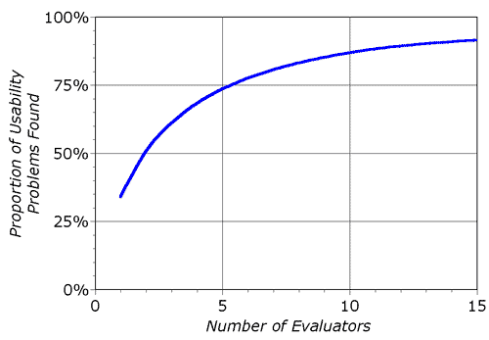
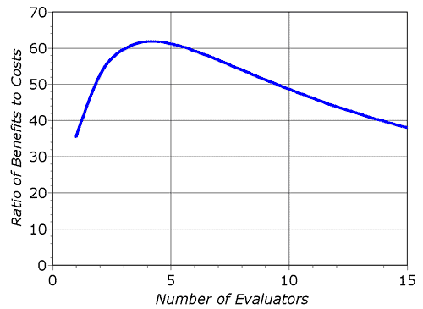
How Many Evaluators?
Nielsen suggests optimal might be 4

Slide 6
HE Methodology
Reference: Neilsen’s “How to Conduct a Heuristic Evaluation”:
http://www.useit.com/papers/heuristic/heuristic_evaluation.html
  Each evaluator inspects interface separately
  OK for designer to answer evaluator’s questions
  Go through interface several times using heuristics
  Can supply evaluators with scenarios of user tasks

Slide 7
Guidelines Guide Design
Knowing these guidelines should improve your designs
Take them into account to avoid violating them
Also, all the other guidelines
  E.g., in Chapter 22
Neilsen evaluated 60 old guidelines (in 2005) and found 90% still valid after 20 years
  Others no longer relevant, only 2 were “wrong”
  http://www.useit.com/alertbox/20050117.html

Slide 8
10 Basic Principles
From Nielsen’s web page: http://www.useit.com/papers/heuristic/heuristic_list.html
Visibility of system status
Match between system and the real world
User control and freedom
Consistency and standards
Error prevention
Recognition rather than recall
Flexibility and efficiency of use
Aesthetic and minimalist design
Help users recognize, diagnose, and recover from errors
Help and Documentation
Also listed in Hartson & Pyla textbook, section 13.4

Slide 9
202 More Guidelines (Chapter 22)
These are primarily intended to guide you to a good design, not to be used for evaluation
Help users plan goals, tasks
Provide a clear model of how users view system in terms of tasks
Help users with system model, metaphors, work context
Design to match user’s conception of high-level task organization
Help users understand what system features exist and how they can be used in their work context
Help users decompose tasks logically
Make clear all possibilities for what users can do at every point
Keep users aware of system state for planning next task
Keep the task context visible to minimize memory load
Help users plan the most efficient ways to complete their tasks
Keep users aware of task progress, what’s been done and what’s left to do
Provide cognitive affordances at the end of critical tasks to remind users to complete the transaction
Provide effective cognitive affordances that help users get access to system functionality
Help users know/learn what actions are needed to carry out intentions
Paraphrased from Chapter 22 of Hartson & Pyla, text

Slide 10
Guidelines, cont.
Help users know how to do something at action/object level
Help users predict outcome of actions
Help users determine what to do to get started
Provide a cognitive affordance for a step the user might forget
Support user with effective sensory affordances in presentation of cognitive affordances
Make cognitive affordances visible
Make cognitive affordances noticeable
Make text legible, readable
Control cognitive affordance presentation complexity with effective layout, organization, and grouping
Present cognitive affordance in time for it to help the user before the associated action
Help user determine actions with effective content/meaning in cognitive affordances
Design cognitive affordances for clarity
Use precise wording in labels, menu titles, menu choices, icons, data fields
Use a verb and noun and even an adjective in labels where appropriate.
Avoid vague, ambiguous terms.

Slide 11
Guidelines, cont.
Be as specific to the interaction situation as possible
Clearly represent work domain concepts
Use dynamically changing labels when toggling
Provide cognitive affordances to indicate formatting within data fields
Constrain the formats of data values to avoid data entry errors
Provide clearly marked exits
Provide clear “do it” mechanism
Be predictable; help users predict outcome of actions with feed-forward information in cognitive affordances
Make choices distinguishable
Be consistent with cognitive affordances
Use consistent wording in labels for menus, buttons, icons, fields
Use similar names for similar kinds of things
Do not use multiple synonyms for the same thing
Use the same term in a reference to an object as the name or label of the object
Use different terms for different things, especially when the difference is subtle

Slide 12
Guidelines, cont.
Be consistent in the way that similar choices or parameter settings are made
Decompose complex instructions into simpler parts
Use appropriate layout and grouping by function to convey content and meaning
Group together objects and design elements associated with related tasks and functions
Do not group together objects and design elements that are not associated with related tasks and functions
Support user choices with likely and useful defaults
Provide the most likely or most useful default selections
Offer most useful default cursor position
Relieve human short term memory loads by maintaining task context visibly or audibly for the user
Support human memory limits with recognition over recall
Avoid requirement to retype or copy from one place to another
Support special human memory needs in audio interaction design
Avoid cognitive indirectness
Be complete in your design of cognitive affordances; include enough information for users to determine correct action

Slide 13
Guidelines, cont.
Prevent loss of productivity due to hesitation, pondering
Use enough words for unambiguous labels
Add supplementary information, if necessary
Give enough information for users to make confident decisions
Give enough alternatives for user needs
Employ usage-centered wording, the language of the user and the work context, in cognitive affordances
Find ways to anticipate and avoid user errors in your design
Help users avoid inappropriate and erroneous choices
Disable buttons, menu choices to make inappropriate choices unavailable
Gray out to make inappropriate choices appear unavailable
But help users understand why a choice is unavailable
Provide a clear way to undo and reverse actions
Offer constructive help for error recovery
Avoid confusing modalities
Distinguish modes clearly
Use “good modes” where they help natural interaction without confusion
Support human memory limitations in the design of task structure
Support user with effective task structure and interaction control
Provide alternative ways to perform tasks

Slide 14
Guidelines, cont.
Provide shortcuts
Provide logical grouping in layout of objects
Group together objects and functions related by task or user work activity
But avoid grouping of objects and functions if they need to be dealt with separately
Support task thread continuity by anticipating the most likely next task, step, or action
Make the most of user’s work
Do not requiring users to re-enter data
Retain user state information
Avoid the feeling of loss of control
Give direct manipulation support
Always provide a way for the user to “bail out” of an on-going operation
Support users making physical actions with effective sensory affordances for sensing physical affordances
Support user with effective physical affordances for manipulating objects, help in doing actions
Avoid physical awkwardness
Accommodate physical disabilities
Design layout to support manual dexterity and Fitts’ law

Slide 15
Guidelines, cont.
Support targeted cursor movement by making selectable objects large enough
Group clickable objects related by task flow close together
But not too close, and do not include unrelated objects in the grouping
Design physical movement to avoid physical overshoot
Include physicality in your design when the alternatives are not as satisfying to the user
Check your functionality for missing features
Check your functionality for non-user-interface software bugs
Avoid too much automation and loss of user control
Help the user by automating where there is an obvious need
Provide feedback for all user actions
Provide progress feedback on long operations
Request confirmation as a kind of intervening feedback
But don’t overuse and annoy
Support user with effective sensory affordances in presentation of feedback
Make feedback visible
Make feedback noticeable
Locate feedback within the user’s focus of attention

Slide 16
Guidelines, cont.
Make feedback large enough to notice
Make text legible, readable
Control feedback presentation complexity with effective layout, organization, and grouping
Help users detect error situations early
Maintain a consistent appearance across similar kinds of feedback
Maintain a consistent location of feedback presentation on the screen to help users notice it quickly.
Use the most effective feedback presentation medium
Consider audio as alternative channel
Help users understand outcomes with effective content/meaning in feedback
Design feedback for clarity
Support clear understanding of outcome (system state change), so users can assess effect of actions
Give clear indication of error conditions
Be complete in your design of feedback; include enough information for users to fully understand outcomes and be either confident that their command worked or certain about why it didn’t
Prevent loss of productivity due to hesitation, pondering

Slide 17
Guidelines, cont.
Add supplementary information, if necessary
Give enough information for users to make confident decisions about the status of their course of interaction
Help users understand what the real error is
Give enough information about the possibilities or alternatives so user can make an informed response to a confirmation request
Design feedback wording, especially error messages, for positive psychological impact
Make the system take blame for errors
Be positive, to encourage
Provide helpful, informative error messages, not “cute” unhelpful messages
Employ usage-centered wording, the language of the user and the work context, in displays, messages, and other feedback
Be consistent with feedback
Label outcome or destination screen or object consistently with starting point and action
Organize feedback for ease of understanding
Provide user control over amount and detail of feedback
Give only most important information at first; more on demand

Slide 18
Guidelines, cont.
Organize information displays for ease of understanding
Eliminate unnecessary words
Group related information
Control density of displays; use white space to set off
Columns are easier to read than wide rows
Use abstraction per Shneiderman’s “mantra”: Overview first; zoom and filter; details on demand
Employ usage-centered wording, the language of the user and the work context
Avoid the use of anthropomorphism in interaction designs
Avoid using first-person speech in dialogue
Avoid condescending offers to help
Avoid poor attempts at humor
Avoid violent, negative, demeaning terms
Avoid use of psychologically threatening terms, such as “illegal”, “invalid”, “abort”
Avoid use of the term “hit” instead of “press” or “click”
Avoid irritation with annoying sound and color in displays
Use color conservatively
Use pastels, not bright colors

Slide 19
Guidelines, cont.
Be aware of color conventions (e.g., avoid red, except for urgency)
Watch out for focusing problem with red and blue
Avoid fancy or cute design without a real purpose
Make presentation of text legible
Make font size large enough for all users
Use good contrast with background
Use mixed case for extensive text
Avoid too many different fonts, sizes
Use legible fonts
Use color other than blue for text
Accommodate sensory disabilities and limitations
Allow user settings, preference options to control presentational parameters
Accommodate different levels of expertise/experience with preferences
Don’t let affordances for new users be performance barriers to experienced users
Be helpful with Help
Do not try to achieve the appearance of simplicity by just reducing usefulness
Organize complex systems to make the most frequent operations simple

Slide 20
Guidelines, cont.
Use consistent layout/location for objects across screens
Maintain custom style guides to support consistency
Use structurally similar names and labels for objects and functions that are structurally similar
Avoid poor attempts at humor
Avoid the use of anthropomorphism in interaction designs
Avoid using first-person speech in system dialogue
Avoid condescending offers to help
Use a tone in dialogue that support a positive psychological impact
Avoid violent, negative, demeaning terms
Avoid use of psychologically threatening terms, such as “illegal,” “invalid,” and
“abort”
Avoid use of the term “hit”; instead use “press” or “click”
Avoid irritation with annoying sound and color in displays
Use color conservatively
Use pastels, not bright colors
Be aware of color conventions (e.g., avoid red, except for urgency)
Watch out for focusing problem with red and blue

Slide 21
Guidelines, cont.
Avoid fancy or cute design without a real purpose
Make presentation of text legible
Make font size large enough for all users
Use good contrast with background
Use mixed case for extensive text
Avoid too many different fonts, sizes
Use legible fonts
Use color other than blue for text
Accommodate sensory disabilities and limitations
Allow user settings, preference options to control presentational parameters
Accommodate different levels of expertise/experience with preferences
Don’t let affordances for new users be performance barriers to experienced users
Be helpful with Help

Slide 22
1. Visibility of system status
So we use Nielsen’s guidelines for evaluation: http://www.useit.com/papers/heuristic/heuristic_list.html
Keep users informed about what is going on
What page they are on and what part of a process
Provide appropriate feedback
  About what system is doing, and how input is being interpreted
  E.g. in XXX product,
    "really ungroup?" -- loses associated behavior

Slide 23
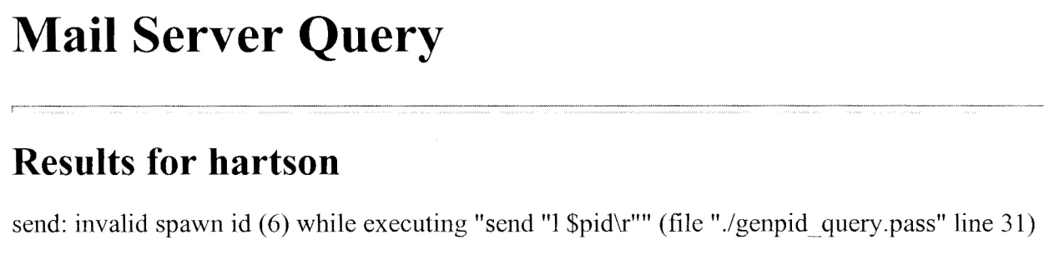
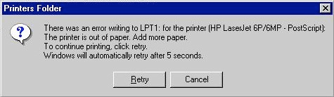
2. Match between system and the real world
Terminology in user’s language
  Not computer terminology
Language from user’s perspective
  “You have bought…” not “We have sold you…”
Use common words,
not “techno-jargon”
Error messages
and feedback refer to
user objects
Allow full-length names
E.g. “Hit any key to continue”

Slide 24
3. User control and freedom
Easy to abort: Cancel buttons
  Cancel order, cancel changing a profile
Easy to Undo
  Web issue: what does “Back” button do?
    Example: many sites can get confused if use back button
Users (even experts) will make errors
E.g. in XXX product,
  no way to get out of editing a text field

Slide 25
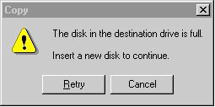
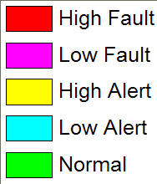
4. Consistency and standards
Same command always have the same effect
Locations for information, names of commands
Give the user a mental model of the system
Size, location, color, wording, function, sequencing, etc.
  E.g., color purple?
Following standards helps
  Web: use templates or CSS, style guides
Seems easy, but often not followed; e.g. in XXX
  naming "F#1.C#1" vs. "F#1", "C#1"
  consistent with industry standards: e.g., Copy
purple?

Slide 26
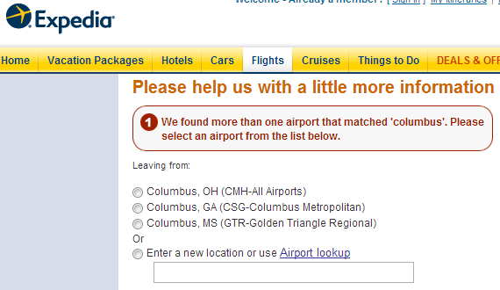
5. Error prevention
Selection rather than entry
  www.Expedia.com: question, when ambiguous city (e.g. Columbus)
Remove or gray-out illegal
choices
  Not common for web pages
Confirmation
Avoid modes
  Definition: same user action has different results
  Make unavoidable modes visible
  E.g. Typing "daytime" to a mail program

Slide 27
6. Recognition rather than recall
Make objects, actions, options visible
See and pick it, not generate it
Short-term memory= 7 ± 2 items; 30 sec to 2 min
  unless interrupted
Menus rather than type-in (but short enough)
Prompts provide format and limits
Don't require retyping of remembered information
Pervasive, generic rules (cut/paste)
E.g. in Aegis, remembering altitude

Slide 28
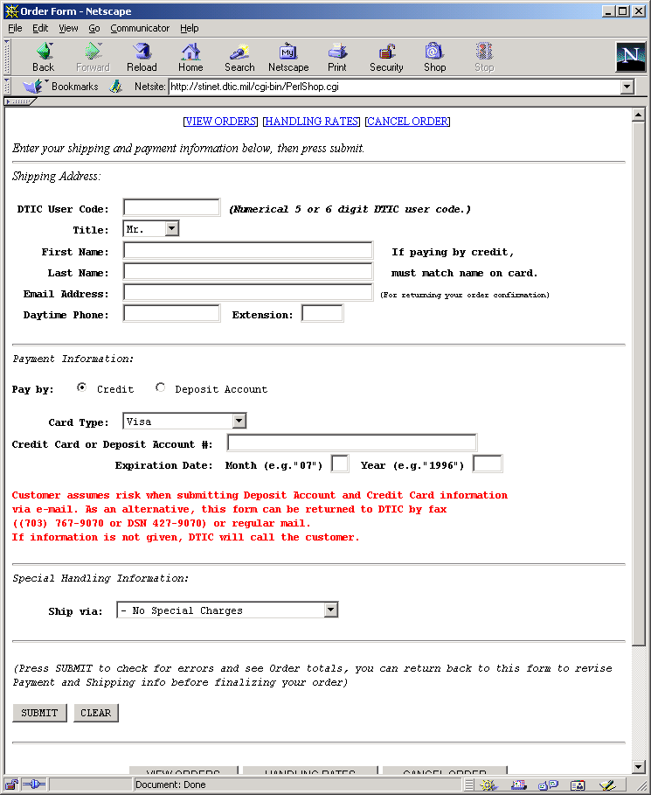
Example: prompts
What is a DTIC user code and how to get one?

Slide 29
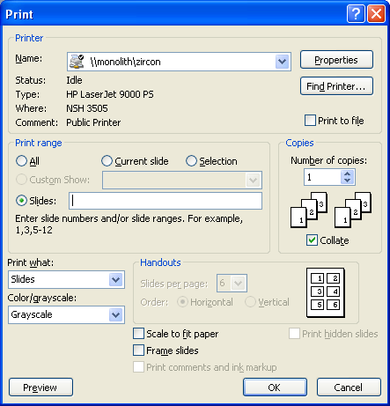
Example: prompts (Print)

Slide 30
7. Flexibility and efficiency of use
Provide Shortcuts
For experienced users
E.g., Command keys
Jump directly to desired location
Reuse previously entered information
Good default values

Slide 31

8. Aesthetic and minimalist design
Good Graphic Design and Color Choice
  Appropriately direct attention
  Group related objects (alignment, decorations)
  Balance and white space
  Maintain display inertia
  Few fonts and colors (5 to 7 colors)
    Appropriate contrast
    Some people are color blind (8% of males)

Slide 32
Minimalist design
“Less is More”
Identify what is really needed
If complex to explain/document, then redesign
Concise language
Avoid extraneous pictures and information
  Fewer options and menu choices
  Reduces planning time
  Extra options can confuse users
  Reduces manual size, etc.
  E.g. in XXX product: "Show Cartouche"

Slide 33
9. Help users recognize, diagnose, and recover from errors
Help users when they are in trouble
Opportunities for users to learn about the system
Clear language; no codes
Be precise; Not “syntax error”
Constructively help the user solve the problem
  Tell why the error happened and how to fix it
Be polite and not accusing; positive wording:
  Not: “FATAL ERROR”, etc.

Slide 34
Error Messages, cont.
Blame the system, not the user
  “Unrecognized” vs. “illegal” command
No humor or snide comments
Easy error recovery
Can have multiple levels of messages
E.g. in XXX product, “can't save file” — why not?

Slide 35
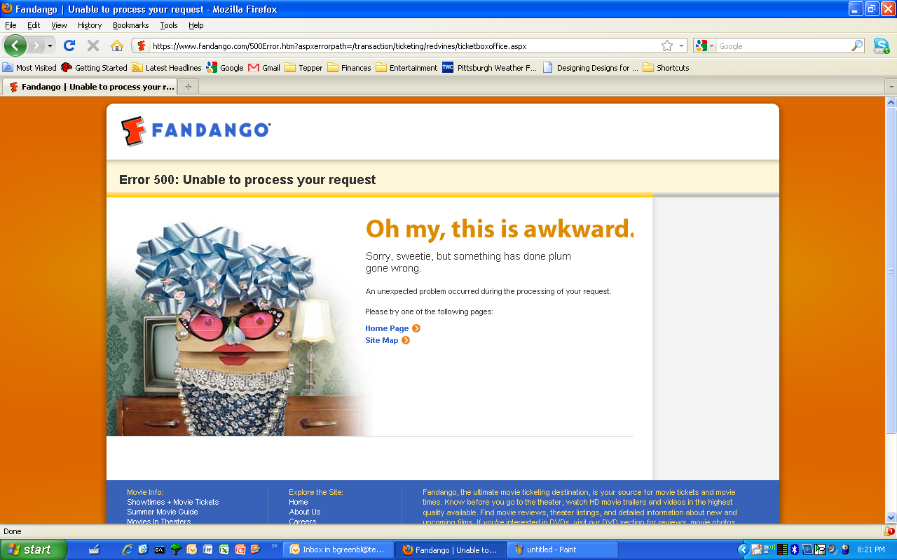
Bad Error Messages

Slide 36
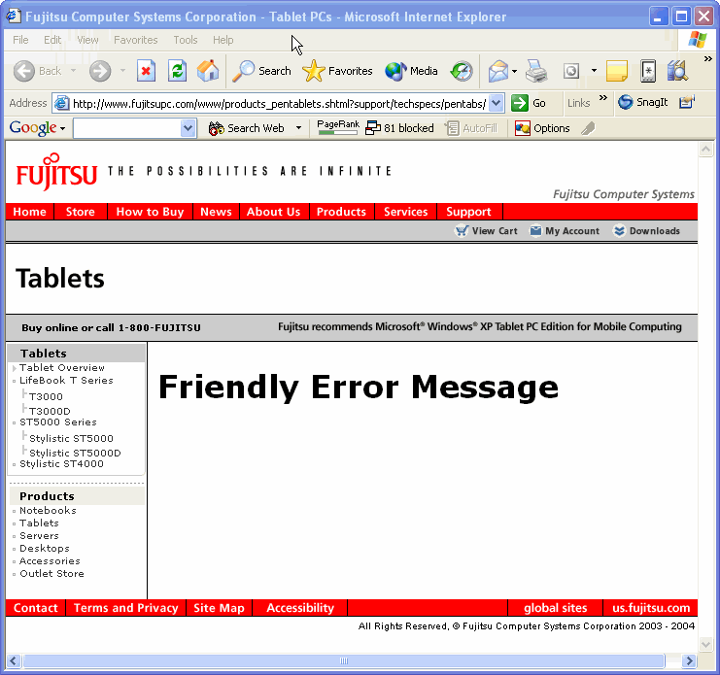
More bad error messages!

Slide 37
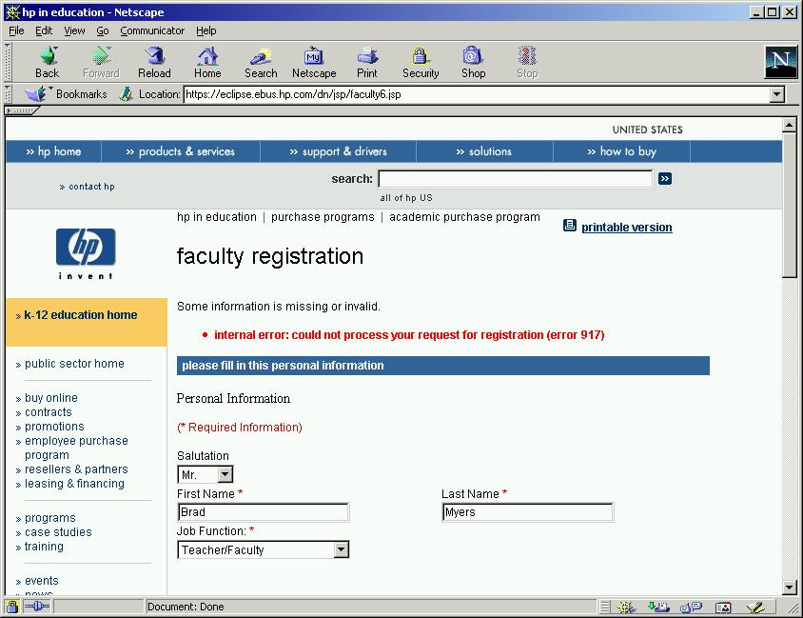
Another Bad Example
http://stinet.dtic.mil/

Slide 38
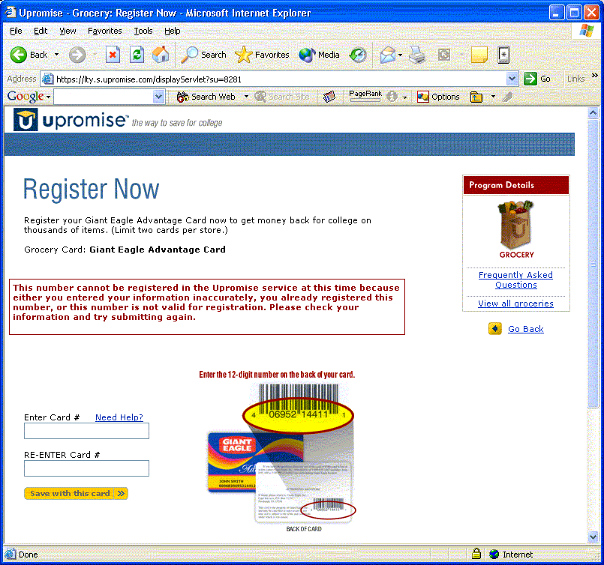
Another Bad Example

Slide 39
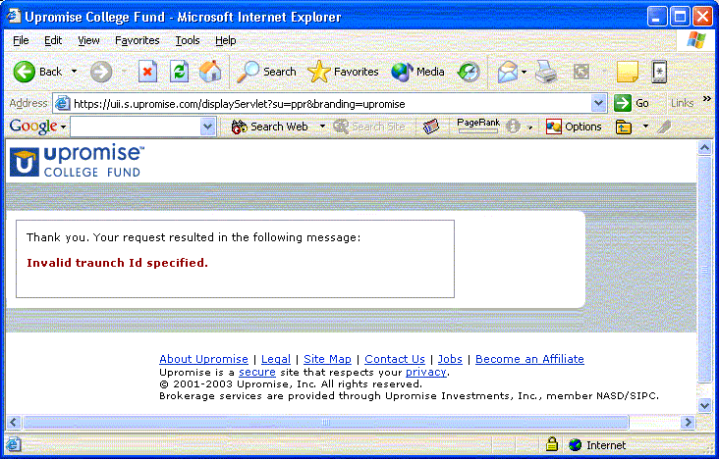
Another Bad Example

Slide 40
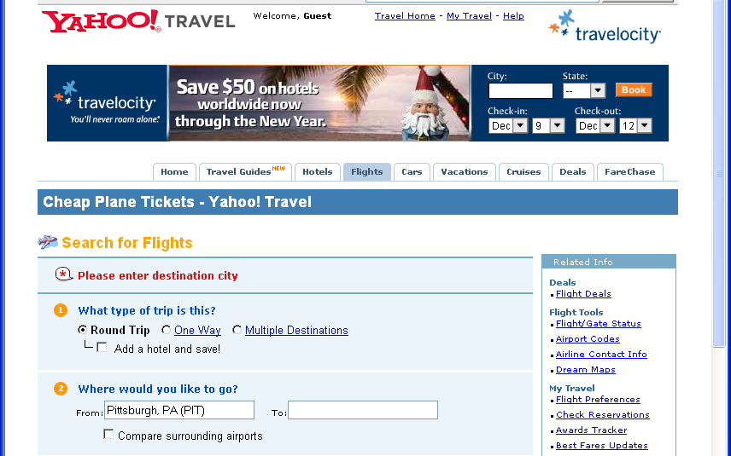
Pretty Good Example
Pretty Good: travel.yahoo.com: Says what to do to fix it
  But language is inconsistent

Slide 41
10. Help and Documentation
True walk up and use?
Most people will not read documentation
  If do, then
    First time product is used, or else
    In a panic, so need information right away
Iterative design of documentation needed
  SuperBook application answer found in 4.3 minutes, compared to 7.6 minutes before fixing
Help system is an extra feature to learn
“Help doesn’t”
  If need to add help, maybe fix the feature?
  Use documentation writers to help refine the system
Good quality writing
Note: not useful to list this one for HW #5
  Not expecting help to be implemented

Slide 42
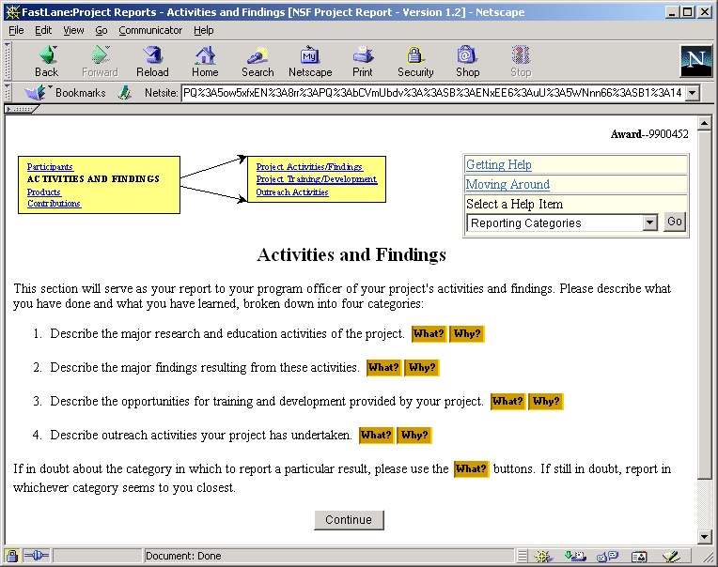
Good Help Example
NSF
report
system
  What
  & Why

Slide 43
HW 5
You will get two (2) systems from your classmates
Will need to find 8 (eight) points that illustrate at least 4 (four) different guidelines to comment on, both good and bad

Slide 44
Template for reporting results
Similar to template that used for user reports:
http://www.cs.cmu.edu/~bam/uicourse/HE_Report_template.doc
Specify which heuristic correctly
Other fields, similar to user studies
  Be sure it is clear where in the screen the problem is
Example of one row filled out:
http://www.cs.cmu.edu/~bam/uicourse/HE_Report_template-Example-CDW.doc

Slide 45
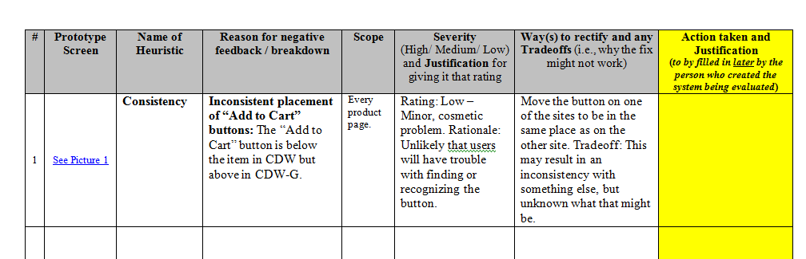
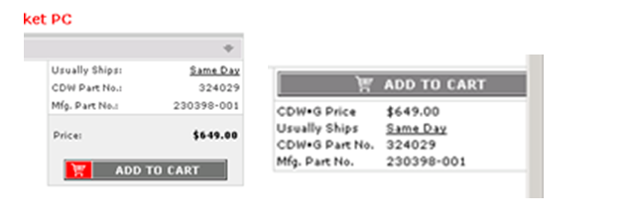
Template example

