Slide 1
In-situ materials characterization for planetary exploration
Eng Keong Chua
echua@andrew.cmu.edu

Slide 2
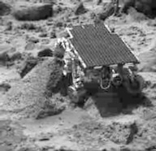
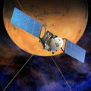
Outline
Motivation
Instruments on lander
  Working principle
  Recent development
    XRD/XRF (CheMin)
    Portable XRD/XRF (Terra)
Instruments on orbiter
  Working principle
  Recent development
    Portable FT-IR
Mars Pathfinder
Mars Express

Slide 3
Motivation
In situ analyses of surface rocks and soils
  Investigation the structure and composition at the site by analysis tools integrated into tele-operated robot
Benefits:
  Survey before planning human to a site of interest
  Acquire information for decisions in real time at the site with remote control

Slide 4
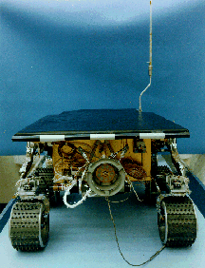
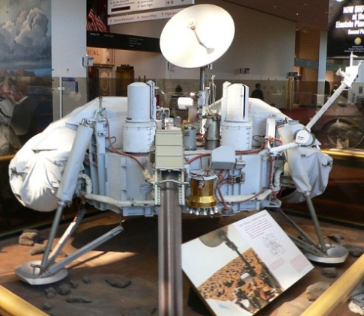
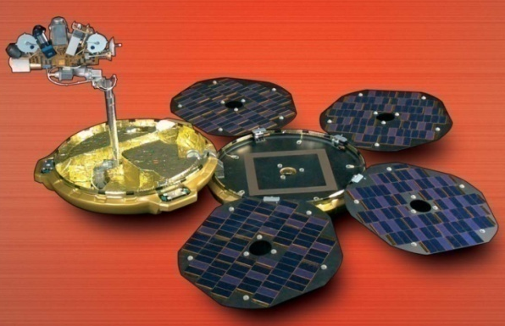
Instruments deployed by space agency
Lander
  Gas Chromatography Mass Spectrometry
  X-Ray Fluorescence Spectroscopy
  Alpha Proton X-Ray Spectrometry
  X-Ray Spectroscopy
Mars
Pathfinder
Beagle 2
Viking 1

Slide 5
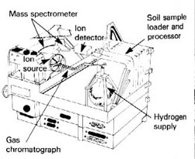
Gas Chromatography Mass Spectrometry
Identify organic molecule
or atmosphere composition
(NASA Viking 1 - 1976)
GCMS setup
  Gas chromatography (GC) separates chemical mixture into pure chemicals
  Mass spectrometer (MS) identifies and quantifies the chemicals
  Data from mass spectometer is sent to a computer to plot mass spectrum

Slide 6
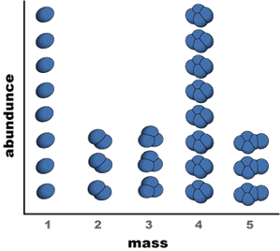
Principle of GCMS
Decomposition of the pure molecules in MS, data is plot as mass spectrum
  This observed spectrum is compared with published
  patterns of known
  decomposition that is
  stored in a fragmentation
  library to identify the
  organic molecule

Slide 7
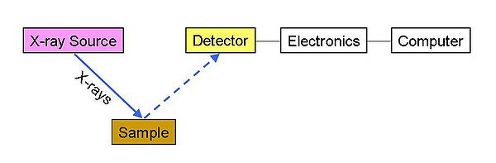
X-Ray Fluorescence Spectroscopy
Identify and determined concentration of elements: (NASA Viking 1 - 1976)
  solid,powdered and liquid samples
XRF setup
Viking 1

Slide 8
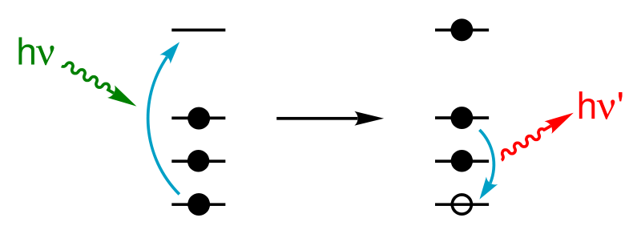
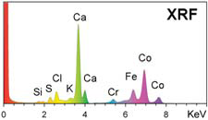
Principle of XRF
Measures characteristics X-rays of fluorescent emission produced by a irradiated sample

Slide 9
Alpha Proton X-Ray Spectrometry
Analyses the chemical element composition of a sample (NASA Mars Pathfinder- 1996)
APXS set up
  Alpha particles sources
  irradiated on sample
  Detector:
    Scattered alpha particles
    Emitted protons
    Fluorescent X-rays
Mars Pathfinder
Notes:
Low power but need nuclear power

Slide 10
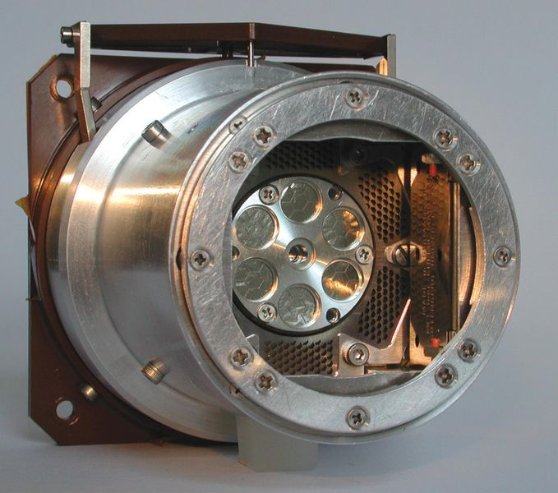
Principle of APXS
Principle:
  Based on interactions of
  alpha particles with matter:
    Collision of alpha particles with
    nuclei
      Elastic scattering of alpha
      particles by nuclei
      Alpha particles absorbed by nuclei produce proton of certain energy by alpha-proton nuclear reactions
    Collision of alpha particles with electrons of the atoms
      Excitation of the atomic structure of atoms leading to the emission of characteristic X-rays

Slide 11
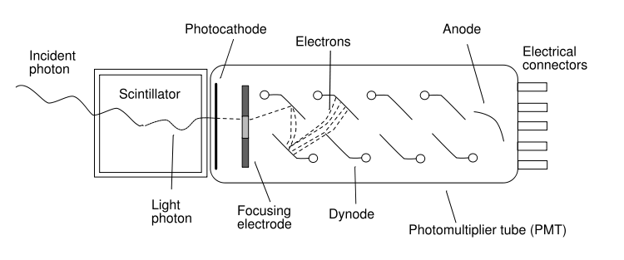
Detector used for the 3 methods
Scintillation counter
  Measures ionizing radiation
    Ionizing radiation
      Charged radiation - eg ions, alpha particle, proton
      Uncharged radiation - eg characteristics X-ray
    Scintillator sensor
      Consists of a transparent crystal, usually phosphor, plastic that luminance when struck by ionizing radiation
    Photomultiplier tube (PMT) measures the light from the crystal.

Slide 12
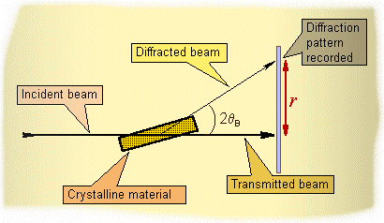
X-Ray Spectroscopy
XRS the most comprehensive tool to identify crystal structure (ESA Beagle 2 - 2003 )
  Examine reflection of X-rays from a material at various angles.
    X-rays were passed through slits to produce narrow beam, which fell on a
    material at centre of the
    spectrometer
    Reflected (Diffracted) beam
    was measured in an charge
    coupled device (CCD)
Beagle 2

Slide 13
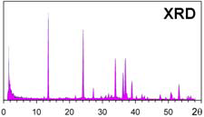
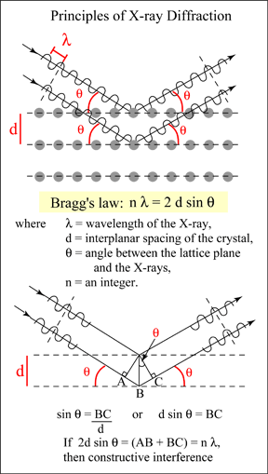
Principle of XRD
Notes:
2.2. DIFFRACTION AND BRAGG’S EQUATION
Without any diffraction effects, the incidence of a primary X-ray beam onto a
sample volume would produce scattering in all directions. Diffraction redistributes
intensity from the whole scattering sphere into distinct directions. Therefore, intensity peaks arise in certain directions, whereas in directions between peaks the
intensity decreases drastically. The intensity integrated over the sphere, however,
remains constant due to energy conservation. In what directions do we observe
such peaks, also called reflections? One way of describing these directions is the
notion of scattering lattice planes and interference between the wavelets scattered
by neighbouring lattice planes. Figure 2 illustrates this situation. Constructive interference
and hence a so called Bragg reflection is obtained when the path of the
wavelet scattered of the lower of the two planes is longer by an integer number of
wavelengths λ than that of the wavelet scattered off the upper plane. A reflection
will thus occur when
nλ = 2d sin . (1)
This is the so-called Bragg equation, where λ is the wavelength of the radiation,
n is an integer number, is the angle between the lattice planes and the incident
beam and d is the distance of the lattice planes for which the peak occurs.

Slide 14
Recent Development
To characterize a material completely, need to identify the composition and structure of a material
  GCMS, XRF and APXS can determine the composition of the element
  XRS can determine the structure of the material
Integration of XRD and XRF
  XRD/XRF (CheMin)
  Portable XRD/XRF (Terra)

Slide 15
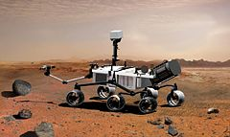
XRD/XRF (CheMin)
CheMin developed (NASA Mars Science Laboratory rover to be launched in 2011)
  Both capable of getting the composition and the structure of the sample

Slide 16
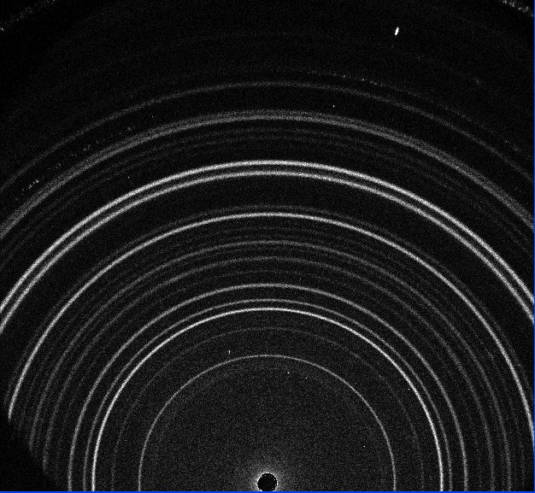
XRD/XRF (CheMin)
Enabler for CheMin integration
  Same source (X-ray)
  An electronic area array detector
    Charge coupled device(CCD) sensitive to X-ray
      Records fluorescent X-rays (characteristics X-rays)
      Records diffracted X-rays that are scattered from sample
Bright rings correspond to diffraction bands; fluoresced pixels have no spatial correlation.

Slide 17
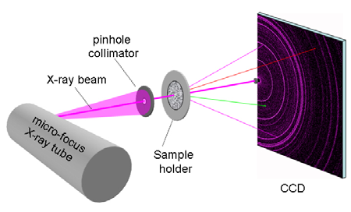
XRD/XRF (CheMin)
Architecture
  X-ray generated by
  microfocus X-ray tube
  Combined with pinhole
  collimator
  Material loaded in sample holder
  CCD detector collects the X-ray signal of sample in term of energy and position
  CCD is cooled to -100°C to limit dark current
  Weighs 30 kg

Slide 18
Portable XRD/XRF (CheMin)
Parties involves:
  inXitu (USA)
  NASA Ames Research Center (USA)
  Los Alamos National Laboratory (USA)
  Indiana University (USA)
  Detector Advanced Development, Jet Propulsion Laboratory (USA)

Slide 19
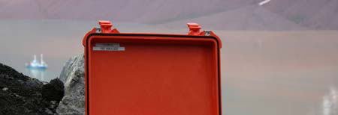

Portable XRD/XRF (Terra)
Terra developed based on CheMin technology to provide a field deployable instrument
  Temperature or humidity sensitive minerals can experience phase transitions during transport to the laboratory.
  Capability to analyze these
  materials in-situ allows
  determination of native
  mineralogical compositions

Slide 20
Portable XRD/XRF (Terra)
Architecture developed based on CheMin
  Redesigned around a smaller CCD to save cost, mass and power.
    CCD is cooled to -45°C using a Peltier cooler.
    Collimation with miniature slits in place of pinhole to maximize throughput.
    System includes an embedded computer to control the instrument, acquire and process data in real time, and offer a graphical user interface through a wireless link.
    Li-ion batteries ~4 hrs of autonomous operation.
    Complete instrument weights less than 15 kg

Slide 21
Portable XRD/XRF (Terra)
Parties involves:
  InXitu (USA)
  Chesapeake Energy Corporation (USA)
  NASA Ames Research Center (USA)
  Earth & Env. Sciences, Los Alamos National Laboratory (USA)
  NASA Johnson Space Center (USA)
  TECSEN, Univ. Paul Cézanne (France)
  Dept. of Geological Sciences, Indiana Univ. (USA)
  Dept. of Geosciences, Univ. of Oslo (Norway)
  Earth and Planetary Exploration Services, Univ. of Oslo (Norway)
  Dept. of Geological Sciences and Geological Engineering, Queen’s Univ. (Canada)

Slide 22
Instruments deployed by space agency
Orbiter
  Infrared Spectrometry
Mars
Pathfider
Beagle 2
Mars Express
Viking 1

Slide 23
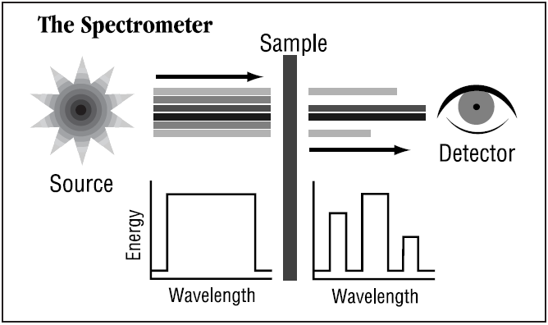
Infrared Spectrometer
SPICAM-IR Atmospheric Spectrometer (ESA Mars Express Orbiter)
  Determining composition of atmosphere from
  wavelengths absorbed by constituent gases
    Record amount of energy absorbed when the frequency of the infrared light is varied to form infrared spectrum
Photo
Detector

Slide 24
Principle of IR
Infrared spectrum represents sample’s fingerprint
  Absorption peaks correspond to frequencies of vibrations between bonds of atoms
  Different material has unique combination of atoms, no two compounds produce same infrared spectrum.
  Range of this photo detector (1.0-1.7 μm)
    Carbon dioxide (absorption at 1.43 μm and 1.57-1.6 μm bands)
    Water vapor (absorption at 1.38 μm)

Slide 25
Recent Development
Portable FT-IR
  Advantages of Portable FT-IR
  Disadvantages of Michelson interferometer
    Solution with Rotary scanning interferometer

Slide 26
Advantages of Portable FT-IR
Provide a rapid on-site spectroscopic information to identify the composition of sample
  Faster measurement technique for collecting infrared spectra
    IR light is guided through an interferometer (Michelson) and pass through the sample, the measured signal is interferogram
    Performing a mathematical Fourier transform on this signal results in a spectrum
  Portable instrument allows an analyst to take the lab to the field

Slide 27
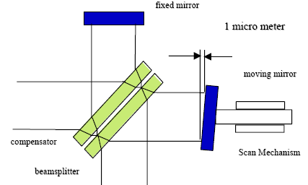
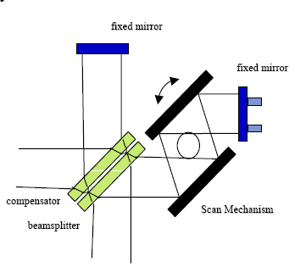
Disadvantages of Michelson interferometer
Mirror alignment sensitive to vibration, shock, temperature, and component fatigue
  Tilt of 1 micrometer will change interferogram by >10%
    Maintaining constant alignment is a routine and costly process
Mirrors are fixed
Stable performance
Repeatable rotary scan mechanism
Michelson interferometer
Rotary scanning interferometer
Notes:
Sensitive to changes in ambient temperature
Materials used in assembly often have different coefficients of thermal expansion and conductivity
Rotary scanning interferometer
Rotary scanning system more convenient & accurate than linear system (Michelson)
Main advantage is its inherent ability to maintain alignment of the output beam throughout the scan.
Precision engineering is practically not required.
Minimal engineering requirements of bearing
Air bearing not required
Maintenance of alignment is insensitive to normal wear in the bearings from extended use

Slide 28
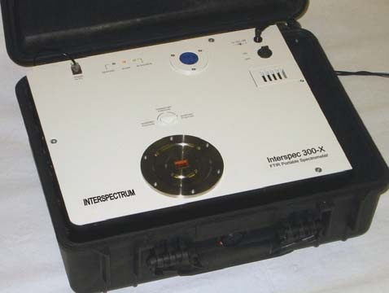
Portable FT-IR
Specifications of portable FT-IR
  Resolution:
    From 4 cm⁻¹ for routine analysis up to 0.5 cm⁻¹ for high resolution work such as gas and multi-component analysis
    Higher energy near-IR (0.8-2.5 μm), wave number ~14000-4000 cm⁻¹
  Dimensions: 49x39x19 cm
  Power consumption: 40 W
  Input voltage:12 V
  Weight: 18 kg
Portable FTIR
spectrometer

Slide 29
Portable FT-IR
Parties involves:
  Tallinn Tech. Univ. (Estonia)
  Monash Univ. (Sydney)
  Interspectrum (Estonia)
  Thermo Scientific (USA)
  ABB (Germany)
  A2 Technologies (USA)
  Bruker AXS (Germany)

Slide 30
assignment
Name:
  2 types of wave that has heat effect
  3 types of radiation that has reaction with a photographic film
  2 types of radiation that has ionisation and kill living cell

Slide 31
assignment
Determine the 4 characteristics that all the radiation share with the 4 hints given:
    Speed of all the radiation?
    What do all the radiation carry from place to place?
    Could all the radiations travel from the Sun to Venus? Is there a need for a medium to enable travelling?
    Is all the radiation longitudinal or transverse type of wave?

Slide 32
References
http://ntrs.nasa.gov/archive/nasa/casi.ntrs.nasa.gov/20050205037_2005206851.pdf
http://www.esa.int/SPECIALS/Mars_Express/SEMUC75V9ED_0.html
http://en.wikipedia.org/wiki/Viking_1
http://www.unsolvedmysteries.oregonstate.edu/MS_05
http://en.wikipedia.org/wiki/Mass_spectrometry#Gas_chromatography
http://cmapsnasacmex.ihmc.us
http://www.daviddarling.info/encyclopedia/V/VikingGCMS.
http://marstech.jpl.nasa.gov/content/detail.cfm?Sect=MTP&Cat=base&subCat=SSA&subSubCat=&TaskID=2256

Slide 33
References
http://serc.carleton.edu/research_education/geochemsheets/techniques/XRF.html
http://en.wikipedia.org/wiki/X-ray_fluorescence
http://en.wikipedia.org/wiki/APXS
http://mpfwww.jpl.nasa.gov/MPF/mpf/sci_desc.html
http://www.nasaimages.org/luna/servlet/view/all/what/Alpha+Proton+X-ray+Spectrometer
http://www.physics.pdx.edu/~pmoeck/phy381/Topic5a-XRD.pdf
http://en.wikipedia.org/wiki/Scintillation_counter
http://en.wikipedia.org/wiki/Photomultiplier
http://www.mcswiggen.com/FAQs/FAQ_EF-6.htm
http://en.wikipedia.org/wiki/Mars_Science_Laboratory

Slide 34
References
P. Sarrazin, et. al., International Centre for Diffraction Data, Advances in X-ray Analysis, Volume 48 (2005)
P. Sarrazin et. al., 39th Lunar and Planetary Science Conference (2008)
S. M. Chemtob et. al., 40th Lunar and Planetary Science Conference (2009)
http://en.wikipedia.org/wiki/Infrared_spectroscopy
http://www.wooster.edu/chemistry/is/brubaker/ir/ir_works_modern.html
T. Tonnisson, IEEE Electronics Conference, 2008
http://www.thermo.com/
http://www.abb.com/
http://www.a2technologies.com/
http://www.bruker-axs.de/

Slide 35
  THE END

