Slide 1
Weather & Atmospheric Sensing for Safety and Reliability of Exploration Robots
Kamol Chuengsatiansup
<kchuengs@andrew.cmu.edu>

Slide 2
Outline
Motivation of weather & atmosphere sensing
How to sense elements in weather & atmosphere
Some exploration robots for weather & atmosphere study
Robot safety
Robot reliability improvement

Slide 3
Why sensing weather & atmosphere
To study the environment
For safety of the robot
Improve reliability of the robot

Slide 4
What is in weather & atmosphere?
Temperature
Pressure
Humidity
Wind speed & direction
Particle, cloud, dust
Chemical composition
Radiation
Notes:
http://en.wikipedia.org/wiki/List_of_sensors

Slide 5
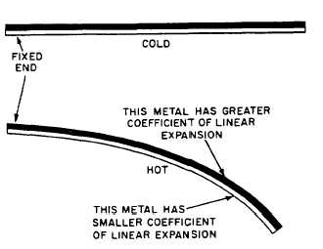
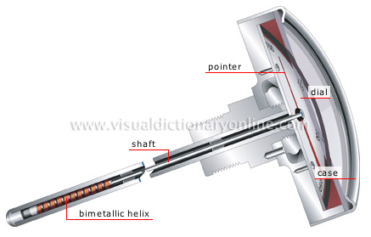
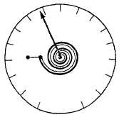
How to sense temperature?
Mechanical domain – thermal expansion
  Liquid-in-glass thermometer – mercury, organic spirit
  Bimetallic thermometer – two different thermal expansion material – beam, helical, spiral
Notes:
Fundamentals of temperature, pressure and flow measurements
Practical Temperature Measurement

Slide 6
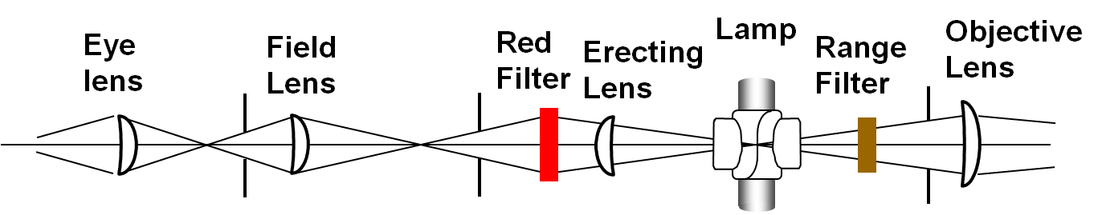
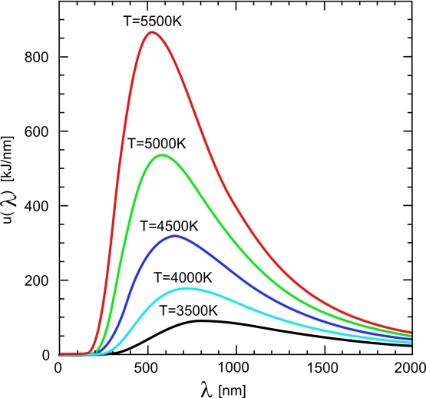



How to sense temperature?
Optical domain – thermal radiation
  Optical pyrometer- single color, two color
Notes:
Fundamentals of temperature, pressure and flow measurements
Practical Temperature Measurement
http://en.wikipedia.org/wiki/Thermal_radiation
http://www.temperatures.com/Howopticals.html

Slide 7
How to sense temperature?
Electrical domain
  Resistance temperature detector - temperature dependent resistor- temperature coefficient of resistance – non linear, coupling w/ strain, circuit – voltage divider, Wheatstone bridge
    Metal/Alloy, Platinum Resistance Thermometer
    Thermistor – semiconductor – LM35
Notes:
Fundamentals of temperature, pressure and flow measurements
Practical Temperature Measurement
http://www.facstaff.bucknell.edu/mastascu/elessonsHTML/Sensors/TempR.html
http://en.wikipedia.org/wiki/Resistance_temperature_detector

Slide 8
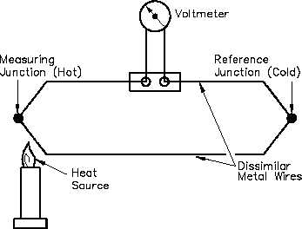
How to sense temperature?
Electrical domain
  Thermocouple – thermoelectric effect – Seebeck effect
    Conventional thermocouple – Type J,K,…
    IC form – Thermocouple + reference temperature control circuit
Notes:
Fundamentals of temperature, pressure and flow measurements
Practical Temperature Measurement
http://www.facstaff.bucknell.edu/mastascu/elessonsHTML/Sensors/TempR.html
http://en.wikipedia.org/wiki/Thermocouple

Slide 9
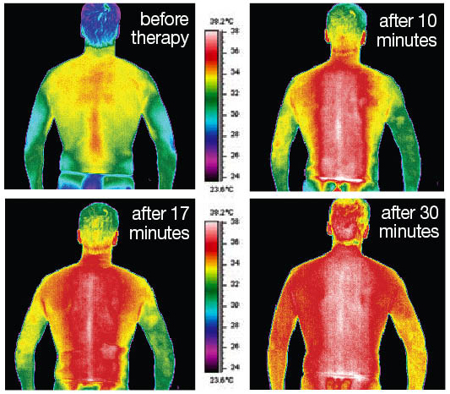
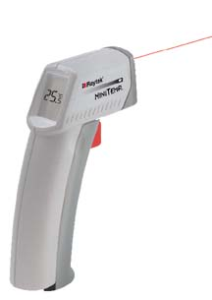
How to sense temperature?
Electrical domain
  Sensor-based Pyrometer/Infrared Thermometer – non contact, thermal radiation – emissivity, distance-to-spot ratio, photovoltaic, photoconductive
    FLIR - http://www.flir.com/
    Raytek - http://www.raytek.com/
Notes:
http://en.wikipedia.org/wiki/Infrared_thermometer
http://www.omega.com/prodinfo/infraredthermometer.html
Principles of Infrared Thermometry W. R. Barron, Williamson Corporation
Principles of Noncontact Temperature Measurement, Raytek
http://www.raytek.com/
http://www.flir.com/

Slide 10
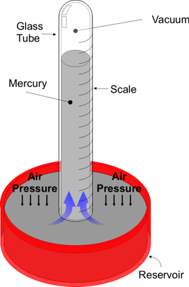
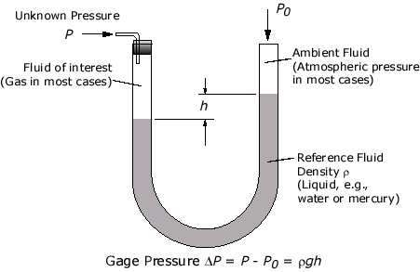
How to sense pressure?
Mechanical domain
  Manometer – reference pressure, U-shape tube
  Barometer – Vacuum tube liquid
Notes:
Fundamentals of temperature, pressure and flow measurements

Slide 11
How to sense pressure?
Electrical domain
  Direct - Piezoelectric pressure transducer
  Indirect = Mechanical domain device + transducer
    Strain gage
    Potentiometer
    Capacitor
    LVDT
Notes:
Fundamentals of temperature, pressure and flow measurements

Slide 12
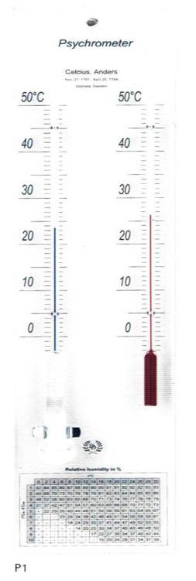
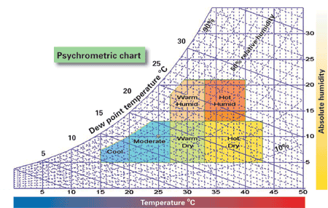
How to sense humidity?
Psychrometer – temperature different between dry and wet air
Notes:
http://en.wikipedia.org/wiki/Hygrometer
http://www.sensorsmag.com/articles/0701/54/main.shtml

Slide 13
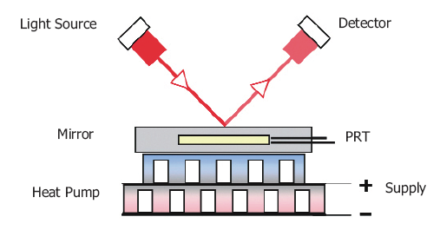
How to sense humidity?
Electronic
  Cooled mirror dew point – Michell Instrument http://www.michell.com/
  Capacitive Relative Humidity
  Resistive Humidity
  Thermal Conductivity
Notes:
http://en.wikipedia.org/wiki/Hygrometer
http://www.sensorsmag.com/articles/0701/54/main.shtml
http://www.michell.com/

Slide 14
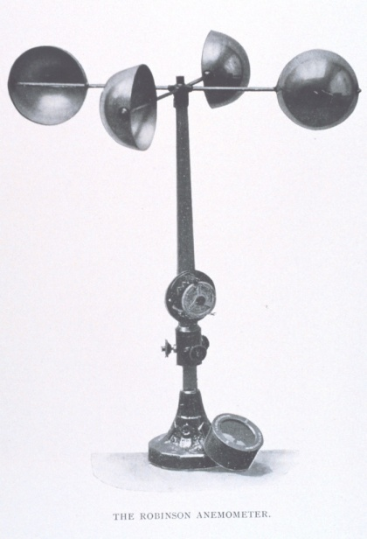
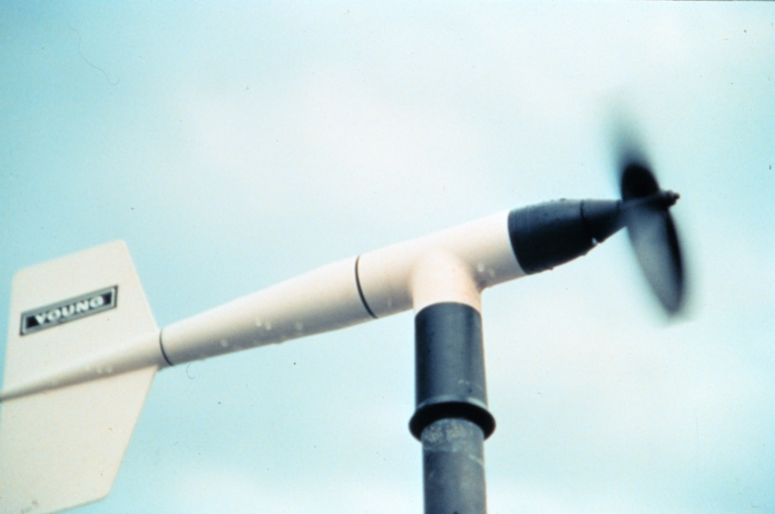
How to sense wind speed & direction?
Mechanical anemometer
  Cup - 3-4 cups, cup size, arm length – anemometer factor
  Wind mill
Notes:
http://en.wikipedia.org/wiki/Anemometer

Slide 15
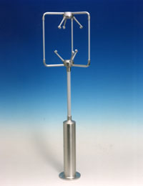
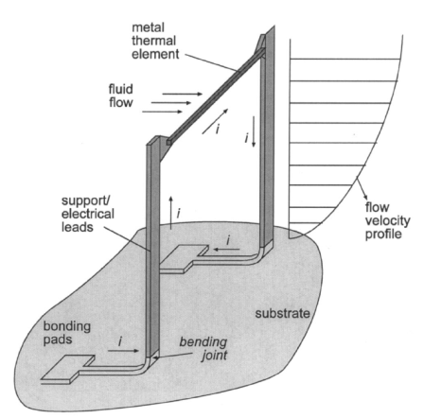
How to sense wind speed & direction?
Laser Doppler anemometer – Doppler shift at particle
Ultrasonic anemometer – TOF in moving medium
Hot wire anemometer –heat convection – constant current/voltage/temperature
Notes:
http://en.wikipedia.org/wiki/Anemometer

Slide 16
How to sense particle/dust/cloud?
LIDAR – measure
  TOF – altitude
  Return intensity – property/density of particle – absorption of particle
  Polarization – property of particle
  Many techniques – DIAL – Differential Absorption Lidar
RADAR – larger particle – rain droplet
Notes:
http://oea.larc.nasa.gov/PAIS/LASE.html
http://oea.larc.nasa.gov/PAIS/LaserSensing.html
http://asd-www.larc.nasa.gov/lase/ASDlase.html
Active Remote Sensing of the Atmosphere - Lidar - , Remote Sensing I lecture, UIP Universitat Bremen

Slide 17
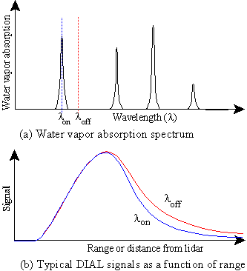
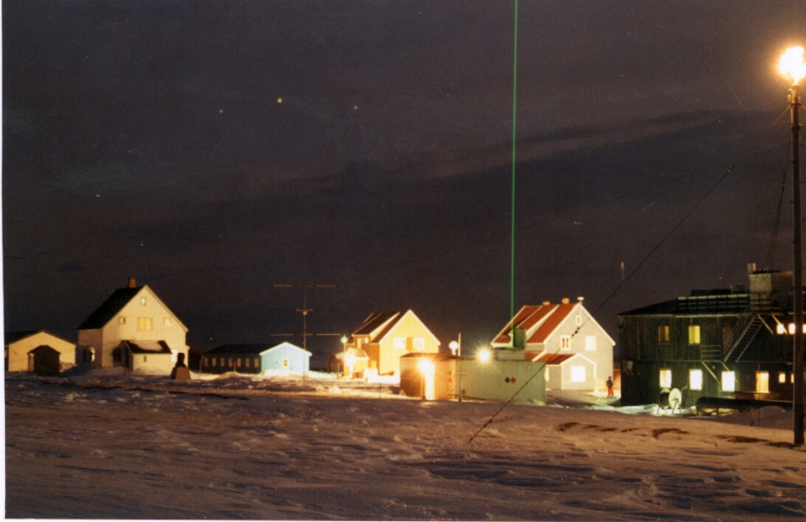
How to sense particle/dust/cloud?
Notes:
http://oea.larc.nasa.gov/PAIS/LASE.html
http://oea.larc.nasa.gov/PAIS/LaserSensing.html
http://asd-www.larc.nasa.gov/lase/ASDlase.html
Active Remote Sensing of the Atmosphere - Lidar - , Remote Sensing I lecture, UIP Universitat Bremen

Slide 18
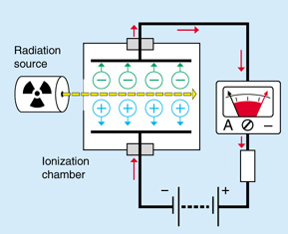
How to sense radiation?
Ionization chamber
  Inert gas-filled tube, 2 electrode at each end
  Gas interacted with radiation ionized
  Measured by galvanometer, electrometer
  Geiger Muller Counter – Alpha, Beta
Notes:
http://www.hps.org/publicinformation/ate/faqs/radiationdetection.html
http://www.hps.org/publicinformation/ate/faqs/radiationtypes.html
http://hyperphysics.phy-astr.gsu.edu/HBASE/nuclear/rdtec.htm

Slide 19
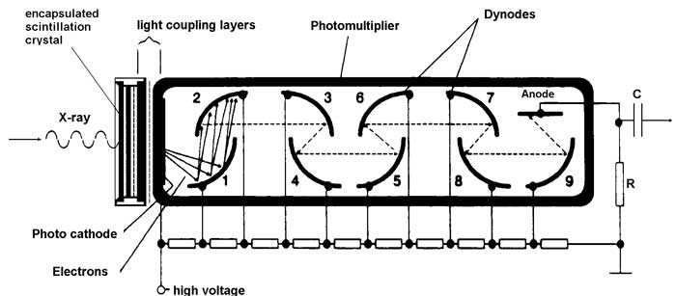
How to sense radiation?
Scintillation counter
  Crystal that fluoresces when interacted with radiation
  Amplified by photomultiplier and count
  Sodium iodide - Gamma
Notes:
http://www.hps.org/publicinformation/ate/faqs/radiationdetection.html
http://www.hps.org/publicinformation/ate/faqs/radiationtypes.html
http://hyperphysics.phy-astr.gsu.edu/HBASE/nuclear/rdtec.htm

Slide 20
How to sense chemical composition?
Chemical sensor
Chromatography
Spectroscopy

Slide 21
Exploration Robots - DustBot
AASS Research Center, Sweden
Pollution monitoring
  Gas distribution – Hydrogen, Carbon Monoxide, Ammonia, Hydrogen Sulfide, Volatile Organic Compound, Methane, Organic Solvents, Carbon Dioxide - Figaro
  Wind speed & direction – ultrasonic anemometer – Young 81000
  Temperature
  Humidity
Notes:
M. Trincavelli et al., Toward Environmental Monitoring with Mobile Robots

Slide 22
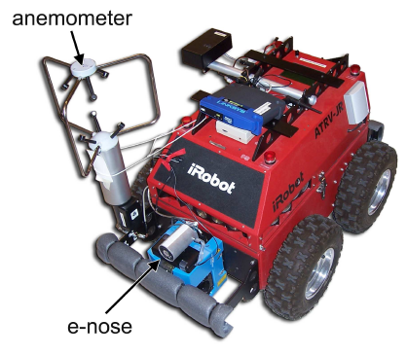
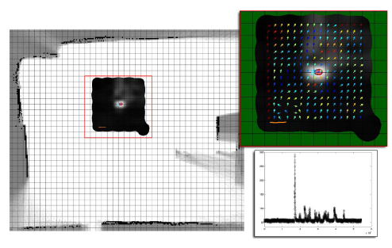
Exploration Robots - DustBot
Notes:
M. Trincavelli et al., Toward Environmental Monitoring with Mobile Robots

Slide 23
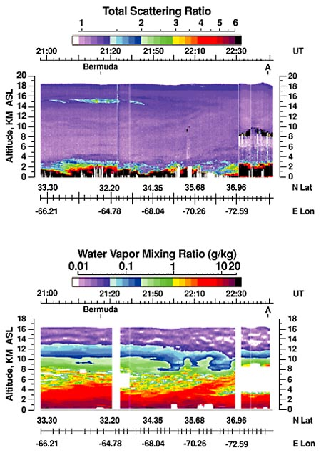

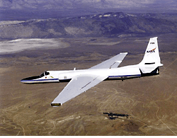
Exploration Robots - LASE
NASA Langley Research Center
LASE = Lidar Atmospheric Sensing Experiment
Measure – water vapor, aerosol, cloud
Use LIDAR install on ER-2 aircraft
Notes:
http://oea.larc.nasa.gov/PAIS/LASE.html

Slide 24
Exploration Robots – Vega Aerobot
Soviet Vega Program, Venus exploration
Lighter-than-air aerobot = balloon + gondola
Sensors
  Thin-film resistance thermometer
  Anemometer
  Photodetector – measure light level
  Vibrating quartz beam – pressure sensor
  Nephelometer – light detection measure cloud density
Notes:
http://en.wikipedia.org/wiki/Vega_program
R. S. Kremnev et al., VEGA Balloon System and Instrumentation, Science, Vol. 231, pp. 1408-1411, 1986

Slide 25
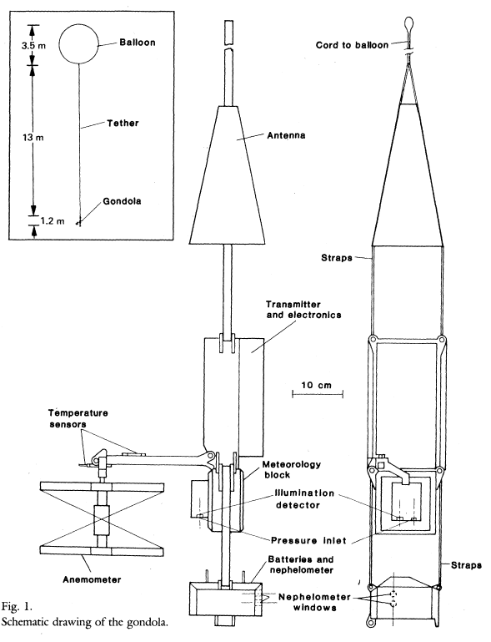
Exploration Robots – Vega Aerobot
Notes:
http://en.wikipedia.org/wiki/Vega_program
R. S. Kremnev et al., VEGA Balloon System and Instrumentation, Science, Vol. 231, pp. 1408-1411, 1986

Slide 26
Robot safety
What harmful to robots and how to prevent?
  Temperature – Warm Electronics Box (WEB), radioisotope heater, material – phase changed material
  Radiation – shielding, radiation tolerant electronic, magnetic field
  Pressure – pressure vessel, material – beryllium titanium matrix
Notes:
http://physicsworld.com/cws/article/news/36558
Extreme Environments Technologiesfor Future Space Science Mission, NASA, 2007

Slide 27
Robot reliability
What effect robot performance and how to improve?
In many cases – temperature
  Extreme temperature – low, high
  Thermal cycling
Notes:
JPL NASA, Survivable Systems for Extreme Environments http://scienceandtechnology.jpl.nasa.gov/research/ResearchTopics/topicdetails/?ID=57

Slide 28
Temperature - Accelerometer
C. Eggett et al., Intelligent Mechanical Systems Lab, Northwestern Univ – Temperature Effect on Accelerometer for Robotics Position Sensors
Use piezoresistive accelerometer
Temperature compensation by
  Thermistor + Post processing
  Dummy cantilever + Signal subtraction
Notes:
C. Eggett et al., TEMPERATURE EFFECT ON ACCELEROMETERS FOR ROBOTICS POSITION SENSORS, May 2001

Slide 29
Temperature - Ultrasonic
A. Carullo et al., Politecnico di Torino, Italy – Ultrasonic Distance Sensor Improvement Using a Two-Level Neural Network
Use piezoelectric ultrasonic transducer
Temperature compensation by
  Commercial solid state temperature sensor
  Post processing with Neural Network
Notes:
A. Carullo et al., Ultrasonic Distance Sensor Improvement Using a Two-Level Neural Network, IEEE Transactions on Instrumentation and Measurement, Vol. 45, No.2, 1996

Slide 30
Temperature – Strain gage
S. Poussier et al., Universite Henri Poincare, France – Adaptable thermal compensation system for strain gage sensors based on programmable chip
Dummy gage – narrow temp range, difficult to get same temp but stress isolated
Temperature compensation by
  Use thermocouple
  Post processing on FPGA
Notes:
S. Poussier et al., Adaptable thermal compensation system for strain gage sensors based on programmable chip, Sensors and Actuator A, Vol. 119, pp 412-417, 2005

Slide 31
Temperature – Humidity
C. Y. Lee et al., National Cheng Kung Univ, Taiwan – Micromechined-based humidity sensor with integrated temperature sensors for signal drift compensation
Capacitive sensor on cantilever beam bended by moisture
Temperature compensation by
  Resistance temperature detector
  Post processing
Notes:
C. Y. Lee et al., Micromachine-based humidity sensors with integrated temperature sensors for signal drift compensation, Journal of Micromechanics and Microengineering, Vol 13, pp 620-627, 2003

Slide 32
Temperature – Pressure
M. Akbar et al. – A fully integrated temperature compensation technique for piezoresistive pressure sensors
Use piezoresistive pressure sensor
Temperature compensation by
  Dummy + Signal subtraction
Notes:
M. Akbar et al., A fully integrated temperature compensation technique for piezoresistive pressure sensors, IEEE Transactions of Instrumentation and Measurement, vol. 42, 1993

Slide 33
Temperature – Pneumatic
Patent – Temperature compensated pneumatic control system
Temperature effect gas pressure/density, flow rate
Use temperature data to adjust controller gain
Notes:
Temperature Compensated Pneumatic Control System, 1973

Slide 34
Robot reliability
In conclusion
  Piezoresistive/Piezoelectric are most effected by temperature
  Sense temperature
  Find relation between deviate temperature and deviate signal – nature of sensor, effect of sensor installation
    Offline calibration
    Machine learning
  Compensation

Slide 35
Future improvement
Drift compensation – piezoresistive, piezoelectric
Thermal imaging – cooling system, bio-inspired material

Slide 36
Assignment
1) In your sensor topic, is there any issue concerning about working environment condition, if so how would it effect sensing performance and how to deal with it?

Slide 37
Assignment
2) Visit http://www.scribd.com/doc/7125272/The-Psychrometric-Chart There is an easy understanding explanation of Psychrometric chart. Come up with a temperature, relative humidity, predict the wet bulb temperature.
Show your work. You can get the Psychrometric chart from http://irc.nrc-cnrc.gc.ca/images/bsi/83-psy_E.gif

Slide 38
Reference
Robert P. Benedict, Fundamentals of temperature, pressure and flow measurements, 1984
Peter R.N. Childs, Practical Temperature Measurement, 2001
http://en.wikipedia.org/wiki/Thermal_radiation
http://www.temperatures.com/Howopticals.html
http://www.facstaff.bucknell.edu/mastascu/elessonsHTML/Sensors/TempR.html
http://en.wikipedia.org/wiki/Resistance_temperature_detector
http://en.wikipedia.org/wiki/Thermocouple
http://en.wikipedia.org/wiki/Infrared_thermometer
http://www.omega.com/prodinfo/infraredthermometer.html
W. R. Barron, Williamson Corporation, Principles of Infrared Thermometry
Raytek, Principles of Noncontact Temperature Measurement

Slide 39
Reference
http://en.wikipedia.org/wiki/Hygrometer
http://www.sensorsmag.com/articles/0701/54/main.shtml
http://en.wikipedia.org/wiki/Anemometer
http://oea.larc.nasa.gov/PAIS/LASE.html
http://oea.larc.nasa.gov/PAIS/LaserSensing.html
http://asd-www.larc.nasa.gov/lase/ASDlase.html
Active Remote Sensing of the Atmosphere - Lidar - , Remote Sensing I lecture, UIP Universitat Bremen
http://www.hps.org/publicinformation/ate/faqs/radiationdetection.html
http://www.hps.org/publicinformation/ate/faqs/radiationtypes.html
http://hyperphysics.phy-astr.gsu.edu/HBASE/nuclear/rdtec.htm
M. Trincavelli et al., Toward Environmental Monitoring with Mobile Robots, Intelligent Robots and System, 2005
http://en.wikipedia.org/wiki/Vega_program

Slide 40
Reference
R. S. Kremnev et al., VEGA Balloon System and Instrumentation, Science, Vol. 231, pp. 1408-1411, 1986
http://physicsworld.com/cws/article/news/36558
NASA , Extreme Environments Technologiesfor Future Space Science Mission,, 2007
JPL NASA, Survivable Systems for Extreme Environments http://scienceandtechnology.jpl.nasa.gov/research/ResearchTopics/topicdetails/?ID=57
C. Eggett et al., Temperature Effect on Accelerometers for Robotics Position Sensors, May 2001
A. Carullo et al., Ultrasonic Distance Sensor Improvement Using a Two-Level Neural Network, IEEE Transactions on Instrumentation and Measurement, Vol. 45, No.2, 1996

Slide 41
Reference
S. Poussier et al., Adaptable thermal compensation system for strain gage sensors based on programmable chip, Sensors and Actuator A, Vol. 119, pp 412-417, 2005
C. Y. Lee et al., Micromachine-based humidity sensors with integrated temperature sensors for signal drift compensation, Journal of Micromechanics and Microengineering, Vol 13, pp 620-627, 2003
M. Akbar et al., A fully integrated temperature compensation technique for piezoresistive pressure sensors, IEEE Transactions of Instrumentation and Measurement, vol. 42, 1993
Temperature Compensated Pneumatic Control System, 1973

