Slide 1
Sensors & Instruments for station-based materials characterization of returned samples
Chun Chia Tan
04/01/2009

Slide 2
Outline
Introduction to materials characterization
General overview of the equipment used to study different material properties
X-ray photoelectron spectroscopy
Atomic force Microscope
Scanning electron Microscope

Slide 3
Introduction to materials characterization
Materials characterization
Unknown material
Examine the chemical composition
Arrangement of the atoms
Superficial observation of the material
Material with known property
Understand and quantify the extent in which it exhibits this property
Understand why it exhibits this property
How can we make use of this material property?

Slide 4
Introduction to materials characterization
To be able to characterize these materials, we must:
Know the material properties we are characterizing
Understand how the properties can be identified
Understand how the equipment for investigating the material property works

Slide 5
Types of material properties for characterization
Chemical composition
Chemical bonding
Material topology
Roughness of the material
Features of the material surface
Crystallization temperatures
Crystal structures
Electrical properties
Magnetic properties
Optical properties

Slide 6
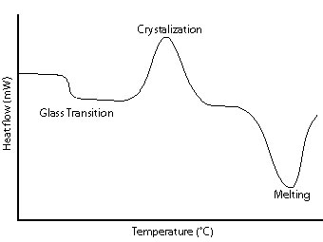
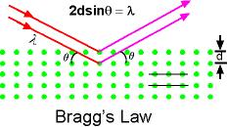
Some equipments used for materials characterization
Different equipments used for materials characterization
Differential scanning calorimetry
Raman Spectroscopy
X-ray Diffraction
X-ray photoelectron spectroscopy
Features of a differential scanning calorimetry curve
Bragg’s Diffraction in XRD

Slide 7
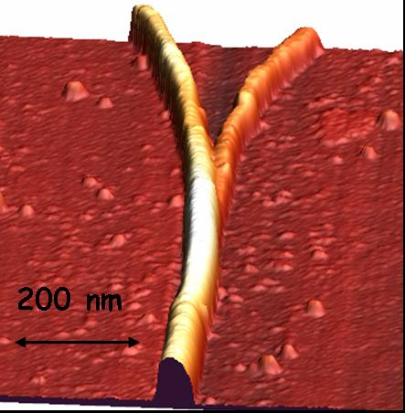
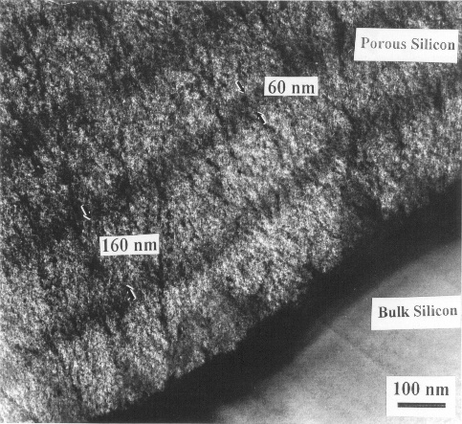
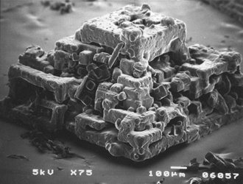
Some equipments used for materials characterization
Different equipments used for materials characterization
Atomic force Microscopy
Scanning electron microscopy
Transmission electron microscopy
AFM: image of a Y-junction carbon nanotube.
SEM: This grain of kosher salt is composed of many cubes stuck together.
TEM: Porous silicon on top of bulk silicon

Slide 8
X-ray Photoelectron Spectroscopy

Slide 9
X-ray Photoelectron Spectroscopy
XPS is a quantitative spectroscopic technique that measures
elemental composition
empirical formula
chemical state
electronic state of the elements which exist in a material
XPS spectra is obtained by focusing X-rays on the sample material then measuring the kinetic energy of the electrons which are emitted from the surface of the material (top 1-10 nm) due to the X-ray.
Requires ultra-high vacuum conditions
Also known as ESCA (Electron Spectroscopy for Chemical analysis)

Slide 10
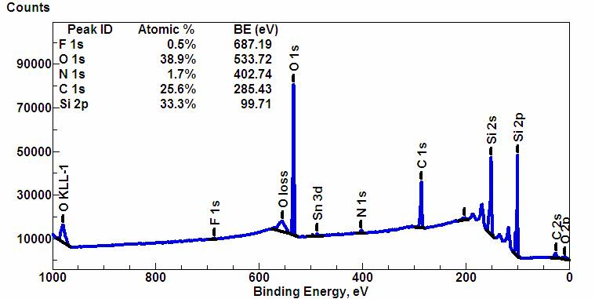
Example of an XPS spectra

Slide 11
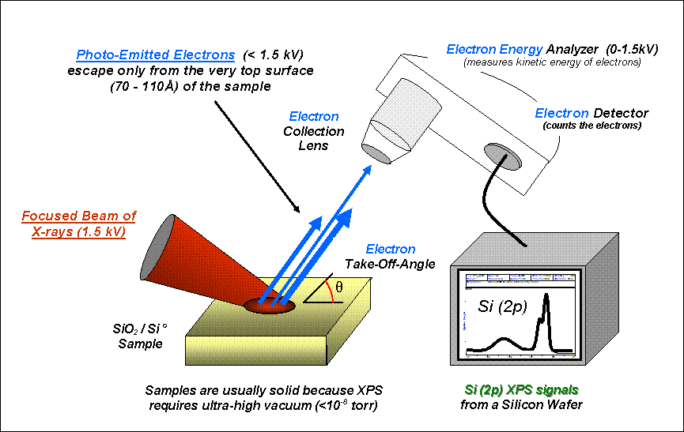
Setup of an XPS machine

Slide 12
Electronic Configuration of atoms
E_{vacuum}
Every element has a specific arrangement of the energy levels
Electrons take up energy levels from the lowest level first
S-orbitals start to fill up then p orbitals then d-orbitals
For example, Sodium has 11 electrons, so they will take up the electronic configuration 1s2 2s2 2p6 3s1
Energy level separations are different in different atoms
3s
2p
Energy
2p
2p
2s
1s

Slide 13
Band structure of solids
Vacuum level
Conduction
band
Fermi Energy
Valence
band
Energy
1 atom
2 atoms
Many atoms

Slide 14
Emission of photoelectrons
Kinetic Energy
of photoelectron
Electron in 1s2 orbital absorbs the energy from the X-ray photon
Energy absorbed is high enough to escape the attractive force of the nucleus, ie the electron can escape into the vacuum level
Electron still possesses kinetic energy and this kinetic energy can be measured
Input energy of the X-ray photon is fixed so we can calculate the binding energy
X-ray photon
E_{kinetic}
Energy at
Vacuum level
E_{X-ray} = hv
3s1
2p6
E_{binding}
2s2
1s2
Energy level
of 1s electron
E_{X-ray} = E_{kinetic} + E_{binding}
E_{binding} = E_{X-ray} - E_{kinetic}

Slide 15
Example of an XPS spectra

Slide 16
Assignment
Use the NIST database (http://srdata.nist.gov/xps/Default.aspx) to identify the elements in the unknown material. What is the suspected chemical compound?

Slide 17
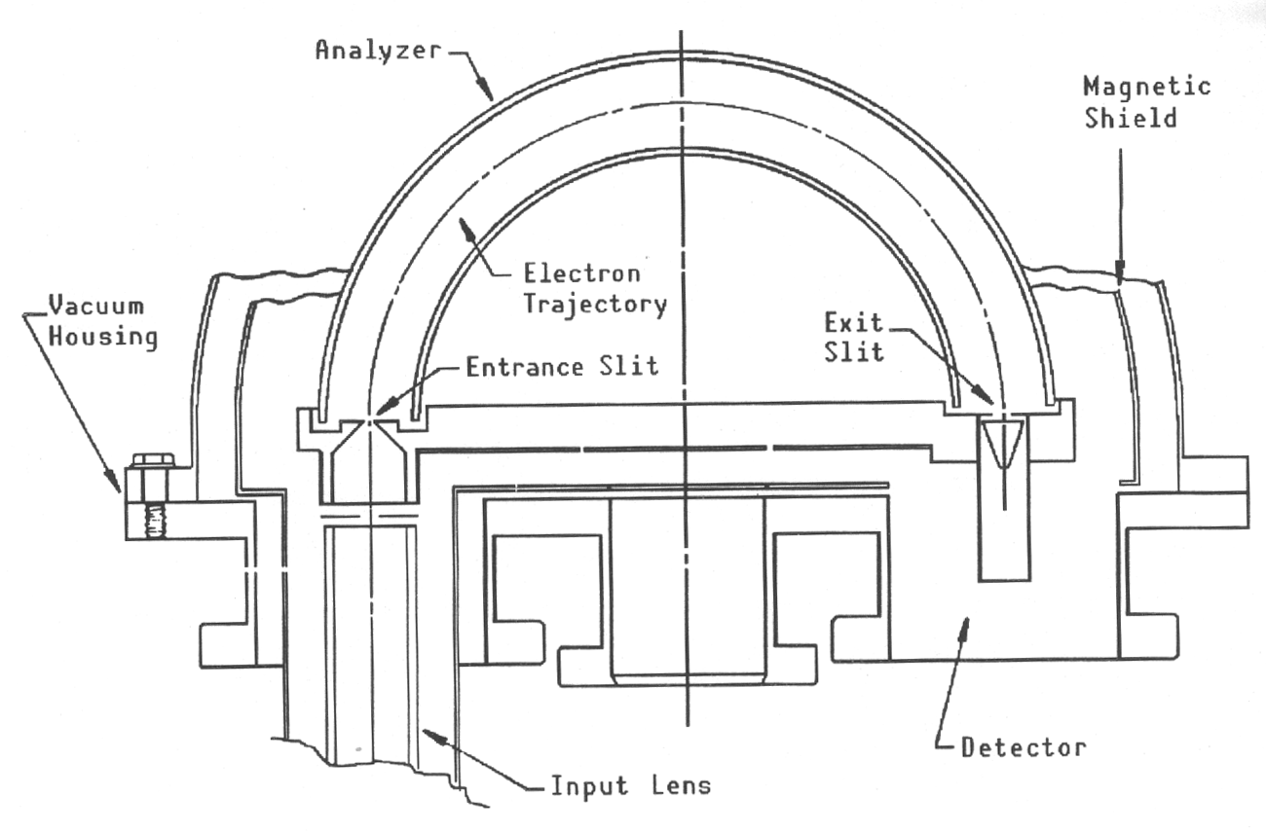
Spectroscopy
Must be able to isolate and separate the electrons with the energy you want
Must be able to focus the electrons of the energy you want
Separate for one thing and bring it together for everything else
+V₁
+V₂

Slide 18
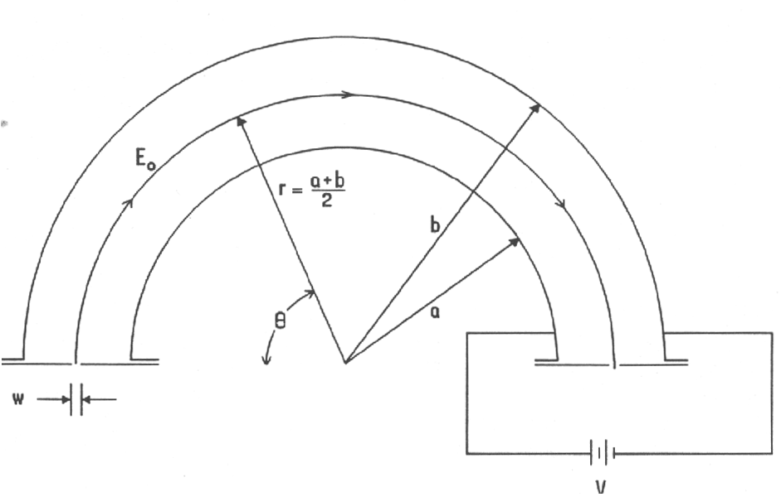
Electron energy analysis: The hemispherical analyzer

Slide 19
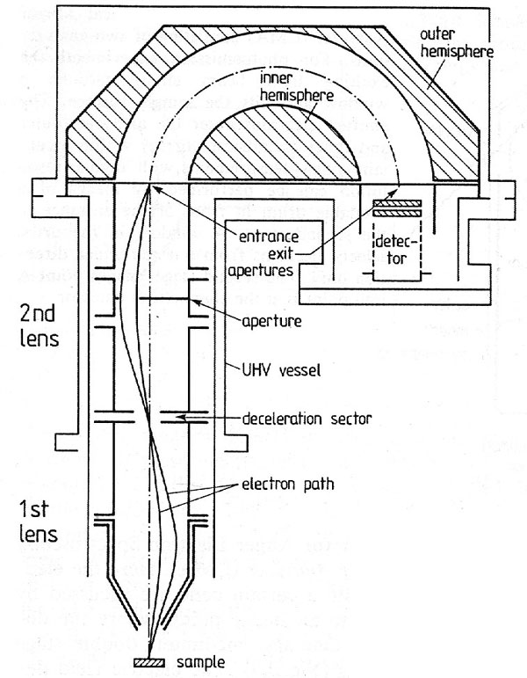
Hemispherical analyzer with retarding field lens

Slide 20
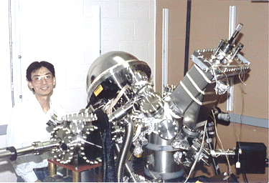

Slide 21
Atomic Force Microscopy

Slide 22
Introduction to the Atomic Force Microscope
AFM, Atomic Force Microscope is also known as SPM or Scanning Probe Microscopy,
AFM’s predecessor is the Scanning tunneling microscope.
STM was developed in 1981 by G. Binnig and H. Rohrer
Both were awarded the 1986 Nobel prize
AFM uses a high-resolution imaging technique that can resolve features as small as an atomic lattice.
Researchers use the AFM to observe and manipulate molecular and atomic level features.

Slide 23
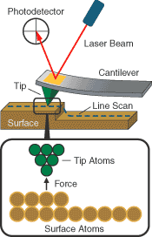
Working Principle of AFM
AFM works by bringing a cantilever tip in contact with the surface to be imaged.
A repulsive/attractive force from the surface atoms applied to the tip bends the cantilever upwards/downwards.
The amount of bending, measured by a laser spot reflected from the cantilever on to the photodetector.
The amount of bending can be used to calculate the force according to Hooke’s Law.

Slide 24
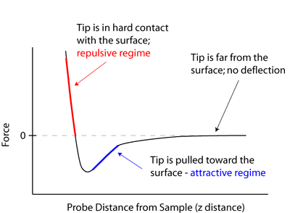
Different operating distances between the probe tip and the sample
There are many regimes of AFM operations.
The force is not measured directly, but calculated by measuring the deflection of the lever, and knowing the stiffness of the cantilever.
Hook’s law gives F = -kz, where F is the force, k is the stiffness of the lever, and z is the distance the lever is bent.

Slide 25
AFM Modes of operation
Mode of operation | Force of interaction
contact mode | strong (repulsive) - constant force or constant distance
non-contact mode | weak (attractive) - vibrating probe
intermittent contact mode | strong (repulsive) - vibrating probe
lateral force mode | frictional forces exert a torque on the scanning cantilever
magnetic force | the magnetic field of the surface is imaged
thermal scanning | the distribution of the thermal conductivity is imaged

Slide 26
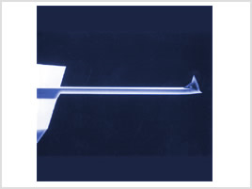
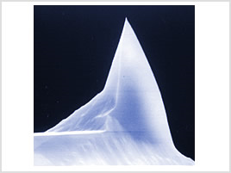
Probe tips
Probe tips from Veeco (TESP)
Resolution of the features depend on the probe tips
Sharper tips give the ability to image high aspect ratio images

Slide 27
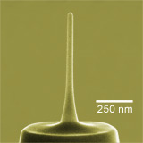
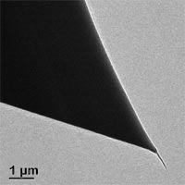
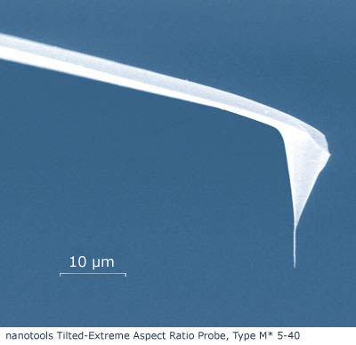
Super sharp AFM tips
To create super sharp AFM tips, carbon nano tubes are placed/grown on the tips
With sharper tips, we can image finer features with higher resolution
As the probes become sharper, the cost of the tip increases and the tips are more fragile.
Tips may be broken by the sample during scanning

Slide 28
Tip selection
Height (nm)
Position
Height (nm)
Position
Using a tip with a large radius could result in incorrect surface imaging
If a sharper tip is used, finer features can be observed with more information.

Slide 29
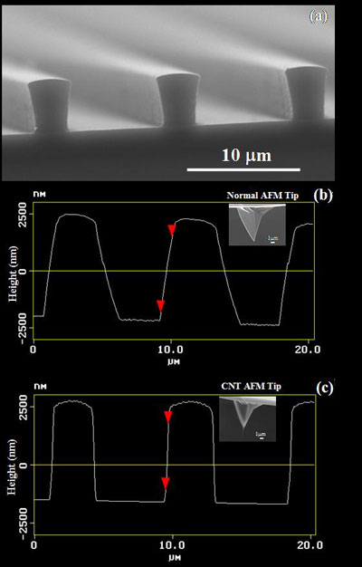
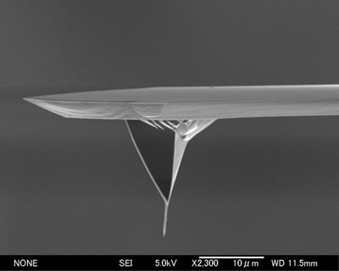
Carbon Nanotubes Tips

Slide 30







Leaders in AFM technology
Most of the AFM companies spun out from research institutes and universities
Park Scientific (Stanford University)
Renamed as Park Systems in 1997
Molecular imaging (Arizona State University)
Acquired by Agilent Technologies in 2005
Digital instruments (University of California – Santa Barbara)
Acquired by Veeco in 2002
For a full history check out: http://www.nanoscience.com/education/chronology.html

Slide 31
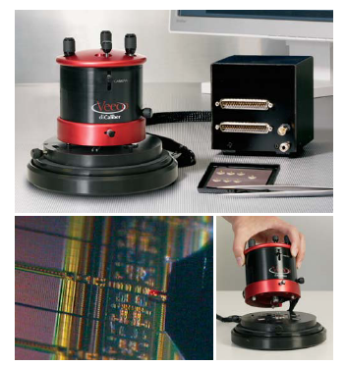
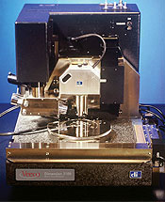
AFM systems
diCaliber SPM
Dimension 3100 SPM

Slide 32
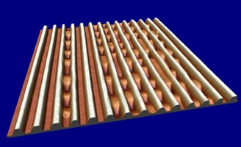
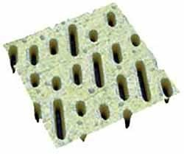
Data storage
HDDVDR recorded marks
AFM image of a CD

Slide 33
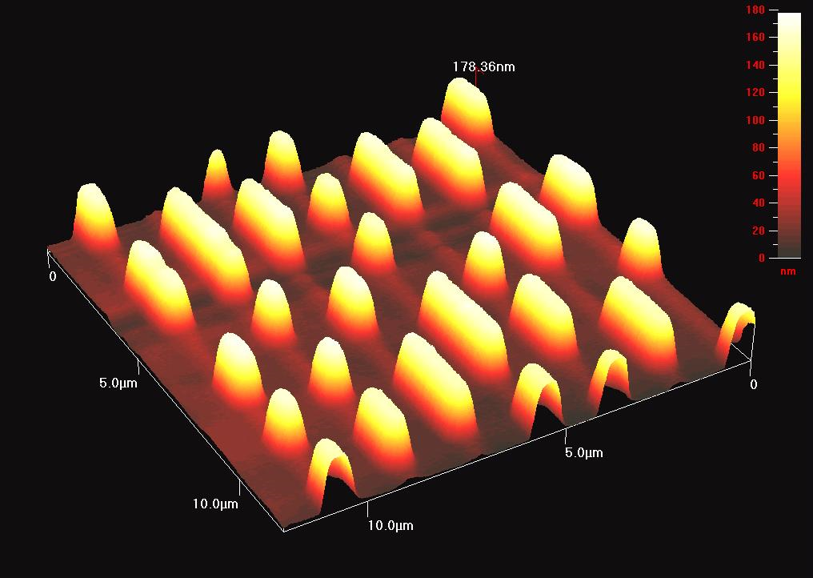
CD stamper

Slide 34
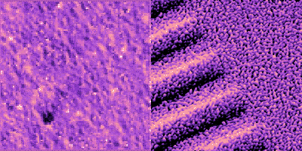
Data Storage
Track edge on metal-evaporated recording tape. Lubrication nodules and surface structure are visible in the topography image (left). The magnetic force image (right) used a lift height of 30 nm, and shows how the bit transitions are related to the virgin magnetic structure. 12 µm scan.

Slide 35
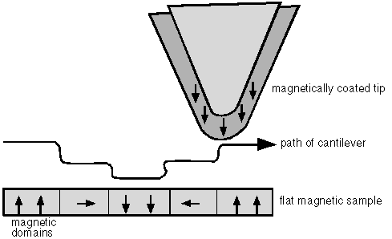
Magnetic Force Microscopy
S
N
Tip is coated with a ferromagnetic thin film
Non-contact mode - detecting changes in the resonant frequency of the cantilever induced by the magnetic field's dependence on tip-to-sample separation
Notes:
An image taken with a magnetic tip contains information about both the topography and the magnetic properties of a surface. Which effect dominates depends upon the distance of the tip from the surface, because the interatomic magnetic force persists for greater tip-to-sample separations than the van der Waals force. If the tip is close to the surface, in the region where standard non-contact AFM is operated, the image will be predominantly topographic. As you increase the separation between the tip and the sample, magnetic effects become apparent. Collecting a series of images at different tip heights is one way to separate magnetic from topographic effects.
http://www.mechmat.caltech.edu/~kaushik/park/1-3-0.htm

Slide 36
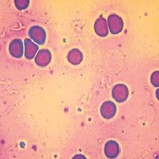
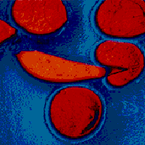
Biology – Imaging Red blood cells
Large scale (100µm) scan of red blood cells
Normal and sickled human red blood cells.

Slide 37
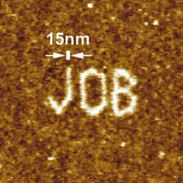
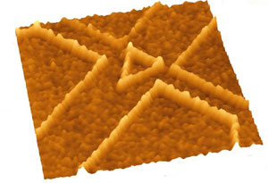
Latest developments in AFM technology
Nanolithography
AFM point-and-click Nanolithography with the low-noise Dimension CL SPM head
CP-II SPM nanolithography pattern created by anodic oxidation with AFM tip

Slide 38
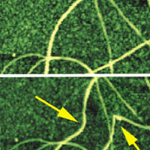
Latest developments in AFM technology
Nano-manipulation
Before
After
Carbon nanotube manipulation

Slide 39
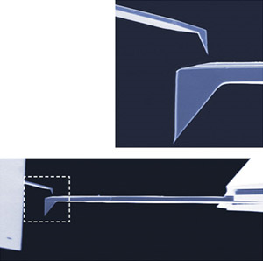
Latest developments in AFM technology
Improving positioning accuracy
Asylum systems Cypher AFM has positioning accuracies up to 60 picometers in the x, y, z directions
Implementing smaller laser dots sizes for deflection measurement
Allows smaller cantilevers to be used for high speed AC imaging
Small Cantilevers provide much higher resonant frequencies than conventional cantilevers without an increase in stiffness.
In-situ measurement of materials
Heat and measure the changes in the materials

Slide 40
Scanning Electron Microscopy

Slide 41
Scanning Electron Microscope
Operation is in high vacuum
Electrons are generated from an electron gun
Electrons are focused by electromagnetic lenses into a beam with diameter (0.4 nm to 5 nm)
Beam is raster scanned across a sample and the radiation signal is picked up by a detector which generates an image
Electron gun
Electrostatic/Magnetic lenses
Scanning coils
Detector

Slide 42
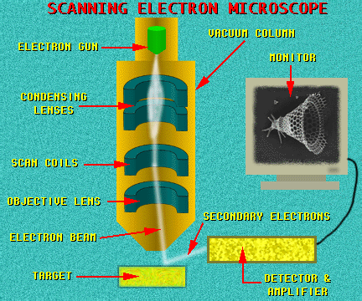

Slide 43
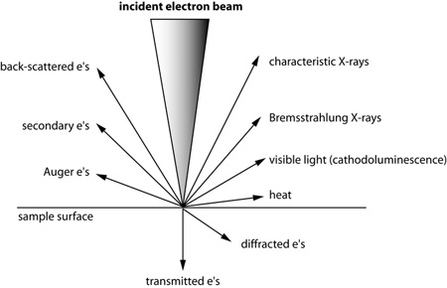
SEM details
Magnification of SEM
From x25 to x250,000
Hitachi S-5500 FeSEM x2 million
Radiation detected
Secondary electrons
Backscattered electrons
X-rays
Type of radiation observed depends on the detector in the SEM
Different radiation gives different information
Sample can be rotated to view topology from different angles
Grayscale images only
Where lots of electrons were given off in the direction of the secondary electron detector, the image is bright.
Where fewer reached the detector, the image is dark.

Slide 44
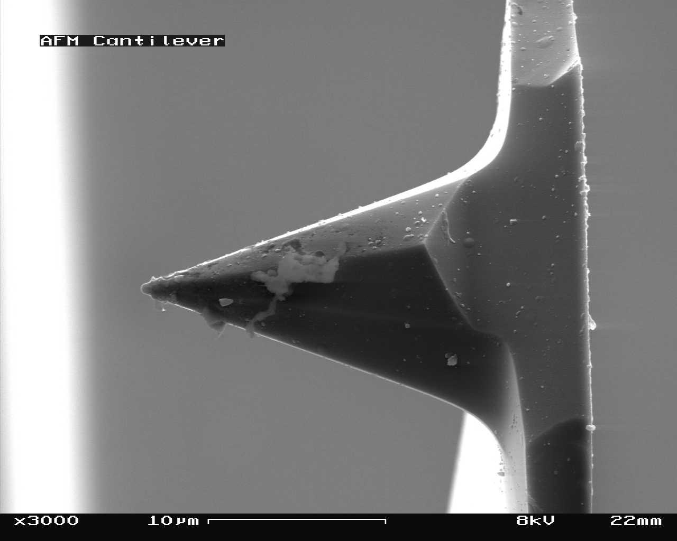
Reading an SEM image

Slide 45
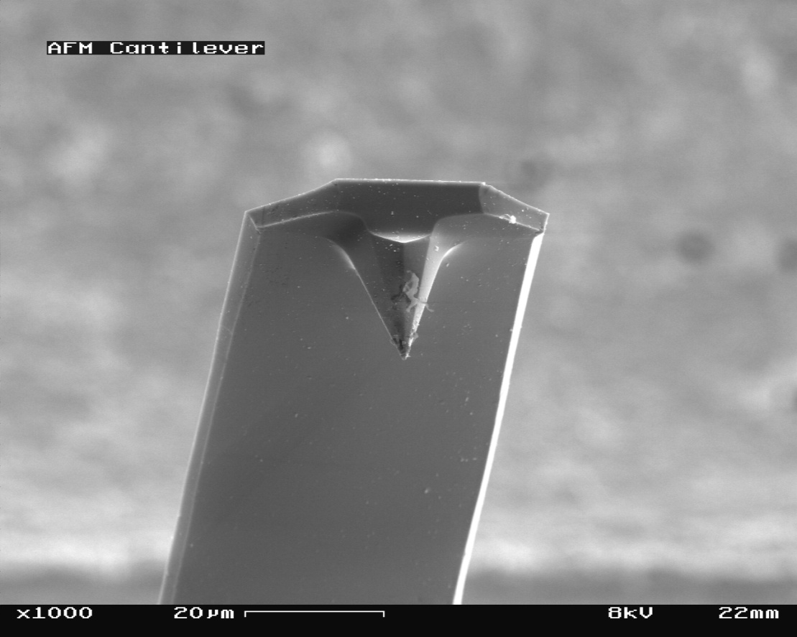
Assignment
Find the width of the AFM cantilever (Show your work)

Slide 46
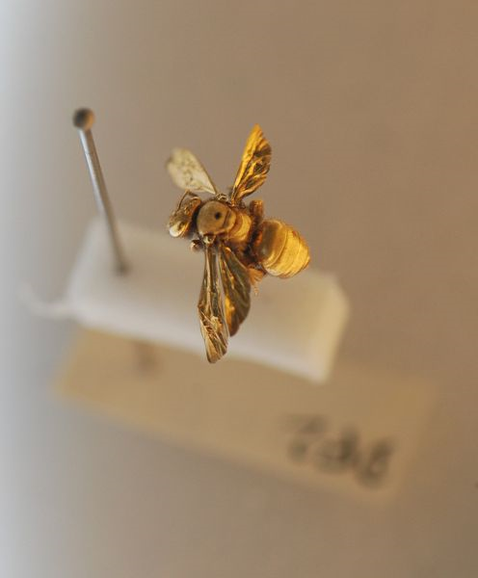
Sample preparation
Sample should be conductive if not charge accumulation occurs
Charging effects leads to image artifacts
Biological specimens may be examined but must be dried

Slide 47
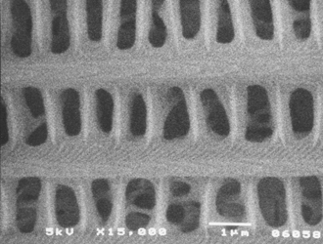
Cecropia Moth Scales x15,000
A close-up of the scale shows that it is mostly air, adding very little weight to the moth

Slide 48
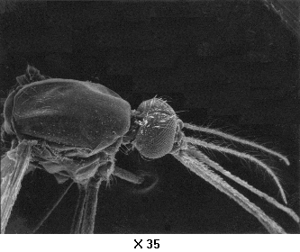
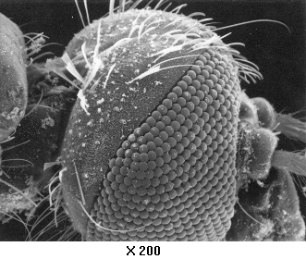
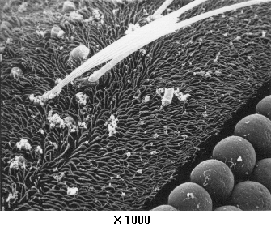
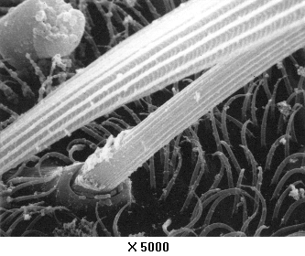
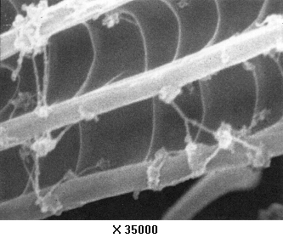
SEM image of the same mosquito

Slide 49
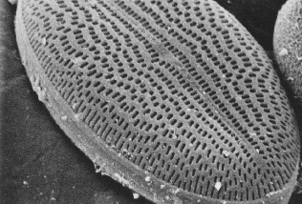
Diatoms x2000
Diatoms are tiny single celled plants that live inside a hard shell.
Shells can be collected and used as diatomaceous earth in swimming pool filters.
Shells allow water to pass through but trap any small dirt particles.

Slide 50
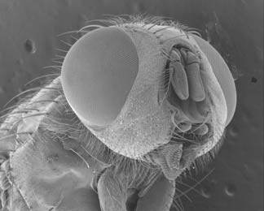
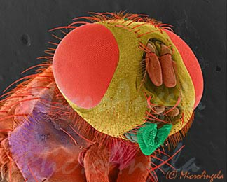
Coloured SEM images
SEM images are grayscale but can be editted

Slide 51
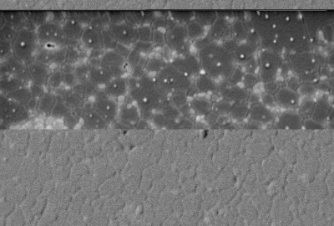
Backscattered electron images
Backscattered electrons give some information of the elements in the sample
Heavy elements (high atomic number) backscatter electrons more strongly than light elements (low atomic number)
Heavy elements appear brighter in the image
Used to detect contrast between areas with different chemical compositions
Top picture: The light spots correspond to the regions of Zirconium (40) in an Aluminum (13) background.
Backscattered Electrons
Secondary Electrons

Slide 52



Leaders in SEM technology
FEI and Jeol work mainly on electron microscopes
Cost of a FeSEM is $200-400k
Latest development in SEM technology
Adding probes for materials characterization
Multi beam SEM-FIB
Table top SEM

Slide 53
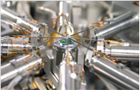
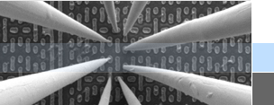

Probes in SEM
Probes used for semiconductor material characterization
Reliability/failure study of integrated circuits
Nano-manipulation of nano-structures

Slide 54

Multi-beam SEM-FIB
Focused Ion Beam (FIB) uses a beam of ions to mill the sample in the SEM
Allows us to view the cross-section of the sample

Slide 55


Table top SEM
Cost efficient
Little space needed
Quick sample loading time
Resolution (30 nm)
Ease of operation

Slide 56
References
Differential scanning calorimetry - Wikipedia, the free encyclopedia, http://en.wikipedia.org/wiki/Differential_scanning_calorimetry, Last Retrieved: 03/27/2009
Photoelectron spectroscopy, http://www.chem.qmul.ac.uk/surfaces/scc/scat5_3.htm, Last Retrieved: 03/27/2009
X-ray photoelectron spectroscopy, Wikipedia, the free encyclopedia, http://en.wikipedia.org/wiki/X-ray_photoelectron_spectroscopy, Last Retrieved: 03/27/2009
Photoemission, http://hamers.chem.wisc.edu/teaching/chem630_fall2006/xps/photoemission.ppt, Last Retrieved: 03/27/2009
AFM principles, http://www.weizmann.ac.il/Chemical_Research_Support/surflab/peter/afmworks/index.html, Last Retrieved: 03/27/2009
Agilent | What is an AFM?, http://nano.tm.agilent.com/index.cgi?CONTENT_ID=809&User:LANGUAGE=en-US, Last Retrieved: 03/27/2009
Agilent | AFM Image Library, http://nano.tm.agilent.com/index.cgi?CONTENT_ID=313, Last Retrieved: 03/27/2009
Atomic Force Microscopy Overview, http://www.nanoscience.com/education/AFM.html, Last Retrieved: 03/27/2009

Slide 57
References
Xintex Inc, Nanotechnology Innovations, http://www.xintek.com/products/afm/index.htm , Last Retrieved: 03/27/2009
Asylum Research, Introducting the Cypher AFM, http://www.asylumresearch.com/Products/Cypher/Cypher.shtml, Last Retrieved: 03/27/2009
SEM Tour slide 20, http://www.mos.org/sln/SEM/tour20.htmlm, Last Retrieved: 03/27/2009
Scanning Electron Microscope - Wikipedia, the free encyclopedia, http://en.wikipedia.org/wiki/Scanning_electron_microscope, Last Retrieved: 03/27/2009
Microangela’s Electron Microscope Image Gallery, http://www5.pbrc.hawaii.edu/microangela/, Last Retrieved: 03/27/2009
SEM – Image Gallery, http://www.mos.org/sln/SEM/sem.html, Last Retrieved: 03/27/2009
Nanotechnology at Zyvex, http://www.zyvex.com/Products/nProber_Features.html, Last Retrieved: 03/27/2009
JEOL JIB-4500 Multi-beam SEM-FIB, http://www.jeol.com/PRODUCTS/ElectronOptics/MultiBeamSEMFIB/JIB4500/tabid/502/Default.aspx, Last Retrieved: 03/27/2009
Phenom Desktop SEM, http://www.fei.com/products/families/phenom.aspx, Last Retrieved: 03/27/2009
Magnetic force Microscopy, http://www.mechmat.caltech.edu/~kaushik/park/1-3-0.htm, Last Retrieved: 03/31/2009

