Slide 1
Dijkstra’s Algorithm
SSSP, non-neg
Edge weights = w(x,y)
Final distances = d(x,y) = d_{w}(x,y)
b
2
2
s
2
e
6
2
c
6
1
d

Slide 2
Dijkstra’s Algorithm
SSSP, non-neg
s | b | c | d | e
0 | ∞ | ∞ | ∞ | ∞
L(x)
b
2
2
s
2
e
6
2
c
x <- extractmin
6
1
// L(x) is the distance of s to x
// mark x as final
d
"relax” all the edges out of x
L(y) <- min ( L(y), L(x) + w(x,y) )

Slide 3
Dijkstra’s Algorithm
SSSP, non-neg
s | b | c | d | e
0 | 2 | 6 | 6 | ∞
L(x)
b
2
2
s
2
e
6
2
c
x <- extractmin
6
1
// L(x) is the distance of s to x
// mark x as final
d
"relax” all the edges out of x
L(y) <- min ( L(y), L(x) + w(x,y) )

Slide 4
Dijkstra’s Algorithm
SSSP, non-neg
s | b | c | d | e
0 | 2 | 4 | 6 | 4
L(x)
b
2
2
s
2
e
6
2
c
x <- extractmin
6
1
// L(x) is the distance of s to x
// mark x as final
d
"relax” all the edges out of x
L(y) <- min ( L(y), L(x) + w(x,y) )

Slide 5
Dijkstra’s Algorithm
SSSP, non-neg
s | b | c | d | e
0 | 2 | 4 | 6 | 4
L(x)
b
2
2
s
2
e
6
2
c
x <- extractmin
6
1
// L(x) is the distance of s to x
// mark x as final
d
"relax” all the edges out of x
L(y) <- min ( L(y), L(x) + w(x,y) )

Slide 6
Dijkstra’s Algorithm
SSSP, non-neg
s | b | c | d | e
0 | 2 | 4 | 5 | 4
L(x)
b
2
2
s
2
e
6
2
c
x <- extractmin
6
1
// L(x) is the distance of s to x
// mark x as final
d
"relax” all the edges out of x
L(y) <- min ( L(y), L(x) + w(x,y) )

Slide 7
Dijkstra’s Algorithm
SSSP, non-neg
m decreasekeys
n extractmins
Fib heap: O(m + n log n)
s | b | c | d | e
0 | 2 | 4 | 5 | 4
L(x)
b
2
2
s
2
e
6
2
c
x <- extractmin
6
1
// L(x) is the distance of s to x
// mark x as final
d
"relax” all the edges out of x
L(y) <- min ( L(y), L(x) + w(x,y) )

Slide 8
Bellman-Ford-Moore Algorithm
SSSP, neg wts OK

Slide 9
Bellman-Ford-Moore Algorithm
SSSP, neg wts OK
n rounds
m time per round
O(mn) time
s | b | c | d | e
0 | ∞ | ∞ | ∞ | ∞
L(x)
// L(x) is an upper bound on d(s,x)
b
2
2
s
2
e
for t = 1 to n-1
6
-2
for all vertices x
c
// "relax” all the edges out of x
6
1
L(y) <- min ( L(y), L(x) + w(x,y) )
d
Claim: if graph has non negative cycles, B-F-M is OK.
Proof: induction. At end of round t, L(y) is shortest path using at most t edges.

Slide 10
Bellman-Ford-Moore Algorithm
SSSP, neg wts OK
n rounds
m time per round
O(mn) time
s | b | c | d | e
0 | 2 | 2 | 5 | 4
L(x)
// L(x) is an upper bound on d(s,x)
b
2
2
s
2
e
for t = 1 to n-1
6
-2
for all vertices x
c
// "relax” all the edges out of x
6
1
L(y) <- min ( L(y), L(x) + w(x,y) )
d
Claim: if graph has non negative cycles, B-F-M is OK.
Proof: induction. At end of round t, L(y) is shortest path using at most t edges.

Slide 11
Bellman-Ford-Moore Algorithm
SSSP, neg wts OK
n rounds
m time per round
O(mn) time
s | b | c | d | e
0 | 2 | 2 | 5 | 4
L(x)
// L(x) is an upper bound on w(s,x)
b
2
2
s
2
e
for t = 1 to n-1
6
-2
for all vertices x
c
// "relax” all the edges out of x
6
1
L(y) <- min ( L(y), L(x) + w(x,y) )
d
Claim: If at end, some edge xy is “over-tight”
( it has L(y) > L(x) + w(x,y) )
then graph has negative cycle.

Slide 12
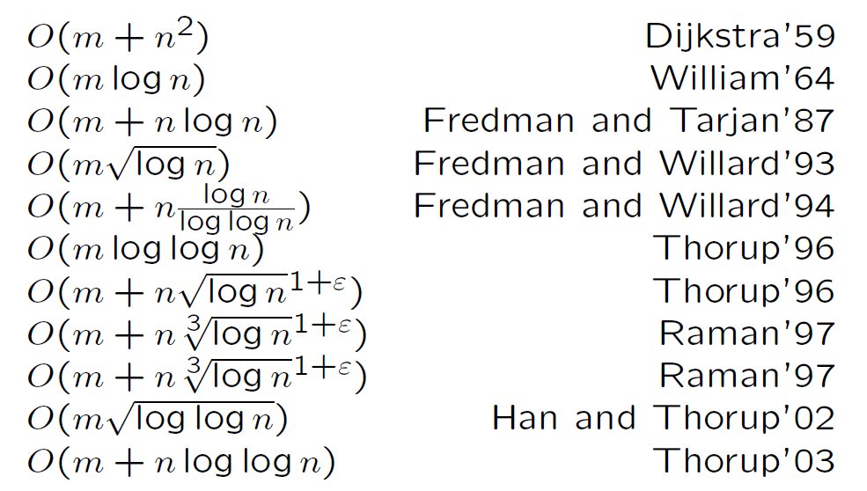
Lots more work!
E.g., extensions and implementations of (just) Dijkstra’s algorithm:
slide from Mikkel Thorup

Slide 13
All Pairs SP
Non-neg weights:
n Dijkstras O(mn + n² log n)
Neg weights:
n B-F-M O(mn²)

Slide 14
Johnson’s Algorithm
APSP, neg wts OK
Find “feasible potentials” ©(x) such that
the “reduced weights”
ŵ(x,y) := ©(x) + w(x,y) - ©(y) ≥ 0
Fact: reduced weights ŵ non-neg
Claim: d_{w} (x,y) = d_{ŵ}(x,y) + ©(y) - ©(x)
b
2
2
e
So shortest paths don’t change, though
their weights might.
⇒ suffices to find APSP in this
non-neg weights graph!
s
2
6
-2
c
6
1
How to find these “feasible potentials”?
d

Slide 15
Johnson’s Algorithm
APSP, neg wts OK
Find “feasible potentials” ©(x) such that
the “reduced weights”
ŵ(x,y) := ©(x) + w(x,y) - ©(y) ≥ 0
Fact: reduced weights ŵ non-neg
Claim: d_{w} (x,y) = d_{ŵ}(x,y) + ©(y) - ©(x)
b
2
2
e
So shortest paths don’t change, though
their weights might.
⇒ suffices to find APSP in this
non-neg weights graph!
s
2
6
-2
c
6
1
0
0
How to find these “feasible potentials”?
d
0
0
Shortest paths from Z.
No negative cycles created, so B-F-M works.
0
Z

Slide 16
All Pairs SP
Non-neg weights:
n Dijkstras O(mn + n² log n)
Neg weights:
n B-F-M O(mn²)
Neg weights:
B-F-M + n Dijkstras O(mn + n² log n)
Neg weights:
Floyd-Warshall O(n³)
for all vertices z
for all vertices x,y
d(x,y) <- min{ d(x,y), d(x,z) + d(z,y)

Slide 17
All Pairs SP
Non-neg weights:
n Dijkstras O(mn + n² log n)
Neg weights:
n B-F-M O(mn²)
Neg weights:
B-F-M + n Dijkstras O(mn + n² log n)
Neg weights:
Floyd-Warshall O(n³)
Neg weights:
Naïve Min-Sum-Product O(n³ log n)

