Slide 1
Solving Imperfect-Information Games with CFR
Noam Brown
Carnegie Mellon University
Computer Science Department

Slide 2
Review: Imperfect-Information Game Tree
C
0.2
0.3
0.5
Information set
P1
P1
P1
Negotiations, security, poker
P2
P2
C
0.5
0.5
2,-2

Slide 3
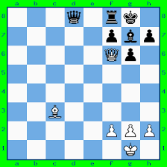
Search in Perfect-Information Games

Slide 4
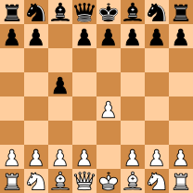
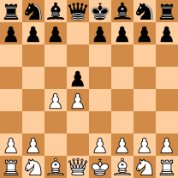
Search in Perfect-Information Games
Sicilian Defense
Queen’s Gambit
An optimal response to Queen’s Gambit does not depend on Sicilian Defense
This is not true in imperfect-information games

Slide 5
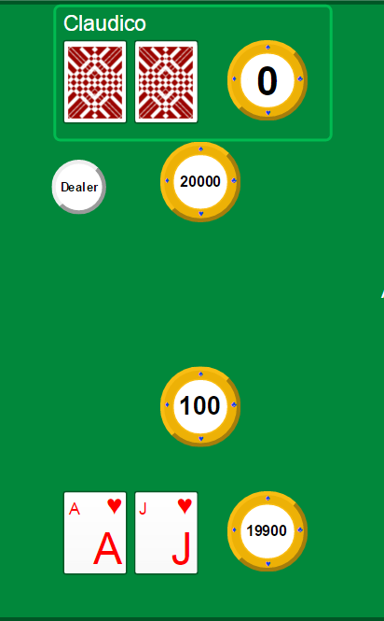
Search in Imperfect-Information Games
Only two options: call or fold
Optimal choice depends on probability distribution of opponent hands (probability distribution over states in this information set)
Opponent hand distribution depends on what they could get for alternative actions for each hand
Therefore, we must consider the entire game as a whole

Slide 6



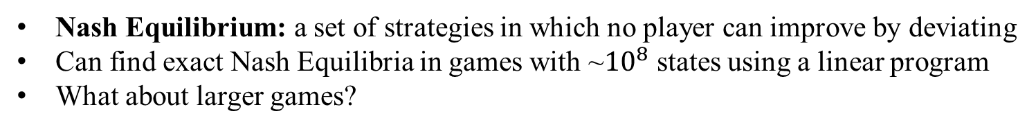
Review: Nash Equilibrium
Nash Equilibrium: a set of strategies in which no player can improve by deviating
Can find exact Nash Equilibria in games with ~${10}^{8}$ states using a linear program
What about larger games?
P1
1/3
1/3
1/3
P2
P2
P2
1/3
1/3
1/3
1/3
1/3
1/3
1/3
1/3
1/3
0
-1
1
1
0
-1
-1
1
0

Slide 7

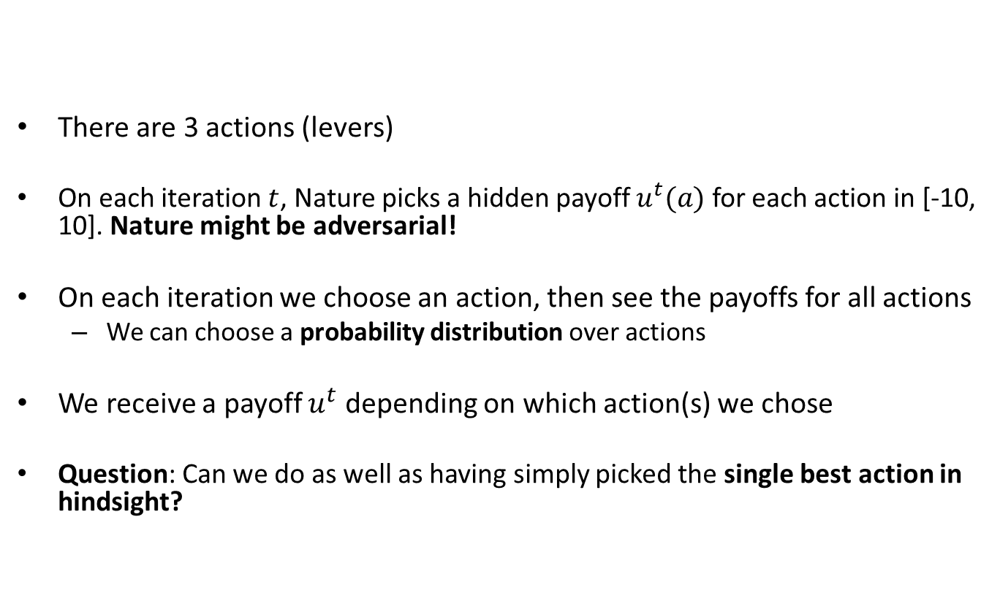
Regret Minimization
There are 3 actions (levers)
On each iteration $t$, Nature picks a hidden payoff $u^{t}(a)$ for each action in [-10, 10]. Nature might be adversarial!
On each iteration we choose an action, then see the payoffs for all actions
We can choose a probability distribution over actions
We receive a payoff $u^{t}$ depending on which action(s) we chose
Question: Can we do as well as having simply picked the single best action in hindsight?

Slide 8
Regret Minimization: Example
Iteration 1
Payoff: 10
Payoff: 0
Payoff: 10
Lever A
Lever B
Lever C
Average Payoff: 0
Average Payoff: 0
Average Payoff: 0
Our Average Payoff: 0
Difference between our
payoff and the best lever
Regret: 0

Slide 9

Regret Minimization: Example
Iteration 1
Payoff: 10
Payoff: 0
Payoff: 10
Lever A
Lever B
Lever C
Average Payoff: 10
Average Payoff: 0
Average Payoff: 10
Our Average Payoff: $0$
Regret: 10

Slide 10
Regret Minimization: Example
Iteration 2
1/3
1/3
1/3
Payoff: 10
Payoff: -10
Payoff: -10
Lever A
Lever B
Lever C
Average Payoff: 10
Average Payoff: -10
Average Payoff: 10
Our Average Payoff: $0$
Regret: 10

Slide 11


Regret Minimization: Example
Iteration 2
1/3
1/3
1/3
Payoff: 10
Payoff: -10
Payoff: -10
Lever A
Lever B
Lever C
Average Payoff: 10
Average Payoff: -5
Average Payoff: 0
Our Average Payoff: $−3\frac{1}{3}$
Regret: $13\frac{1}{3}$

Slide 12
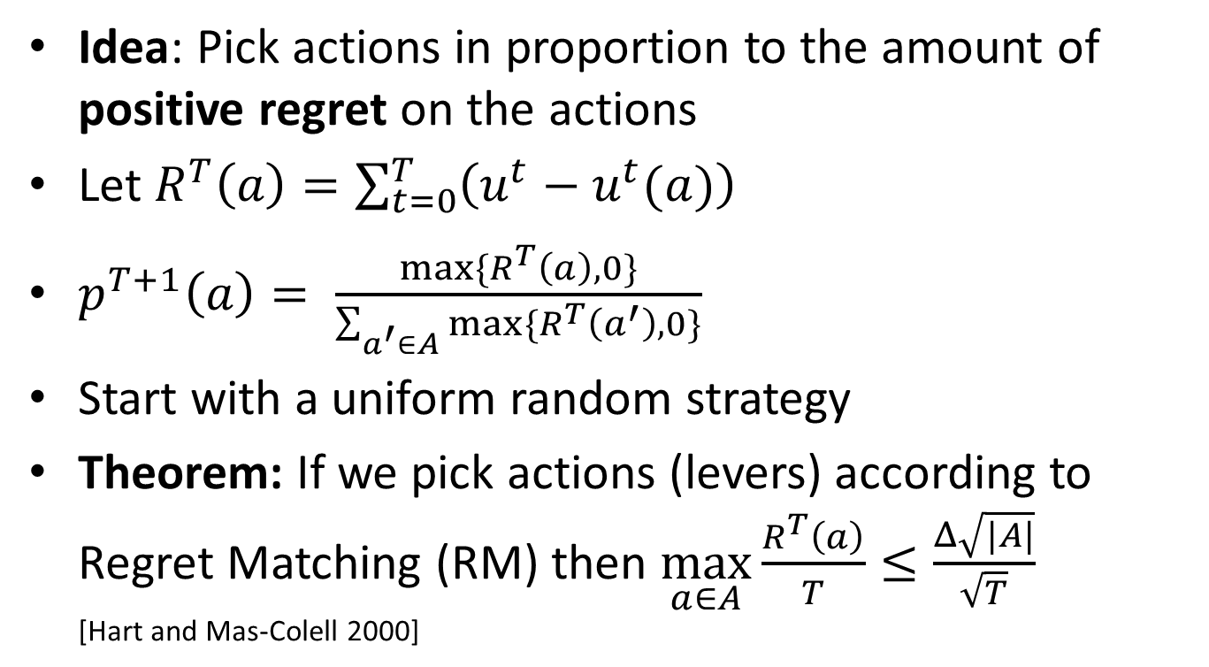
Regret Matching
Idea: Pick actions in proportion to the amount of positive regret on the actions
Let $R^{T}\left(a\right)=\sum_{t=0}^{T}{\left(u^{t}−u^{t}(a)\right)}$
$p^{T+1}\left(a\right)= \frac{max⁡\{R^{T}\left(a\right),0\}}{\sum_{a^{′}∈A}{max⁡\{R^{T}\left(a^{′}\right),0\}}}$
Start with a uniform random strategy
Theorem: If we pick actions (levers) according to Regret Matching (RM) then $\max_{a∈A}{\frac{R^{T}\left(a\right)}{T}≤\frac{Δ\sqrt{|A|}}{\sqrt{T}}}$ [Hart and Mas-Colell 2000]
Range of payoffs
(20 in our example)
Number of actions

Slide 13
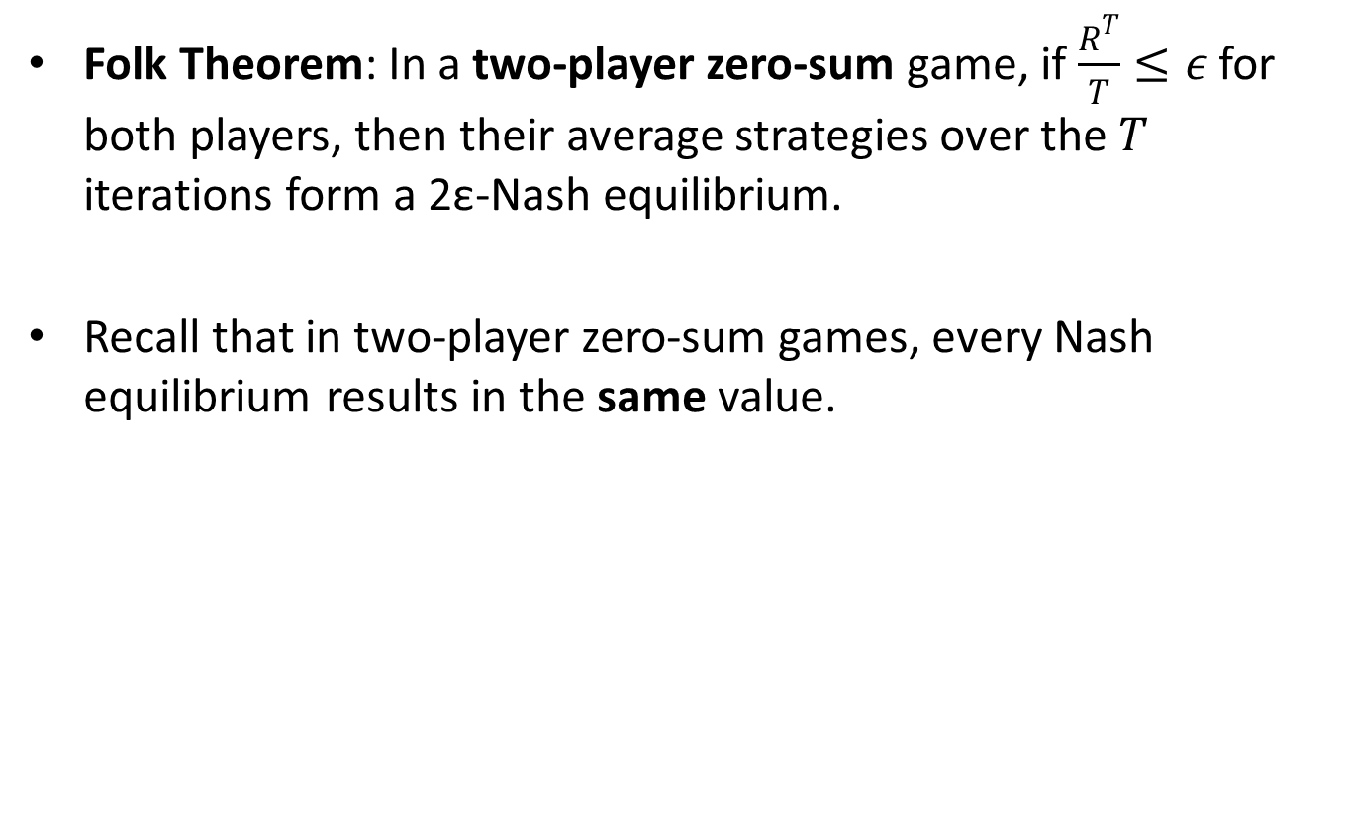
Convergence to Nash Equilibrium
Folk Theorem: In a two-player zero-sum game, if $\frac{R^{T}}{T}≤ε$ for both players, then their average strategies over the $T$ iterations form a 2ε-Nash equilibrium.
Recall that in two-player zero-sum games, every Nash equilibrium results in the same value.

Slide 14
Regret Matching
Iteration 0
Strategy Sum: | 0.0 | 0.0
Regret Sum: | 0.0 | 0.0
Strategy Sum: | Regret Sum:
0.0 | 0.0
0.0 | 0.0
 | Left 50% | Right 50%
Up 50% | 1 | 0
Down 50% | 0 | 2

Slide 15
Regret Matching
Iteration 0
Strategy Sum: | 0.5 | 0.5
Regret Sum: | 0.0 | 0.0
Strategy Sum: | Regret Sum:
0.5 | 0.0
0.5 | 0.0
 | Left 50% | Right 50%
Up 50% | 1 | 0
Down 50% | 0 | 2

Slide 16
Regret Matching
Iteration 0
Strategy Sum: | 0.5 | 0.5
Regret Sum: | 0.0 | 0.0
Strategy Sum: | Regret Sum:
0.5 | 0.0
0.5 | 0.0
 | Left 50% | Right 50%
Up 50% | 1 | 0
Down 50% | 0 | 2
Expected Value: 0.75

Slide 17
Regret Matching
Iteration 0
Strategy Sum: | 0.5 | 0.5
Regret Sum: | 0.0 | 0.0
Strategy Sum: | Regret Sum:
0.5 | 0.0
0.5 | 0.0
 | Left 50% | Right 50%
Up 50% | 1 | 0
Down 50% | 0 | 2
Expected Value: 0.75
Up: 0.5
Regret: 0.5 – 0.75 = -0.25
Down: 1
Regret: 1.0 – 0.75 = 0.25

Slide 18
Regret Matching
Iteration 0
Strategy Sum: | 0.5 | 0.5
Regret Sum: | 0.25 | -0.25
Strategy Sum: | Regret Sum:
0.5 | -0.25
0.5 | 0.25
 | Left 50% | Right 50%
Up 50% | 1 | 0
Down 50% | 0 | 2
Expected Value: 0.75
Up: 0.5
Regret: 0.5 – 0.75 = -0.25
Down: 1
Regret: 1.0 – 0.75 = 0.25

Slide 19
Regret Matching
Iteration 1
Strategy Sum: | 0.5 | 0.5
Regret Sum: | 0.25 | -0.25
Strategy Sum: | Regret Sum:
0.5 | -0.25
0.5 | 0.25
 | Left 100% | Right 0%
Up 0% | 1 | 0
Down 100% | 0 | 2

Slide 20
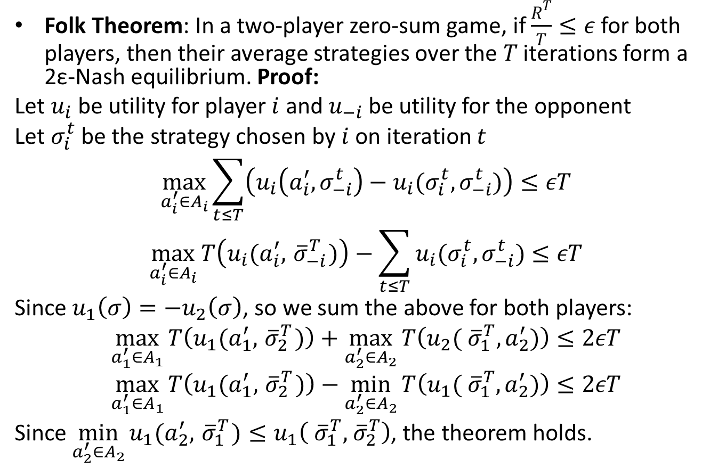
Proof of Convergence
Folk Theorem: In a two-player zero-sum game, if $\frac{R^{T}}{T}≤ε$ for both players, then their average strategies over the $T$ iterations form a 2ε-Nash equilibrium. Proof:
Let $u_{i}$ be utility for player $i$ and $u_{−i}$ be utility for the opponent
Let $σ_{i}^{t}$ be the strategy chosen by $i$ on iteration $t$
$$\max_{a_{i}^{′}∈A_{i}}{\sum_{t≤T}{\left(u_{i}\left(a_{i}^{′},σ_{−i}^{t}\right)−u_{i}(σ_{i}^{t},σ_{−i}^{t})\right)}}≤εT$$
$$\max_{a_{i}^{′}∈A_{i}}{T\left(u_{i}(a_{i}^{′},{ \overline{σ}}_{−i}^{T})\right)−\sum_{t≤T}{u_{i}(σ_{i}^{t},σ_{−i}^{t})}}≤εT$$
Since $u_{1}\left(σ\right)=−u_{2}\left(σ\right)$, so we sum the above for both players:
$$\max_{a_{1}^{′}∈A_{1}}{T\left(u_{1}(a_{1}^{′},{ \overline{σ}}_{2}^{T})\right)}+\max_{a_{2}^{′}∈A_{2}}{T\left(u_{2}({ \overline{σ}}_{1}^{T},a_{2}^{′})\right)}≤2εT$$
$$\max_{a_{1}^{′}∈A_{1}}{T\left(u_{1}(a_{1}^{′},{ \overline{σ}}_{2}^{T})\right)}−\min_{a_{2}^{′}∈A_{2}}{T\left(u_{1}({ \overline{σ}}_{1}^{T},a_{2}^{′})\right)}≤2εT$$
Since $\min_{a_{2}^{′}∈A_{2}}{u_{1}(a_{2}^{′},{ \overline{σ}}_{1}^{T})}≤u_{1}\left({ \overline{σ}}_{1}^{T},{ \overline{σ}}_{2}^{T}\right)$, the theorem holds.
Regret
{
}
Average
strategy
By symmetry
this holds for
player 2 too.

Slide 21
Warm Starting for Regret Minimization
[Brown & Sandholm AAAI-16]

Slide 22
Warm Starting for Regret Minimization
Iteration 0
Strategy Sum: | 0.0 | 0.0
Regret Sum: | 0.0 | 0.0
Strategy Sum: | Regret Sum:
0.0 | 0.0
0.0 | 0.0
 | Left 50% | Right 50%
Up 50% | 1 | 0
Down 50% | 0 | 2
Idea: Rather than start uniformly random, start with the input strategies.

Slide 23
Ineffective Warm Starting
Iteration 0
Strategy Sum: | 0.0 | 0.0
Regret Sum: | 0.0 | 0.0
Strategy Sum: | Regret Sum:
0.0 | 0.0
0.0 | 0.0
 | Left 67% | Right 33%
Up 67% | 1 | 0
Down 33% | 0 | 2
Idea: Rather than start uniformly random, start with the input strategies.

Slide 24
Ineffective Warm Starting
Iteration 0
Strategy Sum: | 0.67 | 0.33
Regret Sum: | -0.0023 | 0.0067
Strategy Sum: | Regret Sum:
0.67 | 0.0023
0.33 | -0.0067
 | Left 67% | Right 33%
Up 67% | 1 | 0
Down 33% | 0 | 2

Slide 25
Ineffective Warm Starting
Iteration 0
Strategy Sum: | 0.67 | 0.33
Regret Sum: | -0.0023 | 0.0067
Strategy Sum: | Regret Sum:
0.67 | 0.0023
0.33 | -0.0067
 | Left 0% | Right 100%
Up 100% | 1 | 0
Down 0% | 0 | 2

Slide 26
Ineffective Warm Starting
Iteration 0
Strategy Sum: | 0.67 | 0.33
Regret Sum: | -1.0023 | 0.0067
Strategy Sum: | Regret Sum:
0.67 | 0.0023
0.33 | 1.9933
 | Left 0% | Right 100%
Up 100% | 1 | 0
Down 0% | 0 | 2
Intuitively, not initializing the regrets is similar to
not setting the initial step size in gradient decent.

Slide 27
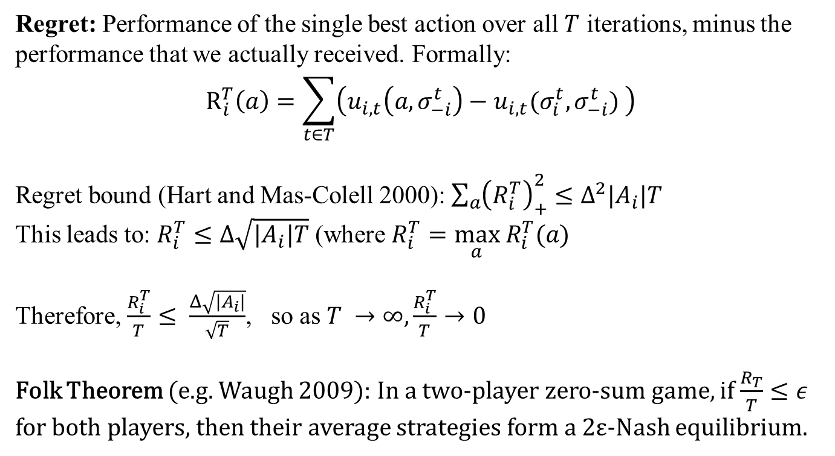
Review of Regret Matching
Regret: Performance of the single best action over all $T$ iterations, minus the performance that we actually received. Formally:
$$R_{i}^{T}\left(a\right)=\sum_{t∈T}{\left(u_{i,t}\left(a,σ_{−i}^{t}\right)−u_{i,t}(σ_{i}^{t},σ_{−i}^{t}) \right)}$$
Regret bound (Hart and Mas-Colell 2000): $\sum_{a}{{\left(R_{i}^{T}\right)}_{+}^{2}}≤Δ^{2}|A_{i}|T$
This leads to: $R_{i}^{T}≤Δ\sqrt{|A_{i}|T}$ (where $R_{i}^{T}=\max_{a} R_{i}^{T}(a)$
Therefore, $\frac{R_{i}^{T}}{T}≤ \frac{Δ\sqrt{|A_{i}|}}{\sqrt{T}}$, so as $T →∞,\frac{R_{i}^{T}}{T}→0$
Folk Theorem (e.g. Waugh 2009): In a two-player zero-sum game, if $\frac{R_{T}}{T}≤ε$ for both players, then their average strategies form a 2ε-Nash equilibrium.

Slide 28
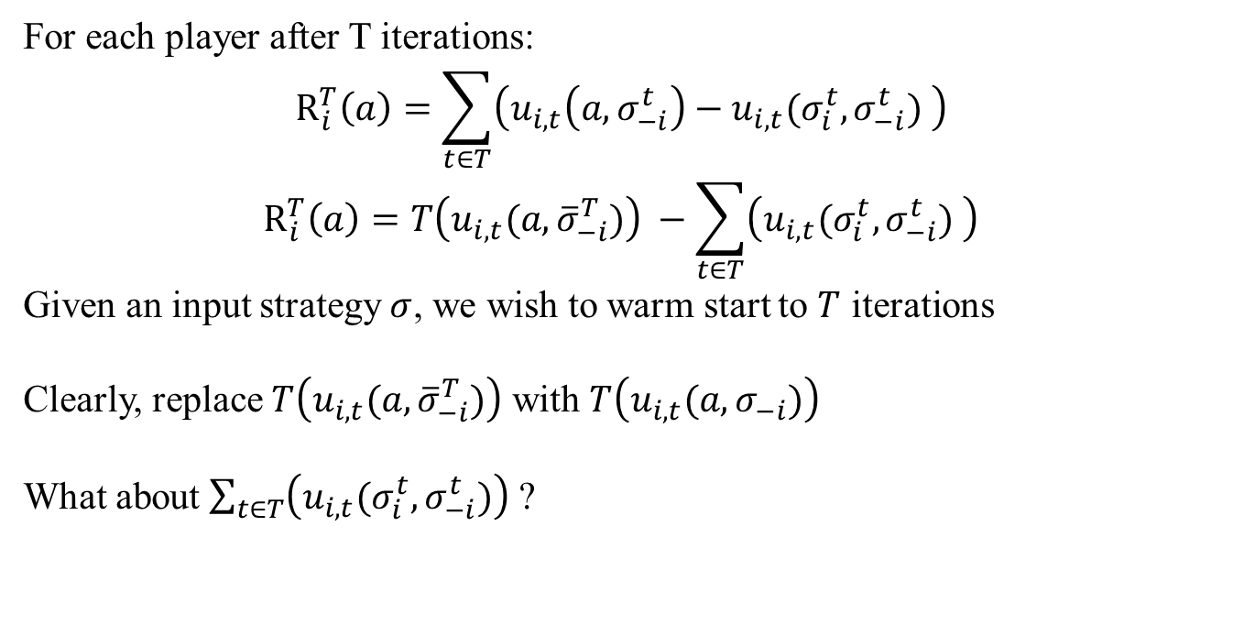
Warm Starting for Regret Minimization [Brown & Sandholm AAAI-16]
For each player after T iterations:
$$R_{i}^{T}\left(a\right)=\sum_{t∈T}{\left(u_{i,t}\left(a,σ_{−i}^{t}\right)−u_{i,t}(σ_{i}^{t},σ_{−i}^{t}) \right)}$$
$$R_{i}^{T}\left(a\right)=T\left(u_{i,t}{(a,\overline{σ}}_{−i}^{T})\right) −\sum_{t∈T}{\left(u_{i,t}(σ_{i}^{t},σ_{−i}^{t}) \right)}$$
Given an input strategy $σ$, we wish to warm start to $T$ iterations
Clearly, replace $T\left(u_{i,t}{(a,\overline{σ}}_{−i}^{T})\right)$ with $T\left(u_{i,t}(a,σ_{−i})\right)$
What about $\sum_{t∈T}{\left(u_{i,t}(σ_{i}^{t},σ_{−i}^{t})\right)}$ ?

Slide 29
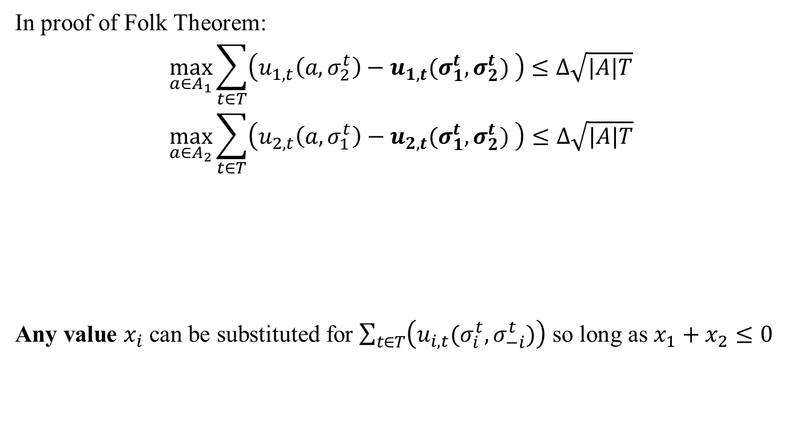
Warm Starting for Regret Minimization [Brown & Sandholm AAAI-16]
In proof of Folk Theorem:
$$\max_{a∈A_{1}}{\sum_{t∈T}{\left(u_{1,t}\left(a,σ_{2}^{t}\right)−u_{1,t}(σ_{1}^{t},σ_{2}^{t}) \right)}}≤Δ\sqrt{|A|T}$$
$$\max_{a∈A_{2}}{\sum_{t∈T}{\left(u_{2,t}\left(a,σ_{1}^{t}\right)−u_{2,t}(σ_{1}^{t},σ_{2}^{t}) \right)}}≤Δ\sqrt{|A|T}$$
Any value $x_{i}$ can be substituted for $\sum_{t∈T}{\left(u_{i,t}(σ_{i}^{t},σ_{−i}^{t})\right)}$ so long as $x_{1}+x_{2}≤0$
Cancels out

Slide 30
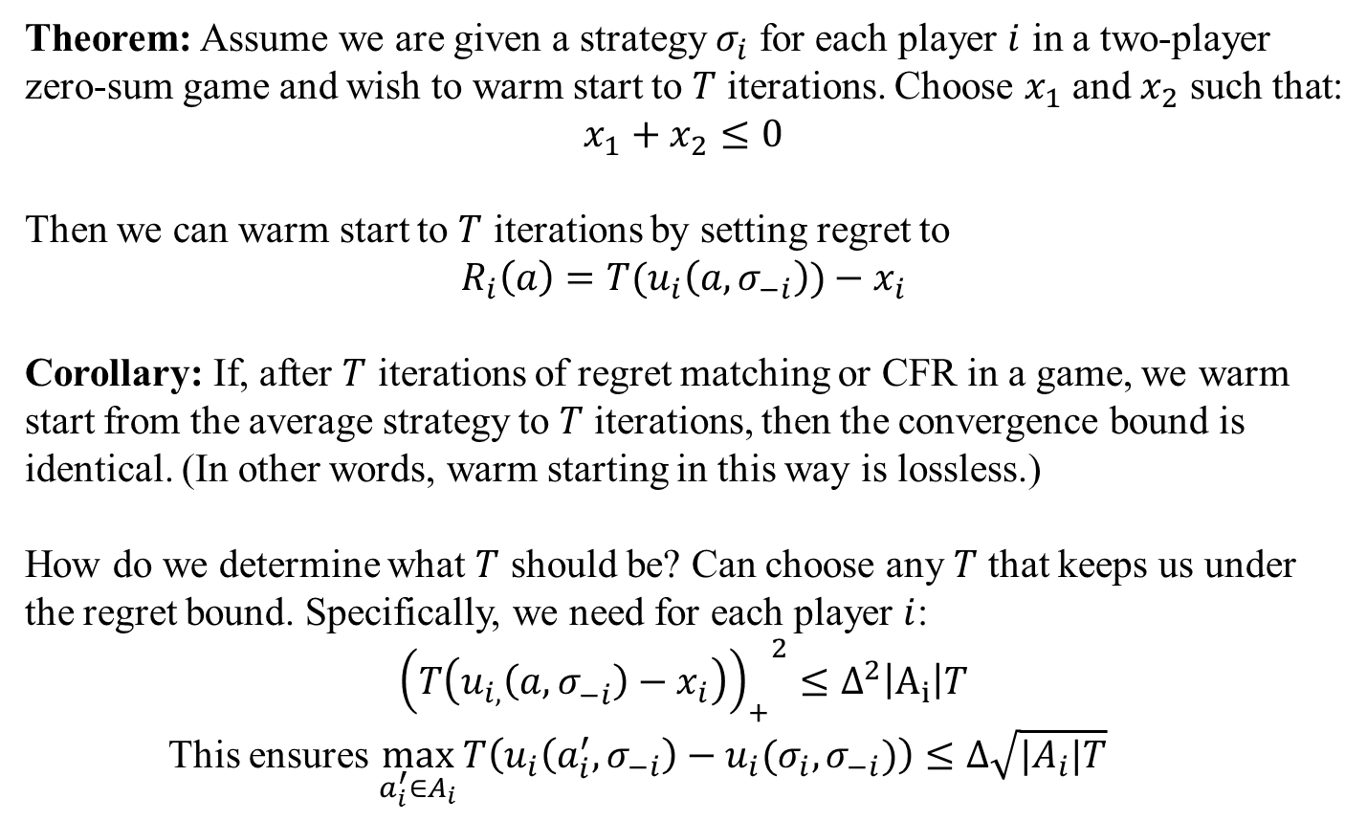
Warm Starting for Regret Minimization [Brown & Sandholm AAAI-16]
Theorem: Assume we are given a strategy $σ_{i}$ for each player $i$ in a two-player zero-sum game and wish to warm start to $T$ iterations. Choose $x_{1}$ and $x_{2}$ such that:
$$x_{1}+x_{2}≤0$$
Then we can warm start to $T$ iterations by setting regret to
$$R_{i}\left(a\right)=T(u_{i}\left(a,σ_{−i}\right))−x_{i}$$
Corollary: If, after $T$ iterations of regret matching or CFR in a game, we warm start from the average strategy to $T$ iterations, then the convergence bound is identical. (In other words, warm starting in this way is lossless.)
How do we determine what $T$ should be? Can choose any $T$ that keeps us under the regret bound. Specifically, we need for each player $i$:
$${{\left(T\left(u_{i,}\left(a,σ_{−i}^{}\right)−x_{i}\right)\right)}_{+}}^{2}≤Δ^{2}\left|A_{i}\right|T$$
This ensures $\max_{a_{i}^{′}∈A_{i}}{T\left(u_{i}\left(a_{i}^{′},σ_{−i}\right)−u_{i}(σ_{i},σ_{−i})\right)}≤Δ\sqrt{|A_{i}|T}$

Slide 31
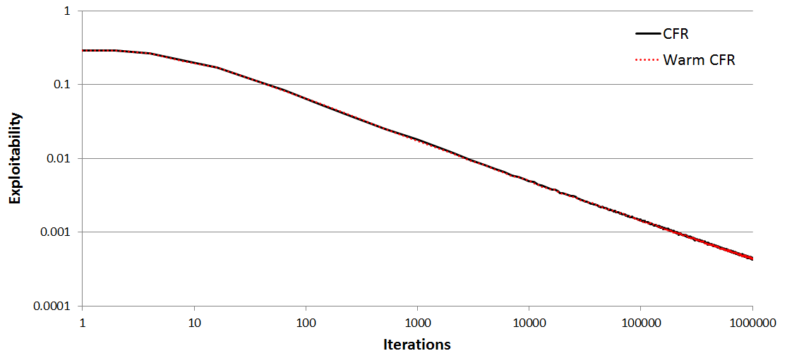
Warm Starting for Regret Minimization

Slide 32
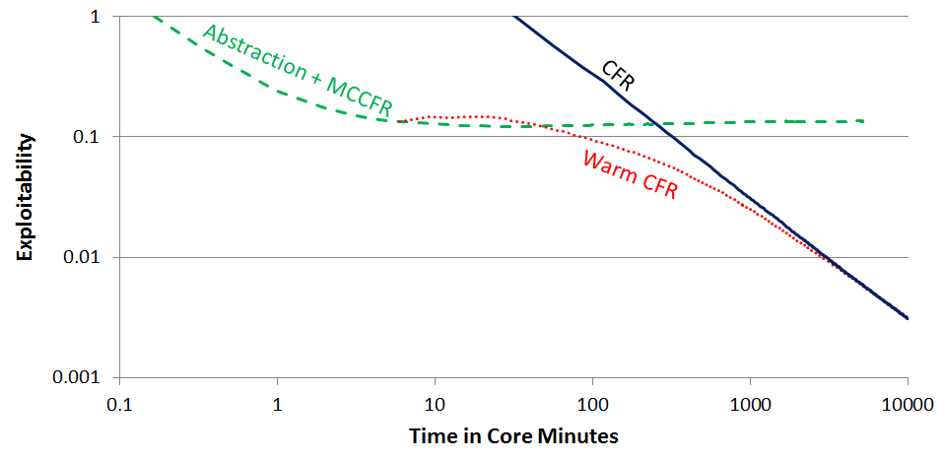
Warm Starting for Regret Minimization

Slide 33
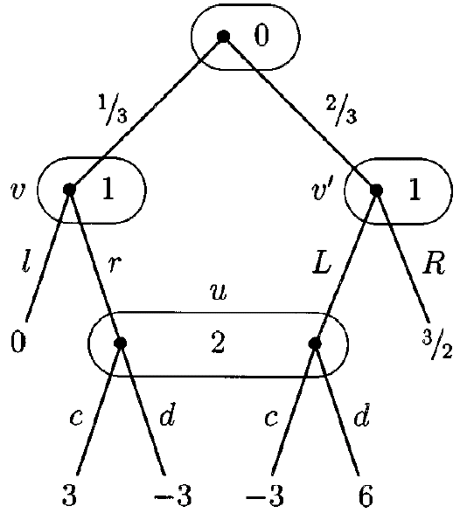
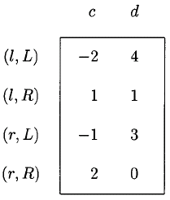
Counterfactual Regret Minimization (CFR)
Recall: All extensive-form games can be converted to normal-form games, so Regret Matching can always be applied.
However, the size of the normal-form game can grow exponentially with the number of actions.

Slide 34
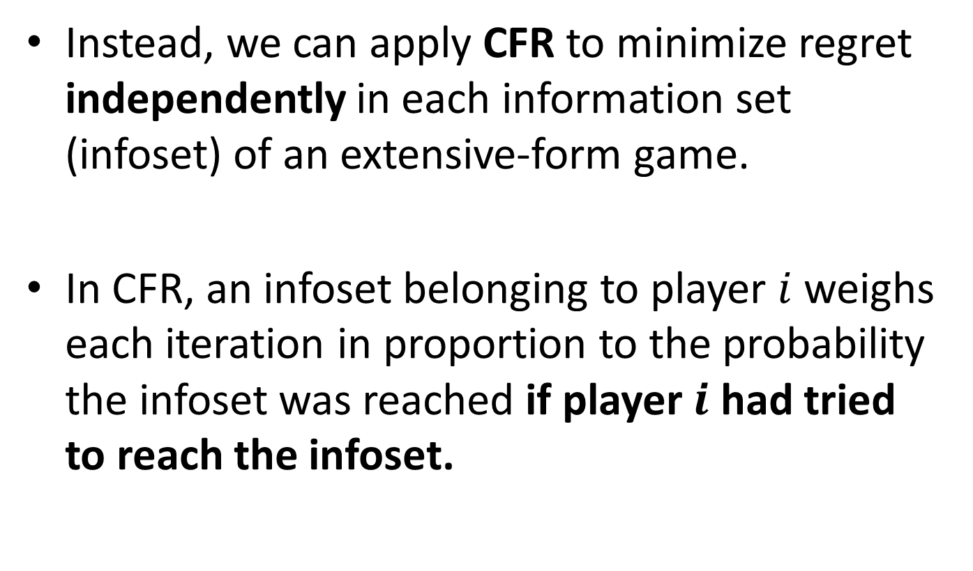
Counterfactual Regret Minimization (CFR) [Zinkevich et al. NIPS-2007]
Instead, we can apply CFR to minimize regret independently in each information set (infoset) of an extensive-form game.
In CFR, an infoset belonging to player $i$ weighs each iteration in proportion to the probability the infoset was reached if player $i$ had tried to reach the infoset.

Slide 35
Counterfactual Regret Minimization (CFR) [Zinkevich et al. NIPS-2007]
P1
P2
P2
P1
P1
P1
P1
-1
1
1
-1
-1
1
1
-1

Slide 36

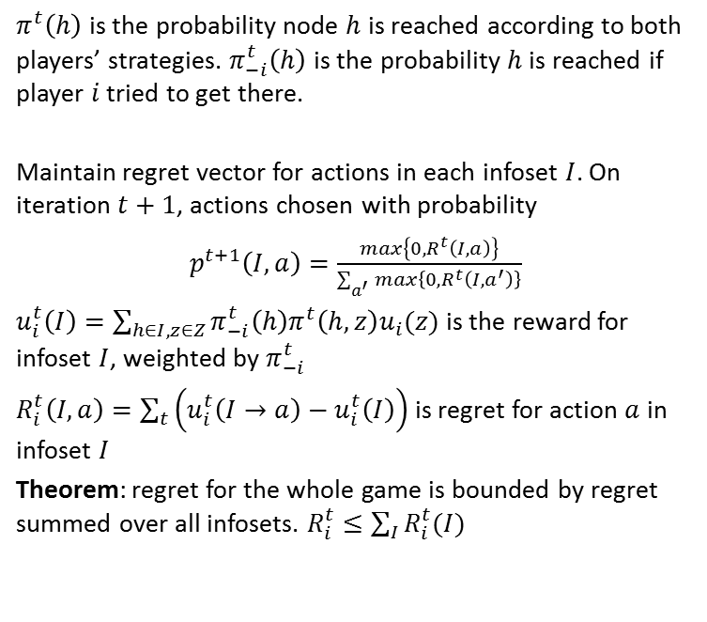
Counterfactual Regret Minimization (CFR) [Zinkevich et al. NIPS-2007]
$π_{−i}^{t}\left(h\right)$ for this history is $0.1$
P1
0.5
0.5
P2
$π_{}^{t}\left(h\right)$ is the probability node $h$ is reached according to both players’ strategies. $π_{−i}^{t}\left(h\right)$ is the probability $h$ is reached if player $i$ tried to get there.
Maintain regret vector for actions in each infoset $I$. On iteration $t+1$, actions chosen with probability
$p^{t+1}\left(I,a\right)=\frac{max\left\{0, R^{t}\left(I,a\right)\right\}}{\sum_{a^{′}}{max\left\{0, R^{t}\left({I,a}^{′}\right)\right\}}}$
$u_{i}^{t}\left(I\right)=\sum_{h∈I,z∈Z}{π_{−i}^{t}\left(h\right)π^{t}\left(h,z\right)u_{i}(z)}$ is the reward for infoset $I$, weighted by $π_{−i}^{t}$
$R_{i}^{t}\left(I,a\right)=\sum_{t}{\left(u_{i}^{t}\left(I→a\right)−u_{i}^{t}\left(I\right)\right)}$ is regret for action $a$ in infoset $I$
Theorem: regret for the whole game is bounded by regret summed over all infosets. $R_{i}^{t}≤\sum_{I}{R_{i}^{t}(I)}$
0.1
0.9
P1
P1
-1
1
1
-1

Slide 37

Counterfactual Regret Minimization (CFR) [Zinkevich et al. NIPS-2007]
P1
0.5
0.5
P2
0.1
0.9
Iteration 1: Regret is $〈0,0〉$, so pick uniform random probability. That is, $p^{1}\left(I\right)=〈0.5, 0.5〉$
P1
P1
0.5
0.5
0.5
0.5
-1
1
1
-1

Slide 38

Counterfactual Regret Minimization (CFR) [Zinkevich et al. NIPS-2007]
P1
0.5
0.5
P2
0.1
0.9
Iteration 1: Regret is $〈0,0〉$, so pick uniform random probability. That is, $p^{1}\left(I\right)=〈0.5, 0.5〉$
$$u_{i}^{1}\left(I\right)=\left(0.1\right)\left(0.5⋅(−1)+0.5⋅1\right)+$$
P1
P1
0.5
0.5
0.5
0.5
-1
1
1
-1

Slide 39

Counterfactual Regret Minimization (CFR) [Zinkevich et al. NIPS-2007]
P1
0.5
0.5
P2
0.1
0.9
Iteration 1: Regret is $〈0,0〉$, so pick uniform random probability. That is, $p^{1}\left(I\right)=〈0.5, 0.5〉$
$$u_{i}^{1}\left(I\right)=\left(0.1\right)\left(0.5⋅(−1)+0.5⋅1\right)+$$
$\left(0.9\right)\left(0.5⋅1+0.5⋅\left(−1\right)\right)=0$
P1
P1
0.5
0.5
0.5
0.5
-1
1
1
-1

Slide 40
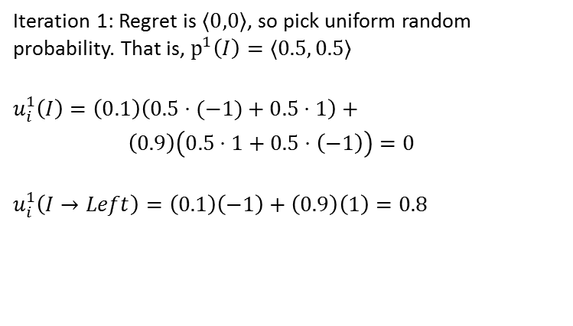
Counterfactual Regret Minimization (CFR) [Zinkevich et al. NIPS-2007]
P1
0.5
0.5
P2
0.1
0.9
Iteration 1: Regret is $〈0,0〉$, so pick uniform random probability. That is, $p^{1}\left(I\right)=〈0.5, 0.5〉$
$$u_{i}^{1}\left(I\right)=\left(0.1\right)\left(0.5⋅(−1)+0.5⋅1\right)+$$
$\left(0.9\right)\left(0.5⋅1+0.5⋅\left(−1\right)\right)=0$
$$u_{i}^{1}\left(I→Left\right)=\left(0.1\right)\left(−1\right)+\left(0.9\right)\left(1\right)=0.8$$
P1
P1
0.5
0.5
0.5
0.5
-1
1
1
-1

Slide 41
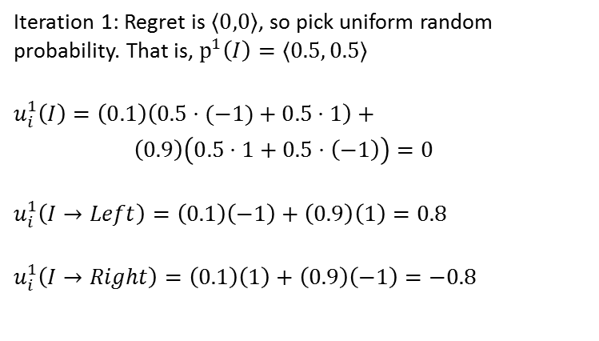
Counterfactual Regret Minimization (CFR) [Zinkevich et al. NIPS-2007]
P1
0.5
0.5
P2
0.1
0.9
Iteration 1: Regret is $〈0,0〉$, so pick uniform random probability. That is, $p^{1}\left(I\right)=〈0.5, 0.5〉$
$$u_{i}^{1}\left(I\right)=\left(0.1\right)\left(0.5⋅(−1)+0.5⋅1\right)+$$
$\left(0.9\right)\left(0.5⋅1+0.5⋅\left(−1\right)\right)=0$
$$u_{i}^{1}\left(I→Left\right)=\left(0.1\right)\left(−1\right)+\left(0.9\right)\left(1\right)=0.8$$
$$u_{i}^{1}\left(I→Right\right)=\left(0.1\right)\left(1\right)+\left(0.9\right)\left(−1\right)=−0.8$$
P1
P1
0.5
0.5
0.5
0.5
-1
1
1
-1

Slide 42
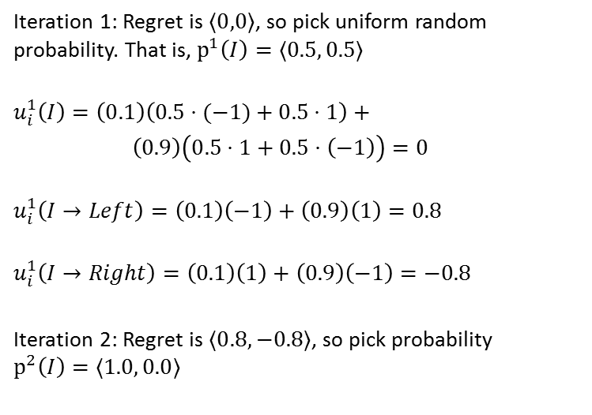
Counterfactual Regret Minimization (CFR) [Zinkevich et al. NIPS-2007]
P1
0.5
0.5
P2
0.1
0.9
Iteration 1: Regret is $〈0,0〉$, so pick uniform random probability. That is, $p^{1}\left(I\right)=〈0.5, 0.5〉$
$$u_{i}^{1}\left(I\right)=\left(0.1\right)\left(0.5⋅(−1)+0.5⋅1\right)+$$
$\left(0.9\right)\left(0.5⋅1+0.5⋅\left(−1\right)\right)=0$
$$u_{i}^{1}\left(I→Left\right)=\left(0.1\right)\left(−1\right)+\left(0.9\right)\left(1\right)=0.8$$
$$u_{i}^{1}\left(I→Right\right)=\left(0.1\right)\left(1\right)+\left(0.9\right)\left(−1\right)=−0.8$$
Iteration 2: Regret is $〈0.8,−0.8〉$, so pick probability $p^{2}\left(I\right)=〈1.0, 0.0〉$
P1
P1
0.5
0.5
0.5
0.5
-1
1
1
-1

Slide 43
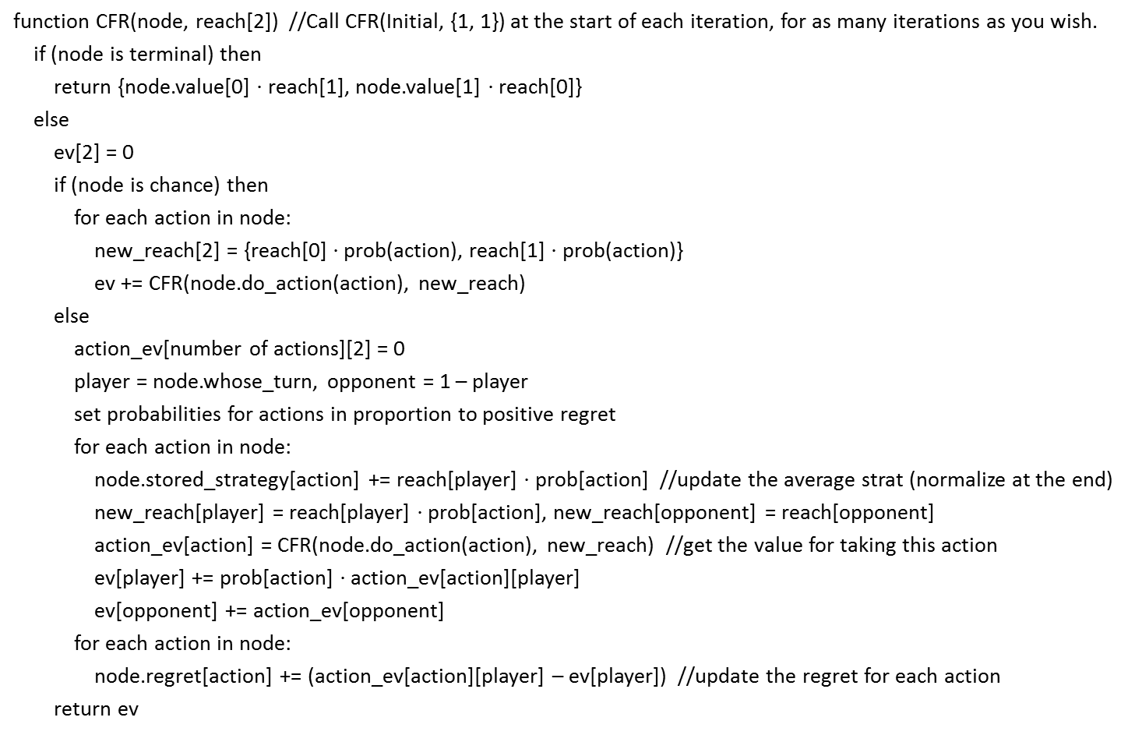
CFR Pseudocode
function CFR(node, reach[2]) //Call CFR(Initial, {1, 1}) at the start of each iteration, for as many iterations as you wish.
if (node is terminal) then
return {node.value[0] $⋅$ reach[1], node.value[1] $⋅$ reach[0]}
else
ev[2] = 0
if (node is chance) then
for each action in node:
new_reach[2] = {reach[0] $⋅$ prob(action), reach[1] $⋅$ prob(action)}
ev += CFR(node.do_action(action), new_reach)
else
action_ev[number of actions][2] = 0
player = node.whose_turn, opponent = 1 – player
set probabilities for actions in proportion to positive regret
for each action in node:
node.stored_strategy[action] += reach[player] $⋅$ prob[action] //update the average strat (normalize at the end)
new_reach[player] = reach[player] $⋅$ prob[action], new_reach[opponent] = reach[opponent]
action_ev[action] = CFR(node.do_action(action), new_reach) //get the value for taking this action
ev[player] += prob[action] $⋅$ action_ev[action][player]
ev[opponent] += action_ev[opponent]
for each action in node:
node.regret[action] += (action_ev[action][player] – ev[player]) //update the regret for each action
return ev

Slide 44
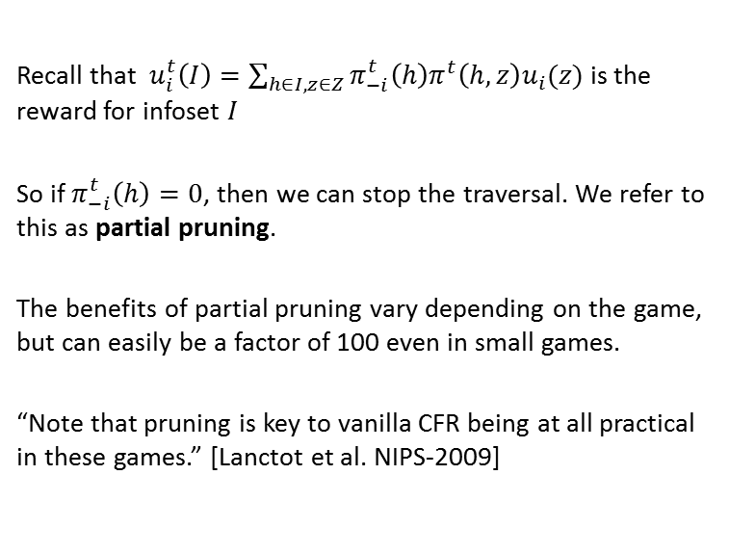
Partial Pruning in CFR
P1
0.5
0.5
P2
0.0
1.0
Recall that $u_{i}^{t}\left(I\right)=\sum_{h∈I,z∈Z}{π_{−i}^{t}\left(h\right)π^{t}\left(h,z\right)u_{i}(z)}$ is the reward for infoset $I$
So if $π_{−i}^{t}\left(h\right)=0$, then we can stop the traversal. We refer to this as partial pruning.
The benefits of partial pruning vary depending on the game, but can easily be a factor of 100 even in small games.
“Note that pruning is key to vanilla CFR being at all practical in these games.” [Lanctot et al. NIPS-2009]
P1
P1
0.5
0.5
0.5
0.5
-1
1
1
-1

Slide 45
CFR-BR
P1
1.0
0.0
P2
0.1
0.9
CFR presents one way of minimizing regret, but it is not the only way.
In CFR-BR, P2 plays according to CFR and P1 plays a best response on every iteration.
A best response can be calculated as efficiently as CFR.
This guarantees zero regret for P1, but (in practice) raises the regret for P2.
P1
P1
1.0
0.0
1.0
0.0
-1
1
1
-1

Slide 46
Zero-Reach CFR-BR
P1
1.0
0.0
P2
P2
0.0
0.75
1.0
0.25
P1
P1
P1
P1
0.5
0.5
0.5
0.5
0.75
0.25
0.75
0.25
-1
P2
1
-1
-1
1
1
-1
0.5
0.5
1
-1

Slide 47
Zero-Reach CFR-BR
P2 will be pruned and doesn’t
care what happens later. So P1
might as well play a best response.
P1
1.0
0.0
P2
P2
0.0
0.75
1.0
0.25
P1
P1
P1
P1
0.5
0.5
0.5
0.5
0.75
0.25
0.75
0.25
-1
P2
1
-1
-1
1
1
-1
0.5
0.5
1
-1

Slide 48
Zero-Reach CFR-BR
P2 will be pruned and doesn’t
care what happens later. So P1
might as well play a best response.
P1
1.0
0.0
P2
P2
0.0
0.75
1.0
0.25
P1
P1
P1
P1
0.5
0.5
0.5
0.5
1.0
0.0
1.0
0.0
-1
P2
1
-1
-1
1
1
-1
0.5
0.5
1
-1

Slide 49
Zero-Reach CFR-BR
P1
1.0
0.0
P2
P2
0.0
0.75
1.0
0.25
P1
P1
P1
P1
0.5
0.5
0.5
0.5
1.0
0.0
1.0
0.0
-1
P2
1
-1
-1
1
1
-1
0.5
0.5
1
-1

Slide 50
Zero-Reach CFR-BR
Zero-Reach CFR-BR improves
CFR by about a factor of 2.
But we can do better!
P1
1.0
0.0
P2
P2
0.0
0.75
1.0
0.25
P1
P1
P1
P1
0.5
0.5
0.5
0.5
1.0
0.0
1.0
0.0
-1
P2
1
-1
-1
1
1
-1
0.0
1.0
1
-1

Slide 51
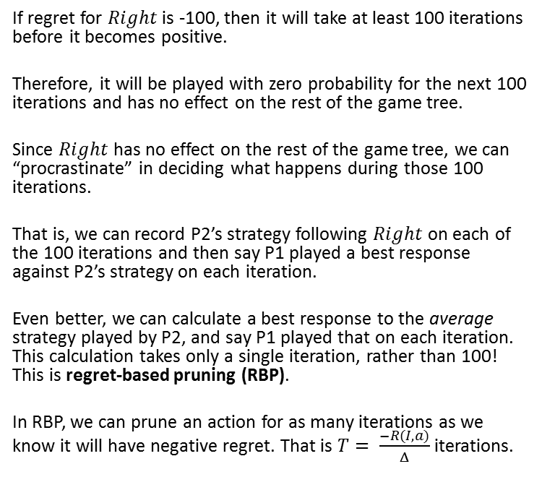

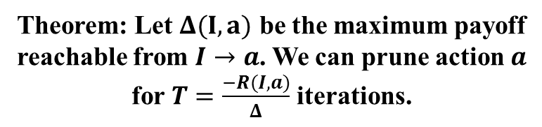
Regret-Based Pruning
Suppose regret for $Right$ is -100.
P1
1.0
0.0
If regret for $Right$ is -100, then it will take at least 100 iterations before it becomes positive.
Therefore, it will be played with zero probability for the next 100 iterations and has no effect on the rest of the game tree.
Since $Right$ has no effect on the rest of the game tree, we can “procrastinate” in deciding what happens during those 100 iterations.
That is, we can record P2’s strategy following $Right$ on each of the 100 iterations and then say P1 played a best response against P2’s strategy on each iteration.
Even better, we can calculate a best response to the average strategy played by P2, and say P1 played that on each iteration. This calculation takes only a single iteration, rather than 100! This is regret-based pruning (RBP).
In RBP, we can prune an action for as many iterations as we know it will have negative regret. That is $T= \frac{−R(I,a)}{Δ}$ iterations.
P2
0.75
0.25
P1
P1
0.75
0.25
0.75
0.25
-1
1
1
-1
Theorem: Let $Δ(I,a)$ be the maximum payoff
reachable from $I→a$. We can prune action $a$
for $T=\frac{−R(I,a)}{Δ}$ iterations.

Slide 52
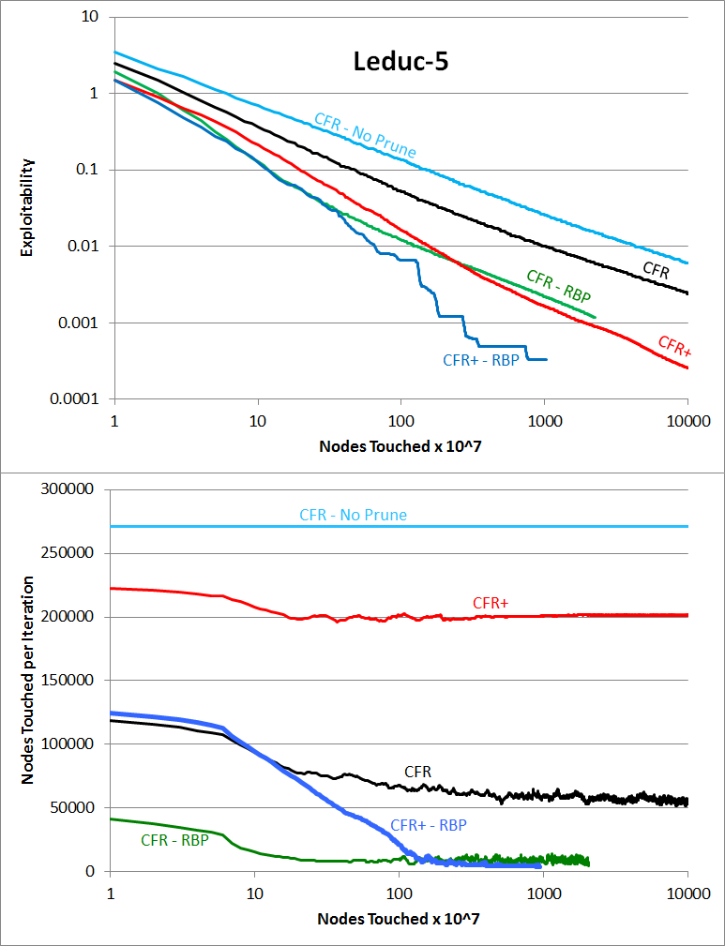
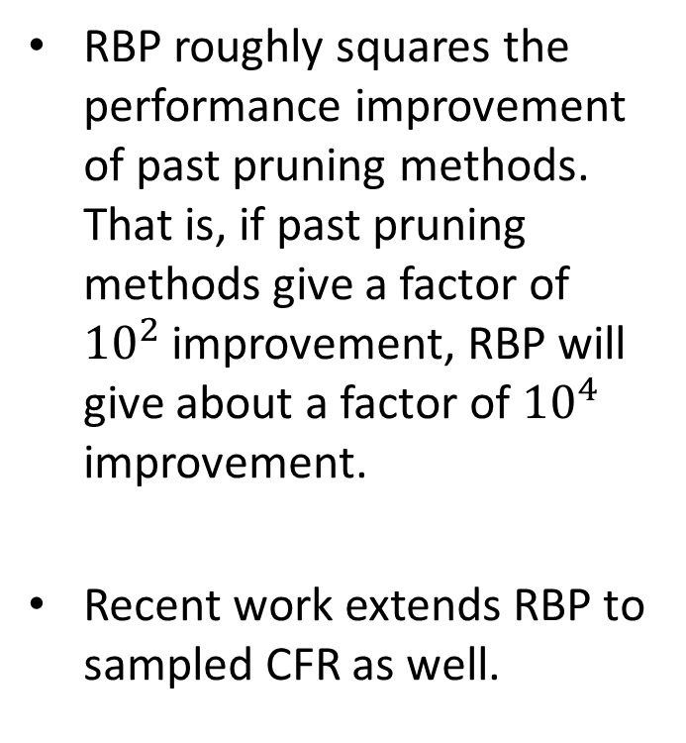
Experimental Results
RBP roughly squares the performance improvement of past pruning methods. That is, if past pruning methods give a factor of ${10}^{2}$ improvement, RBP will give about a factor of ${10}^{4}$ improvement.
Recent work extends RBP to sampled CFR as well.
Notes:
Explain that CFR+ is the state of the art variant of CFR. Explain that CFR and CFR+ in this slide both use partial pruning, while “CFR – No Prune” is the completely vanilla version of CFR.

Slide 53
Other CFR Variants
CFR+: After each iteration, set all negative-regret actions to zero.
Same convergence bound, but faster in practice
Monte-Carlo CFR: Traverse the game tree separately for each player. Sample chance and opponent actions (and treat them as occuring with probability 1).
Does iterations much more quickly, which is particularly useful for large abstracted games.
Don’t need to pass down reach, since it’s always 1.

Slide 54
Abstraction
P1
P2
. . .
P2
P2
P2
. . .
P2
Problem: The game may be too large
No-Limit Texas Hold’em (with 20,000 chips) has ${10}^{161}$ information sets

Slide 55
Abstraction
P1
P2
. . .
P2
P2
P2
. . .
P2
Abstract information set

Slide 56
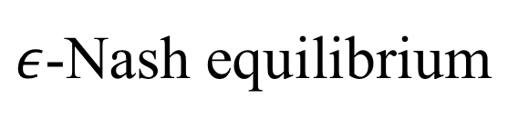
Standard Approach [Gilpin & Sandholm EC-06, J. of the ACM 2007…]
Original game
Abstracted game
Automated abstraction
Custom
equilibrium-finding
algorithm
$ε$-Nash equilibrium
Reverse model
Abstract
Nash equilibrium
Foreshadowed by Shi & Littman 01, Billings et al. IJCAI-03
Notes:
MENTION AS OUTLINE:
- Opponent exploitation
- Bots vs pros
- Learning from bots
(Reverse model is straightforward if only signals are abstracted, but an interesting problem if also actions are abstracted, as in No-Limit Texas Hold’em.)

Slide 57
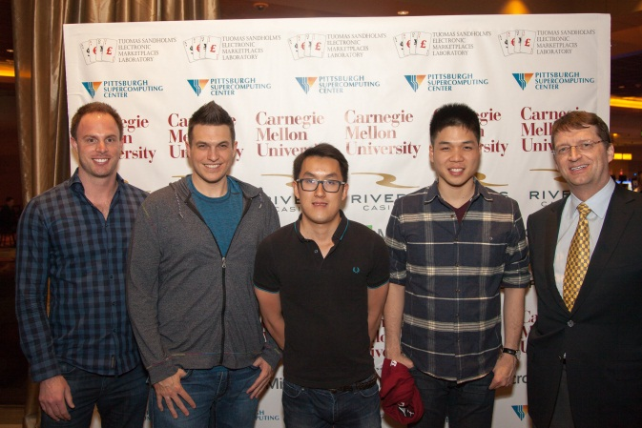
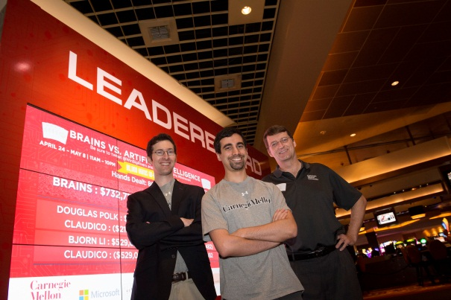
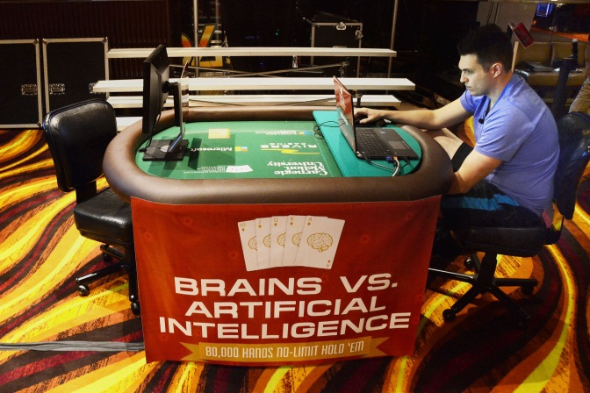
Example: Claudico vs. Human Pros
Annual Computer Poker Competition
Our precursor bot, Tartanian7, won the last ACPC no-limit Hold’em competitions
Claudico lost to the humans by 0.091 BB per hand
The result was not statistically significant, even after 80,000 hands of poker
For perspective, #1 Doug Polk beat #2-3 Ben Sulsky in a publicized challenge by 0.247 BB per hand

Slide 58
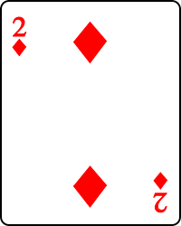
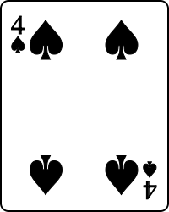
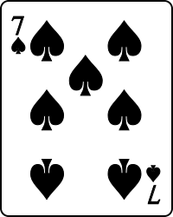
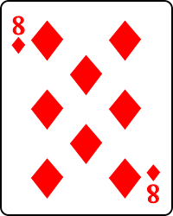
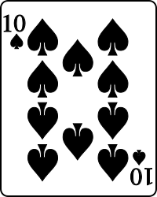
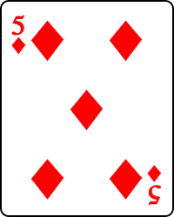
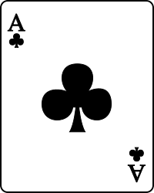
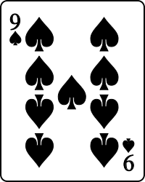
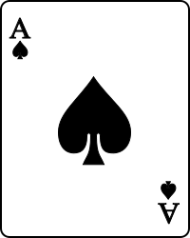
Example: Claudico vs. Human Pros
Annual Computer Poker Competition
Best Hand:

Slide 59
Simultaneous Approach
Original game
Abstracted game
Automated abstraction
Custom
equilibrium-finding
algorithm
$ε$- Nash equilibrium
Reverse model
Abstract
Nash equilibrium
Notes:
MENTION AS OUTLINE:
- Opponent exploitation
- Bots vs pros
- Learning from bots
(Reverse model is straightforward if only signals are abstracted, but an interesting problem if also actions are abstracted, as in No-Limit Texas Hold’em.)

Slide 60
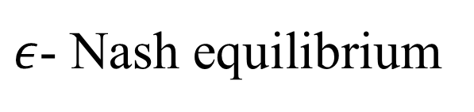
Simultaneous Approach
[Brown & Sandholm IJCAI-15]
Original game
Simultaneous abstraction and
equilibrium finding (SAEF)
Coarse abstraction
Equilibrium finding
Full-game
exploitability
calculation
Warm starting
Abstraction
refinement
$ε$- Nash equilibrium
Notes:
MENTION AS OUTLINE:
- Opponent exploitation
- Bots vs pros
- Learning from bots
(Reverse model is straightforward if only signals are abstracted, but an interesting problem if also actions are abstracted, as in No-Limit Texas Hold’em.)

Slide 61
Simultaneous Approach
[Brown & Sandholm IJCAI-15]
Original game
Simultaneous abstraction and
equilibrium finding (SAEF)
Coarse abstraction
Equilibrium finding
Full-game
exploitability
calculation
Warm starting
Abstraction
refinement
$ε$- Nash equilibrium
Notes:
MENTION AS OUTLINE:
- Opponent exploitation
- Bots vs pros
- Learning from bots
(Reverse model is straightforward if only signals are abstracted, but an interesting problem if also actions are abstracted, as in No-Limit Texas Hold’em.)

Slide 62
Simultaneous Approach
[Brown & Sandholm IJCAI-15]
Original game
Simultaneous abstraction and
equilibrium finding (SAEF)
Coarse abstraction
Equilibrium finding
Full-game
exploitability
calculation
Warm starting
Abstraction
refinement
$ε$- Nash equilibrium
Notes:
MENTION AS OUTLINE:
- Opponent exploitation
- Bots vs pros
- Learning from bots
(Reverse model is straightforward if only signals are abstracted, but an interesting problem if also actions are abstracted, as in No-Limit Texas Hold’em.)

Slide 63
Simultaneous Approach
[Brown & Sandholm IJCAI-15]
Original game
Simultaneous abstraction and
equilibrium finding (SAEF)
Coarse abstraction
Equilibrium finding
Full-game
exploitability
calculation
Warm starting
Abstraction
refinement
$ε$- Nash equilibrium
Notes:
MENTION AS OUTLINE:
- Opponent exploitation
- Bots vs pros
- Learning from bots
(Reverse model is straightforward if only signals are abstracted, but an interesting problem if also actions are abstracted, as in No-Limit Texas Hold’em.)

Slide 64
Simultaneous Approach
[Brown & Sandholm IJCAI-15]
Original game
Simultaneous abstraction and
equilibrium finding (SAEF)
Coarse abstraction
Equilibrium finding
Full-game
exploitability
calculation
Warm starting
Abstraction
refinement
$ε$- Nash equilibrium
Notes:
MENTION AS OUTLINE:
- Opponent exploitation
- Bots vs pros
- Learning from bots
(Reverse model is straightforward if only signals are abstracted, but an interesting problem if also actions are abstracted, as in No-Limit Texas Hold’em.)

Slide 65
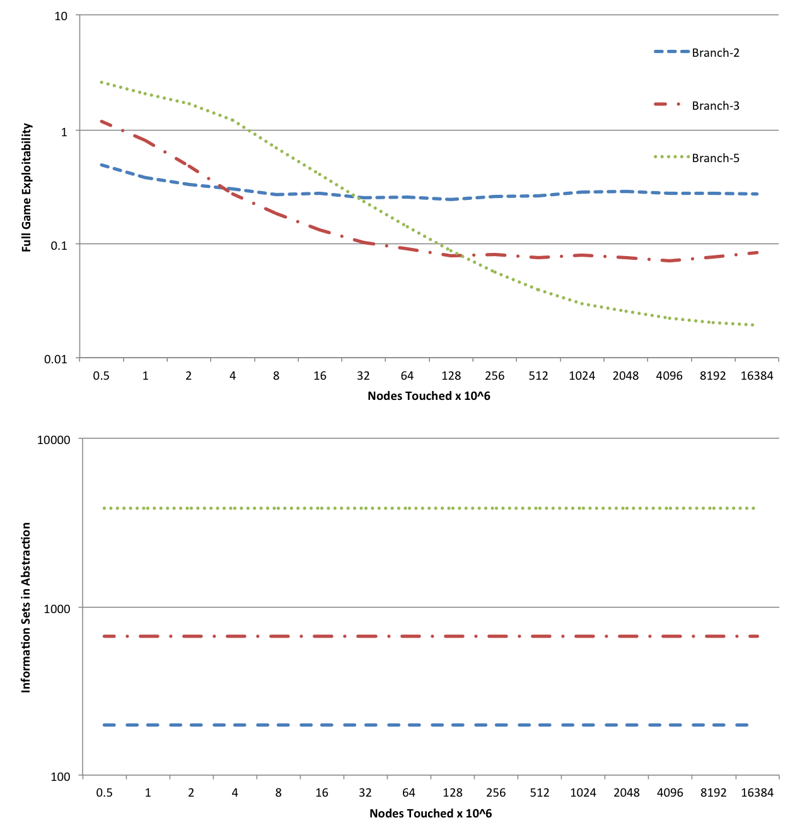
Experiments
Branch-2: Two bet sizes
Branch-3: Three bet sizes
Branch-5: Five bet sizes

Slide 66
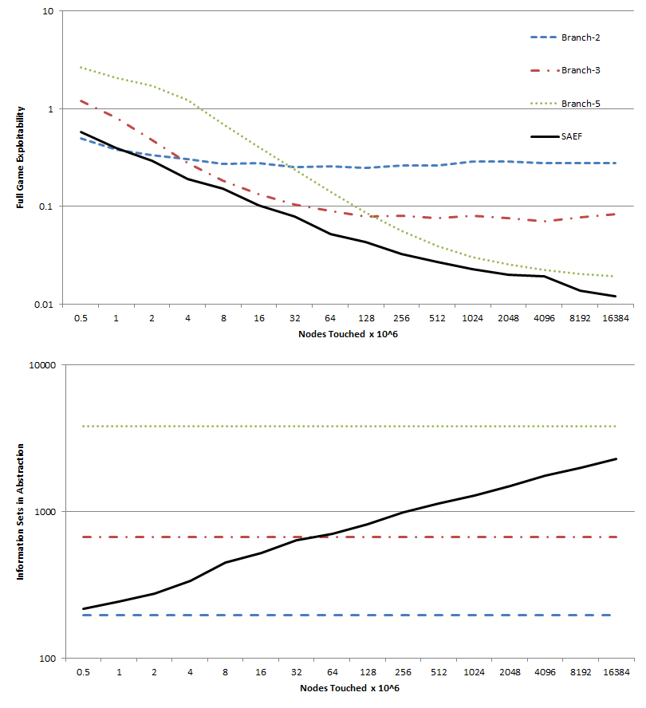
Experiments
Branch-2: Two bet sizes
Branch-3: Three bet sizes
Branch-5: Five bet sizes
SAEF: Uses SAEF condition for adding an action, tightened by a factor of 1.01

