Slide 1
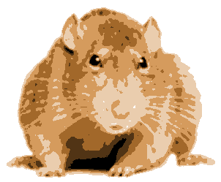
Assignment 3: GraphRats
Graph
Rats
3.0

Slide 2
Topics
Application
Implementation Issues
Optimizing for Parallel Performance
Useful Advice

Slide 3
Basic Idea
Transitions
  Each rat decides where to move next
    Don’t like crowds
    But also don’t like to be alone
  Weighted random choice
t = 0
0
1
2
3
4
5
6
7
8
t = 1
0
1
2
Graph
  W X H grid
Initial State
  Start with all R rats in center
3
4
5
6
7
8

Slide 4
Node Count Representation (18 x 12)
t = 0.
+----+----+----+----+----+----+----+----+----+----+----+----+----+----+----+----+----+----+
| | | | | | | | | | | | | | | | | | |
+----+----+----+----+----+----+----+----+----+----+----+----+----+----+----+----+----+----+
| | | | | | | | | | | | | | | | | | |
+----+----+----+----+----+----+----+----+----+----+----+----+----+----+----+----+----+----+
| | | | | | | | | | | | | | | | | | |
+----+----+----+----+----+----+----+----+----+----+----+----+----+----+----+----+----+----+
| | | | | | | | | | | | | | | | | | |
+----+----+----+----+----+----+----+----+----+----+----+----+----+----+----+----+----+----+
| | | | | | | | | | | | | | | | | | |
+----+----+----+----+----+----+----+----+----+----+----+----+----+----+----+----+----+----+
| | | | | | | | | | | | | | | | | | |
+----+----+----+----+----+----+----+----+----+----+----+----+----+----+----+----+----+----+
| | | | | | | | | |1080| | | | | | | | |
+----+----+----+----+----+----+----+----+----+----+----+----+----+----+----+----+----+----+
| | | | | | | | | | | | | | | | | | |
+----+----+----+----+----+----+----+----+----+----+----+----+----+----+----+----+----+----+
| | | | | | | | | | | | | | | | | | |
+----+----+----+----+----+----+----+----+----+----+----+----+----+----+----+----+----+----+
| | | | | | | | | | | | | | | | | | |
+----+----+----+----+----+----+----+----+----+----+----+----+----+----+----+----+----+----+
| | | | | | | | | | | | | | | | | | |
+----+----+----+----+----+----+----+----+----+----+----+----+----+----+----+----+----+----+
| | | | | | | | | | | | | | | | | | |
+----+----+----+----+----+----+----+----+----+----+----+----+----+----+----+----+----+----+

Slide 5
Simulation Example (18 x 12)
t = 1.
+----+----+----+----+----+----+----+----+----+----+----+----+----+----+----+----+----+----+
| | | | | | | | | | | | | | | | | | |
+----+----+----+----+----+----+----+----+----+----+----+----+----+----+----+----+----+----+
| | | | | | | | | | | | | | | | | | |
+----+----+----+----+----+----+----+----+----+----+----+----+----+----+----+----+----+----+
| | | | | | | | | | | | | | | | | | |
+----+----+----+----+----+----+----+----+----+----+----+----+----+----+----+----+----+----+
| | | | | | | | | | | | | | | | | | |
+----+----+----+----+----+----+----+----+----+----+----+----+----+----+----+----+----+----+
| | | | | | | | | | | | | | | | | | |
+----+----+----+----+----+----+----+----+----+----+----+----+----+----+----+----+----+----+
| | | | | | | | | | 137| | | | | | | | |
+----+----+----+----+----+----+----+----+----+----+----+----+----+----+----+----+----+----+
| | | | | | | | | 144| 7 | 145| | | | | | | |
+----+----+----+----+----+----+----+----+----+----+----+----+----+----+----+----+----+----+
| | | | | | | | | | 147| | | | | | | | |
+----+----+----+----+----+----+----+----+----+----+----+----+----+----+----+----+----+----+
| | | | | | | | | | | | | | | | | | |
+----+----+----+----+----+----+----+----+----+----+----+----+----+----+----+----+----+----+
| | | | | 164| | | | 168| | | | 168| | | | | |
+----+----+----+----+----+----+----+----+----+----+----+----+----+----+----+----+----+----+
| | | | | | | | | | | | | | | | | | |
+----+----+----+----+----+----+----+----+----+----+----+----+----+----+----+----+----+----+
| | | | | | | | | | | | | | | | | | |
+----+----+----+----+----+----+----+----+----+----+----+----+----+----+----+----+----+----+
Note moves to nodes not connected by grid
  Explanation to follow

Slide 6
Simulation Example (18 x 12)
t = 20.
+----+----+----+----+----+----+----+----+----+----+----+----+----+----+----+----+----+----+
| | | 1 | 1 | 1 | 1 | | 1 | 4 | 1 | 1 | | | | | | 1 | |
+----+----+----+----+----+----+----+----+----+----+----+----+----+----+----+----+----+----+
| | 1 | 2 | 1 | 1 | 2 | 5 | 6 | 2 | | 4 | 1 | | | | | | |
+----+----+----+----+----+----+----+----+----+----+----+----+----+----+----+----+----+----+
| | | | | | | | 6 | 8 | 3 | | | | 1 | 2 | | | 1 |
+----+----+----+----+----+----+----+----+----+----+----+----+----+----+----+----+----+----+
| 5 | | | 1 | 1 | 1 | 3 | 1 | 4 | 13 | | 1 | | | | 5 | | 1 |
+----+----+----+----+----+----+----+----+----+----+----+----+----+----+----+----+----+----+
| 1 | 6 | 6 | 5 | | 1 | 8 | 6 | 6 | 4 | 3 | 6 | | | | 1 | 1 | 1 |
+----+----+----+----+----+----+----+----+----+----+----+----+----+----+----+----+----+----+
| 3 | 1 | 2 | 1 | | 8 | 3 | 1 | 9 | 12 | 13 | 10 | 8 | 8 | 1 | 1 | | |
+----+----+----+----+----+----+----+----+----+----+----+----+----+----+----+----+----+----+
| 7 | 8 | 11 | 6 | 8 | 11 | 7 | 4 | 13 | 15 | 8 | 14 | 8 | 12 | 5 | 10 | 9 | 4 |
+----+----+----+----+----+----+----+----+----+----+----+----+----+----+----+----+----+----+
| 4 | 11 | 7 | 7 | 5 | 8 | 9 | 16 | 10 | 3 | 7 | 15 | 7 | 8 | 12 | 11 | 11 | 3 |
+----+----+----+----+----+----+----+----+----+----+----+----+----+----+----+----+----+----+
| 5 | 9 | 11 | 6 | | 12 | 13 | 11 | 12 | 9 | 11 | 8 | 3 | 3 | 8 | 5 | 8 | 6 |
+----+----+----+----+----+----+----+----+----+----+----+----+----+----+----+----+----+----+
| 2 | 2 | 6 | | 31 | 2 | 10 | | 31 | 4 | 8 | 2 | 16 | 1 | 9 | 12 | 15 | 4 |
+----+----+----+----+----+----+----+----+----+----+----+----+----+----+----+----+----+----+
| 4 | 7 | 5 | 4 | 3 | 7 | 9 | 4 | 13 | 16 | 14 | 2 | 4 | 8 | 12 | 9 | 5 | 2 |
+----+----+----+----+----+----+----+----+----+----+----+----+----+----+----+----+----+----+
| 1 | 8 | 10 | 8 | | 4 | 2 | 5 | 15 | 5 | 9 | 6 | 15 | 6 | 10 | 8 | 1 | |
+----+----+----+----+----+----+----+----+----+----+----+----+----+----+----+----+----+----+
Rats dispersed across graph

Slide 7
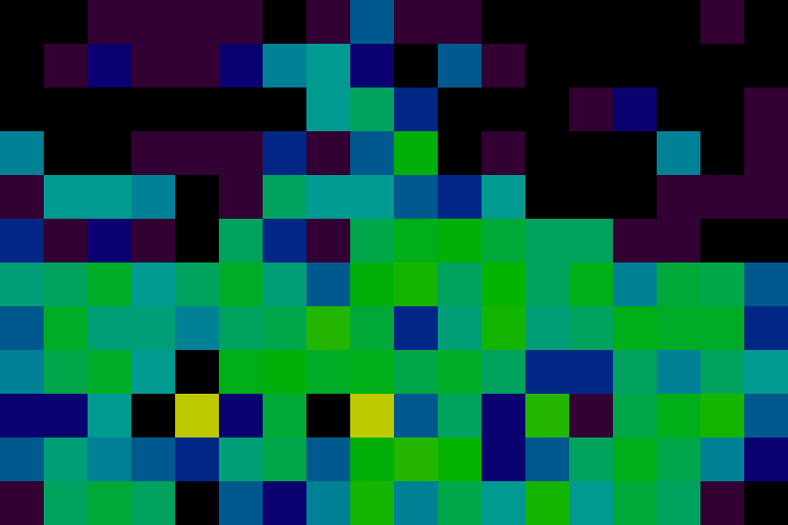
Visualizations
t = 20.
+----+----+----+----+----+----+----+----+----+----+----+----+----+----+----+----+----+----+
| | | 1 | 1 | 1 | 1 | | 1 | 4 | 1 | 1 | | | | | | 1 | |
+----+----+----+----+----+----+----+----+----+----+----+----+----+----+----+----+----+----+
| | 1 | 2 | 1 | 1 | 2 | 5 | 6 | 2 | | 4 | 1 | | | | | | |
+----+----+----+----+----+----+----+----+----+----+----+----+----+----+----+----+----+----+
| | | | | | | | 6 | 8 | 3 | | | | 1 | 2 | | | 1 |
+----+----+----+----+----+----+----+----+----+----+----+----+----+----+----+----+----+----+
| 5 | | | 1 | 1 | 1 | 3 | 1 | 4 | 13 | | 1 | | | | 5 | | 1 |
+----+----+----+----+----+----+----+----+----+----+----+----+----+----+----+----+----+----+
| 1 | 6 | 6 | 5 | | 1 | 8 | 6 | 6 | 4 | 3 | 6 | | | | 1 | 1 | 1 |
+----+----+----+----+----+----+----+----+----+----+----+----+----+----+----+----+----+----+
| 3 | 1 | 2 | 1 | | 8 | 3 | 1 | 9 | 12 | 13 | 10 | 8 | 8 | 1 | 1 | | |
+----+----+----+----+----+----+----+----+----+----+----+----+----+----+----+----+----+----+
| 7 | 8 | 11 | 6 | 8 | 11 | 7 | 4 | 13 | 15 | 8 | 14 | 8 | 12 | 5 | 10 | 9 | 4 |
+----+----+----+----+----+----+----+----+----+----+----+----+----+----+----+----+----+----+
| 4 | 11 | 7 | 7 | 5 | 8 | 9 | 16 | 10 | 3 | 7 | 15 | 7 | 8 | 12 | 11 | 11 | 3 |
+----+----+----+----+----+----+----+----+----+----+----+----+----+----+----+----+----+----+
| 5 | 9 | 11 | 6 | | 12 | 13 | 11 | 12 | 9 | 11 | 8 | 3 | 3 | 8 | 5 | 8 | 6 |
+----+----+----+----+----+----+----+----+----+----+----+----+----+----+----+----+----+----+
| 2 | 2 | 6 | | 31 | 2 | 10 | | 31 | 4 | 8 | 2 | 16 | 1 | 9 | 12 | 15 | 4 |
+----+----+----+----+----+----+----+----+----+----+----+----+----+----+----+----+----+----+
| 4 | 7 | 5 | 4 | 3 | 7 | 9 | 4 | 13 | 16 | 14 | 2 | 4 | 8 | 12 | 9 | 5 | 2 |
+----+----+----+----+----+----+----+----+----+----+----+----+----+----+----+----+----+----+
| 1 | 8 | 10 | 8 | | 4 | 2 | 5 | 15 | 5 | 9 | 6 | 15 | 6 | 10 | 8 | 1 | |
+----+----+----+----+----+----+----+----+----+----+----+----+----+----+----+----+----+----+
Text (“a” for ASCII)
Heat Map (“h”)

Slide 8
Running it yourself
linux> cd some directory
linux> git clone https://github.com/cmu15418/asst3-s20.git
linux> cd asst3-s20/code
Linux> make demoX
X from 1 to 11
Demos
  1: Text visualization, synchronous updates
  2: Heap-map, synchronous updates

Slide 9
Determining Rat Moves
300
8
83
40
120
Count number of rats at current and adjacent locations
  Adjacency structure represented as graph
Compute reward value for each location
  Based on load factor l = count/average count
  l * Ideal load factor (ILF) (varying)
  𝛂 Fitting parameter (= 0.4)

Slide 10
Reward Function
  Maximized at ILF
    Just above average population
    Drops for smaller loads (too few) and larger loads (too crowded)

Slide 11
Reward Function (cont.)
  Falls off gradually
    Reward(1000) = 0.0132

Slide 12
Computing Ideal Load Factor (ILF)
Suppose node has count c_{l} and neighbor has count c_{r}
Compute imbalance as
Maximum +1 c_{r} ≫ c_{l}
Minimum –1 c_{l} ≫ c_{r}

Slide 13
Computing Ideal Load Factor (cont.)
For node u with population p(u)
Define ILF as
Minimum 1.25
  When adjacent nodes much less crowded
Maximum 2.25
  When adjacent nodes much more crowded
Changes as rats move around

Slide 14
Selecting Next Move
Population
Reward (avg load = 10)
300
0.071
8
83
40
0.655
0.226
0.545
120
0.154
Weighted Choices
(node followed by row-major ordering of neighbors)
  Choose random number between 0 and sum of rewards
  Move according to interval hit

Slide 15
Update Models
Synchronous
  Demo 3
  Compute next positions for all rats, and then move them
  Causes oscillations/instabilities
Rat-order
  Demo 4
  For each rat, compute its next position and then move it
  Smooth transitions, but costly
Batch
  Demo 5
  For each batch of B rats, compute next moves and then move them
  B = 0.02 * R
  Smooth enough, with better performance possibilities

Slide 16
What We Provide
Python version of simulator
  Demos 1–2
  Very slow
C version of simulator
  Fast sequential implementation
  Demos 3–5: 36X32 grid, 11,520 rats
  Demos 6–11: 180X160 grid, 1,008,000 rats
    That’s what we’ll be using for benchmarks
Generate visualizations by piping C simulator output into Python simulator
  Operating in visualization mode
  See Makefile for examples

Slide 17
Correctness
Simulator is Deterministic
  Global random seed
  Random seeds for each rat
  Process rats in fixed order
You Must Preserve Exact Same Behavior
  Python simulator generates same result as C simulator
  Use regress.py to check
    Only checks small cases
    Useful sanity check
  Benchmark program compares your results to reference solution
    Handles full-sized graphs

Slide 18
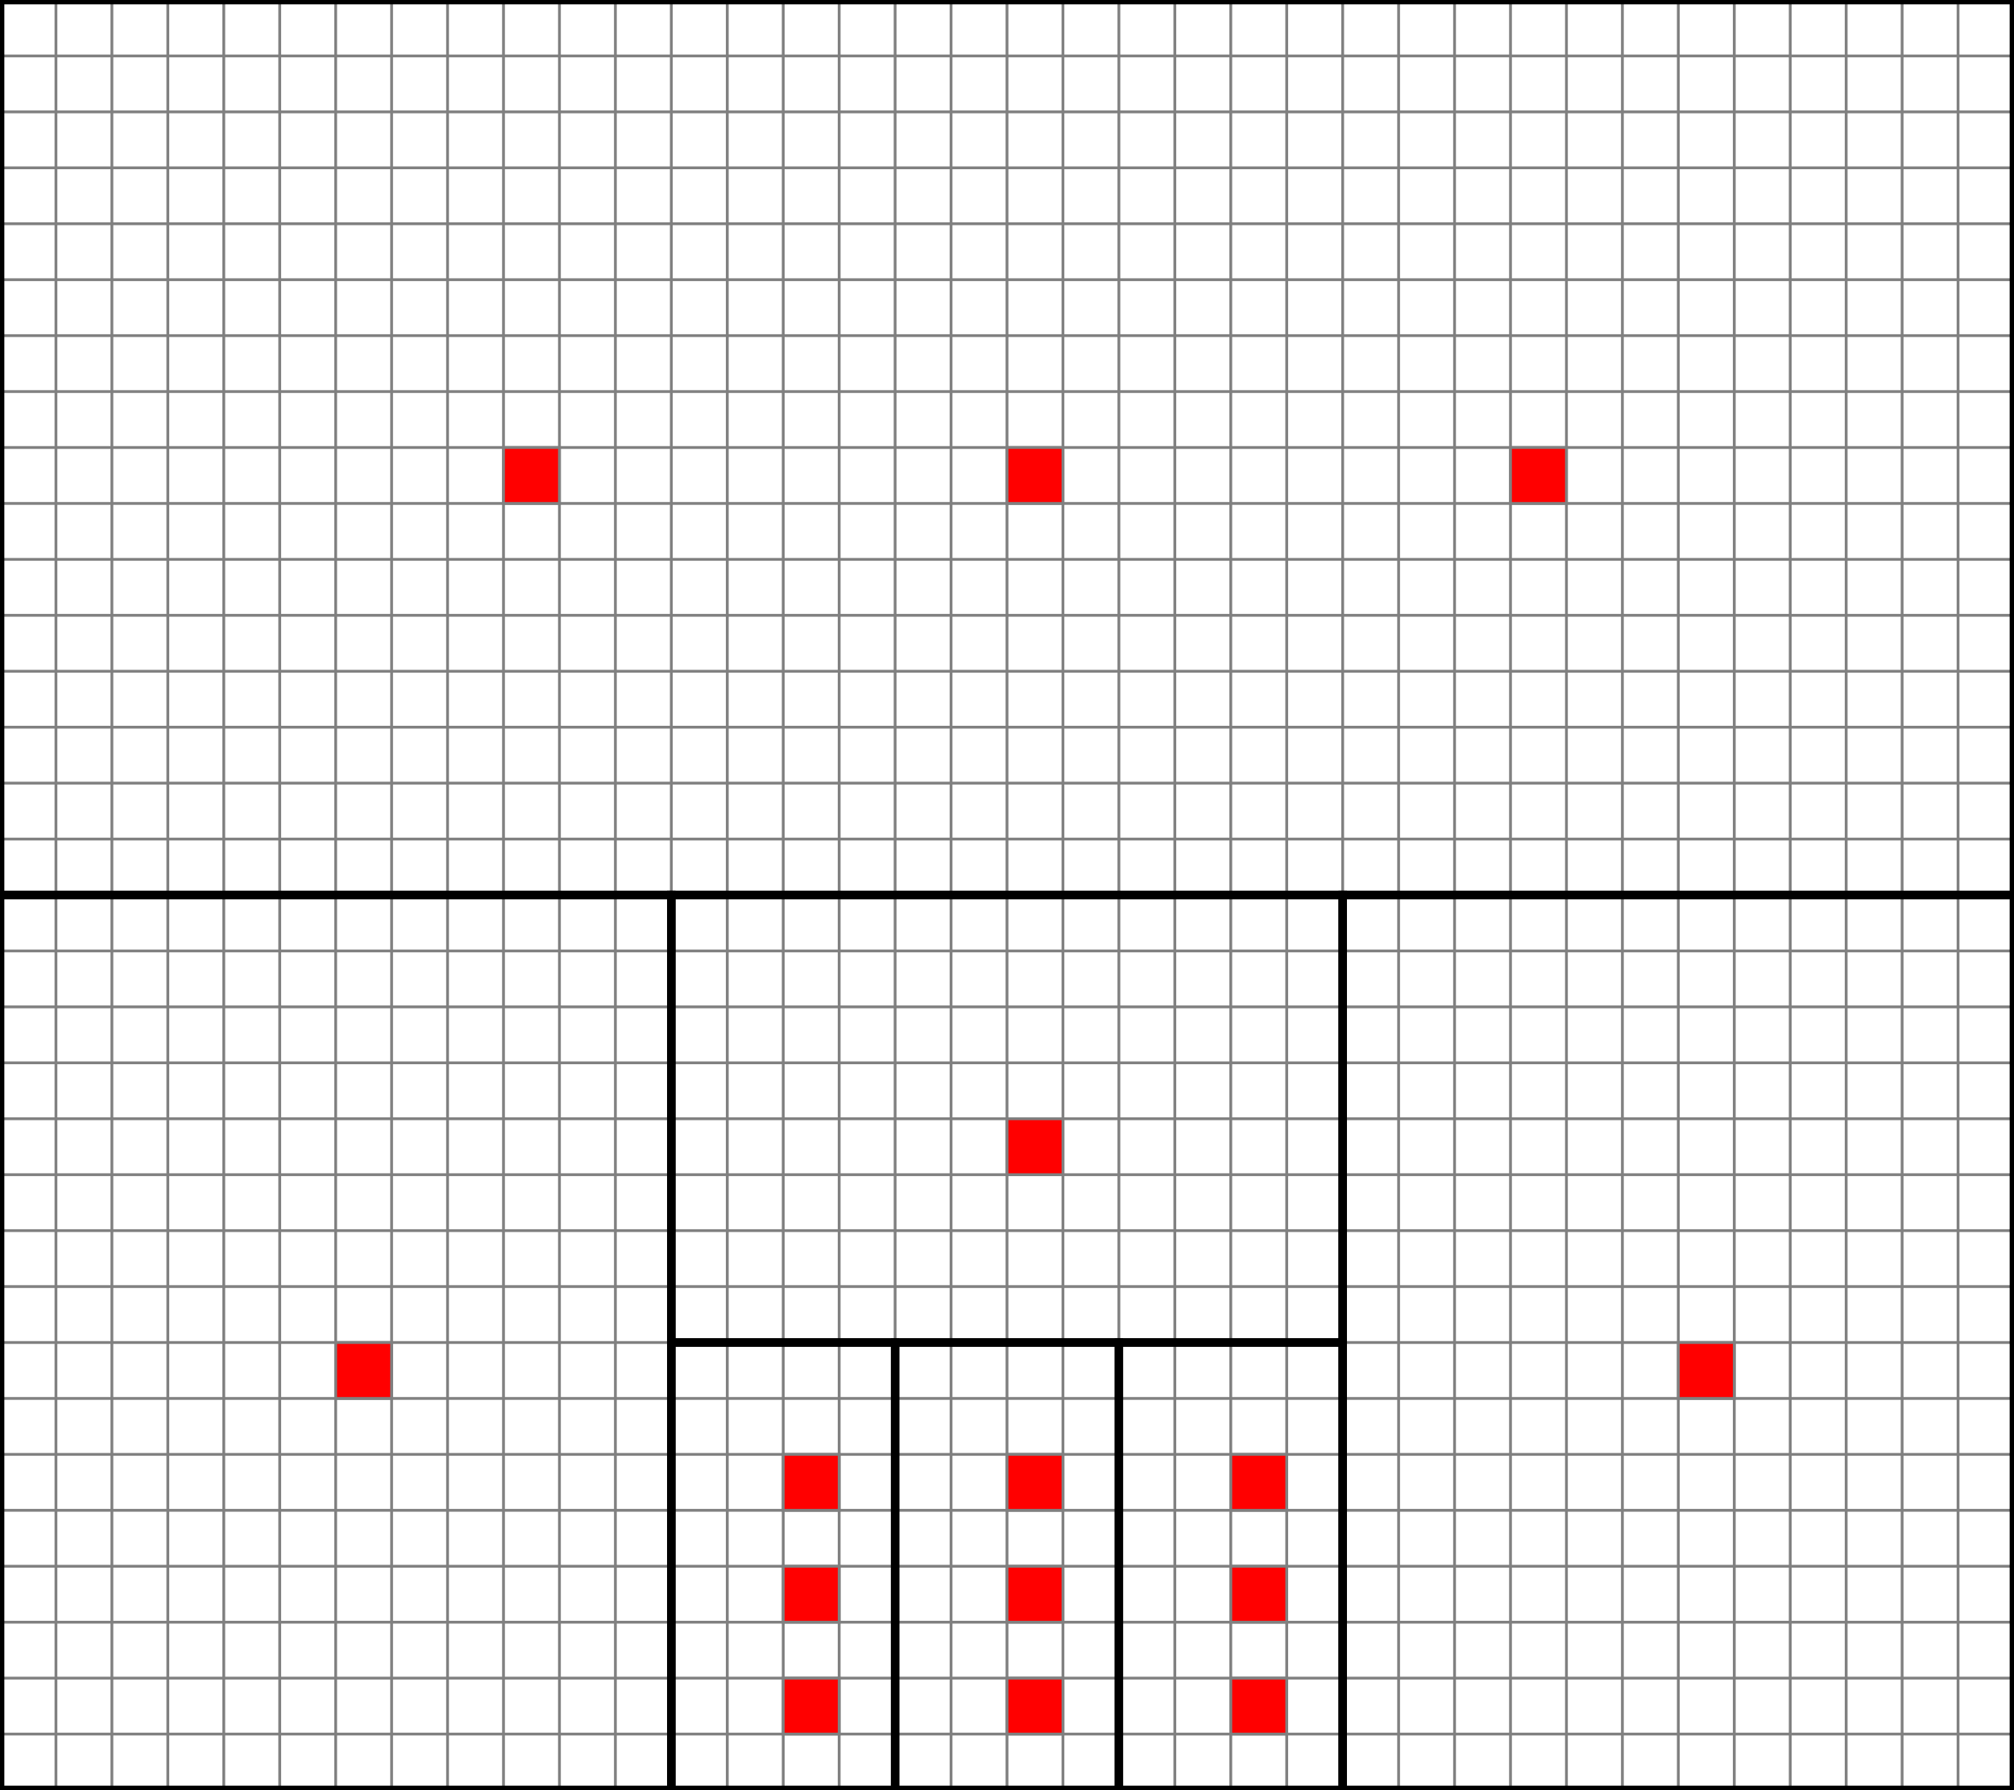
Fractal Graph fracZ (Demos 1–5)
Rats spread quickly within region
More slowly across regions
Hub nodes tend to have high counts
Base grid
  W X H nodes, each with nearest neighbor connectivity
Regions
  Recursively partition rectangles into two or three subrectangles
  Leaves of tree form regions
Hubs
  Connect to every other node in region
  Each region has one or three hubs

Slide 19
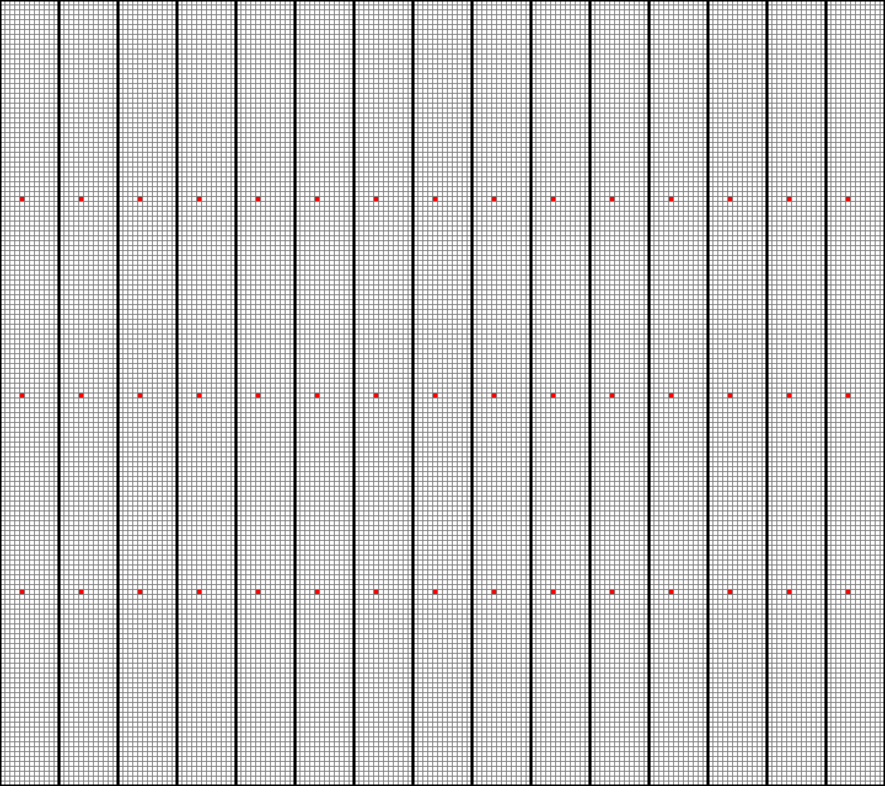
Benchmark Graph UniA (Demo 7)
Nodes | 28,800
Edges | 286,780
Regions | 15
Hubs | 45
Max Degree | 1,919

Slide 20
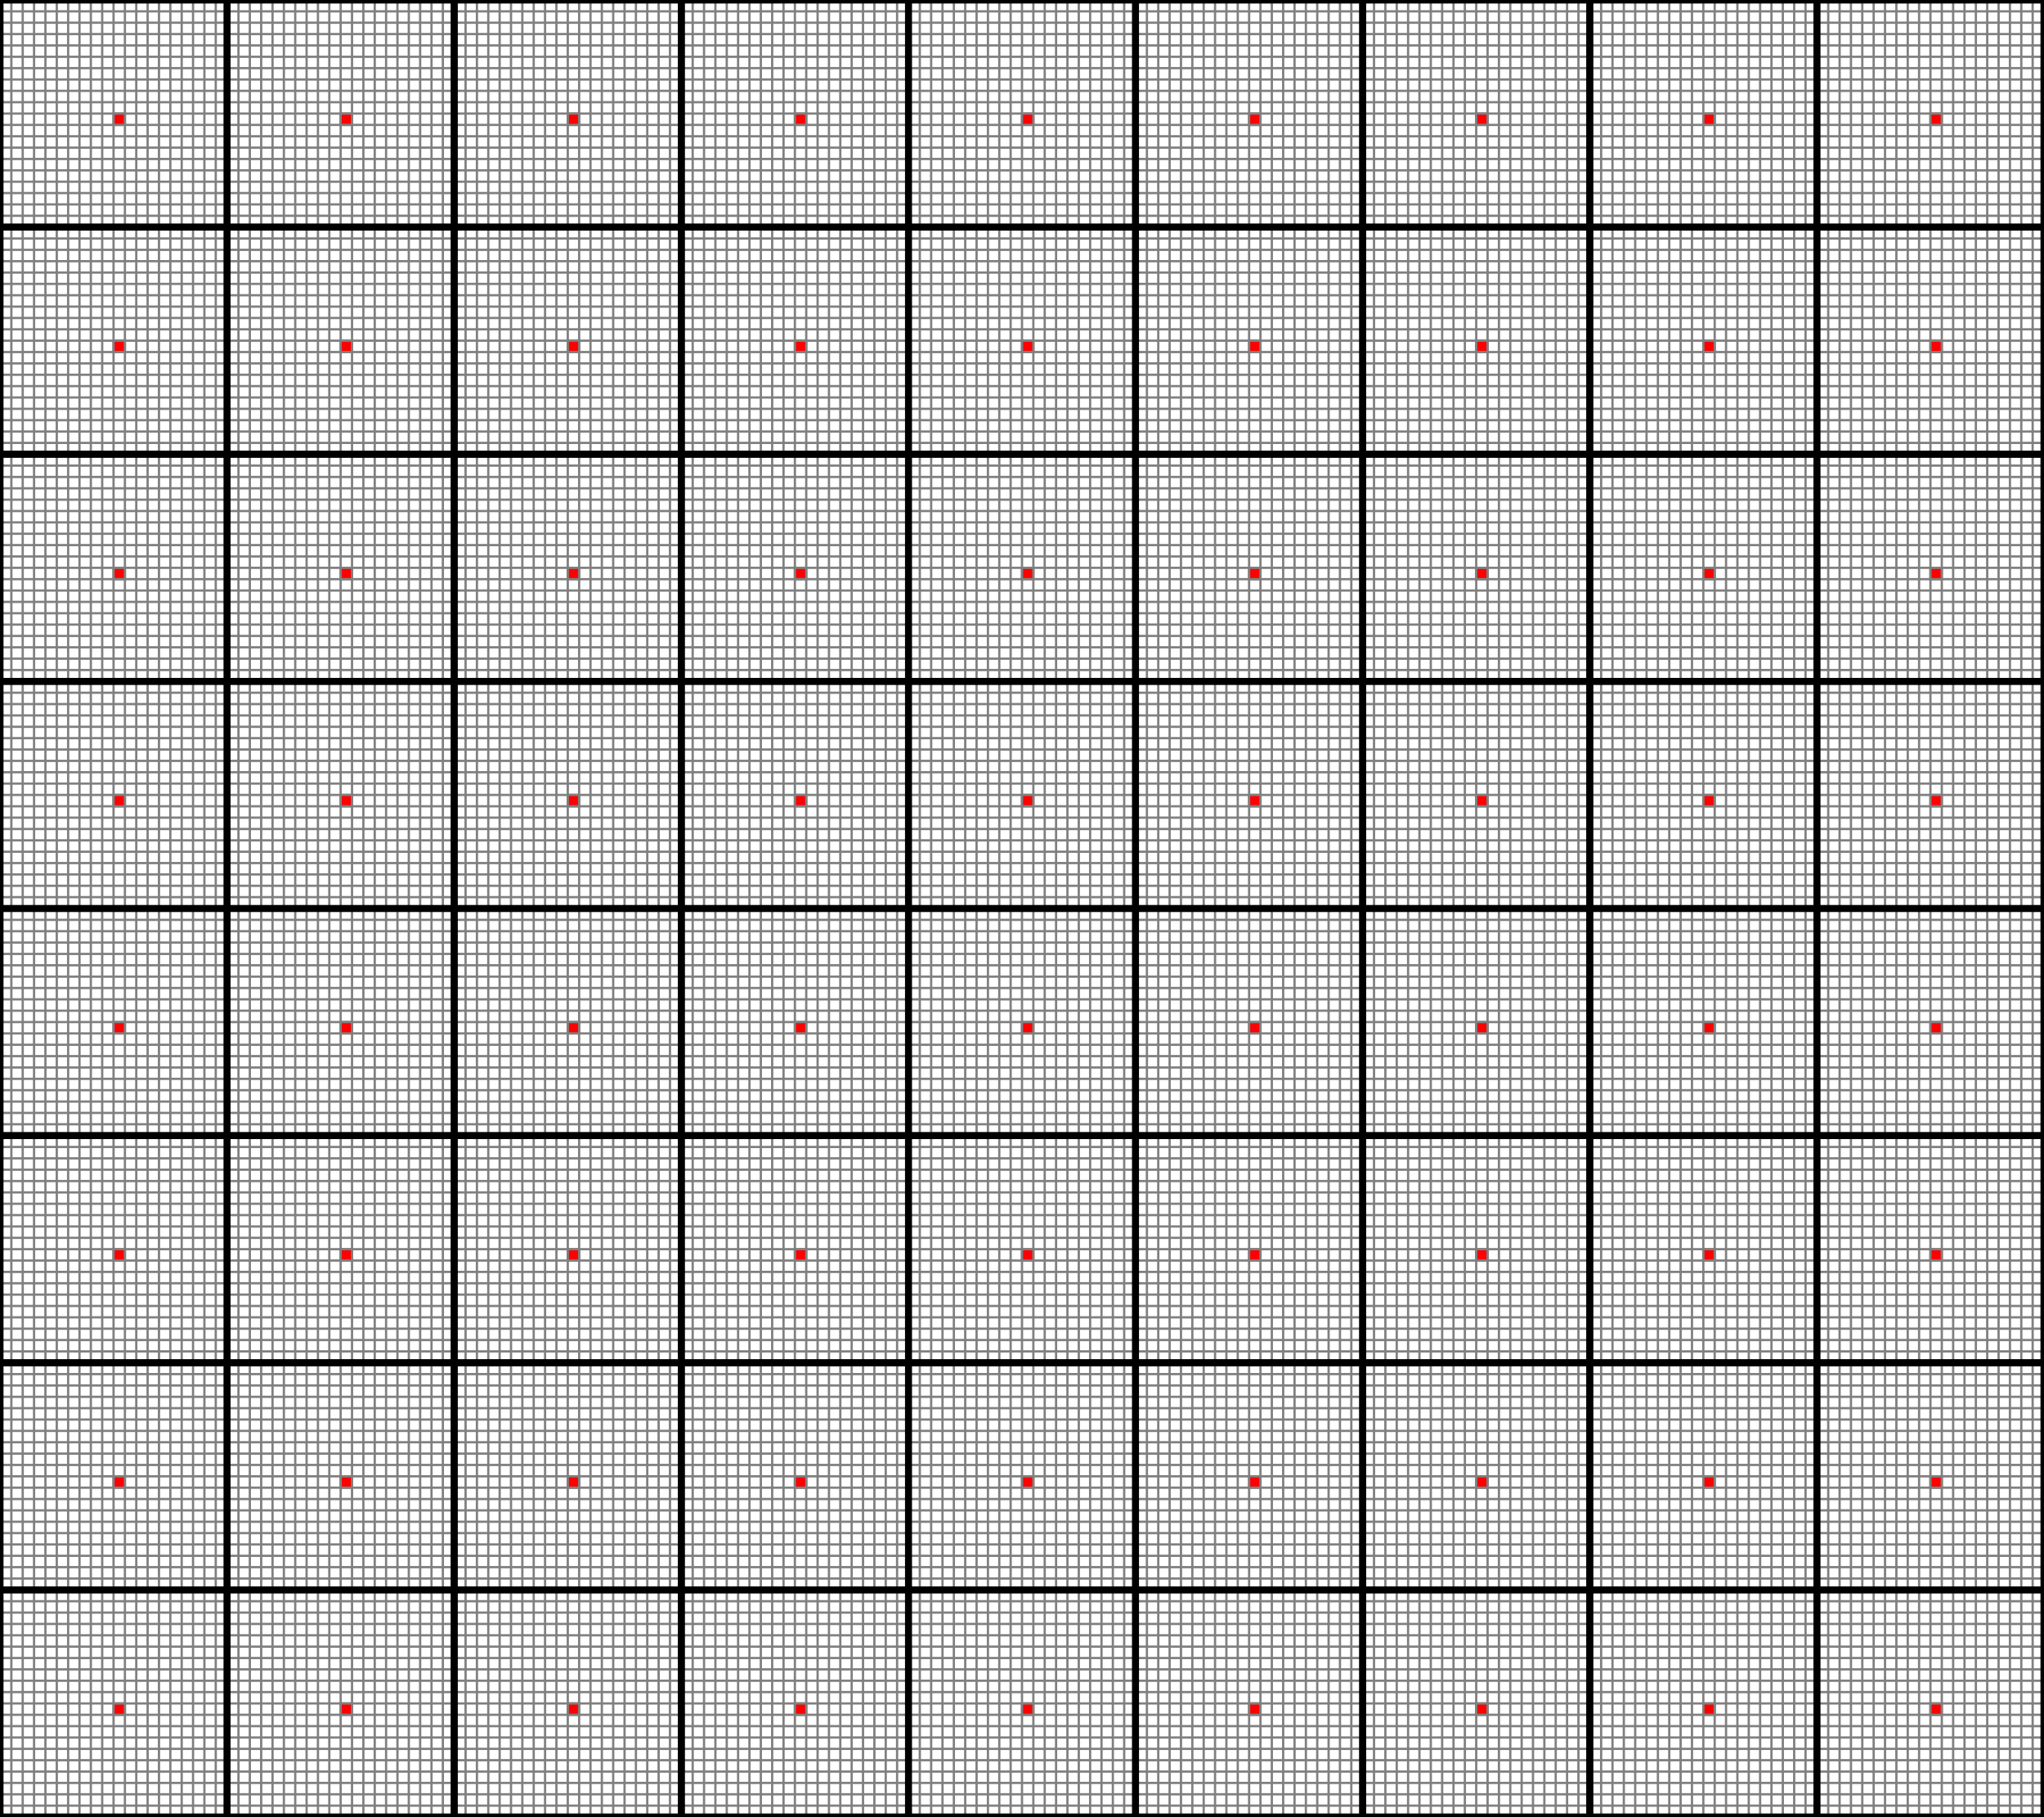
Benchmark Graph UniB (Demo 8)
Nodes | 28,800
Edges | 171,400
Regions | 72
Hubs | 72
Max Degree | 399

Slide 21
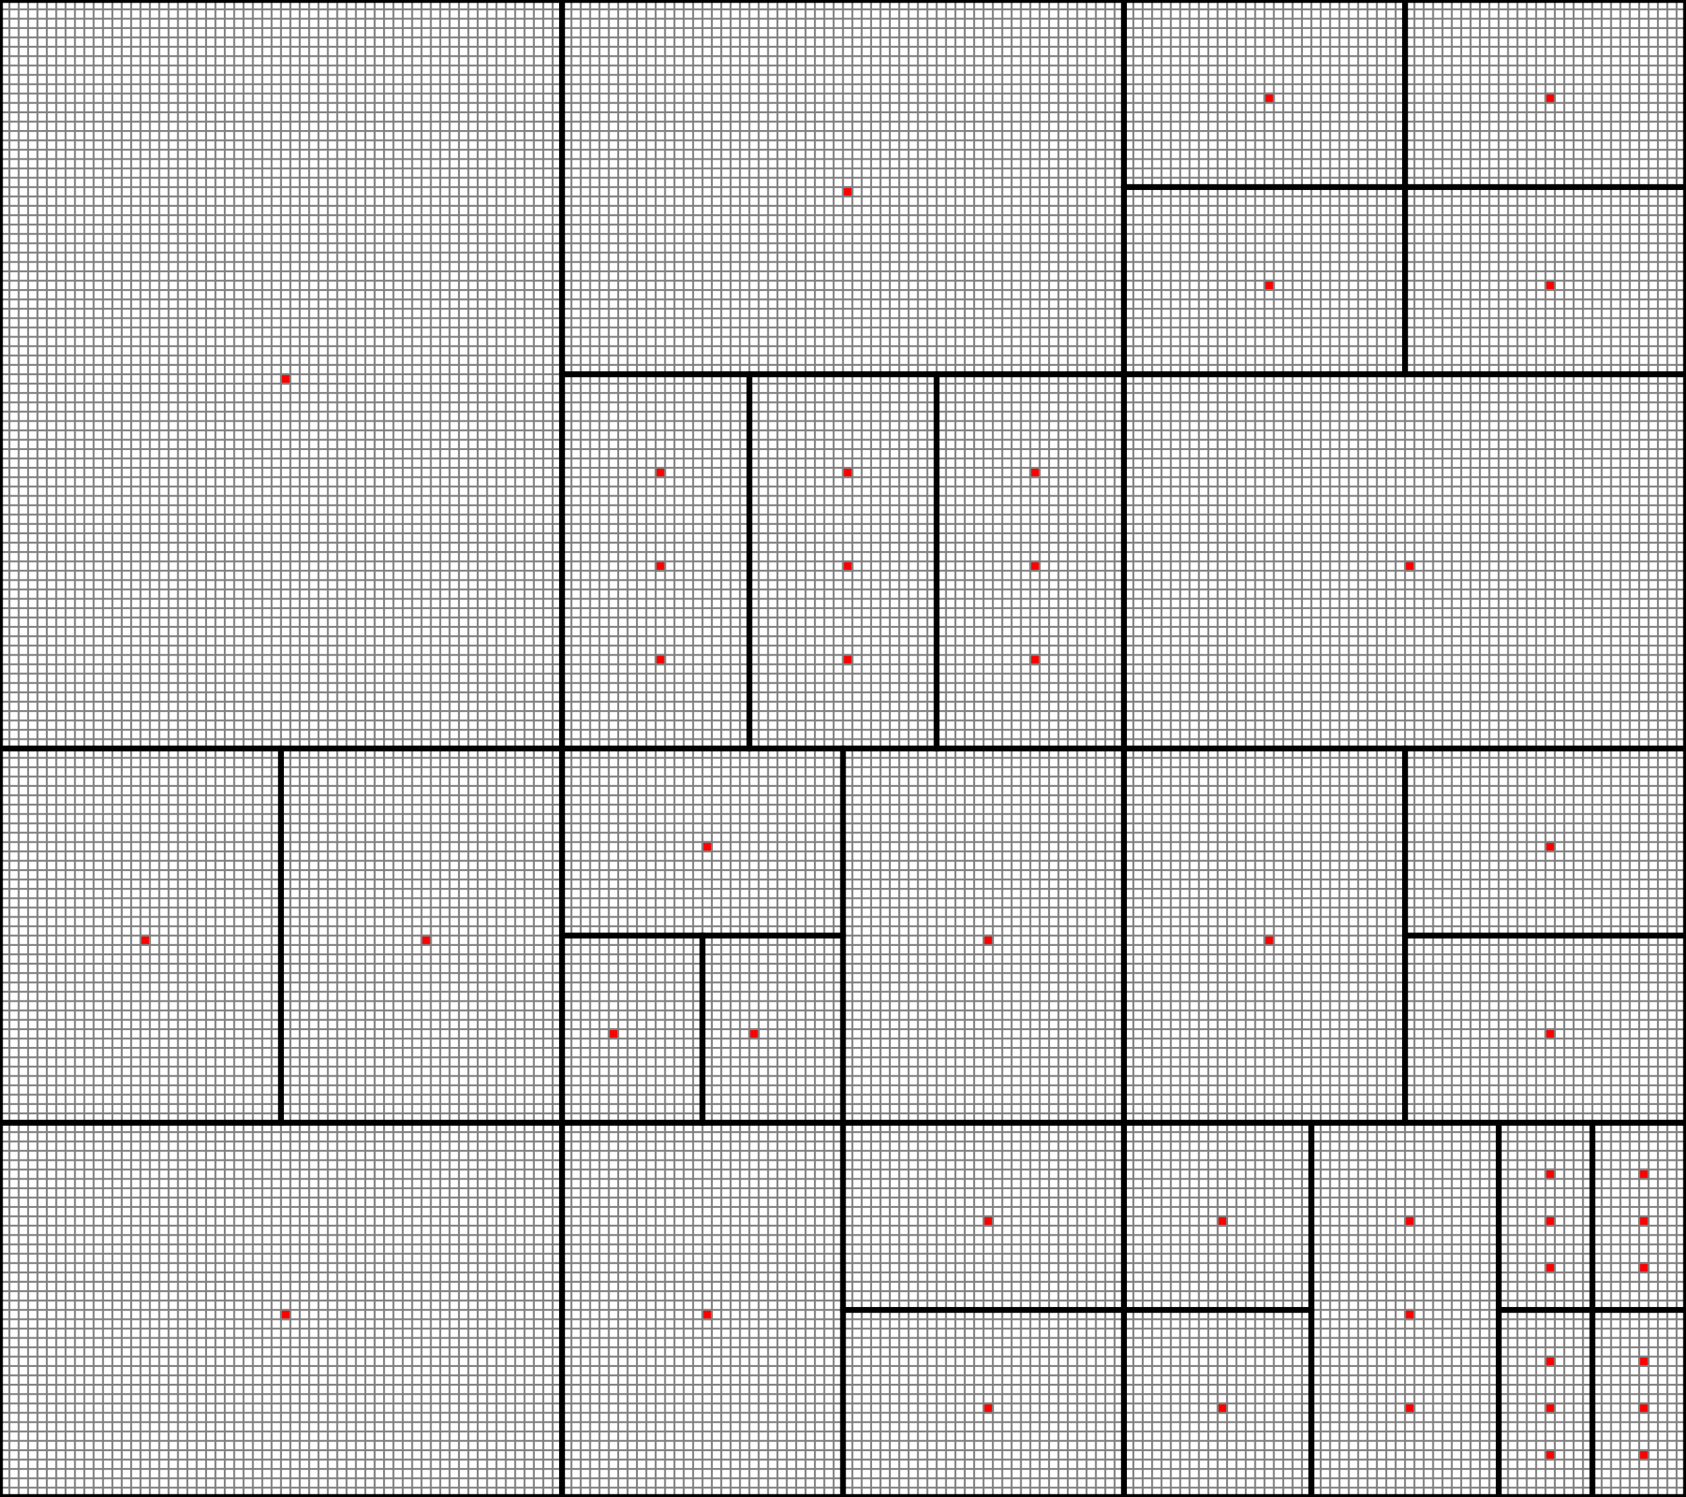
Benchmark Graph FracC (Demos 9–10)
Nodes | 28,800
Edges | 187,612
Regions | 30
Hubs | 46
Max Degree | 4,899

Slide 22
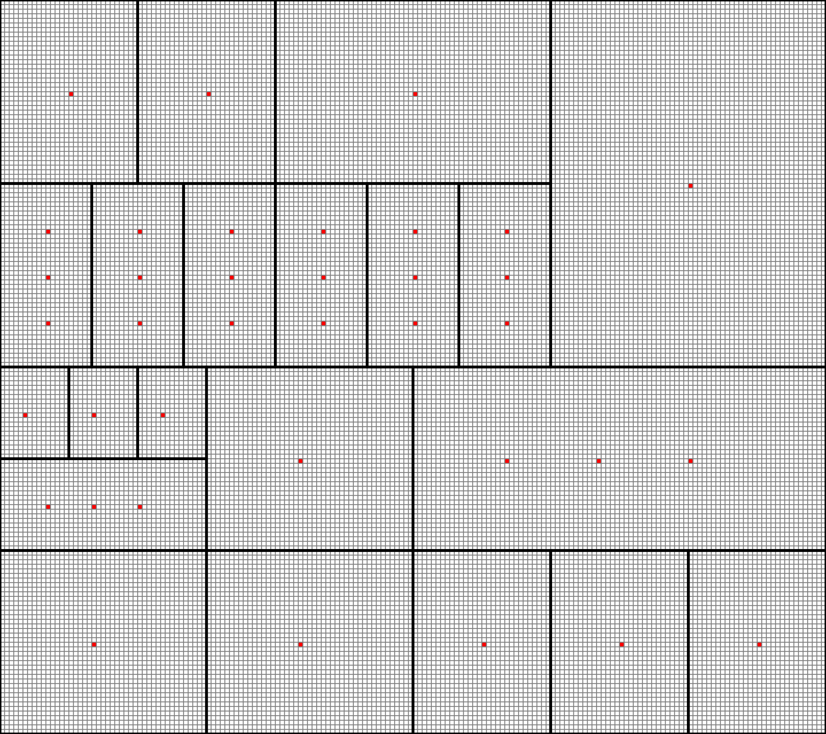
Benchmark Graph FracD
Nodes | 28,800
Edges | 208,902
Regions | 21
Hubs | 37
Max Degree | 4,899

Slide 23
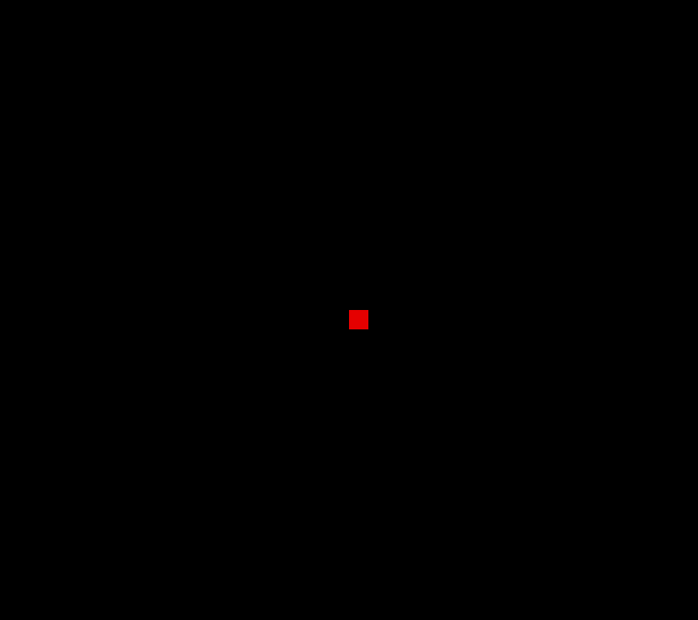


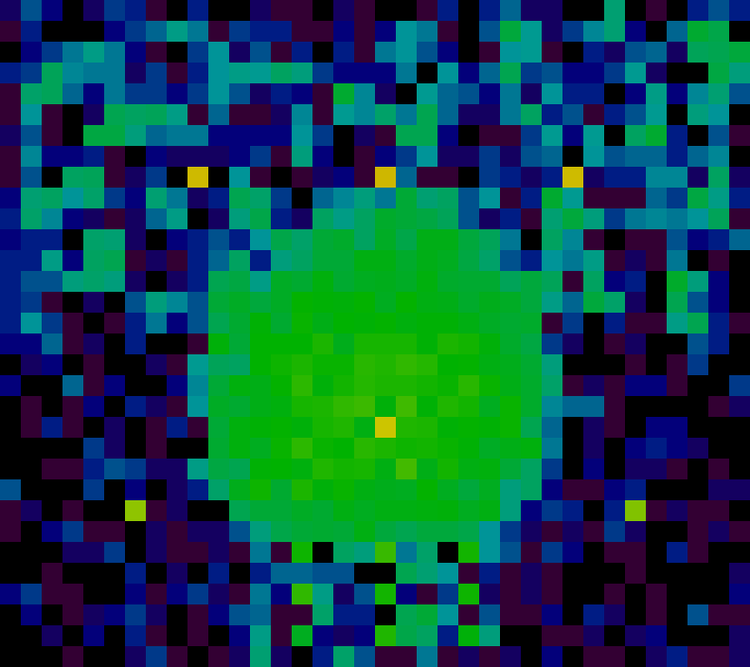
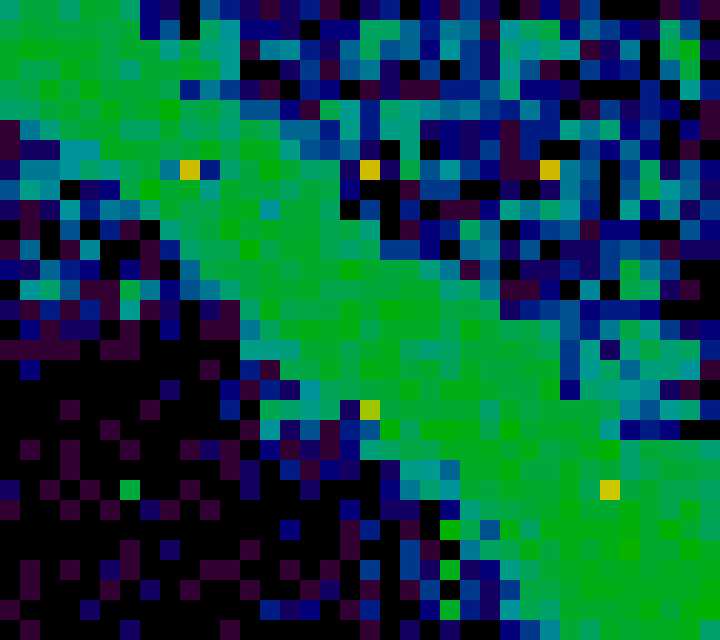
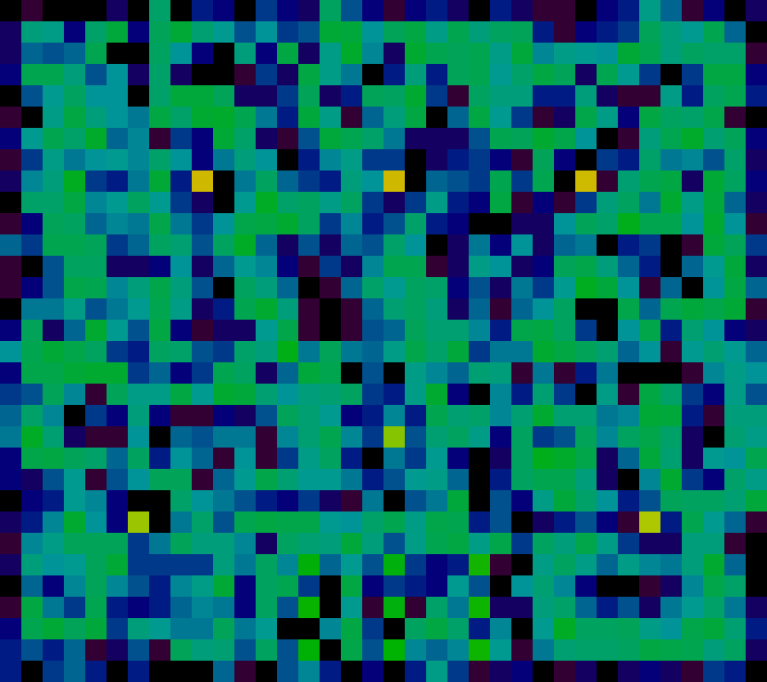
Initial States (fracZ)
Center (r)
~Demo 7
Diagonal (d)
~Demo 9
Random (u)
~Demo 10
t = 0
t = 20

Slide 24
Graph Representation
N node, M edges
0
1
2
neighbor_start (length = N+1)
0
3
7
10
14
19
23
26
30
33
3
4
5
6
7
8
0
1
3
1
0
2
4
2
1
5
3
0
4
6
neighbor
Includes self edges
length = N+M
4
1
3
5
7
5
2
4
8
6
3
7
7
4
6
8
8
5
7
Having pointer to end is useful (why?)

Slide 25
Sample Code
From sim.c
Compute reward value for node
Simulation state stored in state_t struct
Reward function computed by mweight
/* Compute weight for node nid */
static inline double compute_weight(state_t *s, int nid) {
int count = s->rat_count[nid];
double ilf = neighbor_ilf(s, nid);
return mweight((double) count/s->load_factor, ilf);
}

Slide 26
Sample Code
From sim.c
Compute reward value for all nodes
Simulation state stored in state_t struct
static inline void compute_all_weights(state_t *s) {
graph_t *g = s->g;
double *node_weight = s->node_weight;
int nid;
for (nid = 0; nid < g->nnode; nid++)
node_weight[nid] = compute_weight(s, nid);
}

Slide 27
Sample Code
From sim.c
Compute sum of reward values for node
Store cumulative value for each edge
Store total sum for later reuse
static inline void find_all_sums(state_t *s) {
graph_t *g = s->g;
int nid, eid;
for (nid = 0; nid < g->nnode; nid++) {
double sum = 0.0;
for (eid = g->neighbor_start[nid];
eid < g->neighbor_start[nid+1];
eid++) {
sum += s->node_weight[g->neighbor[eid]];
s->neighbor_accum_weight[eid] = sum;
}
s->sum_weight[nid] = sum;
}
}

Slide 28
Sample Code
Compute next move for rat
static inline int fast_next_random_move(state_t *s, int r) {
int nid = s->rat_position[r];
graph_t *g = s->g;
random_t *seedp = &s->rat_seed[r];
double tsum = s->sum_weight[nid];
double val = next_random_float(seedp, tsum);
int estart = g->neighbor_start[nid];
int elen = g->neighbor_start[nid+1] - estart;
/* Find location by binary search */
int offset = locate_value(val,
&s->neighbor_accum_weight[estart],
elen);
return g->neighbor[estart + offset];
}

Slide 29
Instrumented Code
From sim.c
Wrap major sections with instrumentation macros
Simulation state stored in state_t struct
static inline void find_all_sums(state_t *s) {
graph_t *g = s->g;
START_ACTIVITY(ACTIVITY_SUMS);
int nid, eid;
for (nid = 0; nid < g->nnode; nid++) {
double sum = 0.0;
for (eid = g->neighbor_start[nid];
eid < g->neighbor_start[nid+1];
eid++) {
sum += s->node_weight[g->neighbor[eid]];
s->neighbor_accum_weight[eid] = sum;
}
s->sum_weight[nid] = sum;
}
FINISH_ACTIVITY(ACTIVITY_SUMS);
}

Slide 30
Running Instrumented Code
Demo 11
Shows breakdown of where time spent
See speedups of different parts of code
Can instrument both your code & reference version
./crun-seq -g data/g-180x160-fracC.gph
-r data/r-180x160-r35.rats -u b -n 50 -I -q
50 steps, 1008000 rats, 13.770 seconds
228 ms 1.6 % startup
10677 ms 76.3 % compute_weights
750 ms 5.4 % compute_sums
2340 ms 16.7 % find_moves
2 ms 0.0 % unknown
13998 ms 100.0 % elapsed

Slide 31
Finding Parallelism
Sequential constraints
  Must complete time steps sequentially
  Must complete each batch before starting next
    ILF values and weights then need to be recomputed
Sources of parallelism
  Over nodes
    Computing ILFs and reward functions
    Computing cumulative sums
  Over rats (within a batch)
    Computing next moves
    Updating node counts

Slide 32
Performance Measurements
Nanoseconds per move (NPM)
  R rats running for S steps
  Requires time T seconds
  NPM = 10⁹ * T / (R * S)
  Reference solution:
    Average 290 NPM for 1 thread
    Average 44.6 NPM for 12 threads
    Speedups:
      UniA 6.78
      UniB 6.43
      FracC 6.45
      FracD 6.55
  Maybe you can do better!

Slide 33
Performance Targets
Benchmarks
  4 combinations of graph/initial state
  Each counts 16 points
Target performance
  T = measured time
  T_{r} = time for reference solution
  T_{r} / T = How well you reach reference solution performance
    Full credit when ≥ 0.95
    Partial when ≥ 0.60

Slide 34
Machines
Latedays cluster
  16 worker nodes + 1 head node
  Each is 12-core Xeon processor (dual socket with 6 cores each)
  You submit jobs to batch queue
  Assigned single processor for entire run
  Python script provided
Code Development
  OK to do code development and testing on other machines
  But, they have different performance characteristics
  Max threads on GHC cluster = 8
  Code should run for any number of threads (up to machine limit)

Slide 35


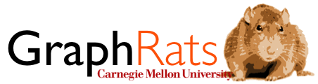
Some Logos

