Slide 1
Recitation 1:
ILP, SIMD, and Thread Parallelism
15-418 Parallel Computer Architecture and Programming
CMU 15-418/15-618, Spring 2020

Slide 2
Goals for today
Topic is parallelism models: ILP, SIMD, threading
Solve some exam-style problems
Walk through example code
Most of all,
ANSWER YOUR QUESTIONS!

Slide 3
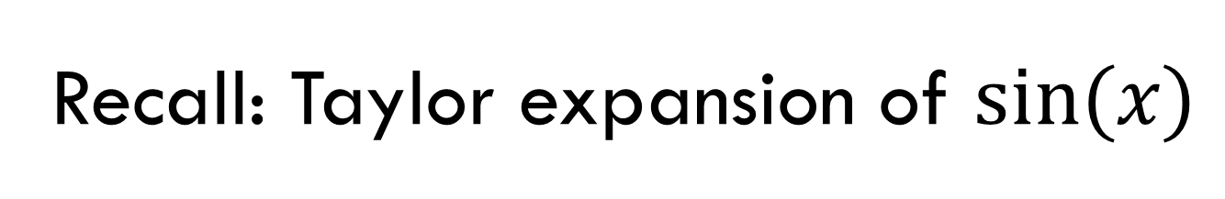
Recall: Taylor expansion of $sin⁡(x)$
void sinx(int N, int terms, float * x,
float *result) {
for (int i=0; i<N; i++) {
float value = x[i];
float numer = x[i]*x[i]*x[i];
int denom = 6; // 3!
int sign = -1;
for (int j=1; j<=terms; j++) {
value += sign * numer / denom;
numer *= x[i] * x[i];
denom *= (2*j+2) * (2*j+3);
sign *= -1;
}
result[i] = value;
}
}
How fast is this code?
Where should we focus optimization efforts?
What is the bottleneck?

Slide 4
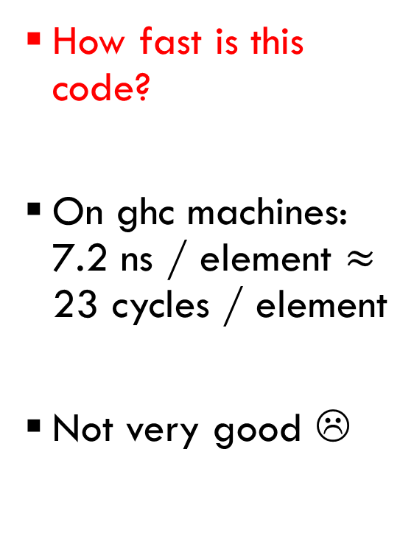
Recall: Taylor expansion of $sin⁡(x)$
void sinx(int N, int terms, float * x,
float *result) {
for (int i=0; i<N; i++) {
float value = x[i];
float numer = x[i]*x[i]*x[i];
int denom = 6; // 3!
int sign = -1;
for (int j=1; j<=terms; j++) {
value += sign * numer / denom;
numer *= x[i] * x[i];
denom *= (2*j+2) * (2*j+3);
sign *= -1;
}
result[i] = value;
}
}
How fast is this code?
On ghc machines: 7.2 ns / element $≈$ 23 cycles / element
Not very good ☹

Slide 5
Recall: Taylor expansion of $sin⁡(x)$
void sinx(int N, int terms, float * x,
float *result) {
for (int i=0; i<N; i++) {
float value = x[i];
float numer = x[i]*x[i]*x[i];
int denom = 6; // 3!
int sign = -1;
for (int j=1; j<=terms; j++) {
value += sign * numer / denom;
numer *= x[i] * x[i];
denom *= (2*j+2) * (2*j+3);
sign *= -1;
}
result[i] = value;
}
}
Where should we focus optimization efforts?
A: Where most of the time is spent

Slide 6
Recall: Taylor expansion of $sin⁡(x)$
void sinx(int N, int terms, float * x,
float *result) {
for (int i=0; i<N; i++) {
float value = x[i];
float numer = x[i]*x[i]*x[i];
int denom = 6; // 3!
int sign = -1;
for (int j=1; j<=terms; j++) {
value += sign * numer / denom;
numer *= x[i] * x[i];
denom *= (2*j+2) * (2*j+3);
sign *= -1;
}
result[i] = value;
}
}
What is the bottleneck?

Slide 7
Takeaways from today
Focus your effort on the performance bottleneck
Usually, you do not need to model processor in detail to find the performance bottleneck

Slide 8








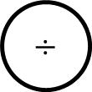



Dataflow for a single iteration
j
value
denom
sign
numer
x[i]
2
$$×$$
LD
$$×$$
1
3
$$+$$
$$+$$
$$+$$
$$÷$$
-1
$$×$$
$$×$$
$$×$$
$$×$$
$$+$$
$$×$$
j’
value’
denom’
sign’
numer’
OK, but how does this perform on a real machine?

Slide 9
Superscalar OOO Processor
What in microarchitecture should we worry about?
CPU
Instruction Buffer
Fetch
Decode
Execute
Execute
Execute
Commit
Fetch
Decode
Commit
In-order
Out-of-order
In-order

Slide 10
GHC Machine Microarchitecture
What in microarchitecture should we worry about?
  Fetch & Decode?
  Execution?
  Commit?
NO. Any reasonable machine will have sufficient frontend throughput to keep execution busy + all branches in this code are easy to predict (not always the case!).
YES. This is where dataflow + most structural hazards will limit our performance.
NO. Again, any reasonable machine will have sufficient commit throughput to keep execution busy.

Slide 11
Intel Skylake (GHC machines) Execution Microarchitecture
 | Integer |  |  | Floating Point
 | Latency | Pipelined? | Number | Latency | Pipelined? | Number
Add | 1 |  | 4 | 4* |  | 2
Multiply | 3 |  | 1 | 4 |  | 2
Divide | 21-83 |  | 1 | 13-14 | ** | 1
Load | 2 |  | 2
* 3 cycles if using x87 instructions
** Can issue another operation after 4 cycles
Source: Search for “Skylake” in
https://www.agner.org/optimize/microarchitecture.pdf
https://www.agner.org/optimize/instruction_tables.pdf

Slide 12

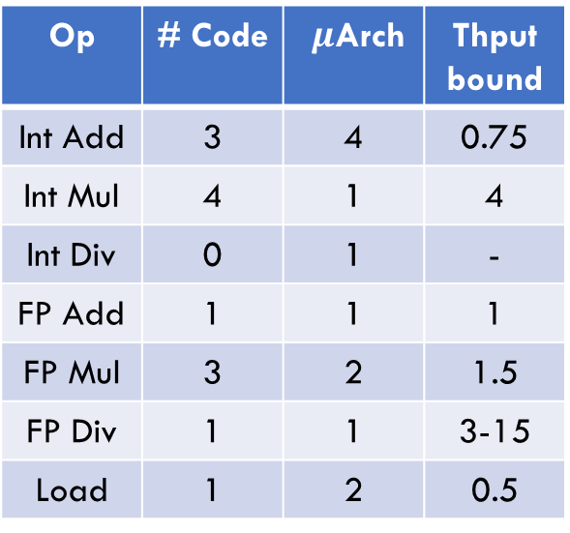










What is our throughput bound?
j
value
denom
sign
numer
x[i]
2
$$×$$
$$×$$
LD
1
3
$$+$$
$$+$$
$$+$$
$$÷$$
-1
$$×$$
$$×$$
$$×$$
$$×$$
$$+$$
$$×$$
Op | # Code | $μ$Arch | Thput bound
Int Add | 3 | 4 | 0.75
Int Mul | 4 | 1 | 4
Int Div | 0 | 1 | -
FP Add | 1 | 1 | 1
FP Mul | 3 | 2 | 1.5
FP Div | 1 | 1 | 3-15
Load | 1 | 2 | 0.5
j’
value’
denom’
sign’
numer’
Throughput bound: Ignore data hazards, think only about max issue rate due to structural hazards
THPUT BOUND!

Slide 13












What is our latency bound?
Latency bound: Ignore structural hazards, think only about the critical path through data hazards
j
value
denom
sign
numer
x[i]
2
$$×$$
LD
$$×$$
1
3
$$+$$
$$+$$
LATENCY BOUND!
-1
$$×$$
$$+$$
$$÷$$
$$×$$
$$×$$
$$×$$
$$+$$
$$×$$
j’
value’
denom’
sign’
numer’
1
3+(3/15)+3=9 to 21
3+1+3+3=10
3
1+3+3=7

Slide 14
Takeaways
Observe performance of 23 cycles / element
Latency bound dominates throughput bound
➔ We are latency bound!
Notes
  This analysis can often be “eyeballed” w/out full dataflow
  Actual execution is more complicated, but latency/thput bounds are good approximation
  (Also, avoid division!!!)

Slide 15

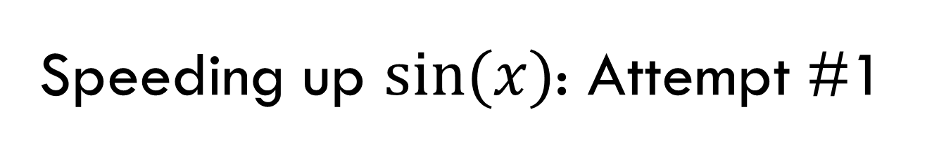
Speeding up $sin⁡(x)$: Attempt #1
What if we eliminate unnecessary work?
void sinx_better(int N, int terms, float * x,
float *result) {
for (int i=0; i<N; i++) {
float value = x[i];
float x2 = x[i]*x[i];
float numer = x2*x[i];
int denom = 6; // 3!
int sign = -1;
for (int j=1; j<=terms; j++) {
value += sign * numer / denom;
numer *= x2;
denom *= (2*j+2) * (2*j+3);
sign = -sign;
}
result[i] = value;
}
}
A: Small improvement.
6ns / element $≈$
18 cycles / element
Why not better?

Slide 16
What is our latency bound?
Find the critical path in the dataflow graph
j
value
denom
sign
numer
x2
2
$$×$$
$$×$$
1
3
$$+$$
$$+$$
LATENCY BOUND!
$$+$$
$$÷$$
NEG
$$×$$
$$×$$
$$+$$
$$×$$
j’
value’
denom’
sign’
numer’
1
3+(3/15)+3=9 to 21
3+1+3+3=10
1
3

Slide 17
Attempt #1 Takeaways
First attempt didn’t change latency bound
To get real speedup, we need to focus on the performance bottleneck
Q: Why did we get any speedup at all?
A: Actual dynamic scheduling is complicated; would need to simulate execution in more detail

Slide 18
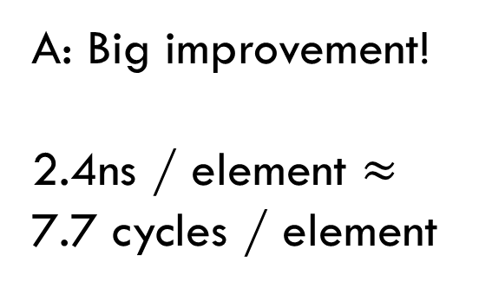
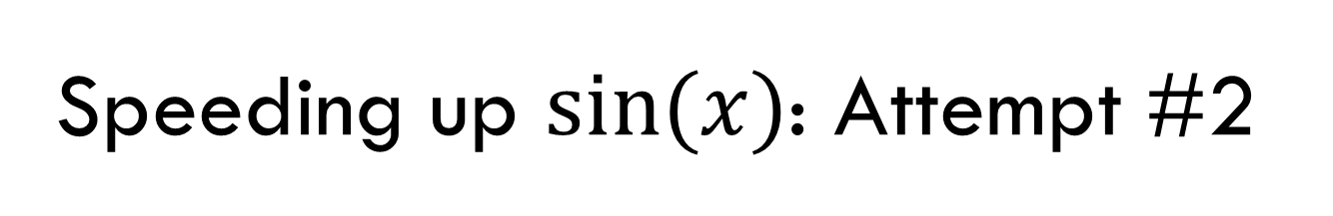
Speeding up $sin⁡(x)$: Attempt #2
Let’s focus on that pesky division…
void sinx_predenom(int N, int terms, float * x, float *result) {
float rdenom[MAXTERMS];
int denom = 6;
for (int j = 1; j <= terms; j++) {
rdenom[j] = 1.0/denom;
denom *= (2*j+2) * (2*j+3);
}
for (int i=0; i<N; i++) {
float value = x[i];
float x2 = value * value;
float numer = x2 * value;
int sign = -1;
for (int j=1; j<=terms; j++) {
value += sign * numer * rdenom[j];
numer *= x2;
sign = -sign;
}
result[i] = value;
}
}
A: Big improvement!
2.4ns / element $≈$
7.7 cycles / element

Slide 19

What is our latency bound?
Find the critical path in the dataflow graph
j
value
rdenom[j]
sign
numer
x2
LD
$$×$$
1
$$+$$
LATENCY BOUND!
NEG
+ & $×$
$$×$$
j’
value’
sign’
numer’
1
3+3=6
1
3

Slide 20

Attempt #2 Takeaways
Here we go! Attacking the bottleneck got nearly 3$×$!
…But performance is still near the latency bound, can we do better?

Slide 21
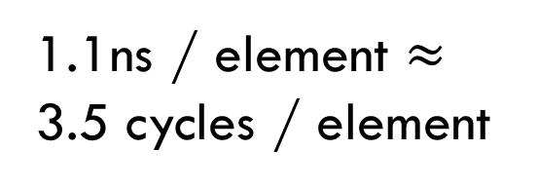
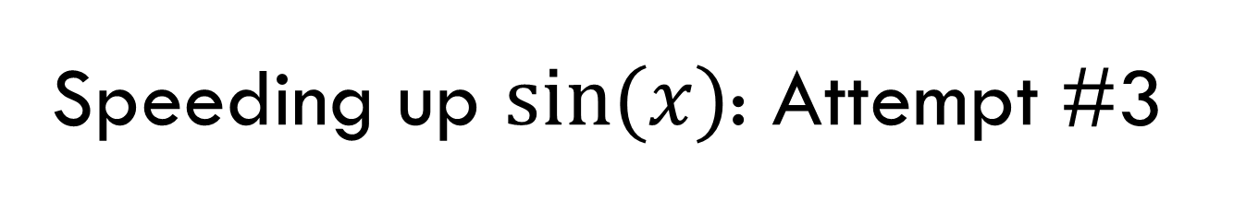
Speeding up $sin⁡(x)$: Attempt #3
Don’t need sign in inner-loop either
void sinx_predenoms(int N, int terms, float * x, float *result) {
float rdenom[MAXTERMS];
int denom = 6;
float sign = -1.0;
for (int j = 1; j <= terms; j++) {
rdenom[j] = sign/denom;
denom *= (2*j+2) * (2*j+3);
sign = -sign;
}
for (int i=0; i<N; i++) {
float value = x[i];
float x2 = value * value;
float numer = x2 * value;
for (int j=1; j<=terms; j++) {
value += numer * rdenom[j];
numer *= x2;
}
result[i] = value;
}
}
1.1ns / element $≈$
3.5 cycles / element

Slide 22
What is our latency bound?
Find the critical path in the dataflow graph
j
value
rdenom[j]
numer
x2
LD
1
$$+$$
LATENCY BOUND!
$$×$$
+ & $×$
j’
value’
numer’
1
3 (LD will be executed speculatively, only depends on j)
3

Slide 23
Attempt #3 Takeaways
We’re down to the latency of a single, fast operation per iteration
+ Observed performance is very close to this latency bound, so throughput isn’t limiting
➔ We’re done optimizing individual iterations
How to optimize multiple iterations?
  Eliminate dependence chains across iterations
  A) Loop unrolling (ILP)
  B) Explicit parallelism (SIMD, threading)

Slide 24

Speeding up $sin⁡(x)$:
Loop unrolling
Compute multiple elements per iteration
void sinx_unrollx2(int N, int terms, float * x, float *result) {
// same predom stuff as before…
for (int i=0; i<N; i++) {
float value = x[i];
float x2 = value * value;
float x4 = x2 * x2;
float numer = x2 * value;
for (int j=1; j<=terms; j+=2) {
value += numer * rdenom[j];
value += numer * x2 * redom[j+1];
numer *= x4;
}
result[i] = value;
}
}
Correct? Not yet…

Slide 25
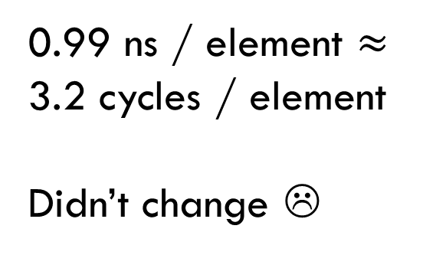
Speeding up $sin⁡(x)$:
Loop unrolling
Compute multiple elements per iteration
void sinx_unrollx2(int N, int terms, float * x, float *result) {
// same predom stuff as before…
for (int i=0; i<N; i++) {
float value = x[i];
float x2 = value * value;
float x4 = x2 * x2;
float numer = x2 * value;
int j;
for (j=1; j<=terms-1; j+=2) {
value += numer * rdenom[j];
value += numer * x2 * redom[j+1];
numer *= x4;
}
for (; j<=terms; j++) {
value += numer * rdenom[j];
numer *= x2;
}
result[i] = value;
}
}
0.99 ns / element $≈$
3.2 cycles / element
Didn’t change ☹

Slide 26



What is our latency bound?
Find the critical path in the dataflow graph
j
value
rdenom[j]
rdenom[j+1]
x2
numer
x4
LD
2
LD
$$×$$
$$+$$
+ & $×$
LATENCY BOUND!
+ & $×$
$$×$$
value’
j’
numer’
1/2=0.5
6/2=3 (LD will be executed speculatively, only depends on j)
3/2=1.5

Slide 27
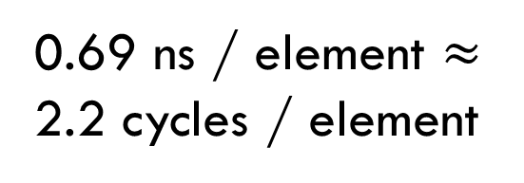

Speeding up $sin⁡(x)$:
Loop unrolling #2
What if floating point associated + distributed?
void sinx_unrollx2(int N, int terms, float * x, float *result) {
// same predom stuff as before…
for (int i=0; i<N; i++) {
float value = x[i];
float x2 = value * value;
float x4 = x2 * x2;
float numer = x2 * value;
int j;
for (j=1; j<=terms-1; j++) {
value += numer * (rdenom[j] + x2 * redom[j+1]);
numer *= x4;
}
for (; j<=terms; j++) {
value += numer * rdenom[j];
numer *= x2;
}
result[i] = value;
}
}
0.69 ns / element $≈$
2.2 cycles / element

Slide 28


What is our latency bound?
Find the critical path in the dataflow graph
j
value
rdenom[j]
rdenom[j+1]
x2
numer
x4
LD
LD
2
$$+$$
LATENCY BOUND!
+ & $×$
$$×$$
+ & $×$
j’
value’
numer’
1/2=0.5
3/2=1.5 (LD will be executed speculatively, only depends on j)
3/2=1.5

Slide 29
Loop unrolling takeaways
Need to break dependencies across iterations to get speedup
  Unrolling by itself doesn’t help
We are now seeing throughput effects
  Latency bound = 1.5 vs. observed = 2.2
Can unroll loop 3x, 4x to improve further, but…
…Diminishing returns (1.65 cycles / element at 4x)

Slide 30
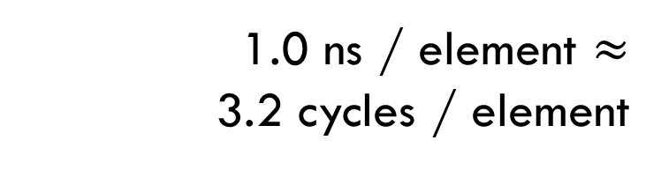

Speeding up $sin⁡(x)$:
Going parallel (explicitly)
Use ISPC to vectorize the code
export void sinx_reference(uniform int N, uniform int terms,
uniform float x[],
uniform float result[]) {
foreach (i=0 ... N) {
float value = x[i];
float numer = x[i]*x[i]*x[i];
uniform int denom = 6; // 3!
uniform int sign = -1;
for (uniform int j=1; j<=terms; j++) {
value += sign * numer / denom;
numer *= x[i] * x[i];
denom *= (2*j+2) * (2*j+3);
sign *= -1;
}
result[i] = value;
}
}
1.0 ns / element $≈$
3.2 cycles / element

Slide 31
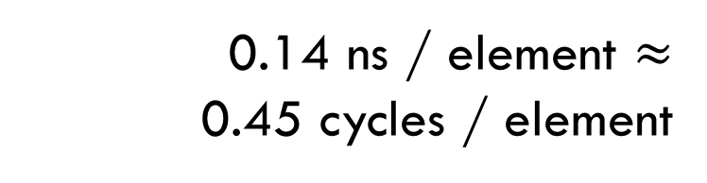

Speeding up $sin⁡(x)$:
Going parallel (explicitly) + optimize
export void sinx_unrollx2a(uniform int N, uniform int terms,
uniform float x[],
uniform float result[]) {
uniform float rdenom[MAXTERMS];
uniform int denom = 6;
uniform float sign = -1;
for (uniform int j = 1; j <= terms; j++) {
rdenom[j] = sign/denom;
denom *= (2*j+2) * (2*j+3);
sign = -sign;
}
foreach (i=0 ... N) {
float value = x[i];
float x2 = value * value;
float x4 = x2 * x2;
float numer = x2 * value;
uniform int j;
for (j=1; j<=terms-1; j+=2) {
value +=
numer * (rdenom[j] +
x2 * rdenom[j+1]);
numer *= x4;
}
for (; j <= terms; j++) {
value += numer * rdenom[j];
numer *= x2;
}
result[i] = value;
}
}
0.14 ns / element $≈$
0.45 cycles / element

Slide 32





SIMD takeaways
Well, that was easy! (Thanks ISPC)
Cycles per element:
Speedup
 | Scalar | Vector
Unoptimized | 23 | 3.2
Unrolled | 2.2 | 0.45
Original
7.2$×$
Vector
Maximum speedup requires hand tuning + explicit parallelism!
10$×$
51$×$
7$×$
Unrolled
4.9$×$
Vector + Unrolled

Slide 33
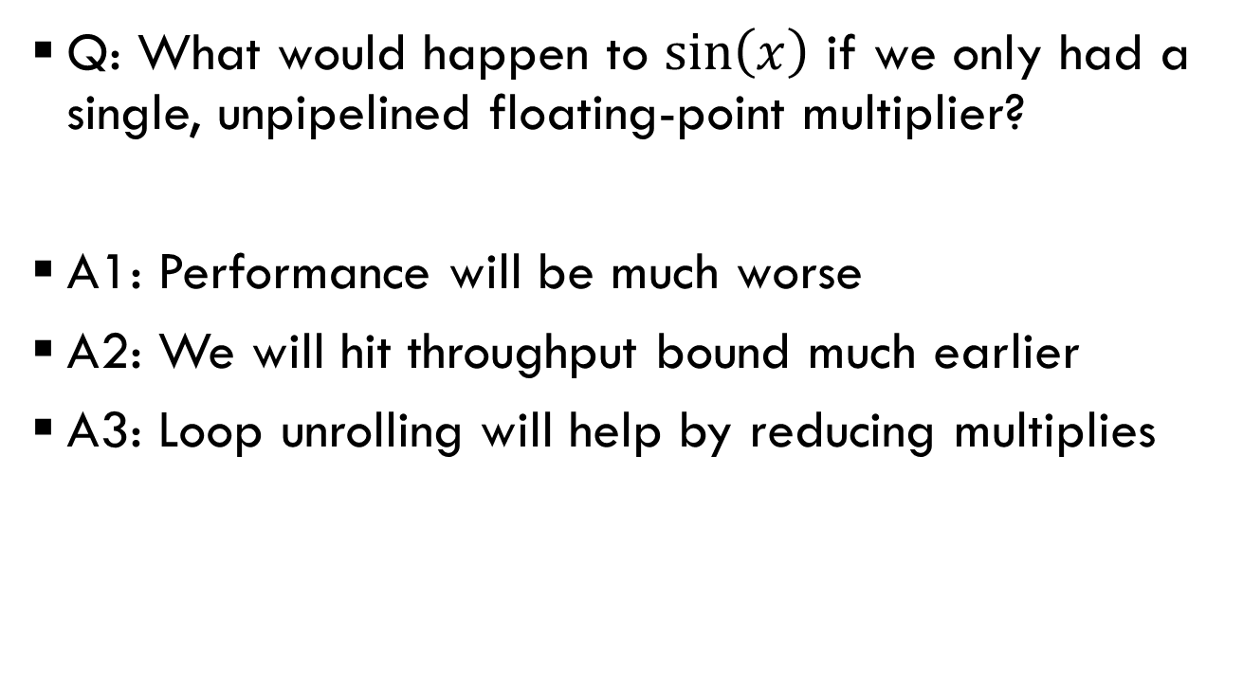
What if? #1
Impact of structural hazards
Q: What would happen to $\sin\left(x\right)$ if we only had a single, unpipelined floating-point multiplier?
A1: Performance will be much worse
A2: We will hit throughput bound much earlier
A3: Loop unrolling will help by reducing multiplies

Slide 34
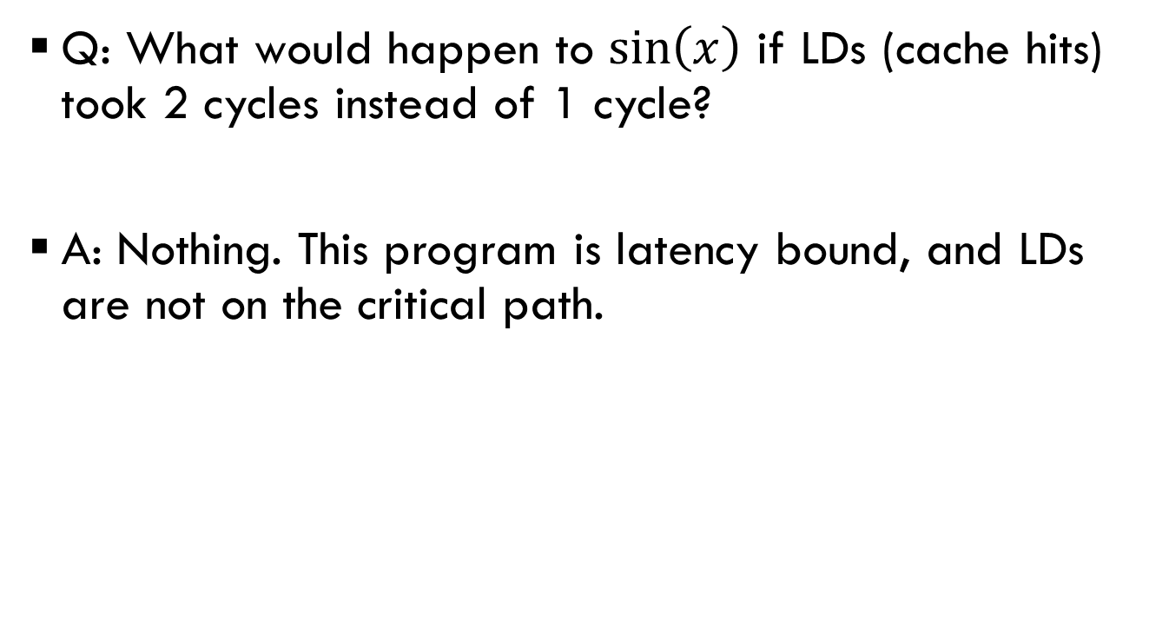
What if? #2
Impact of structural hazards
Q: What would happen to $\sin\left(x\right)$ if LDs (cache hits) took 2 cycles instead of 1 cycle?
A: Nothing. This program is latency bound, and LDs are not on the critical path.

Slide 35
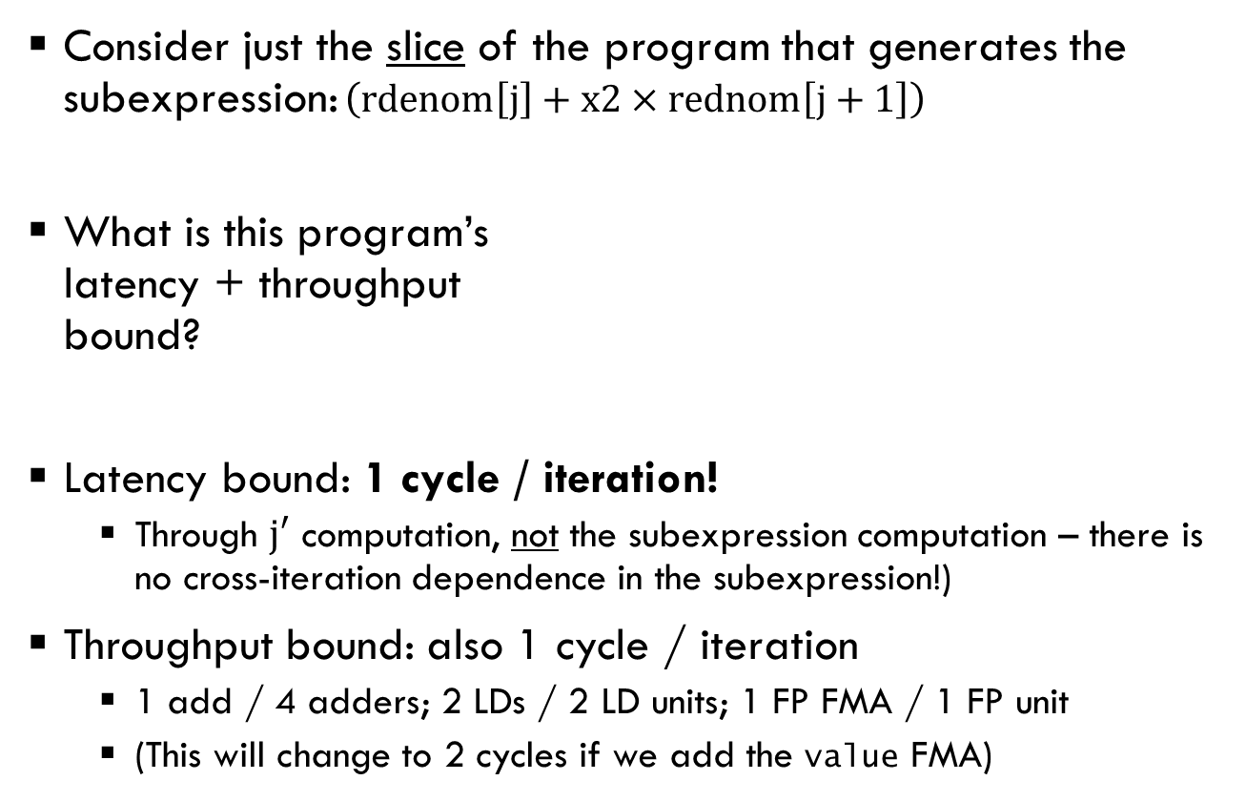



Loads do not limit $sin⁡(x)$
Consider just the slice of the program that generates the subexpression: $\left(rdenom\left[j\right]+x2×rednom\left[j+1\right]\right)$
What is this program’s
latency + throughput
bound?
Latency bound: 1 cycle / iteration!
  Through $j′$ computation, not the subexpression computation – there is no cross-iteration dependence in the subexpression!)
Throughput bound: also 1 cycle / iteration
  1 add / 4 adders; 2 LDs / 2 LD units; 1 FP FMA / 1 FP unit
  (This will change to 2 cycles if we add the value FMA)
2
j
rdenom[j]
rdenom[j+1]
x2
$$+$$
LD
LD
+ & $×$
j’
subexp

Slide 36


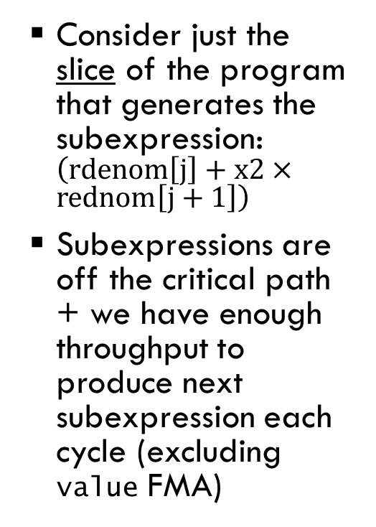









Loads do not limit $sin⁡(x)$:
Visualization
2
0
Consider just the slice of the program that generates the subexpression: $\left(rdenom\left[j\right]+x2×rednom\left[j+1\right]\right)$
Subexpressions are off the critical path + we have enough throughput to produce next subexpression each cycle (excluding value FMA)
$$+$$
LD
2
j
+ & $×$
subexp
LD
$$+$$
LD
2
j’
+ & $×$
subexp’
LD
$$+$$
LD
2
j’’
+ & $×$
subexp’’
LD
$$+$$
LD
2
j’’’
+ & $×$
subexp’’’
LD
$$+$$
LD
j’’’’
+ & $×$
subexp’’’’
LD

Slide 37

Loads do not limit $sin⁡(x)$:
Example execution
Note: Throughput limit is 2 cycles / iteration once we add value FMA, but this is dominated by the latency bound of 3 cycles / iteration (also from value FMA). Regardless, 2-cycle LDs are not the bottleneck.
INT ADD | j=0 | j=2 | j=4 | j=6 | j=8 | ...
LD1 |  | rdenom[0] |  | rdenom[4] |  | rdenom[8] |  | ...
 |  |  | rdenom[2] |  | rdenom[6] |  | ...
LD2 |  | rdenom[1] |  | rdenom[5] |  | rdenom[9] |  | ...
 |  |  | rdenom[3] |  | rdenom[7] |  | ...
FP FMA |  |  |  | subexp’ |  |  | value’ |  |  | value’’ |  |  | value’’’ |  |  | value’’’’
 |  |  |  |  |  | subexp’’’ |  |  | subexp’’’’’
 |  |  |  |  | subexp’’ |  |  | subexp’’’’
FP MUL |  |  | numer’=x^4 |  |  | numer’’=x^8 |  |  | numer’’’=x^12 |  |  | numer’’’’=x^16 |  |  | numer’’’’’=x^20 |  |  | ...

Slide 38
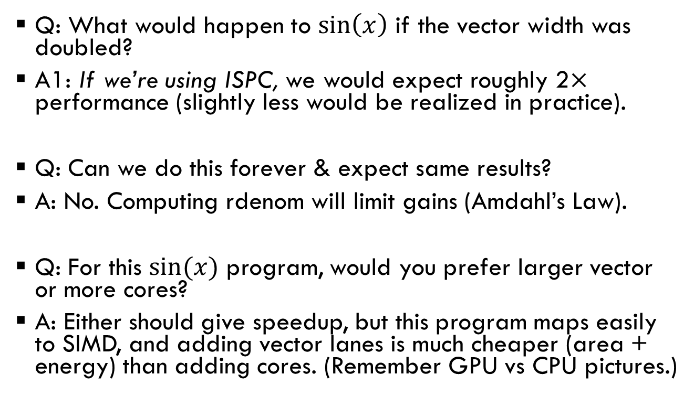
What if? #3
Vector vs. multicore
Q: What would happen to $\sin\left(x\right)$ if the vector width was doubled?
A1: If we’re using ISPC, we would expect roughly 2$×$ performance (slightly less would be realized in practice).
Q: Can we do this forever & expect same results?
A: No. Computing rdenom will limit gains (Amdahl’s Law).
Q: For this $sin⁡(x)$ program, would you prefer larger vector or more cores?
A: Either should give speedup, but this program maps easily to SIMD, and adding vector lanes is much cheaper (area + energy) than adding cores. (Remember GPU vs CPU pictures.)

Slide 39
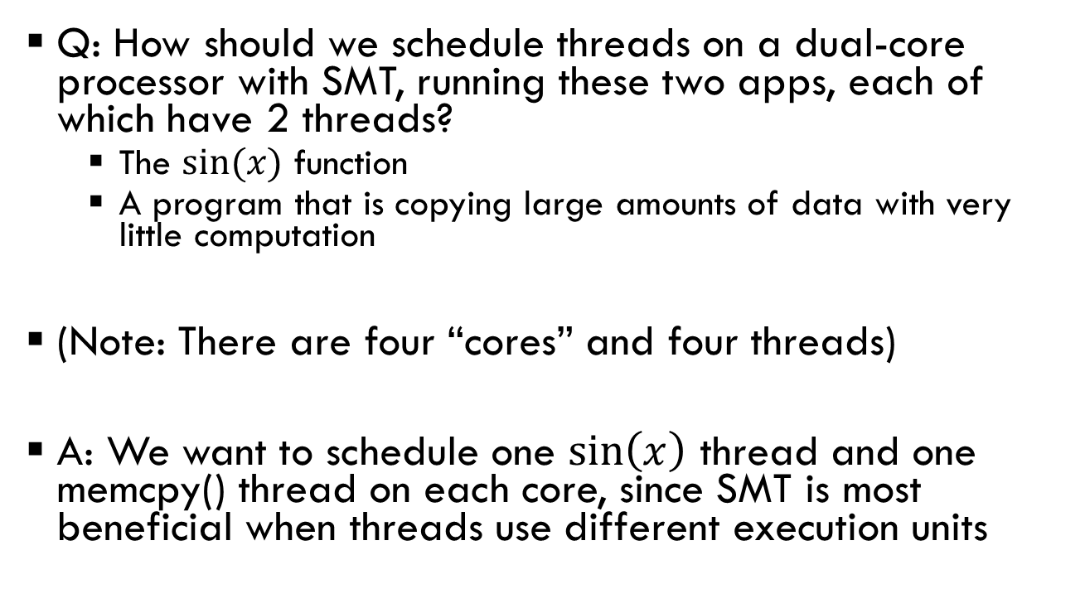
What if? #4
Benefits(?) of SMT
Q: How should we schedule threads on a dual-core processor with SMT, running these two apps, each of which have 2 threads?
  The $sin⁡(x)$ function
  A program that is copying large amounts of data with very little computation
(Note: There are four “cores” and four threads)
A: We want to schedule one $\sin\left(x\right)$ thread and one memcpy() thread on each core, since SMT is most beneficial when threads use different execution units

Slide 40
What if? #5
Limits of speculation
Q: What will limit the “performance” of this (silly) program on a superscalar OOO processor?
int foo() {
int i = 0;
while (i < 100000) {
// assume single-cycle rand instruction
if (rand() % 2 == 0) {
i++;
} else {
i--;
}
}
}
A: Unpredictable branch in if-else will cause frequent pipeline flushes

Slide 41
What if? #6
Benefits(?) of SMT
Q: Would the previous program benefit from running on multiple SMT threads on a single core?
A: Yes! Its performance is limited by the CPU frontend, which is replicated in SMT

