Slide 1
Domain-Specific Programming on Graphs
Lecture 23:

Slide 2
Last time: Increasing acceptance of domain-specific programming systems
Challenge to programmers: modern computers are parallel, heterogeneous machines
  (Architects striving for high area and power efficiency)
Programming systems trend: give up generality in what types of programs can be expressed in exchange for achieving high productivity and high performance
“Performance portability” is a key goal: programs should execute efficiently on a variety of parallel platforms
  Good implementations of same program for different systems required different data structures, algorithms, and approaches to parallelization — not just differences in low-level code generation (e.g., not just a matter of generating SSE vs. AVX vs ARM Neon vs. NVIDIA PTX instructions)

Slide 3
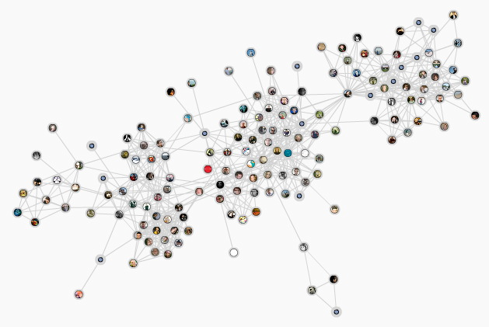
Today’s topic: analyzing big graphs
Many modern applications:
  Web search results, recommender systems, influence determination, advertising, anomaly detection, etc.
Public dataset examples:
Twitter social graph, Wikipedia term occurrences, IMDB actors, Netflix, Amazon communities, G+
Good source of public graphs:
https://snap.stanford.edu/data/
(Jure Leskovec, CMU PhD, 2008)
Notes:
WWW, anomaly detection, sales/marketing, recommender systems
so much ML performed on graphs, it’s led to domain specific languages for expressing these types of analyses

Slide 4
Thought experiment: if we wanted to design a programming system for computing on graphs, where might we begin?
What abstractions do we need?
Notes:
remember, we want to be as good as hand-tuned implementations

Slide 5
Whenever I’m trying to assess the importance of a new programming system, I ask two questions:
“What tasks/problems does the system take off the hands of the programmer?
(are these problems challenging or tedious enough that I feel the system is adding sufficient value for me to want to use it?)”
“What problems does the system leave as the responsibility for the programmer?”
(likely because the programmer is better at these tasks)
Liszt (recall last class):
Programmer’s responsibility:
Halide (recall last class):
Programmer’s responsibility:
Describe mesh connectivity and fields defined on mesh
Describe operations on mesh structure and fields
Describing image processing algorithm as pipeline of operations on images
Describing the schedule for executing the pipeline (e.g., “block this loop, “parallelize this loop”, “fuse these stages”)
Liszt system’s responsibility:
Parallelize operations without violating dependencies or creating data races (uses different algorithms to parallelize application on different platforms)
Choose graph data structure / layout, partition graph across parallel machine, manage low-level communication (MPI send), allocate ghost cells, etc.
Halide system’s responsibility:
Implementing the schedule using mechanisms available on the target machine (spawning pthreads, allocating temp buffers, emitting vector instructions, loop indexing code)
A good exercise: carry out this evaluation for another programming system: like OpenGL, SQL, MapReduce, etc.

Slide 6
Programming system design questions:
What are the fundamental operations we want to be easy to express and efficient to execute?
What are the key optimizations performed by the best implementations of these operations?
  high-level abstractions should not prevent these
  maybe even allow system to perform them for the application
Notes:
iteration over edges
parallel iteration over vertices

Slide 7
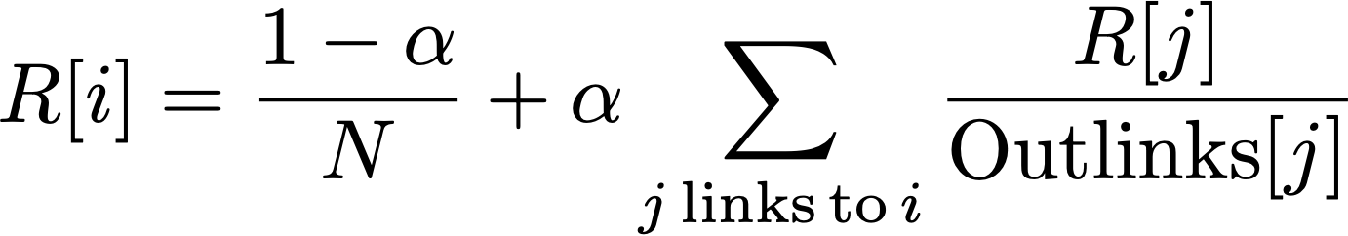
Example graph computation: Page Rank
Page Rank: iterative graph algorithm
  Devised by Larry Page & Sergey Brinn, 1996
Graph nodes = web pages
Graph edges = links between pages
discount
Rank of page i
Weighted combination of rank of pages that link to it
Notes:
R[i] pageRank (value) of vertex i
Alpha is the discount: about 0.85 in the paper (note alpha=0 = uniform prob)
Random walk through web, what’s the likelihood that a random surfer would end up at a page.
R[i] = \frac{1-\alpha}{N} + \alpha \sum_{j\, \textrm{links}\,\textrm{to}\, i}\frac{R[j]}{\textrm{Outlinks}[j]}

Slide 8
Recall assignment 3: “ParaGraph”
What did the ParaGraph library you implemented do for the application developer?
  What did an application developer using ParaGraph “get for free?”
  What did the application developer NOT get for free?
You may be interested in Ligra [Shun et al. 2013]
  Lightweight graph processing for shared memory machines
  http://jshun.github.io/ligra/
Notes:
did do: parallel graph algorithm
did not do: distributed memory

Slide 9

GraphLab
A system for describing iterative computations on graphs
History:
  2009 Prof Carlos Guestrin at CMU, then at U Washington
  2013 Commercialized as Turi
  2016 Acquired by Apple
Implemented as a C++ runtime
Runs on shared memory machines or distributed across clusters
  GraphLab runtime takes responsibility for scheduling work in parallel, partitioning graphs across clusters of machines, communication between master, etc.

Slide 10
GraphLab programs: state
The graph: G = (V, E)
    Application defines data blocks on each vertex and directed edge
    Dv = data associated with vertex v
    Du→v = data associated with directed edge u→v
Read-only global data
    Can think of this as per-graph data, rather than per vertex or per-edge data)
Notice: I always first describe program state
And then describe what operations are available to manipulate this state
Notes:
I start by describing the “stuff”
And then how you can manipulate it

Slide 11
GraphLab operations: the vertex program
Defines per-vertex operations on the vertex’s local neighborhood
Neighborhood (aka “scope”) of vertex:
  The current vertex
  Adjacent edges
  Adjacent vertices
current vertex
vertex or edge data “in scope” of red vertex
(graph data that can be accessed when executing a vertex program at the current (red) vertex)
Notes:
What does this remind you of. List? OpenGL?

Slide 12
Simple example: PageRank *
PageRank_vertex_program(vertex i) {
// (Gather phase) compute the sum of my neighbors rank
double sum = 0;
foreach(vertex j : in_neighbors(i)) {
sum = sum + j.rank / num_out_neighbors(j);
}
// (Apply phase) Update my rank (i)
i.rank = (1-0.85)/num_graph_vertices() + 0.85*sum;
}
(Shown for 𝛼 = 0.85)
Programming in GraphLab amounts to defining how to update graph state at each vertex. The system takes responsibility for scheduling and parallelization.
* This is made up syntax for slide simplicity: actual syntax is C++, as we’ll see on the next slide
Notes:
operations
Q. Where have we seen implicit iteration over a data structure?
CUDA/OGL
At this point... whatever. Syntactic sugar, but not much you couldn’t do with a forall loop

Slide 13
GraphLab: data access
The application’s vertex program executes per-vertex
The vertex program defines:
  What adjacent edges are inputs to the computation
  What computation to perform per edge
  How to update the vertex’s value
  What adjacent edges are modified by the computation
  How to update these output edge values
Note how GraphLab requires the program to tell it all data that will be accessed, and whether it is read or write access

Slide 14
GraphLab-generated vertex program (C++ code)
struct web_page {
std::string pagename;
double pagerank;
web_page(): pagerank(0.0) { }
}
typedef graphlab::distributed_graph<web_page, graphlab::empty> graph_type;
class pagerank_program:
public graphlab::ivertex_program<graph_type, double>,
public graphlab::IS_POD_TYPE {
public:
// we are going to gather on all the in-edges
edge_dir_type gather_edges(icontext_type& context,
const vertex_type& vertex) const {
return graphlab::IN_EDGES;
}
// for each in-edge gather the weighted sum of the edge.
double gather(icontext_type& context, const vertex_type& vertex,
edge_type& edge) const {
return edge.source().data().pagerank / edge.source().num_out_edges();
}
// Use the total rank of adjacent pages to update this page
void apply(icontext_type& context, vertex_type& vertex,
const gather_type& total) {
double newval = total * 0.85 + 0.15;
vertex.data().pagerank = newval;
}
// No scatter needed. Return NO_EDGES
edge_dir_type scatter_edges(icontext_type& context,
const vertex_type& vertex) const {
return graphlab::NO_EDGES;
}
};
Graph has record of type web_page per vertex, and no data on edges
Define edges to gather over in “gather phase”
Compute value to accumulate for each edge
Update vertex rank
PageRank example performs no scatter
Notes:
operations
Q. Where have we seen implicit iteration over a data structure?
CUDA/OGL
At this point... whatever. Syntactic sugar, but not much you couldn’t do with a forall loop

Slide 15
Running the program
graphlab::omni_engine<pagerank_program> engine(dc, graph, "sync");
engine.signal_all();
engine.start();
GraphLab runtime provides “engines” that manage scheduling of vertex programs
engine.signal_all() marks all vertices for execution
You can think of the GraphLab runtime as a work queue scheduler.
And invoking a vertex program on a vertex as a task that is placed in the work queue.
So it’s reasonable to read the code above as: “place all vertices into the work queue”
Or as: “foreach vertex” run the vertex program.
Notes:
dc = distributed control. Think of it like a context or a messaging system
iterate ten times? could wrap all this code in a for loop

Slide 16
Vertex signaling: GraphLab’s mechanism for generating new work
Iterate update of all R[i]’s 10 times
Uses generic “signal” primitive (could also wrap code on previous slide in a for loop)
struct web_page {
std::string pagename;
double pagerank;
int counter;
web_page(): pagerank(0.0),counter(0) { }
}
// Use the total rank of adjacent pages to update this page
void apply(icontext_type& context, vertex_type& vertex,
const gather_type& total) {
double newval = total * 0.85 + 0.15;
vertex.data().pagerank = newval;
vertex.data().counter++;
if (vertex.data().counter < 10)
vertex.signal();
}
Per-vertex “counter”
If counter < 10, signal to scheduler to run the vertex program on the vertex again at some point in the future
Notes:
could just put a for loop around the previous code

Slide 17
Signal: general primitive for scheduling work
Parts of graph may converge at different rates
(iterate PageRank until convergence, but only for vertices that need it)
class pagerank_program:
public graphlab::ivertex_program<graph_type, double>,
public graphlab::IS_POD_TYPE {
private:
bool perform_scatter;
public:
// Use the total rank of adjacent pages to update this page
void apply(icontext_type& context, vertex_type& vertex,
const gather_type& total) {
double newval = total * 0.85 + 0.15;
double oldval = vertex.data().pagerank;
vertex.data().pagerank = newval;
perform_scatter = (std::fabs(oldval - newval) > 1E-3);
}
// Scatter now needed if algorithm has not converged
edge_dir_type scatter_edges(icontext_type& context,
const vertex_type& vertex) const {
if (perform_scatter) return graphlab::OUT_EDGES;
else return graphlab::NO_EDGES;
}
// Make sure surrounding vertices are scheduled
void scatter(icontext_type& context, const vertex_type& vertex,
edge_type& edge) const {
context.signal(edge.target());
}
};
Private variable set during apply phase, used during scatter phase
Check for convergence
Schedule update of neighbor vertices

Slide 18
Synchronizing parallel execution
Local neighborhood of vertex (vertex’s “scope”) can be read and written to by a vertex program
Programs specify what granularity of atomicity (“consistency”) they want GraphLab runtime to provide: this determines amount of available parallelism
“Full consistency”: implementation ensures no other execution reads or writes to data in scope of v when vertex program for v is running.
“Edge consistency”: no other execution reads or writes any data in v or in edges adjacent to v
“Vertex consistency”: no other execution reads or writes to data in v ...
current vertex
= vertex or edge data in scope of red vertex
Notes:
think: the GraphLab schedule takes the appropriate locks before executing the job

Slide 19
GraphLab: job scheduling order
GraphLab implements several work scheduling policies
  Synchronous: update all scheduled vertices “simultaneously” (vertex programs observe no updates from programs run on other vertices in same “round”)
Graph
(stored in data structure A)
Updated graph
(stored in data structure B)
Updated graph
(stored in data structure A)
Run vertex programs for all scheduled vertices.
(output to copy of graph structure)
Run vertex programs for all scheduled vertices.
(output to copy of graph structure)

Slide 20
GraphLab: job scheduling order
GraphLab implements several work scheduling policies
  Synchronous: update all vertices simultaneously (vertex programs observe no updates from programs run on other vertices in same “round”)
  Round-robin: vertex programs observe most recent updates
  Graph coloring: Avoid simultaneous updates by adjacent vertices
  Dynamic: based on new work created by signal
    Several implementations: fifo, priority-based, “splash” ...
Application developer has flexibility for choosing consistency guarantee and scheduling policy
  Implication: choice of schedule impacts program’s correctness/output
  Our opinion: this seems like a weird design at first glance, but this is common (and necessary) in the design of efficient graph algorithms
Notes:
splash is a scheduler that orders computation by spanning trees
A little messier than the Lizst stuff last time
Lizst programs don’t not make assumptions about the schedule

Slide 21
Summary: GraphLab concepts
Program state: data on graph vertices and edges + globals
Operations: per-vertex update programs and global reduction functions (reductions not discussed today)
  Simple, intuitive description of work (follows mathematical formulation)
  Graph restricts data access in vertex program to local neighborhood
  Asynchronous execution model: application creates work dynamically by “signaling vertices” (enable lazy execution, work efficiency on real graphs)
Choice of scheduler and consistency implementation
  In this domain, the order in which nodes are processed can be critical property for both performance and quality of result
  Application responsible for choosing right scheduler for its needs
Notes:
scheduling order was important

Slide 22
Elements of good domain-specific programming system design

Slide 23
#1: good systems identify the most important cases, and provide most benefit in these situations
Structure of code should mimic natural structure of problems in the domain
  e.g., graph processing algorithms are designed in terms of per-vertex operations
Efficient expression: common operations are easy and intuitive to express
Efficient implementation: the most important optimizations in the domain are performed by the system for the programmer
  Our experience: a parallel programming system with “convenient” abstractions that precludes best-known implementation strategies will almost always fail

Slide 24
#2: good systems are usually simple systems
They have a small number of key primitives and operations
  GraphLab: run computation per vertex, trigger new work by signaling
    But GraphLab’s scheduling design gets messy…
  Halide: only a few scheduling primitives
  Hadoop: map + reduce
Allows compiler/runtime to focus on optimizing these primitives
  Provide parallel implementations, utilize appropriate hardware
Common question that good architects ask: “do we really need that?” Or can we reuse an existing primitive?
  For every domain-specific primitive in the system: there better be a strong performance or expressivity justification for its existence

Slide 25
#3: good primitives compose
Composition of primitives allows for wide application scope, even if scope remains limited to a domain
  e.g., frameworks discussed today support a wide variety of graph algorithms
Composition often allows for generalizable optimization
Sign of a good design:
  System ultimately is used for applications original designers never anticipated
Sign that a new feature should not be added (or added in a better way):
  The new feature does not compose with all existing features in the system

Slide 26
Optimizing graph computations
(now we are talking about implementation)

Slide 27
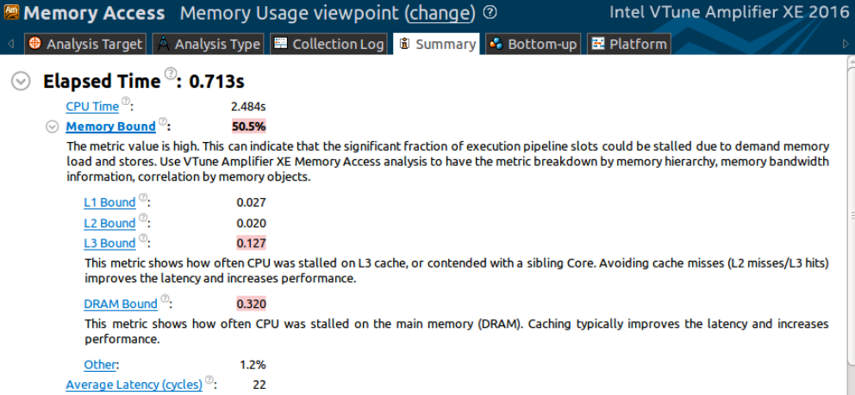
Wait a minute…
So far in this lecture, we’ve discussed issues such as parallelism, synchronization …
But graph processing typically has low arithmetic intensity
VTune profiling results: Memory bandwidth bound!
Walking over edges accesses information from “random” graph vertices
Or just consider PageRank: ~ 1 multiply-accumulate per iteration of summation loop

Slide 28
Two ideas to increase the performance of operations on large graphs *
Reorganize graph structure to increase locality
Compress the graph
* Both optimizations might be performed by a framework without application knowledge

Slide 29
Directed graph representation
Vertex Id
1
2
3
4
5
6
Outgoing Edges
2 3
3 5
2 4 5 6
1 5
1 2 3 6
2 4
Vertex Id
1
2
3
4
5
6
Incoming Edges
4 5
1 3 5 6
1 2 5
3 6
2 3 4
3 6
1
2
6
3
5
4

Slide 30
Memory footprint challenge of large graphs
Challenge: cannot fit all edges in memory for large graphs (but graph vertices may fit)
  From example graph representation:
    Each edge represented twice in graph structure (as incoming/outgoing edge)
    8 bytes per edge to represent adjacency
  May also need to store per-edge values (e.g., 4 bytes for a per-edge weight)
  1 billion edges (modest): ~12 GB of memory for edge information
  Algorithm may need multiple copies of per-edge structures (current, prev data, etc.)
Could employ cluster of machines to store graph in memory
  Rather than store graph on disk
Would prefer to process large graphs on a single machine
  Managing clusters of machines is difficult
  Partitioning graphs is expensive (also needs a lot of memory) and difficult
Notes:
yes memory is growing, but so are graphs
graph operation my require billions of tiny loads from disk

Slide 31
“Streaming” graph computations
Graph operations make “random” accesses to graph data (edges adjacent to vertex v may distributed arbitrarily throughout storage)
  Single pass over graph’s edges might make billions of fine-grained accesses to disk
Streaming data access pattern
  Make large, predictable data accesses to slow storage (achieve high bandwidth data transfer)
  Load data from slow storage into fast storage*, then reuse it as much as possible before discarding it (achieve high arithmetic intensity)
  Can we restructure graph data structure so that data access requires only a small number of efficient bulk loads/stores from slow storage?
Processor
Fast storage
(low latency, high BW, low capacity)
Slow storage
(high latency, low BW, high capacity)
Disk, SSD, etc.
By fast storage, in this context I mean DRAM. However, techniques for streaming from disk into memory would also apply to streaming from memory into a processor’s cache

Slide 32
Sharded graph representation
GraphChi: Large-scale graph computation on just a PC
[Kryola et al. 2013]
Partition graph vertices into intervals (sized so that subgraph for interval fits in memory)
Vertices and (only) incoming edges to these vertices are stored together in a shard
Sort edges in a shard by source vertex id
1
Shard 1:
vertices (1-2)
Shard 2:
vertices (3-4)
Shard 3:
vertices (5-6)
src
dst
value
src
dst
value
src
dst
value
2
1 2 0.3
1 3 0.4
2 5 0.6
6
3 2 0.2
2 3 0.9
3 5 0.9
3 6 0.85
4 1 0.8
3 4 0.15
5 1 0.25
5 2 0.6
5 3 0.2
4 5 0.3
6 4 0.9
5 6 0.2
3
6 2 0.1
5
Yellow = data required to process subgraph containing vertices in shard 1
4
Notice: to construct subgraph containing vertices in shard 1 and their incoming and outgoing edges, only need to load contiguous information from other P-1 shards
Writes to updated outgoing edges require P-1 bulk writes
Notes:
shard 1 represents node 1 and 2 (it’s a list of all incoming edges to node 1 and 2)

Slide 33
Sharded graph representation
GraphChi: Large-scale graph computation on just a PC
[Kryola et al. 2013]
Partition graph vertices into intervals (sized so that subgraph for interval fits in memory)
Store vertices and only incoming edges to these vertices are stored together in a shard
Sort edges in a shard by source vertex id
1
Shard 1:
vertices (1-2)
Shard 2:
vertices (3-4)
Shard 3:
vertices (5-6)
src
dst
value
src
dst
value
src
dst
value
2
1 2 0.3
1 3 0.4
2 5 0.6
6
3 2 0.2
2 3 0.9
3 5 0.9
3 6 0.85
4 1 0.8
3 4 0.15
5 1 0.25
5 2 0.6
5 3 0.2
4 5 0.3
6 4 0.9
5 6 0.2
3
6 2 0.1
5
Yellow = data required to process subgraph containing vertices in shard 2
4
Notes:
shard 1 represents node 1 and 2 (it’s a list of all incoming edges to node 1 and 2)

Slide 34
Sharded graph representation
GraphChi: Large-scale graph computation on just a PC
[Kryola et al. 2013]
Partition graph vertices into intervals (sized so that subgraph for interval fits in memory)
Store vertices and only incoming edges to these vertices are stored together in a shard
Sort edges in a shard by source vertex id
1
Shard 1:
vertices (1-2)
Shard 1:
vertices (1-2)
Shard 2:
vertices (3-4)
Shard 2:
vertices (3-4)
Shard 3:
vertices (5-6)
Shard 3:
vertices (5-6)
src
dst
value
src
dst
value
src
dst
value
2
1 2 0.3
1 3 0.4
2 5 0.6
6
3 2 0.2
2 3 0.9
3 5 0.9
3 6 0.85
4 1 0.8
3 4 0.15
5 1 0.25
5 2 0.6
5 3 0.2
4 5 0.3
6 4 0.9
5 6 0.2
3
6 2 0.1
5
Yellow = data required to process subgraph containing vertices in shard 3
4
Observe: due to sort of incoming edges, iterating over all intervals results in contiguous sliding window over the shards
Notes:
shard 1 represents node 1 and 2 (it’s a list of all incoming edges to node 1 and 2)

Slide 35
Putting it all together: looping over all graph edges
For each partition i of vertices:
  Load shard i (contains all incoming edges)
  For each other shard s
    Load section of s containing data for edges leaving i and entering s
  Construct subgraph in memory
  Do processing on subgraph
Note: a good implementation could hide disk I/O by prefetching data for next iteration of loop

Slide 36
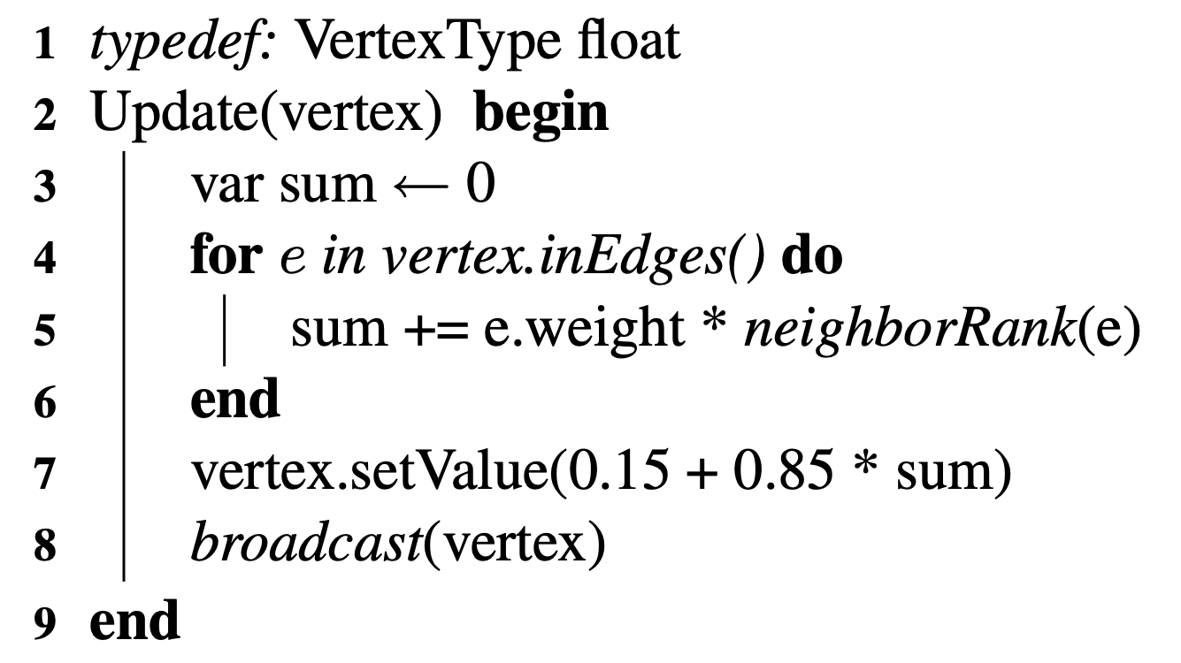
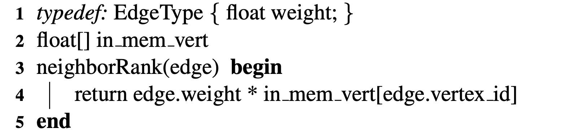
PageRank in GraphChi
GraphChi is a system that implements the out-of-core sliding window approach
PageRank in GraphChi:
Take per-vertex rank and distribute to all outbound edges (memory inefficient: replicates per-vertex rank to all edges)
Alternative model: assume vertex data can be kept in memory and redefine neighborRank() function
Notes:
e.weight is just the number of out neighbors for vertex on the other side of the edge

Slide 37
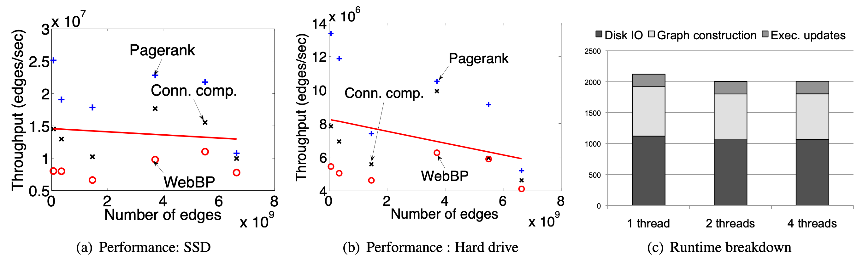
Performance on a Mac mini (8 GB RAM)
Throughput (edges/sec) remains stable as graph size is increased
  Desirable property: throughput largely invariant of dataset size
Notes:
half time spent in IO
construction is overhead
WebBP: belief propagation — inference

Slide 38
Graph compression
Recall: graph operations are often BW-bound
Implication: using CPU instructions to reduce BW requirements can benefit overall performance (the processor is waiting on memory anyway!)
Idea: store graph compressed in memory, decompress on-the-fly when operation wants to read data

Slide 39
Compressing an edge list
Vertex Id
32
Outgoing Edges
1001 10 5 30 6 1025 200000 1010 1024 100000 1030 275000
Sort edges for each vertex
Compute differences
Group into sections requiring same number of bytes
Encode deltas
5 6 10 30 1001 1010 1024 1025 1030 100000 200000 275000
5 6 10 30 1001 1010 1024 1025 1030 100000 200000 275000
0 1 4 20 971 9 14 1 5 98070 100000 75000
relative to vertex index
5 6 10 30 1001 1010 1024 1025 1030 100000 200000 275000
-27 1 4 20 971 9 14 1 5 98070 100000 75000
1 byte
2 bytes
1 byte
4 bytes
Uncompressed encoding: 12 x 4 bytes = 48 bytes
1-byte group header
Compressed encoding: 26 bytes
[ONE_BYTE, 4], -27, 1, 4, 20
(5 bytes)
[TWO_BYTE, 1], 971
(3 bytes)
6 bits: number of edges in group
[ONE_BYTE, 4], 9, 14, 1, 5
(5 bytes)
2 bits: encoding width (1, 2, 4 bytes)
[FOUR_BYTE, 3], 98070, 100000, 75000
(13 bytes)

Slide 40
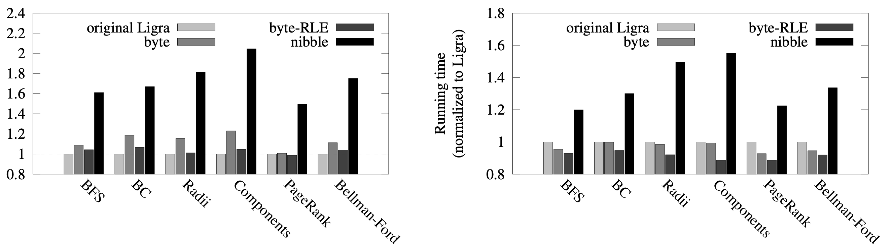
Performance impact of graph compression
[Shun et al. DCC 2015]
Running time on one core (relative to no compression)
Running time on 40 cores (relative to no compression)
Relative runtime
Relative runtime
Benefit of graph compression increases with higher core count, since computation is increasingly bandwidth bound
Performance improves even if graphs already fit in memory
  Added benefit is that compression enables larger graphs to fit in memory
Different data points on graphs are different compression schemes (byte-RLE is the scheme on the previous slide)

Slide 41
Summary
Today there is significant interest in high performance computation on large graphs
Graph processing frameworks abstract details of efficient graph processing from application developer
  handle parallelism and synchronization for the application developer
  handle graph distribution (across a cluster)
  may also handle graph compression and efficient iteration order (e.g., to efficiently stream off slow storage)
Great example of domain-specific programming frameworks
  for more, see: GraphLab, GraphX, Pregel, Ligra/Ligra+

