Slide 1
Lecture 14:
Memory Consistency
Parallel Computer Architecture and Programming
CMU 15-418/15-618, Spring 2020

Slide 2
What is Correct Behavior for a Parallel Memory Hierarchy?
Note: side-effects of writes are only observable when reads occur
  so we will focus on the values returned by reads
Intuitive answer:
  reading a location should return the latest value written (by any thread)
Hmm… what does “latest” mean exactly?
  within a thread, it can be defined by program order
  but what about across threads?
    the most recent write in physical time?
      hopefully not, because there is no way that the hardware can pull that off
        e.g., if it takes >10 cycles to communicate between processors, there is no way that processor 0 can know what processor 1 did 2 clock ticks ago
    most recent based upon something else?
      Hmm…

Slide 3
Refining Our Intuition
Thread 0
Thread 1
Thread 2
// write evens to X
for (i=0; i<N; i+=2) {
X = i;
…
}
// write odds to X
for (j=1; j<N; j+=2) {
X = j;
…
}
…
A = X;
…
B = X;
…
C = X;
…
(Assume: X=0 initially, and these are the only writes to X.)
What would be some clearly illegal combinations of (A,B,C)?
How about:
What can we generalize from this?
  writes from any particular thread must be consistent with program order
    in this example, observed even numbers must be increasing (ditto for odds)
  across threads: writes must be consistent with a valid interleaving of threads
    not physical time! (programmer cannot rely upon that)
(4,8,1)?
(9,12,3)?
(7,19,31)?

Slide 4
Visualizing Our Intuition
Thread 0
Thread 1
Thread 2
// write evens to X
for (i=0; i<N; i+=2) {
X = i;
…
}
// write odds to X
for (j=1; j<N; j+=2) {
X = j;
…
}
…
A = X;
…
B = X;
…
C = X;
…
CPU 0
CPU 1
CPU 2
Single port to memory
Memory
Each thread proceeds in program order
Memory accesses interleaved (one at a time) to a single-ported memory
  rate of progress of each thread is unpredictable

Slide 5
Correctness Revisited
Thread 0
Thread 1
Thread 2
// write evens to X
for (i=0; i<N; i+=2) {
X = i;
…
}
// write odds to X
for (j=1; j<N; j+=2) {
X = j;
…
}
…
A = X;
…
B = X;
…
C = X;
…
CPU 0
CPU 1
CPU 2
Single port to memory
Memory
Recall: “reading a location should return the latest value written (by any thread)”
  “latest” means consistent with some interleaving that matches this model
  this is a hypothetical interleaving; the machine didn’t necessarily do this!

Slide 6
Part 2 of Memory Correctness: Memory Consistency Model
“Cache Coherence”
  do all loads and stores to a given memory location behave correctly?
“Memory Consistency Model” (sometimes called “Memory Ordering”)
  do all loads and stores, even to separate memory locations, behave correctly?
Recall: our intuition
CPU 0
CPU 1
CPU 2
Single port to memory
Memory

Slide 7
Why is this so complicated?
Fundamental issue:
  loads and stores are very expensive, even on a uniprocessor
    can easily take 10’s to 100’s of cycles
What programmers intuitively expect:
  processor atomically performs one instruction at a time, in program order
In reality:
  if the processor actually operated this way, it would be painfully slow
  instead, the processor aggressively reorders instructions to hide memory latency
Upshot:
  within a given thread, the processor preserves the program order illusion
  but this illusion has nothing to do with what happens in physical time!
  from the perspective of other threads, all bets are off!

Slide 8
Hiding Memory Latency is Important for Performance
Idea: overlap memory accesses with other accesses and computation
Hiding write latency is simple in uniprocessors:
  add a write buffer
  (more on this later)
(But this affects correctness in multiprocessors)
write A
write A
read B
read B
Processor
READS
WRITES
write
buffer
Cache

Slide 9
How Can We Hide the Latency of Memory Reads?
“Out of order” pipelining:
  when an instruction is stuck, perhaps there are subsequent instructions that can be executed
Implication: memory accesses may be performed out-of-order!!!
x = *p;
y = x + 1;
z = *q;
*r = c;
suffers expensive cache miss
suffers expensive cache miss
stuck waiting on true dependence
stuck waiting on true dependence
}
these do not need to wait

Slide 10
What About Conditional Branches?
Do we need to wait for a conditional branch to be resolved before proceeding?
  No! Just predict the branch outcome and continue executing speculatively.
    if prediction is wrong, squash any side-effects and restart down correct path
x = *p;
y = x + 1;
z = *q;
*r = c;
if (x != z)
d = e – 7;
else d = e + 5;
…
if hardware guesses that this is true
then execute “then” part (speculatively)
(without waiting for x or z)

Slide 11
How Out-of-Order Pipelining Works in Modern Processors
Fetch and graduate instructions in-order, but issue out-of-order
Intra-thread dependences are preserved, but memory accesses get reordered!
Inst.
Cache
PC:
0x10
0x14
0x18
0x1c
Branch
Predictor
issue (out-of-order)
0x1c: b = c / 3;
issue (out-of-order)
0x1c: *r = c;
Reorder Buffer
issue (out-of-order)
0x18: z = a + 2;
issue (out-of-order)
0x18: z = *q;
0x14: y = x + 1;
0x14: y = x + 1;
can’t issue
can’t issue
issue (cache miss)
0x10: x = *p;
issue (cache miss)
0x10: x = *p;

Slide 12


Analogy: Gas Particles in Balloons
Thread 0
Thread 1
Thread 2
Thread 3
5
4
2
3
Time
1
1
1
1
1
3
5
4
1
1
1
1
(wikiHow)
3
1
3
2
1
1
1
1
4
2
1
5
1
1
1
1
5
1
4
1
2
1
1
1
Imagine that each instruction within a thread is a gas particle inside a twisty balloon
They were numbered originally, but then they start to move and bounce around
When a given thread observes memory accesses from a different thread:
  those memory accesses can be (almost) arbitrarily jumbled around
    like trying to locate the position of a particular gas particle in a balloon
As we’ll see later, the only thing that we can do is to put twists in the balloon

Slide 13
Uniprocessor Memory Model
Memory model specifies ordering constraints among accesses
Uniprocessor model: memory accesses atomic and in program order
Not necessary to maintain sequential order for correctness
  hardware: buffering, pipelining
  compiler: register allocation, code motion
Simple for programmers
Allows for high performance
Processor
write A
write B
read A
read B
READS
WRITES
Reads check for matching addresses in write buffer
write
buffer
Cache

Slide 14
In Parallel Machines (with a Shared Address Space)
Order between accesses to different locations becomes important
(Initially A and Ready = 0)
P1
P2
A = 1;
Ready = 1;
while (Ready != 1);
… = A; // Should be 1

Slide 15
How Unsafe Reordering Can Happen
A = 1;
Ready = 1;
Processor
Processor
Processor
wait (Ready== 1);
… = A;
…
Memory
Memory
Memory
A: 0
Ready:0
→1
A = 1;
Ready = 1;
Interconnection Network
Distribution of memory resources
  accesses issued in order may be observed out of order

Slide 16
Caches Complicate Things More
Multiple copies of the same location
A = 1;
wait (A == 1);
B = 1;
wait (B == 1);
… = A;
Oops!
Processor
Processor
Processor
Cache
A:0
Cache
A:0
B:0
Cache
A:0
B:0
→1
→1
→1
→1
Memory
Memory
Memory
A = 1;
B = 1;
A = 1;
Interconnection Network

Slide 17
Our Intuitive Model: “Sequential Consistency” (SC)
Formalized by Lamport (1979)
  accesses of each processor in program order
  all accesses appear in sequential order
Any order implicitly assumed by programmer is maintained
…
P0
P1
Pn
Memory

Slide 18
Example with Sequential Consistency
Simple Synchronization:
P0 P1
A = 1 (a)
Ready = 1 (b) x = Ready (c)
y = A (d)
all locations are initialized to 0
possible outcomes for (x,y):
  (0,0), (0,1), (1,1)
(x,y) = (1,0) is not a possible outcome (i.e. Ready = 1, A = 0):
  we know a->b and c->d by program order
  b->c implies that a->d
  y==0 implies d->a which leads to a contradiction
  but real hardware will do this!

Slide 19
Another Example with Sequential Consistency
Stripped-down version of a 2-process mutex (minus the turn-taking):
P0 P1
want[0] = 1 (a) want[1] = 1 (c)
x = want[1] (b) y = want[0] (d)
all locations are initialized to 0
possible outcomes for (x,y):
  (0,1), (1,0), (1,1)
(x,y) = (0,0) is not a possible outcome (i.e. want[0]= 0, want[1]= 0):
  a->b and c->d implied by program order
  x = 0 implies b->c which implies a->d
  a->d says y = 1 which leads to a contradiction
  similarly, y = 0 implies x = 1 which is also a contradiction
  but real hardware will do this!

Slide 20
One Approach to Implementing Sequential Consistency
Implement cache coherence
  writes to the same location are observed in same order by all processors
For each processor, delay start of memory access until previous one completes
  each processor has only one outstanding memory access at a time
What does it mean for a memory access to complete?

Slide 21
When Do Memory Accesses Complete?
Memory Reads:
  a read completes when its return value is bound
load r1 ← X
X = ???
(Find X in memory system)
X = 17
r1 = 17

Slide 22
When Do Memory Accesses Complete?
Memory Reads:
  a read completes when its return value is bound
Memory Writes:
  a write completes when the new value is “visible” to other processors
What does “visible” mean?
  it does NOT mean that other processors have necessarily seen the value yet
  it means the new value is committed to the hypothetical serializable order (HSO)
    a later read of X in the HSO will see either this value or a later one
  (for simplicity, assume that writes occur atomically)
store 23 → X
X = 23
(Commit to memory order)
(aka “serialize”)

Slide 23

Summary for Sequential Consistency
Maintain order between shared accesses in each processor
Balloon analogy:
  like putting a twist between each individual (ordered) gas particle
Severely restricts common hardware and compiler optimizations
READ
READ
WRITE
WRITE
Don’t start until
previous access
completes
READ
WRITE
READ
WRITE

Slide 24
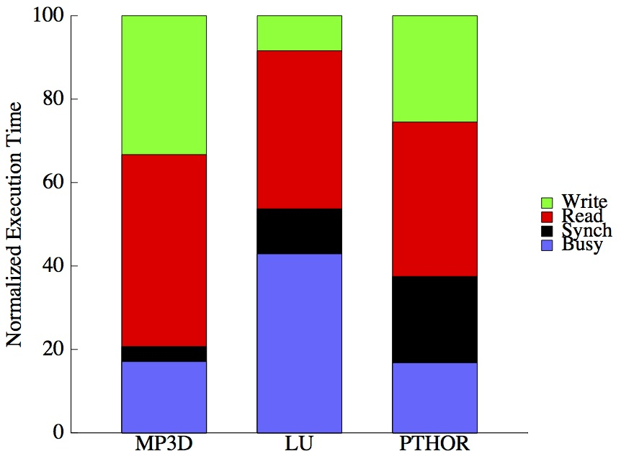
Performance of Sequential Consistency
Processor issues accesses one-at-a-time and stalls for completion
Low processor utilization (17% - 42%) even with caching
From Gupta et al, “Comparative evaluation of latency reducing and tolerating techniques.” In Proceedings of the 18th annual International Symposium on Computer Architecture (ISCA '91)

Slide 25
Alternatives to Sequential Consistency
Relax constraints on memory order
READ
READ
WRITE
WRITE
READ
WRITE
READ
WRITE
Total Store Ordering (TSO) (Similar to Intel)
See Section 8.2 of “Intel® 64 and IA-32 Architectures Software Developer’s Manual, Volume 3A: System Programming Guide, Part 1”,
http://www.intel.com/content/dam/www/public/us/en/documents/manuals/64-ia-32-architectures-software-developer-vol-3a-part-1-manual.pdf
READ
READ
WRITE
WRITE
READ
WRITE
READ
WRITE
Partial Store Ordering (PSO)

Slide 26
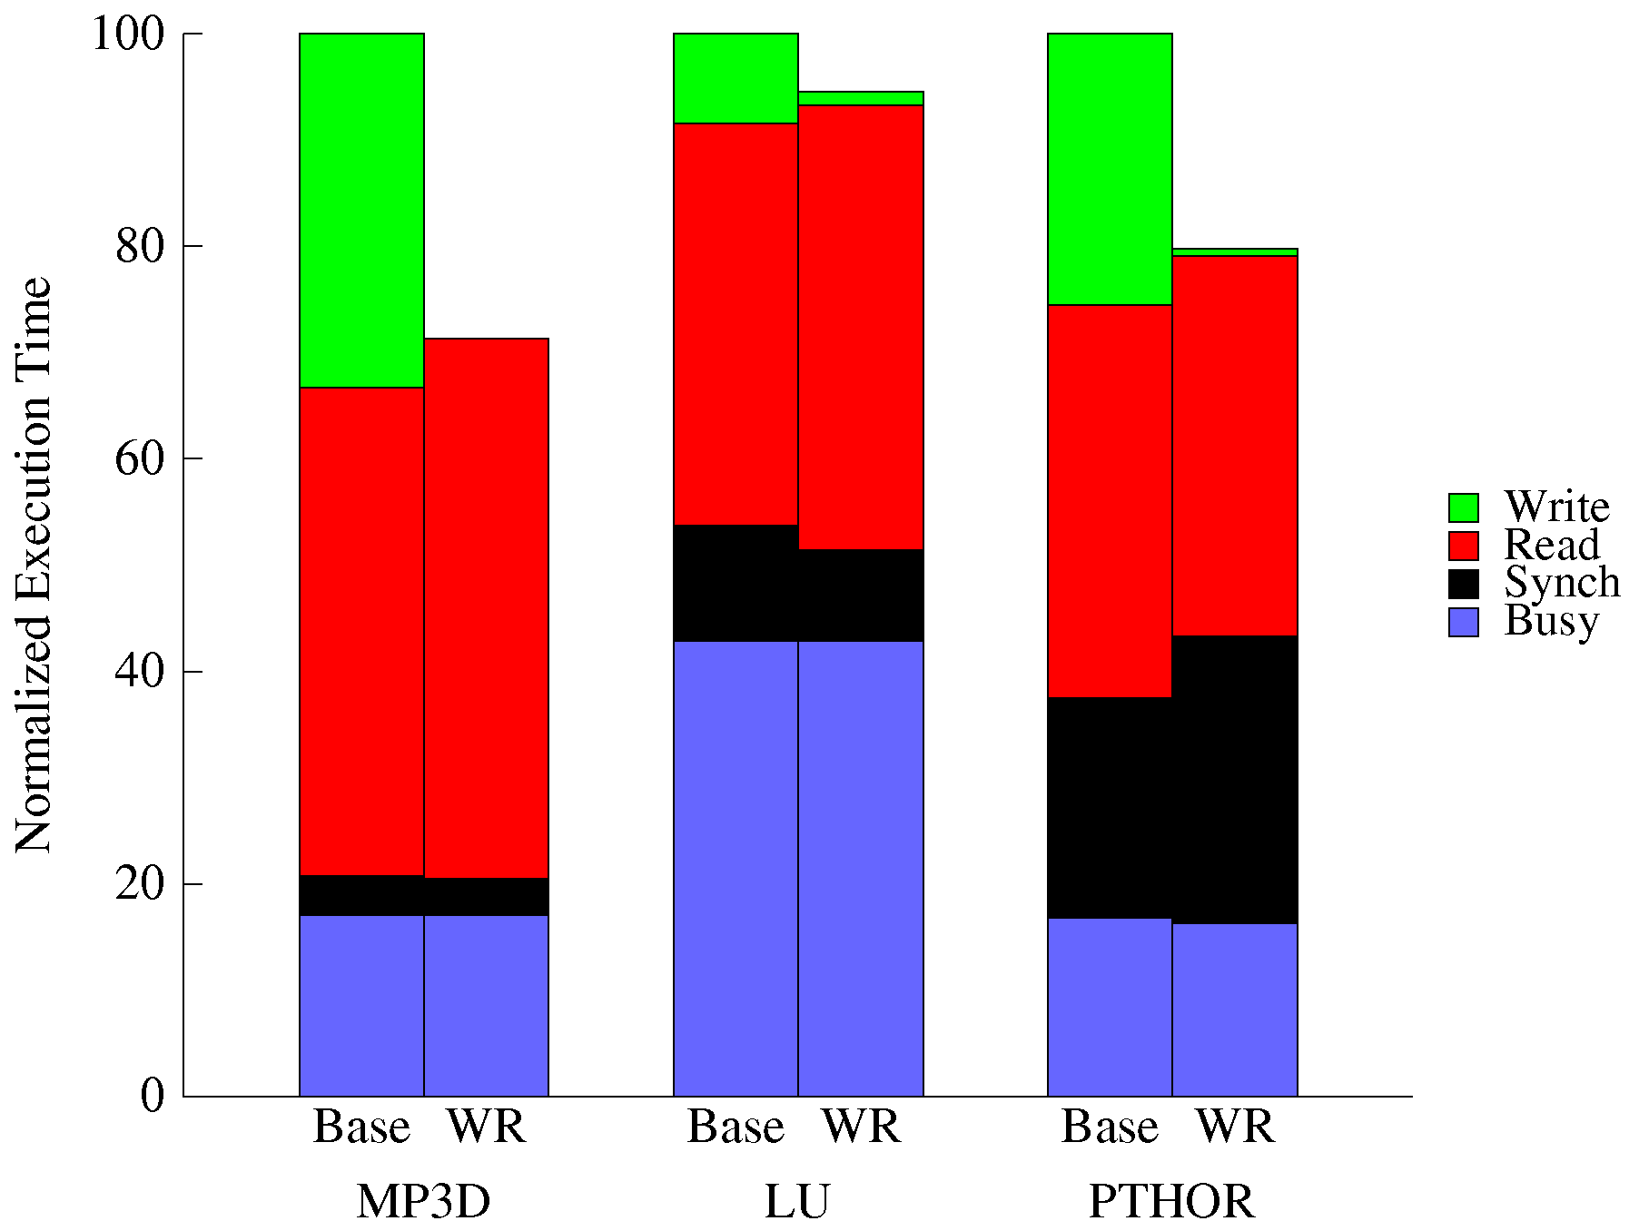
Performance Impact of TSO vs. SC
“Base” = SC
“WR” = TSO
Processor
READS
WRITES
write
buffer
Cache
Can use a write buffer
Write latency is effectively hidden

Slide 27
But Can Programs Live with Weaker Memory Orders?
“Correctness”: same results as sequential consistency
Most programs don’t require strict ordering (all of the time) for “correctness”
But how do we know when a program will behave correctly?
Program Order
Sufficient Order
A = 1;
B = 1;
unlock L;
A = 1;
B = 1;
unlock L;
lock L;
… = A;
… = B;
lock L;
… = A;
… = B;

Slide 28
Identifying Data Races and Synchronization
Two accesses conflict if:
  (i) access same location, and (ii) at least one is a write
Order accesses by:
  program order (po)
  dependence order (do): op1 --> op2 if op2 reads op1
Data Race:
  two conflicting accesses on different processors
  not ordered by intervening accesses
Properly Synchronized Programs:
  all synchronizations are explicitly identified
  all data accesses are ordered through synchronization
P1 P2
Write A
Write Flag Read Flag
Read A
po
do
po

Slide 29
Optimizations for Synchronized Programs
Intuition: many parallel programs have mixtures of “private” and “public” parts*
  the “private” parts must be protected by synchronization (e.g., locks)
  can we take advantage of synchronization to improve performance?
READ/WRITE
…
READ/WRITE
Example:
SYNCH
Grab a lock
READ/WRITE
…
READ/WRITE
Insert node into data structure
Essentially a “private” activity; reordering is ok
SYNCH
Release the lock
Now we make it “public” to the other nodes
READ/WRITE
…
READ/WRITE
*Caveat: shared data is in fact always visible to other threads.

Slide 30
Optimizations for Synchronized Programs
Exploit information about synchronization
properly synchronized programs should yield the same result as on an SC machine
READ/WRITE
…
READ/WRITE
SYNCH
Between synchronization operations:
we can allow reordering of memory operations
(as long as intra-thread dependences are preserved)
READ/WRITE
…
READ/WRITE
SYNCH
Just before and just after synchronization operations:
thread must wait for all prior operations to complete
READ/WRITE
…
READ/WRITE
“Weak Ordering” (WO)

Slide 31

Intel’s MFENCE (Memory Fence) Operation
An MFENCE operation enforces the ordering seen on the previous slide:
  does not begin until all prior reads & writes from that thread have completed
  no subsequent read or write from that thread can start until after it finishes
READ/WRITE
…
READ/WRITE
Balloon analogy: it is a twist in the balloon
no gas particles can pass through it
MFENCE
READ/WRITE
…
READ/WRITE
MFENCE
(wikiHow)
READ/WRITE
…
READ/WRITE

Slide 32
Implementing Lock with Xchg
temp = *mem;
*mem = reg;
reg = temp;
=
xchg(mem, reg)
Done atomically
acquire():
while (1) {
reg = 1;
xchg(&lock, reg);
if (reg == 0)
break;
}
release():
reg = 0;
xchg(&lock, reg);
Good news: xchg also performs MFENCE

Slide 33
ARM Processors
ARM processors have a very relaxed consistency model
ARM has some great examples in their programmer’s reference:
  http://infocenter.arm.com/help/topic/com.arm.doc.genc007826/Barrier_Litmus_Tests_and_Cookbook_A08.pdf
A great list regarding relaxed memory consistency in general:
  http://www.cl.cam.ac.uk/~pes20/weakmemory/

Slide 34
Common Misconception about MFENCE
MFENCE operation does NOT push values out to other threads
  it is not a magic “make every thread up-to-date” operation
It simply stalls the thread that performs the MFENCE until write buffer empty
READ/WRITE
…
READ/WRITE
Thread 0
Thread 1
Thread 2
Thread 3
1
2
4
1
3
MFENCE
Time
1
1
1
1
1
3
5
4
1
1
1
READ/WRITE
…
READ/WRITE
3
1
1
3
2
1
1
1
2
2
5
5
1
1
1
1
5
1
4
1
MFENCE
4
1
1
1
READ/WRITE
…
READ/WRITE
MFENCE operations create partial orderings
that are observable across threads

Slide 35
Earlier (Broken) Example Revisited
Where exactly should we insert MFENCE operations to fix this?
(Assume machine does not provide consistency guarantees.)
P0 P1
[1: Here?]
A = 1
[2: Here?] [4: Here?]
Ready = 1 x = Ready
[3: Here?] [5: Here?]
y = A
[6: Here?]

Slide 36
Earlier (Broken) Example Revisited
Where exactly should we insert MFENCE operations to fix this?
P0 P1
[1: Here?]
A = 1
MFENCE [4: Here?]
Ready = 1 x = Ready
[3: Here?] MFENCE
y = A
[6: Here?]

Slide 37
Exploiting Asymmetry in Synchronization: “Release Consistency”
Lock operation: only gains (“acquires”) permission to access data
Unlock operation: only gives away (“releases”) permission to access data
READ/WRITE
…
READ/WRITE
ACQUIRE
1
READ/WRITE
…
READ/WRITE
1
Overly
Conservative
READ/WRITE
…
READ/WRITE
2
LOCK
READ/WRITE
…
READ/WRITE
3
RELEASE
READ/WRITE
…
READ/WRITE
2
Release Consistency (RC)
Make sure writes completed before exit critical section
Make sure don’t read/write shared state until lock acquired
Allowed overlaps
  Read/write private state in 1 with critical section (2)
  Read/write private state in 3 with critical section (2)
UNLOCK
READ/WRITE
…
READ/WRITE
3
Weak Ordering (WO)

Slide 38
Intel’s Full Set of Fence Operations
In addition to MFENCE, Intel also supports two other fence operations:
  LFENCE: serializes only with respect to load operations (not stores!)
  SFENCE: serializes only with respect to store operations (not loads!)
    Note: It does slightly more than this; see the spec for details:
      Section 8.2.5 of “Intel® 64 and IA-32 Architectures Software Developer’s Manual, Volume 3A: System Programming Guide, Part 1
In practice, you are most likely to use:
  MFENCE
  xchg

Slide 39
Earlier (Broken) Example Revisited
Where exactly should we insert FENCE operations to fix this?
P0 P1
[1: Here?]
A = 1
SFENCE [4: Here?]
Ready = 1 x = Ready
[3: Here?] LFENCE
y = A
[6: Here?]

Slide 40
Take-Away Messages on Memory Consistency Models
DON’T use only normal memory operations for synchronization
  e.g., Peterson’s solution for mutual exclusion
DO use either explicit synchronization operations (e.g., xchg) or fences
boolean want[2] = {false, false};
int turn = 0;
want[i] = true;
turn = 1-i;
while (want[1-i] && turn == 1-i)
continue;
… critical section …
want[i] = false;
Exercise for the reader:
Where should we add fences (and which type) to fix this?
while (!xchg(&lock_available, 0)
continue;
… critical section …
xchg(&lock_available, 1);

Slide 41
Summary: Relaxed Consistency
Motivation:
  obtain higher performance by allowing reordering of memory operations
    (reordering is not allowed by sequential consistency)
One cost is software complexity:
  the programmer or compiler must insert synchronization
    to ensure certain specific orderings when needed
In practice:
  complexities often encapsulated in libraries that provide intuitive primitives
    e.g., lock/unlock, barriers (or lower-level primitives like fence)
  It’s risky to implement your own synchronization primitives
    Hard to make portable
Relaxed models differ in which memory ordering constraints they ignore

