Slide 1
Recitation 4:
OpenMP Programming
15-418 Parallel Computer Architecture and Programming
CMU 15-418/15-618, Spring 2019

Slide 2
Goals for today
Learn to use Open MP
Sparse matrix-vector code
  Understand “CSR” sparse matrix format
  Simplest OpenMP features
Parallelize array sum via OpenMP reductions
Parallelize radix sort
  More complex OpenMP example
Most of all,
ANSWER YOUR QUESTIONS!

Slide 3




Matrix-matrix multiplication
Recall from recitation 2...
$$\sum_{k}{}$$
C
$$(i,j)$$
A
B
$$(k,j)→$$
$$(i,k)→$$

Slide 4
Matrix-matrix multiplication (matmul)
Simple C++ implementation:
/* Find element based on row-major ordering */
#define RM(r, c, width) ((r) * (width) + (c))
// Standard multiplication
void multMatrixSimple(int N, float *matA, float *matB, float *matC) {
for (int i = 0; i < N; i++)
for (int j = 0; j < N; j++) {
float sum = 0.0;
for (int k = 0; k < N; k++)
sum += matA[RM(i,k,N)] * matB[RM(k,j,N)];
matC[RM(i,j,N)] = sum;
}
}

Slide 5
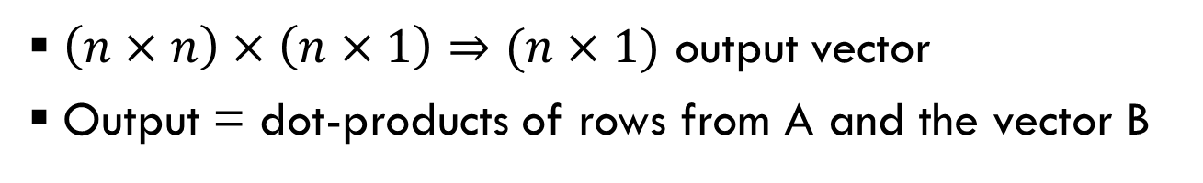



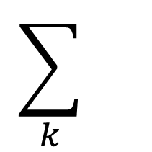
Today: Matrix-vector multiplication
$$\sum_{k}{}$$
C
A
B
$$(i,j)$$
$$(i,k)→$$
$$(k,j)→$$
$\left(n×n\right)×\left(n×1\right)⇒(n×1)$ output vector
Output = dot-products of rows from A and the vector B

Slide 6
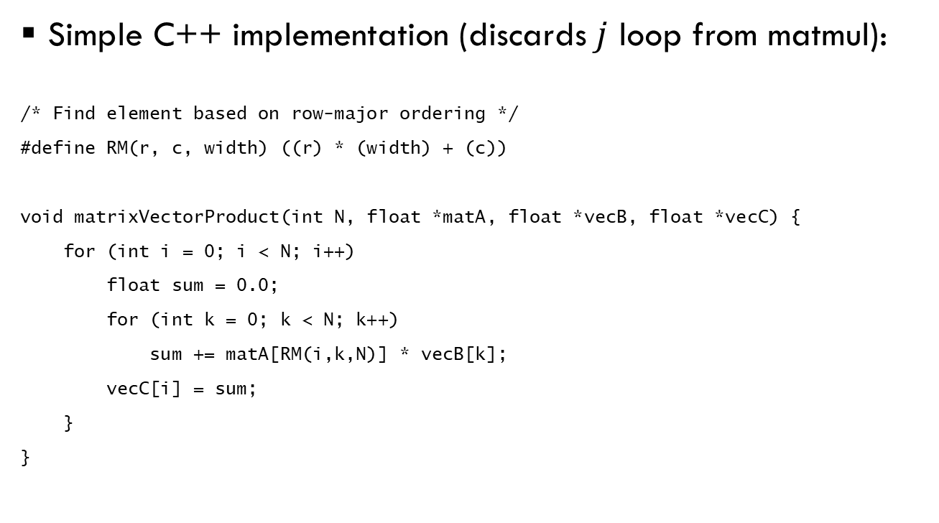
Matrix-vector multiplication
Simple C++ implementation (discards $j$ loop from matmul):
/* Find element based on row-major ordering */
#define RM(r, c, width) ((r) * (width) + (c))
void matrixVectorProduct(int N, float *matA, float *vecB, float *vecC) {
for (int i = 0; i < N; i++)
float sum = 0.0;
for (int k = 0; k < N; k++)
sum += matA[RM(i,k,N)] * vecB[k];
vecC[i] = sum;
}
}

Slide 7

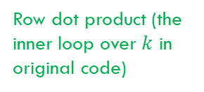
Matrix-vector multiplication
Our code is slightly refactored:
float rvp_dense_seq(dense_t *m, vec_t *x, index_t r) {
index_t nrow = m->nrow;
index_t idx = r*nrow;
float val = 0.0;
for (index_t c = 0; c < nrow; c++)
val += x->value[c] * m->value[idx++];
return val;
}
void mvp_dense_seq(dense_t *m, vec_t *x, vec_t *y, rvp_dense_t rp_fun) {
index_t nrow = m->nrow;
for (index_t r = 0; r < nrow; r++) {
y->value[r] = rp_fun(m, x, r);
}
}
Row dot product (the inner loop over $k$ in original code)
The inner loop over rows (over $i$ in original code)

Slide 8
Benchmarking dense mat-vec
$ ./mrun -l 3 -d 10 -t r –D
Dense 3 10 r
MVP RVP GF
seq seq 0.12
0.12 GFLops … machine capable of 6.4 Gflops
➔ This is bad performance
Why? We are only counting non-zero entries of matrix

Slide 9




Sparse matrix-vector multiplication
What if A is mostly zeroes? (This is common)
Idea: We should only compute on non-zeros in A
➔ Need new sparse matrix representation
$$\sum_{k}{}$$
C
A
B
$$(i,j)$$
$$(i,k)→$$
$$(k,j)→$$

Slide 10
Compressed sparse-row (CSR) matrix format
Row
Dense matrix:
CSR matrix:

Slide 11
Compressed sparse-row (CSR) matrix format
Row
Dense matrix:
CSR matrix:
6
2
4
1
2
9
3
1

Slide 12
Compressed sparse-row (CSR) matrix format
Row
Dense matrix:
CSR matrix:
6
2
4
1
2
9
3
1
Values:
6 2 4 1 2 9 3 1
(Compact non-zeroes into dense format)

Slide 13
Compressed sparse-row (CSR) matrix format
Row
Dense matrix:
CSR matrix:
6
2
4
1
2
9
3
1
Values:
6 2 4 1 2 9 3 1
Indices:
1
(Position corresponding to each value)

Slide 14
Compressed sparse-row (CSR) matrix format
Row
Dense matrix:
CSR matrix:
6
2
4
1
2
9
3
1
Values:
6 2 4 1 2 9 3 1
Indices:
1 5
(Position corresponding to each value)

Slide 15
Compressed sparse-row (CSR) matrix format
Row
Dense matrix:
CSR matrix:
6
2
4
1
2
9
3
1
Values:
6 2 4 1 2 9 3 1
Indices:
1 5 0
(Position corresponding to each value)

Slide 16
Compressed sparse-row (CSR) matrix format
Row
Dense matrix:
CSR matrix:
6
2
4
1
2
9
3
1
Values:
6 2 4 1 2 9 3 1
Indices:
1 5 0 3
(Position corresponding to each value)

Slide 17
Compressed sparse-row (CSR) matrix format
Row
Dense matrix:
CSR matrix:
6
2
4
1
2
9
3
1
Values:
6 2 4 1 2 9 3 1
Indices:
1 5 0 3 7 4 1 6
(Position corresponding to each value)

Slide 18
Compressed sparse-row (CSR) matrix format
Row
Dense matrix:
CSR matrix:
6
2
4
1
2
9
3
1
Values:
6 2 4 1 2 9 3 1
Indices:
1 5 0 3 7 4 1 6
Offsets:
(Where each row starts)

Slide 19
Compressed sparse-row (CSR) matrix format
Row
Dense matrix:
CSR matrix:
6
2
4
1
2
9
3
1
Values:
6 2 4 1 2 9 3 1
Indices:
1 5 0 3 7 4 1 6
Offsets:
0
(Where each row starts)

Slide 20
Compressed sparse-row (CSR) matrix format
Row
Dense matrix:
CSR matrix:
6
2
4
1
2
9
3
1
Values:
6 2 4 1 2 9 3 1
Indices:
1 5 0 3 7 4 1 6
Offsets:
0 2
(Where each row starts)

Slide 21
Compressed sparse-row (CSR) matrix format
Row
Dense matrix:
CSR matrix:
6
2
4
1
2
9
3
1
Values:
6 2 4 1 2 9 3 1
Indices:
1 5 0 3 7 4 1 6
Offsets:
0 2 5
(Where each row starts)

Slide 22
Compressed sparse-row (CSR) matrix format
Row
Dense matrix:
CSR matrix:
6
2
4
1
2
9
3
1
Values:
6 2 4 1 2 9 3 1
Indices:
1 5 0 3 7 4 1 6
Offsets:
0 2 5 6
(Where each row starts)

Slide 23
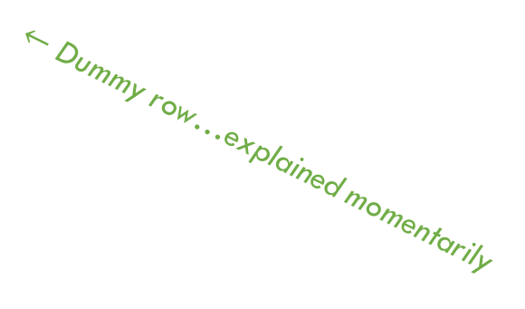
Compressed sparse-row (CSR) matrix format
Row
Dense matrix:
CSR matrix:
6
2
4
1
2
9
3
1
Values:
6 2 4 1 2 9 3 1
Indices:
1 5 0 3 7 4 1 6
Offsets:
0 2 5 6 8
(Where each row starts)
$←$ Dummy row…explained momentarily

Slide 24
Compressed sparse-row (CSR) matrix format
Row
Dense matrix:
CSR matrix:
6
2
4
1
2
9
3
1
Values:
6 2 4 1 2 9 3 1
(Compact non-zeroes into dense format)
Indices:
1 5 0 3 7 4 1 6
(Position corresponding to each value)
Offsets:
0 2 5 6 8
(Where each row starts)

Slide 25
Sparse matrix-vector multiplication (spmv)
float rvp_csr_seq(csr_t *m, vec_t *x, index_t r) {
index_t idxmin = m->rowstart[r]; /* 1. get indices from offsets */
index_t idxmax = m->rowstart[r+1];
float val = 0.0;
for (index_t idx = idxmin; idx < idxmax; idx++) { /* 2. iterate over row */
index_t c = m->cindex[idx]; /* 3. find corresponding index in vector */
data_t mval = m->value[idx]; /* read matrix (using idx) */
data_t xval = x->value[c]; /* read vector (using c) */
val += mval * xval;
}
return val;
}
/* the outer loop (across rows) doesn’t change */
void mvp_csr_seq(csr_t *m, vec_t *x, vec_t *y, rvp_csr_t rp_fun) {
index_t nrow = m->nrow;
for (index_t r = 0; r < nrow; r++) {
y->value[r] = rp_fun(m, x, r);
}
}

Slide 26
Benchmarking dense mat-vec
$ ./mrun -l 3 -d 10 -t r –D
Dense 3 10 r
MVP RVP GF
seq seq 0.12

Slide 27
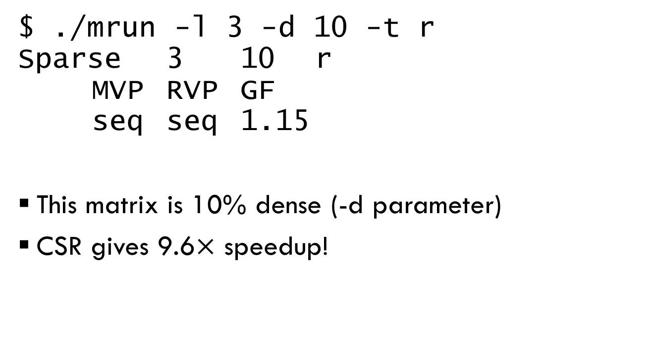
Benchmarking spmv
$ ./mrun -l 3 -d 10 -t r
Sparse 3 10 r
MVP RVP GF
seq seq 1.15
This matrix is 10% dense (-d parameter)
CSR gives 9.6$×$ speedup!

Slide 28
Let’s optimize this code!
Exploit parallelism at multiple levels
ILP
SIMD
Threads
To properly measure parallel speedup, need to start from an optimized baseline

Slide 29
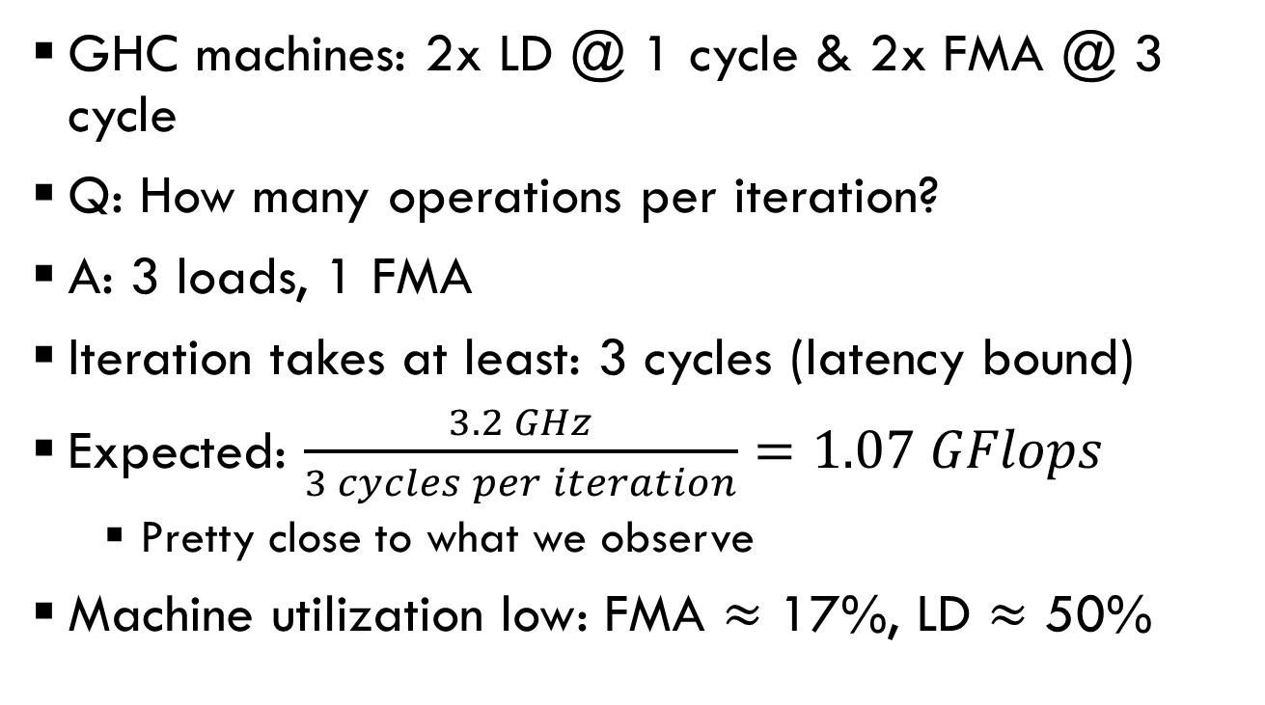
What’s the ILP of spmv?
GHC machines: 2x LD @ 1 cycle & 2x FMA @ 3 cycle
Q: How many operations per iteration?
A: 3 loads, 1 FMA
Iteration takes at least: 3 cycles (latency bound)
Expected: $\frac{3.2 GHz}{3 cycles per iteration}=1.07 GFlops$
  Pretty close to what we observe
Machine utilization low: FMA $≈$ 17%, LD $≈$ 50%

Slide 30
Improving spmv ILP
Note: gcc with –O3 will unroll these loops for us
#define UNROLL 3
float rvp_csr_par(csr_t *m, vec_t *x, index_t r) {
index_t idxmin = m->rowstart[r], idxmax = m->rowstart[r+1];
index_t idx;
float uval[UNROLL];
float val = 0.0;
for (index_t i = 0; i < UNROLL; i++)
uval[i] = 0.0;
for (idx = idxmin; idx+UNROLL <= idxmax; idx+=UNROLL) {
for (index_t i = 0; i < UNROLL; i++) {
index_t c = m->cindex[idx+i];
data_t mval = m->value[idx+i];
data_t xval = x->value[c];
uval[i] += mval * xval;
}
}
for (; idx < idxmax; idx ++) {
index_t c = m->cindex[idx];
data_t mval = m->value[idx];
data_t xval = x->value[c];
val += mval * xval;
}
for (index_t i = 0; i < UNROLL; i++)
val += uval[i];
return val;
}
Accumulate elements mod UNROLL in uval array
Return sum of uval array

Slide 31
Benchmarking spmv
$ ./mrun -l 4 -d 10 -t r
Sparse 4 10 r
MVP RVP GF
seq seq 1.40

Slide 32
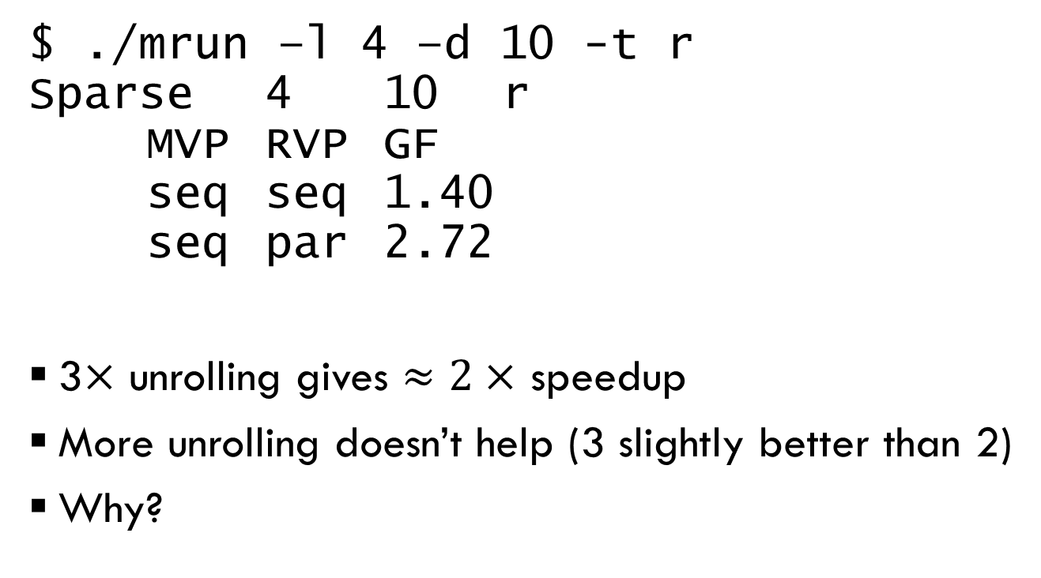
Benchmarking unrolled spmv
$ ./mrun –l 4 –d 10 -t r
Sparse 4 10 r
MVP RVP GF
seq seq 1.40
seq par 2.72
3$×$ unrolling gives $≈2×$ speedup
More unrolling doesn’t help (3 slightly better than 2)
Why?
With 100% hits, LD utilization = 100% when unrolled twice
Unrolling thrice helps a bit, probably by hiding misses on sparse vector loads

Slide 33
Let’s optimize this code!
Exploit parallelism at multiple levels
ILP
SIMD
Threads


Slide 34
Thread parallelism with OpenMP
OpenMP is supported by gcc
“Decorate” your code with #pragmas
We will cover only a few of OpenMP’s features

Slide 35
Parallelizing spmv with OpenMP
Focus on the outer loop
void mvp_csr_seq(csr_t *m, vec_t *x, vec_t *y,
rvp_csr_t rp_fun) {
index_t nrow = m->nrow;
for (index_t r = 0; r < nrow; r++) {
y->value[r] = rp_fun(m, x, r);
}
}

Slide 36
Parallelizing spmv with OpenMP
Focus on the outer loop
void mvp_csr_mps(csr_t *m, vec_t *x, vec_t *y,
rvp_csr_t rp_fun) {
index_t nrow = m->nrow;
#pragma omp parallel for schedule(static)
for (index_t r = 0; r < nrow; r++) {
y->value[r] = rp_fun(m, x, r);
}
}
schedule(static) divides loop statically across system cores (including hyperthreads)

Slide 37
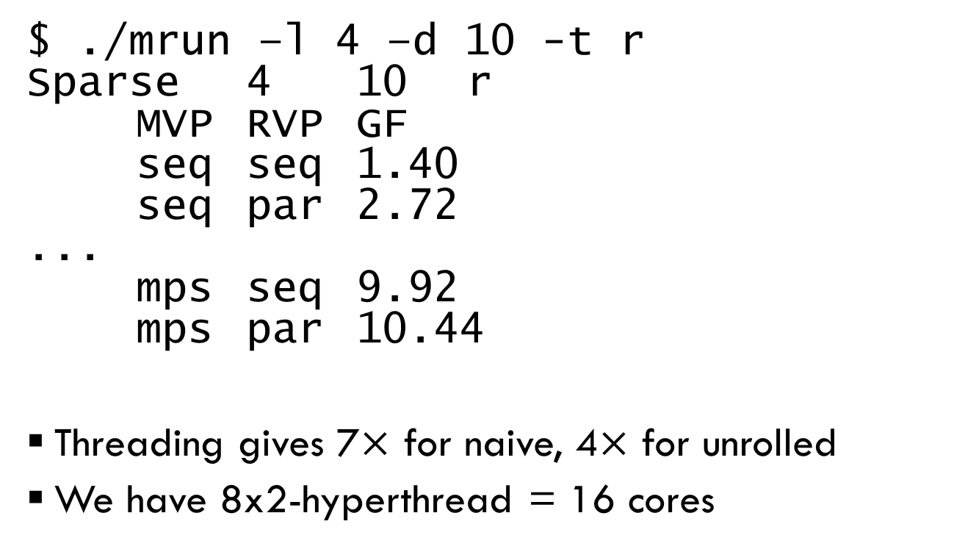
Benchmarking threaded spmv
$ ./mrun –l 4 –d 10 -t r
Sparse 4 10 r
MVP RVP GF
seq seq 1.40
seq par 2.72
...
mps seq 9.92
mps par 10.44
Threading gives 7$×$ for naive, 4$×$ for unrolled
We have 8x2-hyperthread = 16 cores

Slide 38
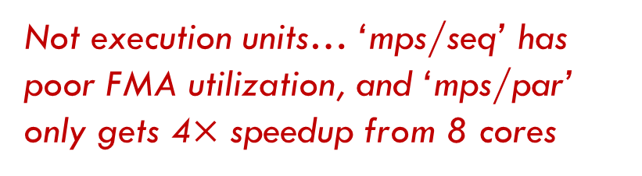

Analyzing poor threading performance
Sources of poor parallel speedup:
Communication/synchronization?
Throughput limitations?
Load imbalance?
No, static work division is $≈$zero overhead
Not execution units… ‘mps/seq’ has poor FMA utilization, and ‘mps/par’ only gets 4$×$ speedup from 8 cores
Maybe…how many elements are there per row? A: its random

Slide 39
Benchmarking threaded spmv
$ ./mrun –l 4 –d 10 -t s
Sparse 4 10 s
MVP RVP GF
seq seq 1.40
seq par 3.30
...
mps seq 2.10
mps par 4.24
Increasing skew (all non-zero elements are in first 10% of rows) reduces speedup significantly
Single-thread is faster (why?), OpenMP is slower (why?)

Slide 40
Benchmarking threaded spmv
$ ./mrun –l 4 –d 10 -t u
Sparse 4 10 u
MVP RVP GF
seq seq 1.45
seq par 2.63
...
mps seq 10.08
mps par 10.51
…But forcing all rows to have the same number of non-zero elements doesn’t change much vs. random
Hypothesis: Memory bandwidth saturated?

Slide 41
Parallelizing spmv with OpenMP
Dealing with skewed workloads
void mvp_csr_mps(csr_t *m, vec_t *x, vec_t *y,
rvp_csr_t rp_fun) {
index_t nrow = m->nrow;
#pragma omp parallel for schedule(static)
for (index_t r = 0; r < nrow; r++) {
y->value[r] = rp_fun(m, x, r);
}
}

Slide 42
Parallelizing spmv with OpenMP
Dealing with skewed workloads
void mvp_csr_mps(csr_t *m, vec_t *x, vec_t *y,
rvp_csr_t rp_fun) {
index_t nrow = m->nrow;
#pragma omp parallel for schedule(dynamic)
for (index_t r = 0; r < nrow; r++) {
y->value[r] = rp_fun(m, x, r);
}
}
schedule(dynamic) divides loop into many small chunks and load balances them across threads

Slide 43
Benchmarking threaded spmv
$ ./mrun –l 4 –d 10 -t s
Sparse 4 10 s
MVP RVP GF
seq seq 1.36
seq par 3.17
...
mpd seq 8.05
mpd par 8.24
Dynamic scheduling increases performance on heavily skewed workloads

Slide 44
Benchmarking threaded spmv
$ ./mrun –l 4 –d 10 -t r
Sparse 4 10 r
MVP RVP GF
seq seq 1.36
seq par 3.17
...
mpd seq 10.52
mpd par 11.24
…And some on slightly skewed workloads

Slide 45
Let’s optimize this code!
Exploit parallelism at multiple levels
ILP
SIMD
Threads

There’s code for this in the tar, but I’m not going to talk about it


Slide 46
Reductions in OpenMP
OpenMP will automatically parallelize reductions (e.g., summation of an array)
float rvp_csr_mpr(csr_t *m, vec_t *x, index_t r) {
index_t idxmin = m->rowstart[r]
index_t idxmax = m->rowstart[r+1];
float val = 0.0;
#pragma omp parallel for reduction(+:val)
for (index_t idx = idxmin;
idx < idxmax; idx++) {
index_t c = m->cindex[idx];
data_t mval = m->value[idx];
data_t xval = x->value[c];
val += mval * xval;
}
return val;
}

Slide 47
Benchmarking spmv w/ OpenMP parallel reductions
$ ./mrun –l 4 –d 10 -t r
Sparse 4 10 r
MVP RVP GF
seq seq 1.36
seq par 3.17
seq mpr 0.50
Parallel reduction too expensive in this case

Slide 48
Example: Summing an array
double sum_array(double *d, int n) {
int i;
double sum = 0.0;
for (i = 0; i < n ; i++) {
double val = d[i];
sum += val;
}
return sum;
}

Slide 49
Parallelizing array sum w/ OpenMP (Attempt #1)
double sum_array(double *d, int n) {
int i;
double sum = 0.0;
#pragma omp parallel for schedule(static)
for (i = 0; i < n ; i++) {
double val = d[i];
sum += val;
}
return sum;
}
Q: Is this OK?
A: No, concurrent updates to sum

Slide 50
Parallelizing array sum w/ OpenMP (Attempt #2)
double sum_array(double *d, int n) {
int i;
double sum = 0.0;
#pragma omp parallel for schedule(static)
for (i = 0; i < n ; i++) {
double val = d[i];
#pragma omp critical
sum += val;
}
return sum;
}
Q: Is this OK?
A: Its correct, but won’t speedup (threads serialize)

Slide 51
Parallelizing array sum w/ OpenMP (Attempt #3)
double sum_array(double *d, int n) {
int i;
double sum = 0.0;
#pragma omp parallel for schedule(static)
for (i = 0; i < n ; i++) {
double val = d[i];
__sync_fetch_and_add(&sum, val);
}
return sum;
}
GCC __sync_* intrinsics compile to x86 atomic instructions (vs. locks for #pragma omp critical)
Faster, but threads still serialize!

Slide 52
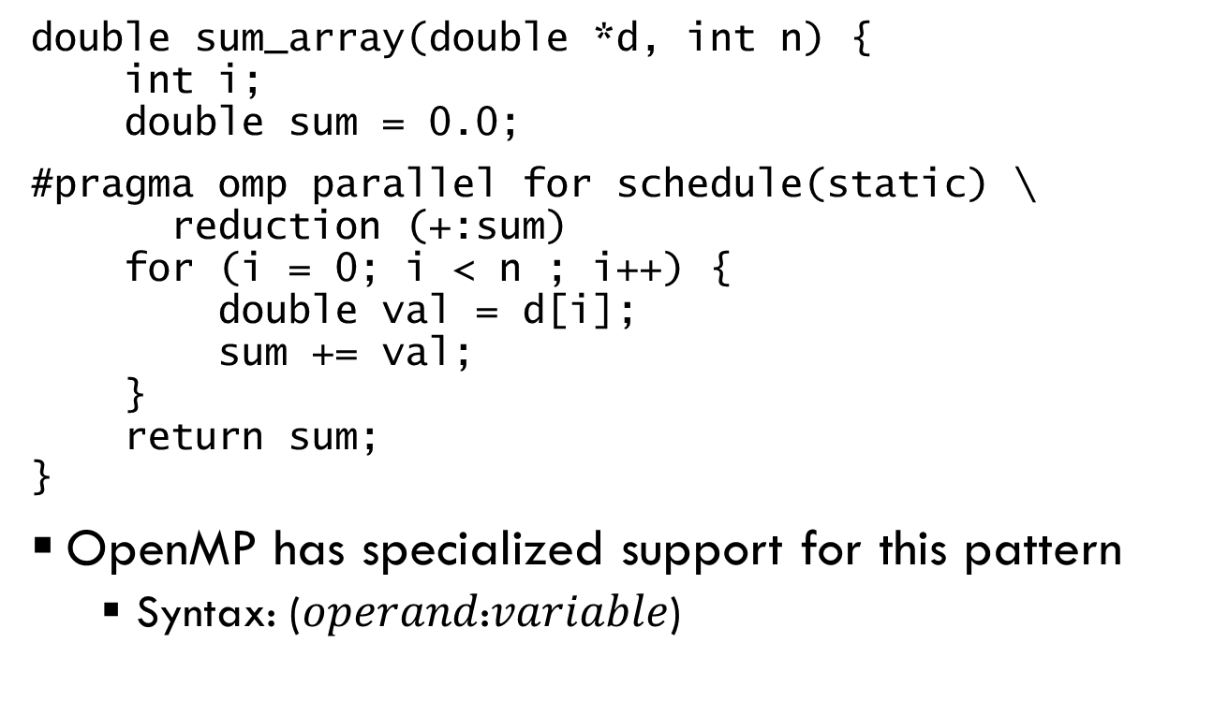
Parallelizing array sum w/ OpenMP (Attempt #4)
double sum_array(double *d, int n) {
int i;
double sum = 0.0;
#pragma omp parallel for schedule(static) \ reduction (+:sum)
for (i = 0; i < n ; i++) {
double val = d[i];
sum += val;
}
return sum;
}
OpenMP has specialized support for this pattern
  Syntax: ($operand$:$variable$)

Slide 53
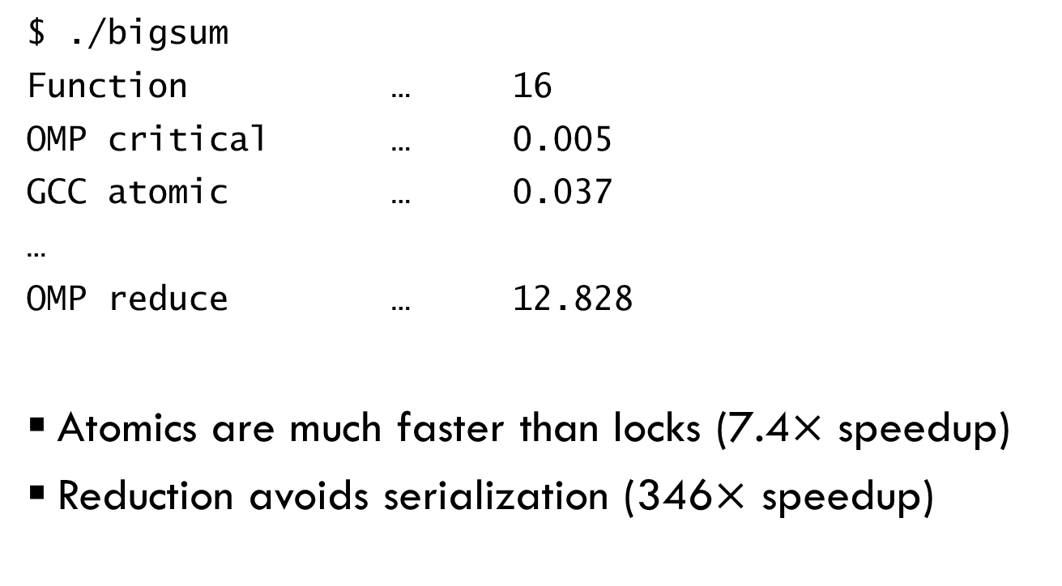
Benchmarking array sum
$ ./bigsum
Function … 16
OMP critical … 0.005
GCC atomic … 0.037
…
OMP reduce … 12.828
Atomics are much faster than locks (7.4$×$ speedup)
Reduction avoids serialization (346$×$ speedup)

Slide 54
More complex example:
Radix sort
Sort numbers digit-by-digit
103
031
593
892
193
576
298
191
031
191
892
103
593
193
576
298
103
031
576
191
892
593
193
298
031
103
191
193
298
576
593
892
Last digit
Middle digit
First digit

Slide 55
More complex example:
Radix sort
void seq_radix_sort(index_t N, data_t *indata,
data_t *outdata, data_t *scratchdata) {
data_t *src = indata;
data_t *dest = scratchdata;
index_t count[BASE];
index_t offset[BASE];
index_t total_digits = sizeof(data_t) * 8;
for (index_t shift = 0; shift < total_digits; shift += BASE_BITS) {
// Accumulate count for each key value
memset(count, 0, BASE*sizeof(index_t));
for (index_t i = 0; i < N; i++) {
data_t key = DIGITS(src[i], shift);
count[key]++;
}
// Compute offsets
offset[0] = 0;
for (index_t b = 1; b < BASE; b++)
offset[b] = offset[b-1] + count[b-1];
// Distribute data
for (index_t i = 0; i < N; i++) {
data_t key = DIGITS(src[i], shift);
index_t pos = offset[key]++;
dest[pos] = src[i];
}
// Swap src/dest (only keep two buffers)
src = dest;
dest = (dest == outdata) ? scratchdata : outdata;
}
}

Slide 56
Translating CUDA ➔ OpenMP
CUDA | OpenMP
__global__ function (kernel) | #pragma omp parallel
if (threadId == 0) { … } | #pragma omp single
__sync_threads() | #pragma omp barrier
Spin lock using ‘atomicExch’ | #pragma omp critical
for-loop (with iterations computed from threadId) | #pragma omp for schedule(static/dynamic)

Slide 57
Radix sort in OpenMP
(credit: Haichuan Wang, UIUC)
Figure out which thread we are
void full_par_radix_sort(index_t N, data_t *indata,
data_t *outdata, data_t *scratchdata) {
data_t *src = indata, *dest = scratchdata;
index_t total_digits = sizeof(data_t) * 8;
index_t count[BASE], offset[BASE];
for(index_t shift = 0; shift < total_digits;
shift+=BASE_BITS) {
memset(count, 0, BASE*sizeof(index_t));
#pragma omp parallel
{
index_t local_count[BASE] = {0};
index_t local_offset[BASE];
#pragma omp for schedule(static) nowait
for(index_t i = 0; i < N; i++){
data_t key = DIGITS(src[i], shift);
local_count[key]++;
}
#pragma omp critical
for(index_t b = 0; b < BASE; b++) {
count[b] += local_count[b];
}
#pragma omp barrier
#pragma omp single
{
offset[0] = 0;
for (index_t b = 1; b < BASE; b++)
offset[b]=count[b-1]+offset[b-1];
}
int nthreads = omp_get_num_threads();
int tid = omp_get_thread_num();
for (int t = 0; t < nthreads; t++) {
if(t == tid) {
for(index_t b = 0; b < BASE; b++){
local_offset[b] = offset[b];
offset[b] += local_count[b];
}
}
#pragma omp barrier
}
#pragma omp for schedule(static)
for(index_t i = 0; i < N; i++) {
data_t key = DIGITS(src[i], shift);
index_t pos = local_offset[key]++;
dest[pos] = src[i];
}
}
src = dest;
dest = (dest == outdata) ?
scratchdata : outdata;
}
}
Run this code in parallel in each thread
Another barrier
Split loop across threads, don’t join at the end
Another loop, with an implicit barrier on exit
Critical section
Barrier
Only one thread runs this code

Slide 58
Radix sort in OpenMP
(credit: Haichuan Wang, UIUC)
void full_par_radix_sort(index_t N, data_t *indata,
data_t *outdata, data_t *scratchdata) {
data_t *src = indata, *dest = scratchdata;
index_t total_digits = sizeof(data_t) * 8;
index_t count[BASE], offset[BASE];
for(index_t shift = 0; shift < total_digits;
shift+=BASE_BITS) {
memset(count, 0, BASE*sizeof(index_t));
#pragma omp parallel
{
index_t local_count[BASE] = {0};
index_t local_offset[BASE];
#pragma omp for schedule(static) nowait
for(index_t i = 0; i < N; i++){
data_t key = DIGITS(src[i], shift);
local_count[key]++;
}
#pragma omp critical
for(index_t b = 0; b < BASE; b++) {
count[b] += local_count[b];
}
#pragma omp barrier
#pragma omp single
{
offset[0] = 0;
for (index_t b = 1; b < BASE; b++)
offset[b]=count[b-1]+offset[b-1];
}
int nthreads = omp_get_num_threads();
int tid = omp_get_thread_num();
for (int t = 0; t < nthreads; t++) {
if(t == tid) {
for(index_t b = 0; b < BASE; b++){
local_offset[b] = offset[b];
offset[b] += local_count[b];
}
}
#pragma omp barrier
}
#pragma omp for schedule(static)
for(index_t i = 0; i < N; i++) {
data_t key = DIGITS(src[i], shift);
index_t pos = local_offset[key]++;
dest[pos] = src[i];
}
}
src = dest;
dest = (dest == outdata) ?
scratchdata : outdata;
}
}
Threads claim parts of the output array in turn
Finally, threads distribute their values
Each thread counts digits locally
Threads add their local counts into the global count
A single thread computes the offsets

Slide 59
Benchmarking radix sort
./rsort -n 10000000 -r 10
Standard library (Quicksort): 28.83
Sequential radix sort: 34.50
OpenMP radix sort: 176.4

