Slide 1
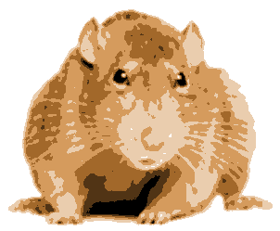
Assignment 3: GraphRats
Graph
Rats

Slide 2
Topics
Application
Implementation Issues
Optimizing for Parallel Performance
Useful Advice

Slide 3
Basic Idea
Transitions
  Each rat decides where to move next
    Don’t like crowds
    But also don’t like to be alone
  Weighted random choice
t = 0
0
1
2
3
4
5
6
7
8
t = 1
0
1
2
Graph
  K X K grid
Initial State
  Start with all R rats in corner
3
4
5
6
7
8

Slide 4
Node Count Representation (K = 12)
t = 0.
+---+---+---+---+---+---+---+---+---+---+---+---+
| | | | | | | | | | | | |
+---+---+---+---+---+---+---+---+---+---+---+---+
| | | | | | | | | | | | |
+---+---+---+---+---+---+---+---+---+---+---+---+
| | | | | | | | | | | | |
+---+---+---+---+---+---+---+---+---+---+---+---+
| | | | | | | | | | | | |
+---+---+---+---+---+---+---+---+---+---+---+---+
| | | | | | | | | | | | |
+---+---+---+---+---+---+---+---+---+---+---+---+
| | | | | | | | | | | | |
+---+---+---+---+---+---+---+---+---+---+---+---+
| | | | | | | | | | | | |
+---+---+---+---+---+---+---+---+---+---+---+---+
| | | | | | | | | | | | |
+---+---+---+---+---+---+---+---+---+---+---+---+
| | | | | | | | | | | | |
+---+---+---+---+---+---+---+---+---+---+---+---+
| | | | | | | | | | | | |
+---+---+---+---+---+---+---+---+---+---+---+---+
| | | | | | | | | | | | |
+---+---+---+---+---+---+---+---+---+---+---+---+
| | | | | | | | | | | |576|
+---+---+---+---+---+---+---+---+---+---+---+---+
t = 1.
+---+---+---+---+---+---+---+---+---+---+---+---+
| | | | | | | | | | | | |
+---+---+---+---+---+---+---+---+---+---+---+---+
| | | | | | | | | | | | |
+---+---+---+---+---+---+---+---+---+---+---+---+
| | | | | | | | | | | | |
+---+---+---+---+---+---+---+---+---+---+---+---+
| | | | | | | | | | | | |
+---+---+---+---+---+---+---+---+---+---+---+---+
| | | | | | | | | | | | |
+---+---+---+---+---+---+---+---+---+---+---+---+
| | | | | | | | | | | | |
+---+---+---+---+---+---+---+---+---+---+---+---+
| | | | | | | | | | | | |
+---+---+---+---+---+---+---+---+---+---+---+---+
| | | | | | | | | | | | |
+---+---+---+---+---+---+---+---+---+---+---+---+
| | | | | | | | | | | | |
+---+---+---+---+---+---+---+---+---+---+---+---+
| | | | | | | | | | | | |
+---+---+---+---+---+---+---+---+---+---+---+---+
| | | | | | | | | | |165|164|
+---+---+---+---+---+---+---+---+---+---+---+---+
| | | | | | | | | | |168| 79|
+---+---+---+---+---+---+---+---+---+---+---+---+

Slide 5
Simulation Example
t = 0.
+---+---+---+---+---+---+---+---+---+---+---+---+
| | | | | | | | | | | | |
+---+---+---+---+---+---+---+---+---+---+---+---+
| | | | | | | | | | | | |
+---+---+---+---+---+---+---+---+---+---+---+---+
| | | | | | | | | | | | |
+---+---+---+---+---+---+---+---+---+---+---+---+
| | | | | | | | | | | | |
+---+---+---+---+---+---+---+---+---+---+---+---+
| | | | | | | | | | | | |
+---+---+---+---+---+---+---+---+---+---+---+---+
| | | | | | | | | | | | |
+---+---+---+---+---+---+---+---+---+---+---+---+
| | | | | | | | | | | | |
+---+---+---+---+---+---+---+---+---+---+---+---+
| | | | | | | | | | | | |
+---+---+---+---+---+---+---+---+---+---+---+---+
| | | | | | | | | | | | |
+---+---+---+---+---+---+---+---+---+---+---+---+
| | | | | | | | | | | | |
+---+---+---+---+---+---+---+---+---+---+---+---+
| | | | | | | | | | | | |
+---+---+---+---+---+---+---+---+---+---+---+---+
| | | | | | | | | | | |576|
+---+---+---+---+---+---+---+---+---+---+---+---+
t = 30.
+---+---+---+---+---+---+---+---+---+---+---+---+
| | | | | | | | | | | | |
+---+---+---+---+---+---+---+---+---+---+---+---+
| | | | | | | | | | 2 | | 1 |
+---+---+---+---+---+---+---+---+---+---+---+---+
| | | | | | | | | | | 3 | 2 |
+---+---+---+---+---+---+---+---+---+---+---+---+
| | | | | | | | 1 | 2 | 3 | 2 | 2 |
+---+---+---+---+---+---+---+---+---+---+---+---+
| | | | | 1 | | 3 | | 9 | 7 | 11| |
+---+---+---+---+---+---+---+---+---+---+---+---+
| | | | 1 | 2 | 2 | 1 | | 5 | 16| 10| 11|
+---+---+---+---+---+---+---+---+---+---+---+---+
| | | | 2 | 1 | | 13| 12| 10| 11| 12| 7 |
+---+---+---+---+---+---+---+---+---+---+---+---+
| | | | | 1 | 9 | 6 | 5 | 8 | 14| 13| 11|
+---+---+---+---+---+---+---+---+---+---+---+---+
| | | 1 | | 9 | 9 | 11| 7 | 10| 14| 13| 13|
+---+---+---+---+---+---+---+---+---+---+---+---+
| | | 1 | 1 | 10| 9 | 6 | 11| 10| 12| 12| 17|
+---+---+---+---+---+---+---+---+---+---+---+---+
| | | | 1 | 10| 7 | 12| 11| 14| 12| 11| 10|
+---+---+---+---+---+---+---+---+---+---+---+---+
| | | | 1 | 4 | 11| 11| 10| 9 | 10| 12| 12|
+---+---+---+---+---+---+---+---+---+---+---+---+

Slide 6

Visualizations
Text (“a” for ASCII)
Heat Map (“h”)
t = 30.
+---+---+---+---+---+---+---+---+---+---+---+---+
| | | | | | | | | | | | |
+---+---+---+---+---+---+---+---+---+---+---+---+
| | | | | | | | | | 2 | | 1 |
+---+---+---+---+---+---+---+---+---+---+---+---+
| | | | | | | | | | | 3 | 2 |
+---+---+---+---+---+---+---+---+---+---+---+---+
| | | | | | | | 1 | 2 | 3 | 2 | 2 |
+---+---+---+---+---+---+---+---+---+---+---+---+
| | | | | 1 | | 3 | | 9 | 7 | 11| |
+---+---+---+---+---+---+---+---+---+---+---+---+
| | | | 1 | 2 | 2 | 1 | | 5 | 16| 10| 11|
+---+---+---+---+---+---+---+---+---+---+---+---+
| | | | 2 | 1 | | 13| 12| 10| 11| 12| 7 |
+---+---+---+---+---+---+---+---+---+---+---+---+
| | | | | 1 | 9 | 6 | 5 | 8 | 14| 13| 11|
+---+---+---+---+---+---+---+---+---+---+---+---+
| | | 1 | | 9 | 9 | 11| 7 | 10| 14| 13| 13|
+---+---+---+---+---+---+---+---+---+---+---+---+
| | | 1 | 1 | 10| 9 | 6 | 11| 10| 12| 12| 17|
+---+---+---+---+---+---+---+---+---+---+---+---+
| | | | 1 | 10| 7 | 12| 11| 14| 12| 11| 10|
+---+---+---+---+---+---+---+---+---+---+---+---+
| | | | 1 | 4 | 11| 11| 10| 9 | 10| 12| 12|
+---+---+---+---+---+---+---+---+---+---+---+---+

Slide 7
Running it yourself
linux> cd some directory
linux> git clone https//github.com/cmu15418/asst3-s19.git
linux> cd asst3-s19/code
Linux> make demoX
X from 1 to 10
Demos
  1: Text visualization, synchronous updates
  2: Heap-map, synchronous updates

Slide 8
Determining Rat Moves
300
8
83
40
120
Count number of rats at current and adjacent locations
  Adjacency structure represented as graph
Compute reward value for each location
  Based on load factor l = count/average count
  l * Ideal load factor (ILF) (varying)
  𝛂 Fitting parameter (= 0.4)

Slide 9
Reward Function
  Maximized at ILF
    Just above average population
    Drops for smaller loads (too few) and larger loads (too crowded)

Slide 10
Reward Function (cont.)
  Falls off gradually
    Reward(1000) = 0.0132

Slide 11
Computing Ideal Load Factor (ILF)
Suppose node has count c_{l} and neighbor has count c_{r}
Compute imbalance as

Slide 12
Computing Ideal Load Factor (cont.)
For node u with population p(u)
Define ILF as
Minimum 1.25
  When adjacent nodes much less crowded
Maximum 2.25
  When adjacent nodes much more crowded
Changes as rats move around

Slide 13
Selecting Next Move
Population
Reward (avg load = 10)
300
0.071
8
83
40
0.678
0.225
0.538
120
0.153
Weighted Choices
(node followed by row-major ordering of neighbors)
x = 1.24
  Choose random number between 0 and sum of rewards
  Move according to interval hit

Slide 14
Update Models
Synchronous
  Demo 2
  Compute next positions for all rats, and then move them
  Causes oscillations/instabilities
Rat-order
  Demo 3
  For each rat, compute its next position and then move it
  Smooth transitions, but costly
Batch
  Demo 4
  For each batch of B rats, compute next moves and then move them
  B = 0.02 * R
  Smooth enough, with better performance possibilities

Slide 15
What We Provide
Python version of simulator
  Demo 4
  Very slow
C version of simulator
  Fast sequential implementation
  Demo 5: 36X36 grid, 1,290 rats
  Demo 6: 180X180 grid, 1,036,800 rats
    That’s what we’ll be using for benchmarks!
Generate visualizations by piping C simulator output into Python simulator
  Operating in visualization mode
  See Makefile for examples

Slide 16
Correctness
Simulator is Deterministic
  Global random seed
  Random seeds for each rat
  Process rats in fixed order
You Must Preserve Exact Same Behavior
  Python simulator generates same result as C simulator
  Use regress.py to check
    Only checks small cases
    Useful sanity check
  Benchmark program compares your results to reference solution
    Handles full-sized graphs

Slide 17
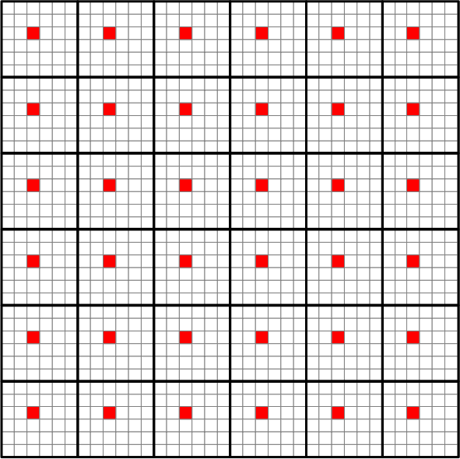
Graphs: Tiled (Demos 1–6)
Rats spread quickly within region
More slowly across regions
Hub nodes tend to have high counts
Base grid
  K X K nodes, each with nearest neighbor connectivity
Hub (red) nodes connect to all other nodes in region
For K = 180
  Most nodes have degree ≤ 5
  Hubs have degree 899

Slide 18
Other graphs
Horizontal
Vertical
Larger regions
k = 180: Max degree = 2,699

Slide 19
Other graphs
Parquet
Larger regions
k = 180: Max degree = 2,699

Slide 20



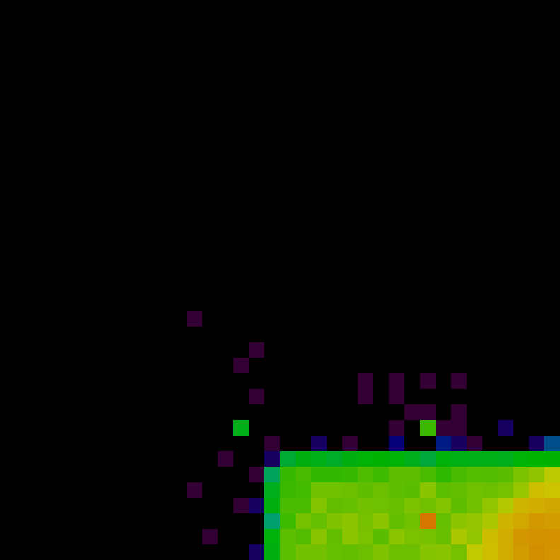
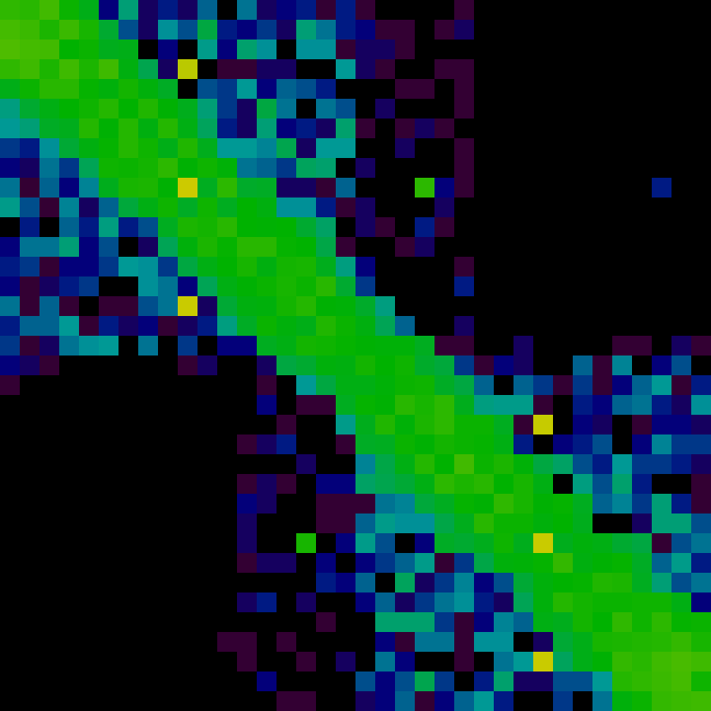
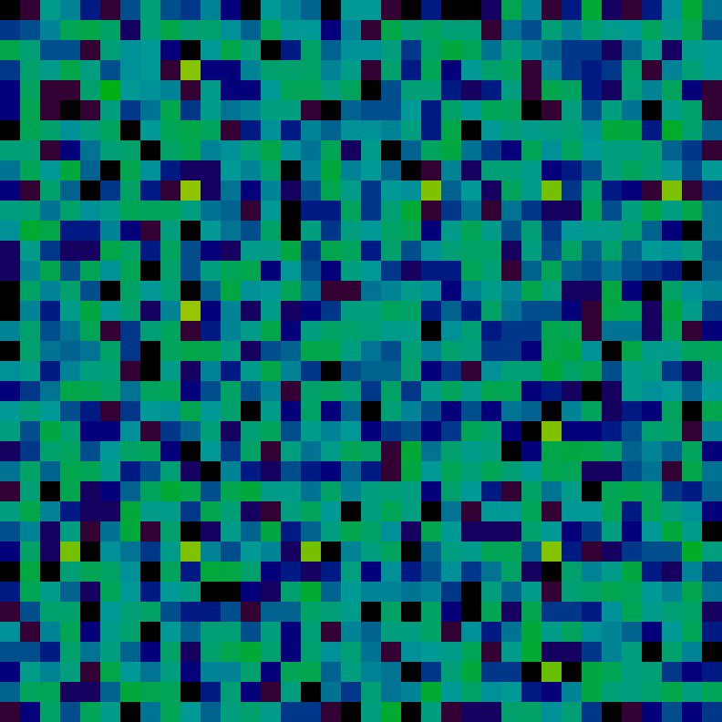
Initial States (Parquet Graph)
Right Corner (r)
Demo 8
Diagonal (d)
Demo 9
Uniform (u)
Demo 10
t = 0
t = 5

Slide 21
Graph Representation
N node, M edges
0
1
2
neighbor_start (length = N+1)
0
3
7
10
14
19
23
26
30
33
3
4
5
6
7
8
0
1
3
1
0
2
4
2
1
5
3
0
4
6
neighbor
Includes self edges
length = N+M
4
1
3
5
7
5
2
4
8
6
3
7
7
4
6
8
8
5
7
Having pointer to end is useful (why?)

Slide 22
Sample Code
From sim.c
Compute reward value for node
Simulation state stored in state_t struct
Reward function computed by mweight
/* Compute weight for node nid */
static inline double compute_weight(state_t *s, int nid) {
int count = s->rat_count[nid];
double ilf = neighbor_ilf(s, nid);
return mweight((double) count/s->load_factor, ilf);
}

Slide 23
Sample Code
From sim.c
Compute sum of reward values for node
Store for later reuse
/* Compute sum of weights in region of nid */
static inline double compute_sum_weight(state_t *s, int nid)
{
graph_t *g = s->g;
double sum = 0.0;
int eid;
int eid_start = g->neighbor_start[nid];
int eid_end = g->neighbor_start[nid+1];
for (eid = eid_start; eid < eid_end; eid++) {
int nbrnid = g->neighbor[eid];
double w = compute_weight(s, nbrnid);
s->node_weight[nbrnid] = w;
sum += w;
}
return sum;
}

Slide 24
Sample Code
Compute next move for rat
static inline int next_random_move(state_t *s, int r)
{
int nid = s->rat_position[r];
random_t *seedp = &s->rat_seed[r];
double tsum = compute_sum_weight(s, nid);
graph_t *g = s->g;
double val = next_random_float(seedp, tsum);
double psum = 0.0;
int eid;
int eid_start = g->neighbor_start[nid];
int eid_end = g->neighbor_start[nid+1];
for (eid = eid_start; eid < eid_end; eid++) {
psum += s->node_weight[neighbor[eid]];
if (val < psum) {
return g->neighbor[eid];
}
}
}

Slide 25
Sequential Efficiency Considerations
Consider move computation for rat at node with degree D
  How many (on average) iterations of loop in next_random_move?
  Is there a better way?
Provided code uses many optimizations
  Precompute weights at start of batch
  Fast search

Slide 26
Finding Parallelism
Sequential constraints
  Must complete time steps sequentially
  Must complete each batch before starting next
    ILF values and weights then need to be recomputed
Sources of parallelism
  Over nodes
    Computing ILFs and reward functions
  Over rats (within a batch)
    Computing next moves
    Updating node counts

Slide 27
Performance Measurements
Nanoseconds per move (NPM)
  R rats running for S steps
  Requires time T
  NPM = 10⁹ * T / (R * S)
  Reference solution:
    665 NPM for 1 thread
    84 NPM for 12 threads
    7.9 X speedup

Slide 28
Performance Targets
Benchmarks
  6 combinations of graph/initial state
  Each counts 15 points
Target performance
  T = measured time
  T_{r} = time for reference solution
  T_{r} / T = How well you reach reference solution performance
    Full credit when ≥ 0.9
    Partial when ≥ 0.5

Slide 29
Machines
Latedays cluster
  16 worker nodes + 1 head node
  Each is 12-core Xeon processor (dual socket with 6 cores each)
  You submit jobs to batch queue
  Assigned single processor for entire run
  Python script provided
Code Development
  OK to do code development and testing on other machines
  But, they have different performance characteristics
  Make sure to use 6 or 12 threads to ensure correct partitioning of nodes across processors

Slide 30
Instrumenting Your Code
How do you know how much time each activity takes?
  Create simple library using cycletimer code
  Bracket steps in your code with library calls
  Use macros so that you can disable code for maximum performance
START_ACTIVITY(ACTIVITY_NEXT);
#pragma omp parallel for schedule(static)
for (ri = 0; ri < local_count; ri++) {
int rid = ri + local_start;
s->rat_position[rid] = fast_next_random_move(s, rid);
}
FINISH_ACTIVITY(ACTIVITY_NEXT);

Slide 31
Evaluating Your Instrumented Code
1 thread
194 ms 1.0 % startup
2077 ms 11.1 % compute_weights
4029 ms 21.6 % compute_sums
11733 ms 62.8 % find_moves
651 ms 3.5 % set_ops
3 ms 0.0 % unknown
12 threads
192 ms 3.2 % startup
426 ms 7.0 % compute_weights
940 ms 15.5 % compute_sums
3168 ms 52.3 % find_moves
1325 ms 21.9 % set_ops
2 ms 0.0 % unknown
Can see which activities account for most time
Can see which activities limit parallel speedup

Slide 32

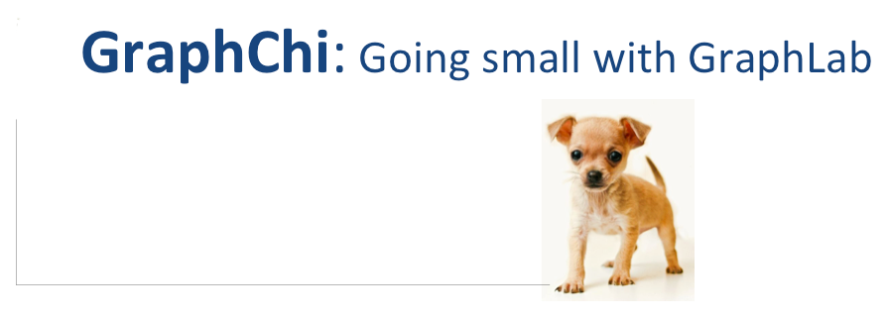
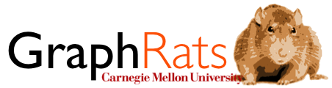
Some Logos

