Slide 1
Recitation 2:
GPU Programming with CUDA
15-418 Parallel Computer Architecture and Programming
CMU 15-418/15-618, Spring 2019

Slide 2
Goals for today
Learn to use CUDA
Walk through example CUDA program
Optimize CUDA performance
Debugging & profiling tools
Most of all,
ANSWER YOUR QUESTIONS!

Slide 3



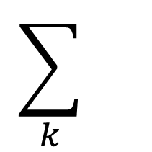
Matrix multiplication
$$\sum_{k}{}$$
C
$$(i,j)$$
A
B
$$(k,j)→$$
$$(i,k)→$$

Slide 4
Matrix multiplication (matmul)
Simple C++ implementation:
/* Find element based on row-major ordering */
#define RM(r, c, width) ((r) * (width) + (c))
// Standard multiplication
void multMatrixSimple(int N, float *matA, float *matB, float *matC) {
for (int i = 0; i < N; i++)
for (int j = 0; j < N; j++) {
float sum = 0.0;
for (int k = 0; k < N; k++)
sum += matA[RM(i,k,N)] * matB[RM(k,j,N)];
matC[RM(i,j,N)] = sum;
}
}

Slide 5
Benchmarking simple C++ matmul
./matrix -n 1024 -N 1024 -m simple
Simple C++: 1950 ms, 1.1 GFlops

Slide 6
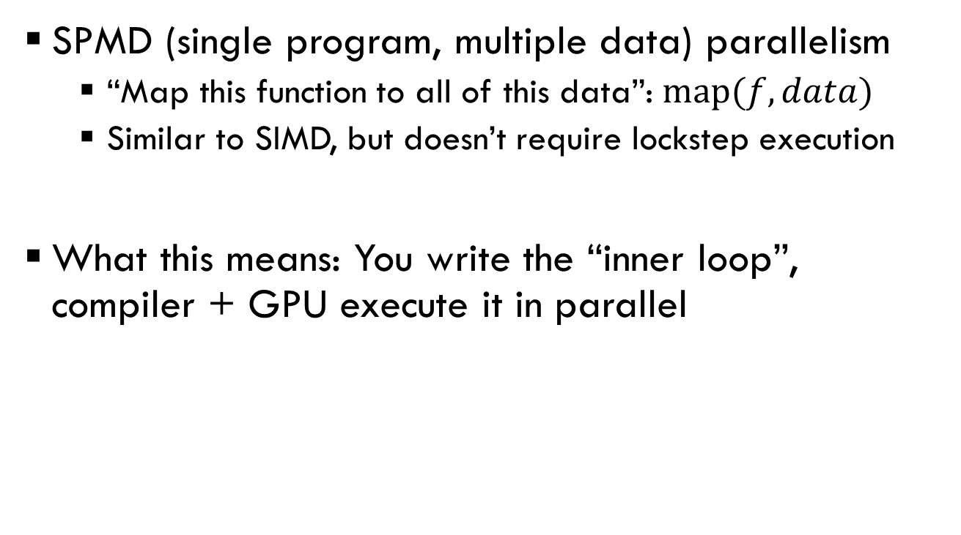
Translating matmul to CUDA
SPMD (single program, multiple data) parallelism
  “Map this function to all of this data”: $map(f, data)$
  Similar to SIMD, but doesn’t require lockstep execution
What this means: You write the “inner loop”, compiler + GPU execute it in parallel

Slide 7
Translating matmul to CUDA
Simple CUDA implementation:
/* Find element based on row-major ordering */
#define RM(r, c, width) ((r) * (width) + (c))
// Standard multiplication
void multMatrixSimple(int N, float *matA, float *matB, float *matC) {
for (int i = 0; i < N; i++)
for (int j = 0; j < N; j++) {
float sum = 0.0;
for (int k = 0; k < N; k++)
sum += matA[RM(i,k,N)] * matB[RM(k,j,N)];
matC[RM(i,j,N)] = sum;
}
}
1. Find the inner loop

Slide 8
Translating matmul to CUDA
Simple CUDA implementation:
__global__ void
cudaSimpleOldKernel(int N, float* dmatA, float* dmatB, float * dmatC) {
int i = blockIdx.x * blockDim.x + threadIdx.x;
int j = blockIdx.y * blockDim.y + threadIdx.y;
if (i >= N || j >= N)
return;
float sum = 0.0;
for (int k = 0; k < N; k++) {
sum += dmatA[RM(i,k,N)] * dmatB[RM(k,j,N)];
}
dmatC[RM(i,j,N)] = sum;
}
2. Write it as a separate function

Slide 9
Translating matmul to CUDA
Simple CUDA implementation:
__global__ void
cudaSimpleOldKernel(int N, float* dmatA, float* dmatB, float * dmatC) {
int i = blockIdx.x * blockDim.x + threadIdx.x;
int j = blockIdx.y * blockDim.y + threadIdx.y;
if (i >= N || j >= N)
return;
float sum = 0.0;
for (int k = 0; k < N; k++) {
sum += dmatA[RM(i,k,N)] * dmatB[RM(k,j,N)];
}
dmatC[RM(i,j,N)] = sum;
}
3. Compute loop index + test bound (no outer loop)

Slide 10
Benchmarking simple CUDA matmul
./matrix -n 1024 -N 1024 -m cosimple
Simple C++: 1950 ms, 1.1 GFlops
Simple CUDA: 44.5 ms, 48.2 Gflops
…actually, not very good yet! (stay tuned)
Parallelism!

Slide 11

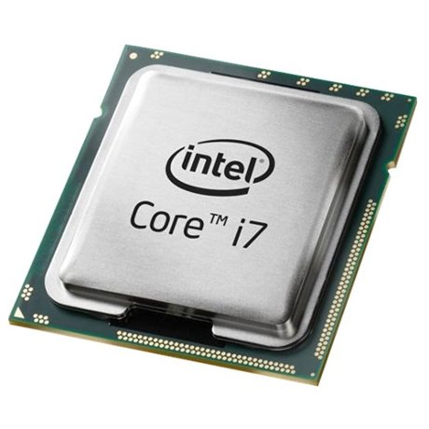
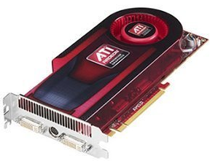
CUDA Terminology
PCIe
CPU
GPU
Host
Device

Slide 12
CUDA Programming Model
Grid
Block
Thread
Programmer writes kernels executed by each thread
Blocks have fast shared memory between threads
Blocks within a grid may execute in any order

Slide 13
CUDA Programming Model
PCIe
Host (CPU)
Device (GPU)
Not all threads used

Slide 14
Invoking CUDA matmul
Setup memory (from CPU to GPU)
Invoke CUDA with special syntax
Get results (from GPU to CPU)

Slide 15
Invoking CUDA matmul
Setup memory (from CPU to GPU)
cudaMalloc((void **) &aDevData, N*N * sizeof(float));
cudaMalloc((void **) &bDevData, N*N * sizeof(float));
cudaMalloc((void **) &cDevData, N*N * sizeof(float));
cudaMemcpy(aDevData, aData, N*N * sizeof(float), cudaMemcpyHostToDevice);
cudaMemcpy(bDevData, bData, N*N * sizeof(float), cudaMemcpyHostToDevice);
Invoke CUDA with special syntax
Get results (from GPU to CPU)
These addresses are only valid on GPU
Need to move data manually (separate address spaces)

Slide 16
Invoking CUDA matmul
Setup memory (from CPU to GPU)
Invoke CUDA with special syntax
#define N 1024
#define LBLK 32
dim3 threadsPerBlock(LBLK, LBLK);
dim3 blocks(updiv(N, LBLK), updiv(N, LBLK)); // updiv() divides + rounds up
cudaSimpleKernelOld<<<blocks, threadsPerBlock>>>(N, aDevData, bDevData, cDevData);
Get results (from GPU to CPU)
These addresses are only valid on GPU

Slide 17
Invoking CUDA matmul
Setup memory (from CPU to GPU)
Invoke CUDA with special syntax
Get results (from GPU to CPU)
tHostData = (float *) calloc(N*N, sizeof(float));
cudaMemcpy(tHostData, tDevData, N*N*sizeof(float), cudaMemcpyDeviceToHost);
cudaFree(aDevData); cudaFree(bDevData); cudaFree(cDevData);
Need to move data manually (separate address spaces)

Slide 18
Compiling + running CUDA
CUDA code is in separate *.cu file (cudaMatrix.cu)
  Compiled like:
  nvcc cudaMatrix.cu –O3 –c –o cudaMatrix.o
  (See assignment 2 for $PATH, etc)
Linked with gcc + flags, e.g.:
  g++ –O3 –L/path/to/cuda –lcudart –o matrix *.o
Run like a normal program, e.g.:
  ./matrix

Slide 19
Profiling performance:
How well are we doing?
Run “nvprof” to generate analysis data
  nvprof --analysis-metrics -f -o cosimple.nvprof ./matrix -n 1024 -N 1024 -m cosimple
  (nvprof has many other options)
Visualize profile with nvvp cosimple.nvprof
  You will want to run this locally so X-windows doesn’t lag

Slide 20
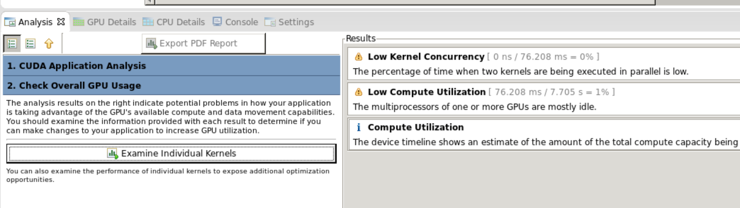
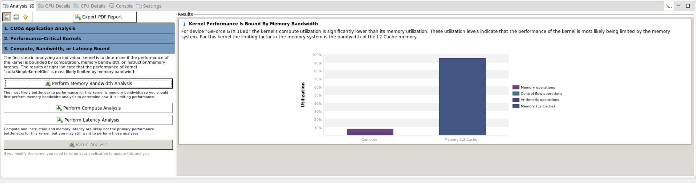
nvprof/nvvp Profiling Results

Slide 21
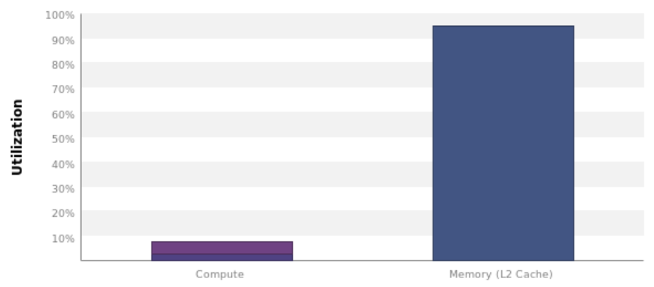
nvprof/nvvp Profiling Results
matmul is memory bound!

Slide 22
GPU microarchitecture
Mem Ctrl
Mem Ctrl
SM
SM
SM
Mem Ctrl
Mem Ctrl
L2 Cache
Mem Ctrl
“Global” memory, accessible across entire device
Mem Ctrl
Mem Ctrl
SM
SM
SM
Mem Ctrl

Slide 23
CUDA Programming Model
Grid
Block
SM
SM
SM
SM
SM
SM

Slide 24
Streaming multiprocessor (SM) microarchitecture
Execution Contexts
Warp Selector
F&D
F&D
Block
Warp Selector
“Cores” (execution units)
F&D
F&D
L1 Cache
Warp Selector
“Shared” memory
(only shared within SM/thread block)
F&D
F&D
Warp
Warp Selector
F&D
F&D
L1 Cache
Within an SM, thread blocks are broken into warps for execution

Slide 25
Improving matmul memory usage
Why is matmul accessing memory so much?
__global__ void
cudaSimpleOldKernel(int N, float* dmatA,
float* dmatB, float * dmatC) {
int i = blockIdx.x * blockDim.x + threadIdx.x;
int j = blockIdx.y * blockDim.y + threadIdx.y;
if (i >= N || j >= N)
return;
float sum = 0.0;
for (int k = 0; k < N; k++) {
sum += dmatA[RM(i,k,N)] * dmatB[RM(k,j,N)];
}
dmatC[RM(i,j,N)] = sum;
}

Slide 26
Improving matmul memory usage:
Peeking under the hood
Need to think about how threads within a warp access memory…
  (This is bad – warps aren’t part of programming model)
CUDA maps threads → warps
row-major: Same y values,
consecutive x values
  Warp 0:
  (0,0) (1,0) (2,0) … (31,0)
X➔
⬅ Y

Slide 27
Improving matmul memory usage: Warp memory access pattern
What memory locations does warp 0 access?
int i = blockIdx.x * blockDim.x + threadIdx.x;
int j = blockIdx.y * blockDim.y + threadIdx.y;
Access: dmatA[RM(i,k,N)], dmatB[RM(k,j,N)], dmatC[RM(i,j,N)] where RM(i,j,N) = i*N + j
Threads have same y + consecutive x ➔
Threads accesses the same j + consecutive i ➔
Threads access memory at stride of N floats ➔
1 reads + 1 writes per thread

Slide 28
Improving matmul memory usage: Better spatial locality
What if we flipped it around?
int i = blockIdx.y * blockDim.y + threadIdx.y;
int j = blockIdx.x * blockDim.x + threadIdx.x;
Threads have same y + consecutive x ➔
Threads access the same i + consecutive j ➔
Threads access memory at stride of 1 ➔
GPU coalesces reads + writes to memory block ➔
1 read + 1 write per warp (if large memory blocks)

Slide 29
Benchmarking improved simple CUDA matmul
./matrix -n 1024 -N 1024 -m csimple
Simple C++: 1950 ms, 1.1 Gflops
Simple CUDA: 44.5 ms, 48.2 Gflops
Simple++ CUDA: 4.95 ms, 434 Gflops

Slide 30
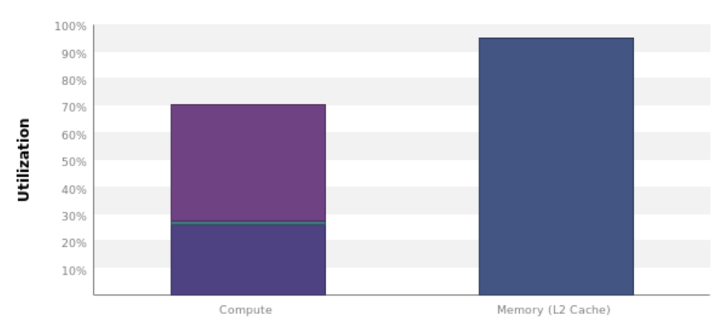
Profiling improved simple CUDA matmul
nvprof --analysis-metrics -f -o csimple.nvprof ./matrix -n 1024 -N 1024 -m csimple
nvvp csimple.nvprof
Doing better!
…Still memory bound, though

Slide 31
CUDA disassembly + its limits
You can look at PTX assembly:
cuobjdump --dump-ptx matrix
…But you will not see difference in this case
(Coalescing done by hardware, not compiler)
.visible .entry _Z19cudaSimpleKernelOldiPfS_S_(
...
ld.global.f32 %f6, [%rd9];
ld.global.f32 %f7, [%rd7];
...
st.global.f32 [%rd12], %f9;
...
.visible .entry _Z19cudaSimpleKernelOldiPfS_S_(
...
ld.global.f32 %f6, [%rd9];
ld.global.f32 %f7, [%rd7];
...
st.global.f32 [%rd12], %f9;
...

Slide 32

Blocked matmul: Even better memory usage
Problem: Entire matrix doesn’t fit in local cache
Classic solution: Block into sub-matrices that do fit in cache, and then multiply and sum sub-matrices
  (This is just a re-association of the original computation)
$$\sum_{k}{\sum_{bk}{}}$$
C
A
B

Slide 33
C
A
B
A
B
A
B
A
B

Slide 34
Blocked matmul: C++ version
void multMatrixBlocked(int N, float *matA, float *matB, float *matC) {
/* Zero out C */
memset(matC, 0, N * N * sizeof(float));
int i, j, k;
for (i = 0; i <= N-SBLK; i+= SBLK) {
for (j = 0; j <= N-SBLK; j+= SBLK) {
for (k = 0; k <= N-SBLK; k+= SBLK) {
for (int bi = 0; bi < SBLK; bi++) {
for (int bj = 0; bj < SBLK; bj++) {
float sum = 0.0;
for (int bk =0; bk < SBLK; bk++)
sum += matA[RM(i+bi,k+bk,N)]
* matB[RM(k+bk,j+bj,N)];
matC[RM(i+bi,j+bj,N)] += sum;
} } } } } }
Outer loops iterate over submatrices in steps of SBLK
Inner bi, bj loops iterate over sub-matrix and accumulate into output matrix
Note: This code assumes SBLK evenly divides N; need extra loops for “leftovers” in general

Slide 35
Benchmarking blocked matmul in C++
./matrix -n 1024 -N 1024 -m block
Simple C++: 1950 ms, 1.1 Gflops
Simple CUDA: 44.5 ms, 48.2 Gflops
Simple++ CUDA: 4.95 ms, 434 Gflops
Block C++: 612 ms, 3.5 Gflops

Slide 36
Blocked matmul: CUDA version
Find the inner loop
Write it as a separate function
Compute indices from block/thread id

Slide 37
Blocked matmul: Attempt #1
__global__ void
cudaBlockKernelCoarse(int N, float *dmatA, float *dmatB, float *dmatC) {
int i = blockIdx.y * blockDim.y + threadIdx.y; i *= LBLK;
int j = blockIdx.x * blockDim.x + threadIdx.x; j *= LBLK;
for (int bi = 0; bi < LBLK; bi++)
for (int bj = 0; bj < LBLK; bj++)
dmatC[RM(i+bi,j+bi,N)] = 0;
for (int k = 0; k <= N-LBLK; k+=LBLK) {
for (int bi = 0; bi < LBLK; bi++) {
for (int bj = 0; bj < LBLK; bj++) {
float sum = 0.0;
for (int bk = 0; bk < LBLK; bk++) {
sum += dmatA[RM(i+bi,k+bk,N)]
* dmatB[RM(k+bk,j+bj,N)];
}
dmatC[RM(i+bi,j+bj,N)] += sum;
} } } }
Map threads across submatrices
Compute submatrix product

Slide 38
Blocked matmul: Attempt #1 + Local memory
__global__ void cudaBlockKernelCoarse(int N, float *dmatA, float *dmatB, float *dmatC) {
int i = blockIdx.y * blockDim.y + threadIdx.y; i *= LBLK;
int j = blockIdx.x * blockDim.x + threadIdx.x; j *= LBLK;
float subA[LBLK * LBLK];
float subB[LBLK * LBLK];
float subC[LBLK * LBLK];
for (int bi = 0; bi < LBLK; bi++) /* Zero out C */
for (int bj = 0; bj < LBLK; bj++)
subC[RM(bi,bj,LBLK)] = 0;
for (int k = 0; k <= N-LBLK; k+=LBLK) {
for (int bi = 0; bi < LBLK; bi++) {
for (int bj = 0; bj < LBLK; bj++) {
subA[RM(bi,bj,LBLK)] = dmatA[RM(i+bi,k+bj,N)];
subB[RM(bi,bj,LBLK)] = dmatB[RM(k+bi,j+bj,N)];
} }
for (int bi = 0; bi < LBLK; bi++) {
for (int bj = 0; bj < LBLK; bj++) {
float sum = 0.0;
for (int bk = 0; bk < LBLK; bk++) {
sum += subA[RM(bi,bk,LBLK)] * subB[RM(bk,bj,LBLK)];
}
subC[RM(bi,bj,LBLK)] += sum;
} } }
for (int bi = 0; bi < LBLK; bi++)
for (int bj = 0; bj < LBLK; bj++)
dmatC[RM(i+bi,j+bj,N)] = subC[RM(bi,bj,LBLK)];
}
Keep a local copy of submatrix
Explicitly read from global to local memory
Only reference local copy in loop
Explicitly write from local to global memory

Slide 39
Benchmarking blocked matmul
./matrix -n 1024 -N 1024 -m block
Simple C++: 1950 ms, 1.1 Gflops
Simple CUDA: 44.5 ms, 48.2 Gflops
Simple++ CUDA: 4.95 ms, 434 Gflops
Block C++: 612 ms, 3.5 Gflops
Block CUDA: 111 ms, 19.4 Gflops ☹

Slide 40
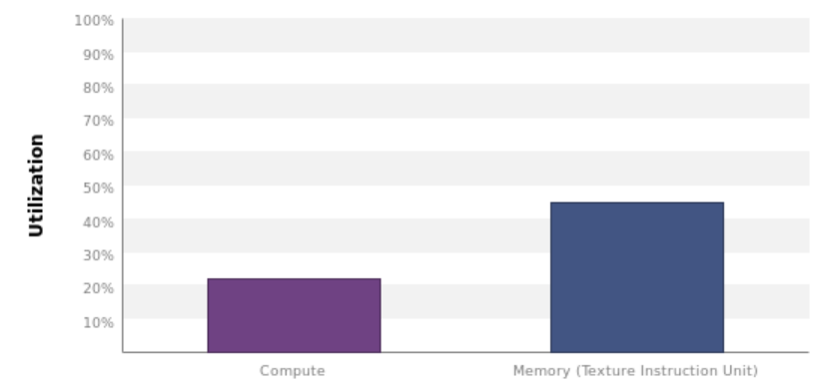
Profiling blocked matmul
nvprof --analysis-metrics -f -o ccblock.nvprof ./matrix -n 1024 -N 1024 -m ccblock
nvvp ccblock.nvprof
Huh…

Slide 41
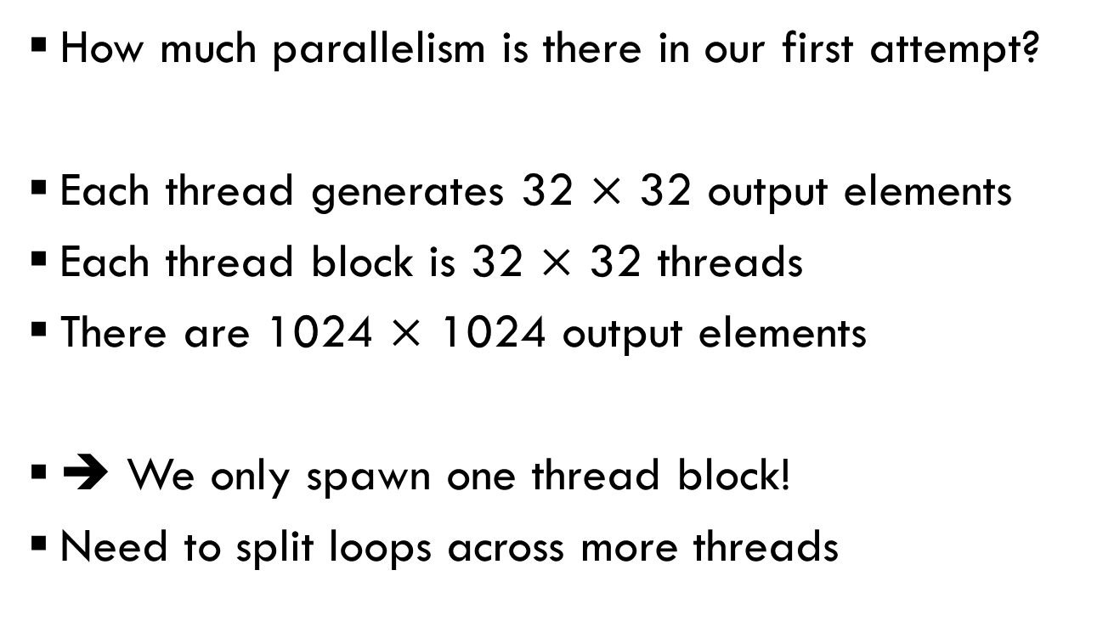
Blocked matmul:
What went wrong?
How much parallelism is there in our first attempt?
Each thread generates 32 $×$ 32 output elements
Each thread block is 32 $×$ 32 threads
There are 1024 $×$ 1024 output elements
➔ We only spawn one thread block!
Need to split loops across more threads

Slide 42
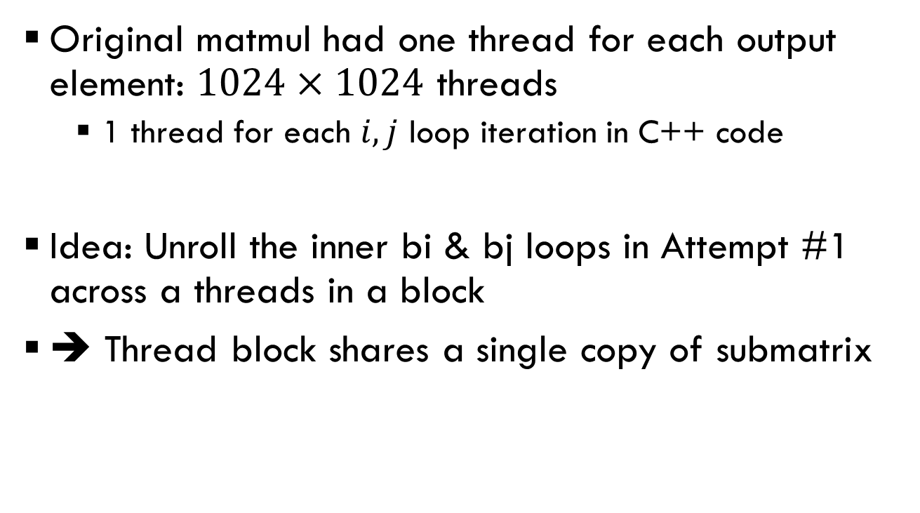
Blocked matmul: Attempt #2
Original matmul had one thread for each output element: $1024×1024$ threads
  1 thread for each $i,j$ loop iteration in C++ code
Idea: Unroll the inner bi & bj loops in Attempt #1 across a threads in a block
➔ Thread block shares a single copy of submatrix

Slide 43

Blocked matmul: Attempt #2
__global__ void cudaBlockKernel(int N, float *dmatA, float *dmatB, float *dmatC) {
int i = blockIdx.y * blockDim.y + threadIdx.y;
int j = blockIdx.x * blockDim.x + threadIdx.x;
int bi = threadIdx.y;
int bj = threadIdx.x;
__shared__ float subA[LBLK * LBLK];
__shared__ float subB[LBLK * LBLK];
float sum = 0;
for (int k = 0; k < N; k += LBLK) {
subA[RM(bi,bj,LBLK)] = dmatA[RM(i,k+bj,N)];
subB[RM(bi,bj,LBLK)] = dmatB[RM(k+bi,j,N)];
for (int bk = 0; bk < LBLK; bk++) {
sum += subA[RM(bi,bk,LBLK)] * subB[RM(bk,bj,LBLK)];
}
}
dmatC[RM(i,j,N)] = sum;
}
Each thread responsible for one output element (like original CUDA code)
But now mapped within
a LBLK $×$ LBLK block
Keep a block-shared copy of submatrix
Explicitly read from global to shared memory
Only reference shared copy in loop
Explicitly write from local to global memory
Is this code correct?

Slide 44
Blocked matmul: Attempt #2
__global__ void cudaBlockKernel(int N, float *dmatA, float *dmatB, float *dmatC) {
int i = blockIdx.y * blockDim.y + threadIdx.y;
int j = blockIdx.x * blockDim.x + threadIdx.x;
int bi = threadIdx.y;
int bj = threadIdx.x;
__shared__ float subA[LBLK * LBLK];
__shared__ float subB[LBLK * LBLK];
float sum = 0;
for (int k = 0; k < N; k += LBLK) {
subA[RM(bi,bj,LBLK)] = dmatA[RM(i,k+bj,N)];
subB[RM(bi,bj,LBLK)] = dmatB[RM(k+bi,j,N)];
__syncthreads();
for (int bk = 0; bk < LBLK; bk++) {
sum += subA[RM(bi,bk,LBLK)] * subB[RM(bk,bj,LBLK)];
}
__syncthreads();
}
dmatC[RM(i,j,N)] = sum;
}
Need barriers across thread block to ensure subA/subB are ready to be read/updated
(A block is executed as multiple warps, which can proceed at different rates through the kernel)

Slide 45
Benchmarking improved blocked matmul
./matrix -n 1024 -N 1024 -m block
Simple C++: 1950 ms, 1.1 Gflops
Simple CUDA: 44.5 ms, 48.2 Gflops
Simple++ CUDA: 4.95 ms, 434 Gflops
Block C++: 612 ms, 3.5 Gflops
Block CUDA: 111 ms, 19.4 Gflops
Block++ CUDA: 2.05ms, 1050 Gflops

Slide 46
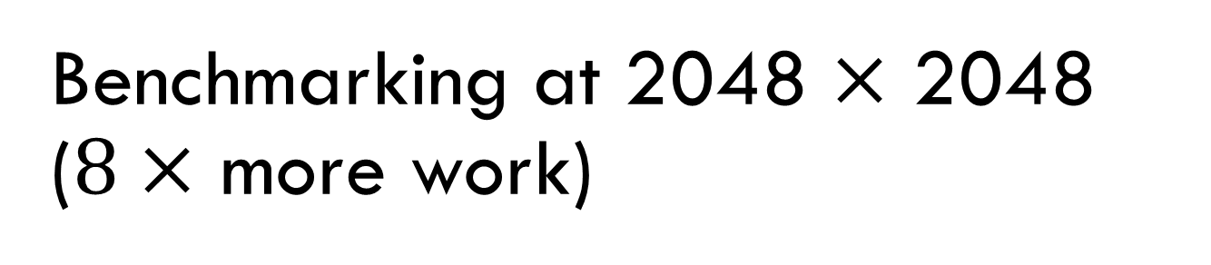
Benchmarking at 2048 $×$ 2048
($8×$ more work)
./matrix -n 1024 -N 1024 -m block
Simple C++: 16000 ms, 1.1 Gflops
Simple CUDA: 301 ms, 57.0 Gflops
Simple++ CUDA: 38.4 ms, 443 Gflops
Block C++: 4940 ms, 3.5 Gflops
Block CUDA: 303 ms, 56.7 Gflops
Block++ CUDA: 15.7ms, 1100 Gflops
Only significant change
(due to increased parallelism)
Notes:
At 4096 x 4096, “Block CUDA” goes up to 70 Gflops. This is still really bad vs. “Block++ CUDA” and even “Simple++ CUDA”.

Slide 47
Debugging tips and pitfalls
printf() is available, but will reorder or lose output
  So be cautious using printf() for debugging!
Check your error codes
#define CHK(ans) gpuAssert((ans), __FILE__, __LINE__);
void gpuAssert(CUDAError_t code, const char *file, int line){
if (code != CUDASuccess)
fprintf(stderr, "GPUassert: %s %s %s\n",
CUDAGetErrorString(code), file, line);
}
#define POSTKERNEL CHK(CUDAPeekAtLastError())

Slide 48
Debugging tips and pitfalls
Write reference version on host in C++
Watch out for out-of-bounds memory errors (all kinds of crazy stuff will happen)
Don’t assume stuff about N (e.g., that it’s a multiple of LBLK)
cuda-gdb lets you step through + inspect code

Slide 49
Debugging tips and pitfalls
What will happen here?
for (int k = 0; k < N; k+= LBLK) {
if (i >= N || j >= N) continue;
// Some computation
__syncthreads();
// Some more computation
__syncthreads();
}

Slide 50
Optimization advice
Get the high-level abstraction + implementation first
  Don’t start with low-level optimizations
Use nvprof to figure out where your bottleneck is
  Low utilization of compute + memory ➔ no parallelism
  Low utilization of compute ➔ memory bound
  Low utilization of memory ➔ compute bound
Memory is often key
  E.g., when to use local/shared/global memory

Slide 51
CUDA syntax
__shared__/__global__: Place variable in block-/device-shared memory
cudaMalloc/cudaMemcpy/cudaFree: Manage device memory (flag sets to/from device)
__syncthreads__(): Barrier within a thread block
kernel<<<blocks,threadsPerBlock>>>(): Invoke kernel on device
blockIdx/threadIdx: current block/thread idx
blockDim/gridDim: Num threads per block/blocks per grid

Slide 52
CUDA as a vector processor
NVIDIA has abused architecture terminology badly
CUDA/GPU Terminology | Classic vector terminology
Grid | Vectorizable loop
Thread | Loop iteration
Block | ??
Warp | Thread
GPU/Device | Vector multicore
SM (streaming multiprocessor) | Core
Core | Lane
Global memory | Memory
Shared memory | Local memory
Local memory | Registers

