Slide 1
Performance Monitoring Tools
Lecture 17:

Slide 2
Scenario
Student walks into office hours and says, “My code is slow / uses lots of memory / is SIGKILLED. I implemented X, Y, and Z. Are those good? What should I do next?”
It depends.

Slide 3
What is my program doing?
Measurements are more valuable than insights
  Insights are best formed from measurements!
We’re Computer Scientists
  We can write programs to analyze programs

Slide 4
Note about Examples
The example programs in today’s lecture are from Spring 2016 Assignment 3
  OpenMP-based graph processing workload (paraGraph)
  Millions to tens of millions of nodes
  Code written for the GHC machines and Xeon Phi

Slide 5
My program is slow today.
What else is running?
  Try “top”
top - 14:43:26 up 25 days, 3:46, 50 users, load average: 0.04, 0.05, 0.01
Tasks: 1326 total, 1 running, 1319 sleeping, 2 stopped, 4 zombie
Cpu(s): 0.0%us, 0.1%sy, 0.0%ni, 99.9%id, 0.0%wa, 0.0%hi, 0.0%si, 0.0%st
Mem: 16220076k total, 7646188k used, 8573888k free, 246280k buffers
Swap: 4194296k total, 3560k used, 4190736k free, 5219176k cached
PID USER PR NI VIRT RES SHR S %CPU %MEM TIME+ COMMAND
2801 nobody 20 0 481m 3860 1192 S 1.0 0.0 63:45.33 gmetad
3306 root 20 0 258m 11m 2128 S 0.7 0.1 161:54.86 lsi_mrdsnmpagen
4920 nobody 20 0 297m 18m 3380 S 0.7 0.1 181:11.80 gmond
49781 -------- 20 0 106m 2144 1456 S 0.3 0.0 0:00.10 bash
58119 bpr 20 0 15976 2220 936 R 0.3 0.0 0:00.30 top
106182 -------- 20 0 24584 2184 1136 S 0.3 0.0 2:27.99 tmux
134225 -------- 20 0 143m 1732 608 S 0.3 0.0 0:02.92 intelremotemond
...

Slide 6
What else can top tell us?
CPU / Memory usage of our program
  ./paraGraph kbfs com-orkut_117m.graph -t 8 -r
top - 15:54:27 up 3 days, 23:58, 6 users, load average: 3.43, 1.15, 0.43
Tasks: 286 total, 2 running, 284 sleeping, 0 stopped, 0 zombie
%Cpu(s): 99.8 us, 0.2 sy, 0.0 ni, 0.0 id, 0.0 wa, 0.0 hi, 0.0 si, 0.0 st
KiB Mem: 32844548 total, 31305468 used, 1539080 free, 435012 buffers
KiB Swap: 7999484 total, 13176 used, 7986308 free. 27364456 cached Mem
PID USER PR NI VIRT RES SHR S %CPU %MEM TIME+ COMMAND
23457 bpr 20 0 1559584 979704 3420 R 796.4 3.0 0:27.91 paraGraph
1071 root 20 0 75892 6560 5564 S 2.0 0.0 19:58.05 cups-brows+
21506 root 20 0 87680 17300 5460 S 0.7 0.1 1:08.43 cupsd
23408 bpr 20 0 24956 3196 2588 R 0.3 0.0 0:00.18 top
1 root 20 0 36100 4204 2632 S 0.0 0.0 0:01.02 init
Notes:
When is 100% not 100%?

Slide 7
Do I have to use top?
No. Time was part of the assignment 3 qsub jobs.
  $ tail -n 1 bpr_grade_performance.job
  time ./grade_performance.py ./$exe
time is often a shell command, there is also the time binary
/usr/bin/time ./paraGraph kbfs com-orkut_117m.graph -t 8 –r
...
33.16user 0.10system 0:05.54elapsed 600%CPU (0avgtext+0avgdata 979708maxresident)k 0inputs+0outputs (0major+5624minor)pagefaults 0swaps

Slide 8
But why is it slow?
Where is the time spent?
  Put timing statements around probable issues
  Print results
OR
  Use a tool to insert timing statements
Notes:
The first option can be valuable: for example, helping inform when to switch between top-down and bottom-up or sparse versus dense.

Slide 9
Program Instrumentation
When to inject the instrumentation?
  When the program is compiled.
  When the program is run.

Slide 10
Instrumentation Tool Families
Program Optimization
  Gprof
  Perf
  VTune
Program Debugging
  Valgrind
  Sanitizers
Advanced Analysis
  Pin
  Contech

Slide 11
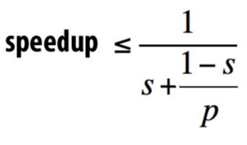
Amdahl’s Law Revisited
1- s – a component of the program
p – speedup of that component
The more time something takes
  The more speedup small improvements make
Concentrate program optimization on:
  Hot code
  Common cases

Slide 12
GProf
Enabled with “-pg” compiler flag
Places a call into every function
  Calls record the call graph
  Calls record time elapsed
Run the program.
Run gprof <prog name>

Slide 13
GProf cont
Output shows both the total time in each function
  And cumulative time in calling trees
Can be useful with large call graphs
$./paraGraph pagerank -t 8 -r soc-pokec_30m.graph
$gprof
% cumulative self self total
time seconds seconds calls ms/call ms/call name
69.35 0.43 0.43 1 430.00 430.00 build_incoming_edges(graph*)
30.65 0.62 0.19 18 10.56 10.56 pagerank(graph*, ...)
0.00 0.62 0.00 1632803 0.00 0.00 addVertex(VertexSet*, int)
0.00 0.62 0.00 7 0.00 0.00 newVertexSet(T, int, int)
0.00 0.62 0.00 7 0.00 0.00 freeVertexSet(VertexSet*)
Notes:
It is often “good enough” to just identify which function(s) are consuming the most cycles, particularly prior to algorithmic analysis.

Slide 14
Perf
Modern architectures expose performance counters
  Cache misses, branch mispredicts, IPC, etc
Perf tool provides easy access to these counters
  perf list – list counters available on the system
  perf stat – count the total events
  perf record – profile using one event
  perf report – Browse results of perf record
Perf is present on GHC machines tested

Slide 15
Perf stat
Can be run with specific events or a general suite
perf stat [-e …] app
  Many counters come in pairs, each needs a separate -e
    cycles, instructions
    branches, branch-misses
    cache-references, cache-misses
    stalled-cycles-frontend
    stalled-cycles-backend
  Processors can only enable ~4 counters, else it must multiplex

Slide 16
Perf stat (default) output
./paraGraph -t 8 -r pagerank /afs/cs/academic/class/15418-s16/public/asst3_graphs/soc-pokec_30m.graph':
2366.633970 task-clock (msec) # 1.758 CPUs utilized
109 context-switches # 0.046 K/sec
9 cpu-migrations # 0.004 K/sec
6,168 page-faults # 0.003 M/sec
7,513,900,068 cycles # 3.175 GHz (83.23%)
6,327,732,886 stalled-cycles-frontend # 84.21% frontend cycles idle (83.42%)
4,019,403,839 stalled-cycles-backend # 53.49% backend cycles idle (66.86%)
3,222,030,372 instructions # 0.43 insns per cycle
# 1.96 stalled cycles per insn (83.43%)
457,170,532 branches # 193.173 M/sec (83.30%)
12,354,902 branch-misses # 2.70% of all branches (83.24%)
So what is the bottleneck?

Slide 17
More perf stat
Maybe memory is a bottleneck.
201,493,787 cache-references
49,347,882 cache-misses # 24.491 % of all cache refs
24% misses, that’s not good.
But what should we do?

Slide 18
Perf record
Pick an event (or use the default cycles)
When the event’s counter overflows
  The processor sends an interrupt
  The kernel records where (PC value) of the program
NOTE: counters update in funny, microarchitectural ways so intuition may be required
“Because of latency in the microarchitecture between the generation of events and the generation of interrupts on overflow, it is sometimes difficult to generate an interrupt close to an event that caused it.”

Slide 19
Perf cache misses
Are cache misses the problem?
  Sort of.
Samples: 11K of event 'cache-misses', Event count (approx.): 181771931
Overhead Command Shared Object Symbol
47.18% paraGraph paraGraph [.] edgeMapS<State<float> >
46.84% paraGraph paraGraph [.] build_incoming_edges
2.70% paraGraph [unknown] [k] 0xffffffff813b2537
1.37% paraGraph [unknown] [k] 0xffffffff813b2915
Notes:
Still on pagerank

Slide 20
Perf report cycles
perf report shows analysis from record
  Commandline interactive interface
Samples: 13K of event 'cycles', Event count (approx.): 11108635969
Overhead Command Shared Object Symbol
65.93% paraGraph paraGraph [.] edgeMapS<State<float> >
27.66% paraGraph paraGraph [.] build_incoming_edges
1.85% paraGraph paraGraph [.] vertexMap<Local<float> >
1.02% paraGraph [kernel.kallsyms] [k] clear_page_c
0.88% paraGraph paraGraph [.] addVertex
0.60% paraGraph [kernel.kallsyms] [k] copy_user_generic_string
Over 25% of program time is in creating the graph
  This also skews the perf stats

Slide 21
Deep dive
Selecting a function will display its assembly with function-local %
| bool update(Vertex s, Vertex d)
| {
| float add = pcurr[s] / outgoing_size(graph, s);
2.97 | divss %xmm1,%xmm0
5.22 | jmp 162
| nop
|160: mov %eax,%edx
| #pragma omp atomic
| pnext[d] += add;
0.16 |162: mov %edx,0x18(%rsp)
1.28 | mov %edx,%eax
0.01 | movss 0x18(%rsp),%xmm2
2.71 | addss %xmm0,%xmm2
4.63 | movss %xmm2,0x18(%rsp)
1.16 | mov 0x18(%rsp),%r15d
3.99 | lock cmpxchg %r15d,(%rcx)
25.22 | cmp %eax,%edx
| jne 160
OMP atomic -> lock cmpxchg
This instruction is 25%*65% of
execution time

Slide 22
Deep dive 2
kBFS is really, really slow. Why?
Samples: 48K of event 'cycles', Event count (approx.): 39218498652
Overhead Command Shared Object Symbol
63.78% paraGraph paraGraph [.] edgeMapS<RadiiUpdate>
19.33% paraGraph paraGraph [.] edgeMap<RadiiUpdate>
8.21% paraGraph paraGraph [.] build_incoming_edges
3.88% paraGraph paraGraph [.] vertexMap<VisitedCopy>
That’s almost all my code. :(

Slide 23
Disassemble it!
What is taking all of kbfs’s time?
bool update(Vertex src, Vertex dst) {
| bool changed = false;
| for (int j = 0; j < NUMWORDS; j++) {
| if (visited[dst][j] != visited[src][j]) {
0.11 | mov 0x0(%r13),%rax
0.21 | mov (%rax,%rdi,1),%rbp
0.20 | mov (%rax,%rcx,8),%rax
14.88 | mov 0x0(%rbp),%ebp
1.15 | mov (%rax),%eax
68.27 | cmp %eax,%ebp
0.02 | je 108
| // word-wide or
| __sync_fetch_and_or(&(nextVisited[dst][j]), visited[dst]
1.54 | mov 0x8(%r13),%rcx
0.34 | or %eax,%ebp
0.02 | mov (%rcx,%rdi,1),%rcx
0.31 | lock or %ebp,(%rcx)
| int oldRadius = radii[dst];
| if (radii[dst] != iter) {
6.45 | mov 0x18(%r13),%ebp

Slide 24
VTune
Part of Intel’s Parallel Studio XE
  Requires (free student) license from Intel
Similar to perf
  Also includes analysis across related counters

Slide 25
VTune Memory Bound
That Spring, I asked many students in office hours:
  “Do you think the graph code is memory bound?”
Let’s find out!
  Create a project (select program + arguments to analyze)
  Create an analysis
    Microarchitecture -> Memory Access Analysis
  Start!

Slide 26
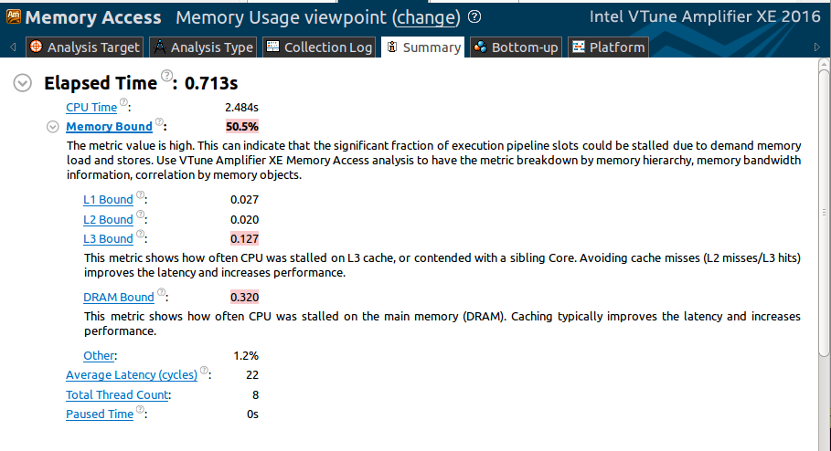
Memory Access Analysis Results
Notes:
kBFS – with flat WORDS design soc-pokec
Each bound comes from mem stalls -> L1 miss stalls -> L2 miss stalls -> L3 miss stalls (i.e., DRAM stalls)

Slide 27

Further Analysis
Input: soc-pokec…
Execution Time (ms)
DRAM Bandwidth (GB/sec)
Graph Initialization
kBFS Iterations

Slide 28

Further Analysis
Input: com-orkut
Execution Time (s)
DRAM Bandwidth (GB/sec)
Graph Initialization
kBFS Iterations

Slide 29
Instrumentation Tool Families
Program Optimization
  Gprof
  Perf
  VTune
Program Debugging
  Valgrind
  Sanitizers
Advanced Analysis
  Pin
  Contech

Slide 30
Valgrind
Heavy-weight binary instrumentation
  Designed to shadow all program values: registers and memory
  Shadowing requires serializing threads
  4x overhead minimum
Comes with several useful tools
  Usually used for memcheck

Slide 31
Valgrind memcheck
Validates memory operations in a program
  Each allocation is freed only once
  Each access is to a currently allocated space
  All reads are to locations already written
  10 – 20x overhead
valgrind --tool=memcheck <prog …>
...
==29991== HEAP SUMMARY:
==29991== in use at exit: 2,694,466,576 bytes in 2,596 blocks
==29991== total heap usage: 16,106 allocs, 13,510 frees, 3,001,172,305 bytes allocated
==29991==
==29991== LEAK SUMMARY:
==29991== definitely lost: 112 bytes in 1 blocks
==29991== indirectly lost: 0 bytes in 0 blocks
==29991== possibly lost: 7,340,200 bytes in 7 blocks
==29991== still reachable: 2,687,126,264 bytes in 2,588 blocks
==29991== suppressed: 0 bytes in 0 blocks

Slide 32
Address Sanitizer
Compilation-based approach to detect memory issues
  GCC and LLVM support
  ~2x overhead
Add “-fsanitize=address”, make clean …
==1902== ERROR: AddressSanitizer: heap-buffer-overflow on address 0x7f683e4c008c at pc 0x41cb77 bp 0x7f683bc14a20 sp 0x7f683bc14a18
READ of size 4 at 0x7f683e4c008c thread T6
#0 0x41cb76 (paraGraph+0x41cb76)
#1 0x7f6852efdf62 (/usr0/local/lib/libiomp5.so+0x89f62)
#2 0x7f6852ea7ae3 (/usr0/local/lib/libiomp5.so+0x33ae3)
#3 0x7f6852ea620a (/usr0/local/lib/libiomp5.so+0x3220a)
#4 0x7f6852ecab80 (/usr0/local/lib/libiomp5.so+0x56b80)
#5 0x7f684fdb7b97 (/usr/lib/x86_64-linux-gnu/libasan.so.0.0.0+0x18b97)
#6 0x7f684efa4181 (/lib/x86_64-linux-gnu/libpthread-2.19.so+0x8181)
#7 0x7f684f2b447c (/lib/x86_64-linux-gnu/libc-2.19.so+0xfa47c)
...
Notes:
Basic performance measurement saw ~10% for paraGraph

Slide 33
Instrumentation Tool Families
Program Optimization
  Gprof
  Perf
  VTune
Program Debugging
  Valgrind
  Sanitizers
Advanced Analysis
  Pin
  Contech

Slide 34
Pin
CompArch research project, now Intel tool
Binary instrumentation tool framework
  “Low” overhead
  Provides many sample tools
Given its architecture roots, it is best suited to specific architectural questions about a program
  What is the instruction mix?
  What memory addresses does it access?

Slide 35
Pin cont.
Pin acts as a virtual machine
  It reassembles the instructions with appropriate instrumentation
Each “pintool” requests specific instrumentation
  On basic block entry, record the static instruction count
  On every memory operation, record the address
  …

Slide 36
(Pin) Instrumentation Granularity
Instruction
Basic Block
  A sequence of instructions
  Single entry, single exit
  Terminated with one control flow instruction
Trace
  A sequence of executed basic blocks
  May span multiple functions

Slide 37
Pintool Example Instruction Count
For every basic block in an identified trace
  Insert somewhere in the block an instrumentation call to my routine
  Pass my routine two arguments: number of instructions, thread ID
// Pin calls this function every time a new basic block is encountered.
// It inserts a call to docount.
VOID Trace(TRACE trace, VOID *v)
{
// Visit every basic block in the trace
for (BBL bbl = TRACE_BblHead(trace); BBL_Valid(bbl); bbl = BBL_Next(bbl))
{
// Insert a call to docount for every bbl, passing the number of instructions.
BBL_InsertCall(bbl, IPOINT_ANYWHERE, (AFUNPTR)docount, IARG_FAST_ANALYSIS_CALL, IARG_UINT32, BBL_NumIns(bbl), IARG_THREAD_ID, IARG_END);
}
}

Slide 38
Pintool Instruction Count Output
$ pin -t pin/source/tools/ManualExamples/obj-intel64/inscount_tls.so -- ./paraGraph bfs -t 8 -r soc-pokec_30m.graph
$ cat inscount_tls.out
Total number of threads = 9
Count[0]= 561617530
Count[1]= 16153
Count[2]= 44659367
Count[3]= 44863462
Count[4]= 44436576
Count[5]= 44458686
Count[6]= 43808683
Count[7]= 44055917
Count[8]= 43408645
Notes:
NOTE: Just running inscount increased runtime by 10x

Slide 39
Pin Cache Example
… -t source/tools/Memory/obj-intel64/dcache.so …
cat dcache.out
PIN:MEMLATENCIES 1.0. 0x0
#
# DCACHE stats
#
# L1 Data Cache:
# Load-Hits: 131764147 59.69%
# Load-Misses: 88995193 40.31%
# Load-Accesses: 220759340 100.00%
#
# Store-Hits: 71830273 71.07%
# Store-Misses: 29242668 28.93%
# Store-Accesses: 101072941 100.00%
#
# Total-Hits: 203594420 63.26%
# Total-Misses: 118237861 36.74%
# Total-Accesses: 321832281 100.00%
Notes:
Time was 1.4s versus 0.025 without pin

Slide 40
Pin Trace Example
From a prior project
  Records the instruction count
  Records read/write and the address
The trace was then used by a simulator
// Print a memory write record and the number of instructions between
// previous memory access and this access
VOID RecordMemWrite(UINT32 thread_id, VOID * addr)
{
// format: W - [total num ins so far] - [num ins between prev mem access and this access] - [address accessed]
total_counts[thread_id]++;
files[thread_id] << "W " << total_counts[thread_id] << " " << icounts[thread_id] << " " << addr << std::endl;
reset_count(thread_id);
}
Notes:
https://github.com/KarimaMa/coherence_cop

Slide 41
Contech
Compiler-based instrumentation
  Uses Clang and LLVM
  Record control flow, memory accesses, concurrency
Multi-language: C, C++, Fortran
Multi-runtime: pthreads, OpenMP, Cilk, MPI
Multi-architecture: x86, ARM

Slide 42
Contech continued
Designed around writing analysis not instrumentation
  All instrumentation is always used
  Assumes the program is correct
  Traces are analyzed after collection, not during
Sample backends (i.e., analysis tools) are available
  Cache Model
  Data race detection
  Memory usage

Slide 43
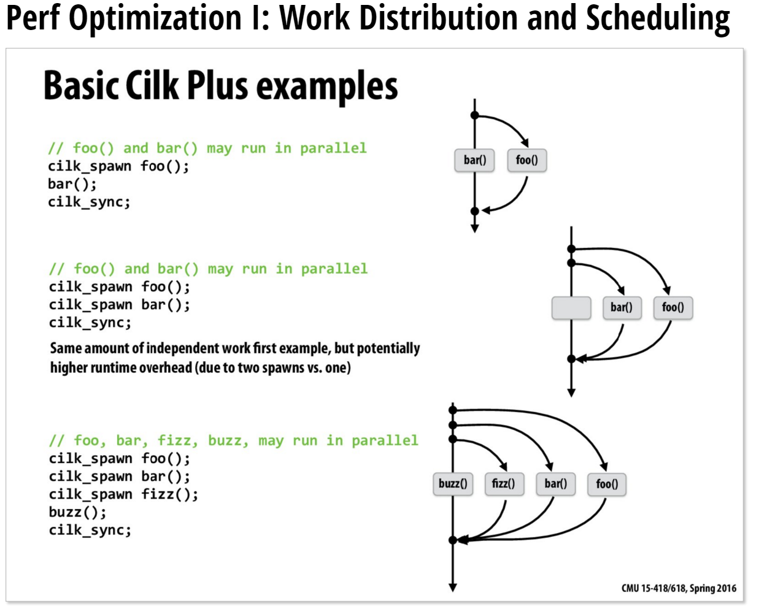
Contech Trace Collection
Running the instrumented program generates a trace
  Traces are processed into taskgraphs
  Taskgraphs store the ordering of concurrent work
Taskgraphs

Slide 44
Contech Trace Collection Example
./paraGraph bfs -t 8 -r soc-pokec_30m.graph
  BFS Time: 0.0215s -> 0.2108s (9.8x slowdown)
  1855MB trace -> 1388MB taskgraph
    91 million basic blocks
    321 million memory accesses
    3 million synchronization operations

Slide 45
Summary Questions
If you may have a performance issue:
  Is the issue reproducible?
    Do you have a workload?
    Is the system stable?
  Is the workload at full CPU?
    If not, are there other users / processes running?
    Or does the workload rely heavily on IO?
  Is the CPU time confined to a small number of functions?
    What is the most time consuming function(s)?
    What is their algorithmic cost and complexity?
time / top
gprof / perf

Slide 46
Summary Continued
You have a reproducible, stable workload
  The machine is otherwise idle
  The workload is fully using its CPUs
  The algorithms are appropriate
Is there a small quantity of hot functions?
  Are their cycles confined to specific functions?
  Are the costs of the instructions understood?
perf / VTune

Slide 47
Instrumentation Tool Links
Gprof - https://sourceware.org/binutils/docs/gprof/
Perf - https://perf.wiki.kernel.org/index.php/Main_Page
VTune - https://software.intel.com/en-us/qualify-for-free-software/student
Valgrind - http://valgrind.org/
Sanitizers - https://github.com/google/sanitizers
Pin - https://software.intel.com/en-us/articles/pin-a-dynamic-binary-instrumentation-tool
Contech - http://bprail.github.io/contech/

Slide 48
Other links
Performance Anti-patterns: http://queue.acm.org/detail.cfm?id=1117403

