Slide 1
Implementing
Synchronization
Lecture 16:

Slide 2
Review: how threads map to cores… again!
Let’s say I have a processor with 4 cores, with support for 2 execution contexts per core.
In each clock, each core executes one instruction (from one execution context)
Fetch/
Decode
Fetch/
Decode
Fetch/
Decode
Fetch/
Decode
Exec 1
Exec 1
Exec 1
Exec 1
Execution
Context
Execution
Context
Execution
Context
Execution
Context
Execution
Context
Execution
Context
Execution
Context
Execution
Context
L1 Cache
L1 Cache
L1 Cache
L1 Cache
L2 Cache
L2 Cache
L2 Cache
L2 Cache
On-chip interconnect
L3 Cache
Memory Controller
Memory Bus (to DRAM)

Slide 3
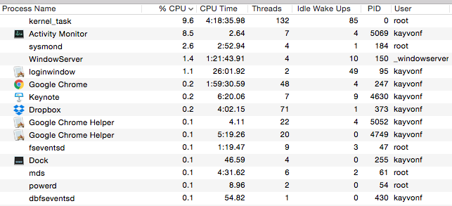
I can run many programs on this computer concurrently
For example, let’s take a look at what’s running on a typical Mac.
Many processes, many of which has spawned many logical threads.
Many more logical threads than cores (and more threads than HW execution contexts)
Who is responsible for choosing what threads execute on the processor?

Slide 4
What does running one thread entail?
A processor runs a logical thread by executing its instructions within a hardware execution context.
If the operating system wants thread T of process P to run, it:
  Chooses a CPU execution context
  It sets the register values in that context to the last state of the thread (e.g., sets PC to point to next instruction the thread must run, sets stack pointer, VM mappings, etc.)
  Then the processor starts running… It grabs the next instruction according to the PC, and executes it:
    If the instruction is: add r0, r1, r2; then the processor adds the contexts of r1 and r2 and stores the result in r0
    If the instruction is: ld r0 mem[r1]; then the processor takes contents of r1, translates it to a physical address according to the page tables referenced by the execution context, and loads the value at that address into r0
    Etc…

Slide 5
The operating system maps logical threads to execution contexts
Since there are more threads than execution contexts, the operating system must interleave execution of threads on the processor
Periodically… the OS:
Interrupts the processor
Copies the register state of threads currently mapped to execution contexts to OS data structures in memory
Copies the register state of other threads it now wants to run onto the processors execution context registers
Tell the processor to continue
  Now these logical threads are running on the processor

Slide 6
But how do 2 execution contexts run on a core that can only run one instruction per clock?
It is the responsibility of the processor (without OS intervention) to choose how to interleave execution of instructions from multiple execution contexts on the resources of a single core.
This is the idea of hardware multi-threading from Lecture 2.
Fetch/
Decode
Fetch/
Decode
Fetch/
Decode
Fetch/
Decode
Exec 1
Exec 1
Exec 1
Exec 1
Execution
Context
Execution
Context
Execution
Context
Execution
Context
Execution
Context
Execution
Context
Execution
Context
Execution
Context
L1 Cache
L1 Cache
L1 Cache
L1 Cache
L2 Cache
L2 Cache
L2 Cache
L2 Cache
On-chip interconnect
L3 Cache
Memory Controller
Memory Bus (to DRAM)

Slide 7
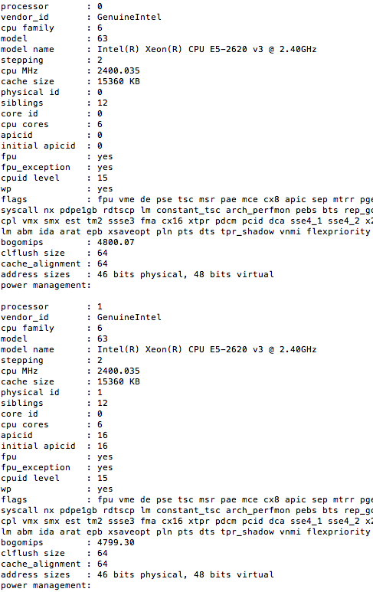
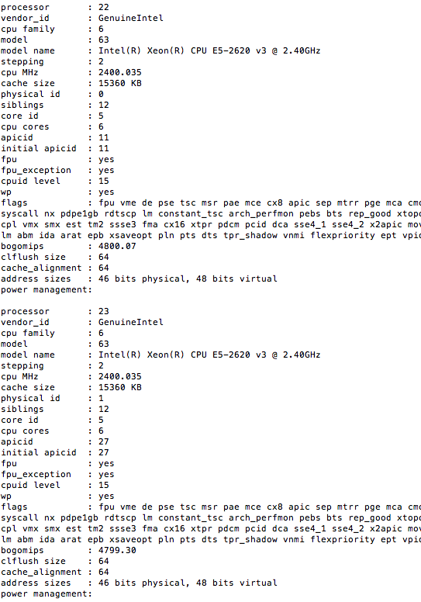
Output of ‘less /proc/cpuinfo’ on latedays
Dual CPU (two socket)
Six-cores per CPU, two threads per core
Linux has 24 execution contexts to fill
Linux reports it is running on a machine with 24 “logical processors” (corresponding to the 24 execution contexts available on the machine)
…

Slide 8
Today’s topic: efficiently implementing synchronization primitives
Primitives for ensuring mutual exclusion
  Locks
  Atomic primitives (e.g., atomic_add)
  Transactions (later in the course)
Primitives for event signaling
  Barriers
  Flags

Slide 9
Three phases of a synchronization event
Acquire method
  How a thread attempts to gain access to protected resource
Waiting algorithm
  How a thread waits for access to be granted to shared resource
Release method
  How thread enables other threads to gain resource when its work in the synchronized region is complete

Slide 10
Busy waiting
Busy waiting (a.k.a. “spinning”)
  while (condition X not true) {}
  logic that assumes X is true
In classes like 15-213 or in operating systems, you have certainly also talked about synchronization
  You might have been taught busy-waiting is bad: why?

Slide 11
“Blocking” synchronization
Idea: if progress cannot be made because a resource cannot be acquired, it is desirable to free up execution resources for another thread (preempt the running thread)
  if (condition X not true)
  block until true; // OS scheduler de-schedules thread
  // (lets another thread use the processor)
pthreads mutex example
  pthread_mutex_t mutex;
  pthread_mutex_lock(&mutex);
Notes:
https://android.googlesource.com/platform/external/pthreads/+/master/pthread_mutex_lock.c

Slide 12
Busy waiting vs. blocking
Busy-waiting can be preferable to blocking if:
  Scheduling overhead is larger than expected wait time
  Processor’s resources not needed for other tasks
    This is often the case in a parallel program since we usually don’t oversubscribe a system when running a performance-critical parallel app (e.g., there aren’t multiple CPU-intensive programs running at the same time)
    Clarification: be careful to not confuse the above statement with the value of multi-threading (interleaving execution of multiple threads/tasks to hide long latency of memory operations) with other work within the same app.
Example:
pthread_spinlock_t spin;
pthread_spin_lock(&spin);
Notes:
https://android.googlesource.com/platform/external/pthreads/+/master/pthread_spin_lock.c

Slide 13
Implementing Locks

Slide 14
Warm up: a simple, but incorrect, spin lock
lock:
ld R0, mem[addr] // load word into R0
cmp R0, #0 // compare R0 to 0
bnz lock // if nonzero jump to top
st mem[addr], #1 // Set lock to 1
unlock:
st mem[addr], #0 // store 0 to address
Problem: data race because LOAD-TEST-STORE is not atomic!
Processor 0 loads address X, observes 0
Processor 1 loads address X, observes 0
Processor 0 writes 1 to address X
Processor 1 writes 1 to address X
Notes:
lock impl: see if the value is 0, if not, try again (go back to the top)
TODO: tell your partner why this doesn’t work as a lock
think about the cache coherence protocol
between the load and the store(1), someone else can get in there
BOTH LOAD 0. ONE WRITES, THEN THE OTHER

Slide 15
Test-and-set based lock
Atomic test-and-set instruction:
ts R0, mem[addr] // load mem[addr] into R0
// if mem[addr] is 0, set mem[addr] to 1
lock:
ts R0, mem[addr] // load word into R0
bnz R0, lock // if 0, lock obtained
unlock:
st mem[addr], #0 // store 0 to address
Notes:
load value from address AND ALSO set value in memory to 1
TODO: talk with partner about how to implement a lock given test and set
http://heather.cs.ucdavis.edu/~matloff/50/PLN/lock.pdf
http://stackoverflow.com/questions/25476662/when-can-the-cpu-ignore-the-lock-prefix-and-use-cache-coherency
http://www.intel.com/Assets/en_US/PDF/manual/253668.pdf

Slide 16
Test & Set in x86
btsq $0 (%rax)
Set CF to bit 0 of addressed data
Set bit 0 of addressed data to 1

Slide 17
Test-and-set lock: consider coherence traffic
Processor 1
Processor 2
Processor 3
T&S
BusRdX
Update line in cache (set to 1)
Invalidate line
Invalidate line
Invalidate line
BusRdX
Attempt to update (t&s fails)
T&S
Invalidate line
BusRdX
Attempt to update (t&s fails)
T&S
[P1 is holding lock...]
BusRdX
Attempt to update (t&s fails)
T&S
Invalidate line
Invalidate line
BusRdX
Attempt to update (t&s fails)
T&S
BusRdX
Update line in cache (set to 0)
Invalidate line
Invalidate line
BusRdX
Update line in cache (set to 1)
T&S
= thread has lock
Notes:
even though the line isn’t in P1’s cache, it is still holding lock
processors 2 and 3 spin, but it’s a writing spin, so the line ping-pongs as the processors keep trying to acquire the lock
Many invalidations
Q. how does P1 release the lock (HOLDING THE LOCK VS HOLDING THE CACHE LINE)

Slide 18
Check your understanding
On the previous slide, what is the duration of time the thread running on P1 holds the lock?
At what points in time does P1’s cache contain a valid copy of the cache line containing the lock variable?

Slide 19
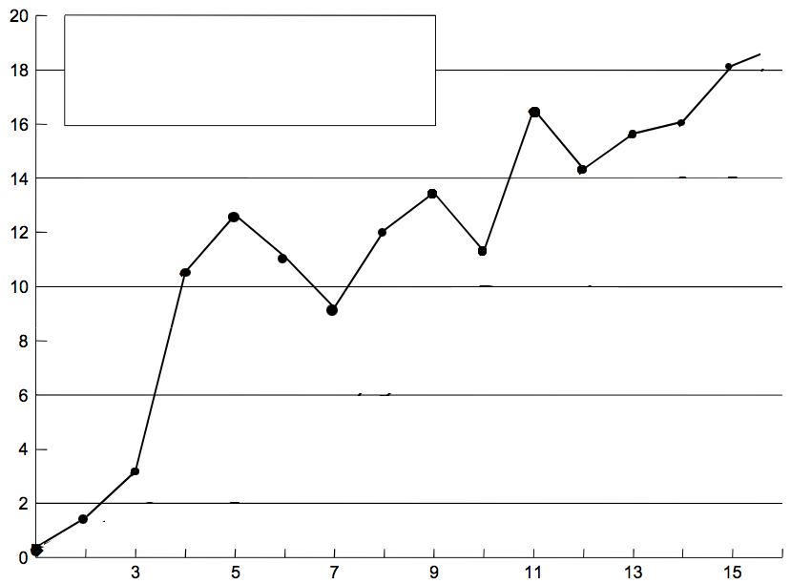
Test-and-set lock performance
Benchmark: execute a total of N lock/unlock sequences (in aggregate) by P processors
Critical section time removed so graph plots only time acquiring/releasing the lock
Benchmark executes:
lock(L);
critical-section(c)
unlock(L);
Time (us)
Bus contention increases amount of time to transfer lock (lock holder must wait to acquire bus to release)
Not shown: bus contention also slows down execution of critical section
Number of processors
Figure credit: Culler, Singh, and Gupta
Notes:
same total number of lock calls executed
critical section time removed, so just lock/unlock delay

Slide 20
Desirable lock performance characteristics
Low latency
  If lock is free and no other processors are trying to acquire it, a processor should be able to acquire the lock quickly
Low interconnect traffic
  If all processors are trying to acquire lock at once, they should acquire the lock in succession with as little traffic as possible
Scalability
  Latency / traffic should scale reasonably with number of processors
Low storage cost
Fairness
  Avoid starvation or substantial unfairness
  One ideal: processors should acquire lock in the order they request access to it
Simple test-and-set lock: low latency (under low contention), high traffic, poor scaling, low storage cost (one int), no provisions for fairness

Slide 21
Test-and-test-and-set lock
void Lock(volatile int* lock) {
while (1) {
while (*lock != 0);
if (test_and_set(lock) == 0)
return;
}
}
void Unlock(volatile int* lock) {
*lock = 0;
}
// while another processor has the lock...
// when lock is released, try to acquire it
Notes:
TODO: talk with partner about why this is different from original t&s lock
How does it behave differently
What is the impact
Q. why volatile?

Slide 22
Test-and-test-and-set lock: coherence traffic
Processor 1
Processor 2
Processor 3
T&S
BusRdX
Update line in cache (set to 1)
[P1 is holding lock...]
BusRdX
Update line in cache (set to 0)
Invalidate line
Invalidate line
BusRd
[Many reads from local cache]
Invalidate line
BusRd
BusRdX
Update line in cache (set to 1)
Invalidate line
Invalidate line
BusRd
[Many reads from local cache]
Invalidate line
BusRd
BusRdX
Attempt to update (t&s fails)
T&S
T&S
= thread has lock
Notes:
up to P invalidations (BusRdX attempts) per lock release
(still a flurry of traffic (N invalidation)) but just once per release, not once per test)
Remember ideal is 1

Slide 23
Test-and-test-and-set characteristics
Slightly higher latency than test-and-set in uncontended case
  Must test... then test-and-set
Generates much less interconnect traffic
  Suppose total of P threads want access to their critical sections
  One invalidation, per waiting processor, per lock release (O(P) invalidations)
  Total of O(P²) bus traffic to handle all P threads.
  Recall: test-and-set lock generated one invalidation per waiting processor per test
More scalable (due to less traffic)
Storage cost unchanged (one int)
Still no provisions for fairness
Notes:
P is the number of waiting processors

Slide 24
Test-and-set lock with back off
Upon failure to acquire lock, delay for awhile before retrying
void Lock(volatile int* lock) {
int amount = 1;
while (1) {
if (test_and_set(lock) == 0)
return;
delay(amount);
amount *= 2;
}
}
Same uncontended latency as test-and-set, but potentially higher latency under contention. Why?
Generates less traffic than test-and-set (not continually attempting to acquire lock)
Improves scalability (due to less traffic)
Storage cost unchanged (still one int for lock)
Exponential back-off can cause severe unfairness
  Newer requesters back off for shorter intervals

Slide 25
Atomic increment vs Lock
volatile int sum;
int A[n];
lock mutex;
Task: Sum elements of array A
Using mutex:
Atomic increment
  Direct hardware support
  Single bus transaction (RdX)
for (int i = 0; i < n/nthread; i++) {
lock(&mutex);
sum += A[i + myid*n/nthread];
unlock(&mutex);
}
for (int i = 0; i < n/nthread; i++)
atomic_increment(&sum, A[i + myid*nthread]);

Slide 26
Atomic Increment in GCC / x86
type __sync_fetch_and_add (type *ptr, type value)
type __sync_add_and_fetch (type *ptr, type value)
From: https://gcc.gnu.org/onlinedocs/gcc-4.1.2/gcc/Atomic-Builtins.html
type is an integral type
Returns pre- or post-incremented value
Variants:
  Add, Subtract, Bitwise-OR, Bitwise-AND, Bitwise-XOR
int fadd(int *loc, int val) {
return __sync_fetch_and_add(loc, val);
}
0000000000000000 <fadd>:
0: 89 f0 mov %esi,%eax
2: f0 0f c1 07 lock xadd %eax,(%rdi)
6: c3 retq

Slide 27
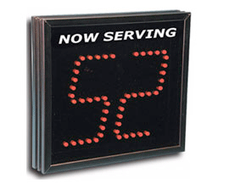
Ticket lock
Main problem with test-and-set style locks: upon release, all waiting processors attempt to acquire lock using test-and-set
struct lock {
volatile int next_ticket;
volatile int now_serving;
};
void Lock(lock* lock) {
int my_ticket = atomic_increment(&lock->next_ticket); // take a “ticket”
while (my_ticket != lock->now_serving); // wait for number
} // to be called
void unlock(lock* lock) {
lock->now_serving++;
}
Single atomic operation needed to acquire the lock
Single write to release lock
O(P) total interconnect traffic for all P threads
Fairness guaranteed, too!
Notes:
Q. Mental model of atomic operation? Do you think about it like a lock?
Q. How is this better? (waiters take the invalidate, and then do a busRead, not busReadX)
A. No atomic operation needed to acquire the lock (just a read... so all the processors waiting take exactly one miss whenever there’s a release, but that’s it. Not a RdX miss)
Implements fairness

Slide 28
Array-based lock
Each processor spins on a different memory address
Utilizes atomic operation to assign address on attempt to acquire
struct lock {
volatile int status[PMAX][W]; // padded to keep off same cache line
volatile int head;
};
int my_element;
void Lock(lock* lock) {
my_element = atomic_increment(&lock->head);
while (lock->status[my_element % PMAX][0] == 1);
}
void unlock(lock* lock) {
lock->status[my_element % PMAX][0] = 1;
lock->status[(my_element+1) % PMAX][0] = 0;
}
O(1) interconnect traffic per release, but lock requires space linear in P
Also, must know upper limit on number of threads PMAX
Notes:
avoids the read-traffic problem
fair: since it grants access in FIFO order
NOTE: standard space + dependencies trade-off

Slide 29
Implementing Barriers

Slide 30
Barrier Attempt #1
(Based on shared counter)
struct Barrier_t {
LOCK lock;
int counter; // initialize to 0
int flag; // the flag field should probably be padded to
// sit on its own cache line. Why?
};
// barrier for P threads
void Barrier(Barrier_t* b, int P) {
lock(b->lock);
if (b->counter == 0) {
b->flag = 0; // first thread arriving at barrier clears flag
}
int num_arrived = ++(b->counter);
unlock(b->lock);
if (num_arrived == P) { // last arriver sets flag
b->counter = 0;
b->flag = 1;
}
else {
while (b->flag == 0); // wait for flag
}
}
Does it work? Consider:
do stuff ...
Barrier(b, P);
do more stuff ...
Barrier(b, P);
Notes:
There’s a bug!!!!
PROBLEM: thread might clear the flag for NEXT BARRIER, before all threads check it and proceed from CURRENT BARRIER
Q. why have the flag at all? Slightly nicer to spin on the FLAG than on the counter.

Slide 31
Barrier #2: Correct
struct Barrier_t {
LOCK lock;
int arrive_counter; // initialize to 0 (number of threads that have arrived)
int leave_counter; // initialize to P (number of threads that have left barrier)
int flag;
};
// barrier for P threads
void Barrier(Barrier_t* b, int P) {
lock(b->lock);
if (b->arrive_counter == 0) { // if first to arrive...
if (b->leave_counter == P) { // check to make sure no other threads “still in barrier”
b->flag = 0; // first arriving thread clears flag
} else {
unlock(lock);
while (b->leave_counter != P); // wait for all threads to leave before clearing
lock(lock);
b->flag = 0; // first arriving thread clears flag (How many can do this?)
}
}
int num_arrived = ++(b->arrive_counter);
unlock(b->lock);
if (num_arrived == P) { // last arriver sets flag
b->arrive_counter = 0;
b->leave_counter = 1;
b->flag = 1;
}
else {
while (b->flag == 0); // wait for flag
lock(b->lock);
b->leave_counter++;
unlock(b->lock);
}
}
Main idea: wait for all processes to leave first barrier, before clearing flag for entry into the second
Notes:
Main point: two spins (waiting for all threads to leave AND waiting for all threads to arrive)
but we know the delay is due to the dependency on flag.
Replication should help us

Slide 32
#3: Centralized barrier with sense reversal
struct Barrier_t {
LOCK lock;
int counter; // initialize to 0
int flag; // initialize to 0
};
int local_sense = 0; // private per processor. Main idea: processors wait for flag
// to be equal to local sense
// barrier for P threads
void Barrier(Barrier_t* b, int P) {
local_sense = (local_sense == 0) ? 1 : 0;
lock(b->lock);
int num_arrived = ++(b->counter);
if (b->counter == P) { // last arriver sets flag
unlock(b->lock);
b->counter = 0;
b->flag = local_sense;
}
else {
unlock(b->lock);
while (b->flag != local_sense); // wait for flag
}
Sense reversal optimization results in one spin instead of two
Notes:
TODO: explain to your partner why this works
first time: set local sense to 1, wait for flag to be 1
next time set local sense to be 0, wait for flag to be 0
flag never gets flipped until count equal p again

Slide 33
Centralized barrier: traffic
O(P) traffic on interconnect per barrier:
  All threads: 2P write transactions to obtain barrier lock and update counter
  (O(P) traffic assuming lock acquisition is implemented in O(1) manner)
  Last thread: 2 write transactions to write to the flag and reset the counter
  (O(P) traffic since there are many sharers of the flag)
  P-1 transactions to read updated flag
But there is still serialization on a single shared lock
  So span (latency) of entire operation is O(P)
  Can we do better?
Notes:
Q. is it cheaper to implement a barrier or P acquisitions of test-test-set lock?
A. barrier is cheaper: O(P), where TTSet x P is O(P^2)

Slide 34
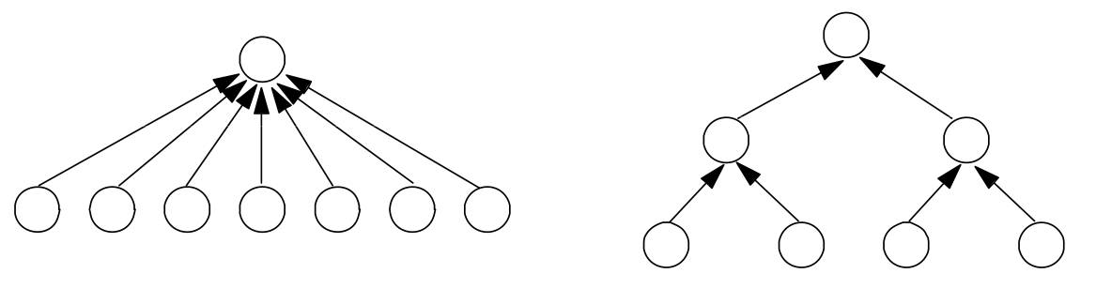
Combining tree implementation of barrier
High contention!
(e.g., single barrier lock and counter)
Centralized Barrier
Combining Tree Barrier
Combining trees make better use of parallelism in interconnect topologies
  lg(P) span (latency)
  Strategy makes less sense on a bus (all traffic still serialized on single shared bus)
Barrier acquire: when processor arrives at barrier, performs increment of parent counter
  Process recurses to root
Barrier release: beginning from root, notify children of release

Slide 35
Coming up…
Imagine you have a shared variable for which contention is low. So it is unlikely that two processors will enter the critical section at the same time?
You could hope for the best, and avoid the overhead of taking the lock since it is likely that mechanisms for ensuring mutual exclusion are not needed for correctness
  Take a “optimize-for-the-common-case” attitude
What happens if you take this approach and you’re wrong: in the middle of the critical region, another process enters the same region?

Slide 36
Preview: transactional memory
atomic
{ // begin transaction
perform atomic computation here ...
} // end transaction
Instead of ensuring mutual exclusion via locks, system will proceed as if no synchronization was necessary. (it speculates!)
System provides hardware/software support for “rolling back” all loads and stores in the critical region if it detects (at run-time) that another thread has entered same region at the same time.

