Slide 1
Directory-Based
Cache Coherence
Lecture 13:

Slide 2
Today you will learn…
What limits the scalability of snooping-based approaches to cache coherence
How a directory-based scheme avoids these problems
How the storage overhead of the directory structure be reduced (and at what cost)
How the interconnection network (bus, point-to-point, ring) affect scalability and design choices

Slide 3
Implementing cache coherence
The snooping cache coherence protocols from the last lecture relied on broadcasting coherence information to all processors over the chip interconnect.
Every time a cache miss occurred, the triggering cache communicated with all other caches!
Processor
Processor
Processor
Processor
Local Cache
Local Cache
Local Cache
Local Cache
Interconnect
Memory
I/O
Notes:
I actually didn’t tell you how to implement the broadcast, but I will in a later lecture
We really only talked about what information needs to be communicated

Slide 4
Scaling problems with snoopy coherence
How does performance scale with number of processors?
Communication limited to one message at a time
Even a scalable point-to-point interconnect requires P messages per memory request (occupying each cache)
Fundamentally, all-to-all broadcast will not scale.
Processor
Processor
Processor
Processor
Processor
Processor
Processor
Processor
Local Cache
Local Cache
Local Cache
Local Cache
Local Cache
Local Cache
Local Cache
Local Cache
Interconnect
Memory
I/O

Slide 5
Scaling cache coherence to large machines
Processor
Processor
Processor
Processor
Local Cache
Local Cache
Local Cache
Local Cache
Memory
Memory
Memory
Memory
Interconnect
Recall non-uniform memory access (NUMA) shared memory systems
Idea: locating regions of memory near the processors increases scalability: it yields higher aggregate bandwidth and reduced latency (especially when there is locality in the application)
But... efficiency of NUMA system does little good if the coherence protocol can’t also be scaled!
Consider this case: processor accesses nearby memory (good...), but to ensure coherence still must broadcast to all other processors it is doing so (bad...)
Some terminology:
  cc-NUMA = “cache-coherent, non-uniform memory access”
  Distributed shared memory system (DSM): cache coherent, shared address space, but architecture implemented by physically distributed memories
Notes:
scaling: the point of local data is for it to be local
if you have to broadcast
one technique to build a system that scales better is to distribute the memories.

Slide 6

Scaling cache coherence in current multicores
ccNUMA typically refers to supercomputing/clusters
Same issues appear in multicores
  NUMA: Memory controllers distributed around chip
  NUCA (non-uniform cache access): L3 banks distributed around the chip too
Core
L3 Cache Bank
Mem
Ctrl
Mem
Ctrl
Mem
Ctrl
Mem
Ctrl

Slide 7
Why did we need a bus?
Ordering
  Bus serializes requests, ordering some before others
  BUT: Coherence does not require ordering of requests to different addresses
    (More on this when we discuss consistency)
Communication
  Simple, fast (but not scalable) broadcast medium
  BUT: Coherence does not require broadcast
    Only need to communicate with sharers
    Most data is not shared by every cache

Slide 8
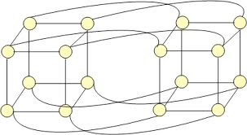
One possible solution: hierarchical snooping
Use snooping coherence at each level
Processor
Processor
Processor
Processor
Processor
Processor
Processor
Processor
Local Cache
Local Cache
Local Cache
Local Cache
Local Cache
Local Cache
Local Cache
Local Cache
Interconnect
Interconnect
Interconnect
Memory
Advantages
Relatively simple to build (already must deal with similar issues due to multi-level caches)
Disadvantages
The root of the network can become a bottleneck
Larger latencies than direct communication
Does not apply to more general network topologies (meshes, cubes)

Slide 9
Scalable cache coherence using directories
Snooping schemes broadcast coherence messages to determine the state of a line in the other caches
Alternative idea: avoid broadcast by storing information about the status of the line in one place: a “directory”
  The directory entry for a cache line contains information about the state of the cache line in all caches.
  Caches look up information from the directory as necessary
  Cache coherence is maintained by point-to-point messages between the caches on a “need to know” basis (not by broadcast mechanisms)
Notes:
centralized location that holds information about the state of a line in a cache’s
DEMO: “hey dude, who’s got X?”

Slide 10
A very simple directory
P presence bits: indicate whether processor P has line in its cache
Processor
Dirty bit: indicates line is dirty in one of the processors’ caches
Local Cache
One directory entry per line of memory
Directory
. . .
One line of memory
Line: A region of memory that would be cached as a single block (e.g., 64 bytes)
Memory
Scalable Interconnect
Notes:
shows memory
and the directory

Slide 11
So we’ve traded a bus bottleneck for a memory bottleneck?
Not quite; directories distributed across memory banks
  Different ordering points for different addresses
Can cache directory entries + avoid memory access
  Caches are much faster + higher bandwidth than memory

Slide 12
A distributed directory in ccNUMA
Example: directory partition is co-located with memory it describes
Processor 0
Processor 1
Processor 2
Local Cache
Local Cache
Local Cache
Directory
Directory
Directory
. . .
. . .
. . .
Memory
Memory
Memory
Scalable Interconnect
“Home node” of a line: node with memory holding the corresponding data for the line
  Example: node 0 is the home node of the yellow line, node 1 is the home node of the blue line
“Requesting node”: node containing processor requesting line
Notes:
if you thought about processor plus it’s local memory as a “node”

Slide 13
A distributed directory in a multicore
As we shall see, directories really live in each L3 bank
Core
L3 Cache Bank
Mem
Ctrl
Dir
Dir
Dir
Dir
Mem
Ctrl
Dir
Dir
Dir
Dir
Dir
Dir
Mem
Ctrl
Dir
Dir
Dir
Dir
Mem
Ctrl
Dir
Dir
Dir
Dir
Dir
Dir

Slide 14
Example 1: read miss to clean line
Read from main memory by processor 0 of the blue line: line is not dirty
Processor 0
Processor 1
Processor 2
Local Cache
Local Cache
Local Cache
Directory
Directory
Directory
. . .
. . .
. . .
Memory
Memory
Memory
Scalable Interconnect
1. Request: read miss msg
Read miss message sent to home node of the requested line
Home directory checks entry for line
Notes:
P1 wants to load the blue line
“TRAFFIC DIRECTOR”
YO, A WANT THE BLUE LINE

Slide 15
Example 1: read miss to clean line
Read from main memory by processor 0 of the blue line: line is not dirty
Processor 0
Processor 1
Processor 2
Local Cache
Local Cache
Local Cache
Directory
Directory
Directory
. . .
. . .
. . .
Memory
Memory
Memory
Scalable Interconnect
1. Request: read miss msg
2. Response (line of data from memory)
Read miss message sent to home node of the requested line
Home directory checks entry for line
  If dirty bit for cache line is OFF, respond with contents from memory, set presence[0] to true
  (to indicate line is cached by processor 0)
Notes:
Sets the presence bit
OKAY, HERE YOU GO
Q. WHAT IF THE DATA IS DIRTY?

Slide 16
Example 2: read miss to dirty line
Read from main memory by processor 0 of the blue line: line is dirty (contents in P2’s cache)
Processor 0
Processor 1
Processor 2
Local Cache
Local Cache
Local Cache
Directory
Directory
Directory
. . .
. . .
. . .
Memory
Memory
Memory
Scalable Interconnect
1. Request: read miss msg
2. Response: owner id
If dirty bit is ON, then data must be sourced by another processor (with the most up-to-date copy of the line)
Home node must tell requesting node where to find data
  Responds with message providing identity of line owner (“get it from P2”)
Notes:
now, what if the line is dirty?
Explain figure. presence[2] and dirty bit is set
YO MAN, I DON’T HAVE THE DATA, GET IT FROM P2

Slide 17
Example 2: read miss to dirty line
Read from main memory by processor 0 of the blue line: line is dirty (contents in P2’s cache)
Processor 0
Processor 1
Processor 2
Local Cache
Local Cache
Local Cache
Directory
Directory
Directory
. . .
. . .
. . .
Memory
Memory
Memory
Scalable Interconnect
1. Request: read miss msg
2. Response: owner id
3. Request: data
4. Response: data
If dirty bit is ON, then data must be sourced by another processor
Home node responds with message providing identity of line owner
Requesting node requests data from owner
Owner changes state in cache to SHARED (read only), responds to requesting node
Notes:
Q. WHAT DOES P2 DO TO LINE BEFORE RESPONDING to P0: it drops from M to S

Slide 18
Example 2: read miss to dirty line
Read from main memory by processor 0 of the blue line: line is dirty (contents in P2’s cache)
Processor 0
Processor 1
Processor 2
Local Cache
Local Cache
Local Cache
Directory
Directory
Directory
. . .
. . .
. . .
Memory
Memory
Memory
Scalable Interconnect
1. Request: read miss msg
5. Response: data+dir revision
2. Response: owner id
3. Request: data
4. Response: data
If dirty bit is ON, then data must be sourced by another processor
Home node responds with message providing identity of line owner
Requesting node requests data from owner
Owner responds to requesting node, changes state in cache to SHARED (read only)
Owner also responds to home node, home clears dirty, updates presence bits, updates memory
Notes:
this is just one possible sequence of steps
Q. What is the state of the line in cache 0 (shared)
Q. Why did we send the data to P1? (because it reduces hops in the future)

Slide 19
Example 3: write miss
Write to memory by processor 0: line is clean, but resident in P1’s and P2’s caches
Processor 0
Processor 1
Processor 2
Local Cache
Local Cache
Local Cache
Directory
Directory
Directory
. . .
. . .
. . .
Memory
Memory
Memory
Scalable Interconnect
1. Request: write miss msg

Slide 20
Example 3: write miss
Write to memory by processor 0: line is clean, but resident in P1’s and P2’s caches
Processor 0
Processor 1
Processor 2
Local Cache
Local Cache
Local Cache
Directory
Directory
Directory
. . .
. . .
. . .
Memory
Memory
Memory
Scalable Interconnect
1. Request: write miss msg
2. Response: sharer ids + data

Slide 21
Example 3: write miss
Write to memory by processor 0: line is clean, but resident in P1’s and P2’s caches
Processor 0
Processor 1
Processor 2
Local Cache
Local Cache
Local Cache
Directory
Directory
Directory
. . .
. . .
. . .
Memory
Memory
Memory
Scalable Interconnect
1. Request: write miss msg
2. Response: sharer ids + data
3. Request: invalidate (2 msgs)

Slide 22
Example 3: write miss
Write to memory by processor 0: line is clean, but resident in P1’s and P2’s caches
Processor 0
Processor 1
Processor 2
Local Cache
Local Cache
Local Cache
Directory
Directory
Directory
. . .
. . .
. . .
Memory
Memory
Memory
Scalable Interconnect
1. Request: write miss msg
2. Response: sharer ids + data
3. Request: invalidate (2 msgs)
4b. Response: ack from P1
4a. Response: ack from P2
After receiving both invalidation acks, P0 can perform write
Notes:
Need to acks because we have a network, and messages can get out of order

Slide 23
Advantage of directories
On reads, directory tells requesting node exactly where to get the line from
  Either from home node (if the line is clean)
  Or from the owning node (if the line is dirty)
  Either way, retrieving data involves only point-to-point communication
On writes, the advantage of directories depends on the number of sharers
  In the limit, if all caches are sharing data, all caches must be communicated with (just like broadcast in a snooping protocol)
Notes:
this second stat is the key one

Slide 24
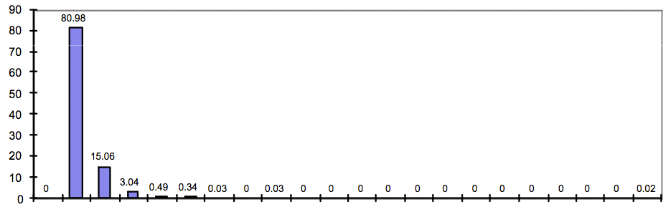
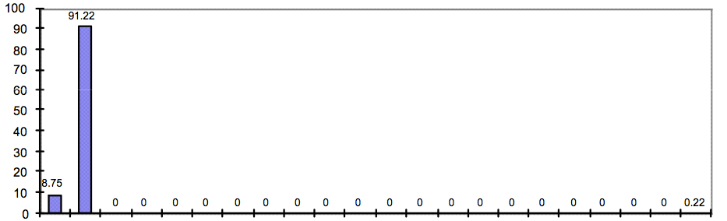
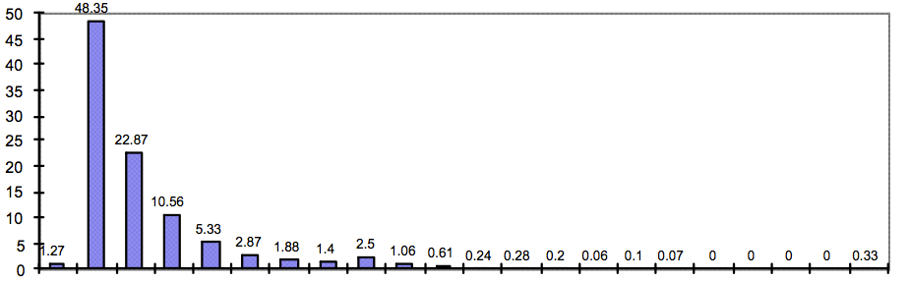
Cache invalidation patterns
64 processor system
Ocean
Graphs plot histogram of number of sharers of a line at the time of a write
In general only a few processors share the line (only a few processors must be told of writes)
Not shown here, but the expected number of sharers typically increases slowly with P (good!)
LU
Barnes-Hut
01234567
8 to 11
12 to 15
16 to 19
20 to 23
24 to 27
28 to 31
32 to 35
36 to 39
40 to 43
44 to 47
48 to 51
52 to 55
56 to 59
Number of sharers ➔
60 to 63
Notes:
Let’s do a demo to talk about why this is the case!
If writes do occur often, it’s unlikely there will be a lot of sharers
If writes infrequent, overhead of invalidating everyone inefficiently isn’t that big of a deal

Slide 25
In general, only a few sharers during a write
Access patterns
  “Mostly-read” objects: lots of sharers but writes are infrequent, so minimal impact on performance (e.g., root node in Barnes-Hut)
  Migratory objects (one processor reads/writes for while, then another, etc.): very few sharers, count does not scale with number of processors
  Frequently read/written objects: frequent invalidations, but sharer count is low because count cannot build up in short time between invalidations (e.g, shared task queue)
  Low-contention locks: infrequent invalidations, no performance problem
  High-contention locks: can be a challenge, because many readers present when lock released
Implication 1: directories are useful for limiting coherence traffic
  Don’t need a broadcast mechanism to “tell everyone”
Implication 2: lets us limit directory storage overhead (how?)
Notes:
migratory objects = one processor manipulates, then another, etc.
frequently read... assume that writes occur frequently enough such that reader list can’t build up
high contention lock, if the lock is held long enough, the reader lists can build up (all other CPUs are spinning on the lock)

Slide 26
Very simple directory storage requirements
P presence bits: indicate whether processor P has line in its cache
Processor
Dirty bit: indicates line is dirty in one of the processors’ caches
Local Cache
One directory entry per line of memory
Directory
. . .
One line of memory
Memory
Assume
  64 bytes / line
  P = 256 processors
  M = main memory size (bytes)
How big is directory?
Scalable Interconnect
Notes:
Number of directory bits = M/64 * P
D = directory bytes = M/512 * P
When P = 256, D = M/2

Slide 27
Full-map directory representation
Recall: one presence bit per node
Storage proportional to P x M
  P = number of nodes (e.g., processors)
  M = number of lines in memory
  # dir entries = M / 64B
  # bytes / dir entry = P / 8
  ➔ Dir size = P * M / 8
Storage overhead rises with P
  Assume 64 byte cache line size (512 bits)
  64 nodes (P=64) →12% overhead
  256 nodes (P=256) → 50% overhead
  1024 nodes (P=1024) → 200% overhead
P
. . .
. . .
M
Notes:
64 bytes = 512 bits
remember, this is a supercomputer. There’s a lot of memory, so 200% overhead is a nasty problem

Slide 28
Reducing storage overhead of directory
Optimizations on full-map directory scheme
  Increase cache line size (reduce M term)
      What are the downsides of this approach?
      (consider graphs from last lecture)
  Group multiple processors into a single directory “node” (reduce P term)
      Need only one directory bit per node, not one bit per processor
      Hierarchical: could use snooping protocol to maintain coherence among processors in a node
      But hierarchical coherence is very complicated + adds latency
We will now discuss two alternative schemes
  Limited pointer schemes (reduce P)
  Sparse directories

Slide 29

Limited directory
Most data has few sharers
➔ Idea: Store only a few pointers in directory
(we only need a list of the nodes holding a valid copy of the line!)
Example: 1024 processor system
Full bit vector scheme needs 1024 bits per line
Instead, we can track most accesses with a few pointers to sharers
Each pointer is $\log_{2}\left(1024\right)=10b$, so anything <100 pointers is a win!
(E.g., >99% of writes with just a five sharers in Ocean)
Ocean
01234567
8 to 11
12 to 15
16 to 19
20 to 23
24 to 27
28 to 31
32 to 35
36 to 39
40 to 43
44 to 47
48 to 51
52 to 55
56 to 59
60 to 63
Notes:
REALLY, WHAT IS THE BIT VECTOR? it’s a representation of a list of sharers
ring a bell with assignment 2?
Q. OVERFLOW?

Slide 30
Managing overflow in limited pointer schemes
Many possible approaches
Fallback to broadcast
Replaces an existing sharer (invalidating its cache) with the new sharer
Coarse bit-vector
  Revert to bit vector representation
  Each bit corresponds to a cluster of K processors
  On write, invalidate all processors in the cluster
Notes:
challenge is dealing with the situation where there’s high dynamic range of list sizes
when are these schemes bad?
broadcast: when there’s X + 1 sharers (or data is just sitting there in a processors cache’s and never touched)
no broadcast: like LRU, can construct an access pattern where always taking a miss
coarse: when the “spatial locality” of sharing does exist

Slide 31
Optimize for the common case!
Limited pointer schemes are a great example of understanding and optimizing for the common case:
Workload-driven observation: in general the number of cache line sharers is low
Make the common case simple and fast: array of pointers for first N sharers
Uncommon case is still handled correctly, just with a slower, more complicated mechanism (the program still works!)
Extra expense of the complicated solution is tolerable, since it happens infrequently

Slide 32
Limited pointer schemes: summary
P ➔ k log P
Limited pointer schemes reduce directory storage overhead caused by large P
Most lines have few sharers, so this works well
But do we really even need to maintain a list of sharers for each line of data in memory?
. . .
. . .
M
Directory
Notes:
rows where bit-vectors
there was a row for every memory line in the machine
one way to think about few sharers
increase cache line size
NOTE: Some students take issue with calling this reducing M, since there’s

Slide 33
Limiting size of directory: sparse directories
Key observations:
1) The coherence protocol only needs sharing information for lines in some cache.
2) Most memory is NOT resident in cache.
➔ Almost all directory entries are empty
E.g., 1 MB cache, 1 GB memory → ≥ 99.9% of entries are empty
Tag
{
One directory entry per line of memory held in some cache
Directory
. . .
Scaling:
Each cache holds C lines
P*C entries / processor
Notes:
original implementation: data for all processors for all lines
limited pointer: most processors are not sharing (sparse sharing)
sparse directories: most lines are not in cache (sparse residency in cache)
But, possible to have case where large fraction of memory resident across set of caches

Slide 34
Limiting size of directory: sparse directories
Key observations:
1) The coherence protocol only needs sharing information for lines in some cache.
2) Most memory is NOT resident in cache.
➔ Almost all directory entries are empty
E.g., 1 MB cache, 1 GB memory → ≥ 99.9% of entries are empty
Processor
Local Cache
One directory entry per line of memory
Directory
. . .
One line of memory
Memory
Interconnect
Notes:
original implementation: data for all processors for all lines
limited pointer: most processors are not sharing (sparse sharing)
sparse directories: most lines are not in cache (sparse residency in cache)
But, possible to have case where large fraction of memory resident across set of caches

Slide 35
Sparse directories: Reducing directory entries
Key observations:
1) The coherence protocol only needs sharing information for lines in some cache.
2) Most memory is NOT resident in cache.
➔ Almost all directory entries are empty
E.g., 1 MB cache, 1 GB memory → ≥ 99.9% of entries are empty
Processor
Tag
Local Cache
One directory entry per line of cache
Directory
One line of memory
Scaling:
Each cache holds C lines
P * C bits / processor
Directory scales with cache (not memory) size
Memory
Interconnect
Notes:
original implementation: data for all processors for all lines
limited pointer: most processors are not sharing (sparse sharing)
sparse directories: most lines are not in cache (sparse residency in cache)
But, possible to have case where large fraction of memory resident across set of caches

Slide 36
Sparse directories: Reducing directory entries
Key observations:
1) The coherence protocol only needs sharing information for lines in some cache.
2) Most memory is NOT resident in cache.
➔ Almost all directory entries are empty
E.g., 1 MB cache, 1 GB memory → ≥ 99.9% of entries are empty
Tag
Processor
One directory entry per line of cache
Directory
Local Cache
One line of memory
Scaling:
Each cache holds C lines
P * C bits / processor
Directory scales with cache (not memory) size
Memory
Interconnect
Notes:
original implementation: data for all processors for all lines
limited pointer: most processors are not sharing (sparse sharing)
sparse directories: most lines are not in cache (sparse residency in cache)
But, possible to have case where large fraction of memory resident across set of caches

Slide 37
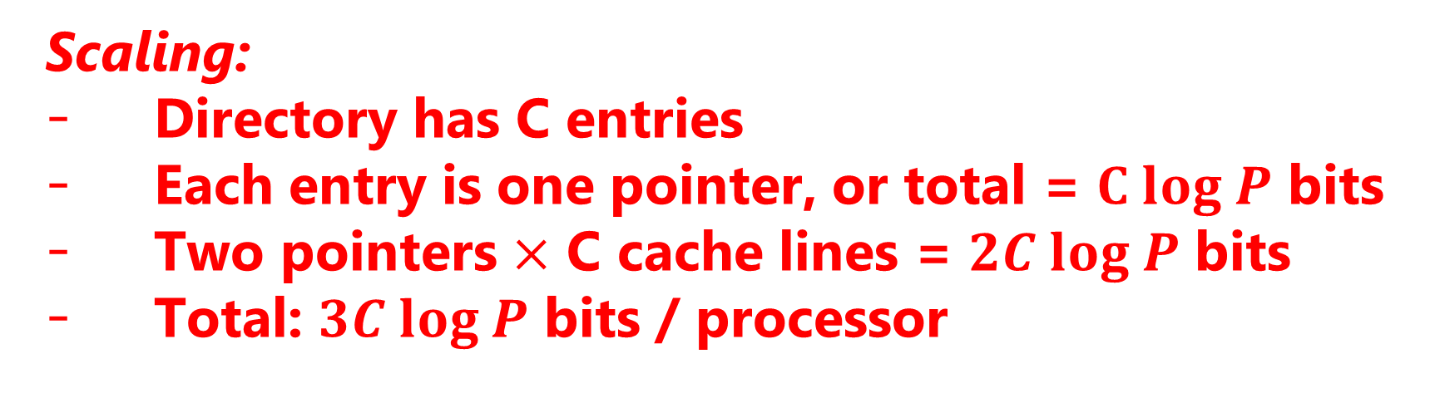
Sparse directories: Limiting entry size
Idea: Store sharers as a linked list
Directory at home node stores only 1 pointer to head of the list (not the full list)
Pointer to next node in list is stored with cache line (alongside the line’s tag, dirty bits, etc)
Directory (home node for line)
On read miss: add requesting node to head of list
M
. . .
On write miss: walk list to invalidate each sharer
On evict: need to patch up list (linked list removal)
line data
Scaling:
Directory has C entries
Each entry is one pointer, or total = $C log P$ bits
Two pointers $×$ C cache lines = $2C log P$ bits
Total: $3C log P$ bits / processor
next ptr
prev ptr
Processor cache: node 0
(last reader)
Processor cache: node 1
Processor cache: node 2
(last reader)
One directory entry per cache line of memory held in some cache
Notes:
Questions:
O(1) read miss
O(sharers) write miss
O(1) evict with forward/back links

Slide 38
Sparse directories: scaling properties
Good:
  Low memory storage overhead
  Traffic on write is proportional to number of sharers (no broadcast fallback)
Directory (home node for line)
Bad:
M
. . .
  Latency of write proportional to number of sharers (invalidation of lines is serial)
  Higher implementation complexity
line data
next ptr
prev ptr
Processor cache: node 0
Processor cache: node 1
Processor cache: node 2
Notes:
Q. what’s the bad?
notice the difference between serial invalidation here, and parallel invalidation in basic bit vector scheme (see next slide)

Slide 39
Recall: write miss in full bit vector scheme
Write to memory by processor 0: line is clean, but resident in P1’s and P2’s caches
Processor 0
Processor 1
Processor 2
Local Cache
Local Cache
Local Cache
Directory
Directory
Directory
. . .
. . .
. . .
Memory
Memory
Memory
Scalable Interconnect
1. Request: write miss msg
2. Response: sharer ids + data
3. Request: invalidate (2 msgs)
Original bit-vector scheme sends same number of invalidation messages as sparse directory approach, but invalidation messages can be sent to all processors in parallel
Notes:
hold this idea (path versus traffic)
dependencies

Slide 40

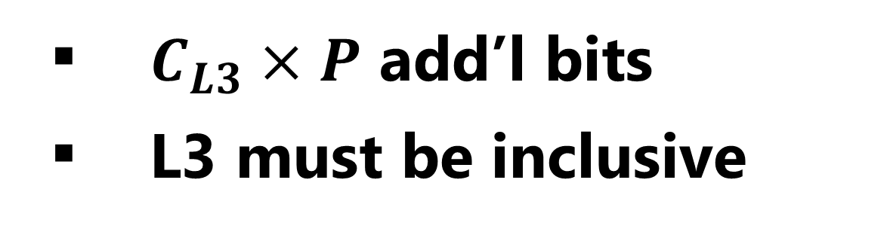
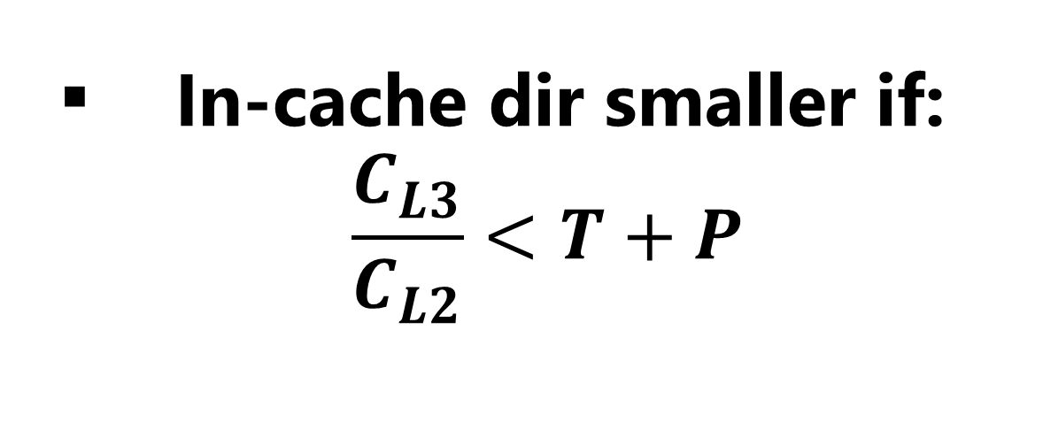
In-cache directories
Recall: Coherence implemented at shared-private boundary
In-cache directory: Add directory entries to shared L3 cache
Sparse directory: Add separately tagged structure to track L2 contents
In-cache directories are common in multicores today
Memory
$C_{L3}×P$ add’l bits
L3 must be inclusive
Shared L3 Cache
(One bank per core)
Tag
Sharers
Data
Interconnect
${P×C}_{L2}×(T+P)$ add’l bits
L3 need not be inclusive
L2 Cache
L2 Cache
L2 Cache
L2 Cache
L1 Data Cache
L1 Data Cache
L1 Data Cache
L1 Data Cache
In-cache dir smaller if:
$\frac{C_{L3}}{C_{L2}}<T+P$
Core
Core
Core
Core

Slide 41
Optimizing directory-based coherence
Reducing storage overhead of directory data structure
  Limited pointer schemes
  Sparse directories
Reducing number of messages sent to implement coherence protocol

Slide 42
Recall: read miss to dirty line
Read from main memory by processor 0 of the blue line: line is dirty (contained in P2’s cache)
Processor 0
Processor 1
Processor 2
Local Cache
Local Cache
Local Cache
Directory
Directory
Directory
. . .
. . .
. . .
Memory
Memory
Memory
Scalable Interconnect
1. Request: read miss msg
Notes:
This for a read miss by P0 to dirty data owned by P2

Slide 43
Recall: read miss to dirty line
Read from main memory by processor 0 of the blue line: line is dirty (contained in P2’s cache) (Note: figure below shows final state of system after operation is complete)
Processor 0
Processor 1
Processor 2
Local Cache
Local Cache
Local Cache
Directory
Directory
Directory
. . .
. . .
. . .
Memory
Memory
Memory
Scalable Interconnect
1. Request: read miss msg
5. Response: data+dir revision
2. Response: owner id
3. Request: data
4. Response: data
Five network transactions in total
Four of the transactions are on the “critical path” (transactions 4 and 5 can be done in parallel)
  Critical path: sequence of dependent operations that must occur to complete operation
Notes:
NOTE: before you built the slide. This is the end result
CAN WE DO BETTER?

Slide 44
Intervention forwarding
Read from main memory by processor 0 of the blue line: line is dirty (contained in P2’s cache)
Processor 0
Processor 1
Processor 2
Local Cache
Local Cache
Local Cache
Directory
Directory
Directory
. . .
. . .
. . .
Memory
Memory
Memory
Scalable Interconnect
1. Request: read miss msg

Slide 45
Intervention forwarding
Read from main memory by processor 0 of the blue line: line is dirty (contained in P2’s cache)
Processor 0
Processor 1
Processor 2
Local Cache
Local Cache
Local Cache
Directory
Directory
Directory
. . .
. . .
. . .
Memory
Memory
Memory
Scalable Interconnect
1. Request: read miss msg
2. Request: intervention read
3. Response: data+dir revision
Home node requests data from owner node (processor 2)
Owning node responds
Notes:
Message 2: Hey can you give me the data. (flush)

Slide 46
Intervention forwarding
Read from main memory by processor 0 of the blue line: line is dirty (contained in P2’s cache)
Processor 0
Processor 1
Processor 2
Local Cache
Local Cache
Local Cache
Directory
Directory
Directory
. . .
. . .
. . .
Memory
Memory
Memory
Scalable Interconnect
1. Request: read miss msg
2. Request: intervention read
4. Response: data
3. Response: data+dir revision
Home node updates directory, and responds to requesting node with data
Four network transactions in total (less traffic)
But all four of the transactions are on the “critical path.” Can we do better?
Notes:
Q. Can we do better?

Slide 47
Request forwarding
Read from main memory by processor 0 of the blue line: line is dirty (contained in P2’s cache)
Processor 0
Processor 1
Processor 2
Local Cache
Local Cache
Local Cache
Directory
Directory
Directory
. . .
. . .
. . .
Memory
Memory
Memory
Scalable Interconnect
1. Request: read miss msg

Slide 48
Request forwarding
Read from main memory by processor 0 of the blue line: line is dirty (contained in P2’s cache)
Processor 0
Processor 1
Processor 2
Local Cache
Local Cache
Local Cache
Directory
Directory
Directory
. . .
. . .
. . .
Memory
Memory
Memory
Scalable Interconnect
1. Request: read miss msg
2. Request: send data to requestor

Slide 49
Request forwarding
Read from main memory by processor 0 of the blue line: line is dirty (contained in P2’s cache)
Processor 0
Processor 1
Processor 2
Local Cache
Local Cache
Local Cache
Directory
Directory
Directory
. . .
. . .
. . .
Memory
Memory
Memory
Scalable Interconnect
1. Request: read miss msg
2. Request: send data to requestor
3/4. Response: data
(2 msgs: sent to both home node and requestor)
Four network transactions in total
Only three of the transactions are on the critical path (transactions 3 and 4 can be done in parallel)
Note: system is no longer pure request/response (since P0 sent request to P1, but receives response from P2)
Notes:
no longer purely request-response: requestor get a response from a node that it didn’t request data from
complex

Slide 50
Directory coherence in Intel Core i7 CPU
L3 hosts in-cache directory (and is inclusive)
Directory maintains list of L2 caches containing line
Instead of broadcasting coherence traffic to all L2’s, only send coherence messages to L2’s that contain the line
(Core i7 interconnect is a ring, it is not a bus)
Directory dimensions:
  P=4
  M = number of L3 cache lines
Shared L3 Cache
(One bank per core)
Ring Interconnect
L2 Cache
L2 Cache
L2 Cache
L2 Cache
L1 Data Cache
L1 Data Cache
L1 Data Cache
L1 Data Cache
Core
Core
Core
Core
Notes:
SINGLE-CHIP directory-based coherence
inclusion: if it’s in an L2, that means there can be coherence traffic, directory entry guaranteed to exist in L3 ***
find the directory entry by finding the line in the L3
Since P is so small, clearly a bit-vector based scheme

Slide 51
Coherence in multi-socket Intel systems
to DRAM…
(with in memory directory)
to DRAM…
(in memory directory)
L3 directory reduces on-chip coherence traffic (previous slide)
In-memory directory (cached by home agent/memory controller) reduces coherence traffic between cores
Memory Controller
Memory Controller
Home Agent
QuickPath Interconnect
(QPI)
Home Agent
Dir cache (16KB)
Dir cache (16KB)
Cache Agent
Cache Agent
L3 Cache
L3 Cache
L2
L2
L2
L2
L2
L2
L2
L2
L1
L1
L1
L1
L1
L1
L1
L1
Core
Core
Core
Core
Core
Core
Core
Core
Notes:
SINGLE-CHIP directory-based coherence
inclusion: if it’s in an L2, that means there can be coherence traffic, directory entry guaranteed to exist in L3 ***
find the directory entry by finding the line in the L3
Since P is so small, clearly a bit-vector based scheme

Slide 52
Xeon Phi
Intel’s NUMA on a chip
Many (50+) x86 cores
  Ours have 61
  “Knight’s Corner”
  4-way hyper threading
  Each with 1–2 vector units
Cache-coherent memory system
Knight’s Corner overall system:
  Max. 8GB memory
  Max. 2 TFLOPS
  0.004 bytes/flop
    not balanced
  300 Watts
Prototype / internal names include:
Larrabee, Knight’s Ferry, Knight’s Corner, Knight’s Landing, Knight’s Hill
China’s Tianhe-2 has 48,000 Knight’s Corner chips

Slide 53
Knight’s Corner Xeon Phi Cache Coherence
  512KB L2 caches
  8 memory controllers
    Total 8GB max.
Prototype / internal names include:
Larrabee, Knight’s Ferry, Knight’s Corner, Knight’s Landing, Knight’s Hill

Slide 54
KC Xeon Phi Ring Communication
Messages sent around bidirectional ring
  Having everything on single chip enables very wide communication paths
  Can get effect of broadcast by circulating message around entire ring
    Advantage over point-to-point

Slide 55
KC Xeon Phi Directory Structure
Directory keeps track of which lines are resident in local L2
  Same as with single-node system
Worst-case memory read or write by P:
  Check local cache
  Circulate request around ring for line in some cache
  Send request around ring to memory controller
Notes:
More like a bus-based cache system, due to broadcast capabilities of ring

Slide 56
Next Generation Xeon Phi
“Knight’s Landing”
72 cores
  Each with 4-way hyper threading
  Each with 2 vector units
Grouped into pairs to give 36 compute nodes
Peak 6 SP TFLOPS
16 GB on package RAM
Access to up to 384 GB off-package RAM

Slide 57
Knight’s Landing Xeon Phi Cache Coherence
  Nodes organized as 2-D mesh
    Some for computation
    Some for memory interfaces
  Use X/Y routing to send messages
  Must use more traditional directory-based scheme

Slide 58
Summary: directory-based coherence
Primary observation: broadcast doesn’t scale, but luckily we don’t need to broadcast to ensure coherence because often the number of caches containing a copy of a line is small
Instead of snooping, just store the list of sharers in a “directory” and check the list as necessary
One challenge: reducing overhead of directory storage
  Use hierarchies of processors or larger line sizes
  Limited pointer schemes: exploit fact the most processors not sharing line
  Sparse directory schemes: exploit fact that most lines are not in cache
Another challenge: reducing the number of messages sent (traffic) and critical path (latency) of message chains needed to implement coherence operations
Ring-based schemes can be much simpler than point-to-point communication

