Slide 1
Snooping-Based
Cache Coherence
Lecture 10:

Slide 2
Cache design review
Let’s say your code executes volatile int x = 1;
(Assume for simplicity x corresponds to the address 0x12345604 in memory—it’s not stored in a register)
One cache line:
Line state
Tag
1
0
0
0
. . .
Data (64 bytes on modern Intel processors)
Dirty bit
Byte 0 of line
Byte 63 of line
Review:
  What is the difference between a write back and a write-through cache?
  What about a allocate vs. write-no-allocate cache?
Notes:
low order bits tell you where in the line (here it is 4)
high-order bits go in the tag, what about the middle bits?
(the set... if the high order bits designated the set, you’d collide on consecutive addresses)
Intel is little endian (so the low order byte of the int = 1, and it’s in the “lowest address” of the word)
======
Reminder about virtually indexed and physically tagged: can to V2P in parallel with reading data from cache. (squelch if tag does not match)

Slide 3
Review: behavior of write-allocate, write-back cache on a write miss (uniprocessor case)
Example: processor executes volatile int x = 1;
Processor performs write to address that is not resident in cache
Cache selects location to place line in cache, if there is a dirty line currently in this location, the dirty line is written out to memory
Cache loads line from memory (“allocates line in cache”)
4 bytes of cache line are updated
Cache line is marked as dirty
Line state
Tag
Data (64 bytes on modern Intel processors)
Dirty bit

Slide 4
A shared memory multi-processor
Processors read and write to shared variables
  More precisely: processors issue load and store instructions
A reasonable expectation of memory is:
  Reading a value at address X should return the last value written to address X by any processor
Processor
Processor
Processor
Processor
Interconnect
Memory
I/O
(A simple view of four processors and their shared address space)
Notes:
how to we expect memory to behave
beautifully simplified view

Slide 5
The cache coherence problem
Modern processors replicate contents of memory in local caches
Problem: processors can observe different values for the same memory location
Processor
Processor
Processor
Processor
Cache
Cache
Cache
Cache
Interconnect
Memory
int foo; (stored at address X)
Action
P1 $
P2 $
P3 $
P4 $
mem[X]
The chart at right shows the value of variable foo (stored at address X) in main memory and in each processor’s cache
Assume the initial value stored at address X is 0
Assume write-back cache behavior
0
P1 load X
0
miss
0
P2 load X
0
0
miss
0
P1 store X
1
0
0
P3 load X
1
0
0
miss
0
P3 store X
1
0
2
0
P2 load X
1
0
hit
2
0
P1 load Y
(assume this load causes
eviction of X)
0
2
1
Notes:
we say they are not coherent
this lecture is about how we resolve this issue

Slide 6
The cache coherence problem
Is this a mutual exclusion problem?
Can you fix the problem by adding locks to your program?
Processor
Processor
Processor
Processor
Cache
Cache
Cache
Cache
Interconnect
NO!
This is a problem created by replicating the data stored at address X in local caches (a hardware implementation detail)
Memory
int foo; (stored at address X)
Action
P1 $
P2 $
P3 $
P4 $
mem[X]
The chart at right shows the value of variable foo (stored at address X) in main memory and in each processor’s cache
Assume the initial value stored at address X is 0
Assume write-back cache behavior
0
P1 load X
0
miss
0
P2 load X
0
0
miss
0
P1 store X
1
0
0
P3 load X
1
0
0
miss
0
P3 store X
1
0
2
0
P2 load X
1
0
hit
2
0
P1 load Y
(assume this load causes
eviction of X)
0
2
1
Notes:
IMPORTANT: this is *not* an issue of mutual exclusion (HOW COULD I SOLVE THIS PROBLEM WITH LOCKS?)
memory operations are atomic (by definition)
there’s only one memory address and there’s wires connected to it, so only one thing happens at the address at once
THIS IS A PROBLEM OF REPLICAS

Slide 7
The memory coherence problem
Intuitive behavior for memory system: reading value at address X should return the last value written to address X by any processor.
Memory coherence problem exists because there is both global storage (main memory) and per-processor local storage (processor caches) implementing the abstraction of a single shared address space.
Notes:
caches are an implementation detail. An optimization

Slide 8
Cache hierarchy of Intel Haswell CPU (2013)
64 byte cache line size
Shared L3 Cache
(One bank per core)
L3: (per chip)
8 MB, inclusive
16-way set associative
32B / clock per bank
26-31 cycle latency
Ring Interconnect
L2: (private per core)
256 KB
8-way set associative, write back
32B / clock, 12 cycle latency
Up to 16 outstanding misses
L2 Cache
L2 Cache
L2 Cache
L2 Cache
L1: (private per core)
32 KB
8-way set associative, write back
2 x 16B loads + 1 x 16B store per clock
4-6 cycle latency
Up to 10 outstanding misses
L1 Data Cache
L1 Data Cache
L1 Data Cache
L1 Data Cache
Core
Core
Core
Core
Notes:
Q. why does associativity grow?
really four L3 caches: note how BW scales up and down with number of cores
also note: some caches are shared, others are not

Slide 9
Intuitive expectation of shared memory
Intuitive behavior for memory system: reading value at address X should return the last value written to address X by any processor.
On a uniprocessor, providing this behavior is fairly simple, since writes typically come from one client: the processor
  Load operation must examine all pending stores in store buffer
  Exception: device I/O via direct memory access (DMA)

Slide 10
Coherence is an issue in a single CPU system
Consider I/O device performing DMA data transfer
Case 1:
Processor writes to buffer in main memory
Processor tells network card to async send buffer
Problem: network card many transfer stale data if processor’s writes (reflected in cached copy of data) are not flushed to memory
Case 2:
Network card receives message
Network card copies message in buffer in main memory using DMA transfer
Card notifies CPU msg was received, buffer ready to read
Problem: CPU may read stale data if addresses updated by network card happen to be in cache
Processor
Cache
Interconnect
Message
Buffer
Network
Card
Memory
Common solutions:
  CPU writes to shared buffers using uncached stores (e.g., driver code)
  OS support:
    Mark virtual memory pages containing shared buffers as not-cachable
    Explicitly flush pages from cache when I/O completes
In practice, DMA transfers are infrequent compared to CPU loads and stores
(so these heavyweight software solutions are acceptable)

Slide 11
Problems with the intuition
Intuitive behavior: reading value at address X should return the last value written to address X by any processor.
What does “last” mean?
  What if two processors write at the same time?
  What if a write by P1 is followed by a read from P2 so close in time that it is impossible to communicate the occurrence of the write to P2 in time?
In a sequential program, “last” is determined by program order (not time)
  Holds true within one thread of a parallel program
  But we need to come up with a meaningful way to describe order across threads in a parallel program

Slide 12
Definition: coherence
Chronology of operations on address X
A memory system is coherent if:
The results of a parallel program’s execution are such that for each memory location, there is a hypothetical serial order of all program operations (executed by all processors) to the location that is consistent with the results of execution, and:
  Memory operations issued by any one processor occur in the order issued by the processor
  The value returned by a read is the value written by the last write to the location… as given by the serial order
P0 write: 5
P1 read (5)
P2 read (5)
P0 read (5)
P1 write: 25
P0 read (25)
Also known as sequential consistency
Notes:
careful: don’t confuse with sequentially consistent

Slide 13
Definition: coherence (said differently)
A memory system is coherent if:
  A read by processor P to address X that follows a write by P to address X, should return the value of the write by P (assuming no other processor wrote to X in between)
  A read by processor P1 to address X that follows a write by processor P2 to X returns the written value... if the read and write are “sufficiently separated” in time (assuming no other write to X occurs in between)
  Writes to the same address are serialized: two writes to address X by any two processors are observed in the same order by all processors.
    (Example: if values 1 and then 2 are written to address X, no processor observes X having value 2 before value 1)
Condition 1: obeys program order (as expected of a uniprocessor system)
Condition 2: “write propagation”: Notification of a write must eventually get to the other processors. Note that
precisely when information about the write is propagated is not specified in the definition of coherence.
Condition 3: “write serialization”
Notes:
1. thread consistent with itself
2. the news of the write gets to others (at some point)
3. write serialization... you can put all the writes on a single line

Slide 14
Write serialization
  Writes to the same location are serialized: two writes to address X by any two processors are observed in the same order by all processors.
  (Example: if a processor observes X having value 1 and then 2, then no processor observes X having value 2 before it has value 1)
  Example: P1 writes value a to X. Then P2 writes value b to X.
  Consider situation where processors P3 and P4 observe different order of writes:
Order observed by P3
ld X →load returns “a”
ld X →load returns “b”
Order observed by P4
ld X →load returns “b”
ld X →load returns “a”
...
...
  In terms of the first coherence definition: there is no global ordering of loads and stores to X that is in agreement with results of this parallel program.
  (you cannot put the two memory operations involving X on a single timeline and have both processor’s observations agree with the timeline)
Notes:
write serialization is that is two writes happen just about at the same time.

Slide 15
Implementing coherence
Software-based solutions
  OS uses page-fault mechanism to propagate writes
  Can be used to implement memory coherence over clusters of workstations
  We won’t discuss these solutions
Hardware-based solutions
  “Snooping”-based coherence implementations (today)
  Directory-based coherence implementations (next week)

Slide 16
Shared caches: coherence made easy
One single cache shared by all processors
  Eliminates problem of replicating state in multiple caches
Obvious scalability problems (since the point of a cache is to be local and fast)
  Interference / contention due to many clients
But shared caches can have benefits:
  Facilitates fine-grained sharing (overlapping working sets)
  Loads/stores by one processor might pre-fetch lines for another processor
Processor
Processor
Processor
Processor
Cache
Interconnect
Memory
I/O
Notes:
eliminate the problem of having state in multiple places

Slide 17
Snooping cache-coherence schemes
Main idea: all coherence-related activity is broadcast to all processors in the system (more specifically: to the processor’s cache controllers)
Cache controllers monitor (“they snoop”) memory operations, and react accordingly to maintain memory coherence
Notice: now cache controller must respond to actions from “both ends”:
LD/ST requests from its local processor
Coherence-related activity broadcast over the chip’s interconnect
Processor
Processor
. . .
Processor
Cache
Cache
Cache
Interconnect
Memory

Slide 18
Very simple coherence implementation
Let’s assume:
  Write-through caches
  Granularity of coherence is cache line
Upon write, cache controller broadcasts invalidation message
As a result, the next read from other processors will trigger cache miss
(processor retrieves updated value from memory due to write-through policy)
Processor
P0
. . .
Processor
P1
Cache
Cache
Interconnect
Memory
Action
Interconnect activity
P0 $
P1 $
mem location X
0
P0 load X
cache miss for X
0
0
P1 load X
cache miss for X
0
0
0
P0 write 100 to X
invalidation for X
100
100
P1 load X
cache miss for X
100
100
100
Notes:
assume write through, so write goes to memory

Slide 19
A clarifying note
The logic we are about to describe is performed by each processor’s cache controller in response to:
  Loads and stores by the local processor
  Messages it receives from other caches
If all cache controllers operate according to this described protocol, then coherence will be maintained
  The caches “cooperate” to ensure coherence is maintained
Cache controller tracks the status of each line in its cache

Slide 20
Write-through invalidation: state diagram
Two cache line states (same as meaning of invalid in uniprocessor cache)
  Invalid (I)
  Valid (V)
Two processor operations (triggered by local processor)
  PrRd (read)
  PrWr (write)
Two bus transactions (from remote caches)
  BusRd (another processor intends to read line)
  BusWr (another processor intends to write to line)
PrRd / --
PrWr / BusWr
V
(Valid)
PrRd / BusRd
BusWr/--
I
(Invalid)
Notation:
A / B: if event A is observed by cache controller, then action B is taken
PrWr / BusWr **
Remote processor (coherence) initiated transaction
Local processor initiated transaction
** Assumes write no-allocate policy (for simplicity)
Notes:
Model cache behavior like a state machine
every cache line has two states, valid and invalid
black lines are transitions due to the processor, let’s look at those
blue dots lines are transitions due to bus traffic
write-no allocate

Slide 21
Write-through invalidation: state diagram
PrRd / --
Requirements of the interconnect:
All write transactions visible to all cache controllers
All write transactions visible to all cache controllers in the same order
Simplifying assumptions here:
Interconnect and memory transactions are atomic
Processor waits until previous memory operations is complete before issuing next memory operation
Invalidation applied immediately as part of receiving invalidation broadcast
PrWr / BusWr
V
(Valid)
PrRd / BusRd
BusWr/--
I
(Invalid)
A / B: if action A is observed by cache controller, action B is taken
PrWr / BusWr **
Remote processor (coherence) initiated transaction
Local processor initiated transaction
** Assumes write no-allocate policy (for simplicity)
Notes:
Model cache behavior like a state machine
every cache line has two states, valid and invalid
black lines are transitions due to the processor, let’s look at those
blue dots lines are transitions due to bus traffic
write-no allocate

Slide 22
Write-through policy is inefficient
Every write operation goes out to memory
  Very high bandwidth requirements
Write-back caches absorb most write traffic as cache hits
  Significantly reduces bandwidth requirements
  But how do we ensure write propagation/serialization?
  This requires more sophisticated coherence protocols

Slide 23
Recall cache line state bits
Line state
Tag
Data (64 bytes on modern Intel processors)
Dirty bit
Notes:
cool thing is that caches already have state per line

Slide 24
Cache coherence with write-back caches
Chronology of operations on address X
Processor
P0
. . .
Processor
P1
Write to X
Load X
P0 write
Cache
Cache
P1 read
X
Interconnect
Memory
Dirty state of cache line now indicates exclusive ownership
  Exclusive: cache is only cache with a valid copy of line (it can safely be written to)
  Owner: cache is responsible for supplying the line to other processors when they attempt to load it from memory (otherwise a load from another processor will get stale data from memory)
Notes:
where we got into trouble, was when data was in two places at once
first thing you want to know is if you are THE ONLY cache with the data. Because if you are, you can just write.
THEN LATER... is someone else READS... the most recent version of the value is sitting HERE. CLICK
TWO ISSUES IN PLAY (when can you write... who provides data on a read)

Slide 25
Invalidation-based write-back protocol
Key ideas:
A line in the “exclusive” state can be modified without notifying the other caches
Processor can only write to lines in the exclusive state
  So they need a way to tell other caches that they want exclusive access to the line
  They will do this by sending messages to all the other caches
When cache controller observes (via snooping) a request for exclusive access to line it contains
  It must invalidate the line in its own cache
  What if the line is dirty?

Slide 26
MSI write-back invalidation protocol
Key tasks of protocol
  Ensuring processor obtains exclusive access for a write
  Locating most recent copy of cache line’s data on cache miss
Three cache line states
  Invalid (I): same as meaning of invalid in uniprocessor cache
  Shared (S): line valid in one or more caches
  Modified (M): line valid in exactly one cache (a.k.a. “dirty” or “exclusive” state)
Two processor operations (triggered by local CPU)
  PrRd (read)
  PrWr (write)
Three coherence-related bus transactions (from remote caches)
  BusRd: obtain copy of line with no intent to modify
  BusRdX: obtain copy of line with intent to modify
  flush: write dirty line out to memory
Notes:
let’s talk about how this works

Slide 27
MSI state transition diagram *
PrRd / --
PrWr / --
A / B: if action A is observed by cache controller, action B is taken
Remote processor (coherence) initiated transaction
Local processor initiated transaction
M
(Modified)
flush = flush dirty line to memory
PrWr / BusRdX
BusRd / flush
PrWr / BusRdX
S
(Shared)
BusRdX / flush
PrRd / BusRd
PrRd / --
BusRdX / --
BusRd / --
I
(Invalid)
* Remember, all caches are carrying out this logic independently to maintain coherence
Notes:
Q. BusRd from S
Q. BusRdX from S (drop the line)
Q. BusRd from M (drop to S shared, AND... have to give the data to the processor, or flush to memory) FLUSH
Q. BusRdX from M (drop the line, AND... have to give data to the processor) FLUSH
BUS UPGRADE COMMENT when processor writes from S. (RATHER THAN BusRdX)

Slide 28
Example Execution
Action | P0 X | P0 Y | P1 X | P1 Y
Initial | I | I | I | I
P0: LD X | S/0
P1: LD X
P0: ST X ← 1
P0: ST X ← 2
P1: ST X ← 3
P1: LD X
P0: LD X
P0: ST X ← 4
P1: LD X
P0: LD Y
P0: ST Y ← 1
P1: ST Y ← 2
X and Y have value 0 at start of execution.
Notes:
Active student participation

Slide 29
Summary: MSI
A line in the M state can be modified without notifying other caches
  No other caches have the line resident, so other processors cannot read these values
  (without generating a memory read transaction)
Processor can only write to lines in the M state
  If processor performs a write to a line that is not exclusive in cache, cache controller must first broadcast a read-exclusive transaction to move the line into that state
  Read-exclusive tells other caches about impending write
  (“you can’t read any more, because I’m going to write”)
  Read-exclusive transaction is required even if line is valid (but not exclusive… it’s in the S state) in processor’s local cache (why?)
  Dirty state implies exclusive
When cache controller snoops a “read exclusive” for a line it contains
  Must invalidate the line in its cache
  Because if it didn’t, then multiple caches will have the line
  (and so it wouldn’t be exclusive in the other cache!)
    And supply line value to requesting cache controller

Slide 30
Does MSI satisfy coherence?
Write propagation
  Achieved via combination of invalidation on BusRdX, and flush from M-state on subsequent BusRd/BusRdX from another processors
Write serialization
  Writes that appear on interconnect are ordered by the order they appear on interconnect (BusRdX)
  Reads that appear on interconnect are ordered by order they appear on interconnect (BusRd)
  Writes that don’t appear on the interconnect (PrWr to line already in M state):
    Sequence of writes to line comes between two interconnect transactions for the line
    All writes in sequence performed by same processor, P (that processor certainly observes them in correct sequential order)
    All other processors observe notification of these writes only after a interconnect transaction for the line. So all the writes come before the transaction.
    So all processors see writes in the same order.
Notes:
can we put all the memory operations on a timeline?
or, do we have write propagation and serialization

Slide 31
MESI invalidation protocol
  MSI requires two interconnect transactions for the common case of reading an address, then writing to it (why is this common?)
    Transaction 1: BusRd to move from I to S state
    Transaction 2: BusRdX to move from S to M state
This inefficiency exists even if application has no sharing at all
Solution: add additional state E (“exclusive clean”)
  Line has not been modified, but only this cache has a copy of the line
  Decouples exclusivity from line ownership (line not dirty, so copy in memory is valid copy of data)
  Upgrade from E to M does not require an interconnect transaction

Slide 32
MESI state transition diagram
PrRd / --
PrWr / --
M
(Modified)
PrWr / --
E
(Exclusive)
PrWr / BusRdX
BusRd / flush
PrWr / BusRdX
BusRd / --
BusRdX / flush
PrRd / --
S
(Shared)
PrRd / BusRd
(no other cache asserts shared)
PrRd / BusRd
BusRdX / --
BusRdX / --
(another cache asserts shared)
PrRd / --
BusRd / --
I
(Invalid)
Notes:
CLICK: here’s the important stuff (top red arrow is the whole point)
CLICK: here are all the same take downs
Q. Can you figure out what blue errors need to come out of E? (busRd, busRdX)
(RESUME FRIDAY)

Slide 33
Example Execution
Action | P0 X | P0 Y | P1 X | P1 Y
Initial | I | I | I | I
P0: LD X | E/0
P1: LD X
P0: ST X ← 1
P0: ST X ← 2
P1: ST X ← 3
P0: LD Y
P0: LD X
P0: ST Y ← 4
P1: LD Y
X and Y have value 0 at start of execution.
Notes:
Active student participation

Slide 34
Lower-level choices
Who should supply data on a cache miss when line is in the E or S state of another cache?
  Can get cache line data from memory or can get data from another cache
  If source is another cache, which one should provide it?
Cache-to-cache transfers add complexity, but commonly used to reduce both latency of data access and reduce memory bandwidth required by application

Slide 35
Increasing efficiency (and complexity)
MESIF (5-state invalidation-based protocol)
  Like MESI, but one cache holds shared line in F state rather than S (F=”forward”)
  Cache with line in F state services miss
  Simplifies decision of which cache should provide block on miss (basic MESI: all caches respond)
  Used by Intel processors
MOESI (5-state invalidation-based protocol)
  In MESI protocol, transition from M to S requires flush to memory
  Instead transition from M to O (O=”owned, but not exclusive”) and do not flush to memory
  Other processors maintain shared line in S state, one processor maintains line in O state
  Data in memory is stale, so cache with line in O state must service cache misses
  Used in AMD Opteron

Slide 36
Invalidation-based vs. Update-based Protocols
Invalidation-based protocol
  To write to a line, cache must obtain exclusive access to it
  All other caches must invalidate their copies
  (All of the examples we have considered so far)
Update-based protocol
  Can write to shared copy by broadcasting update to all other copies
Why is this a useful idea?
Notes:
not exam material

Slide 37
Dragon write-back update protocol
States: (no invalid state, but can think of lines as invalid before loaded for the first time)
  Exclusive-clean (E): only one cache has line, memory up-to-date
  Shared-clean (SC): multiple caches may have line, and memory may or may not ** be up to date
  Shared-modified (SM): multiple caches may have line, memory not up to date
    Only one cache can be in this state for a given line (but others can be in SC)
    Cache with line in SM state is “owner” of data. Must update memory upon eviction
  Modified (M): only one cache has line, it is dirty, memory is not up to date
    Cache is owner of data. Must update memory upon replacement
Processor actions:
  PrRd, PrWr, PrRdMiss, PrWrMiss
Bus transactions:
  Bus read (BusRd), flush [provide entire line to others], bus update (BusUpd) [provide partial line to others]
** Why “may or may not”? Because memory IS up to date if all processors with line have it in SC state.
But memory is not up to date if some other processor has line in SM state.
Notes:
why no invalid? there’s no invalidation
in Sc, someone else may be in Sm, so that’s why memory may not be up to date
Sm is the novel one.

Slide 38
Dragon write-back update protocol
PrRd / --
PrRd / --
BusUpd / Update local line
E
(exclusive-
clean)
SC
(shared-
clean)
PrRdMiss / BusRd
(no other sharing)
BusRd / --
PrRdMiss / BusRd
(with sharing)
PrWr / --
PrWr / BusUpd
(with sharing)
PrWr / BusUpd
(no other sharing)
BusUpd / Update local line
SM
(shared-modified)
M
(modified)
PrWrMiss / BusRd, BusUpd
(with sharing)
BusRd / Flush
PrWrMiss / BusRd
(no other sharing)
PrWr / BusUpd
(no other sharing)
PrRd / --
PrRd / --
PrWr / --
PrWr / BusUpd
(with sharing)
BusRd / Flush
Not shown: upon line replacement, cache must flush line to memory if line is in SM or M state
(Note: there’s no invalid state here: why?)
Notes:
1. “lines-in” come from the startup, invalid state
2. hear BUS READ. May have to service the read, if you are the owner
3. FIRST SHARED WRITE from Sc: have to send BusUpd because someone MIGHT have the line
4. SHARED WRITE from Sm: PrWrMiss: have read the line, modify it, and then send the update
main point: all cache lines are ALWAYS UP TO DATE
5. MISSING: upon replacement, cache must update memory if line is in Sm or M state

Slide 39
Invalidate vs. update-based protocols
Which is better?
Intuitively, update would seem preferable if other processors sharing data continue to access it after a write occurs
But updates are overhead if:
  Data just sits in caches (and is never read by another processor again)
  Application performs many writes before the next read
Notes:
imagine there’s data sitting in cache because it was used once

Slide 40
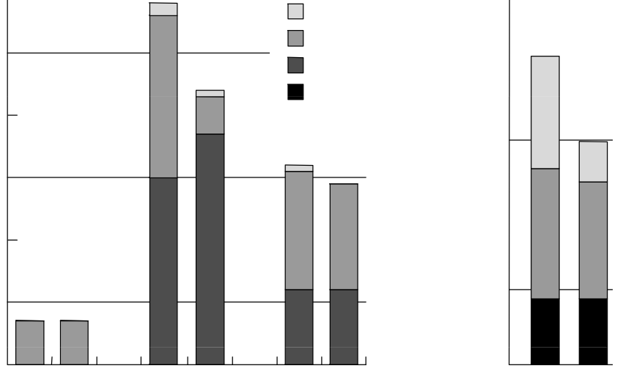
Invalidate vs. update evaluation: miss rate
Simulated 1 MB cache, 64-byte lines
False Sharing
0.5
0.4
0.3
0.2
0.1
0
True Sharing
Capacity/Conflict
2.0
1.5
1.0
0.5
0
Cold
Miss Rate (%)
Miss Rate (%)
Inv
Upd
Inv
Upd
Inv
Upd
Inv
Upd
LU
Ocean Sim
Ray Trace
Radix Sort
So... is update better?
Figure credit: Culler, Singh, and Gupta
Notes:
(True/False) sharing misses go down because the data is not kicked out
Capacity/conflict misses go up because they data is not kicked out (if it was kicked out it would be classified as a true/false sharing miss)
Update looks better right? But notice the Y axis is NOT performance, it is miss rate
Let’s look at another metric

Slide 41
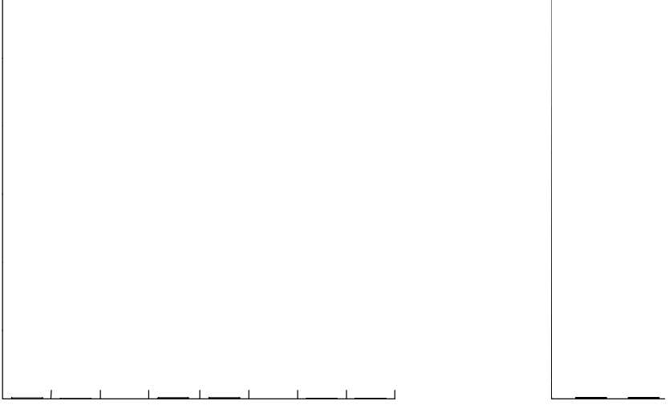
Invalidate vs. update evaluation: traffic
Simulated 1 MB cache, 64-byte lines
8
7
6
5
4
3
2
1
0
2.5
2.0
1.5
1.0
0.5
0
Upgrade/update rate (%)
Upgrade/update rate (%)
Inv
Upd
Inv
Upd
Inv
Upd
Inv
Upd
LU
Ocean Sim
Ray Trace
Radix Sort
Update can suffer from high traffic due to multiple writes before the next read by another processor
Current AMD and Intel implementations of cache coherence are invalidation based
** Charts compare frequency of upgrades in invalidation-based protocol to frequency of updates in update-based protocol
Figure credit: Culler, Singh, and Gupta
Notes:
Why is the comparison with upgrade? (It is S -> M transition that requires traffic in MSI.)
Don’t this is not a comparison with MESI I believe

Slide 42
Reality: multi-level cache hierarchies
Recall Intel Core i7 hierarchy
Challenge: changes made to data at first level cache may not be visible to second level cache controller than snoops the interconnect.
How might snooping work for a cache hierarchy?
  All caches snoop interconnect independently? (inefficient)
  Maintain “inclusion”
Shared L3 Cache
(One bank per core)
Ring Interconnect
L2 Cache
L2 Cache
L2 Cache
L2 Cache
L1 Data Cache
L1 Data Cache
L1 Data Cache
L1 Data Cache
Core
Core
Core
Core
Notes:
interference with processor
often data in L1 is also in L2

Slide 43
Inclusion property of caches
All lines in closer [to processor] cache are also in farther [from processor] cache
  e.g., contents of L1 are a subset of contents of L2
  Thus, all transactions relevant to L1 are also relevant to L2, so it is sufficient for only the L2 to snoop the interconnect
If line is in owned state (M in MSI/MESI) in L1, it must also be in M state in L2
  Allows L2 to determine if a bus transaction is requesting a modified cache line in L1 without requiring information from L1
Notes:
NOTE INCLUSION MIGHT NEED TO BE ADDRESSED IN LATER SNOOPING IMPLEMENTATION ISSUE

Slide 44
Is inclusion maintained automatically if L2 is larger than L1?
No!
Consider this example:
  Let L2 cache be twice as large as L1 cache
  Let L1 and L2 have the same line size, are 2-way set associative, and use LRU replacement policy
  Let A, B, C map to the same set of the L1 cache
A
L1
Cache
  Processor accesses A (L1+L2 miss)
B
✘
Set 0
Set 1
  Processor accesses B (L1+L2 miss).
A
✘
  Processor accesses A many times (all L1 hits).
B
L2
Cache
Set 0
Set 1
  Processor now accesses C, triggering an L1 and L2 miss. L1 and L2 might choose to evict different lines, because the access histories differ.
  As a result, inclusion no longer holds!
Set 2
Set 3
✘
Next victim
Notes:
load B1
load B2
access B1 a whole lot
then load B3 (LRU decides to evict B2 in L1 cache, B1 in L2 cache)

Slide 45
Maintaining inclusion: handling invalidations
  When line X is invalidated in L2 cache due to BusRdX from another cache.
  Must also invalidate line X in L1
Processor
L1
Cache
X
✘
Invalidate
  One solution: each L2 line contains an additional state bit indicating if line also exists in L1
  This bit tells the L2 invalidations of the cache line due to coherence traffic need to be propagated to L1.
“in L1” bit
L2
Cache
✘
X
BusRdX / --
Interconnect
Notes:
so the caches have to do *special work* to maintain inclusion
Note: L1 has to complete invalidate before requesting processor can proceed with it’s write! Yes, that’s latency in the coherence protocol!

Slide 46
Maintaining inclusion: L1 write hit
  Assume L1 is a write-back cache. Processor writes to line X. (L1 write hit)
  Line X in L2 cache is in modified state in the coherence protocol, but it has stale data!
  When coherence protocol requires X to be flushed from L2 (e.g., another processor loads X), L2 cache must request the data from L1.
  Add another bit for “modified-but-stale”
  (flushing a “modified-but-stale” L2 line requires getting the real data from L1 first.)
Processor
L1
Cache
X
“modified-but-stale” bit
Flush X
“in L1” bit
L2
Cache
X
BusRd / Flush X
Interconnect
Notes:
so the caches have to do special work to maintain inclusion

Slide 47
HW implications of implementing coherence
Each cache must listen for and react to all coherence traffic broadcast on interconnect
Additional traffic on interconnect
  Can be significant when scaling to higher core counts
Most modern multi-core CPUs implement cache coherence
To date, discrete GPUs do not implement cache coherence
  Thus far, overhead of coherence deemed not worth it for graphics and scientific computing applications (NVIDIA GPUs provide single shared L2 + atomic memory operations)
  But the latest Intel Integrated GPUs do implement cache coherence

Slide 48
NVIDIA GPUs do not implement cache coherence
Incoherent L1 caches (L1 per SMM)
Single, unified L2 cache
CUDA global memory atomic operations “bypass” L1 cache, so an atomic operation will always observe up-to-date data
// this is a read-modify-write performed atomically on the
// contents of a line in the L2 cache
atomicAdd(&x, 1);
L1 caches are write-through to L2 by default
CUDA volatile qualifier will cause compiler to generate a LD instruction that will bypass the L1 cache. (see ld.cg instruction)
NVIDIA graphics driver will clear L1 caches between any two kernel launches (ensures stores from previous kernel are visible to next kernel. Imagine a case where driver did not clear the L1 between kernel launches…
Kernel launch 1:
  SMM core 0 reads x (so it resides in L1)
SMM core 1 writes x (updated data available in L2)
Kernel launch 2:
SMM core 0 reads x (cache hit! processor observes stale data)
SMM Core
SMM Core
SMM Core
SMM Core
. . .
L1 Cache
L1 Cache
L1 Cache
L1 Cache
Shared L2 Cache
Memory (DDR5 DRAM)
If interested in more details, see “Cache Operators” section of NVIDIA PTX Manual
(Section 8.7.6.1 of Parallel Thread Execution ISA Version 4.1)

Slide 49
Implications of cache coherence to the programmer

Slide 50
Artifactual communication via false sharing
What is the potential performance problem with this code?
  // allocate per-thread variable for local per-thread accumulation
  int myPerThreadCounter[NUM_THREADS];
Why is this better?
  // allocate per thread variable for local accumulation
  struct PerThreadState {
  int myPerThreadCounter;
  char padding[CACHE_LINE_SIZE - sizeof(int)];
  };
  PerThreadState myPerThreadCounter[NUM_THREADS];

Slide 51
Demo: false sharing
void* worker(void* arg) {
volatile int* counter = (int*)arg;
for (int i=0; i<MANY_ITERATIONS; i++)
(*counter)++;
return NULL;
}
threads update a per-thread counter many times
struct padded_t {
int counter;
char padding[CACHE_LINE_SIZE - sizeof(int)];
};
void test1(int num_threads) {
pthread_t threads[MAX_THREADS];
int counter[MAX_THREADS];
for (int i=0; i<num_threads; i++)
pthread_create(&threads[i], NULL,
&worker, &counter[i]);
for (int i=0; i<num_threads; i++)
pthread_join(threads[i], NULL);
}
void test2(int num_threads) {
pthread_t threads[MAX_THREADS];
padded_t counter[MAX_THREADS];
for (int i=0; i<num_threads; i++)
pthread_create(&threads[i], NULL,
&worker, &(counter[i].counter));
for (int i=0; i<num_threads; i++)
pthread_join(threads[i], NULL);
}
Execution time with num_threads=12 on 12 core system: 5.1 sec
Execution time with num_threads=12 on 12 core system: 2.1 sec

Slide 52

False sharing
Cache line
Condition where two processors write to different addresses, but addresses map to the same cache line
Cache line “ping-pongs” between caches of writing processors, generating significant amounts of communication due to the coherence protocol
No inherent communication, this is entirely artifactual communication
False sharing can be a factor in when programming for cache-coherent architectures
P1
P2

Slide 53
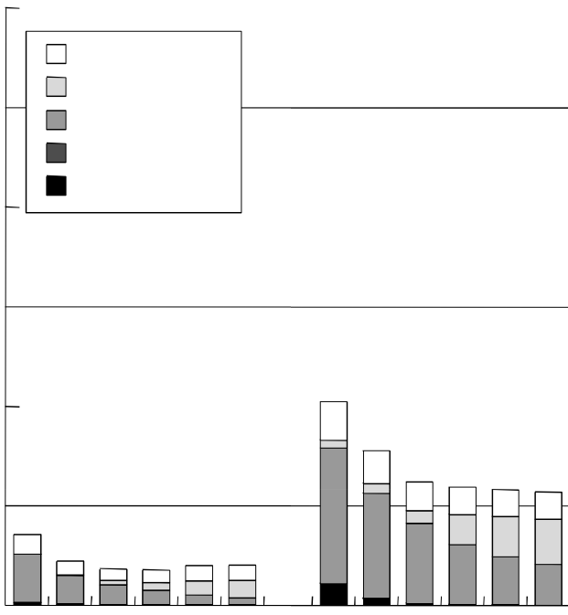
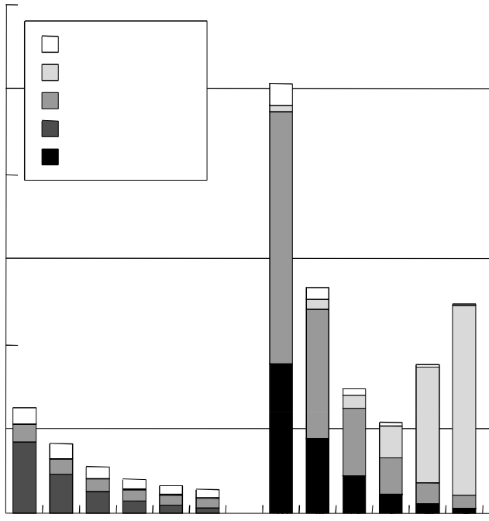
Impact of cache line size on miss rate
Results from simulation of a 1 MB cache (four example applications)
0.6
0.5
0.4
0.3
0.2
0.1
0
12
10
8
6
4
2
0
Upgrade
Upgrade
False sharing
False sharing
True sharing
True sharing
Capacity/Conflict
Capacity/Conflict
Cold
Cold
Miss Rate %
Miss Rate %
8 16 32 64 128 256
8 16 32 64 128 256
8 16 32 64 128 256
8 16 32 64 128 256
Barnes-Hut
Radiosity
Ocean Sim
Radix Sort
Cache Line Size
Cache Line Size
* Note: I separated the results into two graphs because of different Y-axis scales
Figure credit: Culler, Singh, and Gupta
Notes:
two graphs because of Y-axis magnitude issues
Q. How big are the working sets relative to the cache size? (small, not a lot of capacity misses)
Trend: everything but FALSE sharing goes down with line size.
Q. What does that imply? (spatial locality... ocean is a good example)
Q. Why do true sharing misses go down with line size. (same reason: spatial locality) But not really as fast.. particularly in OCEAN
Q. False sharing goes up, what’s going on in radix?

Slide 54
Parallel radix sort of b-bit numbers
Sort array of N, b-bit numbers
Here: radix = 2⁴ = 16
For each group of r bits: (serial loop)
In parallel, on each processor:
Sort elements by r-bit value
Compute number of elements in each bin (2^{r} bins)
Aggregate per-processor counts to compute
compute bin starts
Write elements to appropriate position
LSB
b bits
r bits
(sort key in iter [b/r]-1)
r bits
r bits
r bits
(sort key in iter 0)
P0
P1
P2
P3
Input:
Output:
Potential for lots of false sharing
False sharing decreases with increasing array size
Notes:
TOP: there is a B-bit number. LSB in figure is on the right (this is a LSD radix sort)
RADIX: count number of items for each bin
larger array: more data per processor, more contiguous writes (fewer misses)
more processors: less data per processor, fewer contiguous writes (more misses)

Slide 55
Impact on applications
Read-only data can be handled efficiently
  E.g., build up big table of computed values
  All caches get read-only copies
Writing data can be costly
  Random, overlapping patterns especially problematic
  Potential for false sharing
  Even when no synchronization required by application
Helps to operate program in phases
  Phase 1: All processors generate local copies of data
  Phase 2: Merge copies together (carefully!)
  Phase 3: Lots of read-only access

Slide 56
Summary: snooping-based coherence
The cache coherence problem exists because the abstraction of a single shared address space is not implemented by a single storage unit
  Storage is distributed among main memory and local processor caches
  Data is replicated in local caches for performance
Main idea of snooping-based cache coherence: whenever a cache operation occurs that could affect coherence, the cache controller broadcasts a notification to all other cache controllers
  Challenge for HW architects: minimizing overhead of coherence implementation
  Challenge for SW developers: be wary of artifactual communication due to coherence protocol (e.g., false sharing)
Scalability of snooping implementations is limited by ability to broadcast coherence messages to all caches!
  Next time: scaling cache coherence via directory-based approaches

