Slide 1
Lecture 2:
Pipelining and
Instruction-Level Parallelism
15-418 Parallel Computer Architecture and Programming
CMU 15-418/15-618, Spring 2019

Slide 2
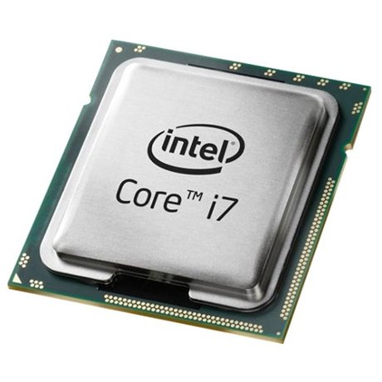
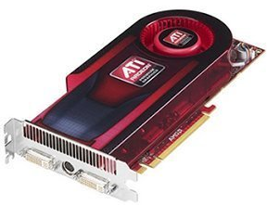
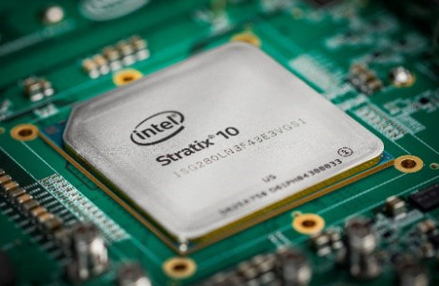
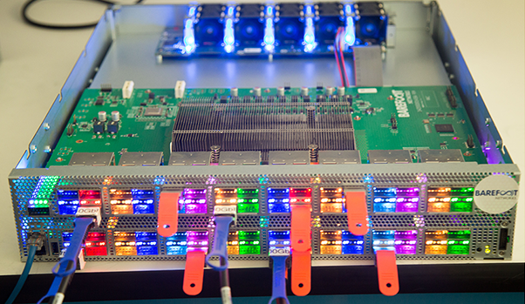
Many kinds of processors
CPU
GPU
FPGA
Etc.
Why so many? What differentiates these processors?

Slide 3
Why so many kinds of processors?
Each processor is designed for different kinds of programs
CPUs
  “Sequential” code – i.e., single / few threads
GPUs
  Programs with lots of independent work ➔ “Embarrassingly parallel”
Many others: Deep neural networks, Digital signal processing, Etc.
TODAY

Slide 4
Parallelism pervades architecture
Speeding up programs is all about parallelism
  1) Find independent work
  2) Execute it in parallel
  3) Profit
Key questions:
  Where is the parallelism?
  Whose job is it to find parallelism?

Slide 5
Where is the parallelism?
Different processors take radically different approaches
CPUs: Instruction-level parallelism
  Implicit
  Fine-grain
GPUs: Thread- & data-level parallelism
  Explicit
  Coarse-grain

Slide 6
Whose job to find parallelism?
Different processors take radically different approaches
CPUs: Hardware dynamically schedules instructions
  Expensive, complex hardware ➔ Few cores (tens)
  (Relatively) Easy to write fast software
GPUs: Software makes parallelism explicit
  Simple, cheap hardware ➔ Many cores (thousands)
  (Often) Hard to write fast software

Slide 7
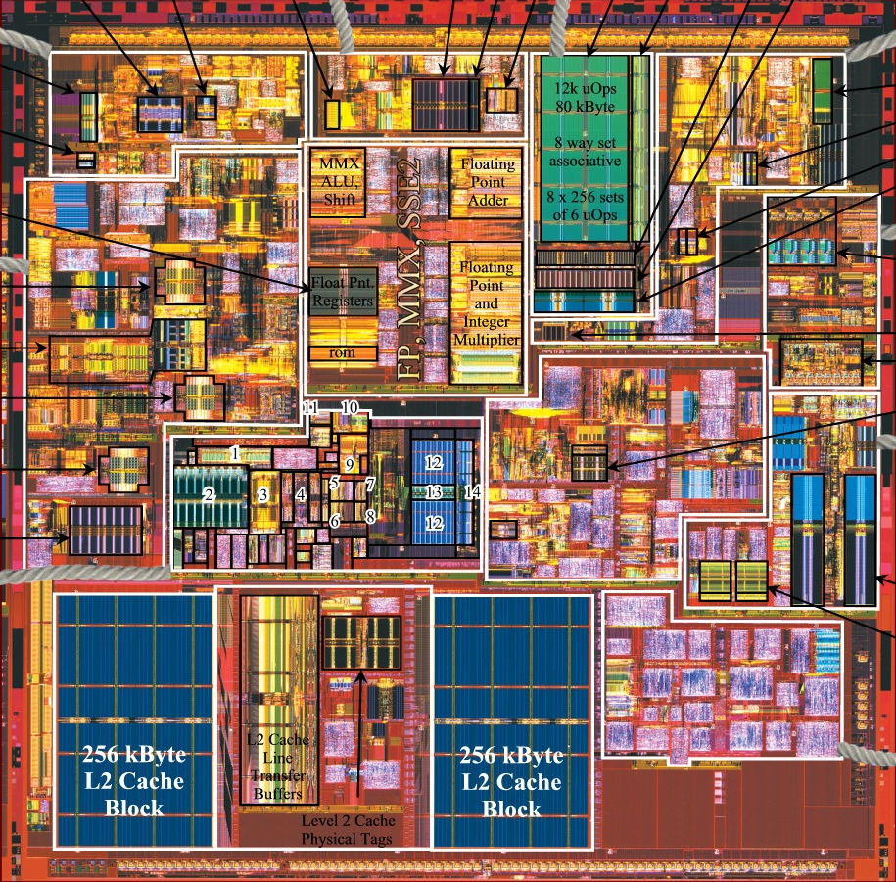
Visualizing these differences
Pentium 4 “Northwood” (2002)

Slide 8
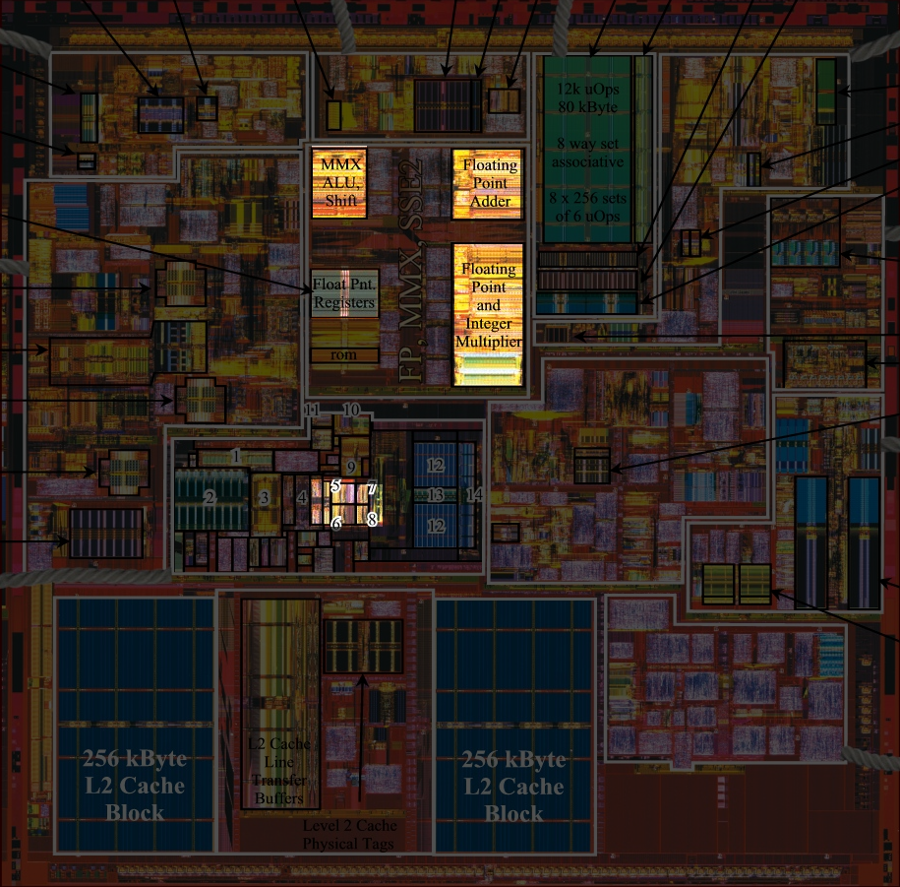
Visualizing these differences
Pentium 4 “Northwood” (2002)
Highlighted areas actually execute instructions
➔ Most area spent on scheduling
(not on executing the program)

Slide 9
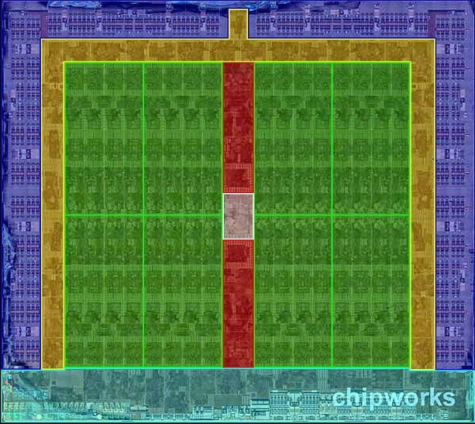
Visualizing these differences
AMD Fiji (2015)

Slide 10
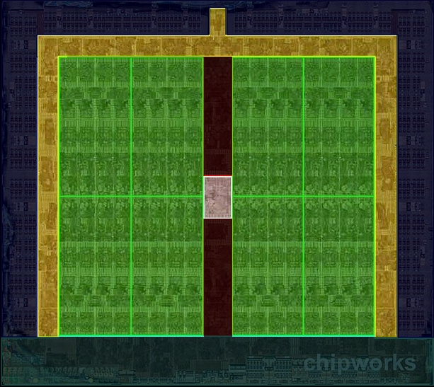
Visualizing these differences
AMD Fiji (2015)
Highlighted areas actually execute instructions
➔ Most area spent executing the program
  (Rest is mostly I/O & memory, not scheduling)

Slide 11
Today you will learn…
How CPUs exploit ILP to speed up straight-line code
Key ideas:
  Pipelining & Superscalar: Work on multiple instructions at once
  Out-of-order execution: Dynamically schedule instructions whenever they are “ready”
  Speculation: Guess what the program will do next to discover more independent work, “rolling back” incorrect guesses
CPUs must do all of this while preserving the illusion that instructions execute in-order, one-at-a-time

Slide 12
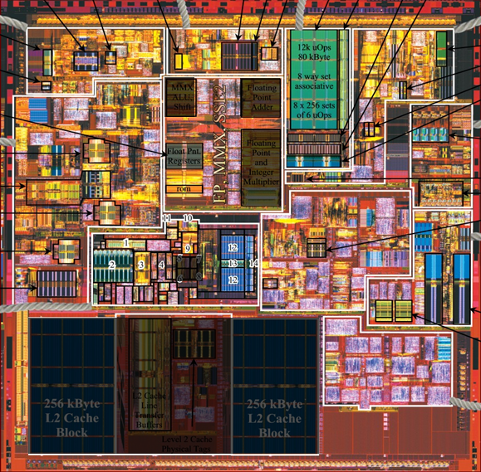
In other words… Today is about:

Slide 13
Buckle up!
…But please ask questions!

Slide 14
Example:
Polynomial evaluation
int poly(int *coef,
int terms, int x) {
int power = 1;
int value = 0;
for (int j = 0; j < terms; j++) {
value += coef[j] * power;
power *= x;
}
return value;
}

Slide 15
Example:
Polynomial evaluation
r0: value
r1: &coef[terms]
r2: x
r3: &coef[0]
r4: power
r5: coef[j]
Compiling on ARM
int poly(int *coef,
int terms, int x) {
int power = 1;
int value = 0;
for (int j = 0; j < terms; j++) {
value += coef[j] * power;
power *= x;
}
return value;
}
poly:
cmp r1, #0
ble .L4
push {r4, r5}
mov r3, r0
add r1, r0, r1, lsl #2
movs r4, #1
movs r0, #0
.L3:
ldr r5, [r3], #4
cmp r1, r3
mla r0, r4, r5, r0
mul r4, r2, r4
bne .L3
pop {r4, r5}
bx lr
.L4:
movs r0, #0
bx lr

Slide 16
Example:
Polynomial evaluation
r0: value
r1: &coef[terms]
r2: x
r3: &coef[0]
r4: power
r5: coef[j]
Compiling on ARM
int poly(int *coef,
int terms, int x) {
int power = 1;
int value = 0;
for (int j = 0; j < terms; j++) {
value += coef[j] * power;
power *= x;
}
return value;
}
poly:
cmp r1, #0
ble .L4
push {r4, r5}
mov r3, r0
add r1, r0, r1, lsl #2
movs r4, #1
movs r0, #0
.L3:
ldr r5, [r3], #4
cmp r1, r3
mla r0, r4, r5, r0
mul r4, r2, r4
bne .L3
pop {r4, r5}
bx lr
.L4:
movs r0, #0
bx lr
Preamble
Iteration
Fini

Slide 17
Example:
Polynomial evaluation
r0: value
r1: &coef[terms]
r2: x
r3: &coef[j]
r4: power
r5: coef[j]
Compiling on ARM
for (int j = 0; j < terms; j++) {
value += coef[j] * power;
power *= x;
}
.L3:
ldr r5, [r3], #4 // r5 <- coef[j]; j++ (two operations)
cmp r1, r3 // compare: j < terms?
mla r0, r4, r5, r0 // value += r5 * power (mul + add)
mul r4, r2, r4 // power *= x
bne .L3 // repeat?

Slide 18
Example:
Polynomial evaluation
Executing poly(A, 3, x)
cmp r1, #0
ble .L4
push {r4, r5}
mov r3, r0
add r1, r0, r1, lsl #2
movs r4, #1
movs r0, #0
ldr r5, [r3], #4
cmp r1, r3
mla r0, r4, r5, r0
mul r4, r2, r4
bne .L3
...

Slide 19
Example:
Polynomial evaluation
Executing poly(A, 3, x)
cmp r1, #0
ble .L4
push {r4, r5}
mov r3, r0
add r1, r0, r1, lsl #2
movs r4, #1
movs r0, #0
ldr r5, [r3], #4
cmp r1, r3
mla r0, r4, r5, r0
mul r4, r2, r4
bne .L3
...
Preamble
J=0 iteration

Slide 20
Example:
Polynomial evaluation
Executing poly(A, 3, x)
cmp r1, #0
ble .L4
push {r4, r5}
mov r3, r0
add r1, r0, r1, lsl #2
movs r4, #1
movs r0, #0
ldr r5, [r3], #4
cmp r1, r3
mla r0, r4, r5, r0
mul r4, r2, r4
bne .L3
...
...
ldr r5, [r3], #4
cmp r1, r3
mla r0, r4, r5, r0
mul r4, r2, r4
bne .L3
ldr r5, [r3], #4
cmp r1, r3
mla r0, r4, r5, r0
mul r4, r2, r4
bne .L3
pop {r4, r5}
bx lr
Preamble
J=1 iteration
J=2 iteration
J=0 iteration
Fini

Slide 21
Example:
Polynomial evaluation
Executing poly(A, 3, x)
cmp r1, #0
ble .L4
push {r4, r5}
mov r3, r0
add r1, r0, r1, lsl #2
movs r4, #1
movs r0, #0
ldr r5, [r3], #4
cmp r1, r3
mla r0, r4, r5, r0
mul r4, r2, r4
bne .L3
...
...
ldr r5, [r3], #4
cmp r1, r3
mla r0, r4, r5, r0
mul r4, r2, r4
bne .L3
ldr r5, [r3], #4
cmp r1, r3
mla r0, r4, r5, r0
mul r4, r2, r4
bne .L3
pop {r4, r5}
bx lr
Preamble
J=1 iteration
J=2 iteration
J=0 iteration
Fini

Slide 22
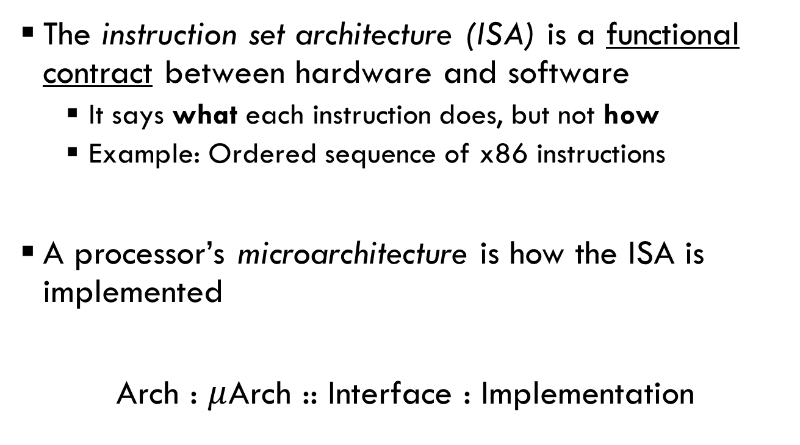
The software-hardware boundary
The instruction set architecture (ISA) is a functional contract between hardware and software
  It says what each instruction does, but not how
  Example: Ordered sequence of x86 instructions
A processor’s microarchitecture is how the ISA is implemented
Arch : $μ$Arch :: Interface : Implementation

Slide 23
Simple CPU model
Execute instructions in program order
Divide instruction execution into stages, e.g.:
  1. Fetch – get the next instruction from memory
  2. Decode – figure out what to do & read inputs
  3. Execute – perform the necessary operations
  4. Commit – write the results back to registers / memory
  (Real processors have many more stages)

Slide 24
Evaluating polynomial on the simple CPU model
ldr r5, [r3], #4
cmp r1, r3
mla r0, r4, r5, r0
mul r4, r2, r4
bne .L3
ldr r5, [r3], #4
cmp r1, r3
mla r0, r4, r5, r0
mul r4, r2, r4
bne .L3
...
CPU
Fetch
Decode
Execute
Commit

Slide 25
Evaluating polynomial on the simple CPU model
ldr r5, [r3], #4
cmp r1, r3
mla r0, r4, r5, r0
mul r4, r2, r4
bne .L3
ldr r5, [r3], #4
cmp r1, r3
mla r0, r4, r5, r0
mul r4, r2, r4
bne .L3
...
CPU
Fetch
Decode
Execute
Commit
ldr
1. Read “ldr r5, [r3] #4” from memory

Slide 26
Evaluating polynomial on the simple CPU model
ldr r5, [r3], #4
cmp r1, r3
mla r0, r4, r5, r0
mul r4, r2, r4
bne .L3
ldr r5, [r3], #4
cmp r1, r3
mla r0, r4, r5, r0
mul r4, r2, r4
bne .L3
...
CPU
Fetch
Decode
Execute
Commit
ldr
2. Decode “ldr r5, [r3] #4” and read input regs

Slide 27
Evaluating polynomial on the simple CPU model
ldr r5, [r3], #4
cmp r1, r3
mla r0, r4, r5, r0
mul r4, r2, r4
bne .L3
ldr r5, [r3], #4
cmp r1, r3
mla r0, r4, r5, r0
mul r4, r2, r4
bne .L3
...
CPU
Fetch
Decode
Execute
Commit
ldr
3. Load memory at r3 and compute r3 + 4

Slide 28
Evaluating polynomial on the simple CPU model
ldr r5, [r3], #4
cmp r1, r3
mla r0, r4, r5, r0
mul r4, r2, r4
bne .L3
ldr r5, [r3], #4
cmp r1, r3
mla r0, r4, r5, r0
mul r4, r2, r4
bne .L3
...
CPU
Fetch
Decode
Execute
Commit
ldr
4. Write values into regs r5 and r3

Slide 29
Evaluating polynomial on the simple CPU model
ldr r5, [r3], #4
cmp r1, r3
mla r0, r4, r5, r0
mul r4, r2, r4
bne .L3
ldr r5, [r3], #4
cmp r1, r3
mla r0, r4, r5, r0
mul r4, r2, r4
bne .L3
...
CPU
Fetch
Decode
Execute
Commit
cmp

Slide 30
Evaluating polynomial on the simple CPU model
ldr r5, [r3], #4
cmp r1, r3
mla r0, r4, r5, r0
mul r4, r2, r4
bne .L3
ldr r5, [r3], #4
cmp r1, r3
mla r0, r4, r5, r0
mul r4, r2, r4
bne .L3
...
CPU
Fetch
Decode
Execute
Commit
cmp

Slide 31
Evaluating polynomial on the simple CPU model
ldr r5, [r3], #4
cmp r1, r3
mla r0, r4, r5, r0
mul r4, r2, r4
bne .L3
ldr r5, [r3], #4
cmp r1, r3
mla r0, r4, r5, r0
mul r4, r2, r4
bne .L3
...
CPU
Fetch
Decode
Execute
Commit
cmp

Slide 32
Evaluating polynomial on the simple CPU model
ldr r5, [r3], #4
cmp r1, r3
mla r0, r4, r5, r0
mul r4, r2, r4
bne .L3
ldr r5, [r3], #4
cmp r1, r3
mla r0, r4, r5, r0
mul r4, r2, r4
bne .L3
...
CPU
Fetch
Decode
Execute
Commit
cmp

Slide 33
Evaluating polynomial on the simple CPU model
ldr r5, [r3], #4
cmp r1, r3
mla r0, r4, r5, r0
mul r4, r2, r4
bne .L3
ldr r5, [r3], #4
cmp r1, r3
mla r0, r4, r5, r0
mul r4, r2, r4
bne .L3
...
CPU
Fetch
Decode
Execute
Commit
mla

Slide 34
Evaluating polynomial on the simple CPU model
How fast is this processor?
1 ns
Latency? Throughput?
TIME
Fetch | ldr |  |  |  | cmp |  |  |  | mla
Decode |  | ldr |  |  |  | cmp |  |  |  | mla
Execute |  |  | ldr |  |  |  | cmp
Commit |  |  |  | ldr |  |  |  | cmp
…
Latency = 4 ns / instr
Throughput = 1 instr / 4 ns

Slide 35
Simple CPU is very wasteful
1 ns
TIME
Fetch | ldr |  |  |  | cmp |  |  |  | mla
Decode |  | ldr |  |  |  | cmp |  |  |  | mla
Execute |  |  | ldr |  |  |  | cmp
Commit |  |  |  | ldr |  |  |  | cmp
Idle Hardware
…

Slide 36
Pipelining

Slide 37
Pipelining keeps CPU busy through instruction-level parallelism
Idea: Start on the next instr’n immediately
ldr r5, [r3], #4
cmp r1, r3
mla r0, r4, r5, r0
mul r4, r2, r4
bne .L3
ldr r5, [r3], #4
cmp r1, r3
mla r0, r4, r5, r0
mul r4, r2, r4
bne .L3
...
CPU
Fetch
Decode
Execute
Commit
ldr

Slide 38
Pipelining keeps CPU busy through instruction-level parallelism
Idea: Start on the next instr’n immediately
ldr r5, [r3], #4
cmp r1, r3
mla r0, r4, r5, r0
mul r4, r2, r4
bne .L3
ldr r5, [r3], #4
cmp r1, r3
mla r0, r4, r5, r0
mul r4, r2, r4
bne .L3
...
CPU
Fetch
Decode
Execute
Commit
cmp
ldr

Slide 39
Pipelining keeps CPU busy through instruction-level parallelism
Idea: Start on the next instr’n immediately
ldr r5, [r3], #4
cmp r1, r3
mla r0, r4, r5, r0
mul r4, r2, r4
bne .L3
ldr r5, [r3], #4
cmp r1, r3
mla r0, r4, r5, r0
mul r4, r2, r4
bne .L3
...
CPU
Fetch
Decode
Execute
Commit
mla
cmp
ldr

Slide 40
Pipelining keeps CPU busy through instruction-level parallelism
Idea: Start on the next instr’n immediately
ldr r5, [r3], #4
cmp r1, r3
mla r0, r4, r5, r0
mul r4, r2, r4
bne .L3
ldr r5, [r3], #4
cmp r1, r3
mla r0, r4, r5, r0
mul r4, r2, r4
bne .L3
...
CPU
Fetch
Decode
Execute
Commit
mul
mla
cmp
ldr

Slide 41
Pipelining keeps CPU busy through instruction-level parallelism
Idea: Start on the next instr’n immediately
ldr r5, [r3], #4
cmp r1, r3
mla r0, r4, r5, r0
mul r4, r2, r4
bne .L3
ldr r5, [r3], #4
cmp r1, r3
mla r0, r4, r5, r0
mul r4, r2, r4
bne .L3
...
CPU
Fetch
Decode
Execute
Commit
bne
mul
mla
cmp

Slide 42
Pipelining keeps CPU busy through instruction-level parallelism
Idea: Start on the next instr’n immediately
ldr r5, [r3], #4
cmp r1, r3
mla r0, r4, r5, r0
mul r4, r2, r4
bne .L3
ldr r5, [r3], #4
cmp r1, r3
mla r0, r4, r5, r0
mul r4, r2, r4
bne .L3
...
CPU
Fetch
Decode
Execute
Commit
ldr
bne
mul
mla

Slide 43
Evaluating polynomial on the pipelined CPU
How fast is this processor?
1 ns
Latency? Throughput?
TIME
Fetch | ldr | cmp | mla | mul | bne | ldr | cmp | mla | mul | bne
Decode |  | ldr | cmp | mla | mul | bne | ldr | cmp | mla | mul
Execute |  |  | ldr | cmp | mla | mul | bne | ldr | cmp | mla
Commit |  |  |  | ldr | cmp | mla | mul | bne | ldr | cmp
…
Throughput = 1 instr / ns
4X speedup!
Latency = 4 ns / instr

Slide 44
Speedup achieved through pipeline parallelism
Processor works on 4 instructions at a time
TIME
Fetch | ldr | cmp | mla | mul | bne | ldr | cmp | mla | mul | bne
Decode |  | ldr | cmp | mla | mul | bne | ldr | cmp | mla | mul
Execute |  |  | ldr | cmp | mla | mul | bne | ldr | cmp | mla
Commit |  |  |  | ldr | cmp | mla | mul | bne | ldr | cmp
…

Slide 45
Limitations of pipelining
Parallelism requires independent work
Q: Are instructions independent?
A: No! Many possible hazards limit parallelism…

Slide 46
Data hazards
ldr ra, [rb], #4 // ra ← Memory[rb]; rb ← rb + 4
cmp rc, rd // rc ← rd + re
Q: When can the CPU pipeline the cmp behind ldr?
Fetch | ldr | cmp | … | … | … | …
Decode |  | ldr | cmp | … | … | …
Execute |  |  | ldr | cmp | … | …
Commit |  |  |  | ldr | cmp | …
A: When they use different registers
  Specifically, when cmp does not read any data written by ldr
  E.g., rb != rd

Slide 47
Dealing with data hazards:
Stalling the pipeline
Cannot pipeline cmp (ldr writes r3)
ldr r5, [r3], #4
cmp r1, r3
mla r0, r4, r5, r0
mul r4, r2, r4
bne .L3
ldr r5, [r3], #4
cmp r1, r3
mla r0, r4, r5, r0
mul r4, r2, r4
bne .L3
...
CPU
Fetch
Decode
Execute
Commit
ldr

Slide 48
Dealing with data hazards:
Stalling the pipeline
Cannot pipeline cmp (ldr writes r3)
ldr r5, [r3], #4
cmp r1, r3
mla r0, r4, r5, r0
mul r4, r2, r4
bne .L3
ldr r5, [r3], #4
cmp r1, r3
mla r0, r4, r5, r0
mul r4, r2, r4
bne .L3
...
CPU
Fetch
Decode
Execute
Commit
cmp
ldr
??

Slide 49
Dealing with data hazards:
Stalling the pipeline
Cannot pipeline cmp (ldr writes r3)
ldr r5, [r3], #4
cmp r1, r3
mla r0, r4, r5, r0
mul r4, r2, r4
bne .L3
ldr r5, [r3], #4
cmp r1, r3
mla r0, r4, r5, r0
mul r4, r2, r4
bne .L3
...
CPU
Fetch
Decode
Execute
Commit
mla
cmp
ldr

Slide 50
Dealing with data hazards:
Stalling the pipeline
Cannot pipeline cmp (ldr writes r3)
ldr r5, [r3], #4
cmp r1, r3
mla r0, r4, r5, r0
mul r4, r2, r4
bne .L3
ldr r5, [r3], #4
cmp r1, r3
mla r0, r4, r5, r0
mul r4, r2, r4
bne .L3
...
CPU
Fetch
Decode
Execute
Commit
mla
cmp
ldr
Inject a “bubble” (NOP) into the pipeline

Slide 51
Dealing with data hazards:
Stalling the pipeline
Cannot pipeline cmp (ldr writes r3)
ldr r5, [r3], #4
cmp r1, r3
mla r0, r4, r5, r0
mul r4, r2, r4
bne .L3
ldr r5, [r3], #4
cmp r1, r3
mla r0, r4, r5, r0
mul r4, r2, r4
bne .L3
...
CPU
Fetch
Decode
Execute
Commit
mul
mla
cmp
cmp proceeds once ldr has committed

Slide 52
Stalling degrades performance
Processor works on 3 instructions at a time
TIME
But stalling is sometimes unavoidable
  E.g., long-latency instructions (divide, cache miss)
Fetch | ldr | cmp | mla | mul | bne | ldr | cmp | mla | mul | bne
Decode |  | ldr | cmp | mla | mul | bne | ldr | cmp | mla | mul
Execute |  |  | ldr |  | cmp | mla | mul | bne | ldr
Commit |  |  |  | ldr |  | cmp | mla | mul | bne | ldr
…

Slide 53
Dealing with data hazards:
Forwarding data
Wait a second… data is available after Execute!
Forwarding eliminates many (not all) pipeline stalls
CPU
Fetch
Decode
Execute
Commit
r3
r3+4
mla
cmp
ldr
mul
r1

Slide 54
Pipelining is not free!
Q: How well does forwarding scale?
A: Not well… many forwarding paths in deep & complex pipelines
CPU
Fetch
Decode
Execute
Execute
Commit
Mem

Slide 55
Control hazards + Speculation
Programs must appear to execute in program order
➔ All instructions depend on earlier ones
Most instructions implicitly continue at the next…
But branches redirect execution to new location

Slide 56
Dealing with control hazards:
Flushing the pipeline
What if we always fetch the next instruction?
ldr r5, [r3], #4
cmp r1, r3
mla r0, r4, r5, r0
mul r4, r2, r4
bne .L3
pop {r4, r5}
bx lr
CPU
Fetch
Decode
Execute
Commit
bne
mul
mla
cmp
Static instruction sequence
(i.e., program layout in memory)

Slide 57
Dealing with control hazards:
Flushing the pipeline
What if we always fetch the next instruction?
ldr r5, [r3], #4
cmp r1, r3
mla r0, r4, r5, r0
mul r4, r2, r4
bne .L3
pop {r4, r5}
bx lr
CPU
Fetch
Decode
Execute
Commit
pop
bne
mul
mla
Static instruction sequence
(i.e., program layout in memory)

Slide 58
Dealing with control hazards:
Flushing the pipeline
What if we always fetch the next instruction?
ldr r5, [r3], #4
cmp r1, r3
mla r0, r4, r5, r0
mul r4, r2, r4
bne .L3
pop {r4, r5}
bx lr
CPU
Fetch
Decode
Execute
Commit
bx
pop
bne
mul
Static instruction sequence
(i.e., program layout in memory)
Whoops! We fetched the wrong instructions! (Loop not finished)

Slide 59
Dealing with control hazards:
Flushing the pipeline
(Next loop iteration)
What if we always fetch the next instruction?
ldr r5, [r3], #4
cmp r1, r3
mla r0, r4, r5, r0
mul r4, r2, r4
bne .L3
pop {r4, r5}
bx lr
CPU
Fetch
Decode
Execute
Commit
ldr
bne
Static instruction sequence
(i.e., program layout in memory)
Whoops! We fetched the wrong instructions! (Loop not finished)

Slide 60
Pipeline flushes destroy performance
Processor works on 2 or 3 instructions at a time
TIME
Penalty increases with deeper pipelines
Fetch | ldr | cmp | mla | mul | bne |  |  | ldr | cmp | mla
Decode |  | ldr | cmp | mla | mul | bne |  |  | ldr | cmp
Execute |  |  | ldr | cmp | mla | mul | bne |  |  | ldr
Commit |  |  |  | ldr | cmp | mla | mul | bne
…

Slide 61
Dealing with control hazards:
Speculation!
Processors do not wait for branches to execute
Instead, they speculate (i.e., guess) where to go next + start fetching
Modern processors use very sophisticated mechanisms
  E.g., speculate in Fetch stage—before processor even knows instrn is a branch!
  >95% prediction accuracy
  Still, branch mis-speculation is major problem

Slide 62
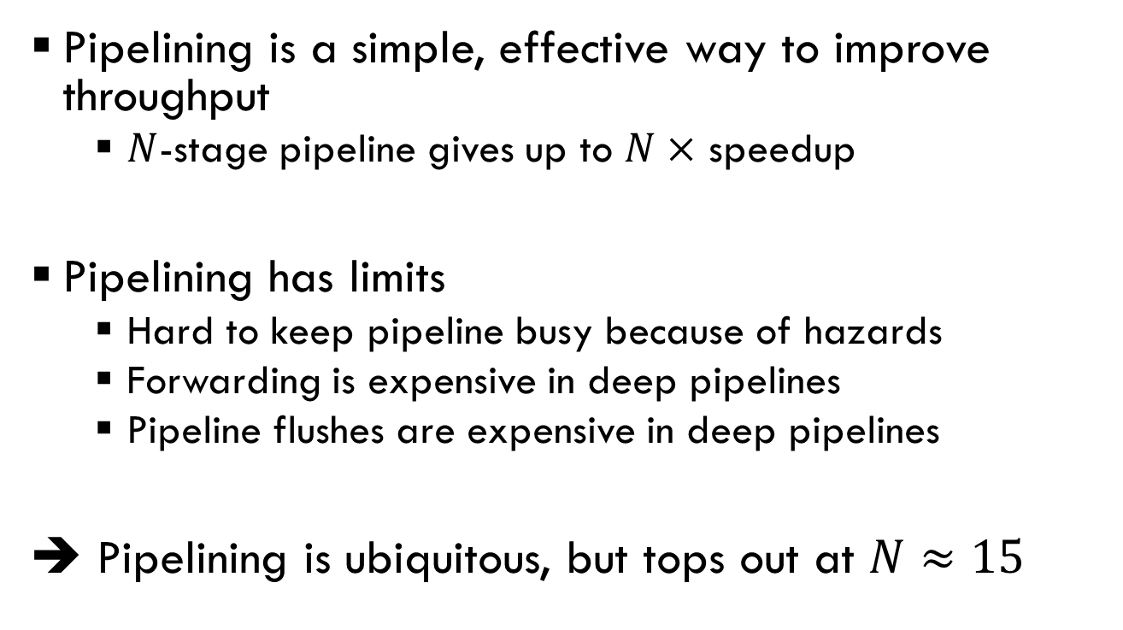
Pipelining Summary
Pipelining is a simple, effective way to improve throughput
  $N$-stage pipeline gives up to $N×$ speedup
Pipelining has limits
  Hard to keep pipeline busy because of hazards
  Forwarding is expensive in deep pipelines
  Pipeline flushes are expensive in deep pipelines
➔ Pipelining is ubiquitous, but tops out at $N≈15$

Slide 63
Out-of-Order Execution

Slide 64
Increasing parallelism via dataflow
Parallelism limited by many false dependencies, particularly sequential program order
Dataflow tracks how instructions actually depend on each other
  True dependence: read-after-write
Dataflow increases parallelism by eliminating unnecessary dependences

Slide 65
Example: Dataflow in polynomial evaluation
ldr
mul
cmp
mla
ldr r5, [r3], #4
cmp r1, r3
mla r0, r4, r5, r0
mul r4, r2, r4
bne .L3
ldr r5, [r3], #4
cmp r1, r3
mla r0, r4, r5, r0
mul r4, r2, r4
bne .L3
...
Loop iteration
bne

Slide 66
Example: Dataflow in polynomial evaluation
cmp
bne
ldr
mul
cmp
mla
ldr r5, [r3], #4
cmp r1, r3
mla r0, r4, r5, r0
mul r4, r2, r4
bne .L3
ldr r5, [r3], #4
cmp r1, r3
mla r0, r4, r5, r0
mul r4, r2, r4
bne .L3
...
Loop iteration
bne
ldr
mul
cmp
mla
bne
ldr
mul

Slide 67
Example: Dataflow polynomial execution
Execution only, with perfect scheduling & unlimited execution units
  ldr, mul execute in 2 cycles
  cmp, bne execute in 1 cycle
  mla executes in 3 cycles
Q: Does dataflow speedup execution? By how much?
Q: What is the performance bottleneck?

Slide 68
1
2
3
4
5
6
7
8
9
10
11
12
13
14
15
16
ldr
TIME
ldr r5, [r3], #4
cmp r1, r3
mla r0, r4, r5, r0
mul r4, r2, r4
bne .L3

Slide 69
1
2
3
4
5
6
7
8
9
10
11
12
13
14
15
16
ldr
 |  | cmp
TIME
ldr r5, [r3], #4
cmp r1, r3
mla r0, r4, r5, r0
mul r4, r2, r4
bne .L3

Slide 70
1
2
3
4
5
6
7
8
9
10
11
12
13
14
15
16
ldr
 |  | cmp |  |  |  | mla
TIME
ldr r5, [r3], #4
cmp r1, r3
mla r0, r4, r5, r0
mul r4, r2, r4
bne .L3

Slide 71
1
2
3
4
5
6
7
8
9
10
11
12
13
14
15
16
ldr |  |  |  |  |  |  |  | mul
 |  | cmp |  |  |  | mla
TIME
ldr r5, [r3], #4
cmp r1, r3
mla r0, r4, r5, r0
mul r4, r2, r4
bne .L3

Slide 72
1
2
3
4
5
6
7
8
9
10
11
12
13
14
15
16
ldr |  |  |  |  |  |  |  | mul
 |  | cmp |  |  |  | mla
 |  |  |  | bne
TIME
ldr r5, [r3], #4
cmp r1, r3
mla r0, r4, r5, r0
mul r4, r2, r4
bne .L3

Slide 73
1
2
3
4
5
6
7
8
9
10
11
12
13
14
15
16
ldr |  |  |  |  |  |  |  | mul
ldr |  | cmp |  |  |  | mla |  | mul
 |  |  |  | bne
 |  | cmp
 |  |  |  | bne |  | mla
TIME
ldr r5, [r3], #4
cmp r1, r3
mla r0, r4, r5, r0
mul r4, r2, r4
bne .L3
ldr r5, [r3], #4
cmp r1, r3
mla r0, r4, r5, r0
mul r4, r2, r4
bne .L3

Slide 74
1
2
3
4
5
6
7
8
9
10
11
12
13
14
15
16
ldr |  |  |  |  |  |  |  | mul
ldr |  | cmp |  |  |  | mla |  | mul
 |  |  |  | bne
ldr |  | cmp |  |  |  |  |  | mul
 |  |  |  | bne |  | mla
 |  | cmp
 |  |  |  | bne
 |  |  |  |  |  | mla
TIME

Slide 75
1
2
3
4
5
6
7
8
9
10
11
12
13
14
15
16
ldr |  |  |  |  |  |  |  | mul
ldr |  | cmp |  |  |  | mla |  | mul
 |  |  |  | bne
ldr |  | cmp |  |  |  |  |  | mul
 |  |  |  | bne |  | mla
ldr |  | cmp |  |  |  |  |  | mul
 |  |  |  | bne
ldr |  | cmp |  |  |  | mla |  | mul
 |  |  |  | bne
ldr |  | cmp |  |  |  |  |  | mul
 |  |  |  | bne |  | mla
ldr |  | cmp |  |  |  |  |  | mul
 |  |  |  | bne
ldr |  | cmp |  |  |  | mla |  | mul
 |  |  |  | bne
TIME

Slide 76
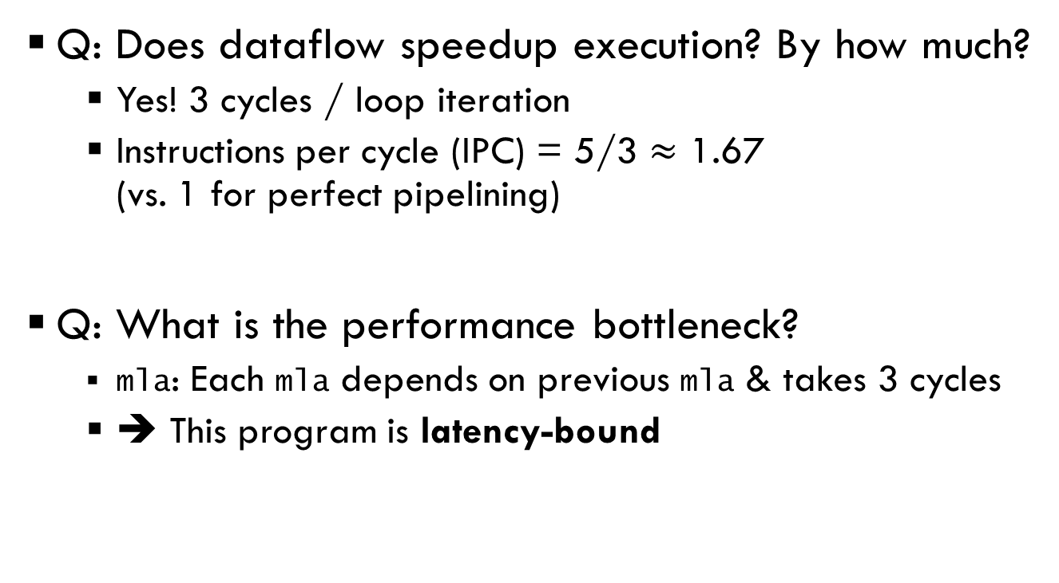
Example: Dataflow polynomial execution
Q: Does dataflow speedup execution? By how much?
  Yes! 3 cycles / loop iteration
  Instructions per cycle (IPC) = 5/3 $≈$ 1.67
  (vs. 1 for perfect pipelining)
Q: What is the performance bottleneck?
  mla: Each mla depends on previous mla & takes 3 cycles
  ➔ This program is latency-bound

Slide 77
Out-of-order (OoO) execution uses dataflow to increase parallelism
Idea: Execute programs in dataflow order, but give the illusion of sequential execution
This is a “restricted dataflow” model
  Restricted to instructions near those currently committing
  (Pure dataflow processors also exist that expose dataflow to software)

Slide 78
High-level OoO microarchitecture
CPU
Instruction Buffer
Fetch
Decode
Execute
Commit
In-order
Out-of-order
In-order

Slide 79
OoO is hidden behind in-order frontend & commit
CPU
Instruction Buffer
Fetch
Decode
Execute
Commit
C
B
A
Instructions only enter & leave instruction buffer in program order; all bets are off in between!

Slide 80
Example: OoO polynomial evaluation
Q: Does OoO speedup execution? By how much?
Q: What is the performance bottleneck?
Assume perfect forwarding & branch prediction

Slide 81
Example: OoO polynomial evaluation pipeline diagram
TIME
Fetch & Decode | ldr
Execute |  | ldr
Commit |  |  |  | ldr

Slide 82
Example: OoO polynomial evaluation pipeline diagram
TIME
Fetch & Decode | ldr | cmp
Execute |  | ldr |  | cmp
Commit |  |  |  | ldr | cmp

Slide 83
Example: OoO polynomial evaluation pipeline diagram
TIME
Fetch & Decode | ldr | cmp | mla
Execute |  | ldr |  | cmp | mla
Commit |  |  |  | ldr | cmp |  |  | mla

Slide 84
Example: OoO polynomial evaluation pipeline diagram
TIME
Fetch & Decode | ldr | cmp | mla | mul
Execute |  | ldr |  | cmp | mla |  |  | mul
Commit |  |  |  | ldr | cmp |  |  | mla |  | mul

Slide 85
Example: OoO polynomial evaluation pipeline diagram
TIME
Fetch & Decode | ldr | cmp | mla | mul | bne
Execute |  | ldr |  | cmp | mla |  |  | mul |  | bne
Commit |  |  |  | ldr | cmp |  |  | mla |  | mul | bne

Slide 86
Example: OoO polynomial evaluation pipeline diagram
TIME
Fetch & Decode | ldr | cmp | mla | mul | bne | ldr | cmp | mla | mul | bne | ldr | cmp | mla | mul | bne | ldr
Execute |  | ldr |  | cmp | mla |  |  | mul |  | bne | ldr |  | cmp | mla
Commit |  |  |  | ldr | cmp |  |  | mla |  | mul | bne |  | ldr | cmp

Slide 87
Example: OoO polynomial evaluation pipeline diagram
TIME
Wait a minute… this isn’t OoO… or even faster than a simple pipeline!
Q: What went wrong?
A: We’re throughput-limited: can only issue 1 instrn
Fetch & Decode | ldr | cmp | mla | mul | bne | ldr | cmp | mla | mul | bne | ldr | cmp | mla | mul | bne | ldr
Execute |  | ldr |  | cmp | mla |  |  | mul |  | bne | ldr |  | cmp | mla
Commit |  |  |  | ldr | cmp |  |  | mla |  | mul | bne |  | ldr | cmp

Slide 88
High-level Superscalar OoO microarchitecture
Must increase pipeline width to increase ILP > 1
CPU
Instruction Buffer
Fetch
Decode
Execute
Execute
Execute
Commit
Fetch
Decode
Commit
In-order
Out-of-order
In-order

Slide 89
Example: Superscalar OoO polynomial evaluation
TIME
Fetch & Decode | ldr
 | cmp
Execute
Commit
ldr r5, [r3], #4
cmp r1, r3
mla r0, r4, r5, r0
mul r4, r2, r4
bne .L3
ldr r5, [r3], #4
cmp r1, r3
mla r0, r4, r5, r0
mul r4, r2, r4
bne .L3

Slide 90
Example: Superscalar OoO polynomial evaluation
TIME
Fetch & Decode | ldr | mla | bne | cmp | mul
 | cmp | mul | ldr | mla | bne
Execute
Commit
ldr r5, [r3], #4
cmp r1, r3
mla r0, r4, r5, r0
mul r4, r2, r4
bne .L3
ldr r5, [r3], #4
cmp r1, r3
mla r0, r4, r5, r0
mul r4, r2, r4
bne .L3

Slide 91
Example: Superscalar OoO polynomial evaluation
TIME
Fetch & Decode | ldr | mla | bne | cmp | mul
 | cmp | mul | ldr | mla | bne
Execute |  | ldr
Commit
ldr r5, [r3], #4
cmp r1, r3
mla r0, r4, r5, r0
mul r4, r2, r4
bne .L3
ldr r5, [r3], #4
cmp r1, r3
mla r0, r4, r5, r0
mul r4, r2, r4
bne .L3

Slide 92
Example: Superscalar OoO polynomial evaluation
TIME
Fetch & Decode | ldr | mla | bne | cmp | mul
 | cmp | mul | ldr | mla | bne
Execute |  | ldr
 |  |  | mul
Commit
ldr r5, [r3], #4
cmp r1, r3
mla r0, r4, r5, r0
mul r4, r2, r4
bne .L3
ldr r5, [r3], #4
cmp r1, r3
mla r0, r4, r5, r0
mul r4, r2, r4
bne .L3

Slide 93
Example: Superscalar OoO polynomial evaluation
TIME
Fetch & Decode | ldr | mla | bne | cmp | mul
 | cmp | mul | ldr | mla | bne
Execute |  | ldr |  | cmp
 |  |  |  | mla
 |  |  | mul
Commit
ldr r5, [r3], #4
cmp r1, r3
mla r0, r4, r5, r0
mul r4, r2, r4
bne .L3
ldr r5, [r3], #4
cmp r1, r3
mla r0, r4, r5, r0
mul r4, r2, r4
bne .L3

Slide 94
Example: Superscalar OoO polynomial evaluation
TIME
Fetch & Decode | ldr | mla | bne | cmp | mul
 | cmp | mul | ldr | mla | bne
Execute |  | ldr |  | cmp | bne
 |  |  |  | mla
 |  |  | mul |  | ldr
Commit
ldr r5, [r3], #4
cmp r1, r3
mla r0, r4, r5, r0
mul r4, r2, r4
bne .L3
ldr r5, [r3], #4
cmp r1, r3
mla r0, r4, r5, r0
mul r4, r2, r4
bne .L3

Slide 95
Example: Superscalar OoO polynomial evaluation
TIME
Fetch & Decode | ldr | mla | bne | cmp | mul
 | cmp | mul | ldr | mla | bne
Execute |  | ldr |  | cmp | bne | mul
 |  |  |  | mla |  |  | mla
 |  |  | mul |  | ldr |  | cmp | bne
Commit
ldr r5, [r3], #4
cmp r1, r3
mla r0, r4, r5, r0
mul r4, r2, r4
bne .L3
ldr r5, [r3], #4
cmp r1, r3
mla r0, r4, r5, r0
mul r4, r2, r4
bne .L3

Slide 96
Example: Superscalar OoO polynomial evaluation
TIME
Fetch & Decode | ldr | mla | bne | cmp | mul
 | cmp | mul | ldr | mla | bne
Execute |  | ldr |  | cmp | bne | mul
 |  |  |  | mla |  |  | mla
 |  |  | mul |  | ldr |  | cmp | bne
Commit |  |  |  | ldr | cmp |  | mla | bne | cmp | mla | bne
 |  |  |  |  |  |  | mul | ldr |  | mul
ldr r5, [r3], #4
cmp r1, r3
mla r0, r4, r5, r0
mul r4, r2, r4
bne .L3
ldr r5, [r3], #4
cmp r1, r3
mla r0, r4, r5, r0
mul r4, r2, r4
bne .L3

Slide 97
Example: Superscalar OoO polynomial evaluation
TIME
Observe:
Front-end & commit in-order (i.e., left-to-right)
Execute
out-of-order
Fetch & Decode | ldr | mla | bne | cmp | mul
 | cmp | mul | ldr | mla | bne
Execute |  | ldr |  | cmp | bne | mul
 |  |  |  | mla |  |  | mla
 |  |  | mul |  | ldr |  | cmp | bne
Commit |  |  |  | ldr | cmp |  | mla | bne | cmp | mla | bne
 |  |  |  |  |  |  | mul | ldr |  | mul

Slide 98
Example: Superscalar OoO polynomial evaluation
TIME
Fetch & Decode | ldr | mla | bne | cmp | mul | ldr | mla | bne | cmp | mul | ldr | mla | bne | cmp | mul | ldr
 | cmp | mul | ldr | mla | bne | cmp | mul | ldr | mla | bne | cmp | mul | ldr | mla | bne | cmp
Execute |  | ldr |  | cmp | bne | mul |  | ldr |  | cmp | bne | mul |  | ldr |  | cmp
 |  |  |  | mla |  |  | mla |  |  | mla |  |  | mla |  |  | mla
 |  |  | mul |  | ldr |  | cmp | bne | mul |  | ldr |  | cmp | bne | mul
Commit |  |  |  | ldr | cmp |  | mla | bne | cmp | mla | bne | cmp | mla | bne | cmp | mla
 |  |  |  |  |  |  | mul | ldr |  | mul | ldr |  | mul | ldr |  | mul
One loop iteration / 3 cycles!

Slide 99
Structural hazards: Other throughput limitations
Execution units are specialized
  Floating-point (add/multiply)
  Integer (add/multiply/compare)
  Memory (load/store)
Processor designers must choose which execution units to include and how many
Structural hazard: Data is ready, but instr’n cannot issue because no hardware is available

Slide 100
Example: Structural hazards can severely limit performance
Fetch & Decode | ldr | mla | bne | cmp | mul | ldr | mla | bne | cmp | mul | ldr | mla | bne | cmp | mul | ldr
 | cmp | mul | ldr | mla | bne | cmp | mul | ldr | mla | bne | cmp | mul | ldr | mla | bne | cmp
Mem Execute |  | ldr |  | ldr |  |  | ldr |  | ldr |  |  | ldr |  | ldr
Int Execute |  |  |  | cmp | bne | cmp | bne |  | cmp | bne | cmp | bne |  | cmp | bne | cmp
Mult Execute |  |  | mla |  |  | mul |  | mla |  |  | mul |  | mla |  |  | mul
Commit |  |  |  | ldr | cmp | mla |  | mul | ldr |  | mla |  | mul | ldr |  | mla
 |  |  |  |  |  |  |  | bne | cmp |  |  |  | bne | cmp
One loop iteration / 5 cycles ☹

Slide 101
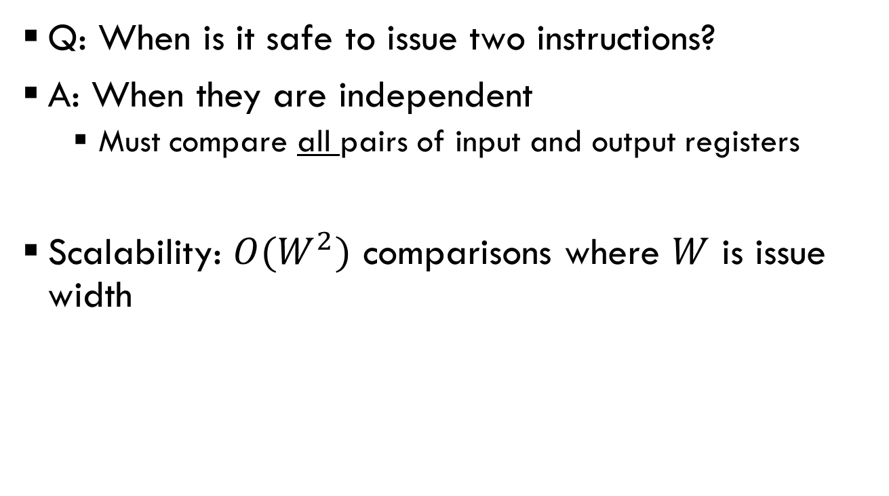
Superscalar scheduling is complex & hard to scale
Q: When is it safe to issue two instructions?
A: When they are independent
  Must compare all pairs of input and output registers
Scalability: $O(W^{2})$ comparisons where $W$ is issue width

Slide 102
OoO x86: Microcoding
Each x86 instruction describes several operations
  E.g., add [esp+4], 5 means:
  1. Load Mem[esp+4]
  2. Add 5 to it
  3. Store result to Mem[esp+4]
This is too much for (fast) hardware
Instead, hardware decodes instr’ns into micro-ops
➔ Rest of pipeline uses micro-ops

Slide 103
…But wait, there’s more!
Many issues we could not touch on
How to eliminate false dependences
  E.g., write-after-read / write-after-write
How to track dependences through memory
  E.g., store→load forwarding
How to rollback mis-speculations

Slide 104
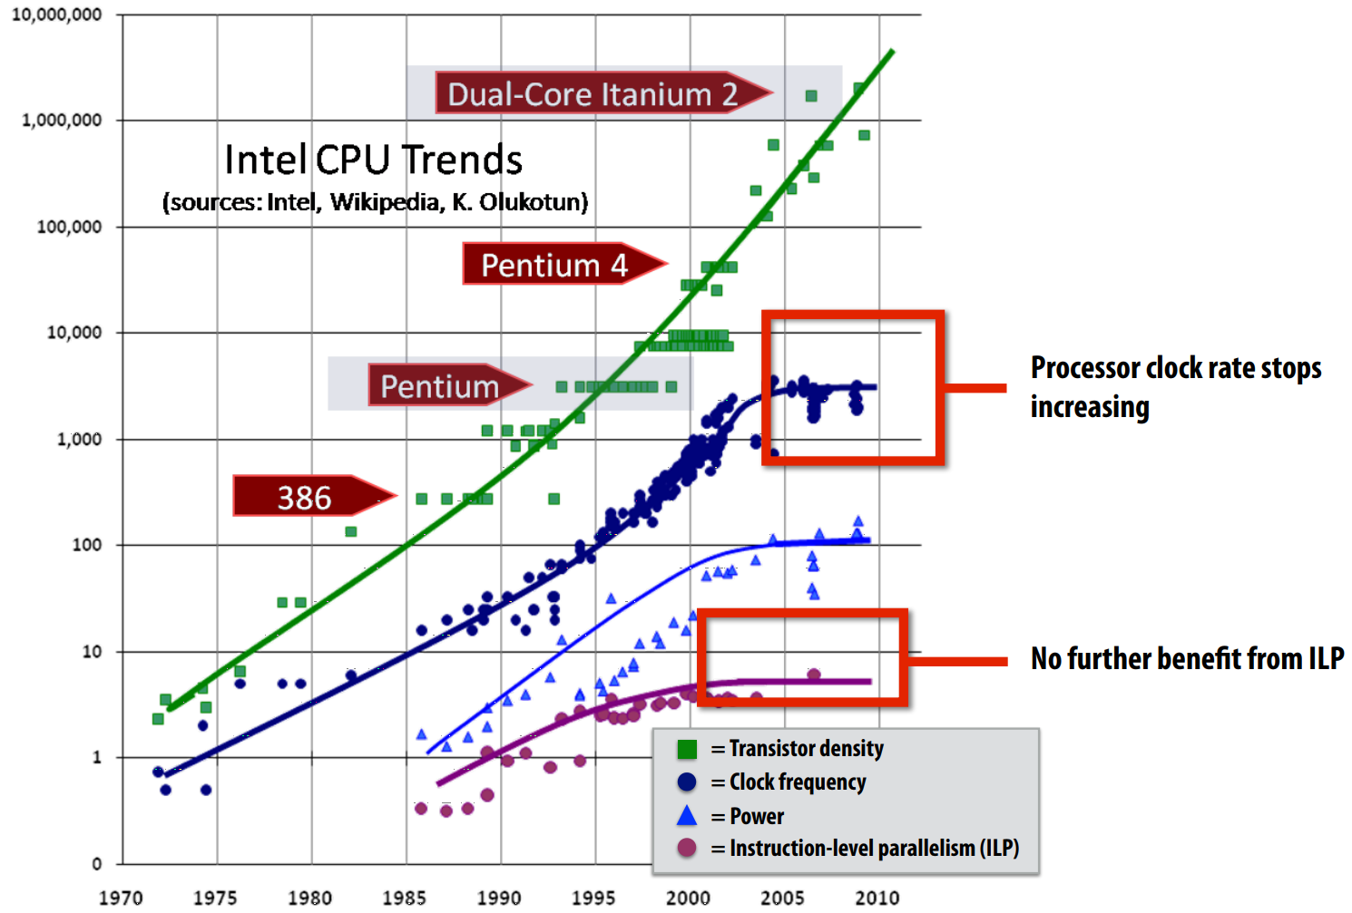
Recall from last time:
ILP tapped out… why?

Slide 105
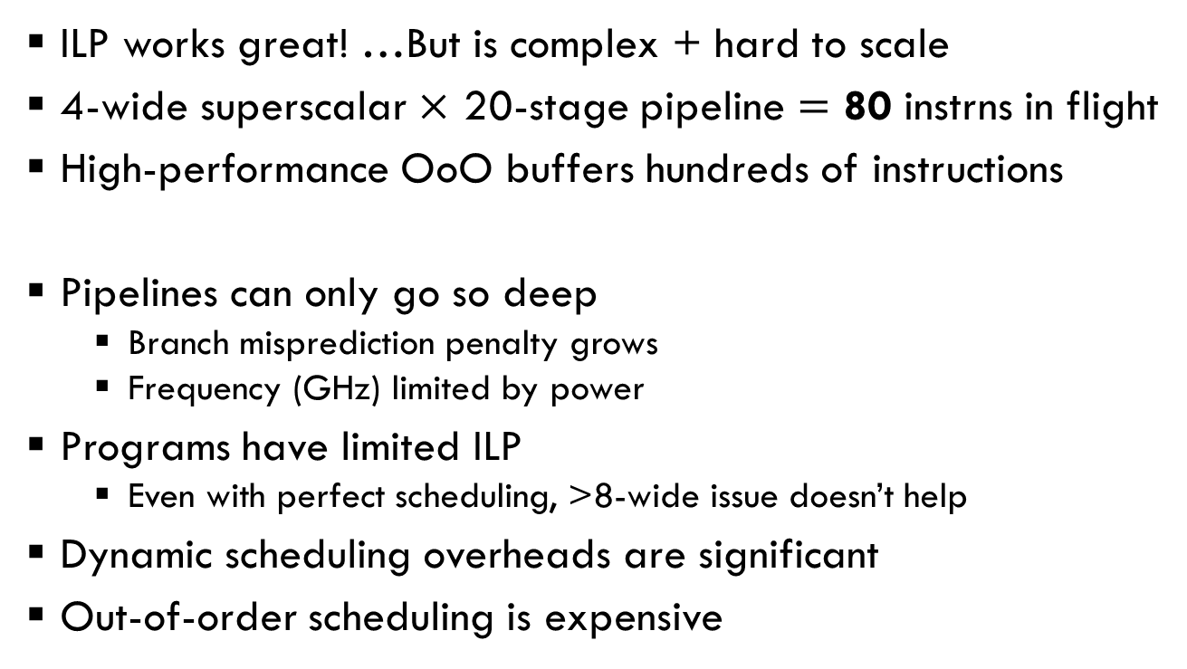
Limitations of ILP
ILP works great! …But is complex + hard to scale
4-wide superscalar $×$ 20-stage pipeline $=$ 80 instrns in flight
High-performance OoO buffers hundreds of instructions
Pipelines can only go so deep
  Branch misprediction penalty grows
  Frequency (GHz) limited by power
Programs have limited ILP
  Even with perfect scheduling, >8-wide issue doesn’t help
Dynamic scheduling overheads are significant
Out-of-order scheduling is expensive

Slide 106
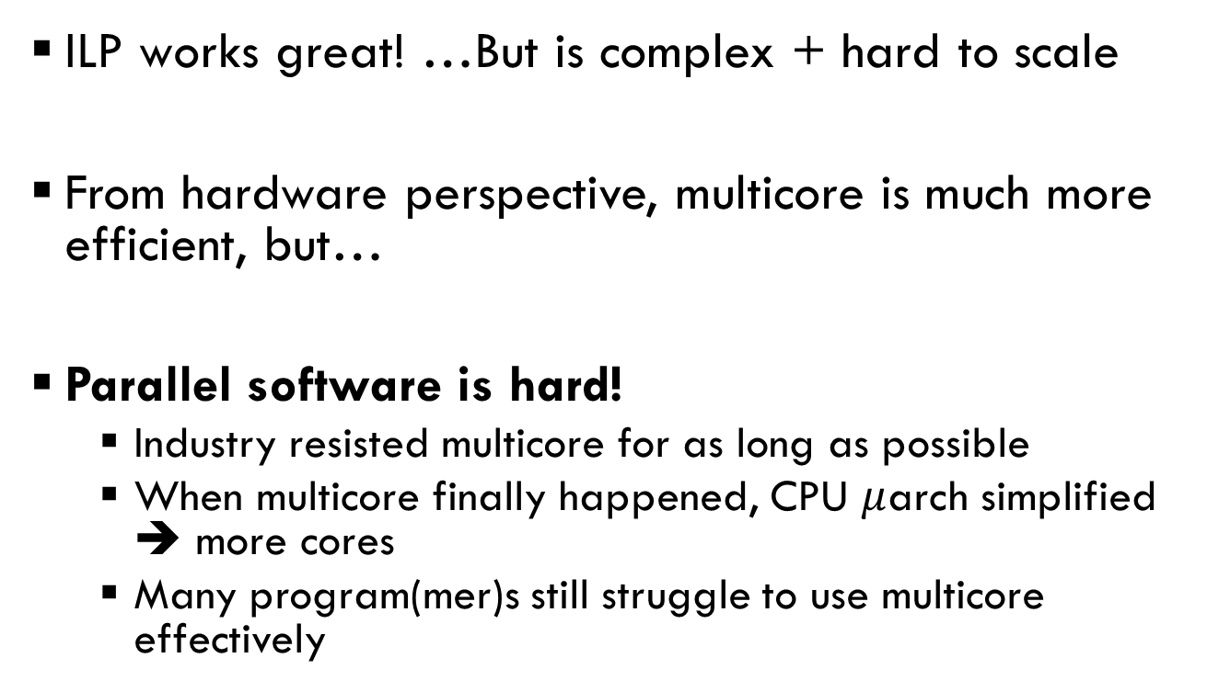
Limitations of ILP ➔ Multicore
ILP works great! …But is complex + hard to scale
From hardware perspective, multicore is much more efficient, but…
Parallel software is hard!
  Industry resisted multicore for as long as possible
  When multicore finally happened, CPU $μ$arch simplified ➔ more cores
  Many program(mer)s still struggle to use multicore effectively

