Slide 1
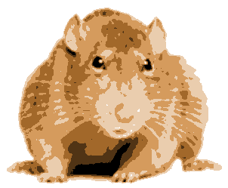
Assignment 3: GraphRats
Graph
Rats

Slide 2
Topics
Application
Implementation Issues
Optimizing for Sequential Performance
Optimizing for Parallel Performance
Useful Advice

Slide 3
Basic Idea
Transitions
Each rat decides where to move next
Don’t like crowds
But also don’t like to be alone
Weighted random choice
t = 0
0
1
2
3
4
5
6
7
8
t = 1
0
1
2
Graph
K X K grid
Initial State
Start with all R rats in corner
3
4
5
6
7
8

Slide 4
Node Count Representation
t = 0
+---+---+---+---+---+---+---+---+
| | | | | | | | |
+---+---+---+---+---+---+---+---+
| | | | | | | | |
+---+---+---+---+---+---+---+---+
| | | | | | | | |
+---+---+---+---+---+---+---+---+
| | | | | | | | |
+---+---+---+---+---+---+---+---+
| | | | | | | | |
+---+---+---+---+---+---+---+---+
| | | | | | | | |
+---+---+---+---+---+---+---+---+
| | | | | | | | |
+---+---+---+---+---+---+---+---+
| | | | | | | |320|
+---+---+---+---+---+---+---+---+
t = 1.
+---+---+---+---+---+---+---+---+
| | | | | | | | |
+---+---+---+---+---+---+---+---+
| | | | | | | | |
+---+---+---+---+---+---+---+---+
| | | | | | | | |
+---+---+---+---+---+---+---+---+
| | | | | | | | |
+---+---+---+---+---+---+---+---+
| | | | | | | | |
+---+---+---+---+---+---+---+---+
| | | | | | | | |
+---+---+---+---+---+---+---+---+
| | | | | | | |142|
+---+---+---+---+---+---+---+---+
| | | | | | |149| 29|
+---+---+---+---+---+---+---+---+

Slide 5
Simulation Example
t = 0
+---+---+---+---+---+---+---+---+
| | | | | | | | |
+---+---+---+---+---+---+---+---+
| | | | | | | | |
+---+---+---+---+---+---+---+---+
| | | | | | | | |
+---+---+---+---+---+---+---+---+
| | | | | | | | |
+---+---+---+---+---+---+---+---+
| | | | | | | | |
+---+---+---+---+---+---+---+---+
| | | | | | | | |
+---+---+---+---+---+---+---+---+
| | | | | | | | |
+---+---+---+---+---+---+---+---+
| | | | | | | |320|
+---+---+---+---+---+---+---+---+
t = 30.
+---+---+---+---+---+---+---+---+
| | | | 1 | 1 | | 1 | 1 |
+---+---+---+---+---+---+---+---+
| | | | | | 1 | 2 | 3 |
+---+---+---+---+---+---+---+---+
| | | 1 | 3 | 7 | 6 | 8 | 6 |
+---+---+---+---+---+---+---+---+
| | | | 7 | 12| 10| 12| 10|
+---+---+---+---+---+---+---+---+
| 2 | | 1 | 10| 7 | 7 | 13| 5 |
+---+---+---+---+---+---+---+---+
| | | 6 | 10| 14| 13| 11| 9 |
+---+---+---+---+---+---+---+---+
| 4 | 5 | 10| 2 | 9 | 3 | 15| 10|
+---+---+---+---+---+---+---+---+
| 1 | 8 | 8 | 7 | 7 | 16| 8 | 7 |
+---+---+---+---+---+---+---+---+

Slide 6

Visualizations
Text (“a” for ASCII)
Heat Map (“h”)
t = 30.
+---+---+---+---+---+---+---+---+
| | | | 1 | 1 | | 1 | 1 |
+---+---+---+---+---+---+---+---+
| | | | | | 1 | 2 | 3 |
+---+---+---+---+---+---+---+---+
| | | 1 | 3 | 7 | 6 | 8 | 6 |
+---+---+---+---+---+---+---+---+
| | | | 7 | 12| 10| 12| 10|
+---+---+---+---+---+---+---+---+
| 2 | | 1 | 10| 7 | 7 | 13| 5 |
+---+---+---+---+---+---+---+---+
| | | 6 | 10| 14| 13| 11| 9 |
+---+---+---+---+---+---+---+---+
| 4 | 5 | 10| 2 | 9 | 3 | 15| 10|
+---+---+---+---+---+---+---+---+
| 1 | 8 | 8 | 7 | 7 | 16| 8 | 7 |
+---+---+---+---+---+---+---+---+

Slide 7
Running it yourself
linux> cd some directory
linux> git clone https//github.com/cmu15418/asst3-s18.git
linux> cd asst3-s18/code
Linux> make demoX
X from 1 to 10
Demos
1: Text visualization, synchronous updates
2: Heap-map, synchronous updates

Slide 8
Determining Rat Moves
300
8
83
40
120
Count number of rats at current and adjacent locations
Adjacency structure represented as graph
Compute reward value for each location
Based on load factor l = count/average count
l * Ideal load factor (= 1.5)
𝛂 Fitting parameter (= 0.5)

Slide 9
Reward Function
Maximized at load factor 1.5
Just above average population
Drops for smaller loads (too few) and larger loads (too crowded)

Slide 10
Reward Function (cont.)
Falls off gradually
Reward(1000) = 0.0123

Slide 11
Selecting Next Move
Population
Reward (avg = 10)
300
0.061
8
83
40
0.721
0.180
0.422
120
0.125
Weighted Choices
(node followed by row-major ordering of neighbors)
x = 1.04
Choose random number between 0 and sum of rewards
Move according to interval hit

Slide 12
Update Models
Synchronous
Demo 2
Compute next positions for all rats, and then move them
Causes oscillations/instabilities
Rat-order
Demo 3
For each rat, compute its next position and then move it
Smooth transitions, but costly
Batch
Demo 4
For each batch of B rats, compute next moves and then move them
B = 0.02 * R
Smooth enough, with better performance possibilities

Slide 13
What We Provide
Python version of simulator
Demo 4
Very slow
C version of simulator
Faster, but still too slow
Demo 5: 8X8 grid, 320 rats
Demo 6: 160X160 grid, 1,024,000 rats
That’s what we’ll be using for benchmarks!
You’ll have to be patient using the starter code
Generate visualizations by piping C simulator output into Python simulator
Operating in visualization mode
See Makefile for examples

Slide 14
Correctness
Simulator is Deterministic
Global random seed
Random seeds for each rat
Process rats in fixed order
You Must Preserve Exact Same Behavior
Python simulator generates same result as C simulator
Use regress.py to check
Don’t rely only on the small cases it currently checks

Slide 15
Graphs: Grid (Demo 6)
Highly regular
Low degree
Rats spread slowly
k X k nodes, each with nearest neighbor connectivity
Max degree = 4
k = 160: 25,600 nodes 101,760 edges

Slide 16
Graphs: Tiled (Demo 7)
Globally regularly, locally irregular
Low/medium degree degree
Rats spread quickly within tile, slowly between tiles
Hub nodes typically have high rat counts
Smaller d X d regions, each with hub node
Node with edge to every other node in region
Regions connected only by nearest-neighbor edges at border
Maximum degree = d²-1 (= 99 for benchmark graph)
k = 160, d = 10: 25,600 nodes 152,850 edges

Slide 17
Fractal Graph (Demo 8)
Highly irregular
Widely varying degrees
Rats spread quickly through regions
Hub nodes typically have high rat counts
Regions of varying size
Some have 4 hub nodes, others 1
Maximum degree = k²/2-1 (= 12,799 for benchmark graph)
k = 160: 25,600 nodes 254,940 edges

Slide 18




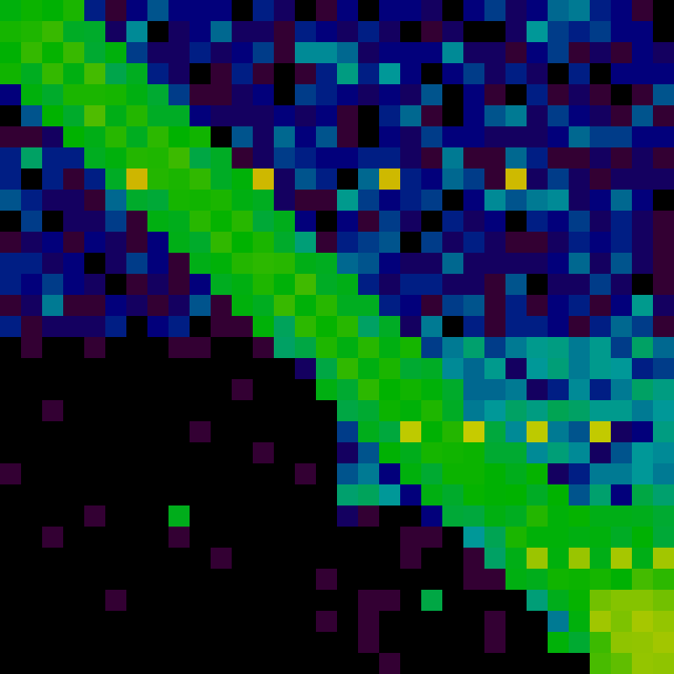
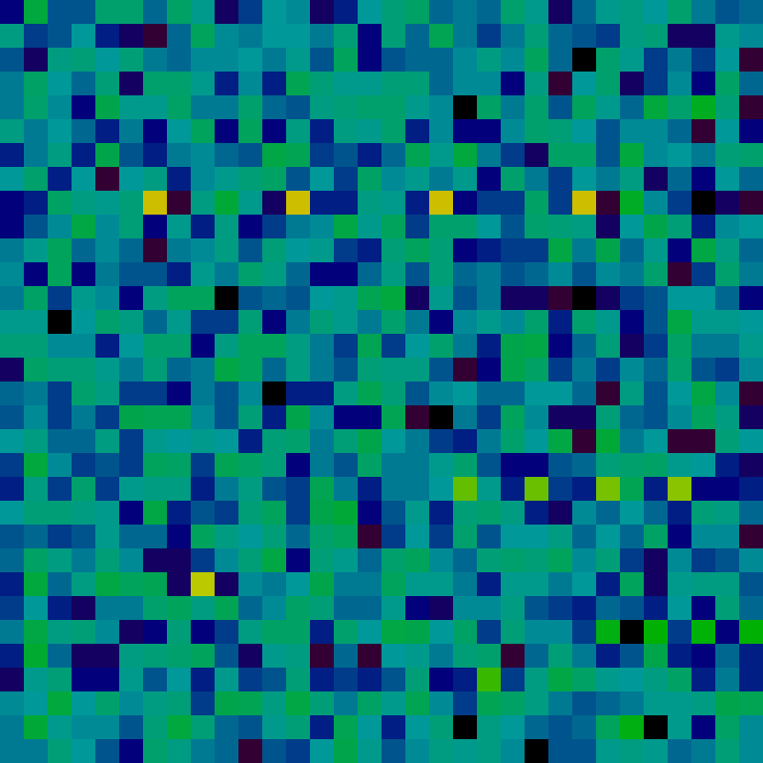
States (Fractal Graph)
Right Corner (r)
Demo 8
Diagonal (d)
Demo 9
Uniform (u)
Demo 10
t = 0
t = 3

Slide 19
Graph Representation
N node, M edges
0
1
2
neighbor_start (length = N+1)
0
3
7
10
14
19
23
26
30
33
3
4
5
6
7
8
0
1
3
1
0
2
4
2
1
5
3
0
4
6
neighbor
Includes self edges
length = N+M
4
1
3
5
7
5
2
4
8
6
3
7
7
4
6
8
8
5
7
Having pointer to end is useful (why?)

Slide 20
Sample Code
From sim.c
Compute reward value for node
Simulation state stored in state_t struct
Reward function computed by mweight
/* Compute weight for node nid */
static inline double compute_weight(state_t *s, int nid)
{
int count = s->rat_count[nid];
return mweight((double) count/s->load_factor);
}

Slide 21
Sample Code
From sim.c
Compute sum of reward values for node
/* Compute sum of weights in region of nid */
static inline double compute_sum_weight(state_t *s, int nid)
{
graph_t *g = s->g;
double sum = 0.0;
int eid;
int eid_start = g->neighbor_start[nid];
int eid_end = g->neighbor_start[nid+1];
int *neighbor = g->neighbor;
for (eid = eid_start; eid < eid_end; eid++) {
sum += compute_weight(s, neighbor[eid]);
}
return sum;
}

Slide 22
Sample Code
Compute next move for rat
static inline int next_random_move(state_t *s, int r)
{
int nid = s->rat_position[r];
random_t *seedp = &s->rat_seed[r];
double tsum = compute_sum_weight(s, nid);
graph_t *g = s->g;
double val = next_random_float(seedp, tsum);
double psum = 0.0;
int eid;
int eid_start = g->neighbor_start[nid];
int eid_end = g->neighbor_start[nid+1];
int *neighbor = g->neighbor;
for (eid = eid_start; eid < eid_end; eid++) {
psum += compute_weight(s, neighbor[eid]);
if (val < psum) {
return neighbor[eid];
}
}
}

Slide 23
Sequential Efficiency Considerations
Consider move computation for rat at node with degree D
How many (on average) iterations of loop in next_random_move?
How many calls are made to mweight?
Suppose there are X rats in batch at single node with degree D
How many (on average) iterations of loop in next_random_move?
How many calls are made to mweight?

Slide 24
Finding Parallelism
Sequential constraints
Must complete time steps sequentially
Must complete each batch before starting next
Sources of parallelism
Over nodes
Computing reward functions
Over rats (within a batch)
Computing next moves
Updating node counts

Slide 25
Performance Targets
Mega-Rats Per Second (MRPS)
R rats running for S steps
Requires time T
MRPS = 10⁻⁶ * R * S / T
Runs
5 combinations of graph/initial state
Compute geometric mean of MRPS’s
Target performance
 | 1 Thread | 12 Threads | Speedup
Synchronous | 32 | 256 | 8.0
Batch | 20 | 70 | 3.5

Slide 26
Some Suggestions
Focus initially on sequential performance
But think of ways that will allow parallelism
Simple ideas / data structures generally work best
Use timing to guide optimizations
Synchronous mode easier to make fast
Both sequentially and parallel
Machines
Can develop on any machine
GHC machines work well
Performance will be evaluated on Latedays machines
Batch submission process
These have different characteristics from GHC machines when measuring parallel performance

Slide 27
Instrumenting Your Code
How do you know how much time each activity takes?
Create simple library using cycletimer code
Bracket steps in your code with library calls
Use macros so that you can disable code for maximum performance
START_ACTIVITY(ACTIVITY_NEXT);
#pragma omp parallel for schedule(static)
for (ri = 0; ri < local_count; ri++) {
int rid = ri + local_start;
s->rat_position[rid] = fast_next_random_move(s, rid);
}
FINISH_ACTIVITY(ACTIVITY_NEXT);

Slide 28
Evaluating Your Instrumented Code
1 thread
194 ms 1.0 % startup
2077 ms 11.1 % compute_weights
4029 ms 21.6 % compute_sums
11733 ms 62.8 % find_moves
651 ms 3.5 % set_ops
3 ms 0.0 % unknown
+++ 25600 t 40 u 400 b 1 18.70 21.91
12 threads
192 ms 3.2 % startup
426 ms 7.0 % compute_weights
940 ms 15.5 % compute_sums
3168 ms 52.3 % find_moves
1325 ms 21.9 % set_ops
2 ms 0.0 % unknown
+++ 25600 t 40 u 400 b 12 6.06 67.55 ( 3.08X)
Can see which activities account for most time
Can see which activities limit parallel speedup

Slide 29



Some Logos

Slide 30
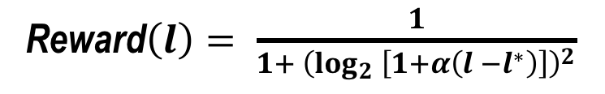
Reward$\left(l\right)= \frac{1}{1+ {\left(\log_{2} \left[1+α\left(l −l^{∗}\right)\right]\right)}^{2}}$

