Slide 1
CS:APP Chapter 4
Computer Architecture
Pipelined
Implementation
Part II
Randal E. Bryant
Carnegie Mellon University
http://csapp.cs.cmu.edu
CS:APP3e

Slide 2
Overview
Make the pipelined processor work!
Data Hazards
Instruction having register R as source follows shortly after instruction having register R as destination
Common condition, don’t want to slow down pipeline
Control Hazards
Mispredict conditional branch
Our design predicts all branches as being taken
Naïve pipeline executes two extra instructions
Getting return address for ret instruction
Naïve pipeline executes three extra instructions
Making Sure It Really Works
What if multiple special cases happen simultaneously?

Slide 3
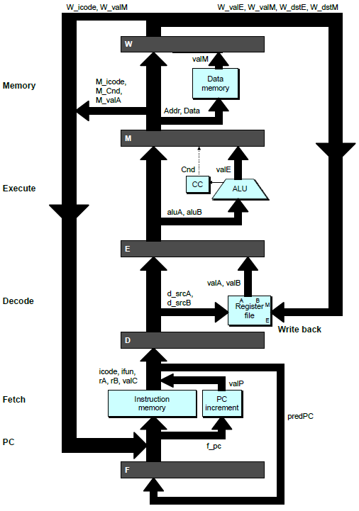
Pipeline Stages
Fetch
Select current PC
Read instruction
Compute incremented PC
Decode
Read program registers
Execute
Operate ALU
Memory
Read or write data memory
Write Back
Update register file

Slide 4
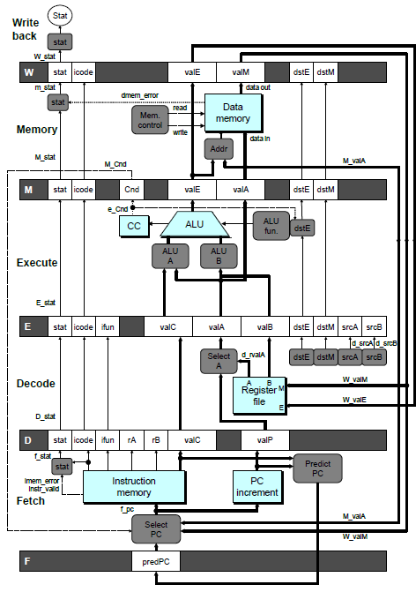
PIPE- Hardware
Pipeline registers hold intermediate values from instruction execution
Forward (Upward) Paths
Values passed from one stage to next
Cannot jump past stages
e.g., valC passes through decode

Slide 5
Data Dependencies: 2 Nop’s
# demo-h2.ys
1
2
3
4
5
6
7
8
9
10
F
F
D
D
E
E
M
M
W
0x000:
irmovq
$10,%
rdx
W
F
F
D
D
E
E
M
M
W
0x00a:
irmovq
$3,%
rax
W
F
F
D
D
E
E
M
M
W
0x014:
nop
W
F
F
D
D
E
E
M
M
W
0x015:
nop
W
F
F
D
D
E
E
M
M
W
0x016:
addq
%
rdx
,%
rax
W
F
F
D
D
E
E
M
M
W
0x018: halt
W
Cycle 6
W
W
W
f
f
R[
f
R[
R[
]
]
]
3
3
%
3
%
%
rax
rax
rax
•
•
•
•
•
•
D
D
D
f
f
valA
f
valA
valA
R[
R[
R[
]
]
]
=
=
=
10
10
%
10
Error
%
%
rdx
rdx
rdx
f
f
valB
f
valB
valB
R[
R[
R[
]
]
]
=
=
=
0
0
%
0
%
%
rax
rax
rax

Slide 6
Data Dependencies: No Nop
# demo-h0.ys
1
2
3
4
5
6
7
8
0x000:
irmovq
$10,%
rdx
F
D
E
M
W
0x00a:
irmovq
$3,%
rax
F
D
E
M
W
0x014:
addq
%
rdx
,%
rax
F
D
E
M
W
0x016: halt
F
D
E
M
W
Cycle 4
M
M_
valE
= 10
M_
dstE
=
%
rdx
E
e_
valE
f
0 + 3 = 3
E_
dstE
=
%
rax
D
D
Error
f
valA
f
valA
R[
R[
]
]
=
=
0
%
0
%
rdx
rdx
f
valB
f
valB
R[
R[
]
]
=
=
0
%
0
%
rax
rax

Slide 7
Stalling for Data Dependencies
# demo-h2.ys
1
2
3
4
5
6
7
8
9
10
11
0x000: irmovq $10,%rdx
F
D
E
M
W
0x00a: irmovq $3,%rax
F
D
E
M
W
0x014: nop
F
D
E
M
W
0x015: nop
F
D
E
M
W
bubble
E
M
W
0x016: addq %rdx,%rax
F
D
D
E
M
W
0x018: halt
F
F
D
E
M
W
If instruction follows too closely after one that writes register, slow it down
Hold instruction in decode
Dynamically inject nop into execute stage

Slide 8
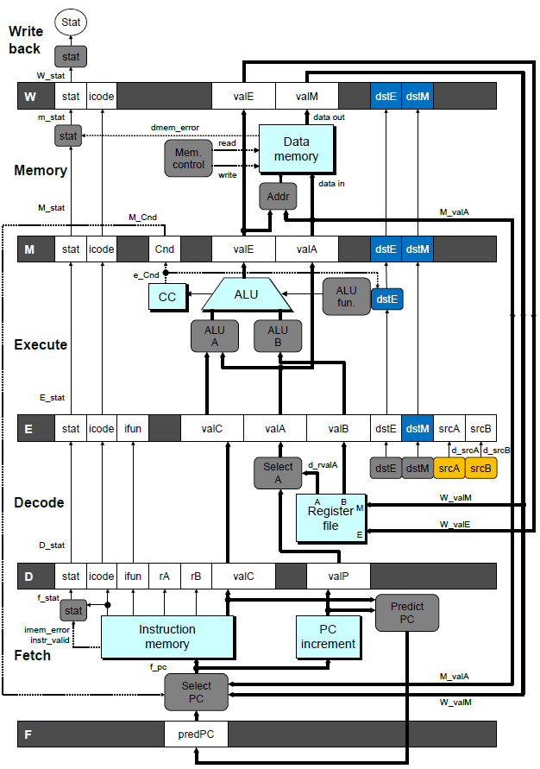
Stall Condition
Source Registers
srcA and srcB of current instruction in decode stage
Destination Registers
dstE and dstM fields
Instructions in execute, memory, and write-back stages
Special Case
Don’t stall for register ID 15 (0xF)
Indicates absence of register operand
Or failed cond. move

Slide 9
Detecting Stall Condition
# demo-h2.ys
1
2
3
4
5
6
7
8
9
10
11
0x000: irmovq $10,%rdx
F
D
E
M
W
0x00a: irmovq $3,%rax
F
D
E
M
W
0x014: nop
F
D
E
M
W
0x015: nop
F
D
E
M
W
bubble
E
M
W
0x016: addq %rdx,%rax
F
D
D
E
M
W
0x018: halt
F
F
D
E
M
W
Cycle 6
W
W_dstE = %rax
W_valE = 3
•
•
•
D
srcA = %rdx
srcB = %rax

Slide 10
Stalling X3
# demo-h0.ys
1
2
3
4
5
6
7
8
9
10
11
0x000: irmovq $10,%rdx
F
D
E
M
W
0x00a: irmovq $3,%rax
F
D
E
M
W
bubble
E
M
W
bubble
E
M
W
bubble
E
M
W
0x014: addq %rdx,%rax
F
D
D
D
D
E
M
W
0x016: halt
F
F
F
F
D
E
M
W
Cycle 6
W
Cycle 5
W_dstE = %rax
M
Cycle 4
M_dstE = %rax
•
•
•
E
•
•
•
e_dstE = %rax
D
D
D
srcA = %rdx
srcB = %rax
srcA = %rdx
srcB = %rax
srcA = %rdx
srcB = %rax

Slide 11
What Happens When Stalling?
# demo-h0.ys
Cycle 4
Cycle 5
Cycle 6
Cycle 7
Cycle 8
0x000: irmovq $10,%rdx
0x000: irmovq $10,%rdx
0x00a: irmovq $3,%rax
bubble
Write Back
bubble
0x00a: irmovq $3,%rax
0x000: irmovq $10,%rdx
0x00a: irmovq $3,%rax
bubble
bubble
Memory
bubble
0x014: addq %rdx,%rax
0x00a: irmovq $3,%rax
bubble
bubble
bubble
Execute
0x014: addq %rdx,%rax
0x016: halt
0x014: addq %rdx,%rax
0x014: addq %rdx,%rax
0x014: addq %rdx,%rax
0x014: addq %rdx,%rax
Decode
0x016: halt
0x016: halt
0x016: halt
0x016: halt
Fetch
0x016: halt
Stalling instruction held back in decode stage
Following instruction stays in fetch stage
Bubbles injected into execute stage
Like dynamically generated nop’s
Move through later stages

Slide 12
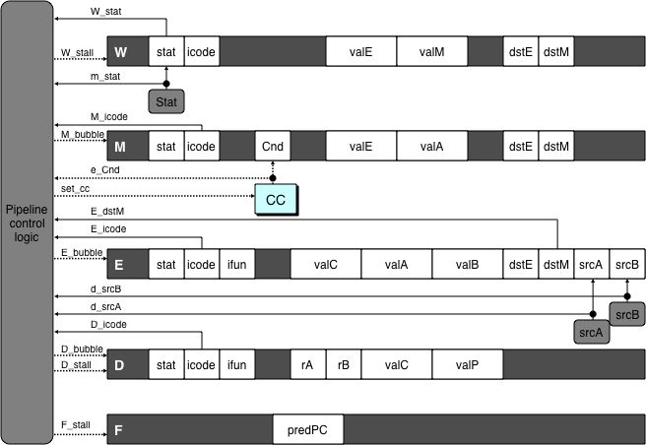
Implementing Stalling
Pipeline Control
Combinational logic detects stall condition
Sets mode signals for how pipeline registers should update
Pipeline
control
logic
Pipeline
control
logic
Pipeline
control
logic
Pipeline
control
logic

Slide 13
Pipeline Register Modes
Rising
Rising
Input = y
Output = x
_
clock
_
Output = y
clock
Normal
x
x
y
y
stall
bubble
= 0
= 0
Rising
Rising
Input = y
Output = x
_
clock
_
Output = x
clock
Stall
x
x
x
x
stall
bubble
= 1
= 0
Rising
Rising
Input = y
Output = x
_
clock
_
Output =
nop
clock
n
Bubble
x
x
o
p
stall
bubble
= 0
= 1

Slide 14
Data Forwarding
Naïve Pipeline
Register isn’t written until completion of write-back stage
Source operands read from register file in decode stage
Needs to be in register file at start of stage
Observation
Value generated in execute or memory stage
Trick
Pass value directly from generating instruction to decode stage
Needs to be available at end of decode stage

Slide 15
Data Forwarding Example
# demo-h2.ys
1
2
3
4
5
6
7
8
9
10
F
F
D
D
E
E
M
M
W
0x000:
irmovq
$10,%
rdx
W
F
F
D
D
E
E
M
M
W
0x00a:
irmovq
$3,%
rax
W
F
F
D
D
E
E
M
M
W
0x014:
nop
W
F
F
D
D
E
E
M
M
W
0x015:
nop
W
F
F
D
D
E
E
M
M
W
0x016:
addq
%
rdx
,%
rax
W
F
F
D
D
E
E
M
M
W
0x018: halt
W
irmovq in write-back stage
Destination value in W pipeline register
Forward as valB for decode stage
Cycle 6
W
W_
dstE
=
%
rax
R[
%
rax
]
f
3
W_
valE
= 3
•
•
•
D
srcA
=
%
rdx
valA
f
R[
%
rdx
]
=
10
srcB
=
%
rax
valB
f
W_
valE
=
3

Slide 16
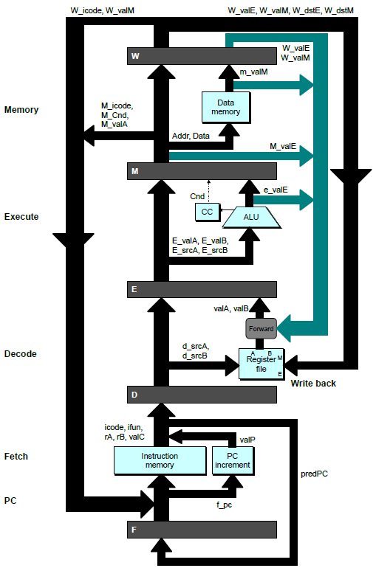
Bypass Paths
Decode Stage
Forwarding logic selects valA and valB
Normally from register file
Forwarding: get valA or valB from later pipeline stage
Forwarding Sources
Execute: valE
Memory: valE, valM
Write back: valE, valM

Slide 17
Data Forwarding Example #2
# demo-h0.ys
1
2
3
4
5
6
7
8
0x000: irmovq $10,%rdx
F
D
E
M
W
0x00a: irmovq $3,%rax
F
D
E
M
W
0x014: addq %rdx,%rax
F
D
E
M
W
0x016: halt
F
D
E
M
W
Register %rdx
Generated by ALU during previous cycle
Forward from memory as valA
Register %rax
Value just generated by ALU
Forward from execute as valB
Cycle 4
M
M_dstE = %rdx
M_valE = 10
E
E_dstE = %rax
e_valE f 0 + 3 = 3
D
srcA = %rdx
srcB = %rax
valA f M_valE = 10
valB f e_valE = 3

Slide 18
Forwarding Priority
# demo-priority.ys
1
2
3
4
5
6
7
8
9
10
F
F
D
D
E
E
M
M
W
0x000: irmovq $1, %rax
W
F
F
D
D
E
E
M
M
W
0x00a: irmovq $2, %rax
W
F
F
D
D
E
E
M
M
W
0x014: irmovq $3, %rax
W
F
F
D
D
E
E
M
M
W
0x01e: rrmovq %rax, %rdx
W
F
F
D
D
E
E
M
M
W
0x020: halt
W
Multiple Forwarding Choices
Which one should have priority
Match serial semantics
Use matching value from earliest pipeline stage
Cycle 5
W
W
f
R[
f
R[
]
]
3
%
1
%
rax
rax
W
M
f
R[
f
R[
]
]
3
%
2
%
rax
rax
W
E
f
R[
f
R[
]
]
3
%
3
%
rax
rax
D
D
D
f
f
valA
f
valA
valA
R[
R[
R[
]
]
]
=
=
=
10
10
%
?
%
%
rax
rdx
rdx
f
f
valB
f
valB
valB
R[
R[
0
%
rax
]
=
0

Slide 19
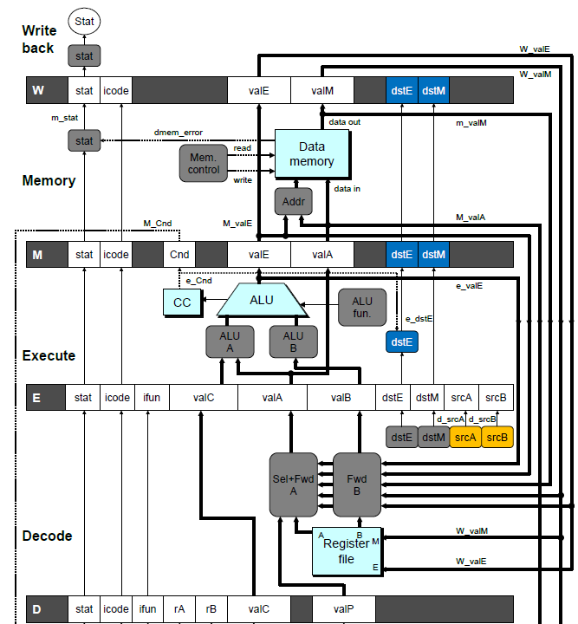
Implementing Forwarding
Add additional feedback paths from E, M, and W pipeline registers into decode stage
Create logic blocks to select from multiple sources for valA and valB in decode stage

Slide 20
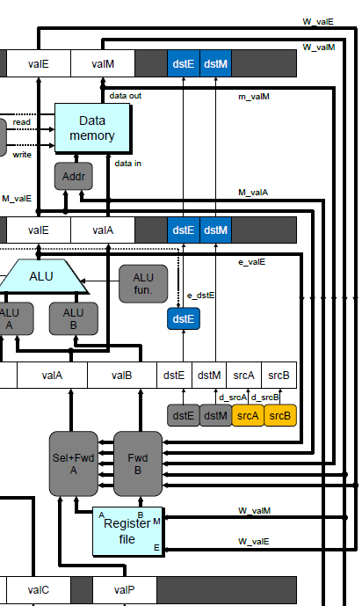
Implementing Forwarding
## What should be the A value?
int d_valA = [
# Use incremented PC
D_icode in { ICALL, IJXX } : D_valP;
# Forward valE from execute
d_srcA == e_dstE : e_valE;
# Forward valM from memory
d_srcA == M_dstM : m_valM;
# Forward valE from memory
d_srcA == M_dstE : M_valE;
# Forward valM from write back d_srcA == W_dstM : W_valM;
# Forward valE from write back
d_srcA == W_dstE : W_valE;
# Use value read from register file
1 : d_rvalA;
];

Slide 21
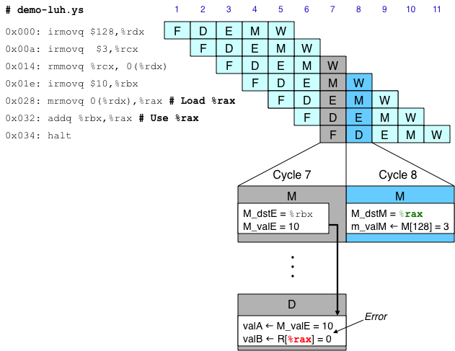
Limitation of Forwarding
Load-use dependency
Value needed by end of decode stage in cycle 7
Value read from memory in memory stage of cycle 8

Slide 22
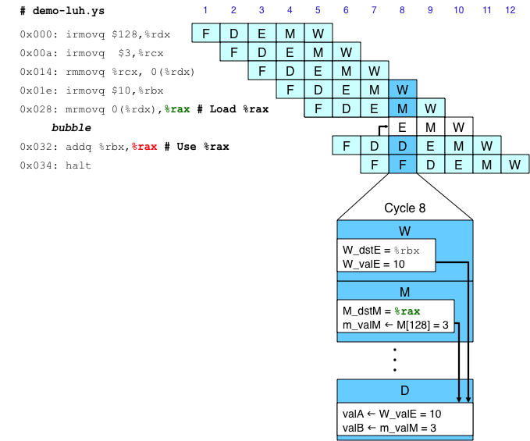
Avoiding Load/Use Hazard
Stall using instruction for one cycle
Can then pick up loaded value by forwarding from memory stage

Slide 23
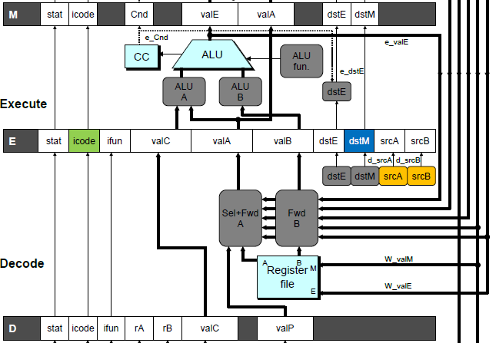
Detecting Load/Use Hazard
Condition | Trigger
Load/Use Hazard | E_icode in { IMRMOVQ, IPOPQ } && E_dstM in { d_srcA, d_srcB }

Slide 24
Control for Load/Use Hazard
# demo
-
luh
.
ys
1
2
3
4
5
6
7
8
9
10
11
12
F
F
D
D
E
E
M
M
W
0x000:
irmovq
$128,%
rdx
W
F
F
D
D
E
E
M
M
W
0x00a:
irmovq
$3,%
rcx
W
F
F
D
D
E
E
M
M
W
0x014:
rmmovq
%
rcx
, 0(%
rdx
)
W
F
F
D
D
E
E
M
M
W
0x01e:
irmovq
$10,%
ebx
W
%
rax
# Load %
rax
F
F
F
D
D
D
E
E
E
M
M
M
W
W
0x028:
mrmovq
0(%
rdx
),
W
bubble
E
M
W
0x032:
addq
%
ebx
,
%
rax
# Use %
rax
F
D
D
E
M
W
0x034: halt
F
F
D
E
M
W
Stall instructions in fetch and decode stages
Inject bubble into execute stage
Condition | F | D | E | M | W
Load/Use Hazard | stall | stall | bubble | normal | normal

Slide 25
Branch Misprediction Example
demo-j.ys
0x000: xorq %rax,%rax
0x002: jne t # Not taken
0x00b: irmovq $1, %rax # Fall through
0x015: nop
0x016: nop
0x017: nop
0x018: halt
0x019: t: irmovq $3, %rdx # Target
0x023: irmovq $4, %rcx # Should not execute
0x02d: irmovq $5, %rdx # Should not execute
Should only execute first 8 instructions

Slide 26
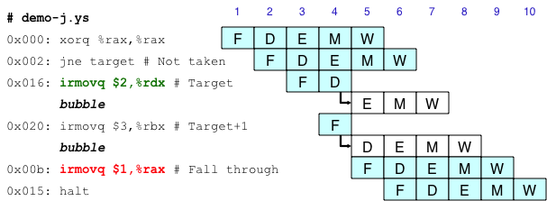
Handling Misprediction
Predict branch as taken
Fetch 2 instructions at target
Cancel when mispredicted
Detect branch not-taken in execute stage
On following cycle, replace instructions in execute and decode by bubbles
No side effects have occurred yet

Slide 27
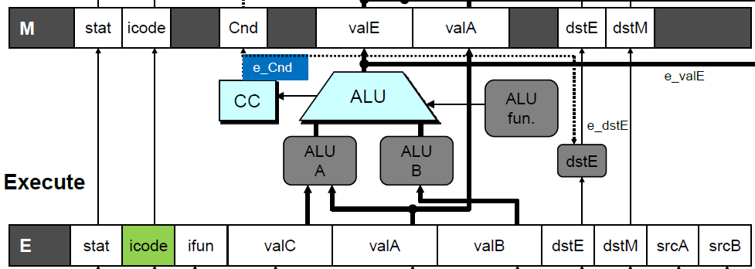
Detecting Mispredicted Branch
Condition | Trigger
Mispredicted Branch | E_icode = IJXX & !e_Cnd

Slide 28
Control for Misprediction
Condition | F | D | E | M | W
Mispredicted Branch | normal | bubble | bubble | normal | normal

Slide 29
Return Example
demo-retb.ys
0x000: irmovq Stack,%rsp # Intialize stack pointer
0x00a: call p # Procedure call
0x013: irmovq $5,%rsi # Return point
0x01d: halt
0x020: .pos 0x20
0x020: p: irmovq $-1,%rdi # procedure
0x02a: ret
0x02b: irmovq $1,%rax # Should not be executed
0x035: irmovq $2,%rcx # Should not be executed
0x03f: irmovq $3,%rdx # Should not be executed
0x049: irmovq $4,%rbx # Should not be executed
0x100: .pos 0x100
0x100: Stack: # Stack: Stack pointer
Previously executed three additional instructions

Slide 30
Correct Return Example
# demo
-
retb
0x026: ret
F
D
E
M
W
bubble
F
D
E
M
W
bubble
F
D
E
M
W
bubble
F
D
E
M
W
F
F
D
D
E
E
M
M
W
0x013:
irmovq
$5,%
rsi
# Return
W
As ret passes through pipeline, stall at fetch stage
While in decode, execute, and memory stage
Inject bubble into decode stage
Release stall when reach write-back stage
W
W
valM
valM
=
=
0x0b
0x013
•
•
•
F
F
f
valC
f
valC
5
5
f
rB
f
rB
%
%
rsi
esi

Slide 31
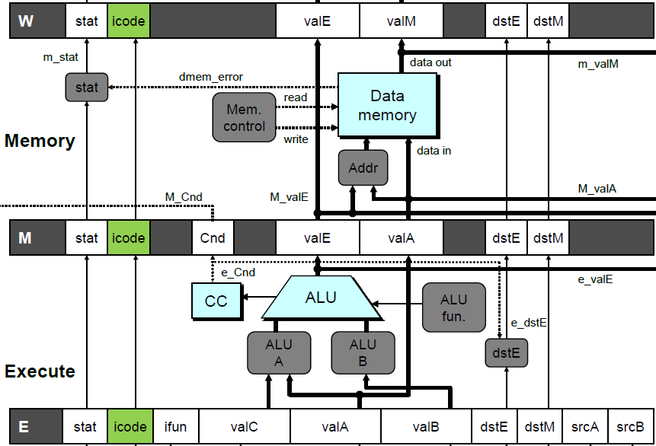
Detecting Return
Condition | Trigger
Processing ret | IRET in { D_icode, E_icode, M_icode }

Slide 32
Control for Return
# demo
-
retb
0x026: ret
F
D
E
M
W
bubble
F
D
E
M
W
bubble
F
D
E
M
W
bubble
F
D
E
M
W
F
F
D
D
E
E
M
M
W
0x014:
irmovq
$5,%
rsi
# Return
W
Condition | F | D | E | M | W
Processing ret | stall | bubble | normal | normal | normal

Slide 33
Special Control Cases
Detection
Action (on next cycle)
Condition | Trigger
Processing ret | IRET in { D_icode, E_icode, M_icode }
Load/Use Hazard | E_icode in { IMRMOVQ, IPOPQ } && E_dstM in { d_srcA, d_srcB }
Mispredicted Branch | E_icode = IJXX & !e_Cnd
Condition | F | D | E | M | W
Processing ret | stall | bubble | normal | normal | normal
Load/Use Hazard | stall | stall | bubble | normal | normal
Mispredicted Branch | normal | bubble | bubble | normal | normal

Slide 34
Implementing Pipeline Control
Combinational logic generates pipeline control signals
Action occurs at start of following cycle

Slide 35
Initial Version of Pipeline Control
bool F_stall =
# Conditions for a load/use hazard
E_icode in { IMRMOVQ, IPOPQ } && E_dstM in { d_srcA, d_srcB } ||
# Stalling at fetch while ret passes through pipeline
IRET in { D_icode, E_icode, M_icode };
bool D_stall =
# Conditions for a load/use hazard
E_icode in { IMRMOVQ, IPOPQ } && E_dstM in { d_srcA, d_srcB };
bool D_bubble =
# Mispredicted branch
(E_icode == IJXX && !e_Cnd) ||
# Stalling at fetch while ret passes through pipeline
IRET in { D_icode, E_icode, M_icode };
bool E_bubble =
# Mispredicted branch
(E_icode == IJXX && !e_Cnd) ||
# Load/use hazard
E_icode in { IMRMOVQ, IPOPQ } && E_dstM in { d_srcA, d_srcB };

Slide 36
Control Combinations
Special cases that can arise on same clock cycle
Combination A
Not-taken branch
ret instruction at branch target
Combination B
Instruction that reads from memory to %rsp
Followed by ret instruction

Slide 37
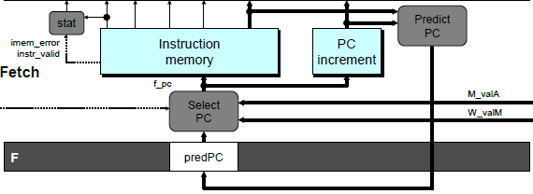
Control Combination A
1
1
Mispredict
1
Mispredict
ret
ret
ret
M
M
M
M
M
JXX
E
JXX
E
E
E
E
ret
ret
D
ret
D
D
D
D
Combination A
Condition | F | D | E | M | W
Processing ret | stall | bubble | normal | normal | normal
Mispredicted Branch | normal | bubble | bubble | normal | normal
Combination | stall | bubble | bubble | normal | normal
Should handle as mispredicted branch
Stalls F pipeline register
But PC selection logic will be using M_valM anyhow

Slide 38
Control Combination B
1
1
Load/use
ret
1
ret
ret
M
M
M
M
E
Load
E
E
E
Use
ret
ret
D
D
ret
D
D
Combination B
Condition | F | D | E | M | W
Processing ret | stall | bubble | normal | normal | normal
Load/Use Hazard | stall | stall | bubble | normal | normal
Combination | stall | bubble + stall | bubble | normal | normal
Would attempt to bubble and stall pipeline register D
Signaled by processor as pipeline error

Slide 39
Handling Control Combination B
1
1
Load/use
ret
1
ret
ret
M
M
M
M
E
Load
E
E
E
Use
ret
ret
D
D
ret
D
D
Combination B
Condition | F | D | E | M | W
Processing ret | stall | bubble | normal | normal | normal
Load/Use Hazard | stall | stall | bubble | normal | normal
Combination | stall | stall | bubble | normal | normal
Load/use hazard should get priority
ret instruction should be held in decode stage for additional cycle

Slide 40
Corrected Pipeline Control Logic
bool D_bubble =
# Mispredicted branch
(E_icode == IJXX && !e_Cnd) ||
# Stalling at fetch while ret passes through pipeline
IRET in { D_icode, E_icode, M_icode }
# but not condition for a load/use hazard
&& !(E_icode in { IMRMOVQ, IPOPQ }
&& E_dstM in { d_srcA, d_srcB });
Condition | F | D | E | M | W
Processing ret | stall | bubble | normal | normal | normal
Load/Use Hazard | stall | stall | bubble | normal | normal
Combination | stall | stall | bubble | normal | normal
Load/use hazard should get priority
ret instruction should be held in decode stage for additional cycle

Slide 41
Pipeline Summary
Data Hazards
Most handled by forwarding
No performance penalty
Load/use hazard requires one cycle stall
Control Hazards
Cancel instructions when detect mispredicted branch
Two clock cycles wasted
Stall fetch stage while ret passes through pipeline
Three clock cycles wasted
Control Combinations
Must analyze carefully
First version had subtle bug
Only arises with unusual instruction combination

