Slide 1
15-251
Some
Great Theoretical Ideas in Computer Science
for

Slide 2
Complexity Theory:
The P vs NP question
Lecture 27 (Nov 23, 2010)

Slide 3
$$$

Slide 4
The $1M Questions
The Clay Mathematics Institute
Millenium Prize Problems
Birch and Swinnerton-Dyer Conjecture
Hodge Conjecture
Navier-Stokes Equations
P vs NP
Poincaré Conjecture
Riemann Hypothesis
Yang-Mills Theory
← solved!

Slide 5
The P versus NP problem
Is perhaps the biggest open problem
in computer science (and mathematics!) today.
(Even featured in the TV show NUMB3RS)
But what is the P-NP problem?

Slide 6
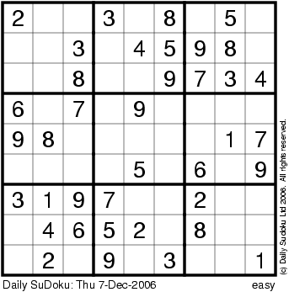
Sudoku
3 x 3 x 3

Slide 7
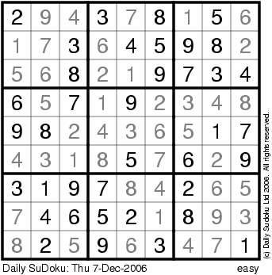
Sudoku
3 x 3 x 3

Slide 8
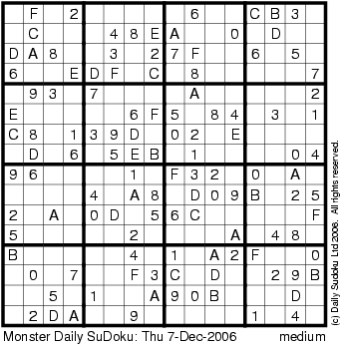
Sudoku
4 x 4 x 4

Slide 9
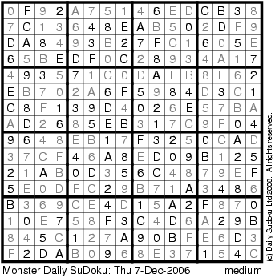
Sudoku
4 x 4 x 4

Slide 10
Sudoku
Suppose it takes you S(n) to solve n x n x n
V(n) time to verify the solution
Fact: V(n) = O(n² x n²)
Question: is there some constant c such that
...
S(n) ≤ n^{c} ?
n x n x n

Slide 11
P vs NP problem
=
Does there exist an algorithm for n x n x n Sudoku that runs in time p(n) for some polynomial p( ) ?
...
n x n x n

Slide 12
The P versus NP problem (informally)
Is proving a theorem much more difficult than checking the proof of a theorem?

Slide 13
Let’s start at the beginning…

Slide 14
Hamilton Cycle
Given a graph G = (V,E), a cycle that visits all the nodes exactly once

Slide 15
The Problem “HAM”
Input: Graph G = (V,E)
Output:
YES if G has a Hamilton cycle
NO if G has no Hamilton cycle
The Set “HAM”
HAM = { graph G | G has a Hamilton cycle }

Slide 16
Circuit-Satisfiability
Input: A circuit C with one output
Output:
YES if C is satisfiable
NO if C is not satisfiable
AND
NOT
AND

Slide 17
The Set “SAT”
SAT = { all satisfiable circuits C }

Slide 18
Bipartite Matching
Input: A bipartite graph G = (U,V,E)
Output:
YES if G has a perfect matching
NO if G does not

Slide 19
The Set “BI-MATCH”
BI-MATCH = { all bipartite graphs that have a perfect matching }

Slide 20
Sudoku
Input: n x n x n sudoku instance
Output:
YES if this sudoku has a solution
NO if it does not
The Set “SUDOKU”
SUDOKU = { All solvable sudoku instances }

Slide 21
Decision Versus Search Problems
Decision Problem
Search Problem
YES/NO answers
Find a Hamilton cycle in G if one exists, else return NO
Does G have a Hamilton cycle?
Find a 3-coloring of G if one exists, else return NO
Can G be 3-colored ?

Slide 22
Reducing Search to Decision
Given an algorithm for decision Sudoku, devise an algorithm to find a solution
Idea:
Fill in one-by-one and use decision algorithm

Slide 23
Reducing Search to Decision
Given an algorithm for decision HAM, devise an algorithm to find a solution
Idea:
Find the edges of the cycle one by one

Slide 24
Decision/Search Problems
We’ll study decision problems because they are almost the same (asymptotically) as their search counterparts

Slide 25
Polynomial Time and The Class “P” of Decision Problems

Slide 26
What is an efficient algorithm?
Is an O(n) algorithm efficient?
How about O(n log n)?
polynomial time
O(n^{c}) for some
constant c
O(n²) ?
O(n¹⁰) ?
O(n^{log n}) ?
non-polynomial
time
O(2^{n}) ?
O(n!) ?

Slide 27
Does an algorithm
running in O(n¹⁰⁰) time count as efficient?
We consider non-polynomial time algorithms to be inefficient.
And hence a necessary condition for an algorithm to be efficient is that it should run in poly-time.

Slide 28
Asking for a poly-time algorithm for a problem sets a (very) low bar when asking for efficient algorithms.
The question is: can we achieve even this
for 3-coloring? SAT?
Sudoku?
HAM?

Slide 29
The Class P
We say a set L ⊆ Σ* is in P if there is
a program A and
a polynomial p( )
such that for any x in Σ*,
A(x) runs for at most p(|x|) time
and answers question “is x in L?” correctly.

Slide 30
The Class P
The class of all sets L that can be recognized in polynomial time.
The class of all decision problems that can be decided in polynomial time.

Slide 31
Why are we looking only at sets ⊆ Σ*?
What if we want to work with graphs or boolean formulas?

Slide 32
Languages/Functions in P?
Example 1:
CONN = {graph G: G is a connected graph}
Algorithm A₁:
If G has n nodes, then run depth first search from any node, and count number of distinct nodes you see. If you see n nodes, G ∈ CONN, else not.
Time: p₁(|x|) = Θ(|x|).

Slide 33
Languages/Functions in P?
HAM, SUDOKU, SAT are not known to be in P
CO-HAM = { G | G does NOT have a Hamilton cycle}
CO-HAM ∈ P if and only if HAM ∈ P

Slide 34
Onto the new class, NP

Slide 35
Verifying Membership
Is there a short “proof” I can give you for:
G ∈ HAM?
G ∈ BI-MATCH?
C ∈ SAT?
G ∈ CO-HAM?

Slide 36
NP
A set L ∈ NP
if there exists an algorithm A and a polynomial p( )
For all x ∈ L
For all x′ ∉ L
there exists y with |y| ≤ p(|x|)
For all y′ with |y′| ≤ p(|x′|)
such that A(x,y) = YES
we have A(x′,y′) = NO
in p(|x|) time
in p(|x|) time

Slide 37
Recall the Class P
We say a set L ⊆ Σ* is in P if there is
a program A and
a polynomial p()
such that for any x in Σ*,
A(x) runs for at most p(|x|) time
and answers question “is x in L?” correctly.
can think of A as “proving” that x is in L

Slide 38
NP
A set L ∈ NP
if there exists an algorithm A and a polynomial p( )
For all x ∈ L
For all x′ ∉ L
there exists a y with |y| ≤ p(|x|)
For all y′ with |y′| ≤ p(|x′|)
such that A(x,y) = YES
Such that A(x′,y′) = NO
in p(|x|) time
in p(|x|) time

Slide 39
Example: HAM ∈ NP
Let A(x,y) be a program that takes two strings x and y, and returns YES if the following conditions hold otherwise it returns NO.
y is a representation of a labeled graph
x is a representation of a cycle with the same labeled vertices as y
every edge of the cycle x is in the graph y
(All of these conditions can be easily checked in linear time)
By our definition, this proves HAM ∈ NP

Slide 40
The Class NP
The class of sets L for which there exist “short” proofs of membership (of polynomial length) that can be “quickly” verified (in polynomial time).
Recall: A doesn’t have to find these proofs y; it just needs to be able to verify that y is a “correct” proof.

Slide 41
P ⊆ NP
For any L in P, we can just take y to be the empty string and satisfy the requirements.
Hence, every language in P is also in NP.

Slide 42
Languages/Functions in NP?
G ∈ HAM?
(Yes, already saw)
G ∈ BI-MATCH?
(is in P)
G ∈ SAT?
(Yes. explain it)
G ∈ CO-HAM?
(not clear)
Proof that something is in NP is often trivial.

Slide 43
Summary: P versus NP
Set L is in P if membership in L can be decided in poly-time.
Set L is in NP if each x in L has a short “proof of membership” that can be verified in poly-time.
Fact: P ⊆ NP
Question: Is NP ⊆ P ?

Slide 44
Why Care?

Slide 45
NP Contains Lots of Problems We Don’t Know to be in P
Classroom Scheduling
Packing objects into bins
Scheduling jobs on machines
Finding cheap tours visiting a subset of cities
Allocating variables to registers
Finding good packet routings in networks
Decryption
…

Slide 46
OK, OK, I care...
But where do I begin
if I want to reason about the P=NP problem?

Slide 47
How can we prove that
NP ⊆ P?
I would have to show that every set in NP has a
polynomial time algorithm…
How do I do that?
It may take a long time!
Also, what if I forgot one of the sets in NP?

Slide 48
We can describe just one problem L in NP, such that if this problem L is in P, then NP ⊆ P.
It is a problem that can capture all other problems in NP.

Slide 49
The “Hardest” Set in NP

Slide 50
Sudoku
Sudoku has a polynomial time algorithm if and only if P = NP
...
n x n x n

Slide 51
The “Hardest” Sets in NP
Sudoku
Clique
SAT
Independent-Set
HAM
3-Colorability
These problems are all “polynomial-time equivalent”.
I.e., each of these can be reduced to any of the others in poly-time

Slide 52
“Poly-time reducible to each other”
Reducing problem Y to problem X in poly-time
F is poly-time computable
Answer
Instance I_{Y} of problem Y
Instance I_{X} = F(I_{Y} ) of problem X
Answer
Oracle for problem Y
Oracle for problem X

Slide 53
How do you prove these are the hardest?

Slide 54
Theorem [Cook/Levin]:
SAT is one language in NP, such that if we can show SAT is in P, then we have shown NP ⊆ P.
SAT is a language in NP that can capture all other languages in NP.
We say SAT is NP-complete.

Slide 55
Last lecture…
3-colorability
Circuit Satisfiability
AND
NOT
AND

Slide 56
Last lecture…
SAT and 3COLOR: Two problems that seem quite different, but are substantially the same.
Also substantially the same as CLIQUE and INDEPENDENT SET.
If you get a polynomial-time algorithm for one, you get a polynomial-time algorithm for ALL.

Slide 57
Proving a problem Q is NP-Complete
Prove that Q is in NP.
Give a reduction that allows an instance of a known NP-complete problem to be reduced to an instance of Q.
Examples of such reductions were given in the last lecture – e.g. reducing SAT to 3-coloring.

Slide 58
Any language in NP
can be reduced (in polytime to)
an instance of
SAT
hence SAT is NP-complete
can be reduced (in polytime to)
an instance of
3COLOR
hence 3COLOR is NP-complete

Slide 59
Definition of P and NP
Definition of problems
SAT, 3-COLOR, HAM, SUDOKU, BI-MATCH
SAT, 3-COLOR, HAM, SUDOKU all essentially equivalent.
Solve any one in poly-time ⇒ solve all of them in poly-time
Here’s What You Need to Know…

