Slide 1
Grade School Revisited:
How To Multiply Two Numbers
Great Theoretical Ideas In Computer Science
Anupam Gupta Danny Sleator |  | CS 15-251 Fall 2010
Lecture 22 | Nov 4, 2010 | Carnegie Mellon University

Slide 2
Time complexity of
grade school addition
T(n) = amount of time grade school addition uses to add two n-bit numbers
+
* * * * * * * * * *
* * * * * * * * * *
* * * * * * * * * * *
T(n) is linear:
T(n) = c₁n

Slide 3
Time complexity of grade school multiplication
X
* * * * * * * *
* * * * * * * *
T(n) = The amount of time grade school multiplication uses to multiply two n-bit numbers
* * * * * * * *
* * * * * * * *
* * * * * * * *
* * * * * * * *
n²
* * * * * * * *
* * * * * * * *
* * * * * * * *
* * * * * * * *
* * * * * * * * * * * * * * * *
T(n) is quadratic:
T(n) = c₂n²

Slide 4
Grade School Addition: Linear time
Grade School Multiplication: Quadratic time
t
ime
# of bits in the numbers
No matter how dramatic the difference in the constants, the quadratic curve will eventually dominate the linear curve

Slide 5
<tangent on asymptotic notation>
Our Goal
We want to define “time” in a way that transcends implementation details and allows us to make assertions about grade school addition in a very general yet useful way.

Slide 6
Roadblock ???
A given algorithm will take different amounts of time on the same inputs depending on such factors as:
        Processor speed
        Instruction set
        Disk speed
        Brand of compiler

Slide 7
On any reasonable computer, adding 3 bits and writing down the two bit answer can be done in constant time
Pick any particular computer M and define
c to be the time it takes to perform on that computer.
Total time to add two n-bit numbers using grade school addition:
cn [i.e., c time for each of n columns]

Slide 8
On another computer M’, the time to perform may be c’.
Total time to add two n-bit numbers using grade school addition:
c’n [c’ time for each of n columns]

Slide 9
t
ime
Machine M: cn
Machine M’: c’n
# of bits in the numbers
The fact that we get a line is invariant under changes of implementations. Different machines result in different slopes, but the time taken grows
linearly as input size increases.

Slide 10
Thus we arrive at an
implementation-independent
insight:
Grade School Addition is a linear time algorithm
This process of abstracting away details and determining the rate of resource usage in terms of the problem size n is one of the fundamental ideas in computer science.

Slide 11
Time vs Input Size
For any algorithm, define
Input Size = # of bits to specify its inputs.
Define
TIME_{n} = the worst-case amount of time used by the algorithm
on inputs of size n
We often ask:
What is the growth rate of Time_{n} ?

Slide 12
How to multiply 2 n-bit numbers.
X
* * * * * * * *
* * * * * * * *
* * * * * * * *
* * * * * * * *
* * * * * * * *
* * * * * * * *
n²
* * * * * * * *
* * * * * * * *
* * * * * * * *
* * * * * * * *
* * * * * * * * * * * * * * * *

Slide 13
How to multiply 2 n-bit numbers.
X
* * * * * * * *
* * * * * * * *
* * * * * * * *
The total time is bounded by cn² (abstracting away the implementation details).
* * * * * * * *
* * * * * * * *
* * * * * * * *
n²
* * * * * * * *
* * * * * * * *
* * * * * * * *
* * * * * * * *
* * * * * * * * * * * * * * * *

Slide 14
Grade School Addition: Linear time
Grade School Multiplication: Quadratic time
t
ime
# of bits in the numbers
No matter how dramatic the difference in the constants, the quadratic curve will eventually dominate the linear curve

Slide 15
How much time does it take to
square the number n using
grade school multiplication?

Slide 16
Grade School Multiplication:
Quadratic time
t
ime
# of bits in numbers
c(log n)² time to square the number n
Input size is measured in bits, unless we say otherwise.

Slide 17
Worst Case Time
Worst Case Time T(n) for algorithm A:
T(n) = Max[all permissible inputs X of size n] Runtime(A,X)
Runtime(A,X) =
Running time of algorithm A on input X.

Slide 18
If T(n) is not polynomial, the algorithm is not efficient: the run time scales too poorly with the input size.
This will be the yardstick with which we will measure “efficiency”.

Slide 19
Multiplication is efficient, what about “reverse multiplication”?
Let’s define FACTORING(N) to be any method to produce a non-trivial factor of N, or to assert that N is prime.

Slide 20
Factoring The Number N
By Trial Division
Trial division up to √N
for k = 2 to √N do
if k | N then
return “N has a non-trivial factor k”
return “N is prime”
c √N (logN)² time if division is c (logN)² time
Is this efficient?
No! The input length n = log N.
Hence we’re using c 2^{n/2} n² time.

Slide 21
Can we do better?
We know of methods for FACTORING that are sub-exponential (about 2^{n1/3} time) but nothing efficient.

Slide 22
Notation to Discuss Growth Rates
For any monotonic function f from the positive integers to the positive integers, we say
“f = O(n)” or “f is O(n)”
If some constant times n eventually dominates f
[Formally: there exists a constant c such that for all sufficiently large n: f(n) ≤ cn ]

Slide 23
f = O(n) means that there is a line that can be drawn that stays above f from some point on
t
ime
# of bits in numbers

Slide 24
Other Useful Notation: Ω
For any monotonic function f from the positive integers to the positive integers, we say
“f = Ω(n)” or “f is Ω(n)”
If f eventually dominates some constant times n
[Formally: there exists a constant c such that for all sufficiently large n: f(n) ≥ cn ]

Slide 25
f = Ω(n) means that there is a line that can be drawn that stays below f from some point on
t
ime
# of bits in numbers

Slide 26
Yet More Useful Notation: Θ
For any monotonic function f from the positive integers to the positive integers, we say
“f = Θ(n)” or “f is Θ(n)”
if: f = O(n) and f = Ω(n)

Slide 27
f = Θ(n) means that f can be sandwiched between two lines
from some point on.
t
ime
# of bits in numbers

Slide 28
Notation to Discuss Growth Rates
For any two monotonic functions f and g from the positive integers to the positive integers, we say
“f = O(g)” or “f is O(g)”
If some constant times g eventually dominates f
[Formally: there exists a constant c such that for all sufficiently large n: f(n) ≤ c g(n) ]

Slide 29
f = O(g) means that there is some constant c such that c g(n) stays above f(n) from some point on.
1.5g
t
ime
g
f
# of bits in numbers

Slide 30
Other Useful Notation: Ω
For any two monotonic functions f and g from the positive integers to the positive integers, we say
“f = Ω(g)” or “f is Ω(g)”
If f eventually dominates some constant times g
[Formally: there exists a constant c such that for all sufficiently large n: f(n) ≥ c g(n) ]

Slide 31
Yet More Useful Notation: Θ
For any two monotonic functions f and g from the positive integers to the positive integers, we say
“f = Θ(g)” or “f is Θ(g)”
If: f = O(g) and f = Ω(g)
</tangent on asymptotic notation>

Slide 32
Can we even break the quadratic time barrier?
In other words, can we do something very different than grade school multiplication?

Slide 33
Divide And Conquer
An approach to faster algorithms:
DIVIDE a problem into smaller subproblems
CONQUER them recursively
GLUE the answers together so as to obtain the answer to the larger problem

Slide 34
Multiplication of 2 n-bit numbers
n bits
X =
Y =
X
a
b
Y
c
d
n/2 bits
n/2 bits
X = a 2^{n/2} + b
Y = c 2^{n/2} + d
X × Y = ac 2^{n} + (ad + bc) 2^{n/2} + bd

Slide 35
Multiplication of 2 n-bit numbers
X =
Y =
a
b
c
d
n/2 bits
n/2 bits
X × Y = ac 2^{n} + (ad + bc) 2^{n/2} + bd
MULT(X,Y):
If |X| = |Y| = 1 then return XY
else break X into a;b and Y into c;d
return MULT(a,c) 2^{n} + (MULT(a,d) + MULT(b,c)) 2^{n/2} + MULT(b,d)

Slide 36
Same thing for numbers in decimal
n digits
X =
Y =
a
b
c
d
n/2 digits
n/2 digits
X = a 10^{n/2} + b Y = c 10^{n/2} + d
X × Y = ac 10^{n} + (ad + bc) 10^{n/2} + bd

Slide 37
Multiplying (Divide & Conquer style)
12345678 * 21394276
1234*2139
1234*4276
5678*2139
5678*4276
12*21 12*39 34*21 34*39
1*2 1*1 2*2 2*1
2
1
4
2
Hence: 12*21 = 2*10² + (1 + 4)10¹ + 2 = 252
X =
Y =
X × Y = ac 10^{n} + (ad + bc) 10^{n/2} + bd
a
b
c
d

Slide 38
Multiplying (Divide & Conquer style)
12345678 * 21394276
1234*2139 1234*4276 5678*2139 5678*4276
252
12*21 12*39 34*21 34*39
468
714
1326
*10⁴ + *10² + *10² + *1
= 2639526
X =
Y =
X × Y = ac 10^{n} + (ad + bc) 10^{n/2} + bd
a
b
c
d

Slide 39
Multiplying (Divide & Conquer style)
12345678 * 21394276
2639526
1234*2139 1234*4276 5678*2139 5678*4276
5276584
12145242
24279128
*10⁸ + *10⁴ + *10⁴ + *1
= 264126842539128
X =
Y =
X × Y = ac 10^{n} + (ad + bc) 10^{n/2} + bd
a
b
c
d

Slide 40
Multiplying (Divide & Conquer style)
12345678 * 21394276
= 264126842539128
X =
Y =
X × Y = ac 10^{n} + (ad + bc) 10^{n/2} + bd
a
b
c
d

Slide 41
Divide, Conquer, and Glue
MULT(X,Y)

Slide 42
Divide, Conquer, and Glue
MULT(X,Y):
if |X| = |Y| = 1
then return XY, else…

Slide 43
Divide, Conquer, and Glue
X=a;b Y=c;d
MULT(X,Y):
Mult(a,c)
Mult(b,d)
Mult(a,d)
Mult(b,c)

Slide 44
Divide, Conquer, and Glue
X=a;b Y=c;d
MULT(X,Y):
Mult(b,d)
Mult(a,d)
Mult(b,c)
Mult(a,c)

Slide 45
Divide, Conquer, and Glue
X=a;b Y=c;d
MULT(X,Y):
ac
Mult(b,d)
Mult(a,d)
Mult(b,c)

Slide 46
Divide, Conquer, and Glue
X=a;b Y=c;d
MULT(X,Y):
ac
Mult(b,d)
Mult(b,c)
Mult(a,d)

Slide 47
Divide, Conquer, and Glue
X=a;b Y=c;d
MULT(X,Y):
ac
Mult(b,d)
ad
Mult(b,c)

Slide 48
Divide, Conquer, and Glue
X=a;b Y=c;d
MULT(X,Y):
ac
Mult(b,d)
ad
Mult(b,c)

Slide 49
Divide, Conquer, and Glue
X=a;b Y=c;d
MULT(X,Y):
ac
Mult(b,d)
ad
bc

Slide 50
Divide, Conquer, and Glue
X=a;b Y=c;d
MULT(X,Y):
ac
ad
bc
Mult(b,d)

Slide 51
Divide, Conquer, and Glue
XY = ac2^{n}
+(ad+bc)2^{n/2}
+ bd
X=a;b Y=c;d
MULT(X,Y):
ac
ad
bc
bd

Slide 52
Time required by MULT
T(n) = time taken by MULT on two n-bit numbers
What is T(n)? What is its growth rate?
Big Question: Is it Θ(n²)?
T(n) = 4 T(n/2) + O(n)
conquering time
divide and glue

Slide 53
Recurrence Relation
T(1) = 1
T(n) = 4 T(n/2) + O(n)

Slide 54
Simplified Recurrence Relation
T(1) = 1
T(n) = 4 T(n/2) + n
conquering time
divide and glue

Slide 55
=
n
T(n)
T(n/2)
T(n/2)
T(n/2)
T(n/2)

Slide 56
=
n
T(n)
n/2
T(n/2)
T(n/2)
T(n/2)
T
(n/4)
T
(n/4)
T
(n/4)
T
(n/4)

Slide 57
=
n
T(n)
n/2
n/2
T(n/2)
T(n/2)
T
(n/4)
T
(n/4)
T
(n/4)
T
(n/4)
T
(n/4)
T
(n/4)
T
(n/4)
T
(n/4)

Slide 58
0
n
n/2 + n/2 + n/2 + n/2
. . . . . . . . . . . . . . . . . . . . . . . . . .
1+1+1+1+1+1+1+1+1+1+1+1+1+1+1+1+1+1+1+1+1+1+1+1+1+1+1+1
1
2
i
Level i is the sum of 4^{i} copies of n/2^{i}

Slide 59
1n =
n
n/2 + n/2 + n/2 + n/2
Level i is the sum of 4^{i} copies of n/2^{i}
. . . . . . . . . . . . . . . . . . . . . . . . . .
1+1+1+1+1+1+1+1+1+1+1+1+1+1+1+1+1+1+1+1+1+1+1+1+1+1+1+1
2n =
4n =
2^{i}n =
(n)n =
n(1+2+4+8+ . . . +n) = n(2n-1) = 2n²-n

Slide 60
Divide and Conquer MULT: Θ(n²) time
Grade School Multiplication: Θ(n²) time
Bummer!
MULT calls itself 4 times. Can you see a way to reduce the number of calls?

Slide 61
Gauss’ Complex Puzzle
Remember how to multiply two complex numbers a + bi and c + di?
(a+bi)(c+di) = [ac – bd] + [ad + bc] i
Input: a,b,c,d
Output: ac-bd, ad+bc
If multiplying two real numbers costs $1 and adding them costs a penny, what is the cheapest way to obtain the output
from the input?
Can you do better than $4.03?

Slide 62
Gauss’ $3.05 Method
Input: a,b,c,d
Output: ac-bd, ad+bc
¢
X₁ = a + b
¢
X₂ = c + d
$
X₃ = X₁ X₂ = ac + ad + bc + bd
$
X₄ = ac
$
X₅ = bd
¢
X₆ = X₄ – X₅ = ac - bd
¢¢
X₇ = X₃ – X₄ – X₅ = bc + ad

Slide 63
The Gauss optimization saves one multiplication out of four.
It requires 25% less work.

Slide 64
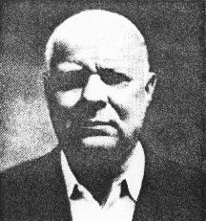
Karatsuba, Anatolii Alexeevich
(1937-2008)
In 1962 Karatsuba had formulated the first mult. algorithm to break the n² barrier!

Slide 65
Gaussified MULT
(Karatsuba 1962)
MULT(X,Y):
If |X| = |Y| = 1 then return XY
else break X into a;b and Y into c;d
e : = MULT(a,c)
f := MULT(b,d)
return
e 2^{n} + (MULT(a+b,c+d) – e – f) 2^{n/2} + f
T(n) = 3 T(n/2) + n

Slide 66
=
n
T(n)
T(n/2)
T(n/2)
T(n/2)

Slide 67
=
n
T(n)
n/2
T(n/2)
T(n/2)
T
(n/4)
T
(n/4)
T
(n/4)

Slide 68
=
n
T(n)
n/2
n/2
T(n/2)
T
(n/4)
T
(n/4)
T
(n/4)
T
(n/4)
T
(n/4)
T
(n/4)

Slide 69
=
n
T(n)
n/2
n/2
n/2
T
(n/4)
T
(n/4)
T
(n/4)
T
(n/4)
T
(n/4)
T
(n/4)
T
(n/4)
T
(n/4)
T
(n/4)

Slide 70
0
n
n/2 + n/2 + n/2
. . . . . . . . . . . . . . . . . . . . . . . . . .
1+1+1+1+1+1+1+1+1+1+1+1+1+1+1+1+1+1+1+1+1+1+1+1+1+1+1+1
1
2
i
Level i is the sum of 3^{i} copies of n/2^{i}
log₂(n)

Slide 71
1n =
n
n/2 + n/2 + n/2
Level i is the sum of 3^{i} copies of n/2^{i}
. . . . . . . . . . . . . . . . . . . . . . . . . .
1+1+1+1+1+1+1+1+1+1+1+1+1+1+1+1+1+1+1+1+1+1+1+1+1+1+1+1
3/2n =
9/4n =
(3/2)^{i}n =
(3/2)^{log n}n =
n(1+3/2+(3/2)²+ . . . + (3/2)^{log2 n})= 3n^{1.58…} – 2n

Slide 72
Dramatic Improvement for Large n
T(n) = 3n^{log2 3} – 2n
= Θ(n^{log2 3})
= Θ(n^{1.58…})
A huge savings over Θ(n²) when n gets large.

Slide 73
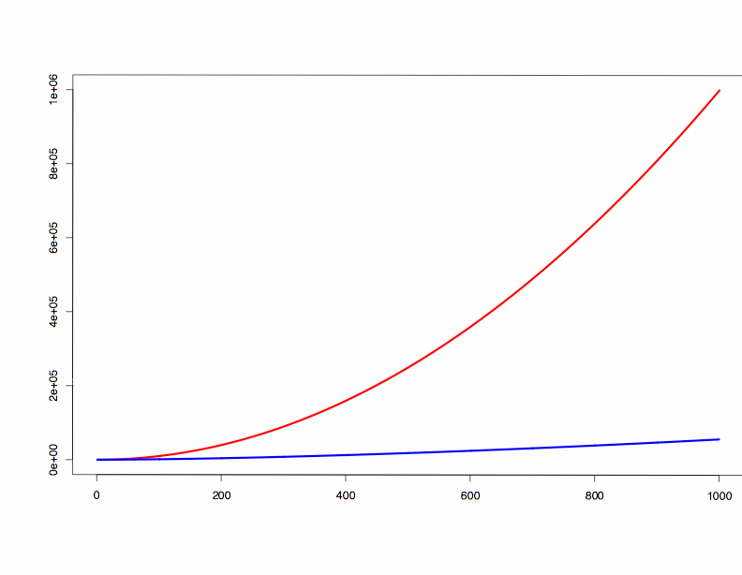
n²
n ^{1.584}

Slide 74
3-Way Multiplication
The key idea of the algorithm is to divide a large integer into 3 parts (rather than 2) of size approximately n/3 and then multiply those parts.
154517766 = 154 ∗ 10⁶ + 517 ∗ 10³ + 766

Slide 75
3-Way Multiplication
Let
X = x₂ 10^{2p} + x₁ 10^{p} + x₀
Y = y₂ 10^{2p} + y₁ 10^{p} + y₀
Then
X*Y=10^{4p} x₂y₂+10^{3p} (x₂y₁+x₁y₂)+
10^{2p} (x₂y₀+x₁y₁+x₀y₂)+10^{p} (x₁y₀+x₀y₁)+x₀y₀
T(n) = 9 T(n/3) + Θ(n)
T(n) = Θ(n²)

Slide 76
3-Way Multiplication
Consider the equation in general form p > 3
T(n) = p T(n/3) + O(n)
Its solution is given by
T(n) = O(n^{log}₃^{p})
Thus, this is faster if p = 5 or less
T(n) = O(n ^{log}₃⁵)=O(n ^{1.46…})

Slide 77
Is it possible to reduce the number of multiplications to 5?
Here is the system of new variables:
(x₀ y₀) =Z₀
12 (x₁y₀+x₀y₁) =8 Z₁-Z₂-8 Z₃+Z₄
24 (x₂y₀+x₁y₁+x₀y₂) =-30 Z₀+16 Z₁-Z₂+16 Z₃-Z₄
12 (x₂y₁+x₁y₂) =-2 Z₁+Z₂+2 Z₃-Z₄
24 (x₂y₂) =6 Z₀-4 Z₁+Z₂-4 Z₃+Z₄

Slide 78
5 Multiplications Suffice
Here are the values of Z_{k} which make this work:
Z₀ = x₀ y₀
Z₁ = (x₀+x₁+x₂) (y₀+y₁+y₂)
Z₂ = (x₀+2 x₁+4 x₂) (y₀+2 y₁+4 y₂)
Z₃ = (x₀-x₁+x₂) (y₀-y₁+y₂)
Z₄ = (x₀-2 x₁+4 x₂) (y₀-2 y₁+4 y₂)
We leave checking this to the reader. Note that multiplying and dividing by small constants (eg:2,4,12,24) are O(n) time and absorbed by the constant term in the recurrence.

Slide 79
Further Generalizations
It is possible to develop a faster algorithm by increasing the number of splits.
A 4-way splitting:
T(n) = 7 T(n/4) + O(n)
T(n) = O(n ^{1.403…})

Slide 80
Further Generalizations
In similar fashion, the k-way split requires 2k-1 multiplications. (We do not show that here. See http://en.wikipedia.org/wiki/Toom-Cook_multiplication)
A k-way splitting:
T(n) = (2k-1) T(n/k) + O(n)
T(n) = O(n ^{log}_{k} ^{(2k-1)} )
n^{1.58}, n^{1.46}, n^{1.40}, n^{1.36}, n^{1.33}, …
Note, we will never get a linear performance

Slide 81
Multiplication Algorithms
Grade School | O(n²)
Karatsuba | O(n^{1.58…})
3-way split | O(n^{1.46…})
K-way split | O(n ^{log}_{k} ^{(2k-1)} )
Fast Fourier Transform | O(n logn loglogn)

Slide 82
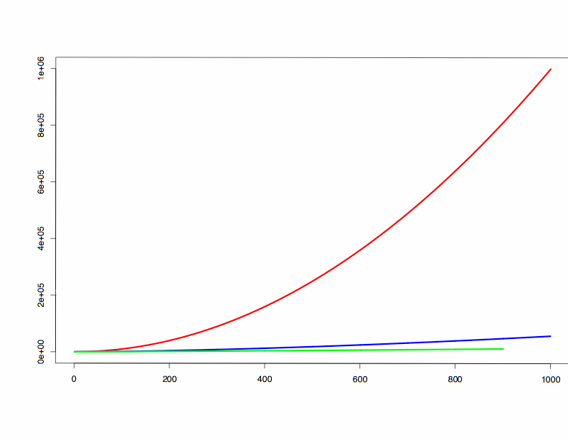
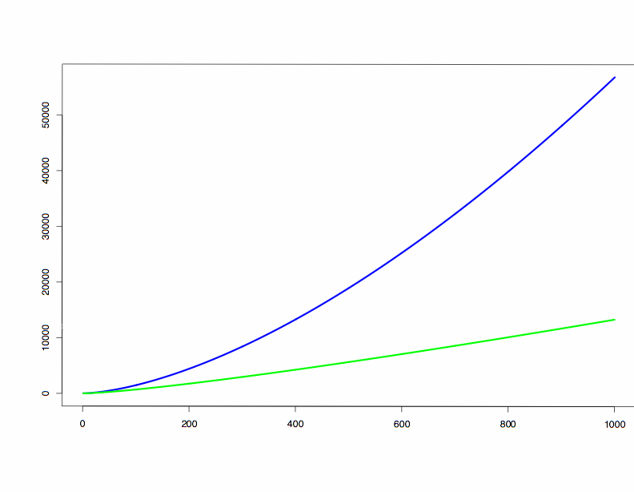
n²
n ^{1.584}
n log(n) loglog(n)
n ^{1.584}

Slide 83
Study Bee
Asymptotic notation
Divide and Conquer
Karatsuba Multiplication
Solving Recurrences

