Slide 1
15-251
Great Theoretical Ideas in Computer Science

Slide 2
Graphs II
Anupam Gupta
Danny Sleator
Lecture 19, October 26, 2010

Slide 3
Recap

Slide 4
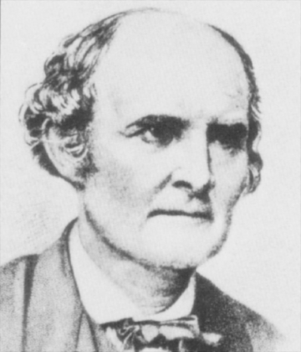
Cayley’s Formula
The number of labeled trees on n nodes is n^{n-2}

Slide 5
A graph is planar if
it can be drawn in the plane without crossing edges
Kuratowski’s Theorem
A graph G is planar if and only if K_{3,3} and K₅ are not minors of G.
The 5-color theorem and the 4-color theorem

Slide 6
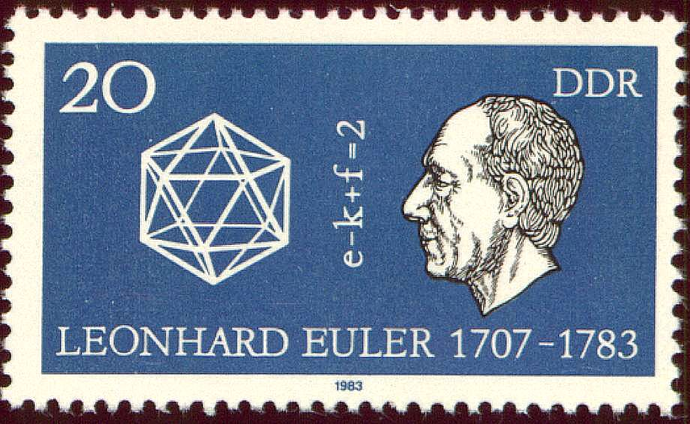
Euler’s Formula
If G is a connected planar graph with n vertices, e edges and f faces, then n – e + f = 2

Slide 7
Spanning Trees
A spanning tree of a graph G is a tree that touches every node of G and uses only edges from G
Every connected graph has a spanning tree

Slide 8
Counting Spanning Trees
How can we count the number of spanning trees in a graph?
( )
e
Brute force: try all subsets of n-1 edges.
n-1
There’s a faster way.

Slide 9
Counting Spanning Trees Efficiently
Form the Laplacian of the graph. This is an nxn matrix L, where:
Degree(i) if i=j
L_{i} _{j} =
-1 if (i,j) ∈ E
0 otherwise
2
3 -1 0 -1 -1 -1 2 -1 0 0 0 -1 2 -1 0 -1 0 -1 3 -1 -1 0 0 -1 2
1
3
L =
4
5

Slide 10
Counting Spanning Trees Efficiently
Matrix-Tree Theorem: The number of spanning trees of a graph is the determinant of the Laplacian with one row and column removed.
Proof:
Beyond the scope of this course

Slide 11
2
3 -1 0 -1 -1 -1 2 -1 0 0 0 -1 2 -1 0 -1 0 -1 3 -1 -1 0 0 -1 2
1
3
L =
4
5
2 -1 0 0 -1 2 -1 0 0 -1 3 -1 0 0 -1 2
(do on doc cam)
= 11
Number of spanning trees = 11
(do on doc cam)

Slide 12
If G is the complete graph on n nodes what happens? We have this (n-1)x(n-1) det:
n-1 -1 … -1
Subtract 1st column from every other column
n-1 -n … -n
-1 n-1… -1
-1 n … 0
. . .
. . .
. . .
. . .
. . .
. . .
-1 -1… n-1
-1 0 … n
Add every one of the rows to the first
1 0 … 0
-1 n … 0
= n^{n-2}
Cayley’s Formula!
. . .
. . .
. . .
-1 0 … n

Slide 13
This is a beautiful example from
Spectral Graph Theory
Which involves using linear algebra to study and compute things on graphs

Slide 14
Finding Minimum Spanning Trees
Say that each edge in a graph has a cost. A very natural question to ask is:
What is the cheapest subset of edges that connect the nodes?
i.e: what is the minimum spanning tree of the graph?

Slide 15
Finding Optimal Trees
Problem: Find a minimum spanning tree, that is, a tree that has a node for every node in the graph, such that the sum of the edge weights is minimum

Slide 16
Minimum Spanning Trees
7
8
4
5
9
7
6
8
9
11

Slide 17
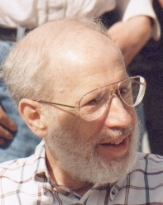
Kruskal’s Algorithm
A simple algorithm for finding a minimum spanning tree

Slide 18
Finding an MST: Kruskal’s Algorithm
Create a forest where each node is a separate tree
Make a sorted list of edges S
While S is non-empty:
Remove an edge from S with minimal weight
If it connects two different trees, add the edge. Otherwise discard it.

Slide 19
Applying the Algorithm
7
4
1
5
9
6
9
10
7
3

Slide 20
Proving the Algorithm Works
The algorithm outputs a spanning tree T.
Suppose that it’s not minimal. (For simplicity, assume all edge weights in graph are distinct)
Let M be a minimum spanning tree.
Let e be the first edge chosen by the algorithm that is not in M.
If we add e to M, it creates a cycle. Since this cycle isn’t fully contained in T, it has an edge f not in T.
N = M+e-f is another spanning tree.

Slide 21
Proving the Algorithm Works
N = M+e-f is another spanning tree.
Claim: e < f, and therefore N < M
Suppose not: e > f
Then f would have been visited before e by the algorithm, but not added, because adding it would have formed a cycle.
But all of these cycle edges are also edges of M, since e was the first edge not in M. This contradicts the assumption M is a tree.

Slide 22
Greed is Good (In this case…)
The greedy algorithm, by adding the least costly edges in each stage, succeeds in finding an MST
But — in math and life — if pushed too far, the greedy approach can lead to bad results.

Slide 23
TSP: Traveling Salesman Problem
Given a number of cities and the costs of traveling from any city to any other city, what is the cheapest round-trip route that visits each city at least once and then returns to the starting city?

Slide 24
TSP from Trees
We can use an MST to derive a TSP tour that is no more expensive than twice the optimal tour.
Idea: walk “around” the MST and take shortcuts if a node has already been visited.
We assume that all pairs of nodes are connected, and edge weights satisfy the triangle inequality d(x,y) ≤ d(x,z) + d(z,y)

Slide 25
Tours from Trees
Shortcuts only decrease the cost, so
Cost(Greedy Tour) ≤ 2 Cost(MST)
≤ 2 Cost(Optimal Tour)
This is a 2-competitive algorithm

Slide 26
Bipartite Graph
A graph is bipartite if the nodes can be partitioned into two sets V₁ and V₂ such that all edges go only between V₁ and V₂ (no edges go from V₁ to V₁ or from V₂ to V₂)

Slide 27
Dancing Partners
A group of 100 boys and girls attend a dance. Every boy knows 5 girls, and every girl knows 5 boys. Can they be matched into dance partners so that each pair knows each other?

Slide 28
Dancing Partners

Slide 29
Perfect Matchings
A matching is a set of edges, no two of which share a vertex. The matching is perfect if it includes every vertex.
Regular Bipartite Matching Theorem: If every node in a bipartite graph has the same degree d ≥ 1, then the graph has a perfect matching.
Note: if degrees are the same then |A| = |B|, where A is the set of nodes “on the left” and B is the set of nodes “on the right”

Slide 30
A Matter of Degree
Claim: If degrees are the same then |A| = |B|
Proof:
If there are m boys, there are md edges
If there are n girls, there are nd edges
The Regular Bipartite Matching Theorem follows from a stronger theorem, which we now come to. (Remind me to return to the proof of the RBMT later.)

Slide 31
The Marriage Theorem
Theorem: A bipartite graph has a perfect matching if and only if |A| = |B| = n and for all k ∈ [1,n]: for any subset of k nodes of A there are at least k nodes of B that are connected to at least one of them.

Slide 32


The Marriage Theorem
For any subset of (say) k nodes of A there are at least k nodes of B that are connected to at least one of them
The condition fails for this graph

Slide 33
The Feeling is Mutual
The condition of the theorem still holds if we swap the roles of A and B: If we pick any k nodes in B, they are connected to at least k nodes in A
A
B
Proof by
Contradiction:
k>
k
n-k<
n-k

Slide 34
Proof of Marriage Theorem
Call a bipartite graph “matchable” if it has the same number of nodes on left and right, and any k nodes on the left are connected to at least k on the right
Strategy: Break up the graph into two matchable parts, and recursively partition each of these into two matchable parts, etc., until each part has only two nodes

Slide 35
Proof of Marriage Theorem
Select two nodes a ∈ A and b ∈ B connected by an edge
Idea: Take G₁ = (a,b) and G₂ = everything else
If G₂ is matchable, we’re done. So let’s assume that G₂ is not matchable.
If G₂ is not matchable then there is a set of k nodes in G₂ that has only k-1 neighbors.

Slide 36
Proof of Marriage Theorem
The only way this could fail is if one of the missing nodes is b
a
b
k-1
k
Add this in to form G₁, and take G₂ to be everything else.
This is a matchable partition!*
(*Done in lecture on the document cam.)

Slide 37

Example
Suppose that a standard deck of cards is dealt into 13 piles of 4 cards each
Then it is possible to select a card from each pile so that the 13 chosen cards contain exactly one card of each rank

Slide 38
Proof: Form a bipartite graph as follows: Start with 52 cards on the left and the same 52 cards on the right, connected by 52 edges.
Now group the cards on the left into 13 sets according to the given piles. Group the cards on the right into 13 groups according to rank. Let the edges be inherited from the original ones.
This bipartite graph is matchable -- k groups on the left have to connect to 4k cards on the right, thus they connect to at least k groups on the right.
And thus has a perfect matching.

Slide 39
Generalized Marriage: Hall’s Theorem
Let S = {S₁, S₂, …S_{n}} be a set of finite subsets that satisfies: For any subset T of {1,2,…,n} let U = the union of S_{t} for t in T, we have: |U| ≥ |T|. I.E. any k subsets contain at least k elements
Then we can choose an element x_{i} from each S_{i} so that {x₁, x₂, …} are all distinct

Slide 40
The proof of Hall’s Theorem is slightly more complicated (but not much) than our proof of the Marriage Theorem.
You can find the proof on Wikipedia, or on pages 218 and 219 of Mathematical Thinking by D’Angelo and West.

Slide 41

Minimum Spanning Tree
- Definition
Counting spanning trees
- Matrix-Tree Theorem
Kruskal’s Algorithm
- Definition
- Proof of Correctness
Traveling Salesman Problem
- Definition
- Using MST to get an
approximate solution
The Marriage Theorem
Here’s What You Need to Know…

