Slide 1
15-251
Some
Great Theoretical Ideas in Computer Science
for

Slide 2
Anupam Gupta
Danny Sleator
Graphs
Lecture 18 (October 21, 2010)

Slide 3
Graph – informal definitions
Set of vertices (or nodes)
Set of edges, each a pair of vertices
Write G=(V,E).
A self-loop is an edge that connects to the same vertex twice
A multi-edge (parallel edges) is a set of two or more edges that have the same two vertices
A graph is simple if it has no multi-edges or self-loops.
In this course “graph” means simple graph. Use “arbitrary” graph otherwise.

Slide 4
More terms
Cycles
Acyclic
Paths
Connected
The degree of a vertex
Directed: an edge is an ordered pair of vertices
Undirected: edge is unordered pair of vertices
(this lecture is all undirected)

Slide 5
What’s a tree?
A tree is a connected graph with no cycles

Slide 6
Tree

Slide 7
Not Tree

Slide 8
Not Tree

Slide 9
Tree

Slide 10
How Many n-Node Trees?
1:
2:
3:
4:
5:

Slide 11
Notation
In this lecture:
n will denote the number of nodes in a graph
e will denote the number of edges in a graph

Slide 12
Theorem: Let G be a graph with n nodes and e edges
The following are equivalent:
1. G is a tree (connected, acyclic)
2. Every two nodes of G are joined by a unique path
3. G is connected and n = e + 1
4. G is acyclic and n = e + 1
5. G is acyclic and if any two non-adjacent nodes are joined by an edge, the resulting graph has exactly one cycle

Slide 13
To prove this, it suffices to show
1 ⇒ 2 ⇒ 3 ⇒ 4 ⇒ 5 ⇒ 1
In the interest of time, we’ll just show
1 ⇔ 2 ⇔ 3
and leave the rest to the reader

Slide 14
1 ⇒ 2
1. G is a tree (connected, acyclic)
2. Every two nodes of G are joined by a unique path
Proof: (by contradiction)
Assume G is a tree that has two nodes connected by two different paths:
Then there exists a cycle!

Slide 15
2 ⇒ 1
1. G is a tree (connected, acyclic)
2. Every two nodes of G are joined by a unique path
Proof: We prove the contrapositive ¬2⇒¬1.
¬2 means either there’s no path between a pair, then it’s not connected, thus ¬1. Or it means there are two nodes connected by two different paths:
Then there exists a cycle!

Slide 16
2 ⇒ 3
2. Every two nodes of G are joined by a unique path
3. G is connected and n = e + 1
Proof: (by induction)
Assume true for every graph with < n nodes
Let G have n nodes and let x and y be adjacent
G₁
G₂
x
y
Let n₁,e₁ be number of nodes and edges in G₁
Then n = n₁ + n₂ = e₁ + e₂ + 2 = e + 1

Slide 17
3 ⇒ 2
2. Every two nodes of G are joined by a unique path
3. G is connected and e = n - 1
Proof:
Imagine trying to connect the n nodes of G with n-1 edges, by inserting the edges one by one.
The only way to completely connect the graph is if on every step we connect two components together, otherwise we run out of edges. Each component has the unique paths property.
x
y
It’s easy to see that the unique path property holds in the result.

Slide 18
Corollary: Every nontrivial tree has at least two endpoints (points of degree 1)
Proof (by contradiction):
Assume all but one of the points in the tree have degree at least 2
In any graph, sum of the degrees =
2e
Then the total number of edges in the tree is at least (2n-1)/2 = n - 1/2 > n - 1

Slide 19
How many labeled trees are there with three nodes?
1
2
3
1
3
2
2
1
3

Slide 20
How many labeled trees are there with four nodes?
a
c
b
d

Slide 21
How many labeled trees are there with five nodes?
5
labelings
4
5 x x
3
5!/
2
labelings
labelings
125 labeled trees

Slide 22
How many labeled trees are there with n nodes?
3 labeled trees with 3 nodes
16 labeled trees with 4 nodes
125 labeled trees with 5 nodes
n^{n-2} labeled trees with n nodes

Slide 23
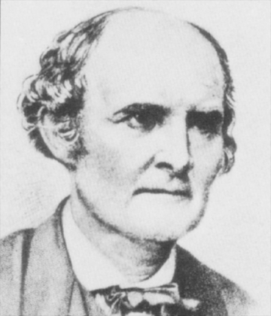
Cayley’s Formula
The number of labeled trees on n nodes is n^{n-2}

Slide 24
The proof will use the correspondence principle.
Let T be the set of labeled n-node trees.
Let S be {1,2,…,n}^{n-2} (that is, all sequences of n-2 numbers, each in the range [1..n])
We’ll exhibit a bijection between S and T.

Slide 25
How to make a sequence from a tree?
Loop through i from 1 to n-2
Let L be the degree-1 node with the lowest label
Define the i^{th} element of the sequence as the label of the node adjacent to L
Delete the node L from the tree
Example:
5
8
3
4
1
7
2
6
1
3
3
4
4
4

Slide 26
5
8
3
4
1
7
2
6
1
3
3
4
4
4
What can you say about the set of numbers that occur in this sequence? Which nodes are they in the tree?

Slide 27
Lemma: The node labels occurring in a sequence are precisely those with degree at least 2.
Proof: Every time a label is output, that node’s degree decreases by 1. At the end there are two nodes of degree 1. Therefore all the degree ≥ 2 must have been output.☐
Therefore, we can, by looking at the the sequence, identify the nodes of initial degree 1. Among those, the one deleted first is the lowest. This leads to the following…..

Slide 28
How to reconstruct the unique tree from a sequence S:
Let I = {1, 2, 3, …, n}
Loop until S is empty
Let i = smallest # in I but not in S
Let s = first label in sequence S
Add edge {i, s} to the tree
Delete i from I
Delete s from S
5
8
3
4
1
7
Add edge {a,b}, where I = {a,b}
2
6
1
3
3
4
4
4

Slide 29
For any sequence this algorithm always
generates a labeled tree that inverts the
encoding algorithm.
The invariant that is preserved as the
algorithm runs is that the set of available
labels (l) always contains all the labels
remaining in the sequence.

Slide 30
Spanning Trees
A spanning tree of a graph G is a tree that touches every node of G and uses only edges from G
Every connected graph has a spanning tree

Slide 31
A graph is planar if it can be drawn in the plane without crossing edges

Slide 32
Examples of Planar Graphs
=

Slide 33
http://www.planarity.net

Slide 34
Faces
A planar graph splits the plane into disjoint faces
4 faces

Slide 35
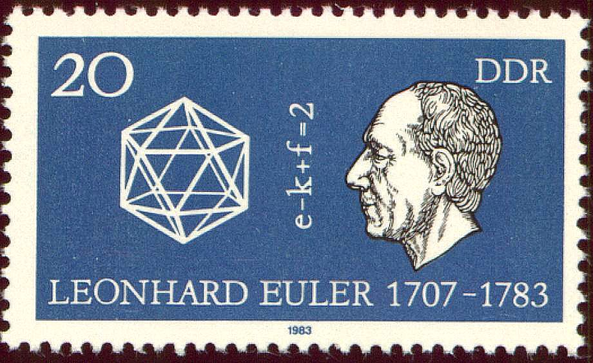
Euler’s Formula
If G is a connected planar graph with n vertices, e edges and f faces, then n – e + f = 2

Slide 36
Proof of Euler’s Formula
For connected arbitrary planar graphs n-e+f=2
The proof is by induction.
Let’s build up the graph by adding edges one at a time, always preserving the Euler formula.
Start with a single edge and 2 vertices. n=2, f=1, e=1. Check.
Add the edges in an order so that what we’ve added so far is connected.

Slide 37
There are two cases to consider.
The edge connects two vertices already there.
The edge connects the current graph to a new vertex
In case (1) we add a new edge (e++) and we split one face in half (f++). So n-e+f is preserved.
In case (2) we add a new vertex (n++) and a new edge (e++). So again n-e+f is preserved.

Slide 38
Corollary 1: Let G be a simple connected planar graph with n > 2 vertices. Then G has a vertex of degree at most 5.
Proof: Because of simplicity and n>2 every face has at least three edges around it. Thus 3f ≤ 2e (draw picture on doc cam).
Let d_{i} be the degree of node i. ∑d_{i} = 2e. (draw picture on doc cam).
Euler: n-e+f=2
⇒ 6e = 6n+6f-12 ≤ 6n+4e-12 ⇒ 2e≤6n-12
⇒ ∑d_{i} ≤ 6n-12 ⇒ ∑d_{i} / n ≤ 6-12/n
⇒ Average Degree < 6
⇒ there exists a vertex of degree at most 5

Slide 39
Corollary 2: Let G be a simple connected planar graph with n > 2 vertices. G has at most 3n – 6 edges
Proof: We already showed that under these conditions 2e≤6n-12. Thus e≤3n-6. QED.
Note: This theorem is important because it shows that in a simple planar graph e = O(n).

Slide 40
Graph Minors
A graph M is a minor in a graph G if you can obtain M by deleting vertices and edges in G and then merging pairs of edges incident on degree two vertices.
is a minor in

Slide 41
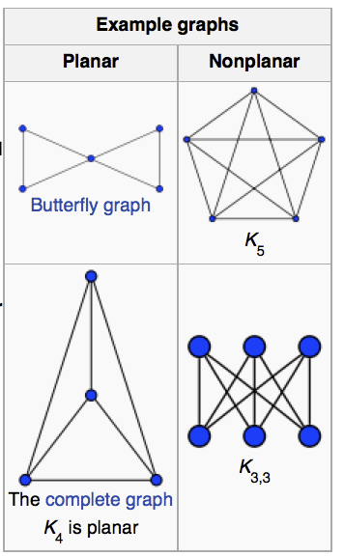
Kuratowski’s Theorem
A graph G is planar if and only if K_{3,3} and K₅ are not minors of G.

Slide 42
Graph Coloring
A coloring of a graph is an assignment of a color to each vertex such that no neighboring vertices have the same color

Slide 43
Graph Coloring
Arises surprisingly often in CS
Register allocation: assign temporary variables to registers for scheduling instructions. Variables that interfere, or are simultaneously active, cannot be assigned to the same register

Slide 44
Theorem: Every planar graph can be 5-colored
Proof (by induction):
Assume every planar graph with less than n vertices can be 5-colored. A base case of n<6 is trivial.
Assume G has n vertices
Since G is planar, it has some node v with degree at most 5.
If deg(v)<5, Remove v and color by with 5 colors. Now color v with a color not used among its neighbors.
(A slight technicality here is that we have to keep the graph connected in order to apply the Euler formula. If removal of v disconnects the graph, then you can add sufficient edges among the neighbors of v to retain connectivity. )

Slide 45
What if v has degree 5?
We know that all pairs of the neighbors of v cannot be edges (they’d form K₅)
So there is a pair (v,w) which are not neighbors.
We now identify these two vertices as one, and apply the 5-coloring method to the resulting smaller connected planar graph.
Now notice that we can apply this coloring to G, and among the neighbor of v, only 4 colors are used. Thus we can color v with the 5th color.

Slide 46
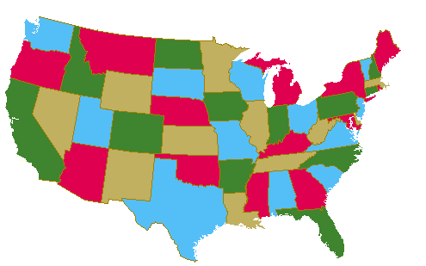
A computer-assisted proof of the 4-color theorem was discovered in 1976 by Appel and Haken of the University of Illinois.

Slide 47
Implementing Graphs

Slide 48
Adjacency Matrix
Suppose we have a graph G with n vertices. The adjacency matrix is the n x n matrix A=[a_{ij}] with:
a_{ij} = 1 if (i,j) is an edge
a_{ij} = 0 if (i,j) is not an edge
Good for dense graphs!

Slide 49
Example
0 1 1 1
1 0 1 1
A =
1 1 0 1
1 1 1 0

Slide 50
Counting Paths
The number of paths of length k from node i to node j is the entry in position (i,j) in the matrix A^{k}
0 1 1 1
0 1 1 1
1 0 1 1
1 0 1 1
A² =
1 1 0 1
1 1 0 1
1 1 1 0
1 1 1 0
3 2 2 2
2 3 2 2
=
2 2 3 2
2 2 2 3

Slide 51
Adjacency List
Suppose we have a graph G with n vertices. The adjacency list is the list that contains all the nodes that each node is adjacent to
Good for sparse graphs!

Slide 52
Example
1
3
1: 2,3
2: 1,3,4
3: 1,2,4
4: 2,3
2
4

Slide 53

Trees
Counting Trees
Different Characterizations
Planar Graphs
Definition
Euler’s Theorem
Planar Graphs
  Kuratowski’s thm.
  5 and 4 coloring
Adjacency Matrix and List
Definition
Useful for counting
Here’s What You Need to Know…

