Slide 1
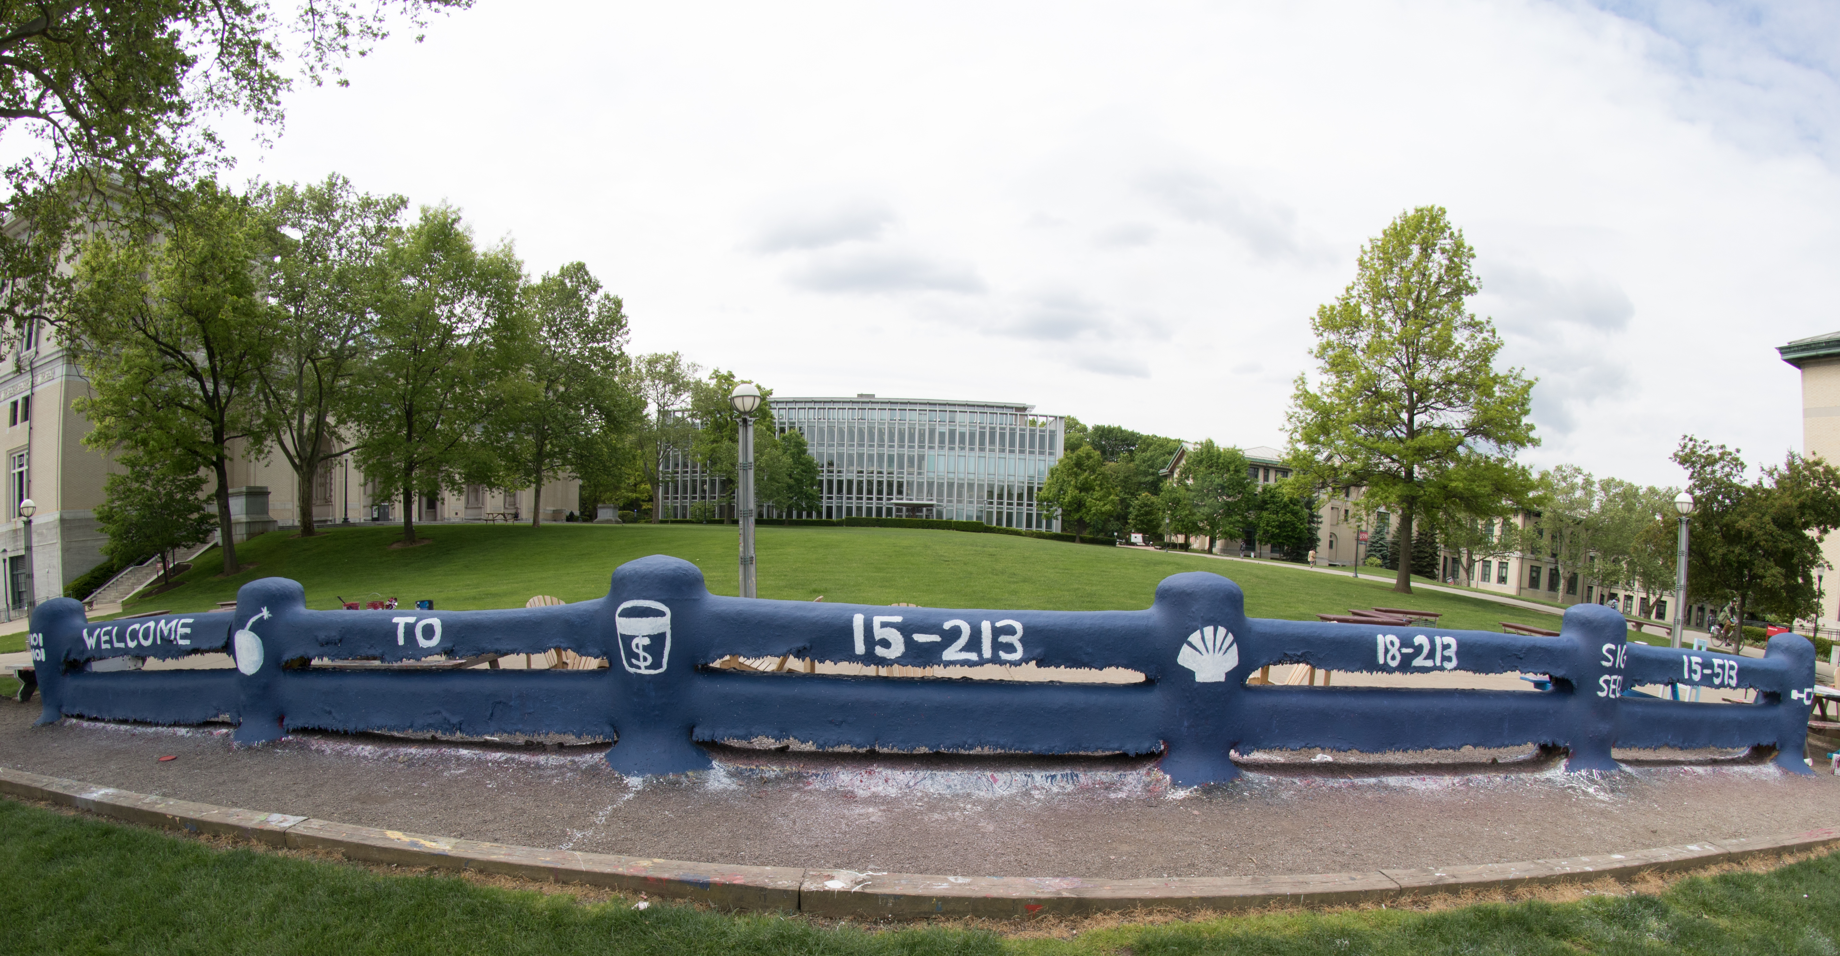

Slide 2
Bits, Bytes, and Integers – Part 2
15-213: Introduction to Computer Systems
3rd Lecture, Sept. 4, 2018

Slide 3
Assignment Announcements
Lab 0 available via course web page and Autolab.
  Due Thurs. Sept. 6, 11:59pm
  No grace days
  No late submissions
  Just do it!
Lab 1 available via Autolab
  Due Thurs, Sept. 13, 11:59pm
  Read instructions carefully: writeup, bits.c, tests.c
    Quirky software infrastructure
  Based on lectures 2, 3, and 4 (CS:APP Chapter 2)
  After today’s lecture you will know everything for the integer problems
  Floating point covered Thursday Sept. 6

Slide 4
Summary From Last Lecture
Representing information as bits
Bit-level manipulations
Integers
  Representation: unsigned and signed
  Conversion, casting
  Expanding, truncating
  Addition, negation, multiplication, shifting
Representations in memory, pointers, strings
Summary

Slide 5
Encoding Integers
Unsigned
Two’s Complement
Sign Bit
Two’s Complement Examples (w = 5)
-16 | 8 | 4 | 2 | 1
0 | 1 | 0 | 1 | 0
10 =
8+2 = 10
-16 | 8 | 4 | 2 | 1
1 | 0 | 1 | 1 | 0
-10 =
-16+4+2 = -10

Slide 6
Unsigned & Signed Numeric Values
Equivalence
  Same encodings for nonnegative values
Uniqueness
  Every bit pattern represents unique integer value
  Each representable integer has unique bit encoding
  Expression containing signed and unsigned int:
  int is cast to unsigned
X
B2U(X)
B2T(X)
0000
0
0
0001
1
1
0010
2
2
0011
3
3
0100
4
4
0101
5
5
0110
6
6
0111
7
7
1000
8
–8
1001
9
–7
1010
10
–6
1011
11
–5
1100
12
–4
1101
13
–3
1110
14
–2
1111
15
–1

Slide 7
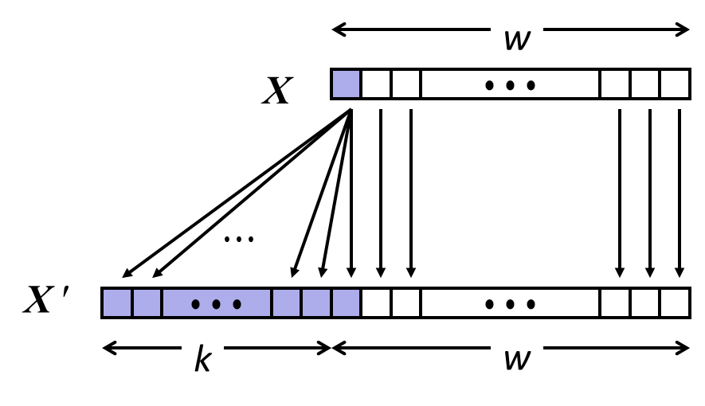
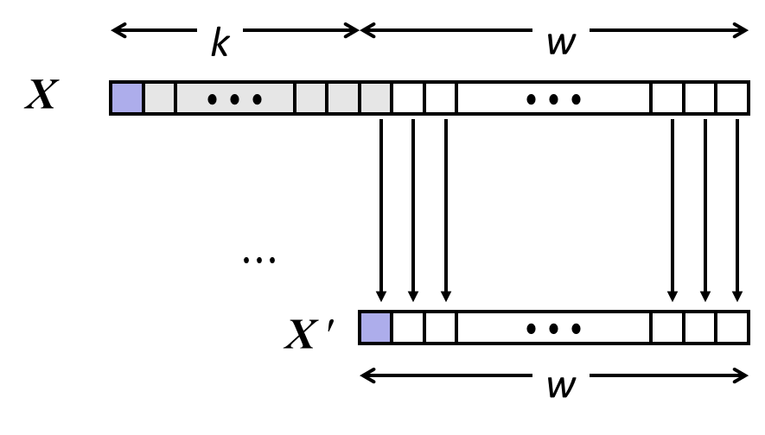
Sign Extension and Truncation
Sign Extension
Truncation

Slide 8
Today: Bits, Bytes, and Integers
Representing information as bits
Bit-level manipulations
Integers
  Representation: unsigned and signed
  Conversion, casting
  Expanding, truncating
  Addition, negation, multiplication, shifting
Representations in memory, pointers, strings
Summary

Slide 9
Unsigned Addition
u
Operands: w bits
• • •
+
v
• • •
True Sum: w+1 bits
u + v
• • •
Discard Carry: w bits
UAdd_{w}(u , v)
• • •
Decimal
Hex
Binary
Standard Addition Function
  Ignores carry output
Implements Modular Arithmetic
  s = UAdd_{w}(u , v) = u + v mod 2^{w}
0
0
0000
1
1
0001
2
2
0010
3
3
0011
4
4
0100
5
5
0101
6
6
0110
7
7
0111
unsigned char
1110 1001
+ 1101 0101
E9
+ D5
223
+ 213
8
8
1000
9
9
1001
A
10
1010
1 1011 1110
1BE
446
B
11
1011
C
12
1100
1011 1110
BE
190
D
13
1101
E
14
1110
F
15
1111

Slide 10
Visualizing (Mathematical) Integer Addition
Integer Addition
  4-bit integers u, v
  Compute true sum Add₄(u , v)
  Values increase linearly with u and v
  Forms planar surface
Add₄(u , v)
v
u

Slide 11
Visualizing Unsigned Addition
Wraps Around
  If true sum ≥ 2^{w}
  At most once
Overflow
UAdd₄(u , v)
True Sum
2^{w+1}
Overflow
2^{w}
v
0
Modular Sum
u

Slide 12
Two’s Complement Addition
Operands: w bits
u
• • •
+
v
• • •
True Sum: w+1 bits
u + v
• • •
Discard Carry: w bits
TAdd_{w}(u , v)
• • •
TAdd and UAdd have Identical Bit-Level Behavior
  Signed vs. unsigned addition in C:
  int s, t, u, v;
  s = (int) ((unsigned) u + (unsigned) v);
  t = u + v
  Will give s == t
1110 1001
+ 1101 0101
E9
+ D5
-23
+ -43
1 1011 1110
1BE
-66
1011 1110
BE
-66

Slide 13
TAdd Overflow
Functionality
  True sum requires w+1 bits
  Drop off MSB
  Treat remaining bits as 2’s comp. integer
True Sum
0 111…1
2^{w}–1
PosOver
TAdd Result
0 100…0
2^{w –1}–1
011…1
0 000…0
0
000…0
1 011…1
–2^{w –1}
100…0
1 000…0
–2^{w}
NegOver

Slide 14
Visualizing 2’s Complement Addition
NegOver
Values
  4-bit two’s comp.
  Range from -8 to +7
Wraps Around
  If sum ≥ 2^{w–1}
    Becomes negative
    At most once
  If sum < –2^{w–1}
    Becomes positive
    At most once
TAdd₄(u , v)
v
u
PosOver

Slide 15
Characterizing TAdd
Positive Overflow
Functionality
  True sum requires w+1 bits
  Drop off MSB
  Treat remaining bits as 2’s comp. integer
TAdd(u , v)
> 0
v
< 0
< 0
> 0
u
Negative Overflow
2^{w}
(NegOver)
2^{w}
(PosOver)

Slide 16
Multiplication
Goal: Computing Product of w-bit numbers x, y
  Either signed or unsigned
But, exact results can be bigger than w bits
  Unsigned: up to 2w bits
    Result range: 0 ≤ x * y ≤ (2^{w} – 1) ² = 2^{2w} – 2^{w+1} + 1
  Two’s complement min (negative): Up to 2w-1 bits
    Result range: x * y ≥ (–2^{w–1})*(2^{w–1}–1) = –2^{2w–2} + 2^{w–1}
  Two’s complement max (positive): Up to 2w bits, but only for (TMin_{w})²
    Result range: x * y ≤ (–2^{w–1}) ² = 2^{2w–2}
So, maintaining exact results…
  would need to keep expanding word size with each product computed
  is done in software, if needed
    e.g., by “arbitrary precision” arithmetic packages

Slide 17
Unsigned Multiplication in C
u
• • •
Operands: w bits
*
v
• • •
True Product: 2*w bits
u · v
• • •
• • •
UMult_{w}(u , v)
Discard w bits: w bits
• • •
Standard Multiplication Function
  Ignores high order w bits
Implements Modular Arithmetic
  UMult_{w}(u , v) = u · v mod 2^{w}
1110 1001
* 1101 0101
E9
* D5
223
* 213
1100 0001 1101 1101
C1DD
47499
1101 1101
DD
221

Slide 18
Signed Multiplication in C
u
• • •
Operands: w bits
*
v
• • •
True Product: 2*w bits
u · v
• • •
• • •
TMult_{w}(u , v)
Discard w bits: w bits
• • •
Standard Multiplication Function
  Ignores high order w bits
  Some of which are different for signed vs. unsigned multiplication
  Lower bits are the same
1110 1001
* 1101 0101
E9
* D5
-23
* -43
0000 0011 1101 1101
03DD
989
1101 1101
DD
-35

Slide 19
Power-of-2 Multiply with Shift
Operation
  u << k gives u * 2^{k}
  Both signed and unsigned
Examples
  u << 3 == u * 8
  (u << 5) – (u << 3) == u * 24
  Most machines shift and add faster than multiply
    Compiler generates this code automatically
k
u
• • •
Operands: w bits
*
2^{k}
0
•••
0
1
0
•••
0
0
True Product: w+k bits
u · 2^{k}
• • •
0
•••
0
0
Discard k bits: w bits
UMult_{w}(u , 2^{k})
•••
0
•••
0
0
TMult_{w}(u , 2^{k})

Slide 20
Unsigned Power-of-2 Divide with Shift
Quotient of Unsigned by Power of 2
  u >> k gives ⎣ u / 2^{k} ⎦
  Uses logical shift
k
u
•••
•••
Binary Point
Operands:
/
2^{k}
0
•••
0
1
0
•••
0
0
Division:
u / 2^{k}
0
.
0
•••
0
0
•••
•••
Result:
⎣ u / 2^{k} ⎦
0
0
•••
0
0
•••

Slide 21
Signed Power-of-2 Divide with Shift
Quotient of Signed by Power of 2
  x >> k gives ⎣ x / 2^{k} ⎦
  Uses arithmetic shift
  Rounds wrong direction when u < 0
k
x
•••
•••
Binary Point
Operands:
/
2^{k}
0
•••
0
1
0
•••
0
0
Division:
x / 2^{k}
0
•••
•••
.
•••
Result:
RoundDown(x / 2^{k})
0
•••
•••

Slide 22
Correct Power-of-2 Divide
Quotient of Negative Number by Power of 2
  Want ⎡ x / 2^{k} ⎤ (Round Toward 0)
  Compute as ⎣ (x+2^{k}-1)/ 2^{k} ⎦
    In C: (x + (1<<k)-1) >> k
    Biases dividend toward 0
Case 1: No rounding
k
Dividend:
u
1
•••
0
•••
0
0
+2^{k} –1
0
•••
0
0
1
•••
1
1
Binary Point
1
•••
1
•••
1
1
Divisor:
/
2^{k}
0
•••
0
1
0
•••
0
0
⎡ u / 2^{k} ⎤
0
.
1
•••
1
1
1
•••
1
•••
1
1
    Biasing has no effect

Slide 23
Correct Power-of-2 Divide (Cont.)
Case 2: Rounding
k
Dividend:
x
1
•••
•••
+2^{k} –1
0
•••
0
0
1
•••
1
1
1
•••
•••
Incremented by 1
Binary Point
Divisor:
/
2^{k}
0
•••
0
1
0
•••
0
0
⎡ x / 2^{k} ⎤
.
0
1
•••
1
1
1
•••
•••
Incremented by 1
    Biasing adds 1 to final result

Slide 24
Negation: Complement & Increment
Negate through complement and increase
~x + 1 == -x
Example
  Observation: ~x + x == 1111…111 == -1
x
1
0
0
1
1
1
0
1
+
~x
0
1
1
0
0
0
1
0
-1
1
1
1
1
1
1
1
1
x = 15213

Slide 25
Complement & Increment Examples
x = 0
x = TMin
Canonical counter example

Slide 26
Today: Bits, Bytes, and Integers
Representing information as bits
Bit-level manipulations
Integers
  Representation: unsigned and signed
  Conversion, casting
  Expanding, truncating
  Addition, negation, multiplication, shifting
  Summary
Representations in memory, pointers, strings

Slide 27
Arithmetic: Basic Rules
Addition:
  Unsigned/signed: Normal addition followed by truncate,
  same operation on bit level
  Unsigned: addition mod 2^{w}
    Mathematical addition + possible subtraction of 2^{w}
  Signed: modified addition mod 2^{w} (result in proper range)
    Mathematical addition + possible addition or subtraction of 2^{w}
Multiplication:
  Unsigned/signed: Normal multiplication followed by truncate, same operation on bit level
  Unsigned: multiplication mod 2^{w}
  Signed: modified multiplication mod 2^{w} (result in proper range)

Slide 28
Why Should I Use Unsigned?
Don’t use without understanding implications
  Easy to make mistakes
    unsigned i;
    for (i = cnt-2; i >= 0; i--)
    a[i] += a[i+1];
  Can be very subtle
    #define DELTA sizeof(int)
    int i;
    for (i = CNT; i-DELTA >= 0; i-= DELTA)
    . . .

Slide 29
Counting Down with Unsigned
Proper way to use unsigned as loop index
    unsigned i;
    for (i = cnt-2; i < cnt; i--)
    a[i] += a[i+1];
See Robert Seacord, Secure Coding in C and C++
  C Standard guarantees that unsigned addition will behave like modular arithmetic
    0 – 1 → UMax
Even better
    size_t i;
    for (i = cnt-2; i < cnt; i--)
    a[i] += a[i+1];
  Data type size_t defined as unsigned value with length = word size
  Code will work even if cnt = UMax
  What if cnt is signed and < 0?

Slide 30
Why Should I Use Unsigned? (cont.)
Do Use When Performing Modular Arithmetic
  Multiprecision arithmetic
Do Use When Using Bits to Represent Sets
  Logical right shift, no sign extension
Do Use In System Programming
  Bit masks, device commands,…

Slide 31
Quiz Time!
Check out:
https://canvas.cmu.edu/courses/5835

Slide 32
Today: Bits, Bytes, and Integers
Representing information as bits
Bit-level manipulations
Integers
  Representation: unsigned and signed
  Conversion, casting
  Expanding, truncating
  Addition, negation, multiplication, shifting
  Summary
Representations in memory, pointers, strings

Slide 33
Byte-Oriented Memory Organization
00•••0
FF•••F
• • •
Programs refer to data by address
  Conceptually, envision it as a very large array of bytes
    In reality, it’s not, but can think of it that way
  An address is like an index into that array
    and, a pointer variable stores an address
Note: system provides private address spaces to each “process”
  Think of a process as a program being executed
  So, a program can clobber its own data, but not that of others

Slide 34
Machine Words
Any given computer has a “Word Size”
  Nominal size of integer-valued data
    and of addresses
  Until recently, most machines used 32 bits (4 bytes) as word size
    Limits addresses to 4GB (2³² bytes)
  Increasingly, machines have 64-bit word size
    Potentially, could have 18 EB (exabytes) of addressable memory
    That’s 18.4 X 10¹⁸
  Machines still support multiple data formats
    Fractions or multiples of word size
    Always integral number of bytes

Slide 35
Word-Oriented Memory Organization
32-bit
Words
64-bit
Words
Bytes
Addr.
Addresses Specify Byte Locations
  Address of first byte in word
  Addresses of successive words differ by 4 (32-bit) or 8 (64-bit)
0000
Addr
=
??
0001
0000
0002
Addr
=
??
0003
0000
0004
Addr
=
??
0005
0004
0006
0007
0008
Addr
=
??
0009
0008
0010
Addr
=
??
0011
0008
0012
Addr
=
??
0013
0012
0014
0015

Slide 36
Example Data Representations
C Data Type | Typical 32-bit | Typical 64-bit | x86-64
char | 1 | 1 | 1
short | 2 | 2 | 2
int | 4 | 4 | 4
long | 4 | 8 | 8
float | 4 | 4 | 4
double | 8 | 8 | 8
pointer | 4 | 8 | 8

Slide 37
Byte Ordering
So, how are the bytes within a multi-byte word ordered in memory?
Conventions
  Big Endian: Sun (Oracle SPARC), PPC Mac, Internet
    Least significant byte has highest address
  Little Endian: x86, ARM processors running Android, iOS, and Linux
    Least significant byte has lowest address

Slide 38
Byte Ordering Example
Example
  Variable x has 4-byte value of 0x01234567
  Address given by &x is 0x100
Big Endian
0x100
0x101
0x102
0x103
01
01
23
23
45
45
67
67
Little Endian
0x100
0x101
0x102
0x103
67
67
45
45
23
23
01
01

Slide 39
Representing Integers
Decimal: 15213
Binary: 0011 1011 0110 1101
Hex: 3 B 6 D
int A = 15213;
long int C = 15213;
Increasing addresses
IA32, x86-64
Sun
IA32
x86-64
Sun
6D
00
3B
00
6D
6D
00
00
3B
3B
3B
00
00
6D
00
00
3B
00
00
6D
00
int B = -15213;
00
IA32, x86-64
Sun
00
00
93
FF
C4
FF
FF
C4
FF
93
Two’s complement representation

Slide 40
Examining Data Representations
Code to Print Byte Representation of Data
  Casting pointer to unsigned char * allows treatment as a byte array
typedef unsigned char *pointer;
void show_bytes(pointer start, size_t len){
size_t i;
for (i = 0; i < len; i++)
printf(”%p\t0x%.2x\n",start+i, start[i]);
printf("\n");
}
Printf directives:
%p: Print pointer
%x: Print Hexadecimal

Slide 41
show_bytes Execution Example
int a = 15213;
printf("int a = 15213;\n");
show_bytes((pointer) &a, sizeof(int));
Result (Linux x86-64):
int a = 15213;
0x7fffb7f71dbc 6d
0x7fffb7f71dbd 3b
0x7fffb7f71dbe 00
0x7fffb7f71dbf 00

Slide 42
Representing Pointers
int B = -15213;
int *P = &B;
Sun
IA32
x86-64
EF
FF
FB
2C
AC
28
F5
FF
3C
1B
FE
82
FD
7F
00
00
Different compilers & machines assign different locations to objects
Even get different results each time run program

Slide 43
Representing Strings
char S[6] = "18213";
Strings in C
  Represented by array of characters
  Each character encoded in ASCII format
    Standard 7-bit encoding of character set
    Character “0” has code 0x30
      Digit i has code 0x30+i
  String should be null-terminated
    Final character = 0
Compatibility
  Byte ordering not an issue
IA32
Sun
31
38
32
31
33
00
31
38
32
31
33
00

Slide 44
Reading Byte-Reversed Listings
Disassembly
  Text representation of binary machine code
  Generated by program that reads the machine code
Example Fragment
Deciphering Numbers
  Value: 0x12ab
  Pad to 32 bits: 0x000012ab
  Split into bytes: 00 00 12 ab
  Reverse: ab 12 00 00
Address Instruction Code Assembly Rendition
8048365: 5b pop %ebx
8048366: 81 c3 ab 12 00 00 add $0x12ab,%ebx
804836c: 83 bb 28 00 00 00 00 cmpl $0x0,0x28(%ebx)

Slide 45


Integer C Puzzles
x < 0 ⇒ ((x*2) < 0)
ux >= 0
x & 7 == 7 ⇒ (x<<30) < 0
ux > -1
x > y ⇒ -x < -y
x * x >= 0
x > 0 && y > 0 ⇒ x + y > 0
x >= 0 ⇒ -x <= 0
x <= 0 ⇒ -x >= 0
(x|-x)>>31 == -1
ux >> 3 == ux/8
x >> 3 == x/8
x & (x-1) != 0
Initialization
int x = foo();
int y = bar();
unsigned ux = x;
unsigned uy = y;

Slide 46
Summary
Representing information as bits
Bit-level manipulations
Integers
  Representation: unsigned and signed
  Conversion, casting
  Expanding, truncating
  Addition, negation, multiplication, shifting
Representations in memory, pointers, strings
Summary

