Slide 1
Future of Computing II:
What’s So Special About Big Learning?
15-213: Introduction to Computer Systems
28th Lecture, Dec. 6, 2016
Instructor:
Phil Gibbons

Slide 2

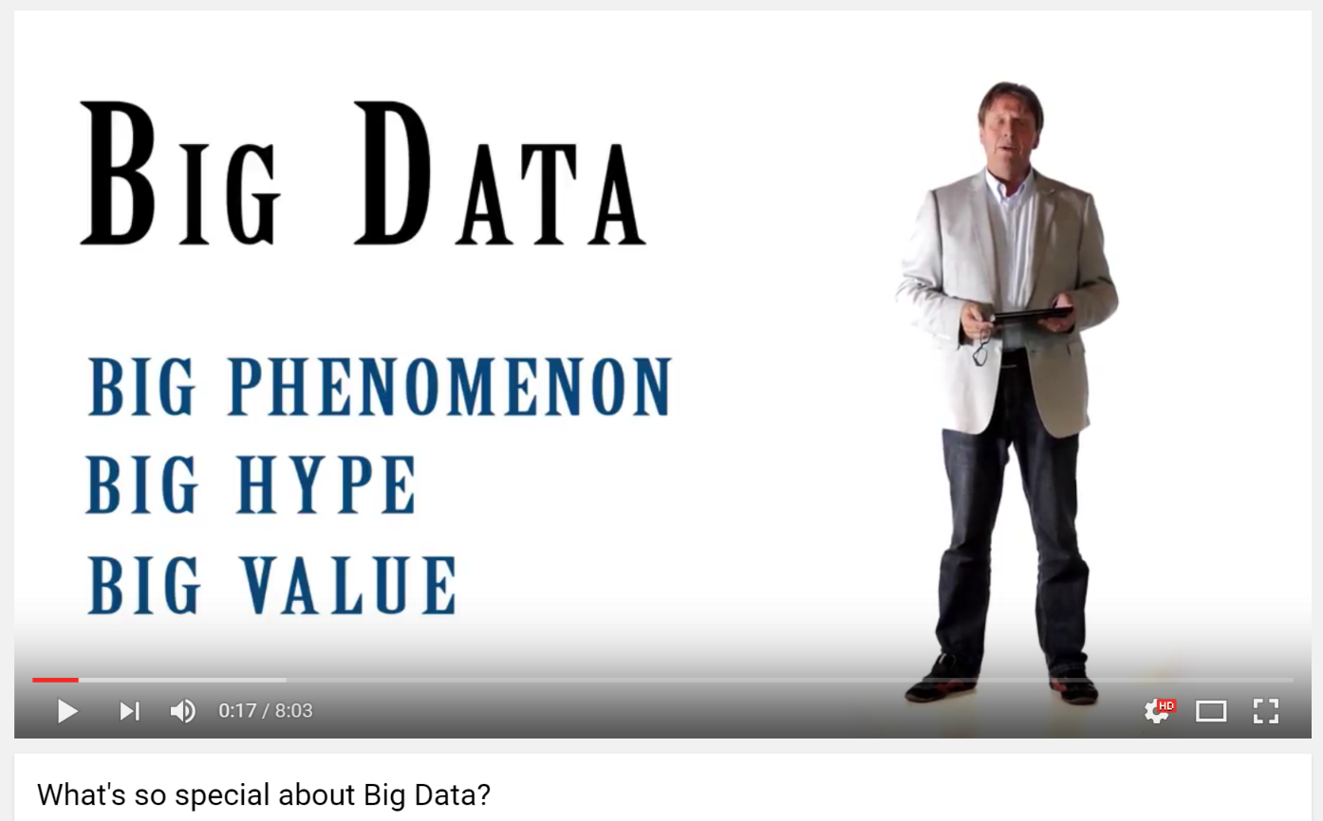

What’s So Special about…Big Data?

Slide 3
Focus of this Talk: Big Learning
Machine Learning over Big Data
Examples:
    Collaborative Filtering (via Matrix Factorization)
      Recommending movies
    Topic Modeling (via LDA)
      Clusters documents into K topics
    Multinomial Logistic Regression
      Classification for multiple discrete classes
    Deep Learning neural networks:
    Also: Iterative graph analytics, e.g. PageRank

Slide 4
Big Learning Frameworks & Systems
Goal: Easy-to-use programming framework
for Big Data Analytics that delivers good performance on large (and small) clusters
A few popular examples (historical context):
    Hadoop (2006-)
    GraphLab / Dato (2009-)
    Spark / Databricks (2009-)

Slide 5

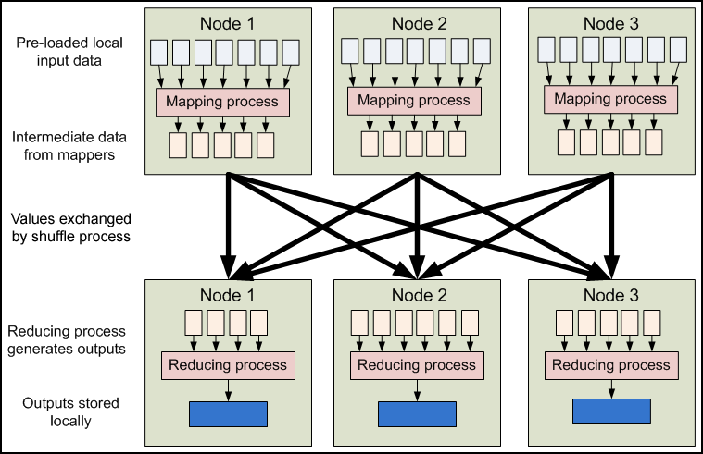
Hadoop
Hadoop Distributed File System (HDFS)
Hadoop YARN resource scheduler
Hadoop MapReduce
Image from: developer.yahoo.com/hadoop/tutorial/module4.html
Key Learning: Ease of use trumps performance

Slide 6

GraphLab
Graph Parallel: “Think like a vertex”
Graph Based
Data Representation
Update Functions
User Computation
Scheduler
Consistency Model
Slide courtesy of Carlos Guestrin
Key Learning: Graph Parallel is quite useful

Slide 7
Triangle Counting* in Twitter Graph
*How often are two of a user’s friends also friends?
Total: 34.8 Billion Triangles
40M Users
1.2B Edges
1536 Machines
423 Minutes
64 Machines, 1024 Cores
1.5 Minutes
Key Learning:
Graph Parallel is MUCH faster than Hadoop!
Hadoop results from [Suri & Vassilvitskii '11]
Notes:
Hadoop [1] S. Suri and S. Vassilvitskii, “Counting triangles and the curse of the last reducer,” presented at the WWW '11: Proceedings of the 20th international conference on World wide web, 2011.

Slide 8
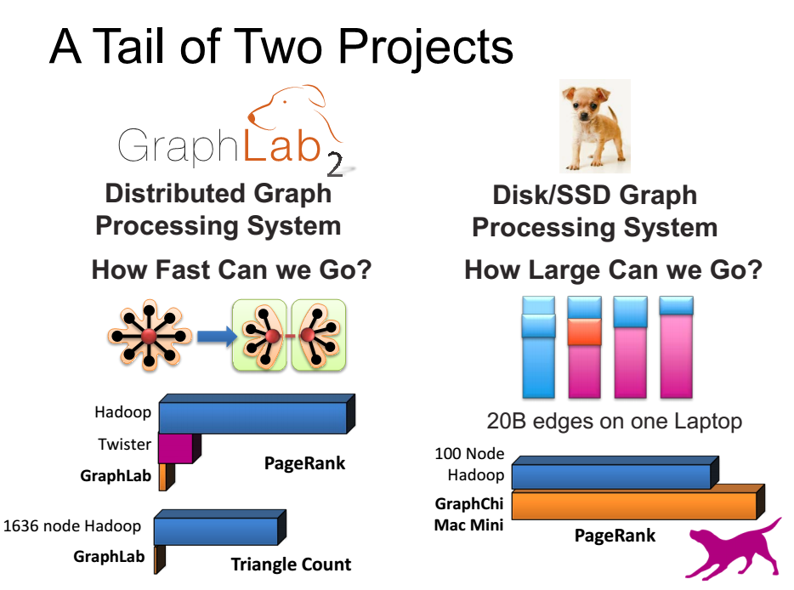
GraphLab & GraphChi
How to handle high degree nodes: GAS approach
Slide courtesy of Carlos Guestrin
Can do fast BL on a machine w/SSD-resident data

Slide 9
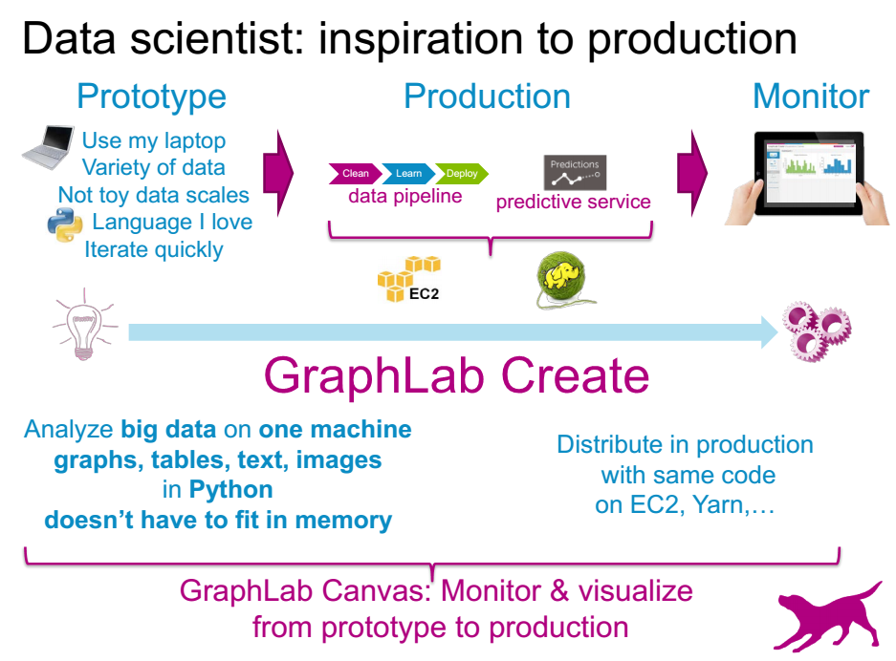
GraphLab Create
User experience is paramount for customers

Slide 10

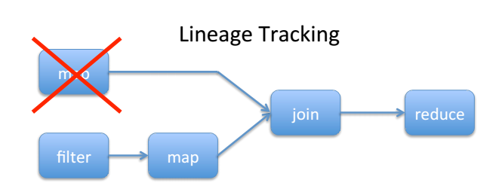
Spark: Key Idea
Features:
In-memory speed w/fault tolerance via lineage tracking
Bulk Synchronous
Resilient Distributed Datasets: A Fault-Tolerant Abstraction for In­Memory Cluster Computing,
[Zaharia et al, NSDI’12, best paper]
    A restricted form of shared memory, based on coarse-grained deterministic transformations rather than fine-grained updates to shared state: expressive, efficient and fault tolerant
In-memory compute can be fast & fault-tolerant

Slide 11
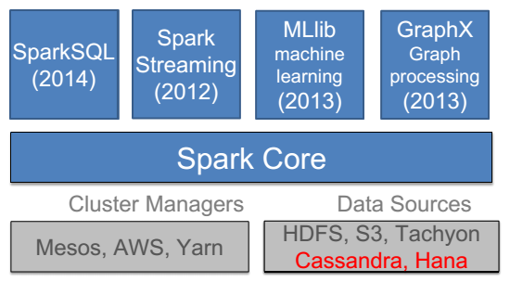
Spark Stack continued innovations
(Start to)
Build it and they will come
1000+ companies use Spark
(help build it)
& many contribute

Slide 12

A Brave New World
Spark Timeline
Research breakthrough in 2009
First open source release in 2011
Into Apache Incubator in 2013
In all major Hadoop releases by 2014
Pipeline of research breakthroughs (publications in best conferences) fuel continued leadership & uptake
Start-up (Databricks), Open Source Developers, and Industry partners (IBM, Intel) make code commercial-grade
Fast path for Academics impact via Open Source:
Pipeline of research breakthroughs into
widespread commercial use in 2 years!

Slide 13
Big Learning Frameworks & Systems
Goal: Easy-to-use programming framework
for Big Data Analytics that delivers good performance on large (and small) clusters
A few popular examples (historical context):
    Hadoop (2006-)
    GraphLab / Dato (2009-)
    Spark / Databricks (2009-)
Our Idea: Discover & take advantage of distinctive properties (“what’s so special”) of Big Learning training algorithms

Slide 14
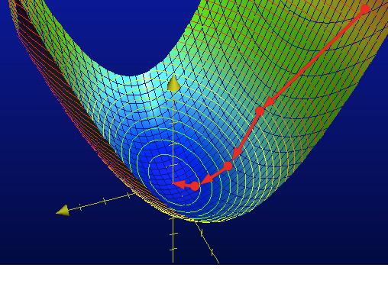
What’s So Special about Big Learning?
…A Mathematical Perspective
Formulated as an optimization problem
    Use training data to learn model parameters
No closed-form solution, instead algorithms
iterate until convergence
    E.g., Stochastic Gradient Descent for Matrix Factorization or Multinomial Logistic Regression,
    LDA via Gibbs Sampling, Deep Learning, Page Rank
Image from charlesfranzen.com

Slide 15
What’s So Special about Big Learning?
…A Distributed Systems Perspective
The Bad News
Lots of Computation / Memory
    Many iterations over Big Data
    Big Models
    Need to distribute computation widely
Lots of Communication / Synchronization
    Not readily “partitionable”
Model Training is SLOW
    hours to days to weeks, even on many machines
…why good distributed systems research is needed!

Slide 16
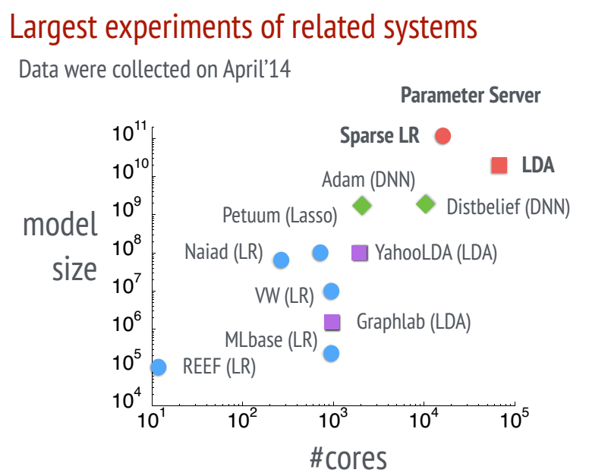
Big Models, Widely Distributed
[Li et al, OSDI’14]

Slide 17
Lots of Communication / Synchronization e.g. in BSP Execution (Hadoop, Spark)
Wasted computing time!
Thread 1
1
2
3
Thread 2
1
2
3
Thread 3
1
2
3
Thread 4
1
2
3
Time
Exchange ALL updates at END of each iteration
    Frequent, bursty communication
Synchronize ALL threads each iteration
    Straggler problem: stuck waiting for slowest

Slide 18
What’s So Special about Big Learning?
…A Distributed Systems Perspective
The Good News
Commutative/Associative parameter updates
Tolerance for lazy consistency of parameters
Repeated parameter data access pattern
Intra-iteration progress measure
Parameter update importance hints
Layer-by-layer pattern of deep learning
…can exploit to run orders of magnitude faster!

Slide 19

Parameter Servers for Distributed ML
Provides all workers with convenient access to
global model parameters
Easy conversion of single-machine parallel ML algorithms
    “Distributed shared memory” programming style
    Replace local memory access with PS access
Single
Machine
Parallel
UpdateVar(i) {
old = y[i]
delta = f(old)
y[i] += delta }
Worker 1
Parameter
Table
Worker 2
UpdateVar(i) {
old = PS.read(y,i)
delta = f(old)
PS.inc(y,i,delta) }
(sharded across machines)
Distributed
with PS
Worker 3
Worker 4
[Power & Li, OSDI’10], [Ahmed et al, WSDM’12], [NIPS’13], [Li et al, OSDI’14], Petuum, MXNet, TensorFlow, etc

Slide 20
Cost of Bulk Synchrony (e.g., in Spark)
Thread 1
1
2
3
Thread 2
1
2
3
Thread 3
1
2
3
Thread 4
1
2
3
Time
Exchange ALL updates at END of each iteration
Synchronize ALL threads each iteration
Bulk Synchrony => Frequent, bursty communication
& stuck waiting for stragglers
But: Fully asynchronous => No algorithm convergence guarantees
Better idea: Bounded Staleness: All threads within S iterations

Slide 21
Stale Synchronous Parallel (SSP)
Staleness Bound S=3
Thread 1 waits until
Thread 2 has reached iter 4
Thread 1
Thread 1 will always see
these updates
Thread 2
Thread 3
Thread 1 may not see
these updates
Thread 4
0
1
2
3
4
5
6
7
8
9
Iteration
Fastest/slowest threads not allowed to drift >S iterations apart
Allow threads to usually run at own pace
Protocol: check cache first; if too old, get latest version from network
Slow threads check only every S iterations – fewer network accesses, so catch up!
Exploits: 1. commutative/associative updates &
2. tolerance for lazy consistency (bounded staleness)
[NIPS’13]

Slide 22
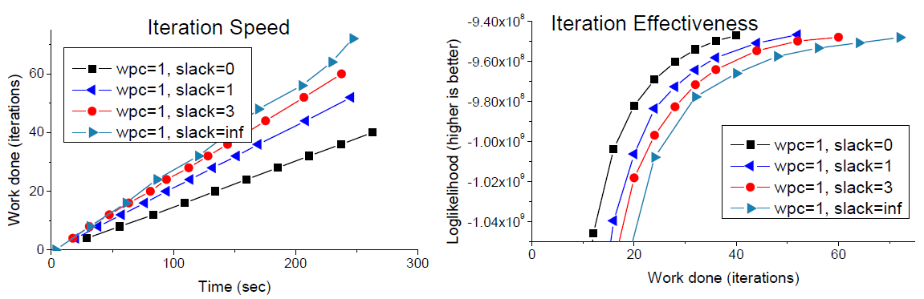
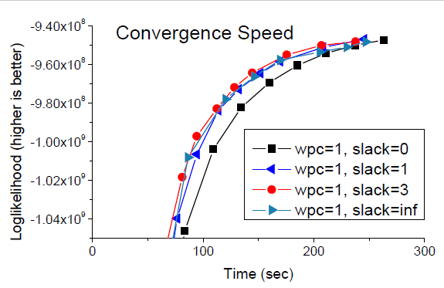
Staleness Sweet Spot
Topic Modeling
Nytimes dataset
400k documents
100 topics
LDA w/Gibbs sampling
8 machines x 64 cores
40Gbps Infiniband
[ATC’14]

Slide 23
What’s So Special about Big Learning?
…A Distributed Systems Perspective
The Good News
Commutative/Associative parameter updates
Tolerance for lazy consistency of parameters
Repeated parameter data access pattern
Intra-iteration progress measure
Parameter update importance hints
Layer-by-layer pattern of deep learning
…can exploit to run orders of magnitude faster!

Slide 24
Repeated Data Access in PageRank
Input data: a set of links, stored locally in workers
Parameter data: ranks of pages, stored in PS
Page0
Worker-0
Init ranks to random value
loop
foreach link from i to j {
read Rank(i)
update Rank(j)
}
while not converged
Link-0
Link-2
Link-3
Page2
Link-1
Page1
Worker-1

Slide 25
Repeated Data Access in PageRank
Input data: a set of links, stored locally in workers
Parameter data: ranks of pages, stored in PS
Worker-0
loop
# Link-0
read page[2].rank
update page[0].rank
# Link-1
read page[1].rank
update page[2].rank
clock()
while not converged
Page0
Worker-0
Link-0
Link-2
Link-3
Page2
Link-1
Page1
Worker-1
Repeated access sequence depends only
on input data (not on parameter values)

Slide 26
Exploiting Repeated Data Access
Collect access sequence in “virtual iteration”
Enables many optimizations:
Parameter data placement across machines
Machine-0
Machine-1
ML Worker
ML Worker
PS shard
PS shard

Slide 27
Exploiting Repeated Data Access
Collect access sequence in “virtual iteration”
Enables many optimizations:
Parameter data placement across machines
Prefetching
Static cache policies
More efficient marshalling-free data structures
NUMA-aware memory placement
Benefits are resilient to moderate deviation
in an iteration’s actual access pattern

Slide 28
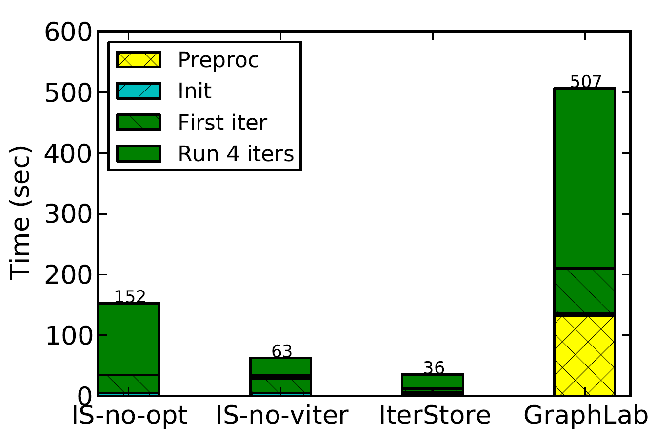
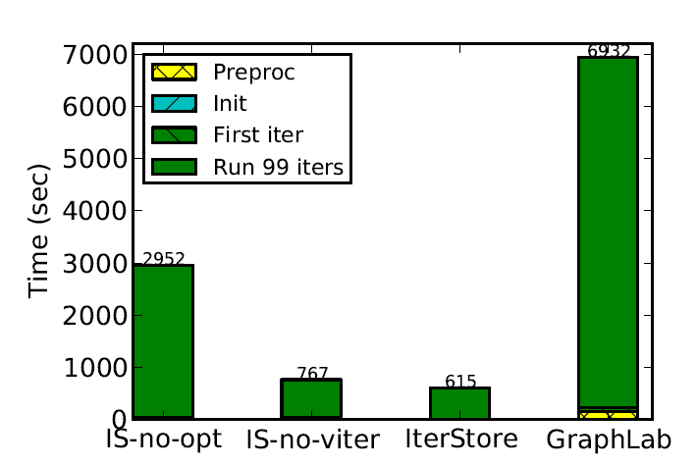
IterStore: Exploiting Iterativeness
4 iterations
[SoCC’14]
Collaborative Filtering
(Matrix Factorization)
NetFlix data set
8 machines x 64 cores
40 Gbps Infiniband
99 iterations
4-5x faster than baseline
11x faster than GraphLab

Slide 29
What’s So Special about Big Learning?
…A Distributed Systems Perspective
The Good News
Commutative/Associative parameter updates
Tolerance for lazy consistency of parameters
Repeated parameter data access pattern
Intra-iteration progress measure
Parameter update importance hints
Layer-by-layer pattern of deep learning
…can exploit to run orders of magnitude faster!

Slide 30
Addressing the Straggler Problem
  Many sources of transient straggler effects
    Resource contention
    System processes (e.g., garbage collection)
    Slow mini-batch at a worker
    Causes significant slowdowns for Big Learning
  FlexRR: SSP + Low-overhead work migration (RR)
  to mitigate transient straggler effects
    Simple: Tailored to Big Learning’s special properties
    E.g., cloning (used in MapReduce) would break
    the algorithm (violates idempotency)!
    Staleness provides slack to do the migration

Slide 31
Rapid-Reassignment Protocol
Multicast to preset possible helpees (has copy of tail of helpee’s input data)
Intra-iteration progress measure:
percentage of input data processed
Can process input data in any order
Assignment is percentage range
State is only in PS
Work must be done exactly once
Ok
Fast
Slow
Ignore
(I don’t need help)
I’m this far
I’m this far
I’m behind
(I need help)
Do assignment #1
(red work
Started Working
Do assignment #2
(green work)
Cancel

Slide 32
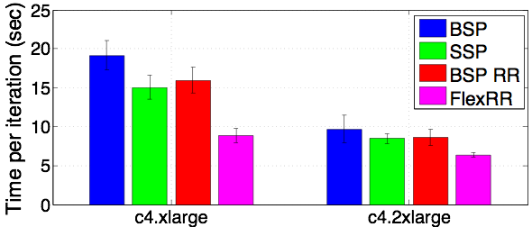
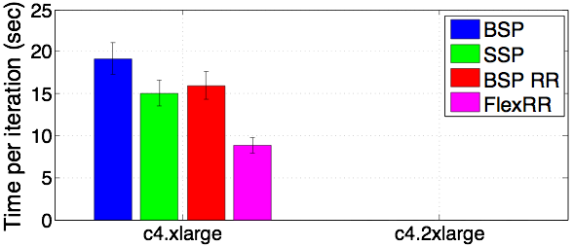
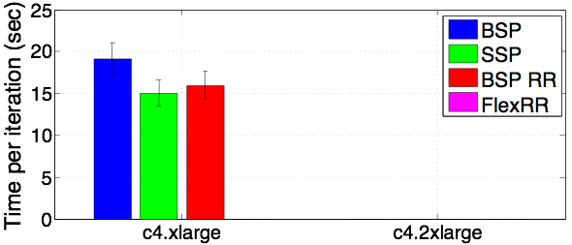
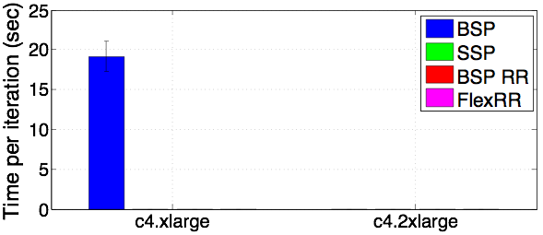
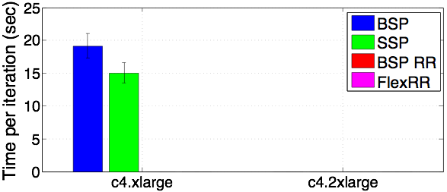
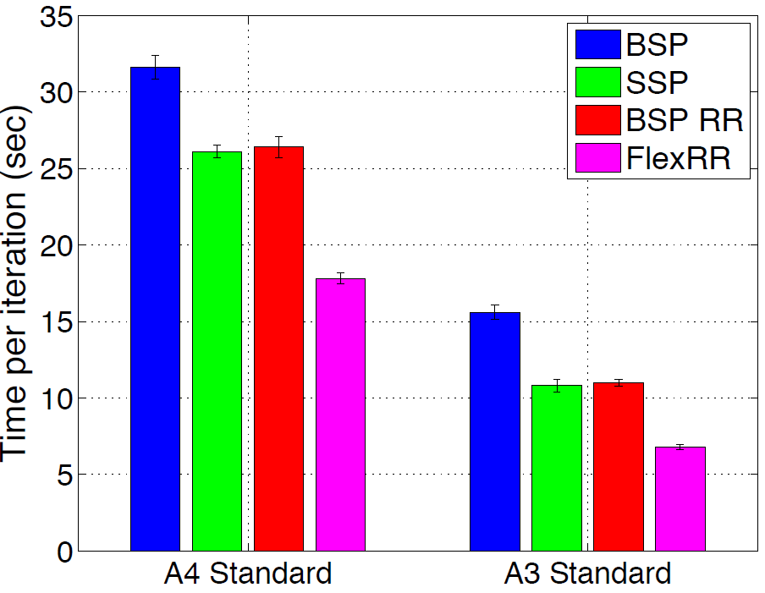
FlexRR Performance
64 EC2 Instances
64 Azure
Instances
Matrix Factorization
Netflix dataset
[SoCC’16]
Both SSP & RR required.
Nearly ideal straggler mitigation

Slide 33
FlexRR Performance
64 EC2 Instances
64 Azure
Instances
Matrix Factorization
Netflix dataset
[SoCC’16]
Both SSP & RR required.
Nearly ideal straggler mitigation

Slide 34
What’s So Special about Big Learning?
…A Distributed Systems Perspective
The Good News
Commutative/Associative parameter updates
Tolerance for lazy consistency of parameters
Repeated parameter data access pattern
Intra-iteration progress measure
Parameter update importance hints
Layer-by-layer pattern of deep learning
…can exploit to run orders of magnitude faster!

Slide 35
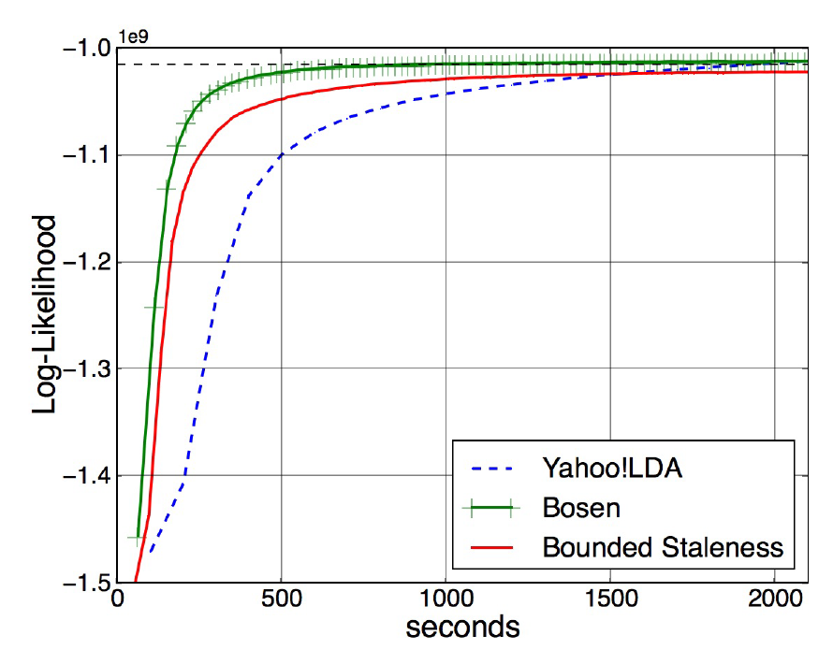
Bosen: Managed Communication
Combine SSP’s lazy transmission of parameter
updates with:
    early transmission of larger parameter changes
    (Idea: larger change likely to be an important update)
    up to bandwidth limit & staleness limit
LDA Topic Modeling
Nytimes dataset
16x8 cores
[SoCC’15]

Slide 36
What’s So Special about Big Learning?
…A Distributed Systems Perspective
The Good News
Commutative/Associative parameter updates
Tolerance for lazy consistency of parameters
Repeated parameter data access pattern
Intra-iteration progress measure
Parameter update importance hints
Layer-by-layer pattern of deep learning
…can exploit to run orders of magnitude faster!

Slide 37


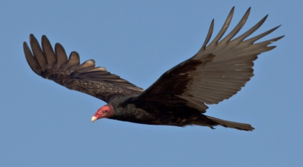
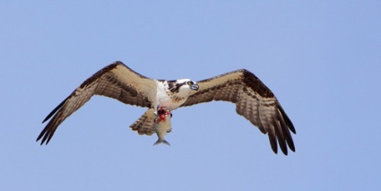
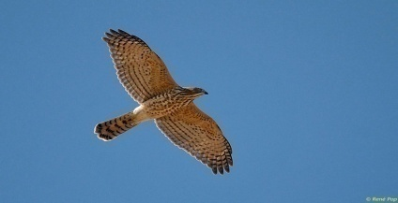
Distributed Deep Learning
Eagle
Parameter server
for GPUs
Vulture
read, update
Osprey
Accipiter
Partitioned
training data
Distributed
ML workers
Shared
model parameters

Slide 38
Layer-by-Layer Pattern of DNN
For each iteration (mini-batch)
    A forward pass
    Then a backward pass
Pairs of layers used at a time
Class probabilities
Training images

Slide 39
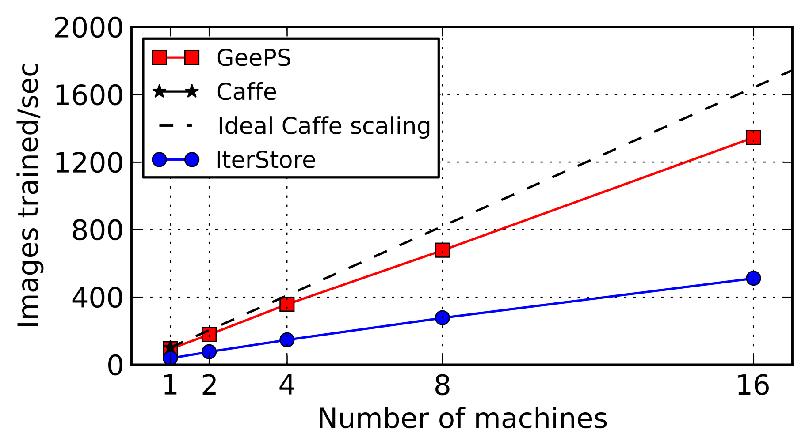
GeePS: Parameter Server for GPUs
Careful management of GPU & CPU memory
    Use GPU memory as cache to hold pairs of layers
    Stage remaining data in larger CPU memory
ImageNet22K
Adam model
[EuroSys’16]
GeePS is 13x faster than Caffe (1 GPU) on 16 machines,
2.6x faster than IterStore (CPU parameter server)

Slide 40
What’s So Special about Big Learning?
…A Distributed Systems’ Perspective
The Good News
Commutative/Associative parameter updates
Tolerance for lazy consistency of parameters
Repeated parameter data access pattern
Intra-iteration progress measure
Parameter update importance hints
Layer-by-layer pattern of deep learning
…can exploit to run orders of magnitude faster!

Slide 41
What’s So Special about Big Learning?
…A Distributed Systems’ Perspective
More Bad News
Sensitivity to tunables
Costly: can we use spot instances?
Geo-distributed data (with skew)

Slide 42
Sensitivity to Tunables
Many tunables in ML algorithms:
    Coefficients in optimization function,
    e.g., weights on regularization terms
    Configuration tunables in optimization algorithm, e.g., learning rate, mini-batch size, staleness
  Quality of solution & rate of convergence are highly sensitive to these tunables
    Today, mostly human trial-and-error
Image classification on DNN
Ongoing Research: How to automate?
Orange: lr = 0.001
Blue: lr = 0.01
Red: lr = 0.001
Green: lr = 0.001
[submitted]

Slide 43
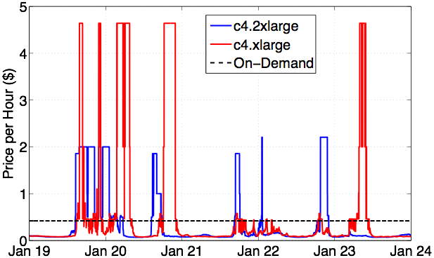
Costly => Use Spot Instances?
Spot Instances are often 85%-90% cheaper,
but can be taken away at short notice
Each
machine
class
is a
bidding
market
[submitted]
Ongoing Research:
Effective, elastic, “Spot Dancing” Big Learning

Slide 44

Geo-Distributed Data (with Skew)
Data sources are everywhere (geo-distributed)
    Too expensive (or not permitted) to ship all data to single data center
  Big Learning over geo-distributed data
    Low Bandwidth & High Latency of Inter-data-center communication relative to Intra-data-center
    Geo-distributed data may be highly skewed
    Regional answers also of interest
Ongoing Research:
Effective Big Learning systems for Geo-distributed data
[NSDI’17]

Slide 45
What’s So Special about Big Learning?
…A Distributed Systems’ Perspective
The Bad News: Model Training is SLOW
Lots of Computation / Memory
    Many iterations over Big Data
    Big Models
    => Need to distribute computation widely
Lots of Communication / Synchronization
    Not readily “partitionable”
More Bad News:
Sensitivity to tunables
Costly=>spot instances?
Geo-distributed data (with skew)

Slide 46
What’s So Special about Big Learning?
…A Distributed Systems’ Perspective
The Good News
Commutative/Associative parameter updates
Tolerance for lazy consistency of parameters
Repeated parameter data access pattern
Intra-iteration progress measure
Parameter update importance hints
Layer-by-layer pattern of deep learning
Others to be discovered
…can exploit to run orders of magnitude faster!

Slide 47
Thanks to Collaborators & Sponsors
CMU Faculty: Greg Ganger, Garth Gibson, Eric Xing
CMU/ex-CMU Students: James Cipar, Henggang Cui,
Wei Dai, Jesse Haber-Kucharsky, Aaron Harlap,
Qirong Ho, Kevin Hsieh, Jin Kyu Kim, Dimitris Konomis,
Abhimanu Kumar, Seunghak Lee, Aurick Qiao,
Alexey Tumanov, Nandita Vijaykumar, Jinliang Wei,
Lianghong Xu, Hao Zhang
Sponsors:
    Intel (via ISTC for Cloud Computing & new ISTC for Visual Cloud Systems)
    PDL Consortium: Avago, Citadel, EMC, Facebook, Google, Hewlett-Packard Labs, Hitachi, Intel, Microsoft Research, MongoDB, NetApp, Oracle, Samsung, Seagate, Symantec, Two Sigma, Western Digital
    National Science Foundation
(Bold=first author)
(Many of these slides adapted from slides by the students)

Slide 48
References
(in order of first appearance)
  [Zaharia et al, NSDI’12] M. Zaharia, M. Chowdhury, T. Das, A. Dave, J. Ma, M. McCauly, M. J. Franklin, S. Shenker, and I. Stoica. Resilient Distributed Datasets: A Fault-Tolerant Abstraction for In­-Memory Cluster Computing. Usenix NSDI, 2012.
  [Li et al, OSDI’14] M. Li, D. G. Anderson, J. W. Park, A. J. Smola, A. Ahmed, V. Josifovski, J. Long, E. J. Shekita, and B.-Y. Su. Scaling distributed machine learning with the parameter server. Usenix OSDI, 2014.
  [Power & Li, OSDI’10] R. Power and J. Li. Piccolo: Building Fast, Distributed Programs with Partitioned Tables. Usenix OSDI, 2010.
[Ahmed et al, WSDM’12] A. Ahmed, M. Aly, J. Gonzalez, S. M. Narayanamurthy, and A. J. Smola. Scalable inference in latent variable models. ACM WSDM, 2012.
[NIPS’13] Q. Ho, J. Cipar, H. Cui, S. Lee, J. K. Kim, P. B. Gibbons, G. Gibson, G. Ganger, and E. Xing. More effective distributed ML via a state synchronous parallel parameter server. NIPS, 2013.
[Petuum] petuum.org
[MXNet] T. Chen, M. Li, Y. Li, M. Lin, N. Wang, M. Wang, T. Xiao, B. Xu, C. Zhang, and Z. Zhang. MXNet: A flexible and efficient machine learning library for heterogeneous distributed systems. arXiv:1512.01274, 2015.
[TensorFlow] tensorflow.org
[ATC’14] H. Cui, J. Cipar, Q. Ho, J. K. Kim, S. Lee, A. Kumar, J. Wei, W. Dai, G. R. Ganger, P. B. Gibbons, G. A. Gibson, and E. P. Xing. Exploiting Bounded Staleness to Speed Up Big Data Analytics. Usenix ATC, 2014.
[SoCC’14] H. Cui, A. Tumanov, J. Wei, L. Xu, W. Dai, J. Haber-Kucharsky, Q. Ho, G. R. Ganger, P. B. Gibbons, G. A. Gibson, and E. P. Xing. Exploiting iterative-ness for parallel ML computations. ACM SoCC, 2014.
[SoCC’16] A. Harlap, H. Cui, W. Dai, J. Wei, G. R. Ganger, P. B. Gibbons, G. A. Gibson, and E. P. Xing. Addressing the straggler problem for iterative convergent parallel ML. ACM SoCC, 2016.

Slide 49
References (cont.)
  [SoCC’15] J. Wei, W. Dai, A. Qiao, Q. Ho, H. Cui, G. R. Ganger, P. B. Gibbons, G. A. Gibson, and E. P. Xing. Managed Communication and Consistency for Fast Data-Parallel Iterative Analytics. ACM SoCC, 2015.
[EuroSys’16] H. Cui, H. Zhang, G. R. Ganger, P. B. Gibbons, E. P. Xing. GeePS: Scalable deep learning on distributed GPUs with a GPU-specialized parameter server. EuroSys, 2016.
[NSDI’17] K. Hsieh, A. Harlap, N. Vijaykumar, D. Konomis, G. R. Ganger, P. B. Gibbons, and O. Mutlu. Gaia: Geo-Distributed Machine Learning Approaching LAN Speeds. NSDI, 2017.

