Slide 1
Future of Computing:
Moore’s Law & Its Implications
+ High-Performance Computing
15-213: Introduction to Computer Systems
27th Lecture, Dec. 1, 2016
Instructors:
Randy Bryant

Slide 2
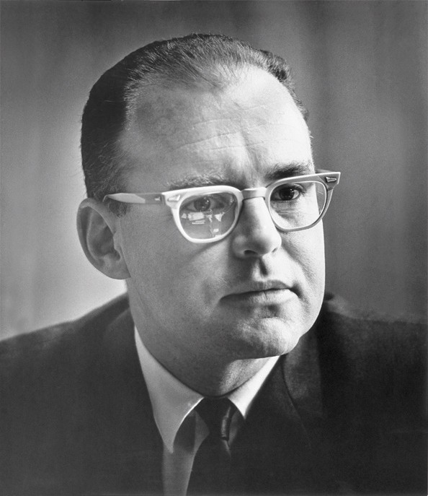
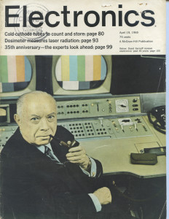
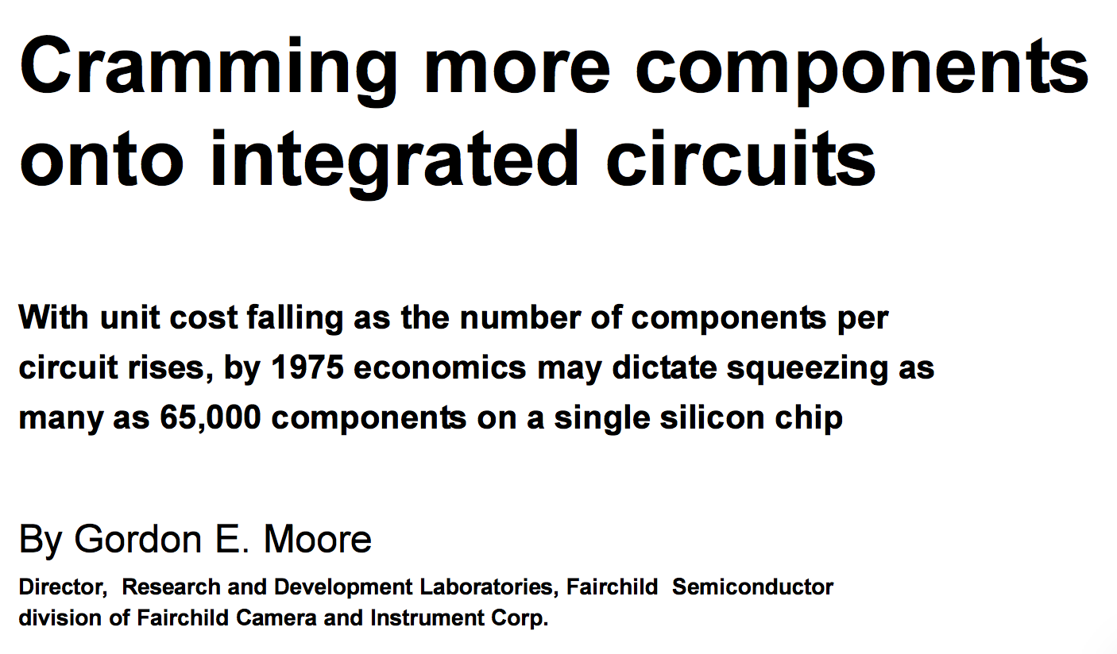
Moore’s Law Origins
April 19, 1965

Slide 3
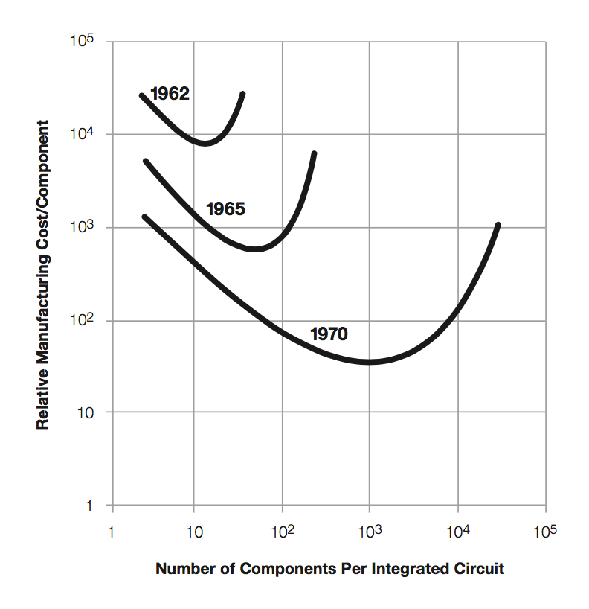
Moore’s Law Origins
Moore’s Thesis
  Minimize price per device
  Optimum number of devices / chip increasing 2x / year
Later
  2x / 2 years
  “Moore’s Prediction”
1965: 50
1970: 1000

Slide 4
Moore’s Law: 50 Years
Sample of
117 processor chips

Slide 5

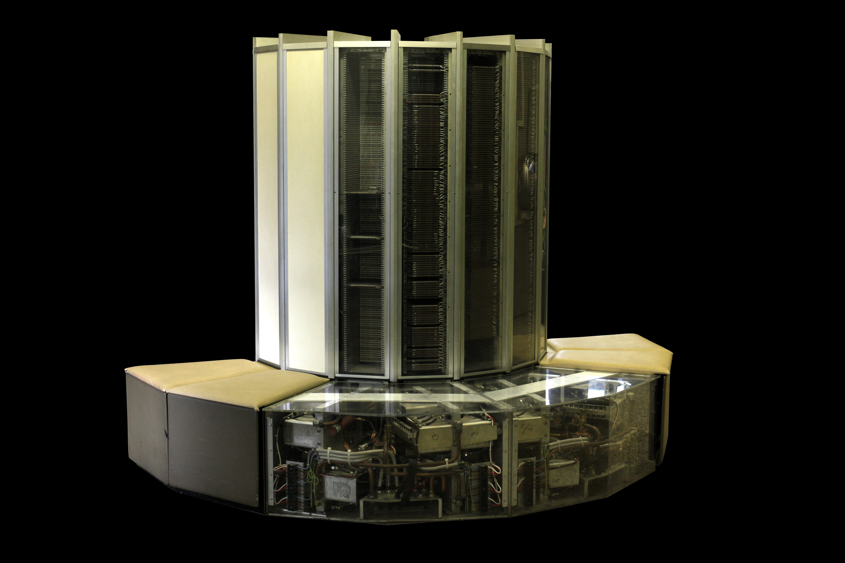
What Moore’s Law Has Meant
1976 Cray 1
  250 M Ops/second
  ~170,000 chips
  0.5B transistors
  5,000 kg, 115 KW
  $9M
  80 manufactured
2014 iPhone 6
  > 4 B Ops/second
  ~10 chips
  > 3B transistors
  120 g, < 5 W
  $649
  10 million sold in first 3 days

Slide 6
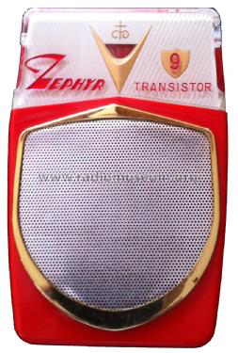
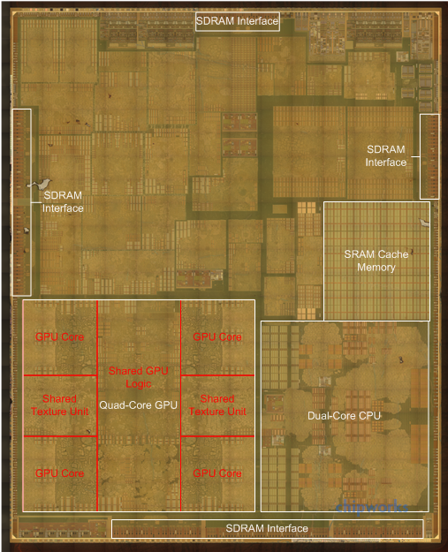
What Moore’s Law Has Meant
1965 Consumer Product
2015 Consumer Product
Apple A8 Processor
2 B transistors

Slide 7
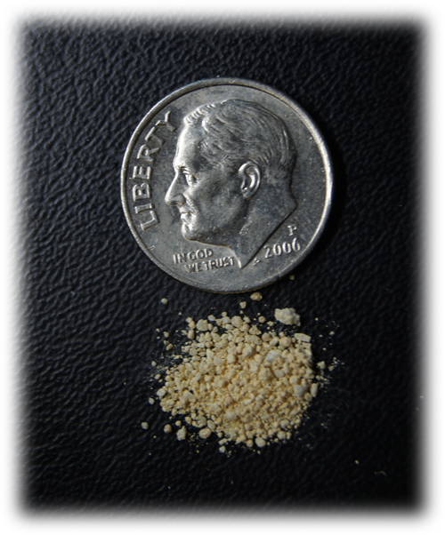
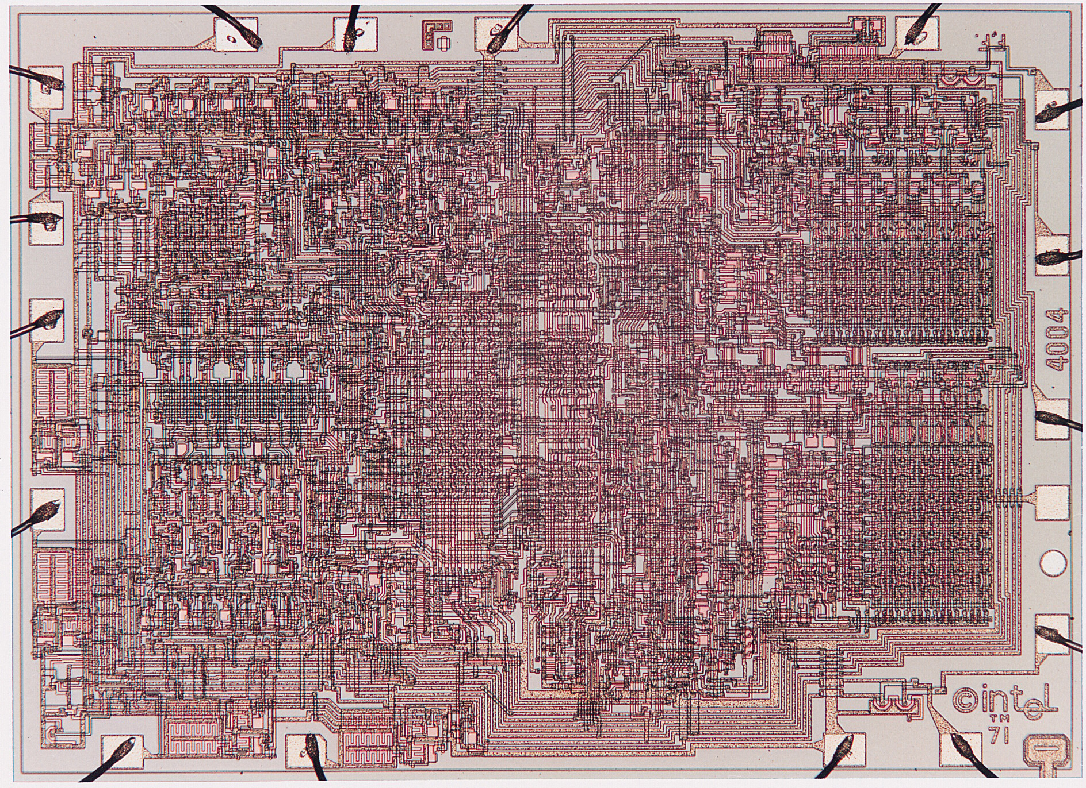
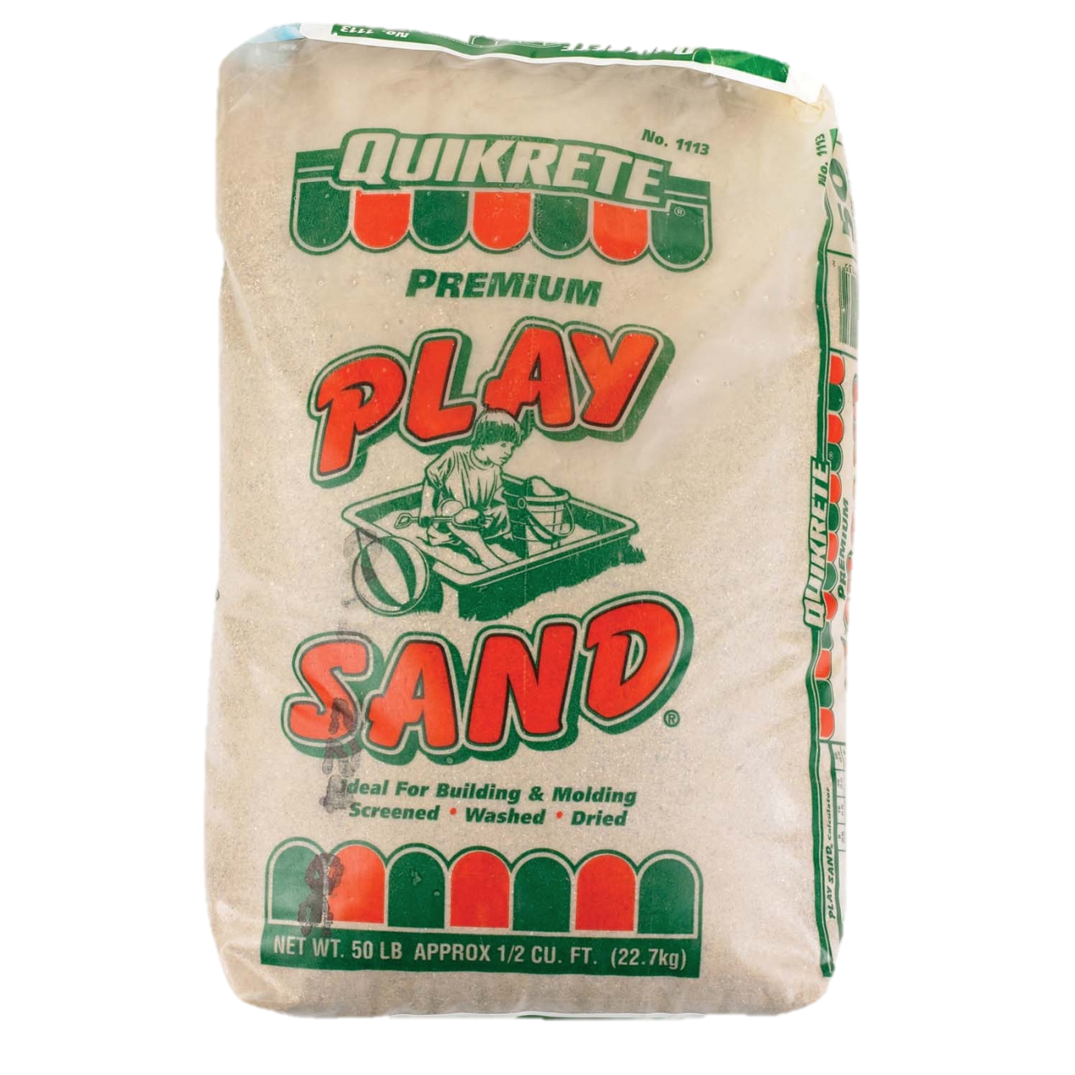
Visualizing Moore’s Law to Date
If transistors were the size of a grain of sand
Intel 4004
1970
2,300 transistors
0.1 g
Apple A8
2014
2 B transistors
88 kg

Slide 8
Moore’s Law Economics
Better
Products
Sales $$
Capital +
R&D Investment
Product
Design
New Technology
Consumer products sustain the
$300B semiconductor industry

Slide 9
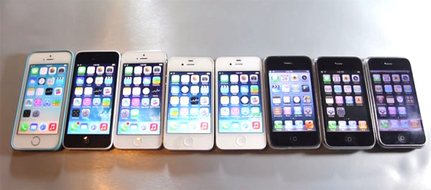
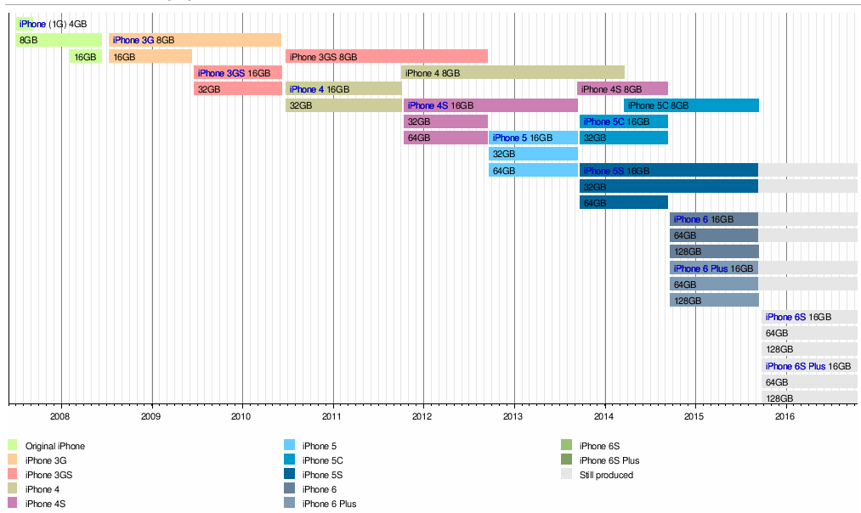
What Moore’s Law Has Meant
9 generations of iPhone since 2007

Slide 10
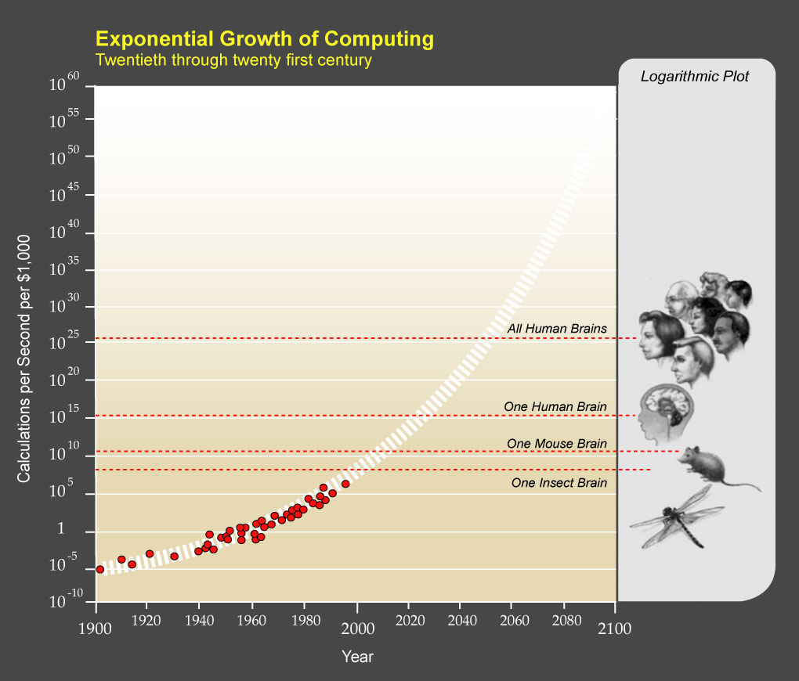
What Moore’s Law Could Mean
Kurzweil, The Singularity is Near, 2005

Slide 11
What Moore’s Law Could Mean
2015 Consumer Product
2065 Consumer Product
  Portable
  Low power
  Will drive markets & innovation
?

Slide 12
Requirements for Future Technology
Must be suitable for portable, low-power operation
  Consumer products
  Internet of Things components
  Not cryogenic, not quantum
Must be inexpensive to manufacture
  Comparable to current semiconductor technology
    O(1) cost to make chip with O(N) devices
Need not be based on transistors
  Memristors, carbon nanotubes, DNA transcription, ...
  Possibly new models of computation
  But, still want lots of devices in an integrated system

Slide 13
Moore’s Law: 100 Years
10¹⁷ devices!

Slide 14
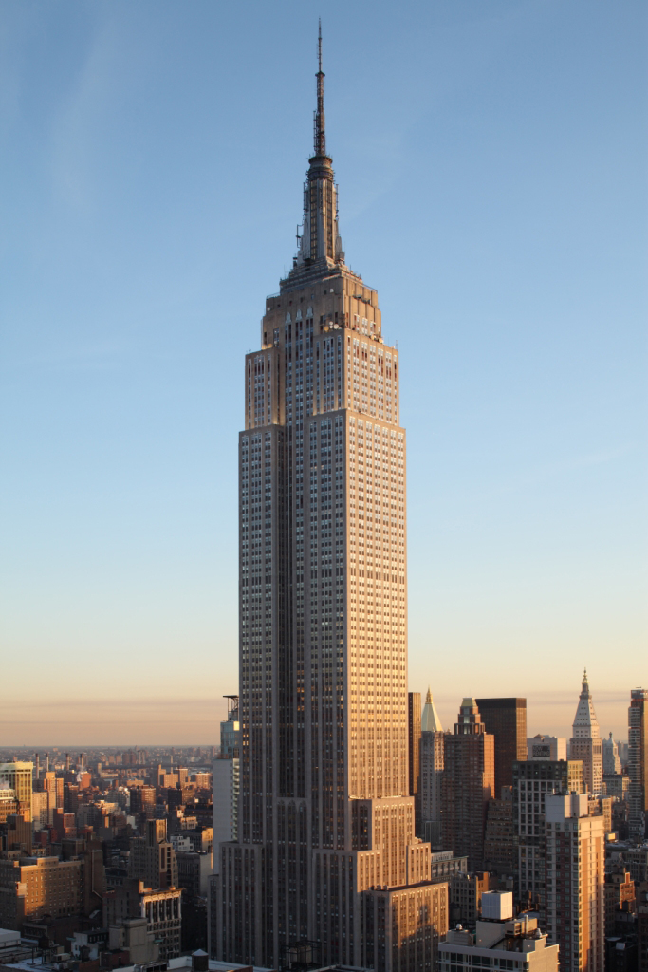
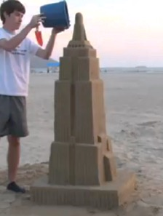
Visualizing 10¹⁷ Devices
If devices were the size of a grain of sand
0.1 m³
3.5 X 10⁹ grains
1 million m³
0.35 X 10¹⁷ grains

Slide 15
Increasing Transistor Counts
Chips have gotten bigger
  1 area doubling / 10 years
Transistors have gotten smaller
  4 density doublings / 10 years
Will these trends continue?

Slide 16
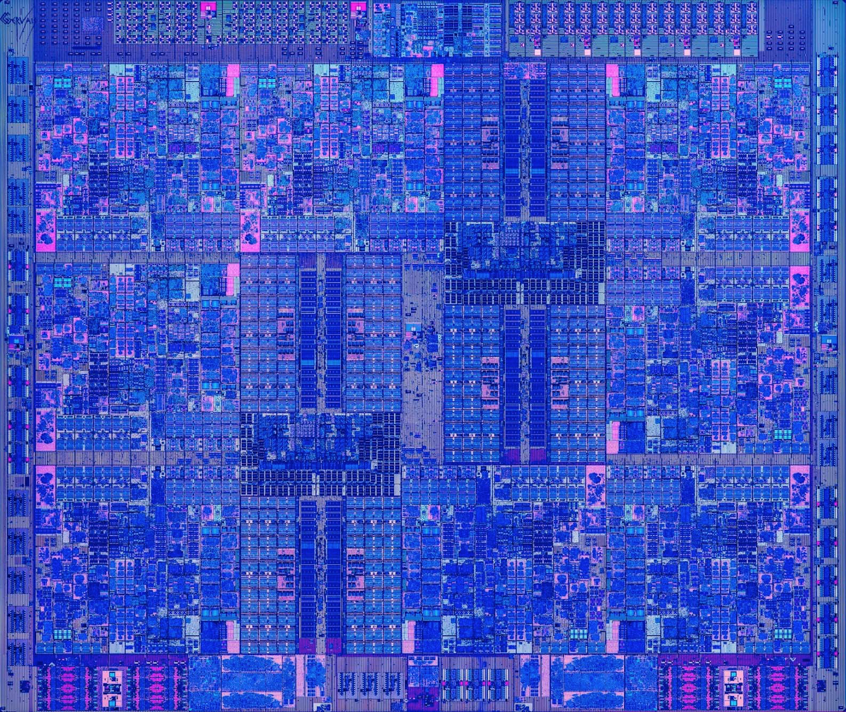
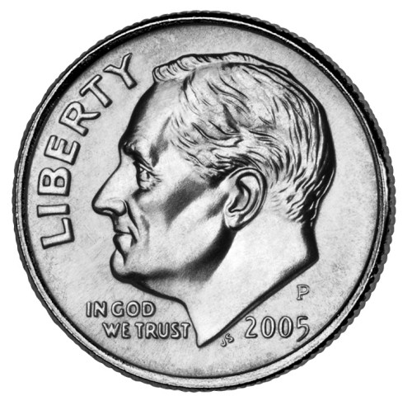
Chips Have Gotten Bigger
Intel 4004
1970
2,300 transistors
12 mm²
Apple A8
2014
2 B transistors
89 mm²
IBM z13
205
4 B transistors
678 mm²

Slide 17
Chip Size Trend
2x every 9.5 years

Slide 18
Chip Size Extrapolation
173 cm²

Slide 19
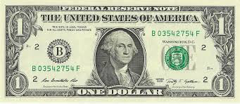
Extrapolation: The iPhone 31s
Apple A59
2065
10¹⁷ transistors
173 cm²

Slide 20
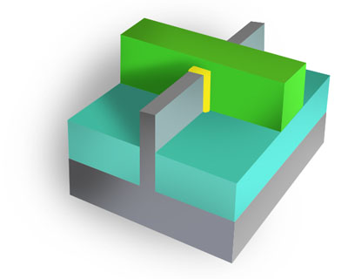
Transistors Have Gotten Smaller
  Area A
  N devices
  Linear Scale L
L

Slide 21
Linear Scaling Trend
1/2x every 5 years ➔
2x transistor density every 2.5 years

Slide 22
Decreasing Feature Sizes
Apple A8
2014
2 B transistors
L = 211 nm
Intel 4004
1970
2,300 transistors
L = 72,000 nm

Slide 23
Linear Scaling Trend
Submillimeter
Submicrometer

Slide 24
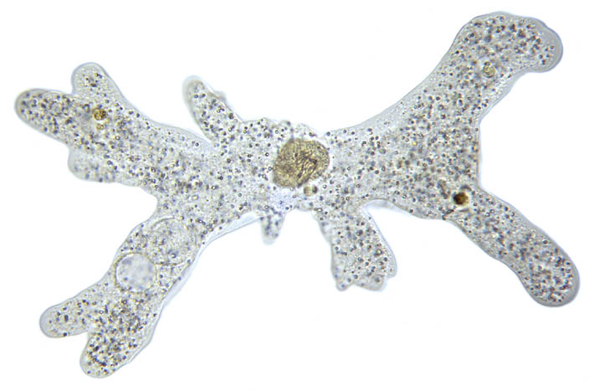

Submillimeter Dimensions
10⁻³
1 millimeter (mm)
500μm: Length of amoeba
10⁻⁴
72μm: Intel 4004 linear scale
50μm: Average size of cell in human body
10⁻⁵
10μm: Thickness of sheet of plastic food wrap
5μm: Spider silk thickness
2μm: E coli bacterium length
1 micrometer (μm)
10⁻⁶

Slide 25

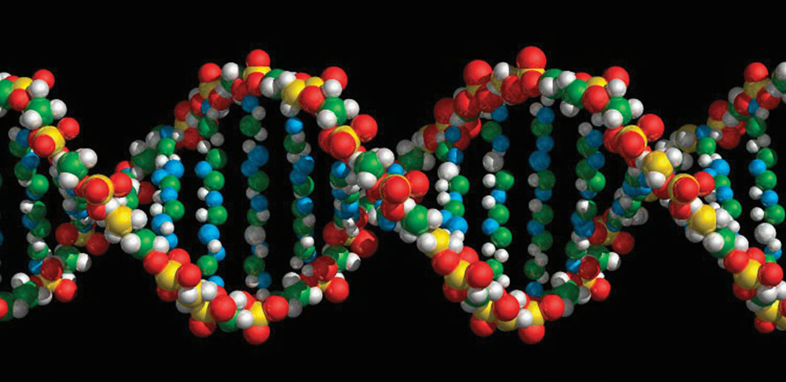
Submicrometer Dimensions
10⁻⁶
1 micrometer (μm)
400-700nm: Visible light wavelengths
211nm: Apple A8 linear scale
10⁻⁷
30nm: Minimum cooking oil smoke particle diameter
10⁻⁸
9nm: Cell membrane thickness
2nm: DNA helix diameter
10⁻⁹
1 nanometer (nm)
1nm: Carbon nanotube diameter

Slide 26
Linear Scaling Extrapolation
230 pm

Slide 27
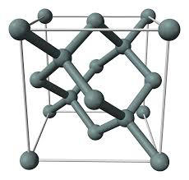
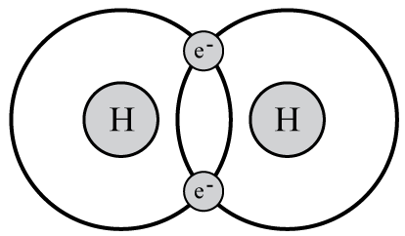
Subnanometer Dimensions
1 nanometer (nm)
10⁻⁹
1nm: Carbon nanotube diameter
543pm: Silicon crystal lattice spacing
230pm: 2065 linear scale projection
10⁻¹⁰
74pm: Spacing between atoms in hydrogen molecule
53pm: Electron-proton spacing in hydrogen (Bohr radius)
10⁻¹¹
2.4pm: Electron wavelength (Compton wavelength)
1 picometer
(pm)
10⁻¹²

Slide 28
Reaching 2065 Goal
Target
  10¹⁷ devices
  400 mm²
  L = 63 pm
Is this possible?
No!
Not with 2-d
fabrication

Slide 29
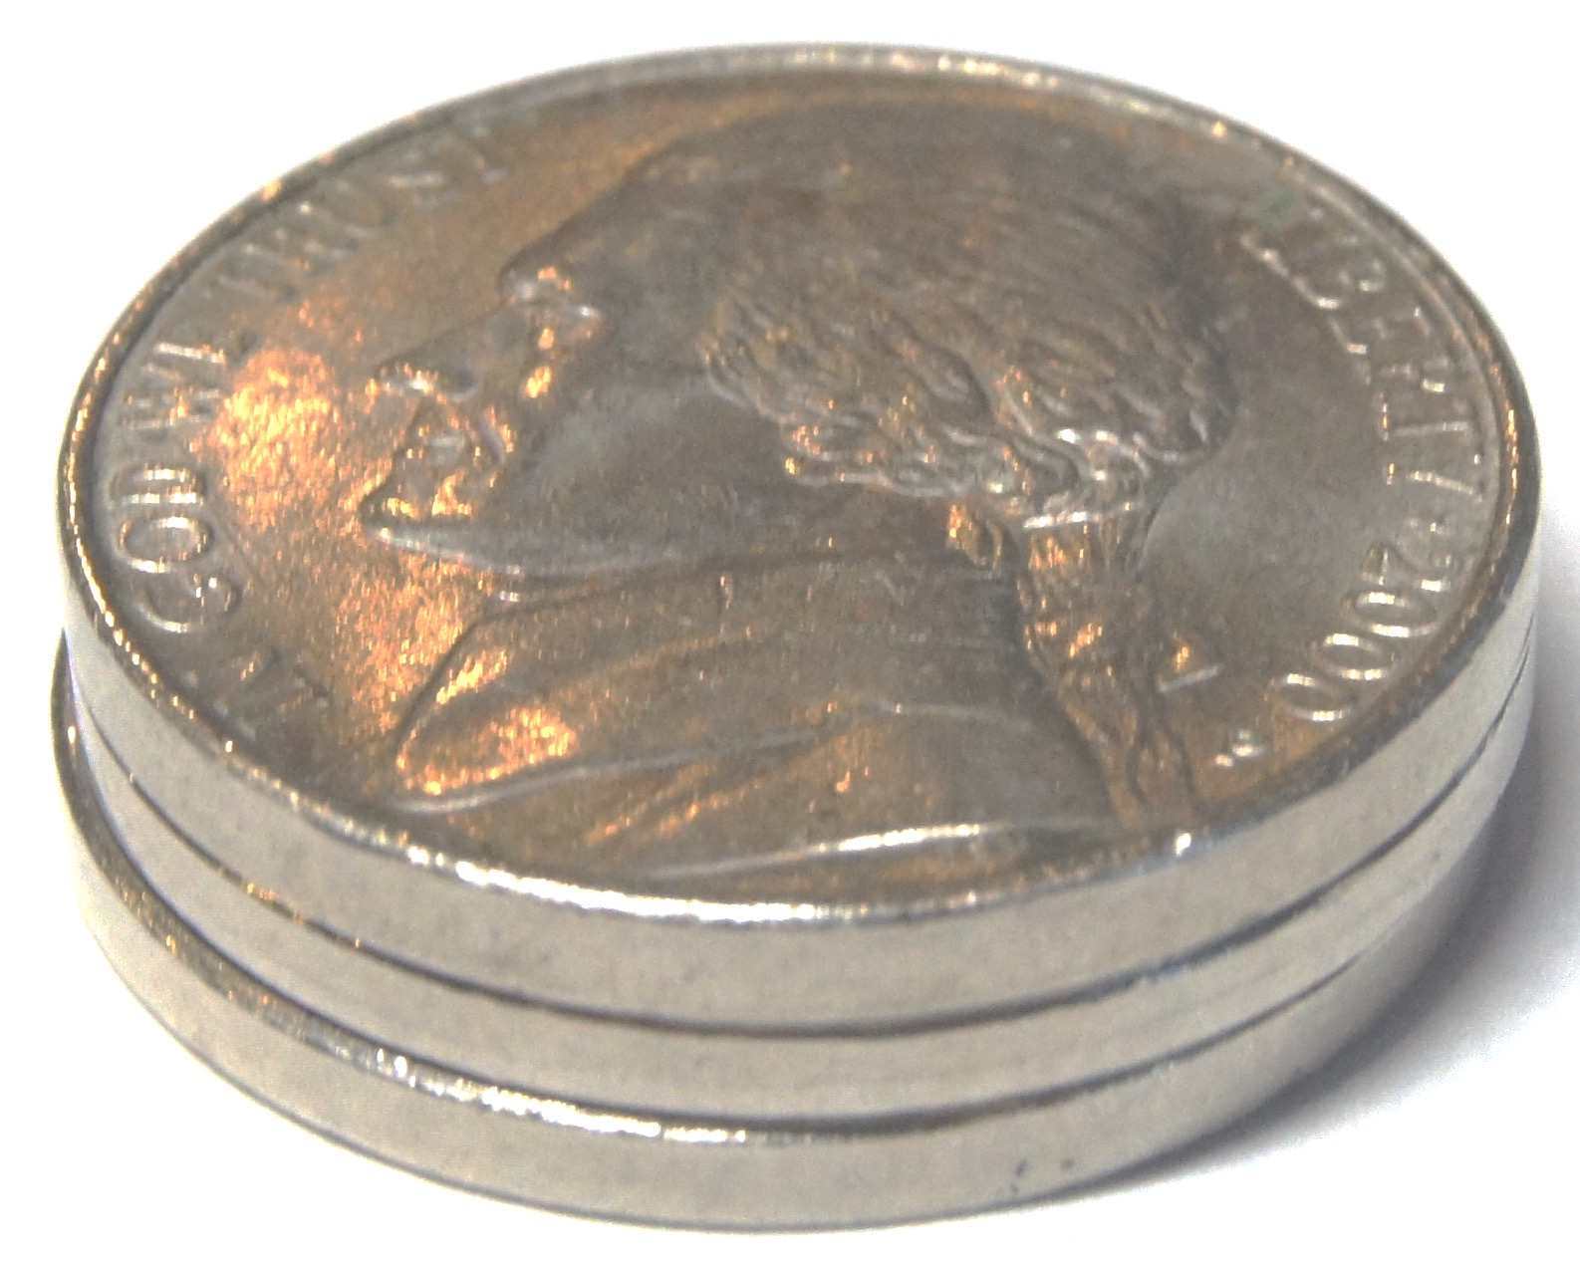
Fabricating in 3 Dimensions
2000 mm³
5 mm
20 mm
20 mm
Parameters
  10¹⁷ devices
  100,000 logical layers
    Each 50 nm thick
    ~1,000,000 physical layers
      To provide wiring and isolation
  L = 20 nm
    10x smaller than today
2065 mm³

Slide 30
3D Fabrication Challenges
Yield
  How to avoid or tolerate flaws
Cost
  High cost of lithography
Power
  Keep power consumption within acceptable limits
  Limited energy available
  Limited ability to dissipate heat

Slide 31
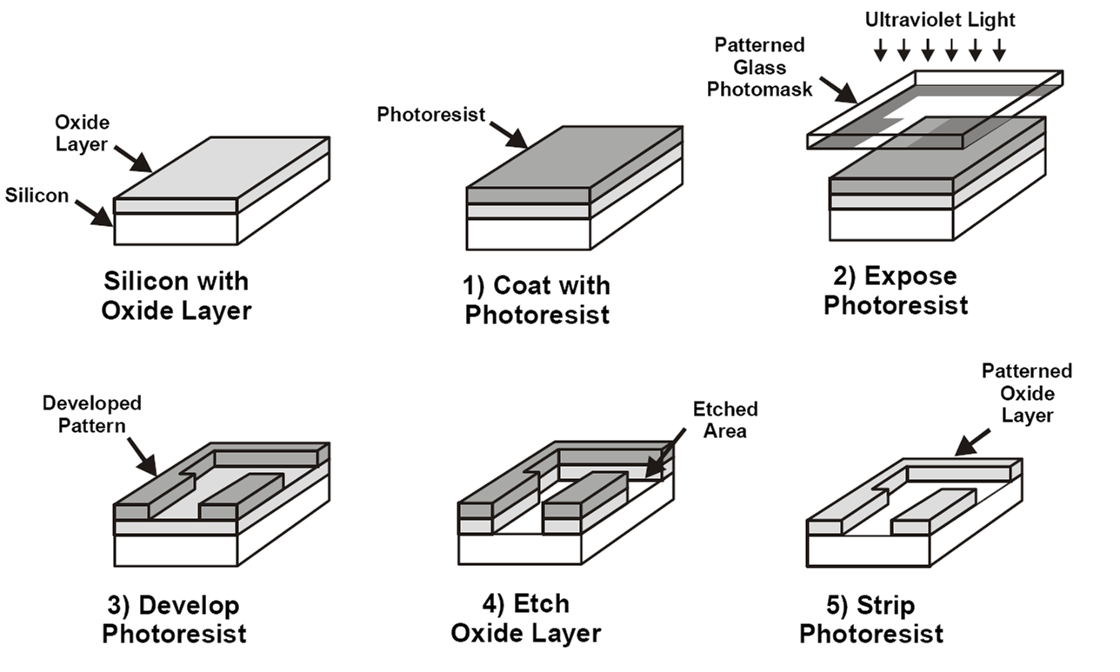
Photolithography
  Pattern entire chip in one step
  Modern chips require ~60 lithography steps
  Fabricate N transistor system with O(1) steps

Slide 32
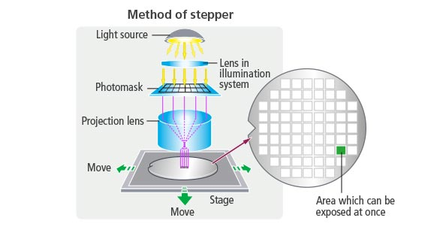
Fabrication Costs
Stepper
  Most expensive equipment in fabrication facility
  Rate limiting process step
    18s / wafer
  Expose 858 mm² per step
    1.2% of chip area

Slide 33
Fabrication Economics
Currently
  Fixed number of lithography steps
  Manufacturing cost $10–$20 / chip
    Including amortization of facility
Fabricating 1,000,000 physical layers
  Cannot do lithography on every step
Options
  Chemical self assembly
    Devices generate themselves via chemical processes
  Pattern multiple layers at once

Slide 34
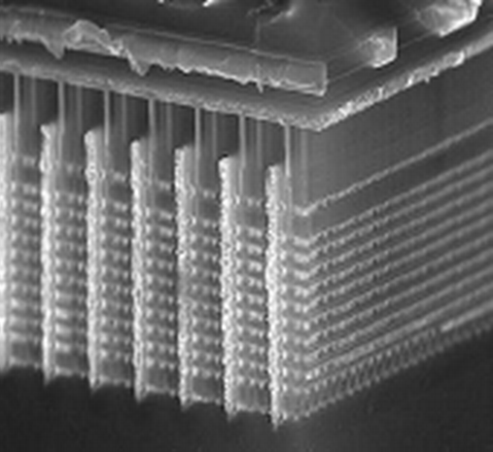
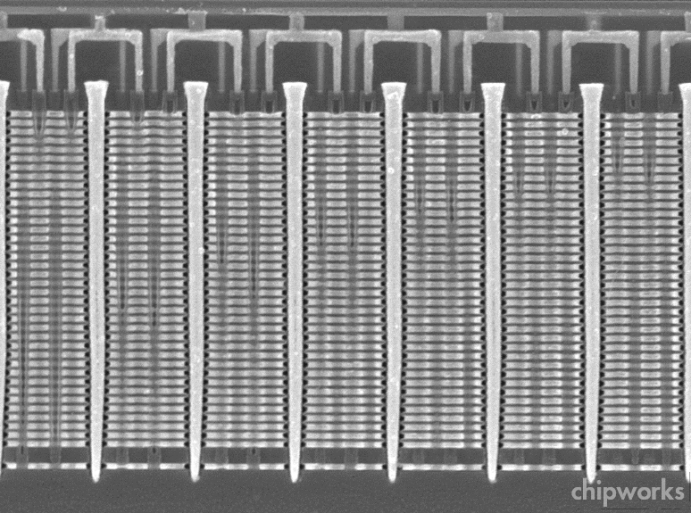
Samsung V-Nand Flash Example
  Build up layers of unpatterned material
  Then use lithography to slice, drill, etch, and deposit material across all layers
  ~30 total masking steps
  Up to 48 layers of memory cells
  Exploits particular structure of flash memory circuits

Slide 35
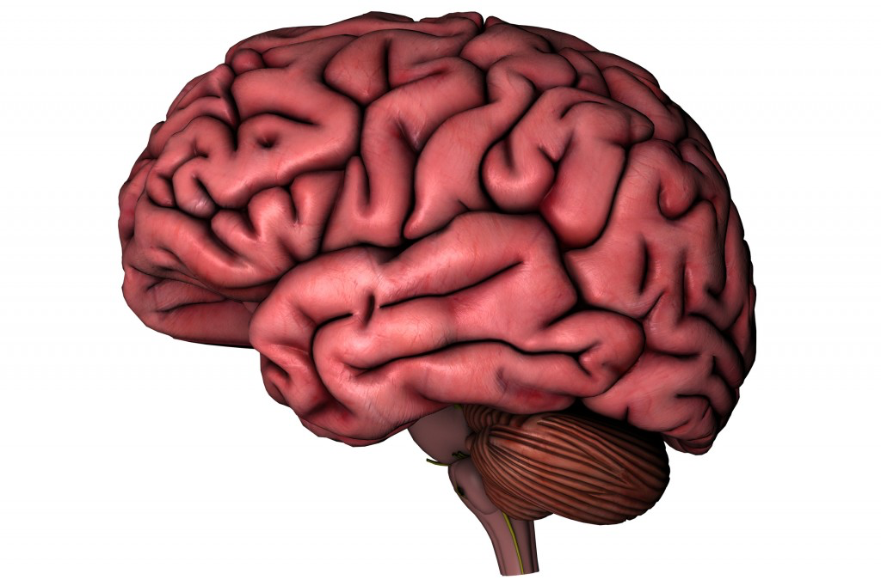
Meeting Power Constraints
  2 B transistors
  2 GHz operation
  1—5 W
  64 B neurons
  100 Hz operation
  15—25 W
    Liquid cooling
    Up to 25% body’s total energy consumption
Can we increase number of devices by 500,000x without increasing power requirement?

Slide 36
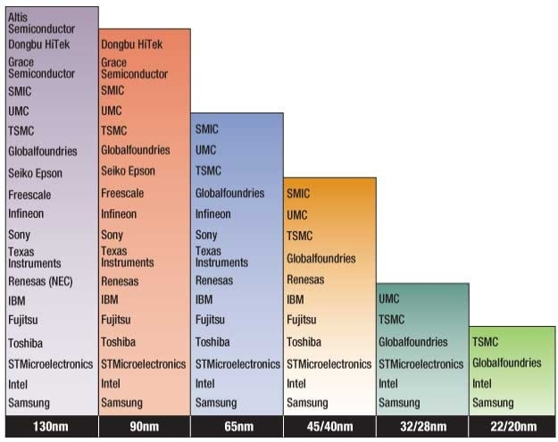
Challenges to Moore’s Law: Economic
Growing Capital Costs
  State of art fab line ~$20B
  Must have very high volumes to amortize investment
  Has led to major consolidations

Slide 37
Dennard Scaling
  Due to Robert Dennard, IBM, 1974
  Quantifies benefits of Moore’s Law
How to shrink an IC Process
  Reduce horizontal and vertical dimensions by k
  Reduce voltage by k
Outcomes
  Devices / chip increase by k²
  Clock frequency increases by k
  Power / chip constant
Significance
  Increased capacity and performance
  No increase in power

Slide 38
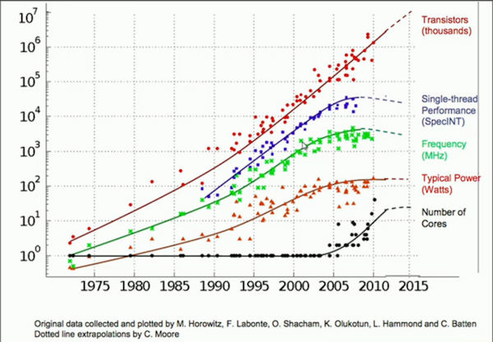
End of Dennard Scaling
What Happened?
  Can’t drop voltage below ~1V
  Reached limit of power / chip in 2004
  More logic on chip (Moore’s Law), but can’t make them run faster
    Response has been to increase cores / chip

Slide 39
Final Thoughts about Technology
Compared to future, past 50 years will seem fairly straightforward
  50 years of using photolithography to pattern transistors on two-dimensional surface
Questions about future integrated systems
  Can we build them?
  What will be the technology?
  Are they commercially viable?
  Can we keep power consumption low?
  What will we do with them?
  How will we program / customize them?

Slide 40
High-Performance Computing

Slide 41
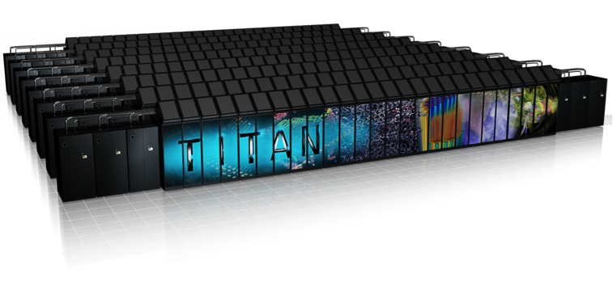
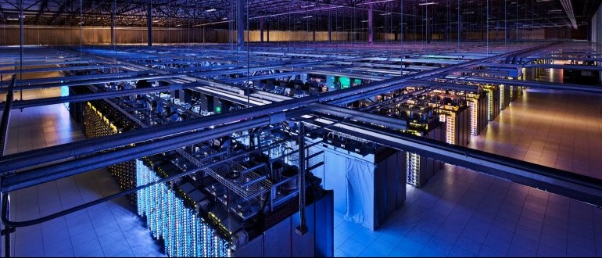
Comparing Two Large-Scale Systems
Oakridge Titan
  Monolithic supercomputer (3rd fastest in world)
  Designed for compute-intensive applications
Google Data Center
  Servers to support millions of customers
  Designed for data collection, storage, and analysis

Slide 42
Computing Landscape
Google Data Center
Data Intensity
Web search
Mapping / directions
Language translation
Video streaming
Internet-Scale
Computing
Cloud
Services
Oakridge Titan
Traditional Supercomputing
Modeling &
Simulation-Driven
Science &
Engineering
Personal
Computing
Computational Intensity

Slide 43
Supercomputing Landscape
Data Intensity
Oakridge Titan
Traditional Supercomputing
Modeling &
Simulation-Driven
Science &
Engineering
Personal
Computing
Computational Intensity

Slide 44
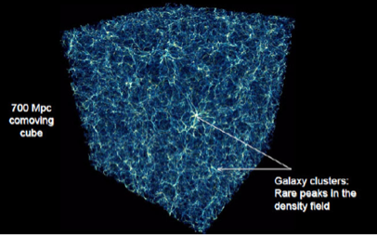
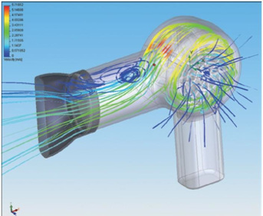
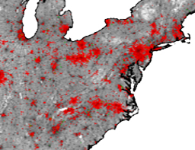
Supercomputer Applications
Science
Industrial Products
Public Health
Simulation-Based Modeling
  System structure + initial conditions + transition behavior
  Discretize time and space
  Run simulation to see what happens
Requirements
  Model accurately reflects actual system
  Simulation faithfully captures model

Slide 45
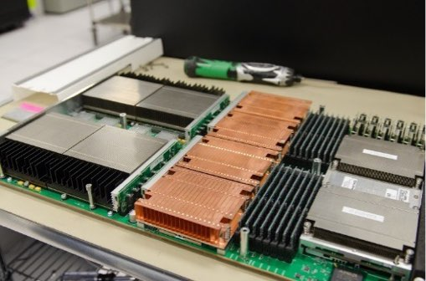
Titan Hardware
Local Network
CPU
CPU
CPU
• • •
GPU
GPU
GPU
Node 1
Node 2
Node 18,688
Each Node
  AMD 16-core processor
  nVidia Graphics Processing Unit
  38 GB DRAM
  No disk drive
Overall
  7MW, $200M

Slide 46
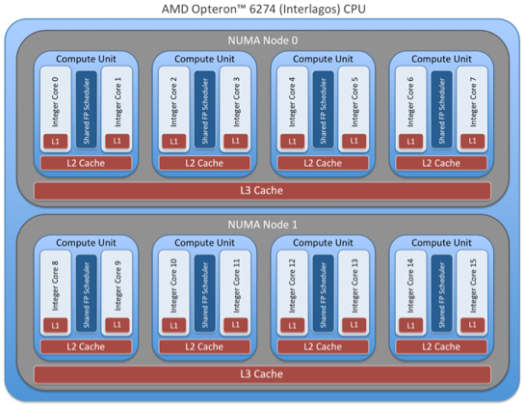
Titan Node Structure: CPU
DRAM
Memory
CPU
  16 cores sharing common memory
  Supports multithreaded programming
  ~0.16 x 10¹² floating-point operations per second (FLOPS) peak performance

Slide 47
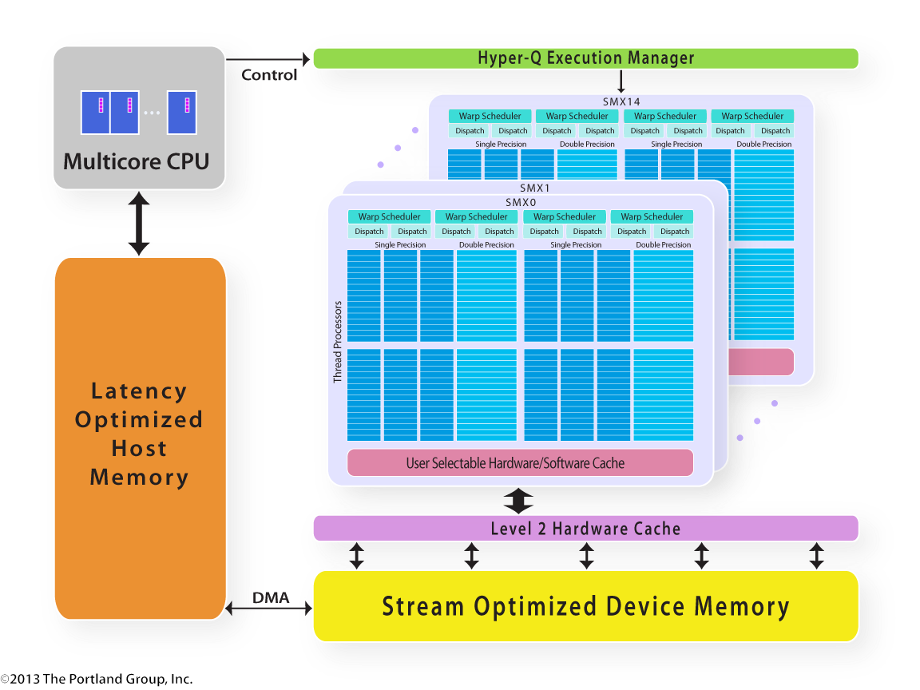
Titan Node Structure: GPU
Kepler GPU
  14 multiprocessors
  Each with 12 groups of 16 stream processors
    14 X 12 X 16 = 2688
  Single-Instruction, Multiple-Data parallelism
    Single instruction controls all processors in group
  4.0 x 10¹² FLOPS peak performance

Slide 48
Titan Programming: Principle
Solving Problem Over Grid
  E.g., finite-element system
  Simulate operation over time
Bulk Synchronous Model
  Partition into Regions
    p regions for p-node machine
  Map Region per Processor

Slide 49
Titan Programming: Principle (cont)
Bulk Synchronous Model
  Map Region per Processor
  Alternate
    All nodes compute behavior of region
      Perform on GPUs
    All nodes communicate values at boundaries
P₁
P₂
P₃
P₄
P₅
Compute
Communicate
Compute
Communicate
Compute
Communicate

Slide 50
Bulk Synchronous Performance
P₁
P₂
P₃
P₄
P₅
  Limited by performance of slowest processor
Strive to keep perfectly balanced
  Engineer hardware to be highly reliable
  Tune software to make as regular as possible
  Eliminate “noise”
    Operating system events
    Extraneous network activity
Compute
Communicate
Compute
Communicate
Compute
Communicate

Slide 51
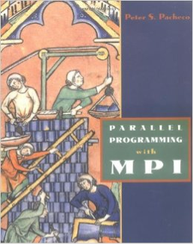
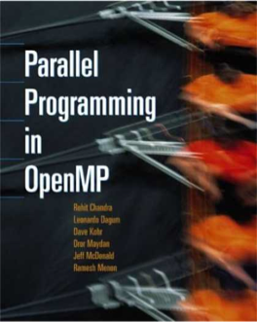
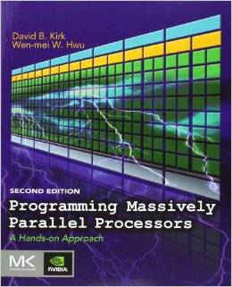
Titan Programming: Reality
System Level
  Message-Passing Interface (MPI) supports node computation, synchronization and communication
Node Level
  OpenMP supports thread-level operation of node CPU
  CUDA programming environment for GPUs
    Performance degrades quickly if don’t have perfect balance among memories and processors
Result
  Single program is complex combination of multiple programming paradigms
  Tend to optimize for specific hardware configuration

Slide 52
My GPU Experience
Multiply two 1024 x 1024 matrices (MM)
  2 X 10⁹ floating point operations
  Express performance in Giga FLOPS
  Program in CUDA and map onto nVidia GPU

Slide 53
Matrix Multiplication Progress
Versions
  Naive 1
  Simple parallel 11
  Blocking 70
  nVidia Example Code 388
  Reorient memory accesses 382
  Packed data access 777
Observations
  Progress is very nonlinear
    Not even monotonic
  Requires increased understanding of how program maps onto hardware
  Becomes more specialized to specific hardware configuration

Slide 54
MPI Fault Tolerance
Checkpoint
  Periodically store state of all processes
  Significant I/O traffic
Restore
  When failure occurs
  Reset state to that of last checkpoint
  All intervening computation wasted
Performance Scaling
  Very sensitive to number of failing components
P₁
P₂
P₃
P₄
P₅
Checkpoint
Compute &
Communicate
Wasted
Computation
Restore
Compute &
Communicate

Slide 55
Supercomputer Programming Model
Application
Programs
  Program on top of bare hardware
Performance
  Low-level programming to maximize node performance
  Keep everything globally synchronized and balanced
Reliability
  Single failure causes major delay
  Engineer hardware to minimize failures
Software
Packages
Machine-Dependent
Programming Model
Hardware

Slide 56
Data-Intensive Computing Landscape
Google Data Center
Data Intensity
Web search
Mapping / directions
Language translation
Video streaming
Internet-Scale
Computing
Cloud
Services
Personal
Computing
Computational Intensity

Slide 57

Internet Computing
Web Search
  Aggregate text data from across WWW
  No definition of correct operation
  Do not need real-time updating
Mapping Services
  Huge amount of (relatively) static data
  Each customer requires individualized computation
Online Documents
  Must be stored reliably
  Must support real-time updating
  (Relatively) small data volumes

Slide 58


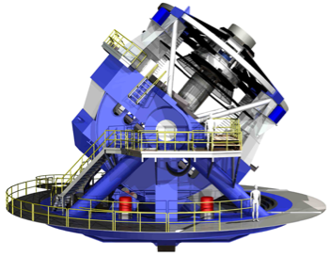
Other Data-Intensive Computing Applications
Wal-Mart
  267 million items/day, sold at 6,000 stores
  HP built them 4 PB data warehouse
  Mine data to manage supply chain, understand market trends, formulate pricing strategies
LSST
  Chilean telescope will scan entire sky every 3 days
  A 3.2 gigapixel digital camera
  Generate 30 TB/day of image data

Slide 59
Data-Intensive Application Characteristics
Diverse Classes of Data
  Structured & unstructured
  High & low integrity requirements
Diverse Computing Needs
  Localized & global processing
  Numerical & non-numerical
  Real-time & batch processing

Slide 60
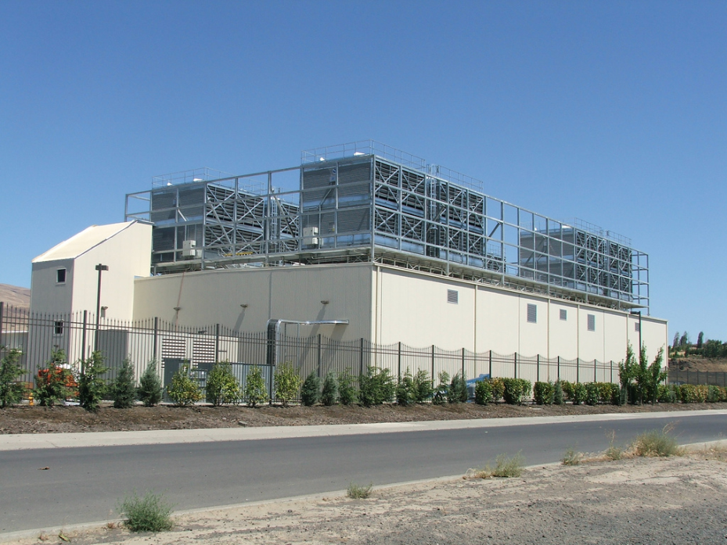
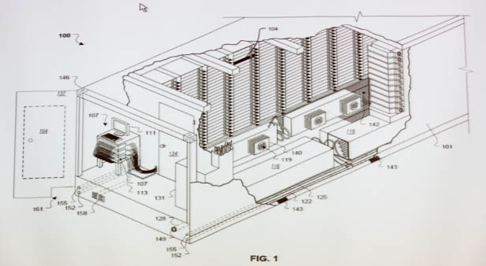
Google Data Centers
Dalles, Oregon
  Hydroelectric power @ 2¢ / KW Hr
  50 Megawatts
    Enough to power 60,000 homes
  Engineered for low cost, modularity & power efficiency
  Container: 1160 server nodes, 250KW
Notes:
One of the biggest users of cluster computing is Google. They have set up dozens of data centers around the world, containing more computer power than just about anyone else.
Here’s a picture of their data center in Dalles, Oregon. It cost them $600M and requires around 50 megawatts of power. (For reference, that much power would supply the residential electricity needs of 6,000 households in the U.S.). They located the data center near the Columbia River to take advantage of low-cost electricity.
Imagine what our intelligence sources could do if they had facilities on this scale to store and process satellite imagery, voice signals, and feeds from media outlets.

Slide 61
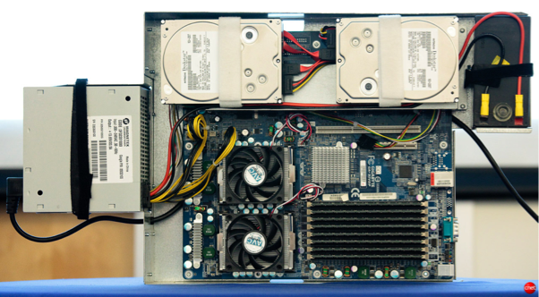
Google Cluster
Local Network
CPU
CPU
CPU
• • •
Node 1
Node 2
Node n
  Typically 1,000−2,000 nodes
Node Contains
  2 multicore CPUs
  2 disk drives
  DRAM

Slide 62

Hadoop Project
File system with files distributed across nodes
  Store multiple (typically 3 copies of each file)
    If one node fails, data still available
  Logically, any node has access to any file
    May need to fetch across network
Map / Reduce programming environment
  Software manages execution of tasks on nodes
Local Network
CPU
CPU
CPU
• • •
Node 1
Node 2
Node n

Slide 63
Map/Reduce Programming Model
k₁
k₁
k_{r}
• • •
Reduce
Key-Value
Pairs
M
M
M
• • •
M
Map
x₁
x₂
x₃
x_{n}
  Map computation across many objects
    E.g., 10¹⁰ Internet web pages
  Aggregate results in many different ways
  System deals with issues of resource allocation & reliability
Dean & Ghemawat: “MapReduce: Simplified Data Processing on Large Clusters”, OSDI 2004

Slide 64
Map/Reduce Operation
Characteristics
  Computation broken into many, short-lived tasks
    Mapping, reducing
  Tasks mapped onto processors dynamically
  Use disk storage to hold intermediate results
Strengths
  Flexibility in placement, scheduling, and load balancing
  Can access large data sets
Weaknesses
  Higher overhead
  Lower raw performance
Map/Reduce
Map
Reduce
Map
Reduce
Map
Reduce
Map
Reduce

Slide 65
Map/Reduce Fault Tolerance
Data Integrity
  Store multiple copies of each file
  Including intermediate results of each Map / Reduce
    Continuous checkpointing
Recovering from Failure
  Simply recompute lost result
    Localized effect
  Dynamic scheduler keeps all processors busy
Use software to build reliable system on top of unreliable hardware
Map/Reduce
Map
Reduce
Map
Reduce
Map
Reduce
Map
Reduce

Slide 66
Cluster Programming Model
  Application programs written in terms of high-level operations on data
  Runtime system controls scheduling, load balancing, …
Scaling Challenges
  Centralized scheduler forms bottleneck
  Copying to/from disk very costly
  Hard to limit data movement
    Significant performance factor
Application
Programs
Machine-Independent
Programming Model
Runtime
System
Hardware

Slide 67

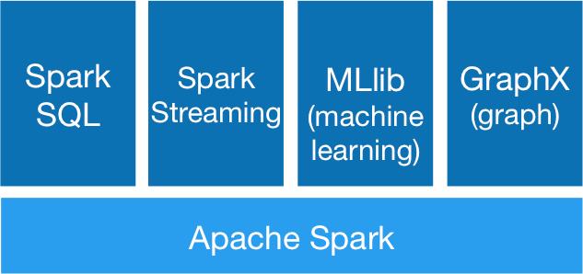

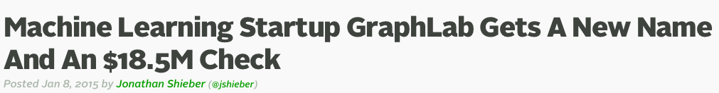
Recent Programming Systems
Spark Project
  at U.C., Berkeley
  Grown to have large open source community
GraphLab
  Started as project at CMU by Carlos Guestrin
  Environment for describing machine-learning algorithms
    Sparse matrix structure described by graph
    Computation based on updating of node values

Slide 68
Computing Landscape Trends
Data Intensity
Mixing simulation
with data analysis
Modeling &
Simulation-Driven
Science &
Engineering
Traditional
Supercomputing
Computational Intensity

Slide 69
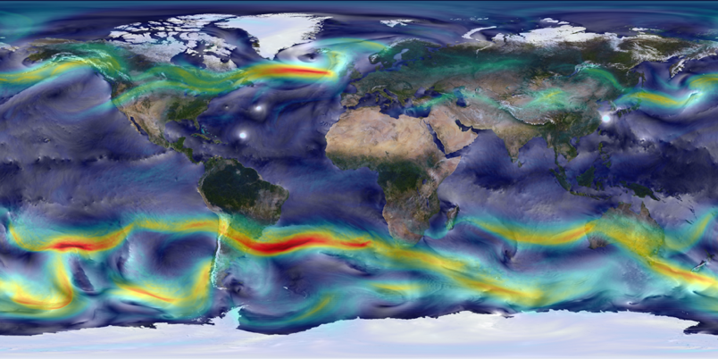
Combining Simulation with Real Data
Limitations
  Simulation alone: Hard to know if model is correct
  Data alone: Hard to understand causality & “what if”
Combination
  Check and adjust model during simulation

Slide 70
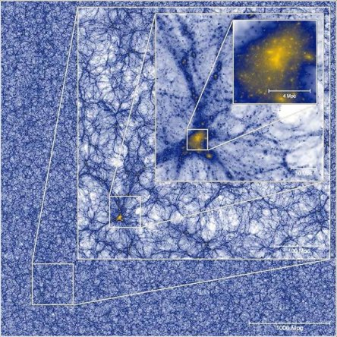
Real-Time Analytics
Millenium XXL Simulation (2010)
  3 X 10⁹ particles
  Simulation run of 9.3 days on 12,228 cores
  700TB total data generated
    Save at only 4 time points
    70 TB
  Large-scale simulations generate large data sets
What If?
  Could perform data analysis while simulation is running
Simulation
Engine
Analytic
Engine

Slide 71
Computing Landscape Trends
Google Data Center
Data Intensity
Sophisticated
data analysis
Internet-Scale
Computing
Computational Intensity

Slide 72


Example Analytic Applications
Microsoft Project Adam
Classifier
Image
Description
English
Text
Transducer
German
Text

Slide 73

Data Analysis with Deep Neural Networks
Task:
  Compute classification of set of input signals
Training
  Use many training samples of form input / desired output
  Compute weights that minimize classification error
Operation
  Propagate signals from input to output

Slide 74


DNN Application Example
Facebook DeepFace Architecture

Slide 75
Training DNNs
Model Size
Training Data
Training Effort
×
➔
Characteristics
  Iterative numerical algorithm
  Regular data organization
Project Adam Training
  2B connections
  15M images
  62 machines
  10 days

Slide 76
Trends
Google Data Center
Data Intensity
Sophisticated
data analysis
Internet-Scale
Computing
Convergence?
Mixing simulation
with real-world data
Modeling &
Simulation-Driven
Science &
Engineering
Traditional
Supercomputing
Computational Intensity

Slide 77
Challenges for Convergence
Supercomputers
Data Center Clusters
Hardware
  Customized
  Optimized for reliability
  Source of “noise”
  Static scheduling
  Low-level, processor-centric model
  Consumer grade
  Optimized for low cost
  Provides reliability
  Dynamic allocation
  High level, data-centric model
Run-Time System
Application Programming

Slide 78
Summary: Computation/Data Convergence
Two Important Classes of Large-Scale Computing
  Computationally intensive supercomputing
  Data intensive processing
    Internet companies + many other applications
Followed Different Evolutionary Paths
  Supercomputers: Get maximum performance from available hardware
  Data center clusters: Maximize cost/performance over variety of data-centric tasks
  Yielded different approaches to hardware, runtime systems, and application programming
A Convergence Would Have Important Benefits
  Computational and data-intensive applications
  But, not clear how to do it

