Slide 1
Malloc Recitation
By sseshadr

Slide 2
Agenda
Macros in C
Pointer declarations
Casting and Pointer Arithmetic
Malloc

Slide 3
Macros

Slide 4
Macros
Runtime, compile-time, or pre-compile time?
Constant:
  #define NUM_ENTRIES 100
  OK
Macro
  #define twice(x) 2*x
    Not OK
    twice(x+1) becomes 2*x+1
  #define twice(x) (2*(x))
    OK
  Use lots of parenthesis, it’s a naïve search-and-replace!

Slide 5
Macros
Why macros?
  “Faster” than function calls
    Why?
  For malloc
    Quick access to header information (payload size, valid)
What’s the keyword inline do?
  At compile-time replaces “function calls” with code

Slide 6
Pointer declarations

Slide 7
C operators (K&R p. 53)
Operators Associativity
() [] -> . left to right
! ~ ++ -- + - * & (type) sizeof right to left
* / % left to right
+ - left to right
<< >> left to right
< <= > >= left to right
== != left to right
& left to right
^ left to right
| left to right
&& left to right
|| left to right
?: right to left
= += -= *= /= %= &= ^= != <<= >>= right to left
, left to right
Note: Unary +, -, and * have higher precedence than binary forms

Slide 8
Review of C Pointer Declarations
(K&R section 5.12)
int *p
int *p[13]
int *(p[13])
int **p
int (*p)[13]
int *f()
int (*f)()
int (*(*f())[13])()
int (*(*x[3])())[5]
p is a pointer to int
p is an array[13] of pointer to int
p is an array[13] of pointer to int
p is a pointer to a pointer to an int
p is a pointer to an array[13] of int
f is a function returning a pointer to int
f is a pointer to a function returning int
f is a function returning ptr to an array[13]
of pointers to functions returning int
x is an array[3] of pointers to functions
returning pointers to array[5] of ints

Slide 9
Pointer casting, arithmetic, and dereferencing

Slide 10
Pointer casting
Separate from non-pointer casting
  float to int, int to float
  <struct_a> to <struct_b>
    No! gcc error.
Cast from
  <type_a> * to <type_b> *
  <type_a> * to integer/ unsigned int
  integer/ unsigned int to <type_a> *

Slide 11
Pointer casting
What actually happens in a pointer cast?
  Nothing! It’s just an assignment. Remember all pointers are the same size.
  The magic happens in dereferencing and arithmetic

Slide 12
Pointer arithmetic
The expression ptr + a doesn’t always evaluate into the arithmetic sum of the two
Consider:
<type_a> * pointer = …;
(void *) pointer2 = (void *) (pointer + a);
Think about it as
  leal (pointer, a, sizeof(type_a)), pointer2;

Slide 13
Pointer arithmetic
int * ptr = (int *)0x12341234;
int * ptr2 = ptr + 1;
char * ptr = (char *)0x12341234;
char * ptr2 = ptr + 1;
int * ptr = (int *)0x12341234;
int * ptr2 = ((int *) (((char *) ptr) + 1));
void * ptr = (char *)0x12341234;
void * ptr2 = ptr + 1;
void * ptr = (int *)0x12341234;
void * ptr2 = ptr + 1;

Slide 14
Pointer arithmetic
int * ptr = (int *)0x12341234;
int * ptr2 = ptr + 1; //ptr2 is 0x12341238
char * ptr = (char *)0x12341234;
char * ptr2 = ptr + 1; //ptr2 is 0x12341235
int * ptr = (int *)0x12341234;
int * ptr2 = ((int *) (((char *) ptr) + 1));
//ptr2 is 0x12341235
void * ptr = (char *)0x12341234;
void * ptr2 = ptr + 1; //ptr2 is 0x12341235
void * ptr = (int *)0x12341234;
void * ptr2 = ptr + 1; //ptr2 is still 0x12341235

Slide 15
More pointer arithmetic
int ** ptr = (int **)0x12341234;
int * ptr2 = (int *) (ptr + 1);
char ** ptr = (char **)0x12341234;
short * ptr2 = (short *) (ptr + 1);
int * ptr = (int *)0x12341234;
void * ptr2 = &ptr + 1;
int * ptr = (int *)0x12341234;
void * ptr2 = ((void *) (*ptr + 1));
This is on a 64-bit machine!

Slide 16
More pointer arithmetic
int ** ptr = (int **)0x12341234;
int * ptr2 = (int *) (ptr + 1); //ptr2 = 0x1234123c
char ** ptr = (char **)0x12341234;
short * ptr2 = (short *) (ptr + 1);
//ptr2 = 0x1234123c
int * ptr = (int *)0x12341234;
void * ptr2 = &ptr + 1; //ptr2 = ??
//ptr2 is actually 8 bytes higher than the address of the variable ptr
int * ptr = (int *)0x12341234;
void * ptr2 = ((void *) (*ptr + 1)); //ptr2 = ??
//ptr2 is just one higher than the value at 0x12341234 (so probably segfault)

Slide 17
Pointer dereferencing
Basics
  It must be a POINTER type (or cast to one) at the time of dereference
  Cannot dereference (void *)
  The result must get assigned into the right datatype (or cast into it)

Slide 18
Pointer dereferencing
What gets “returned?”
int * ptr1 = malloc(100);
*ptr1 = 0xdeadbeef;
int val1 = *ptr1;
int val2 = (int) *((char *) ptr1);
What are val1 and val2?

Slide 19
Pointer dereferencing
What gets “returned?”
int * ptr1 = malloc(sizeof(int));
*ptr1 = 0xdeadbeef;
int val1 = *ptr1;
int val2 = (int) *((char *) ptr1);
// val1 = 0xdeadbeef;
// val2 = 0xffffffef;
What happened??

Slide 20
Malloc

Slide 21
Malloc basics
What is dynamic memory allocation?
Terms you will need to know
  malloc / calloc / realloc
  free
  sbrk
  payload
  fragmentation (internal vs. external)
  coalescing
    Bi-directional
    Immediate vs. Deferred

Slide 22
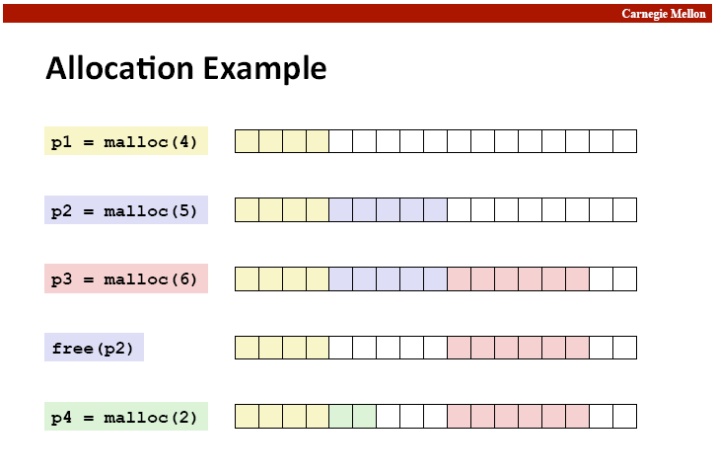

Slide 23
Fragmentation
Internal fragmentation
  Result of payload being smaller than block size.
  void * m1 = malloc(3); void * m1 = malloc(3);
  m1,m2 both have to be aligned to 8 bytes…
External fragmentation

Slide 24
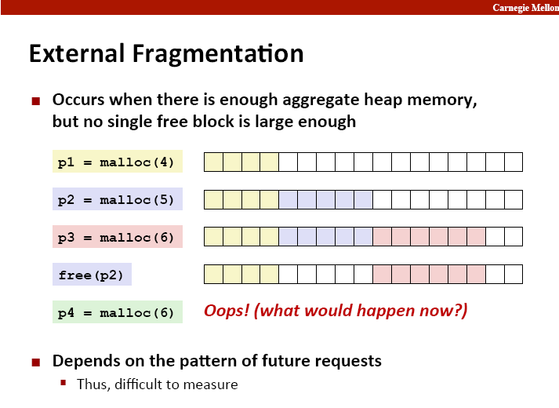

Slide 25
Implementation Hurdles
How do we know where the chunks are?
How do we know how big the chunks are?
How do we know which chunks are free?
Remember: can’t buffer calls to malloc and free… must deal with them real-time.
Remember: calls to free only takes a pointer, not a pointer and a size.
Solution: Need a data structure to store information on the “chunks”
  Where do I keep this data structure?

Slide 26
The data structure
Requirements:
  The data structure needs to tell us where the chunks are, how big they are, and whether they’re free
  We need to be able to CHANGE the data structure during calls to malloc and free
  We need to be able to find the next free chunk that is “a good fit for” a given payload
  We need to be able to quickly mark a chunk as free/allocated
  We need to be able to detect when we’re out of chunks.
    What do we do when we’re out of chunks?

Slide 27
The data structure
It would be convenient if it worked like:
  malloc_struct malloc_data_structure;
  …
  ptr = malloc(100, &malloc_data_structure);
  …
  free(ptr, &malloc_data_structure);
  …
Instead all we have is the memory we’re giving out.
  All of it doesn’t have to be payload! We can use some of that for our data structure.

Slide 28
The data structure
The data structure IS your memory!
A start:
  <h1> <pl1> <h2> <pl2> <h3> <pl3>
  What goes in the header?
    That’s your job!
  Lets say somebody calls free(p2), how can I coalesce?
    Maybe you need a footer? Maybe not?

Slide 29
The data structure
Common types
  Implicit List
    Root -> chunk1 -> chunk2 -> chunk3 -> …
  Explicit List
    Root -> free chunk 1 -> free chunk 2 -> free chunk 3 -> …
  Segregated List
    Small-malloc root -> free small chunk 1 -> free small chunk 2 -> …
    Medium-malloc root -> free medium chunk 1 -> …
    Large-malloc root -> free large chunk1 -> …

Slide 30
Design considerations
I found a chunk that fits the necessary payload… should I look for a better fit or not?
Splitting a free block:
void* ptr = malloc(200);
free(ptr);
ptr = malloc(50); //use same space, then “mark” remaining bytes as free
void* ptr = malloc(200);
free(ptr);
ptr = malloc(192);//use same space, then “mark” remaining bytes as free??

Slide 31
Design Considerations
Free blocks: address-ordered or LIFO
  What’s the difference?
  Pros and cons?
Implicit / Explicit / or Seg?
  Implicit won’t get you very far… too slow.
  Explicit is a good place to start, and can be turned into a seg-list.
  Seg-list: what are the thresholds?

