Slide 1
Exam #2 Review
sseshadr

Slide 2
Agenda
Administrative things
Exam tomorrow, should’ve been studying
Proxy lab out tomorrow
You’re probably done with malloc. Congratulations!
Exam Review
Brief intro to proxy lab

Slide 3
Studying
What to do
Look at the 213 lecture schedule and read lectures
Read the book
Do the past exams
Understand the labs
Lectures?
“Memory Hierarchy” to “Dynamic Memory Allocation”
Book?
The readings next to the lectures on the schedule

Slide 4
[Subset of] Exam Topics
Physical Memory
SRAM/DRAM? SSD? Volatile vs. non-volatile? Bus?
Disks (calculating capacity, mem. access time)
Locality (temporal, spatial)
Cache memories
Terms: types of misses, write-{through/back/allocate}, blocking, L1, L2, …
Given S E B & memory accesses, calculate hits/misses/evictions

Slide 5
[Subset of] Exam Topics
Linking
Types of ELF files (.o, .so, and the “a.out” file)
Static libraries (.a “archive files”)
What goes in an ELF?
Symbol resolution (strong/weak, global/external/local?)
static keyword
The ld command? What is dynamic linking (dlopen)?
Types of interpositioning

Slide 6
[Subset of] Exam Topics
ECF and Processes
What is ECF and “when can it happen”
Kernel code vs. user code, context switching at a high level
Synchronous ECF (traps, faults, aborts) vs. asynchronous ECF (interrupts)
SIGNALS and HANDLERS (a lot to know here….)
Non-queuing, signal system calls, defaults, deferring
Here is some code with signals and handlers and…
It’s trying to do X, but it doesn’t. What’s wrong with it?
What all could it print output? (Gets worse with sys io)

Slide 7
[Subset of] Exam Topics
ECF and Processes
Types of processes, what is reaping?
What is a process group?
What is async-signal-safety?
fork, exec, wait/waitpid
Fork COPIES and ISOLATES memory
Exec REPLACES memory
Process lab concepts
SYNCHRONIZATION
Non-local jumps
How do you use sigsetjmp, siglongjmp? Stack dangers?

Slide 8
[Subset of] Exam Topics
I/O
open/close/read/write, wrappers, RIO, standard IO
When do you use what?
File descriptor table, initialized with 0, 1, 2
File metadata
File sharing and redirection
Interaction with fork (refcnt, file position)
dup and dup2

Slide 9
[Subset of] Exam Topics
Virtual Memory (a lot to know here…)
TRANSLATIONS
Address anatomy
VM system design
TLB
Page table & PTEs
mmap
Page faults
Special registers
COW and Demand Paging (ZFOD)?

Slide 10
[Subset of] Exam Topics
Virtual Memory
Diagrams…

Slide 11
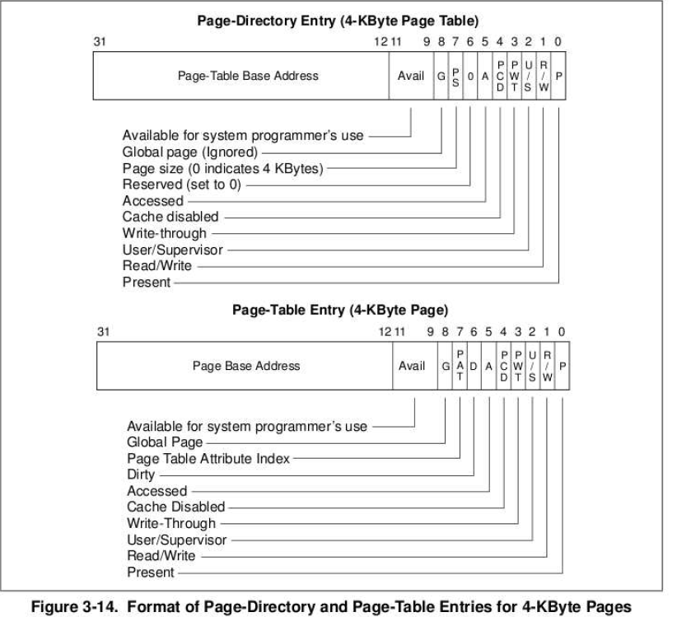

Slide 12
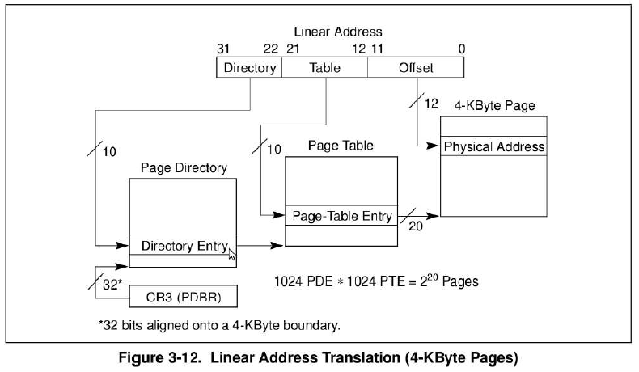

Slide 13
[Subset of] Exam Topics
Dynamic Memory Allocation
malloc/calloc/realloc/free/sbrk
Types of fragmentation
Ways to coalesce
Implementation
Types of lists (pros and cons)
First-fit/best-fit? Address-ordered vs. LIFO?
Garbage collection
Identifying memory bugs

Slide 14
[Subset of] Exam Topics
Lab & Recitation Topics
Can you
Simulate a cache?
Simulate calls to malloc/free?
Draw process trees?
Macros
Pointer declarations

Slide 15
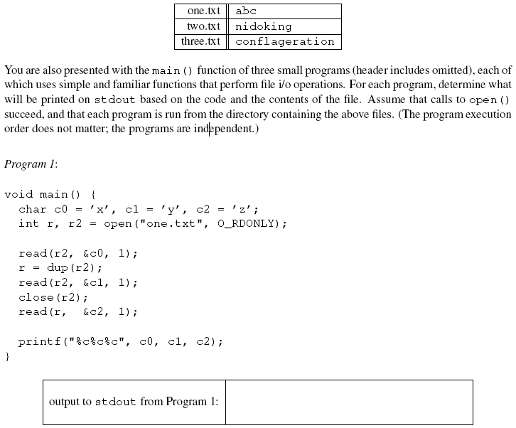
abc

Slide 16

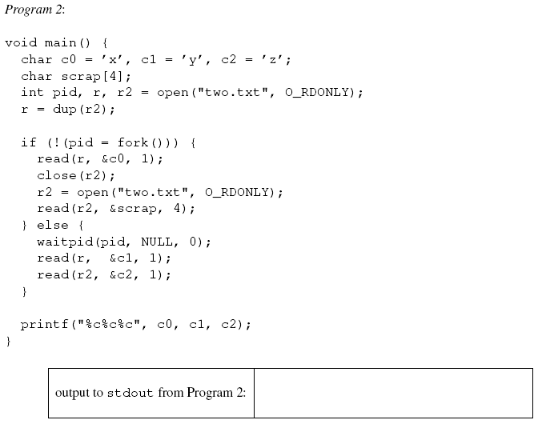
nyzxid

Slide 17
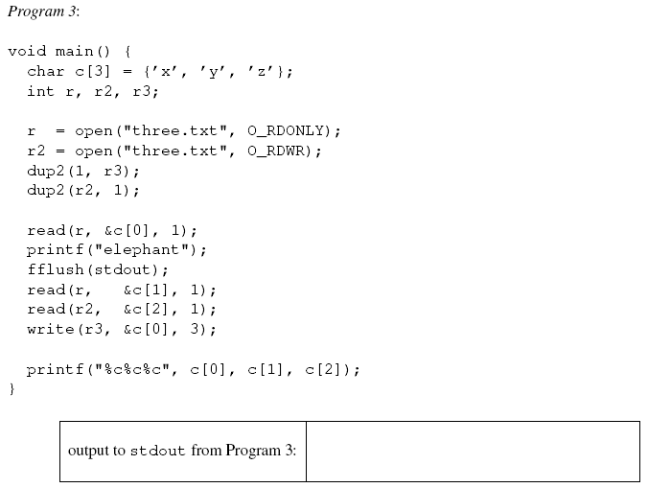
Pretend r3 was initialized to some nice value (even 0 works)
clr

Slide 18
Questions?

