Slide 1
Local & Adversarial Search
CSD 15-780: Graduate Artificial Intelligence
Instructors: Zico Kolter and Zack Rubinstein
TA: Vittorio Perera

Slide 2
Local search algorithms
Sometimes the path to the goal is irrelevant:
8-queens problem, job-shop scheduling
circuit design, computer configuration
automatic programming, automatic graph drawing
Optimization problems may have no obvious “goal test” or “path cost”.
Local search algorithms can solve such problems by keeping in memory just one current state (or perhaps a few).

Slide 3
Advantages of local search
Very simple to implement.
Very little memory is needed.
Can often find reasonable solutions in very large state spaces for which systematic algorithms are not suitable.

Slide 4
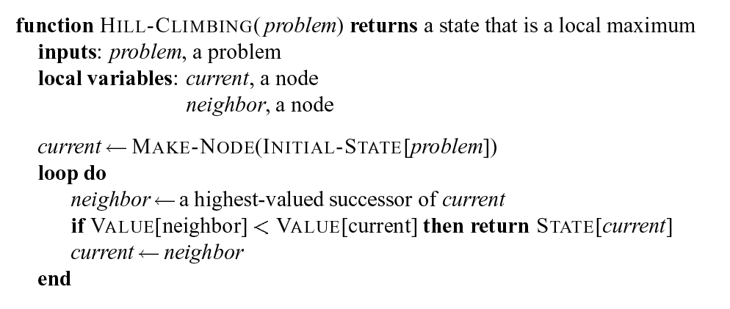
Hill-climbing search

Slide 5
Problems with hill-climbing
Can get stuck at a local maximum.
Cannot climb along a narrow ridge when each possible step goes down.
Unable to find its way off a plateau.
Solutions:
Stochastic hill-climbing – select using weighted random choice
First-Choice hill-climbing – randomly generate neighbors until one better
Random restarts – run multiple HC searches with different initial states.

Slide 6
Simulated Annealing Search
Based on annealing in metallurgy where metal is hardened by heating to high state and cool gradually.
The main idea is to avoid local maxima (or minima) by having a controlled randomness in the search that gradually decreases.

Slide 7
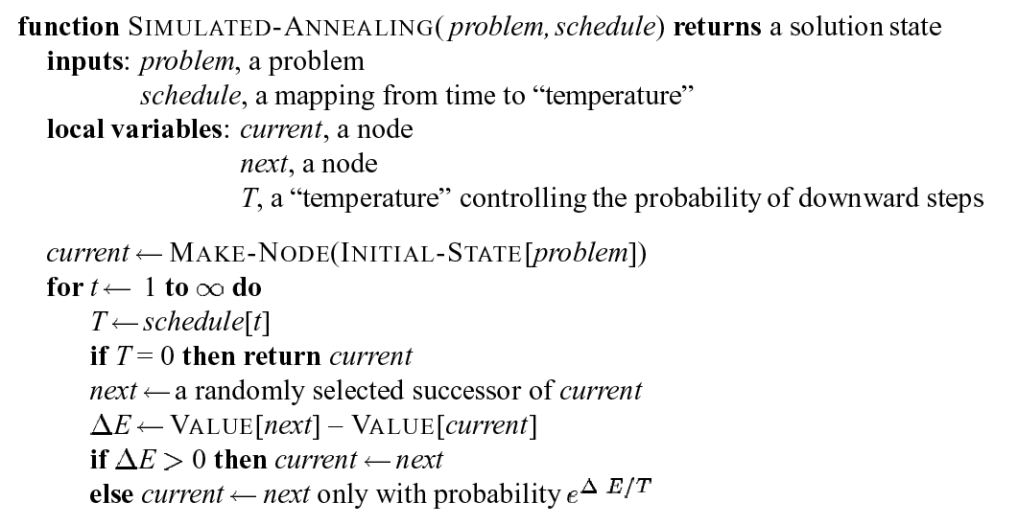
Simulated annealing search

Slide 8
Beam Search
Like hill-climbing but instead of tracking just one best state, it tracks k best states.
Start with k states and generate successors
If solution in successors, return it.
Otherwise, select k best states selected from all successors.
Like hill-climbing, there are stochastic forms of beam search.

Slide 9
Genetic Algorithms
Similar to stochastic beam search, except that successors are drawn from two parents instead of one.
General idea is to find a solution by iteratively selecting fittest individuals from a population and breeding them until either a threshold on iterations or fitness is hit.

Slide 10
Genetic algorithms cont.
An individual state is represented by a sequence of “genes”.
The selection strategy is randomized with probability of selection proportional to “fitness”.
Individuals selected for reproduction are randomly paired, certain genes are crossed-over, and some are mutated.

Slide 11
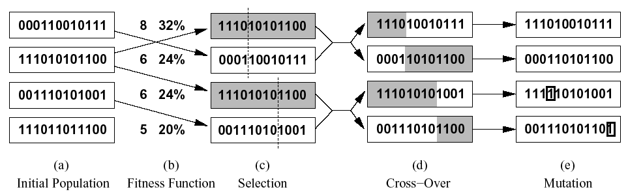
Genetic algorithms cont.

Slide 12
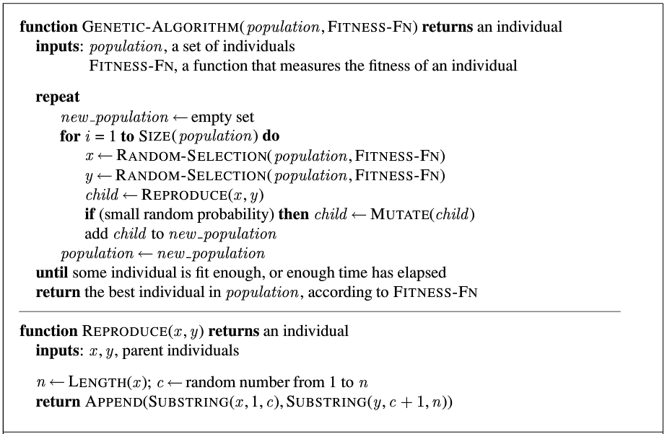
Genetic Algorithm

Slide 13
Genetic algorithms cont.
Genetic algorithms have been applied to a wide range of problems.
Results are sometimes very good and sometimes very poor.
The technique is relatively easy to apply and in many cases it is beneficial to see if it works before thinking about another approach.

Slide 14
Adversarial Search
The minimax algorithm
Alpha-Beta pruning
Games with chance nodes
Games versus real-world competitive situations

Slide 15
Adversarial Search
An AI favorite
Competitive multi-agent environments modeled as games

Slide 16
From single-agent to two-players
Actions no longer have predictable outcomes
Uncertainty regarding opponent and/or outcome of actions
Competitive situation
Much larger state-space
Time limits
Still assume perfect information

Slide 17
Formalizing the search problem
Initial state = initial game/board position and player
Successors = operators = all legal moves
Terminal state test (not “goal”-test) = a state in which the game ends
Utility function = payoff function = reward
Game tree = a graph representing all the possible game scenarios

Slide 18
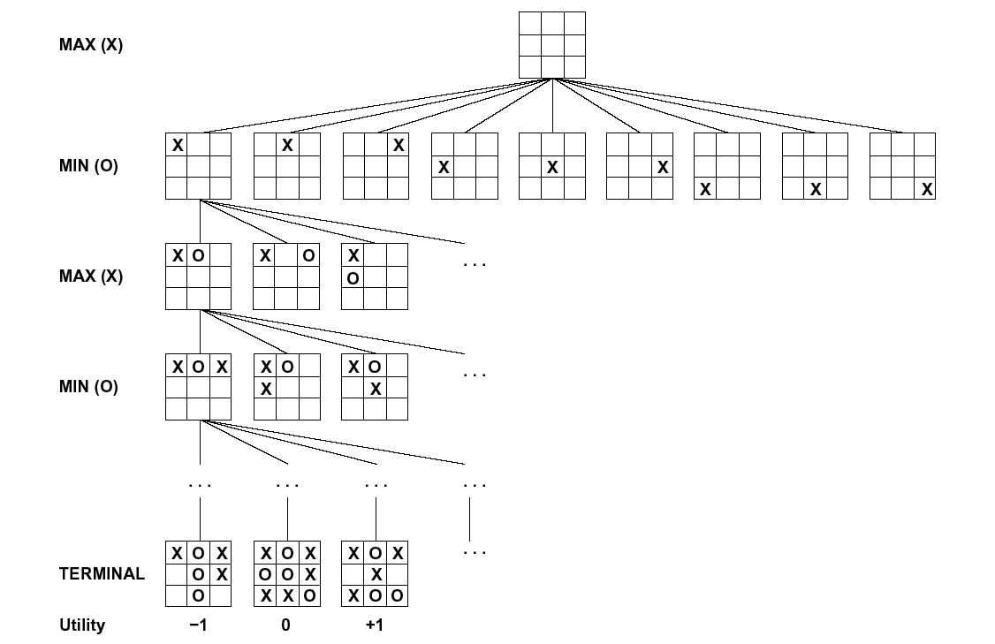
Partial game tree for Tic-Tac-Toe

Slide 19
What are we searching for?
Construct a “strategy” or “contingent plan” rather than a “path”
Must take into account all possible moves by the opponent
Representation of a strategy
Optimal strategy = leads to the highest possible guaranteed payoff

Slide 20
The minimax algorithm
Generate the whole tree
Label the terminal states with the payoff function
Work backwards from the leaves, labeling each state with the best outcome possible for that player
Construct a strategy by selecting the the best moves for “Max”

Slide 21
Minimax algorithm cont.
Labeling process leads to the “minimax decision” that guarantees maximum payoff, assuming that the opponent is rational
Labeling can be implemented using depth-first search using linear space

Slide 22
Illustration of minimax
MAX
MIN
3
3
2
2
3
12
8
2
4
6
14
5
2

Slide 23
But seriously...
Can’t search all the way to leaves
Use Cutoff-Test function; generate a partial tree whose leaves meet the cutoff-test
Apply heuristic to each leaf
Assume that the heuristic represents payoffs, and back up using minimax

Slide 24
What’s in an evaluation function?
Evaluation function assigns each state to a category, and imposes an ordering on the categories
Some claim that the evaluation function should measure P(winning)...

Slide 25
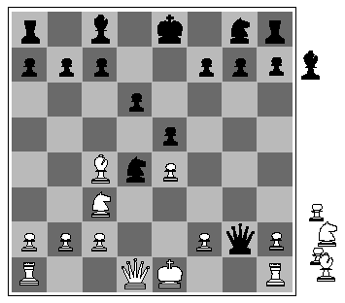
Evaluating states in chess
“material” evaluation
Count the pieces for each side, giving each a weight (queen=9, rook=5, knight/bishop=3, pawn=1)
What properties do we care about in the evaluation function?
Only the ordering matters

Slide 26
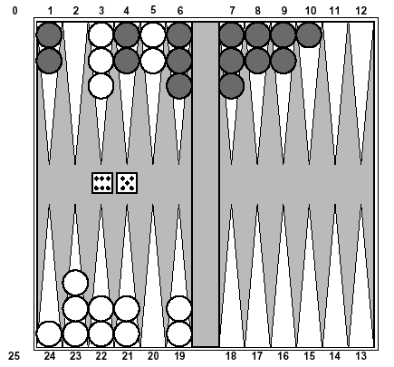
Evaluating states in backgammon
Possible goals (features):
Hit your opponent's blots
Reduce the number of blots that are in danger
Build points to block your opponent
Remove men from board
Get out of opponent's home
Don't build high points
Spread the men at home positions

Slide 27
Learning evaluation functions
Learning the weights of chess pieces... can use anything from linear regression to hill-climbing.
The harder question is picking the primitive features to use.

Slide 28
Problems with minimax
Uniform depth limit
Horizon problem: over-rates sequences of moves that “stall” some bad outcome
Does not take into account possible “deviations” from guaranteed value
Does not factor search cost into the process

Slide 29
Minimax may be inappropriate…
MAX
MIN
99
100
99
1000
1000
1000
100
101
102
100

Slide 30
Reducing search cost
In chess, can only search full-width tree to about 4 levels
The trick is to “prune” certain subtrees
Fortunately, best move is provably insensitive to certain subtrees

Slide 31
Alpha-Beta pruning
Goal: compute the minimax value of a game tree with minimal exploration.
Along current search path, record best choice for Max (alpha), and best choice for Min (beta).
If any new state is known to be worse than alpha or beta, it can be pruned.
Simple example of “meta-reasoning”

Slide 32
Illustration of Alpha-Beta
11
11
10
11
48
10
11
9
48
10
10

Slide 33
Implementation of Alpha-Beta
function Alpha (state, α, β)
if Cutoff (state) then return Value(state)
for each s in Successors(state) do
α ← Max(α, Beta (s, α, β))
if α ≥ β then return β
end
return α

Slide 34
Implementation cont.
function Beta (state, α, β)
if Cutoff (state) then return Value(state)
for each s in Successors(state) do
β ← Min(β, Alpha (s, α, β))
if β ≤ α then return α
end
return β

Slide 35
Effectiveness of Alpha-Beta
Depends on ordering of successors.
With perfect ordering, can search twice as deep in a given amount of time (i.e., effective branching factor is SQRT(b)).
While perfect ordering cannot be achieved, simple heuristics are very effective.

Slide 36
What about time limits?
Iterative deepening (minimax to depths 1, 2, 3, ...)
Can even use iterative deepening results to improve top-level ordering

Slide 37
Games with an element of chance
Add chance nodes to the game tree
Use the expecti-max or expecti-minimax algorithm
One problem: evaluation function is now scale dependent (not just ordering!)
There is even an alpha-beta trick for this case

Slide 38
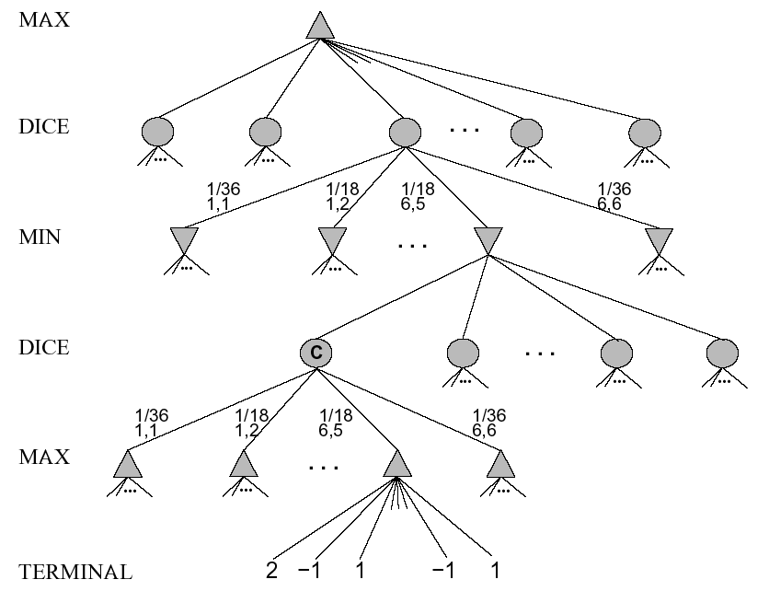

Slide 39
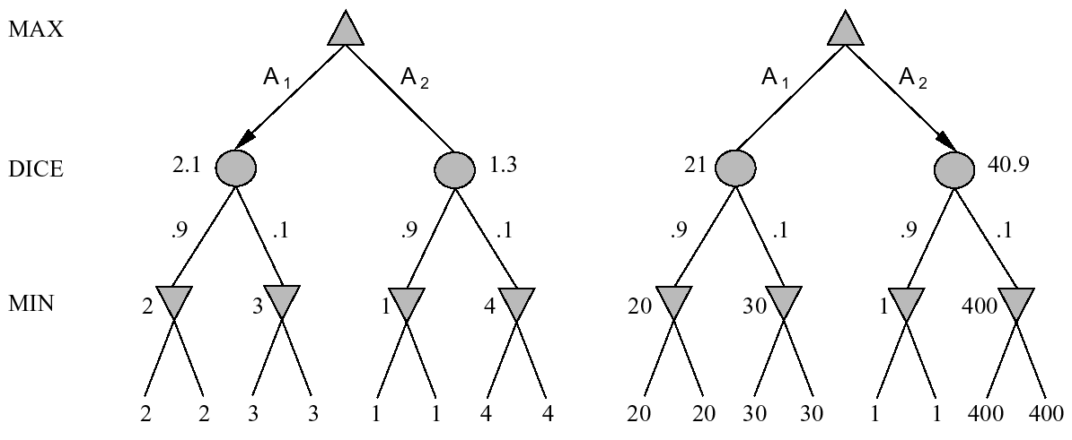
Evaluation is scale dependent

Slide 40
State-of-the-art programs
Chess: Deep Blue [Campbell, Hsu, and Tan; 1997]
Defeated Gary Kasparov in a 6-game match.
Used parallel computer with 32 PowerPCs and 512 custom VLSI chess processors.
Could search 100 bilion positions per move, reaching depth 14.
Used alpha-beta with improvements, following “interesting” lines more deeply.
Extensive use of libraries of openings and endgames.

Slide 41
State-of-the-art programs
Checkers: [Samuel, 1952]
Expert-level performance using a 1KHz CPU with 10,000 words of memory.
One of the early example of machine learning.
Checkers: Chinook [Schaeffer, 1992]
Won the 1992 U.S. Open and first to challenge for a world championship.
Lost in match against Tinsley (World champion for over 40 years who had lost only in 3 games before match).
Became world champion in 1994.
Used alpha-beta search combined with a database of all 444 bilion positions with 8 pieces or less on board.

Slide 42
State-of-the-art programs
Backgammon: TD-Gammon [Tesauro, 1992]
Ranked among the top three players in the world.
Combined Samuel’s RL method with neural network techniques to develop a remarkably good heuristic evaluator.
Used expecti-minimax search to depth 2 or 3.

Slide 43
State-of-the-art programs
Bridge: GIB [Ginsburg, 1999]
Won computer bridge championship; finished 12th in a field of 35 at the 1998 world championship.
Examine how each choice works for a random sample of the up to 10 million possible arrangements of the hidden cards.
Used explanation-based generalization to compute and cache general rules for optimal play in various classes of situations.

Slide 44
Lots of theoretical problems...
Minimax only valid on whole tree
P(win) is not well defined
Correlated errors
Perfect play assumption
No planning

